Slide 1
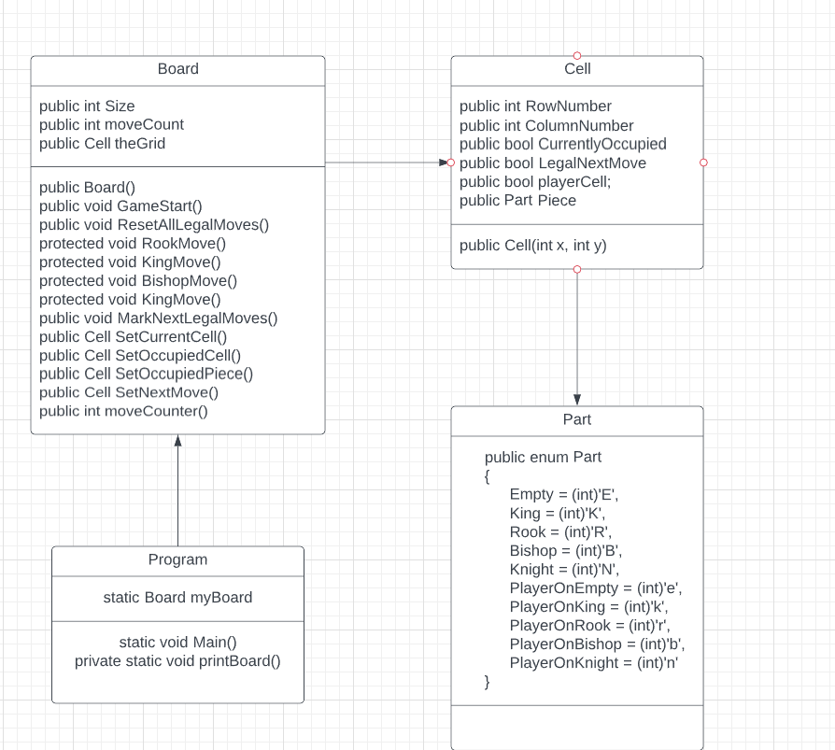
Class Diagram

Slide 2
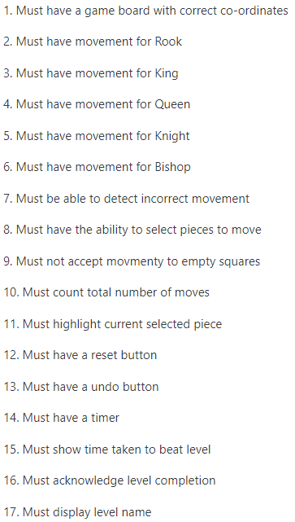
Must haves
I had 16 must have features

Slide 3
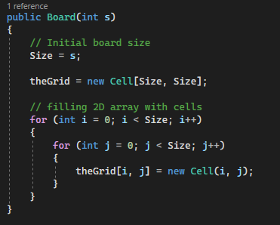
Must have a game board with correct co-ordinates
Created a 2D array that starts at 0,0
and creates a grid of a set Size

Slide 4
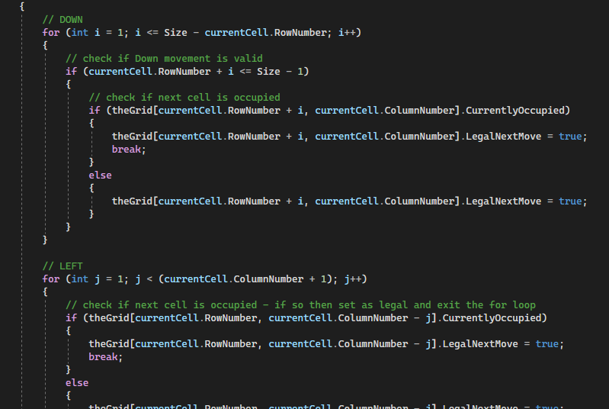
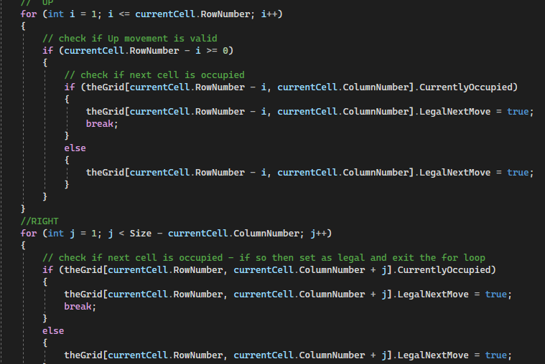
Must have movement for Rook

Slide 5
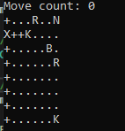
Rook Movement Test

Slide 6
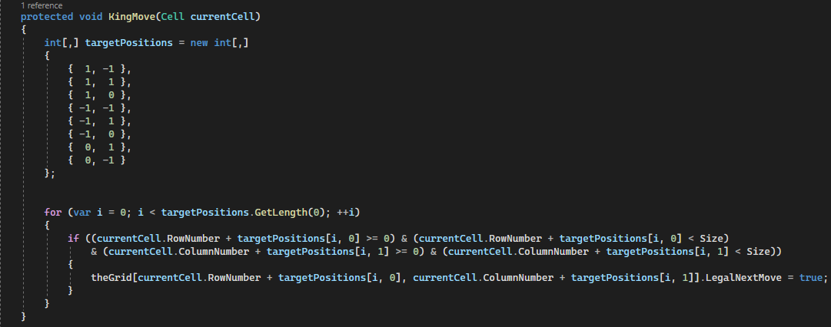
Must have movement for King

Slide 7
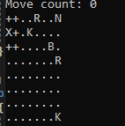
King Movement Test

Slide 8
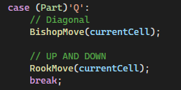
Must have movement for Queen
Queen Movement is a combination of the Rook and Bishop movement

Slide 9
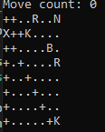
Queen Movement Test

Slide 10
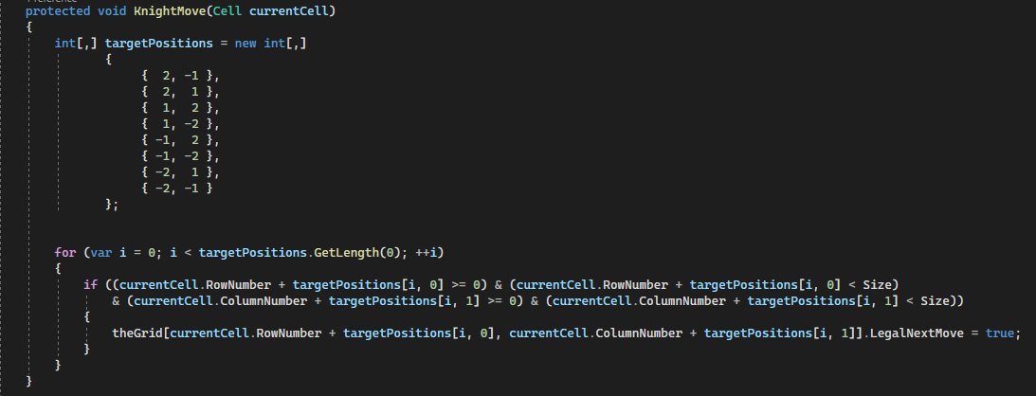
Must have movement for Knight

Slide 11
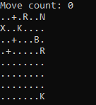
Knight Movement Test

Slide 12
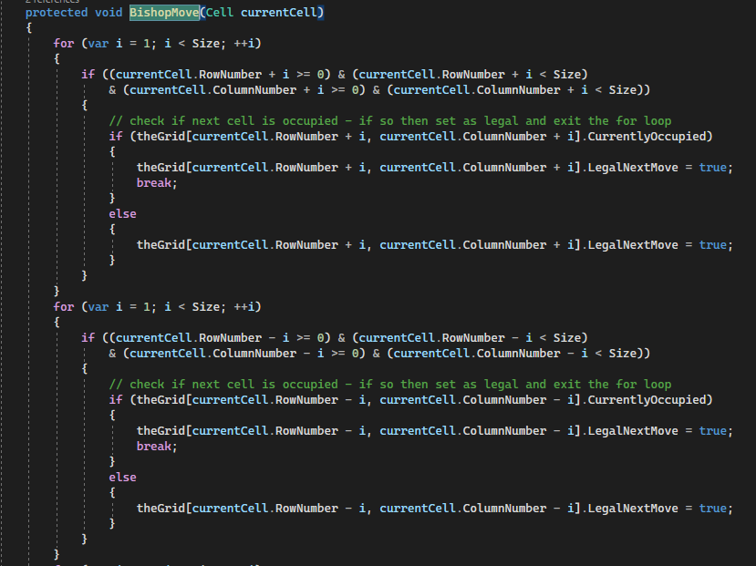
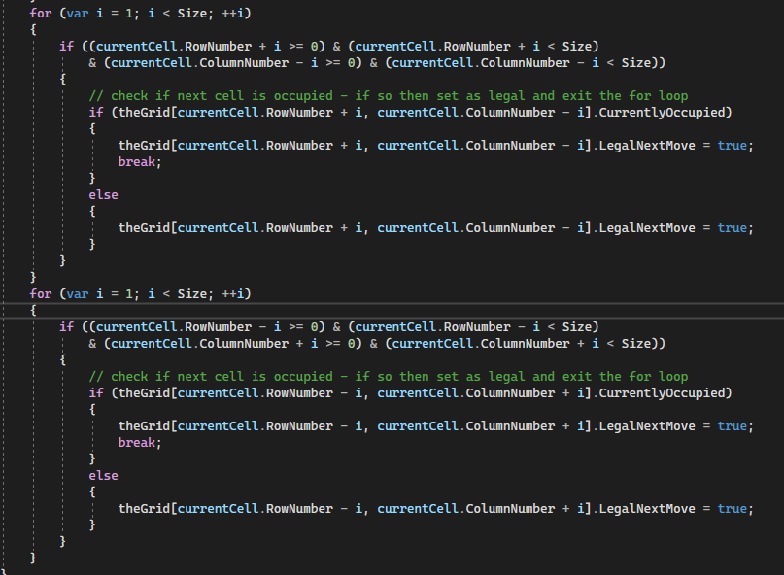
Must have movement for Bishop

Slide 13
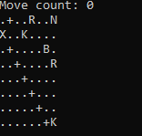
Bishop Movement Test

Slide 14
Must be able to detect incorrect movement

Slide 15
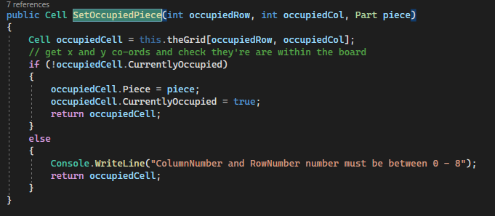
Must have the ability to select pieces to move

Slide 16
Must not accept movement to empty squares

Slide 17
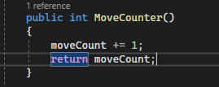
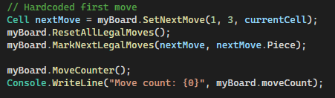
Must count total number of moves
Call MoveCounter() after a move to count the moves

Slide 18
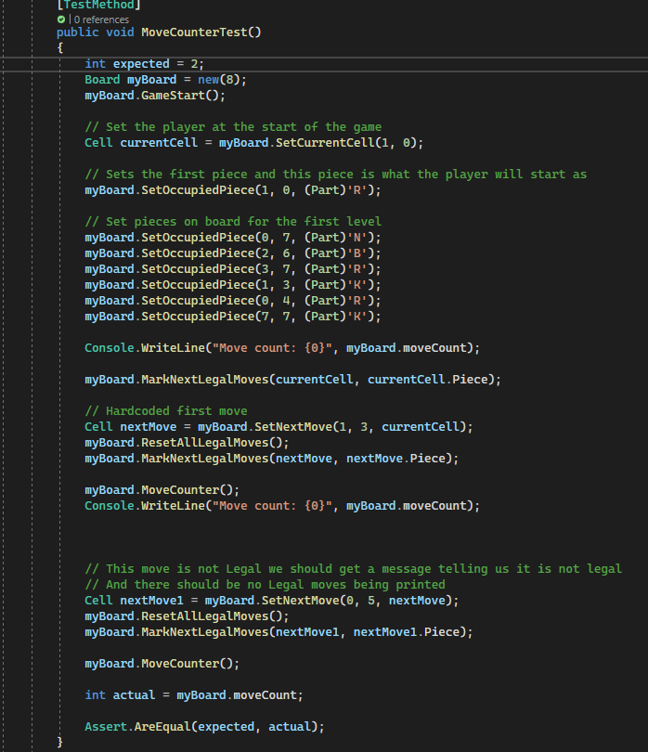
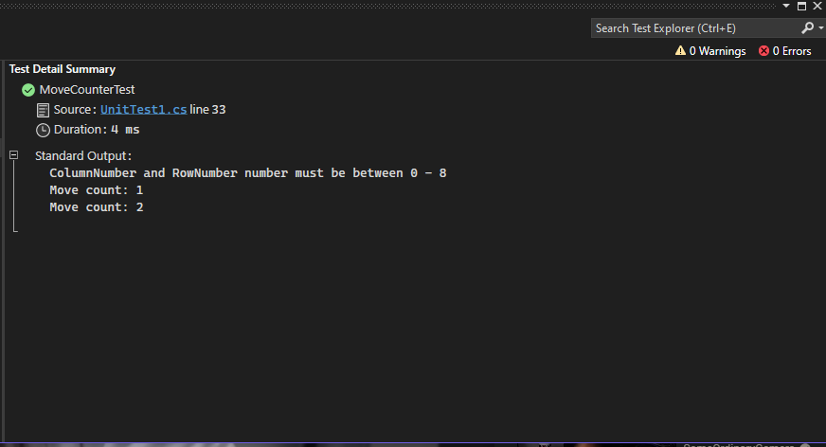
MoveCounter() Test
I moved the pieces twice so in the end
we should have two moves

Slide 19
Must highlight current piece

Slide 20
Must have reset button

Slide 21
Must have undo button

Slide 22
Must have timer

Slide 23
Must show time taken to beat level

Slide 24
Must acknowledge level completion

Slide 25
Must display level name

