Slide 1
Expected marks Part A
35/37

Slide 2


1 Selection statements, 31 Named Arguments

Slide 3


2 Iteration Statement

Slide 4



3 Constants

Slide 5


4 Arrays

Slide 6

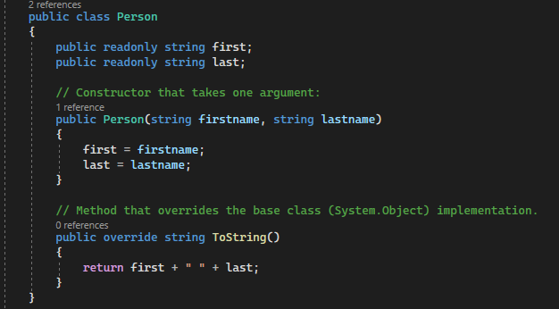
5 Classes, 9 Constructors, 25 Properties

Slide 7

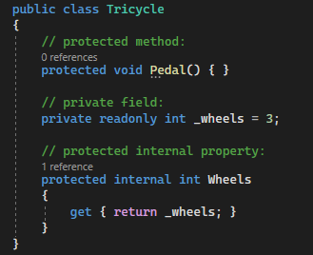
6 Access modifiers, 7 Fields, 8 Readonly

Slide 8


10 Passing by value, 24 Static

Slide 9


11 Passing by reference

Slide 10

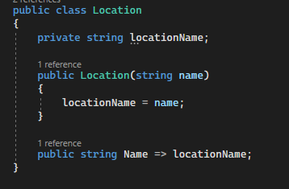
12 Expression body definitions =>

Slide 11

13 Lambda expressions

Slide 12

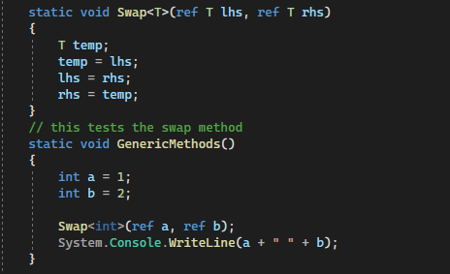
14 Generic Methods

Slide 13
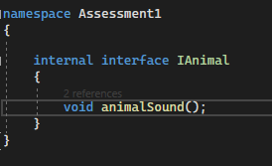

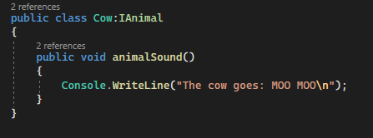
15 Interfaces, 16 Inheritance

Slide 14
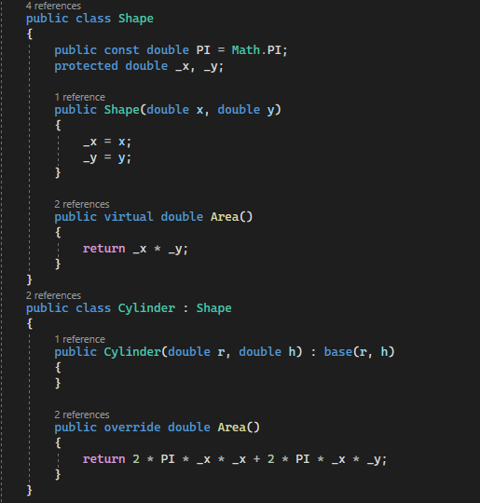

17 Virtual

Slide 15

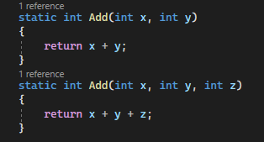
18 Overload

Slide 16

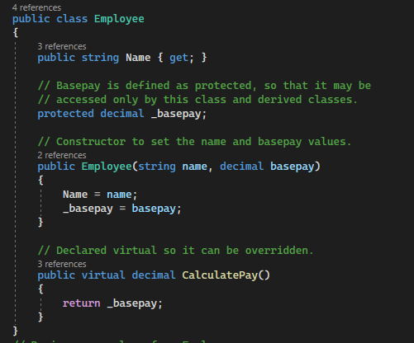
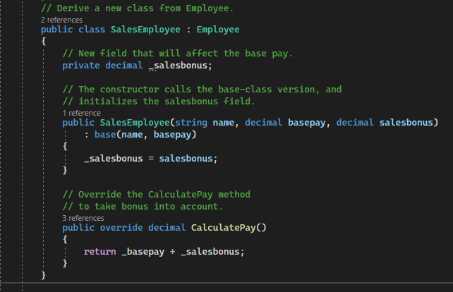
19 Override, 22 Base

Slide 17
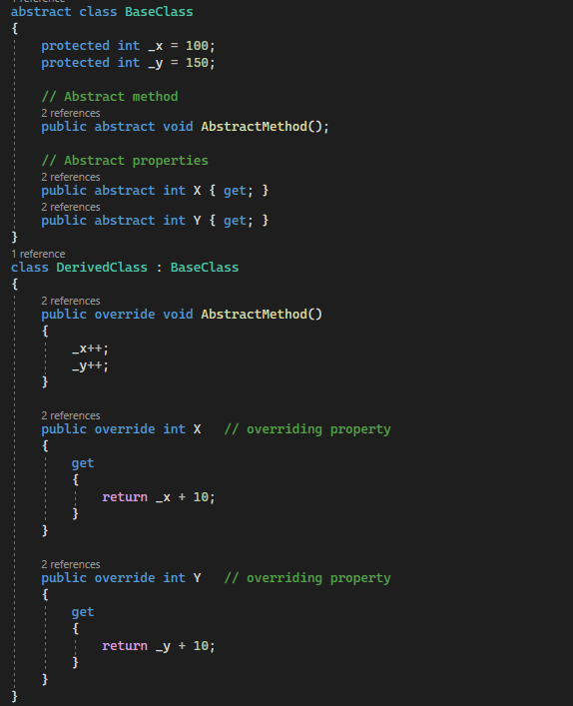

20 Abstract Classes and Abstract Class Members

Slide 18

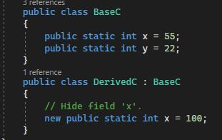
21 New Modifier, 23 Sealed Classes and Sealed Class Members

Slide 19

26 $ - string interpolation

Slide 20

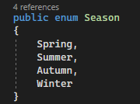
27 Enumeration types

Slide 21
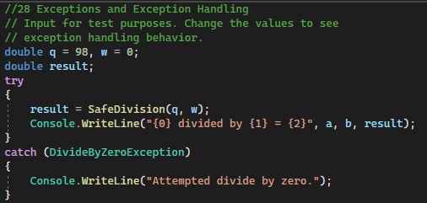

28 Exceptions and Exception Handling

Slide 22

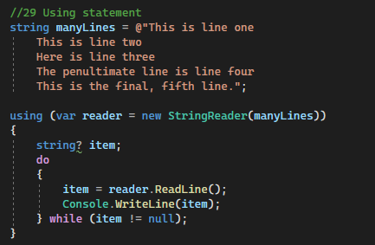
29 Using statements

Slide 23
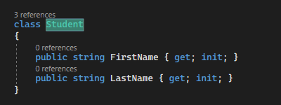

30 Init accessors

Slide 24
32

Slide 25

33 Object and Collection Initializers

Slide 26

34 Reflection

Slide 27
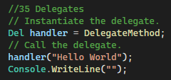

35 Delegates

Slide 28
36 Events

Slide 29

37 Indexers

