Slide 1
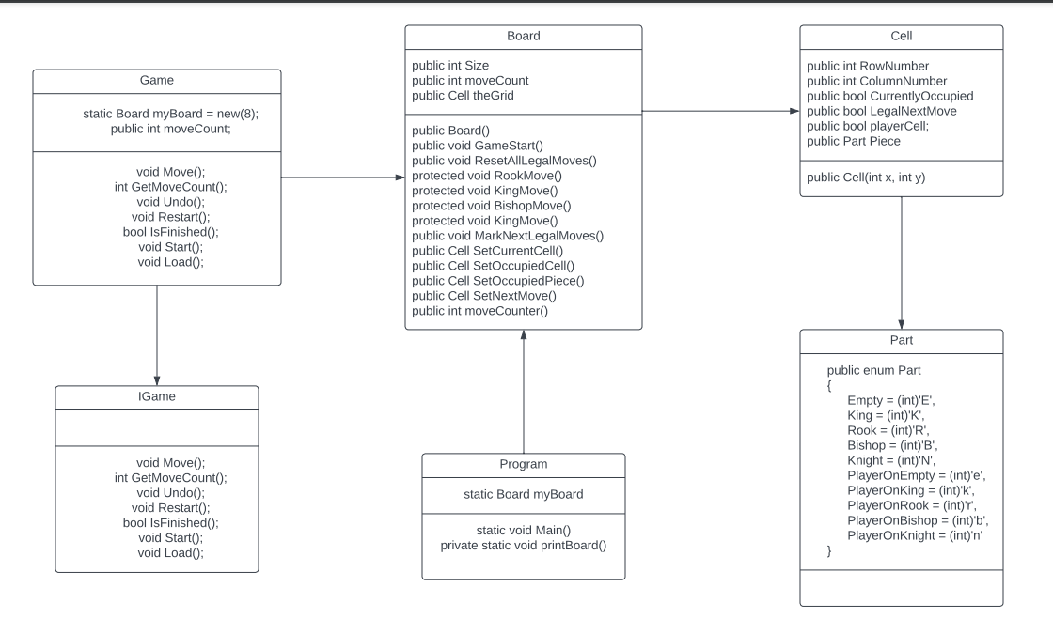
Class Diagram

Slide 2
Self Marks
Features: 5/5 I implemented all 17 of my must have features
Tests: 3/5 Did not have full test coverage I have 17 tests
UML Class diagram: 4/5

Slide 3
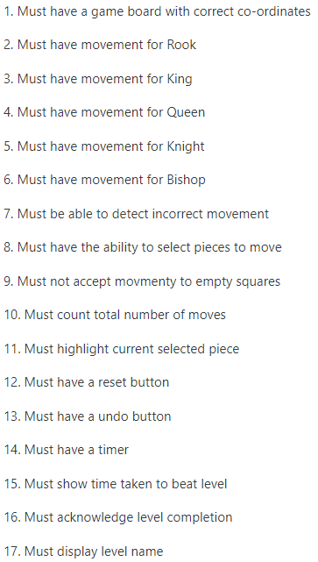
Must haves
I had 17 must have features

Slide 4
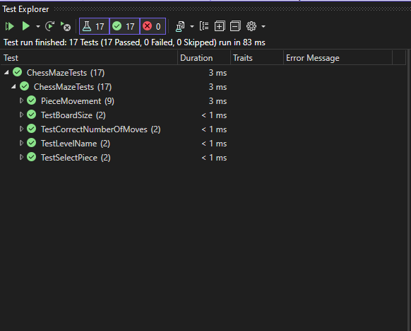
All Tests

Slide 5
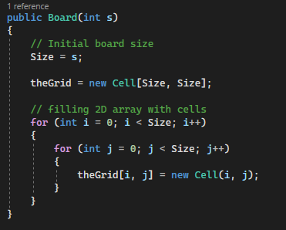
Must have a game board with correct co-ordinates
Created a 2D array that starts at 0,0
and creates a grid of a set Size

Slide 6
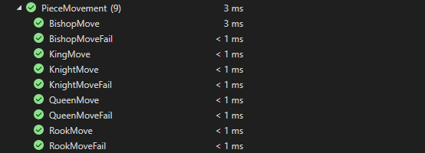
Piece Movement Tests

Slide 7
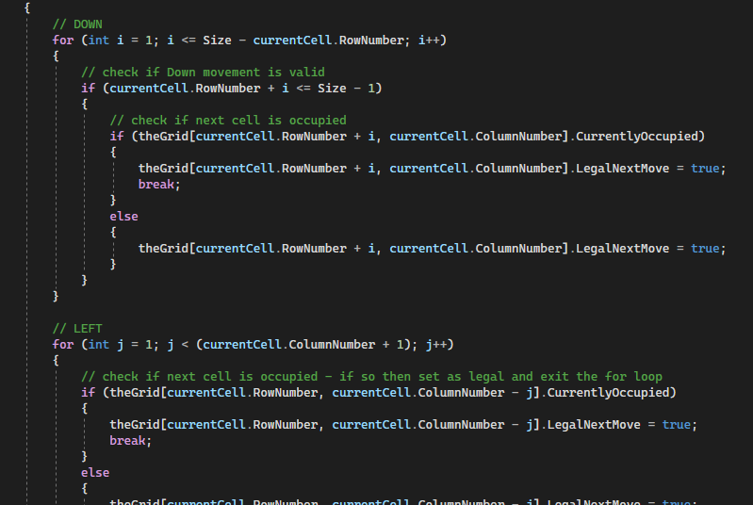
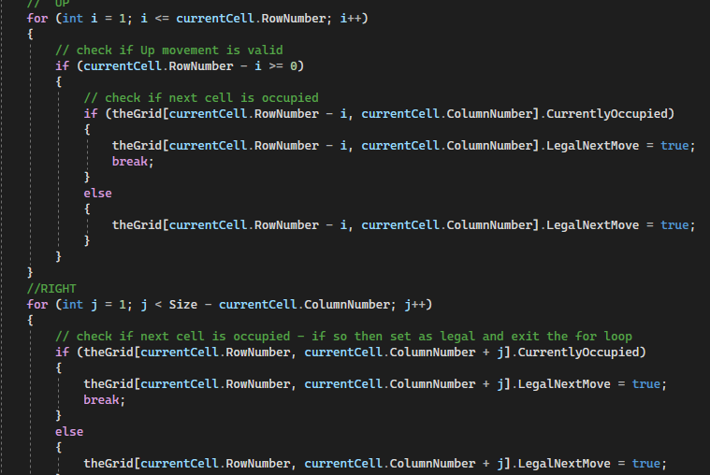
Must have movement for Rook

Slide 8
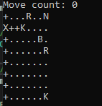
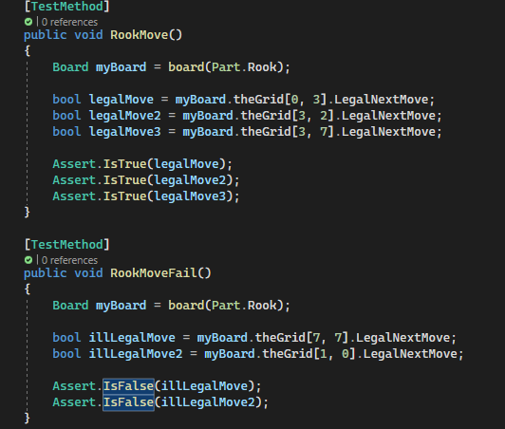
Rook Movement Test

Slide 9
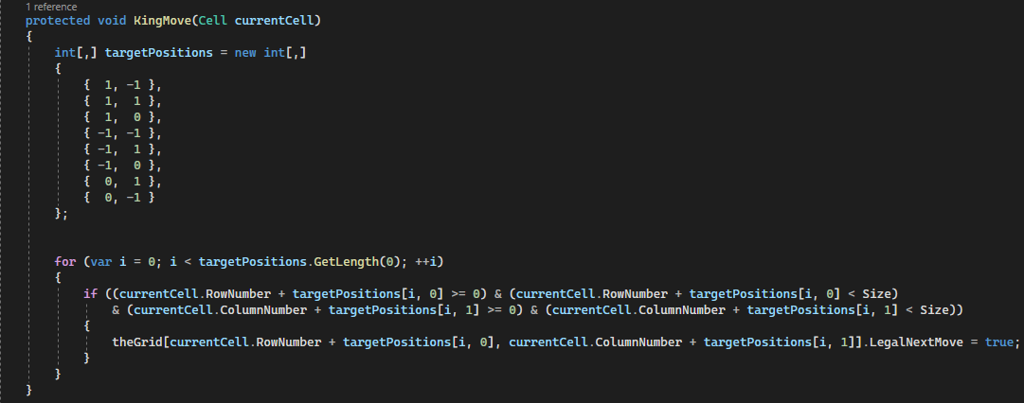
Must have movement for King

Slide 10
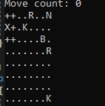
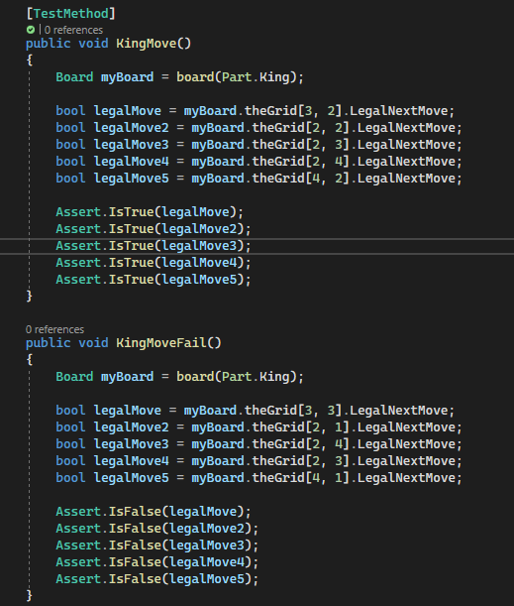
King Movement Test

Slide 11
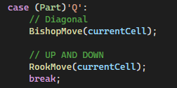
Must have movement for Queen
Queen Movement is a combination of the Rook and Bishop movement

Slide 12
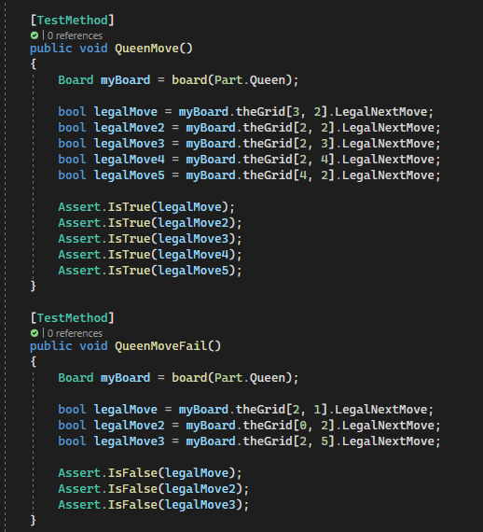
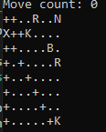
Queen Movement Test

Slide 13
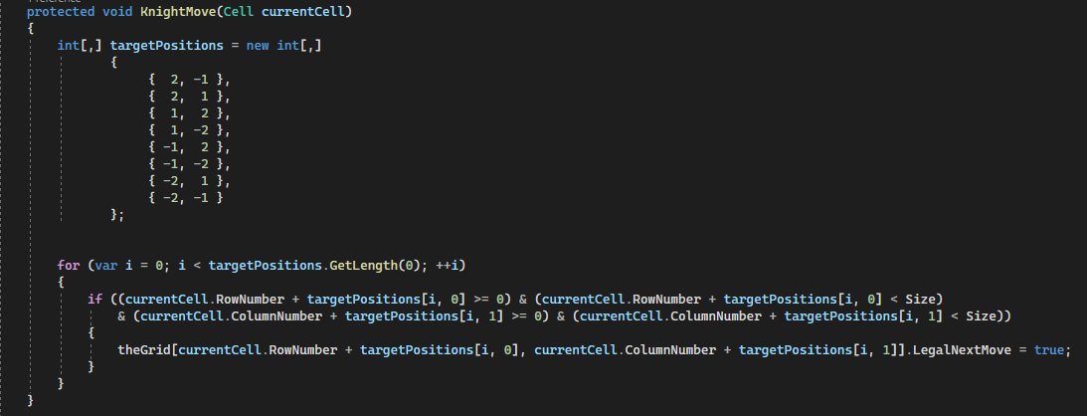
Must have movement for Knight

Slide 14
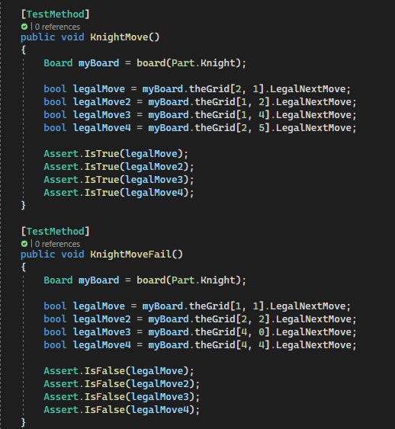
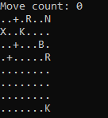
Knight Movement Test

Slide 15
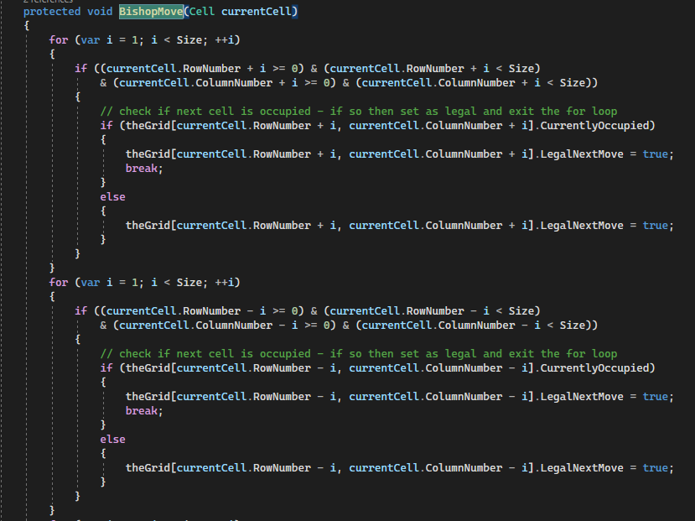
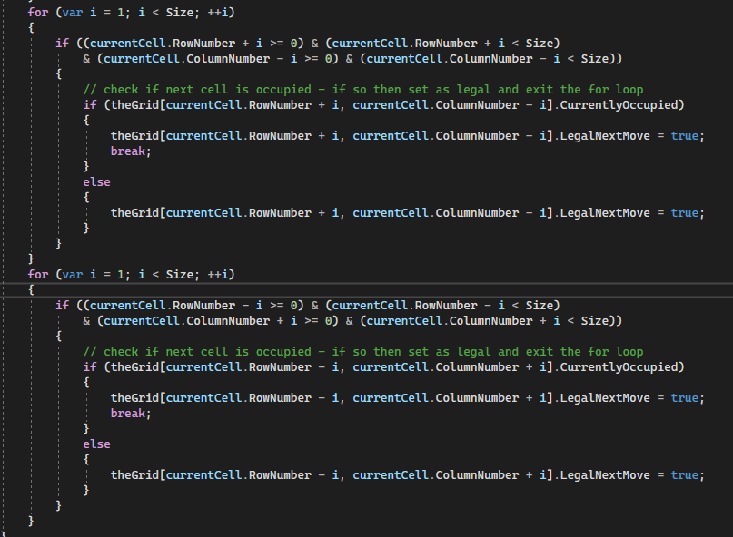
Must have movement for Bishop

Slide 16
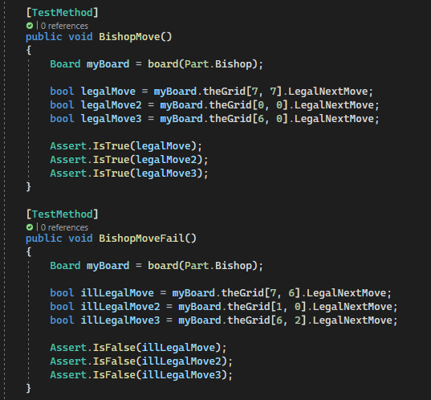
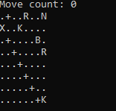
Bishop Movement Test

Slide 17
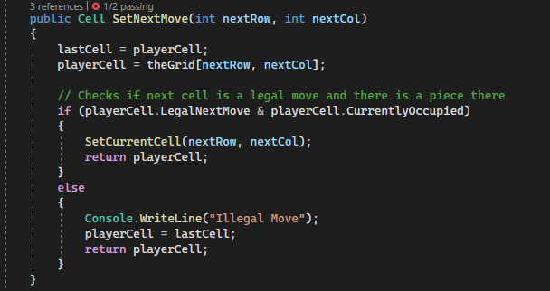
Must be able to detect incorrect movement
Checks the players next move to see if it is a legal move for the piece

Slide 18
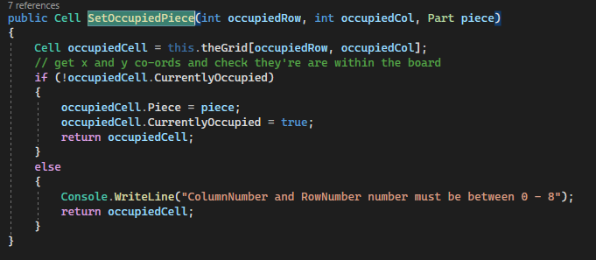
Must have the ability to select pieces to move

Slide 19
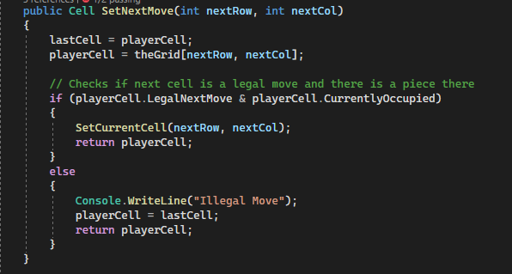
Must not accept movement to empty squares
If the player selects a next move that is outside of the legal moves or is an empty square, it will print that that was an illegal move, and the player will stay in place

Slide 20
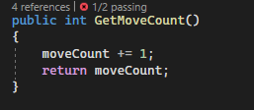
Must count total number of moves
After the player makes a move we call GetMoveCount() and that increments the move count variable by one

Slide 21
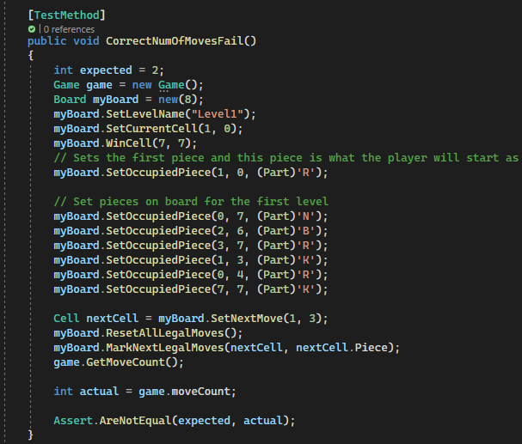
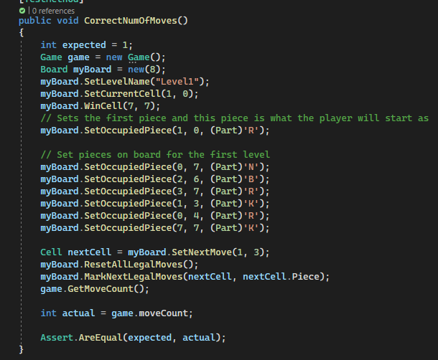
MoveCounter() Test

Slide 22
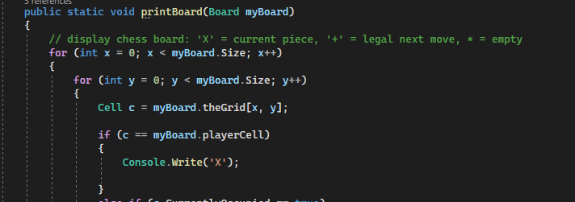
Must highlight current piece
Checks to see if the current piece is a player piece and if it is I print a X instead

Slide 23
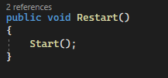
Must have reset button
When the Restart function is called the board gets reset and is the same as what it first started as

Slide 24
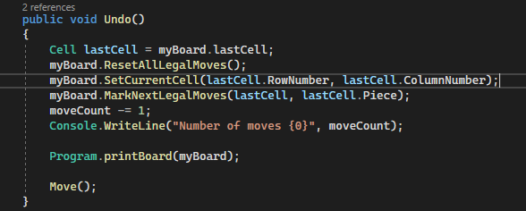
Must have undo button

Slide 25
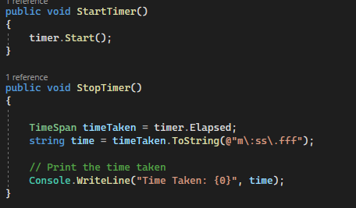
Must have timer

Slide 26
Must show time taken to beat level
Displays the total elapsed time from start to finish

Slide 27
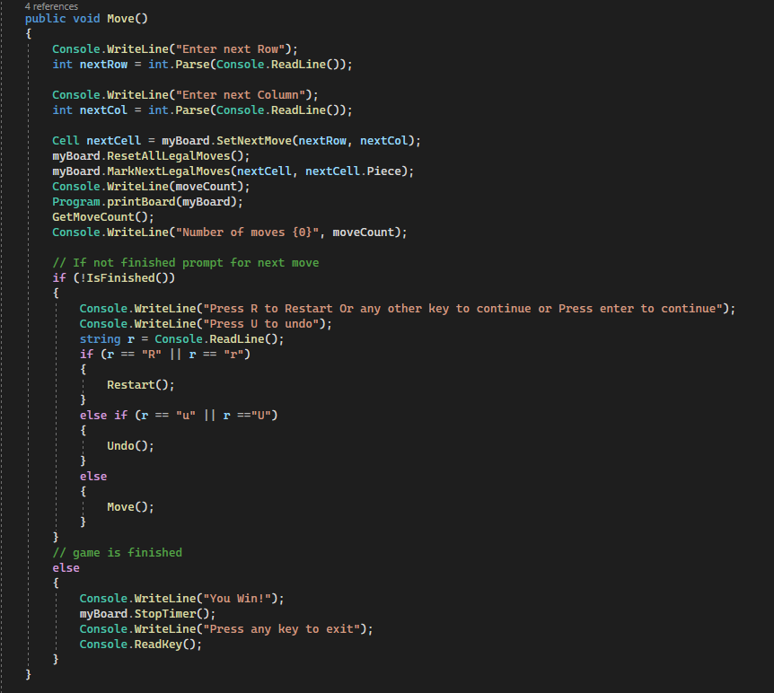
Must acknowledge level completion
Checks every move to see if the next move will land on the last piece and if it does print You Win.

Slide 28
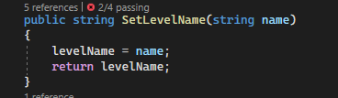
Must display level name
Call the SetLevelName() in load function where the level is being loaded to set the name and then print the name out

Slide 29
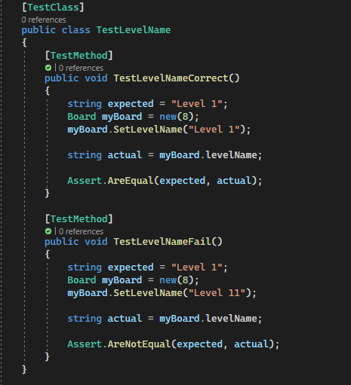
Display Level name Test

