Slide 1
Expected marks Part B
19/37

Slide 2
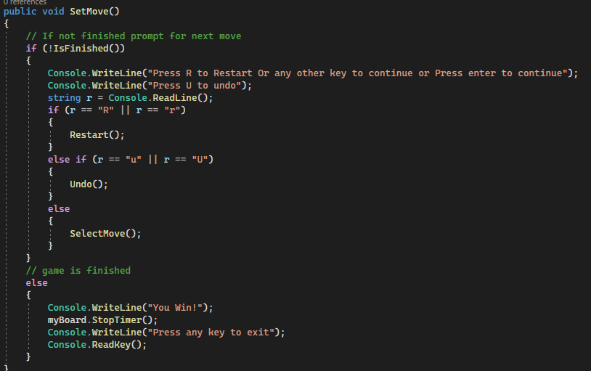
1 Selection Statement

Slide 3
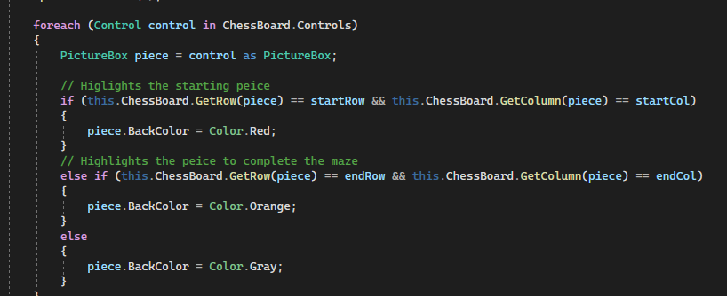
2 iteration statement

Slide 4
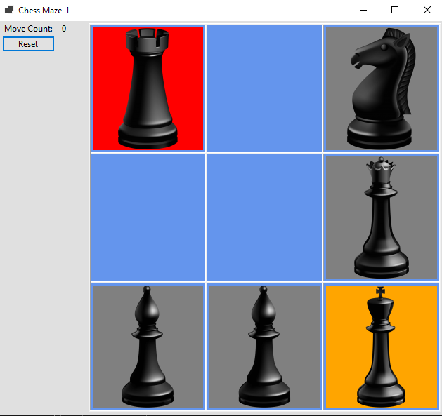

Slide 5

3 Constants

Slide 6
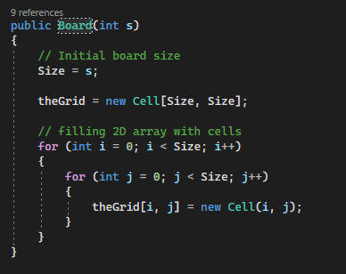
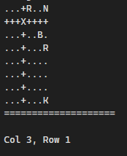
4 Arrays

Slide 7
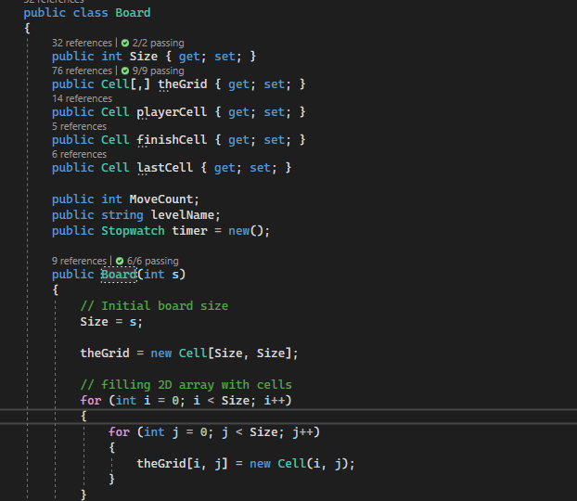
5 Classes, 9 Constructors, 25 Properties
The board class is responsible for creating the board and moving all the pieces on the board

Slide 8
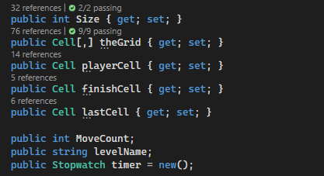

6 Access modifiers, 7 Fields, 8 Readonly

Slide 9
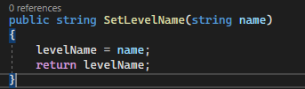

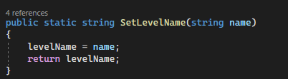

10 Passing by value, 24 Static

Slide 10
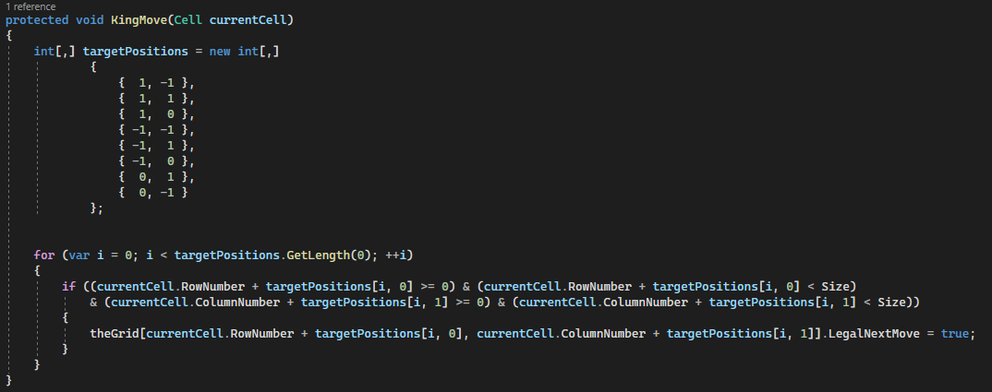
11 Passing by reference
Passing a Cell as a reference

Slide 11
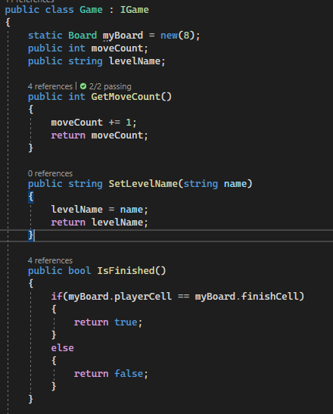
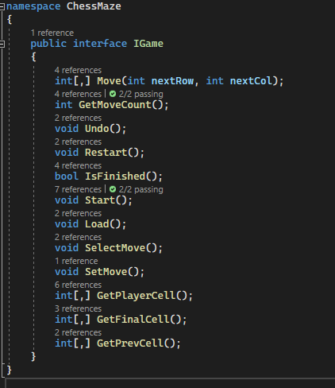
15 Interfaces, 16 Inheritance

Slide 12

21 new modifier

Slide 13
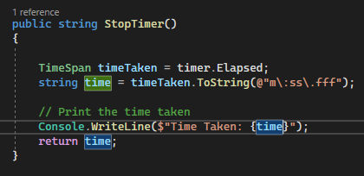
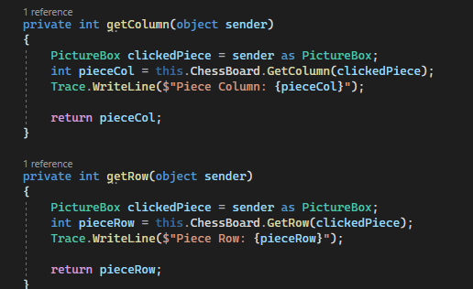
26 $ - string interpolation

Slide 14
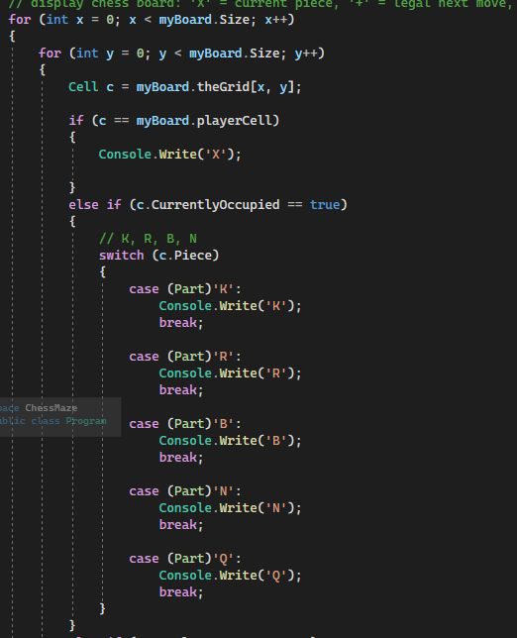
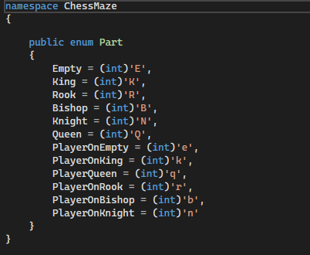
27 Enumeration types

Slide 15
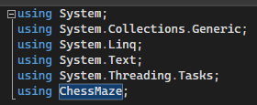

29 Using Statement

