Slide 1
Keagan Erasmus

Slide 2
Game Player Must haves
4-5

Slide 3
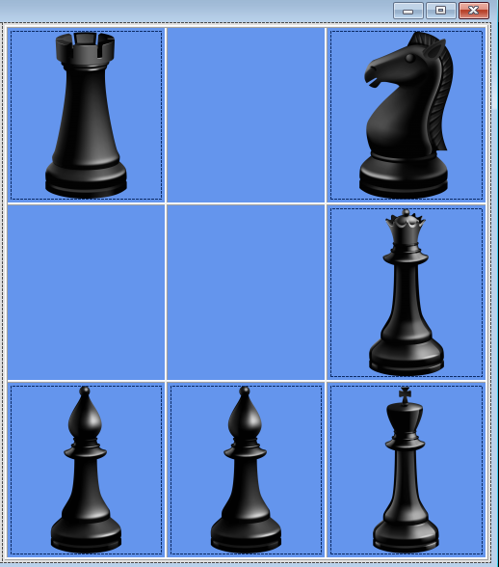
Display a grid

Slide 4
Display the Pieces as distinct images

Slide 5

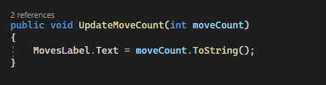
Display the move count

Slide 6
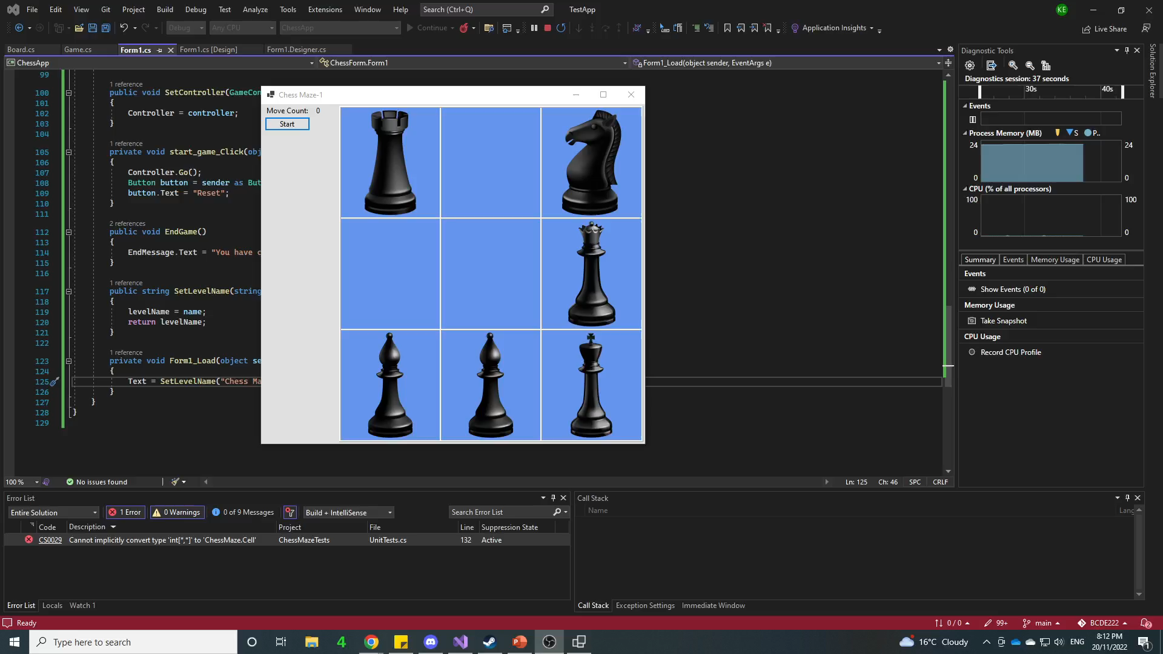
Actually works – is playable
The move counter does not get reset back to zero.

Slide 7
Implement a view – Manual GUI

Slide 8
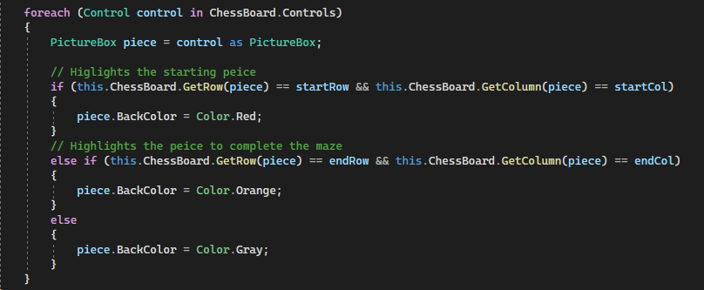
Implement view programmatically

Slide 9
Working with another students Model
I implemented Sam Moulson’s model to see if my view still worked and it did The next few slides will explain what changes I had to make to get his model to work with mine

Slide 10
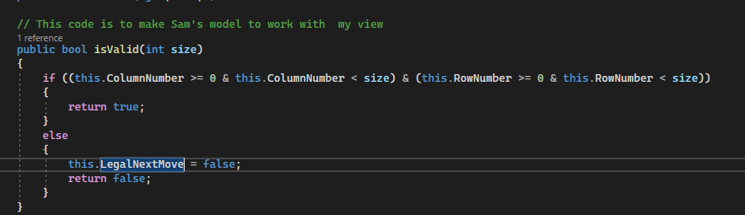
Added a is valid function to my Cell class

Slide 11


Had to rename some variables like the row and col to rowNumber and columnNumber
His model
My model

Slide 12
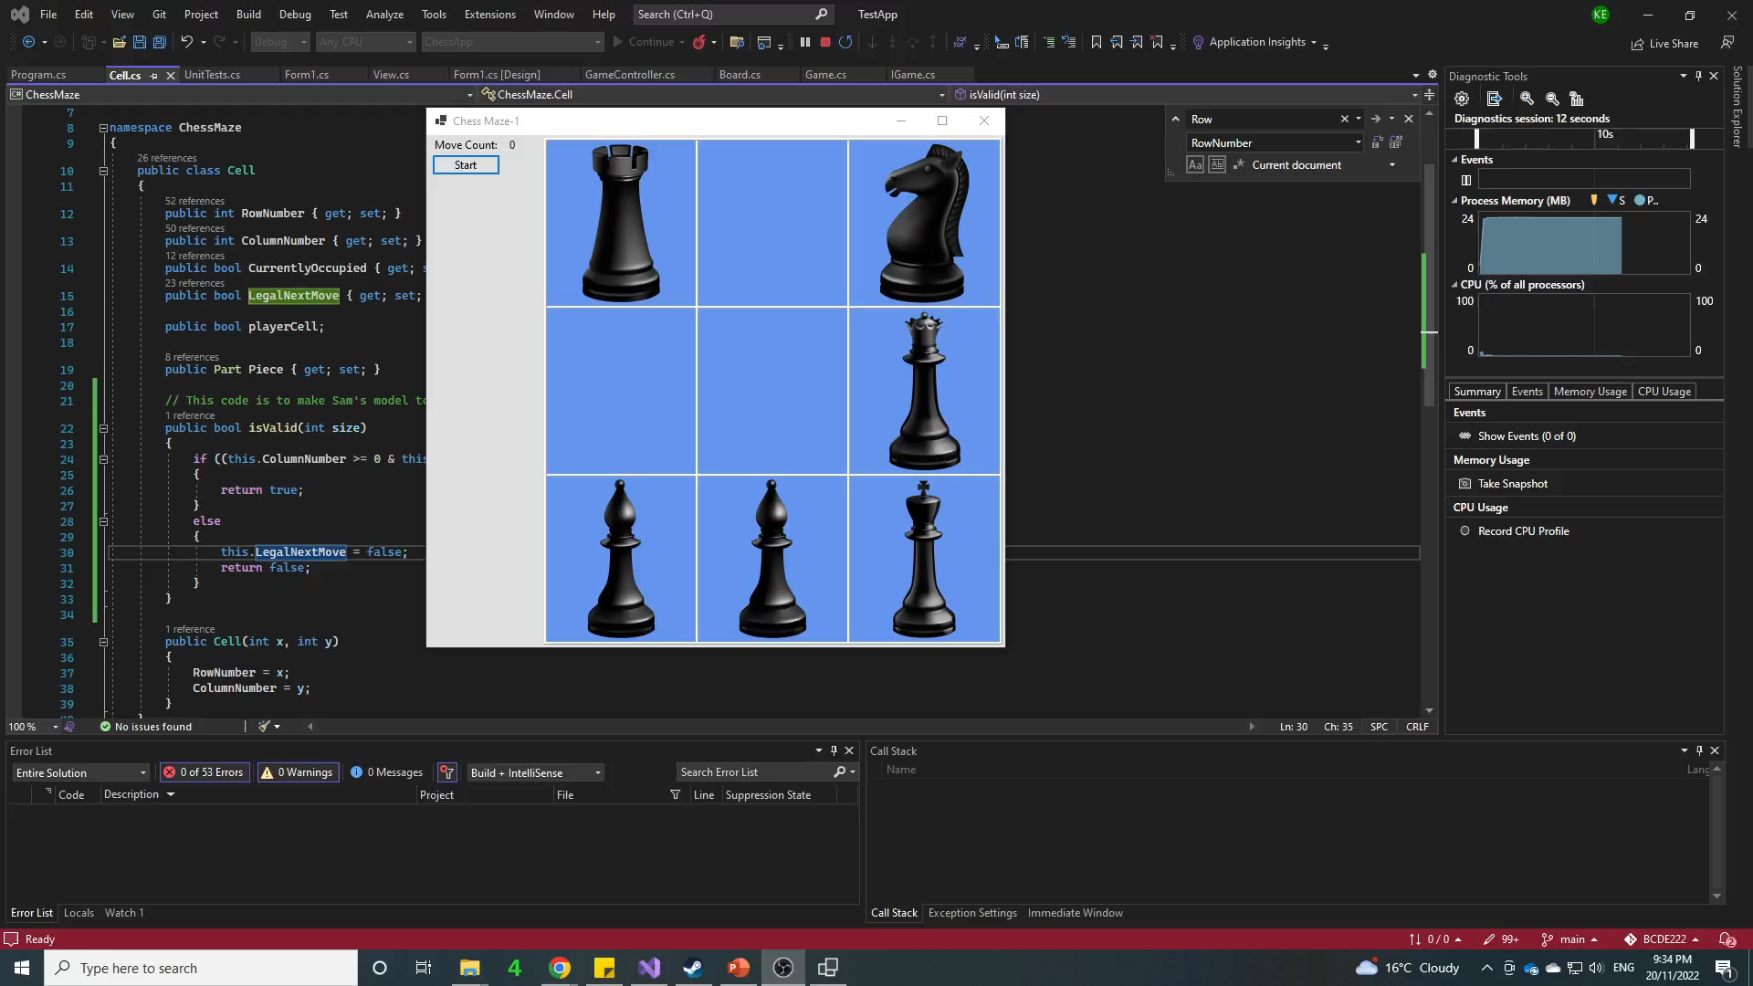
Another student’s model working

Slide 13
Make your Controller and Model work with another student’s View
I inserted my controller and model into another student’s view to see if it worked it did work but I had to make a few changes to my model as the other student had extra functions to add to mine

Slide 14
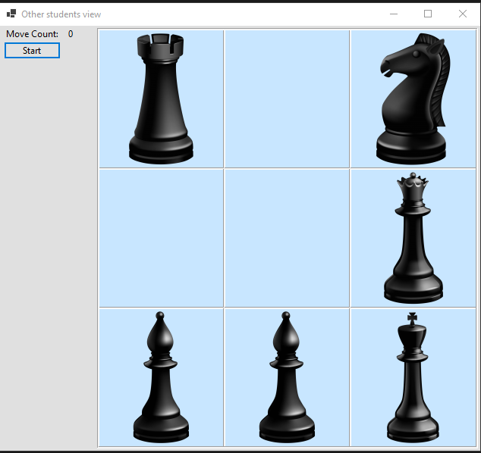
The working game

Slide 15
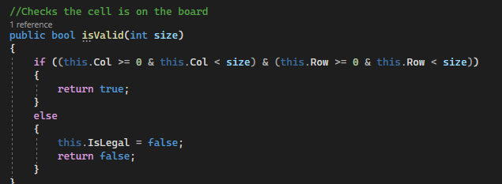
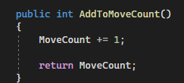
Changes I had to make to my controller
Create a AddToMoveCount function
Add a function to see if a particular cell is a valid cell
After adding these functions and changing some of my function names to match the other students view it worked

Slide 16
Refactoring
I refactored my queen piece moving code I had realised that the queen piece was a combination of the bishop and the rook so I got rid of the queenMove function and instead in the switch statement I just called the bishop and rook code

Slide 17
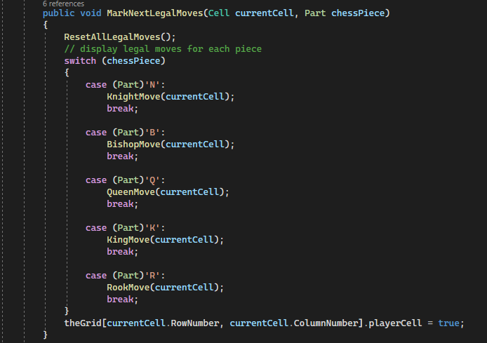
Example-before

Slide 18
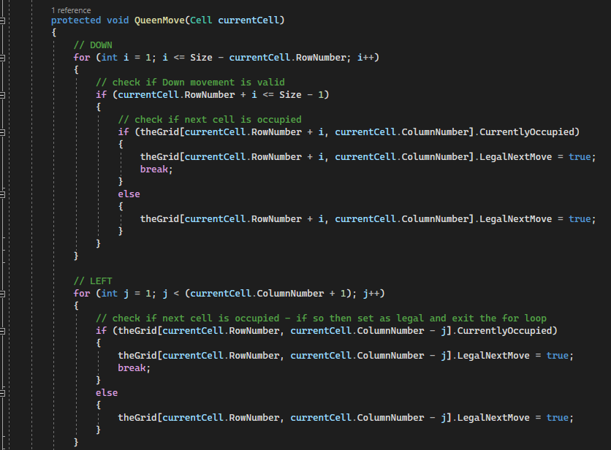
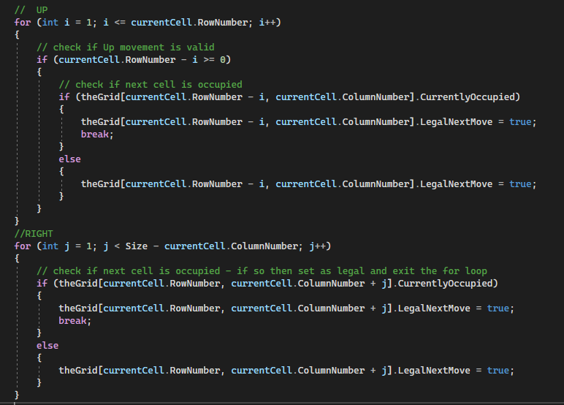

Slide 19
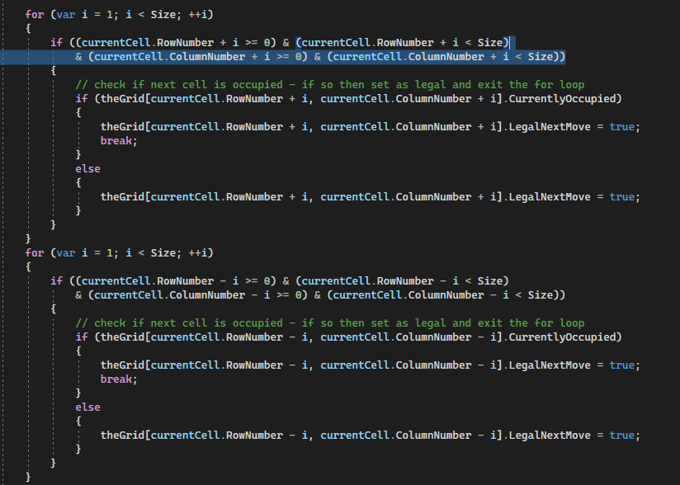
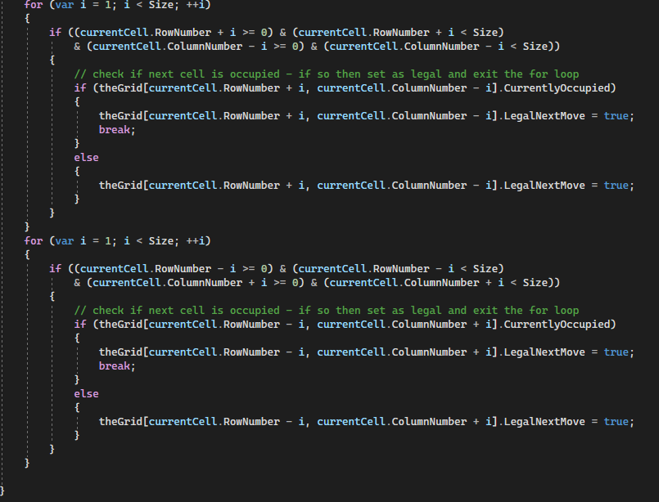

Slide 20
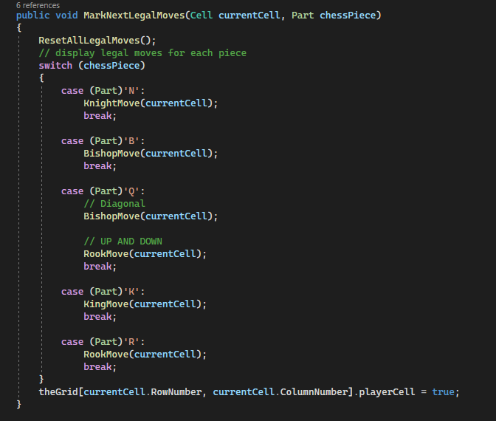
Example-after

