Slide 1
Expected marks Part A
26/37

Slide 2

1# Selection statements

Slide 3

2# Iteration Statement

Slide 4


3# Constants

Slide 5

4# Arrays

Slide 6

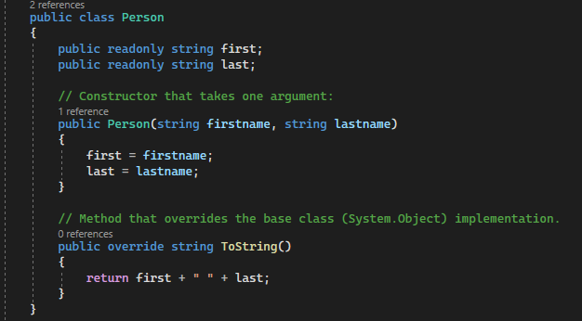
5 Classes, 9 Constructors, 25 Properties

Slide 7

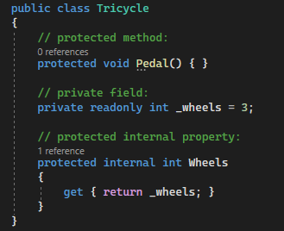
6 Access modifiers, 7 Fields, 8 Readonly

Slide 8


10 Passing by value, 24 Static

Slide 9


11 Passing by reference

Slide 10

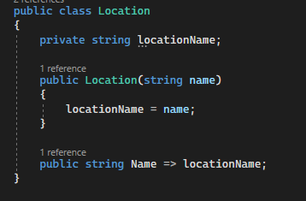
12 Expression body definitions =>

Slide 11

13 Lambda expressions

Slide 12

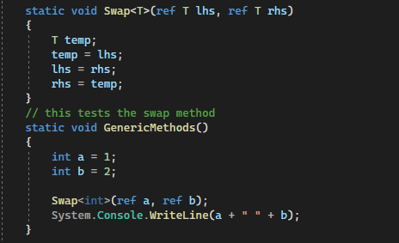
14 Generic Methods

Slide 13
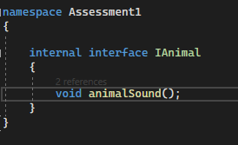

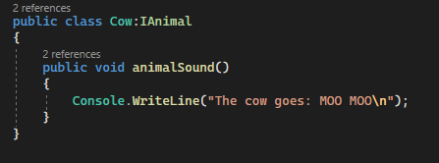
15 Interfaces, 16 Inheritance

Slide 14
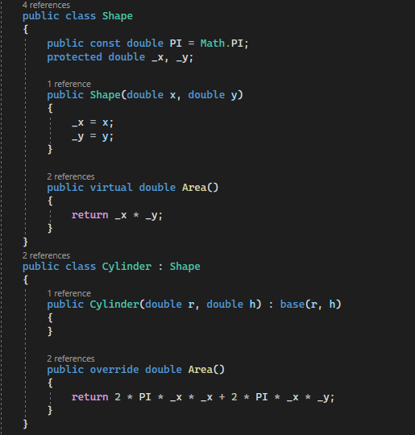

17 Virtual

Slide 15

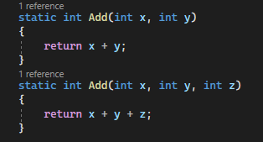
18 Overload

Slide 16

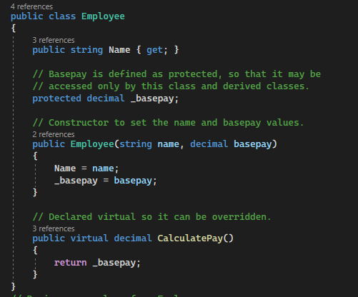
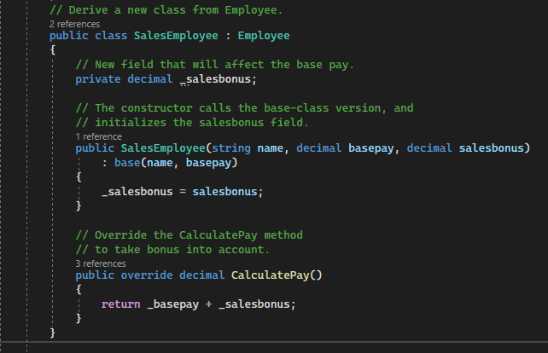
19 Override, 22 Base

Slide 17
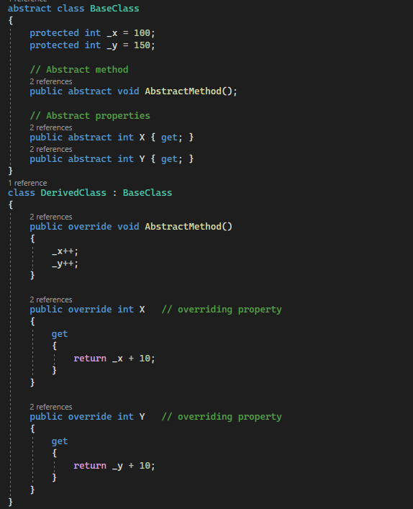

20 Abstract Classes and Abstract Class Members

Slide 18

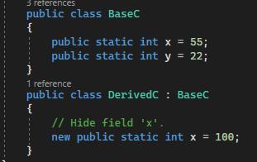
21 New Modifier, 23 Sealed Classes and Sealed Class Members

Slide 19

26 $ - string interpolation

