Slide 1
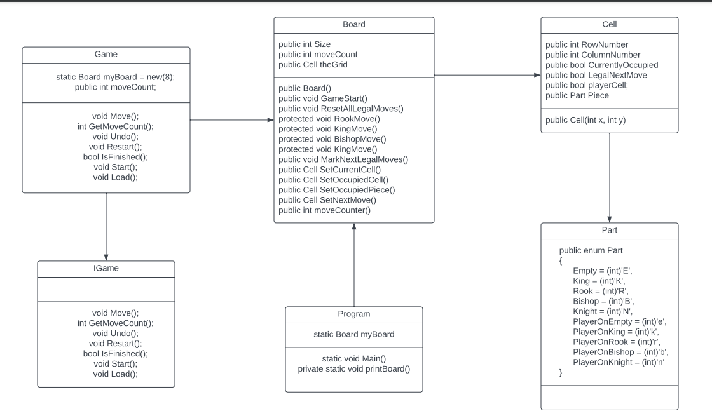
Class Diagram

Slide 2
Self Marks
Features: 5/5 I implemented all 17 of my must have features
Tests: 1/5 Did not have full test coverage
UML Class diagram: 4/5

Slide 3
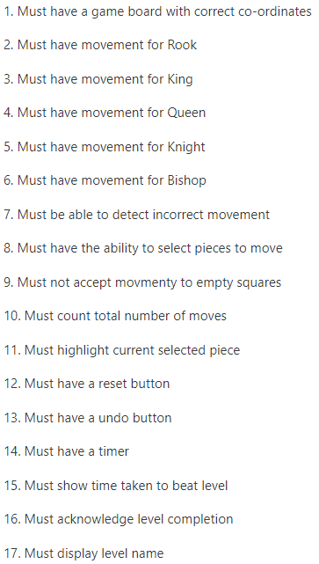
Must haves
I had 17 must have features

Slide 4
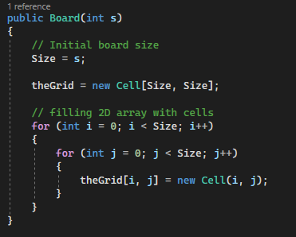
Must have a game board with correct co-ordinates
Created a 2D array that starts at 0,0
and creates a grid of a set Size

Slide 5
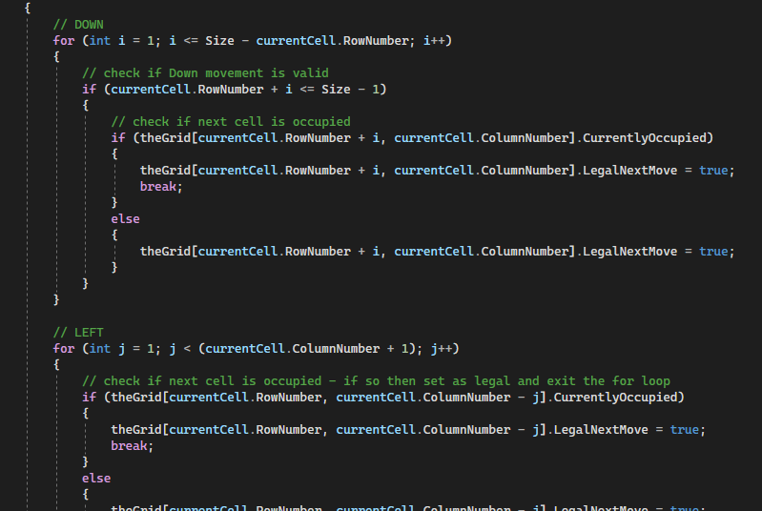
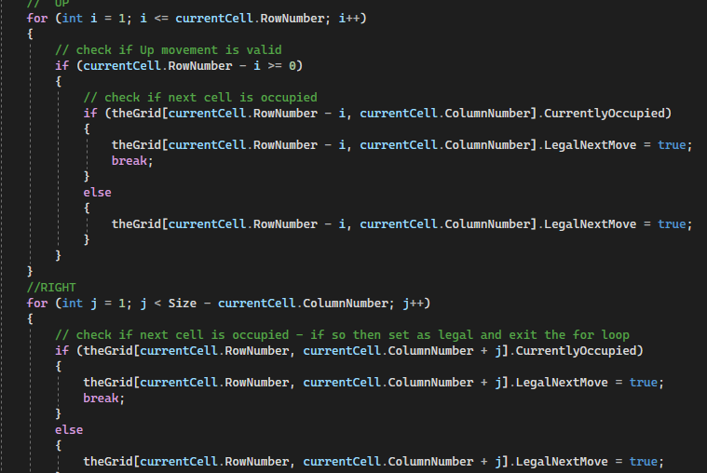
Must have movement for Rook

Slide 6
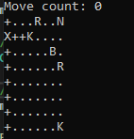
Rook Movement Test

Slide 7
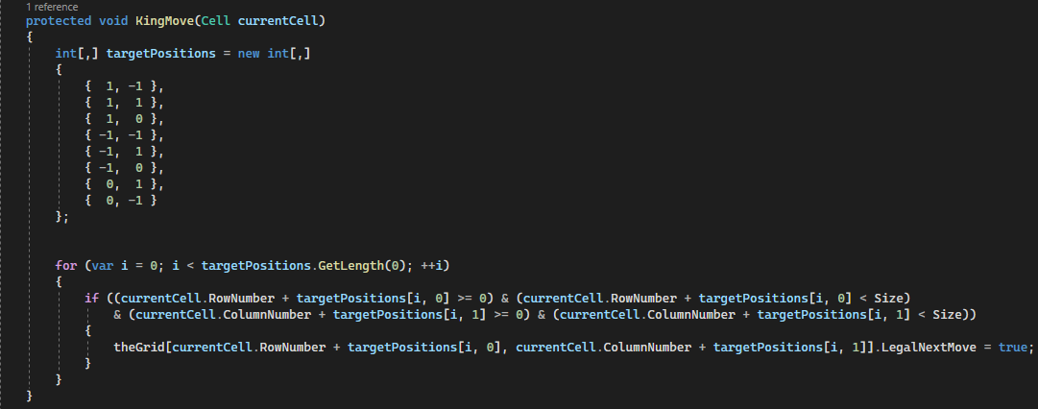
Must have movement for King

Slide 8
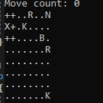
King Movement Test

Slide 9
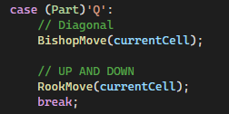
Must have movement for Queen
Queen Movement is a combination of the Rook and Bishop movement

Slide 10
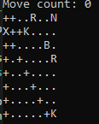
Queen Movement Test

Slide 11
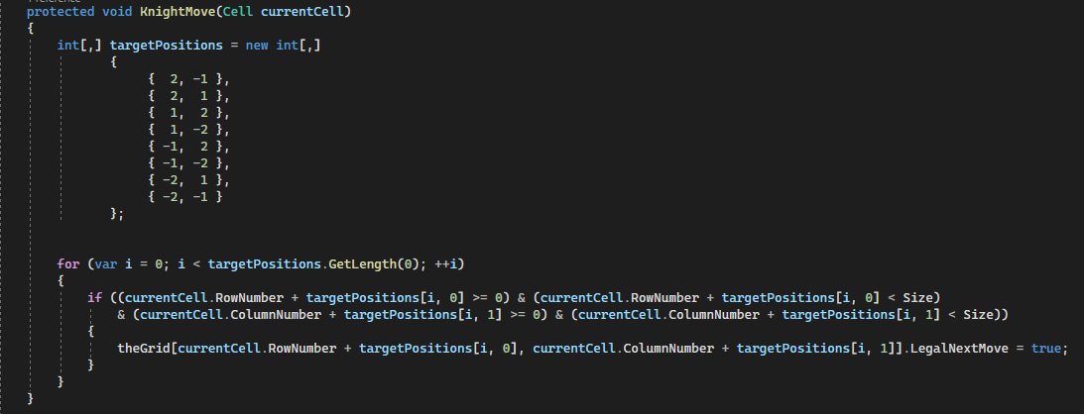
Must have movement for Knight

Slide 12
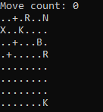
Knight Movement Test

Slide 13
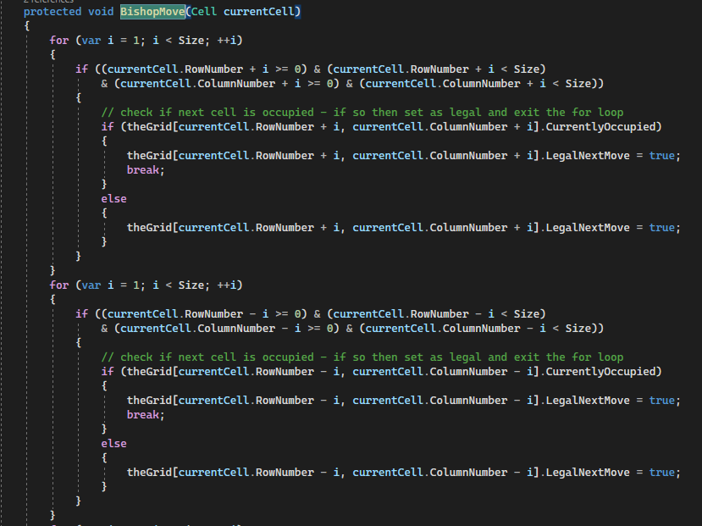
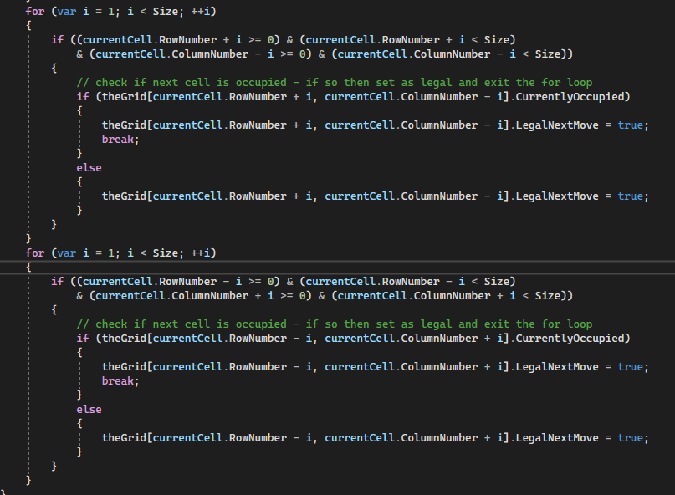
Must have movement for Bishop

Slide 14
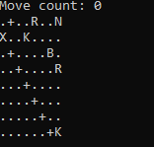
Bishop Movement Test

Slide 15
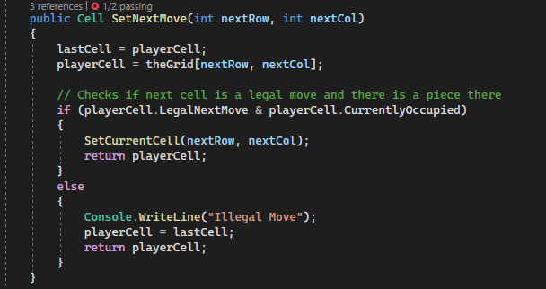
Must be able to detect incorrect movement
Checks the players next move to see if it is a legal move for the piece

Slide 16
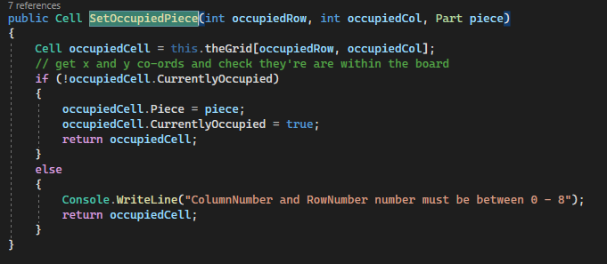
Must have the ability to select pieces to move

Slide 17
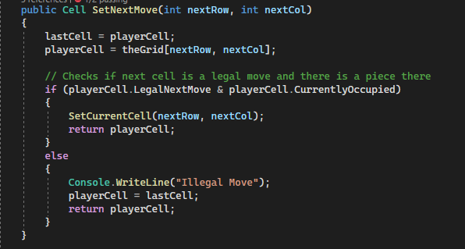
Must not accept movement to empty squares
If the player selects a next move that is outside of the legal moves or is an empty square, it will print that that was an illegal move, and the player will stay in place

Slide 18
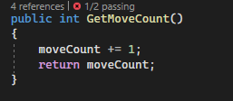
Must count total number of moves
After the player makes a move we call GetMoveCount() and that increments the move count variable by one

Slide 19
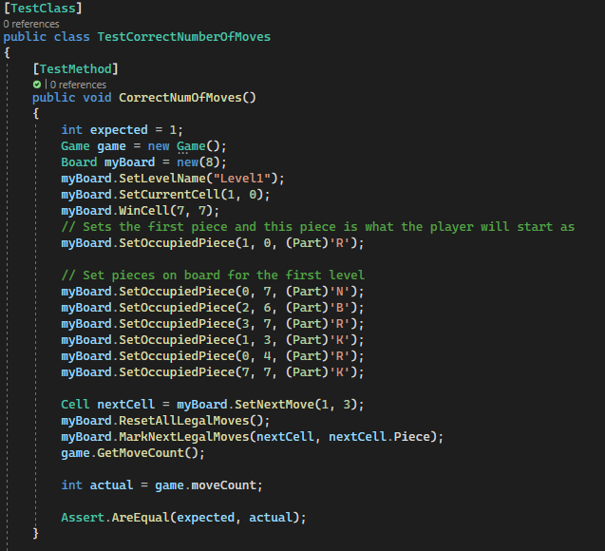
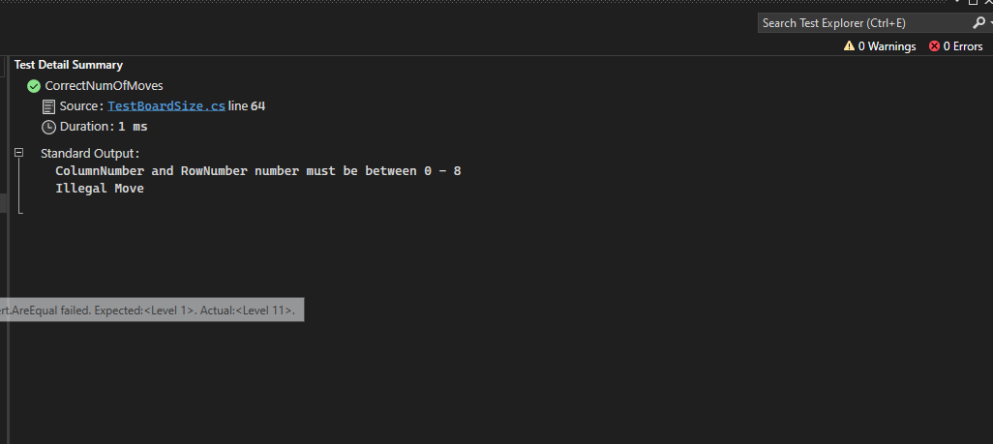
MoveCounter() Test

Slide 20
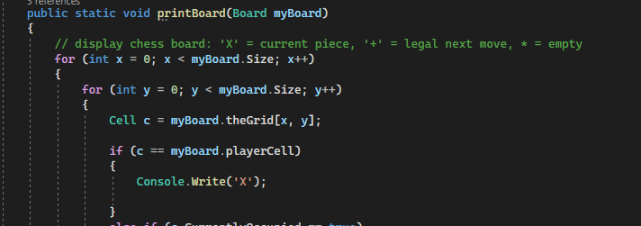
Must highlight current piece
Checks to see if the current piece is a player piece and if it is I print a X instead

Slide 21
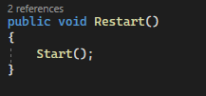
Must have reset button
When the Restart function is called the board gets reset and is the same as what it first started as

Slide 22
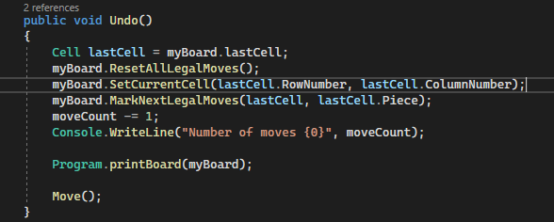
Must have undo button

Slide 23
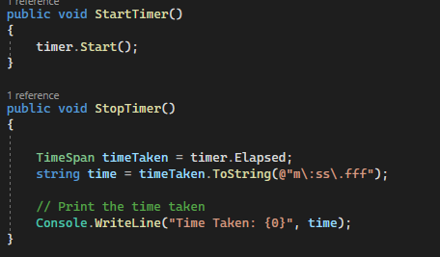
Must have timer

Slide 24
Must show time taken to beat level
Displays the total elapsed time from start to finish

Slide 25
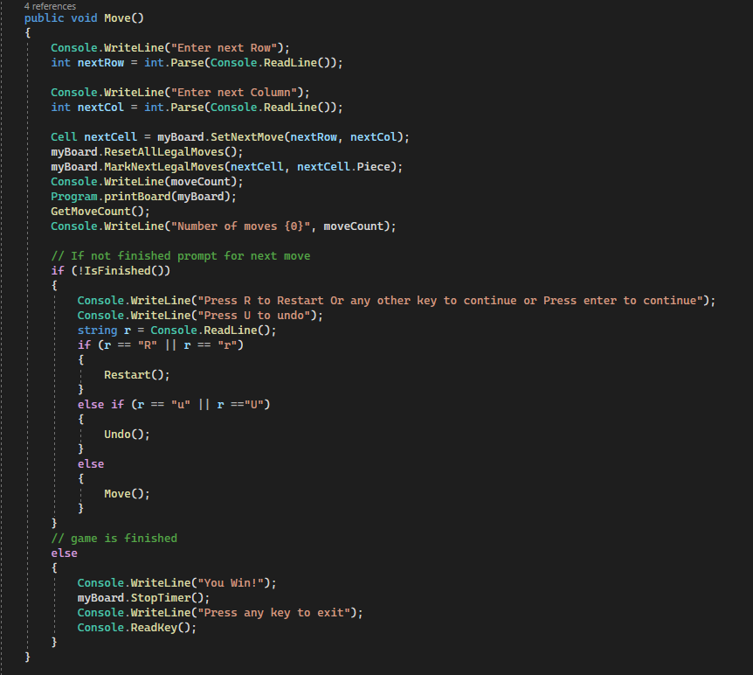
Must acknowledge level completion
Checks every move to see if the next move will land on the last piece and if it does print You Win.

Slide 26
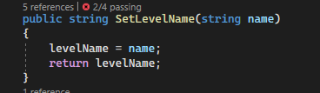
Must display level name
Call the SetLevelName() in load function where the level is being loaded to set the name and then print the name out

Slide 27
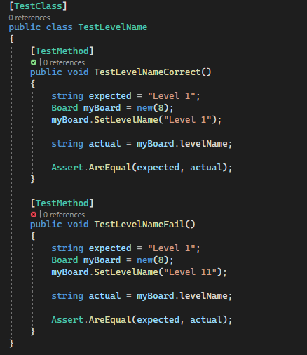

Display Level name Test
I had a test with the correct name and the incorrect name to ensure my test was working

