Slide 1
19/26
Part A

Slide 2
I’ve tried this

Slide 3
10/26
Primitive Data Types
Arrays
Control flow statements
Classes
Passing Information to a Method or a Constructor and returning values
Controlling Access to Members of a Class
Static and final
Lambda Expressions
9 Method references
List

Slide 4
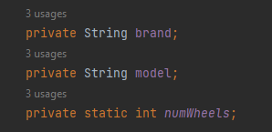
Primitive Data Types

Slide 5
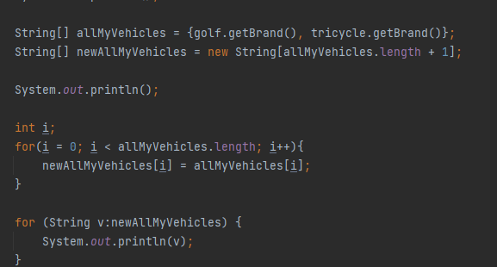
Arrays

Slide 6
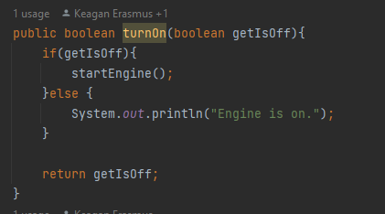
Control flow statements

Slide 7
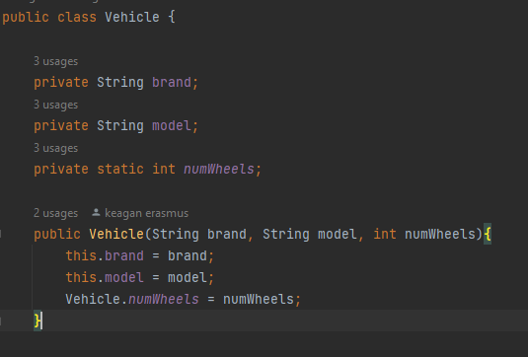
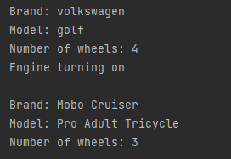
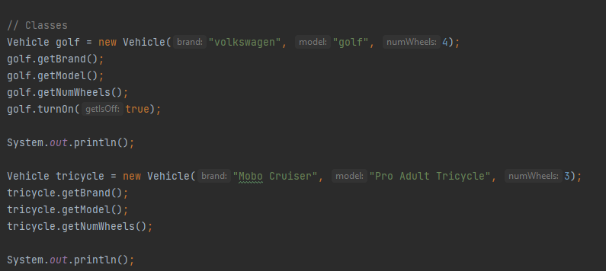
Classes

Slide 8
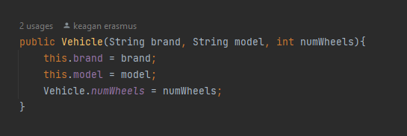
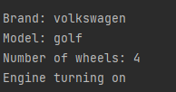
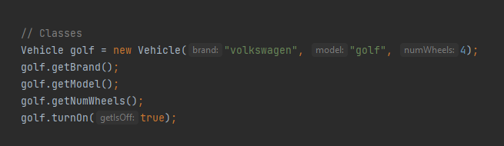
Passing Information to a Method or a Constructor and returning values

Slide 9
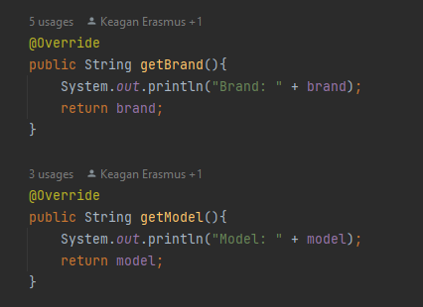

Controlling Access Members of a Class

Slide 10

Static and Final

Slide 11
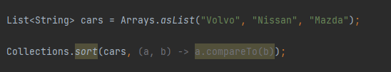

Lambda Expression

Slide 12
Method References

Slide 13
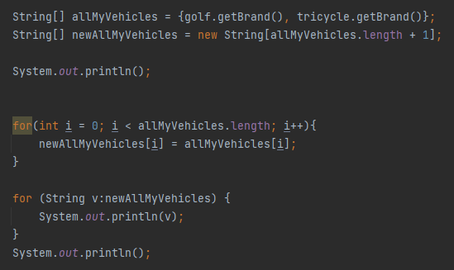
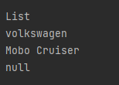
List

Slide 14
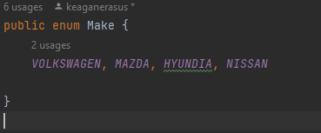
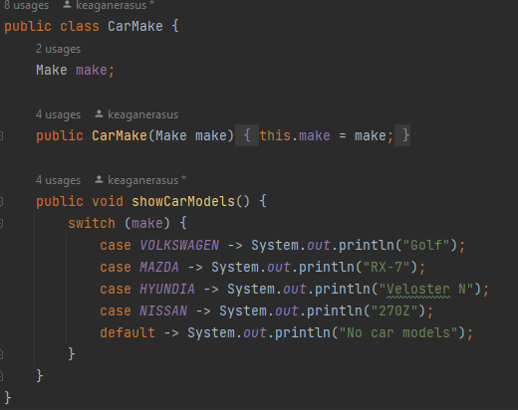
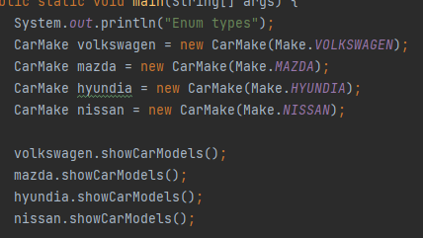
Enum Types

Slide 15
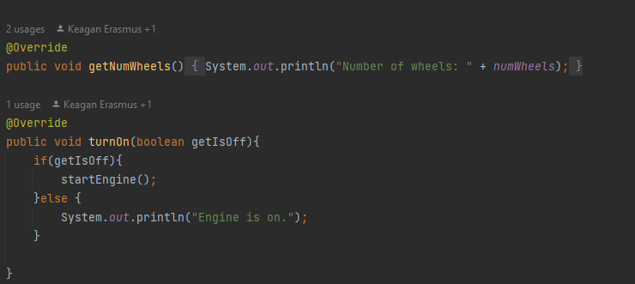
Annotations

Slide 16
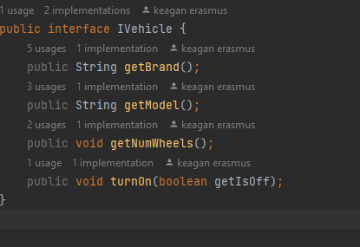
Interface

Slide 17

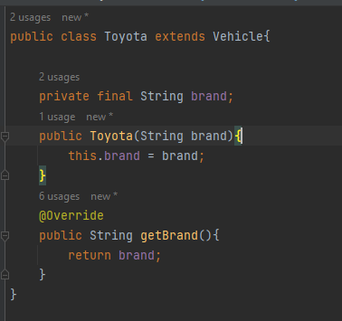


Inheritance

Slide 18
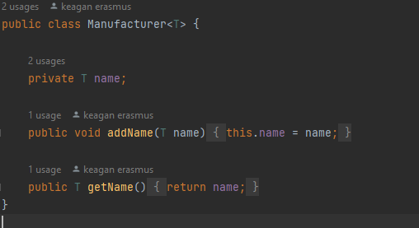
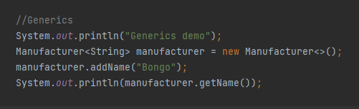
Generics

Slide 19
Packages

Slide 20
File I/O streams

Slide 21
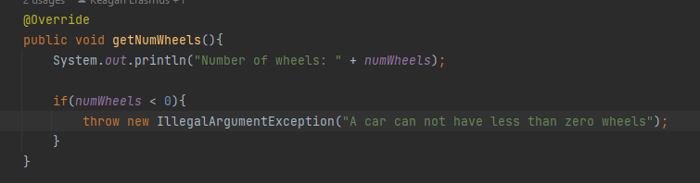
Exceptions

Slide 22
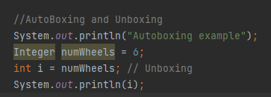
autoboxing and unboxing

Slide 23
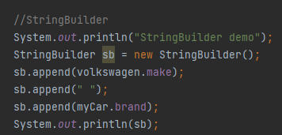

StringBuilder

Slide 24
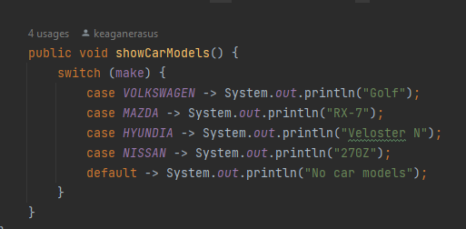
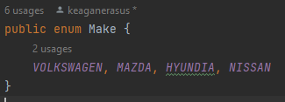
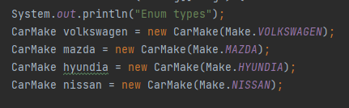
Switch expressions

Slide 25
Record classes

Slide 26
var local type inference

Slide 27
Sealed classes

Slide 28
Text Blocks

Slide 29
Pattern Matching

