Slide 1
Eyeball Maze
Keagan Erasmus

Slide 2
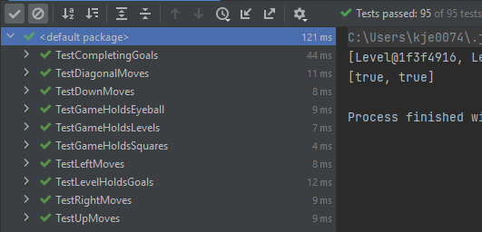
Expected Marks
Tests 95/95
Class Diagram 5/5
Total Marks 100/100 ☺

Slide 3
TestGameHoldsLevels
testGetLevelWidth
testGetLevelheight
testGetLevelCountWithTwoLevels
testMostRecentlyAddedLevelIsCurrentLevelbyCheckingSize
testSettingLevelChangesCurrentLevelbyCheckingSize
testSettingLeveltoToolargeNumberThrowsException

Slide 4
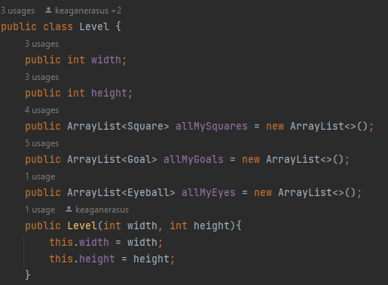
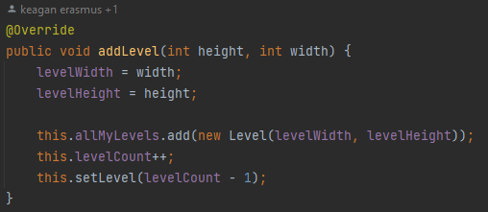
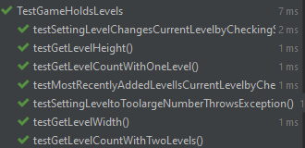

Slide 5
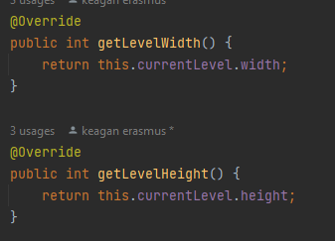
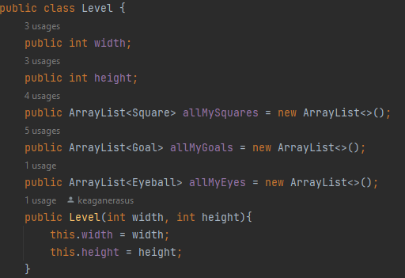
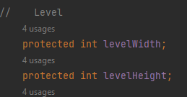
testGetLevelWidth & testGetLevelHeight

Slide 6


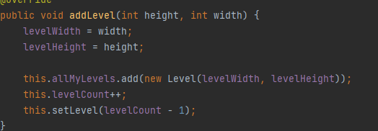
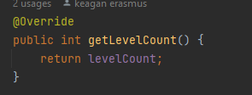
testGetLevelCountWithOneLevel & testGetLevelCountWithTwoLevels

Slide 7
testMostRecentlyAddedLevelIsCurrentLevelbyCheckingSize

Slide 8
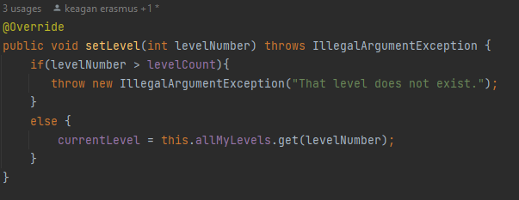
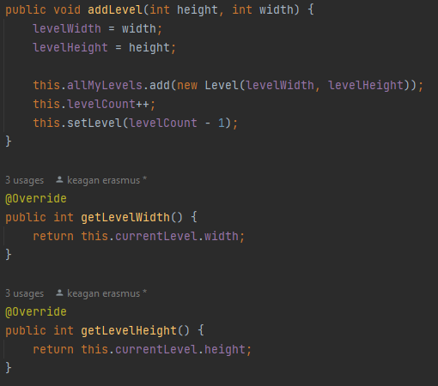
testSettingLevelChangesCurrentLevelbyCheckingSize

Slide 9
testSettingLeveltoToolargeNumberThrowsException

Slide 10
TestLevelHoldsGoals
testAddingOneGoalIncreasesGoalCountTo1
testAddingOneGoalputsGoalAtExpectedPosition
testAddingTwoGoalIncreasesGoalCountTo2
testAddingTwoGoalsPutsGoalsAtExpectedPositions
testNewGamehas0CompletedGoals
testAddingGoalOutsideLevelHeightThrowsRangeException
testAddingGoalsOutsideLevelWidthThrowsRangeException

Slide 11
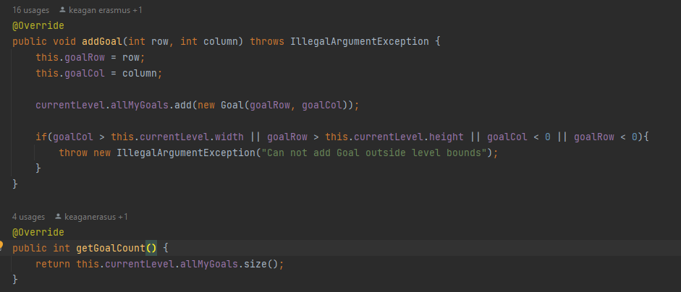
testAddingOneGoalIncreasesGoalCountTo1 testAddingTwoGoalIncreasesGoalCountTo2

Slide 12
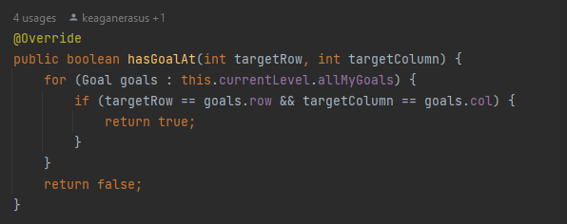
testAddingOneGoalputsGoalAtExpectedPosition testAddingTwoGoalsPutsGoalsAtExpectedPositions

Slide 13

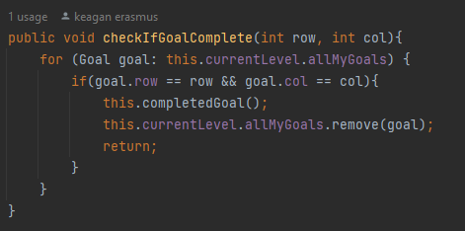
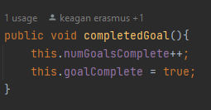
testNewGamehas0CompletedGoals

Slide 14
testAddingGoalOutsideLevelHeightThrowsRangeException testAddingGoalsOutsideLevelWidthThrowsRangeException

Slide 15
TestGameHoldsSquares
testAddingSquareOutsideLevelWidthThrowsException
testAddingSquareOutsideLevelHeightThrowsException
testColoursAreAdded
testShapesAreAdded

Slide 16
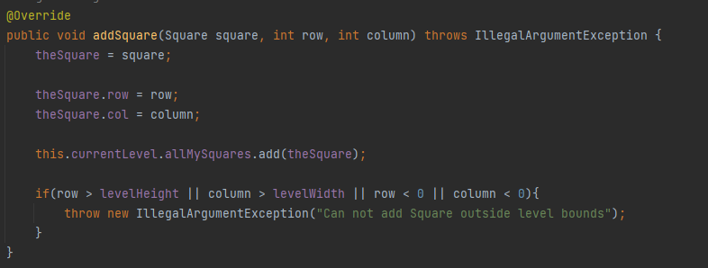
testAddingSquareOutsideLevelWidthThrowsException testAddingSquareOutsideLevelHeightThrowsException

Slide 17
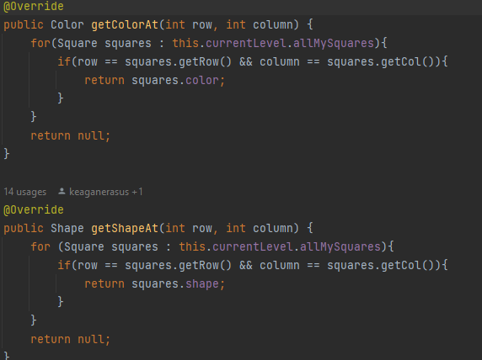
testColoursAreAdded testShapesAreAdded

Slide 18
TestGameHoldsEyeBall
testAddingEyeballOutsideHeightThrowsException
testAddingEyeballOutsideWidthThrowsException
testAddingEyeballPutsItWhereExpected
testAddingEyeballFacingUpFacesUp
testAddingEyeballFacingDownFacesDown
testAddingEyeballFacingLeftFacesLeft
testAddingEyeballFacingRightFacesRight

Slide 19
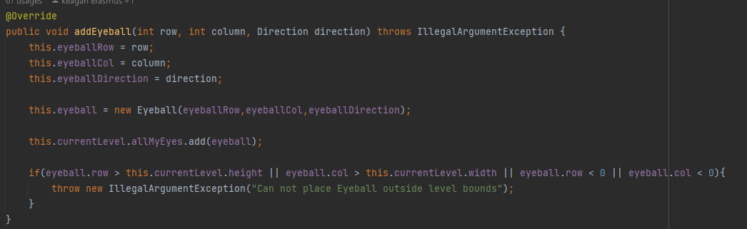
testAddingEyeballOutsideHeightThrowsException testAddingEyeballOutsideWidthThrowsException

Slide 20
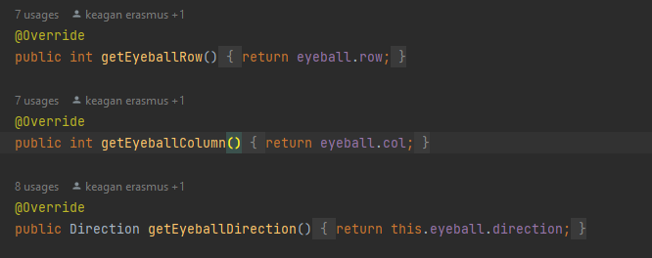
testAddingEyeballPutsItWhereExpected

Slide 21
testAddingEyeballFacingUpFacesUp testAddingEyeballFacingDownFacesDown testAddingEyeballFacingLeftFacesLeft testAddingEyeballFacingRightFacesRight

Slide 22
TestMovesUp/Left/Right/Up/Down/Diagonal
testOkToMoveToSameColorOrShape
testNotOkToMoveToDifferentColorAndShape
testNoErrorMessageWhenMovingToSameColorOrShape
testGetsErrorMessageWhenMovingToDifferentColorAndShape
testOkWhenEyeballFacesRightOnMovingUp
testOkWhenEyeballFacesLeftOnMovingUp
testNotOkWhenMovingBackwards
testsGetsErrorMessageWhenMovingBackwards
testNotOkWhenPathToDestinationCrossesBlank
testEyeballMovesToDestinationRowAndColumn
testEyeballFacesUPOnMovingUp

Slide 23
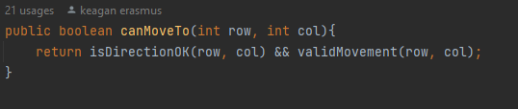
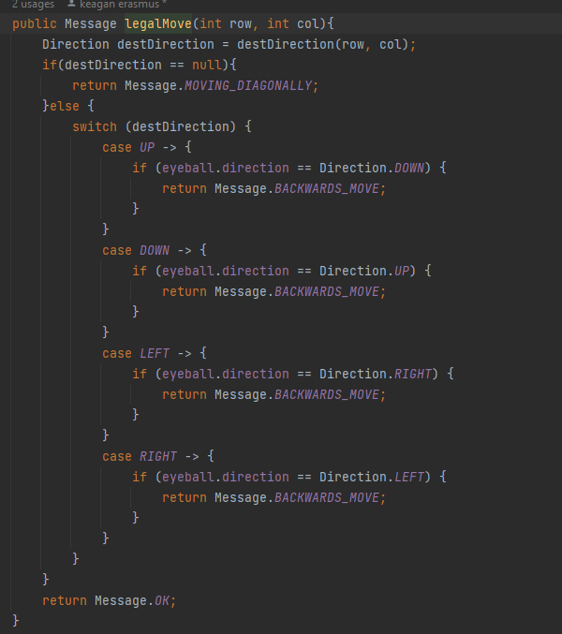
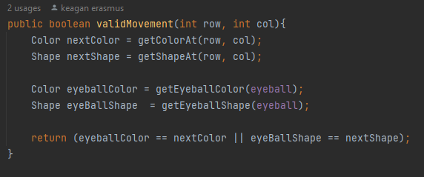
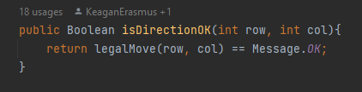
testOkToMoveToSameColorOrShape

Slide 24
testNotOkToMoveToDifferentColorAndShape

Slide 25
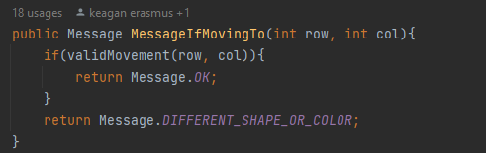
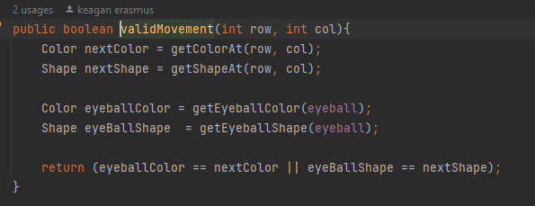
testNoErrorMessageWhenMovingToSameColorOrShape

Slide 26
testGetsErrorMessageWhenMovingToDifferentColorAndShape

Slide 27
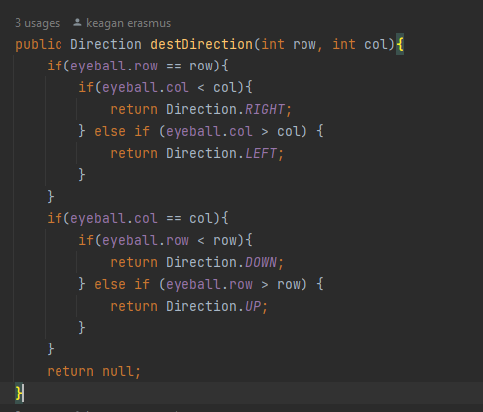
Test facing in the right directions

Slide 28
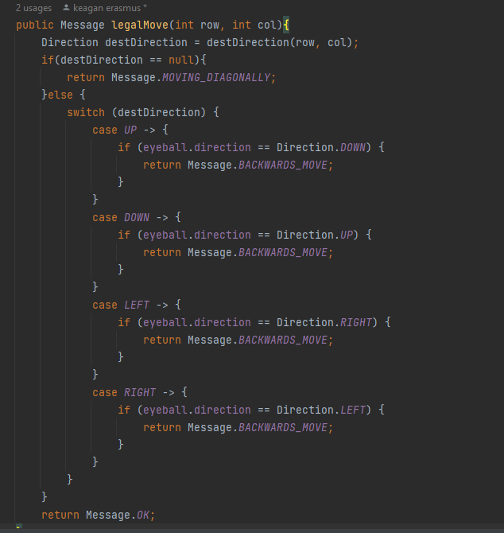
testNotOkWhenMovingBackwards testsGetsErrorMessageWhenMovingBackwards

Slide 29
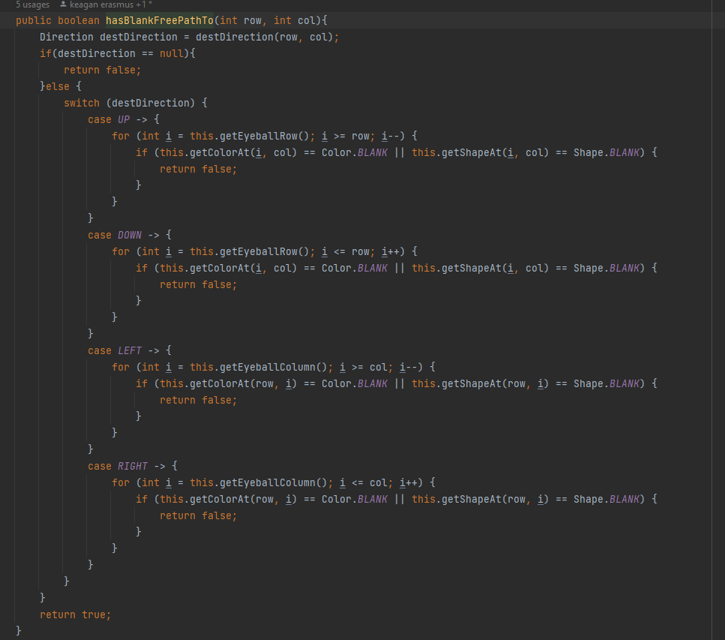
testNotOkWhenPathToDestinationCrossesBlank

Slide 30
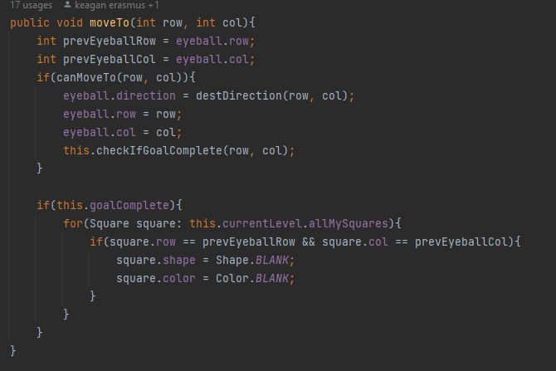
testEyeballMovesToDestinationRowAndColumn

Slide 31
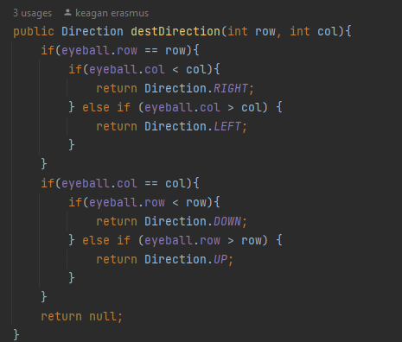
Test Eyeball faces correct direction after moving

Slide 32
TestCompletingGoals
testCompletingLevelOne
testOkToMoveToAGoalWithSameColorOrShape
testNoErrorMessageWhenMovingToAGoalWithSameColorOrShape
testNotOkToMoveToAGoalWithDifferentColorOrShape
testGetsErrorMessageWhenMovingToAGoalWithDifferentColorOrShape
testNotOkToMoveToAGoalAtADiagonalSquare
testNotOkWhenMovingBackwardsToAGoalWithSameColorOrShape
testCompleting1GoalIncreasesCompletedGoalCountBy1
testCompleting1GoalDecreaseGoalCountBy1
testGoalWillBeRemovedFromSquareAfterCompletingTheGoal
testGoalSquareWillNotBeChangedWhenEyeballMovesOntoIt
testGoalSquareBecomesBlankSquareAfterEyeballMovesToAnotherSquare

Slide 33
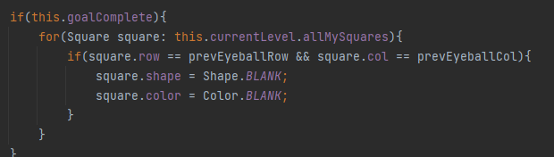
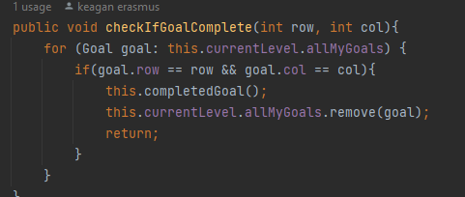
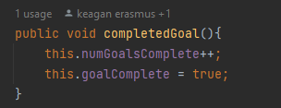
testCompletingLevelOne

Slide 34
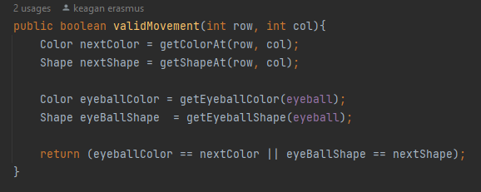
testOkToMoveToAGoalWithSameShapeOrColor

Slide 35
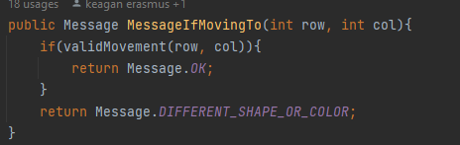
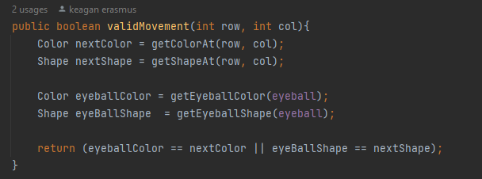
testNoErrorMessageWhenMovingToAGoalWithSameColorOrShape

Slide 36
testNotOkToMoveToAGoalWithDifferentColorOrShape

Slide 37
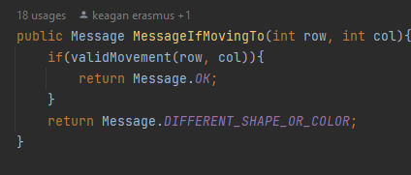
testGetsErrorMessageWhenMovingToAGoalWithDifferentColorOrShape

Slide 38
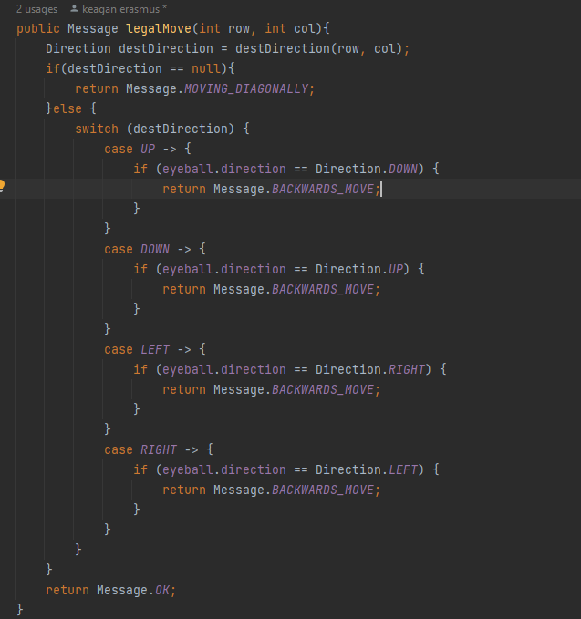
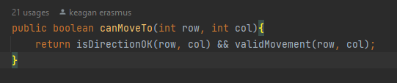
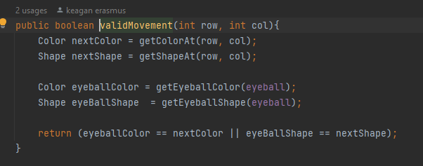
testNotOkToMoveToAGoalAtADiagonalSquare

Slide 39
testNotOkWhenMovingBackwardsToAGoalWithSameColorOrShape

Slide 40
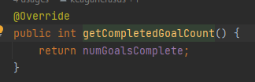
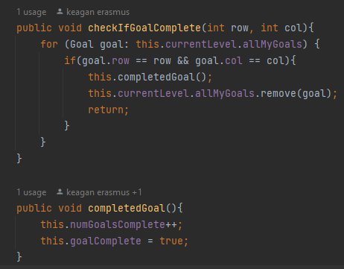
testCompleting1GoalIncreasesCompletedGoalCountBy1 testCompleting1GoalDecreaseGoalCountBy1

Slide 41
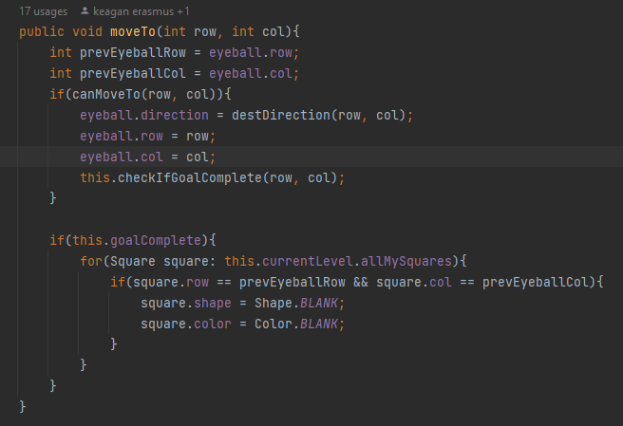
testGoalWillBeRemovedFromSquareAfterCompletingTheGoal

Slide 42
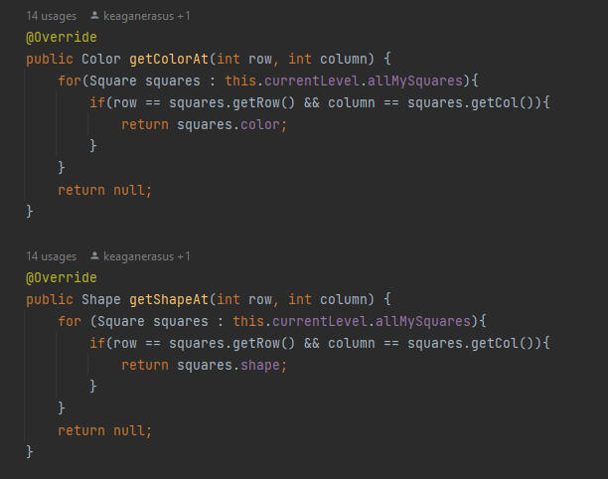
testGoalSquareWillNotBeChangedWhenEyeballMovesOntoIt

Slide 43
testGoalSquareBecomesBlankSquareAfterEyeballMovesToAnotherSquare

