Slide 1
24/26
Part A
I’ve tried this

Slide 2
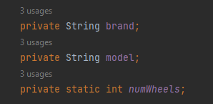
Primitive Data Types

Slide 3
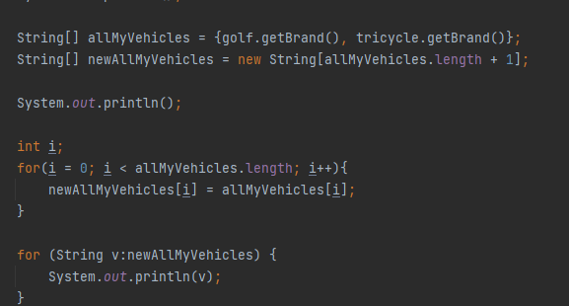
Arrays

Slide 4
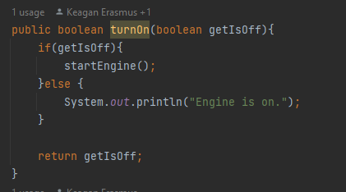
Control flow statements

Slide 5
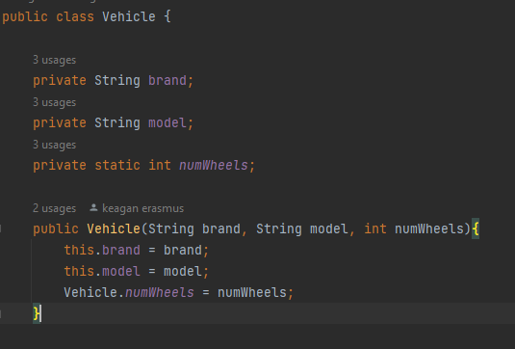
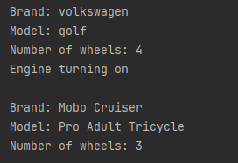
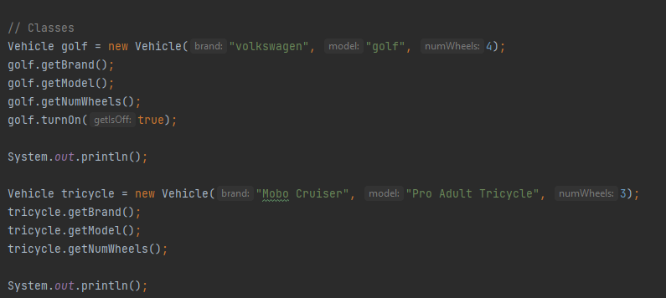
Classes

Slide 6
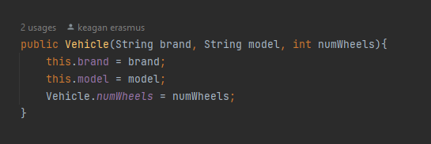
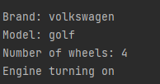

Passing Information to a Method or a Constructor and returning values

Slide 7
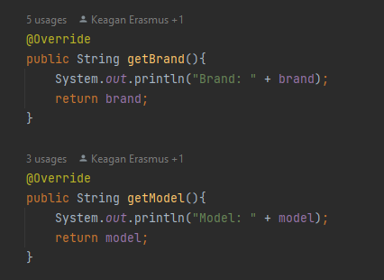

Controlling Access Members of a Class

Slide 8

Static and Final

Slide 9


Lambda Expression

Slide 10
Method References

Slide 11
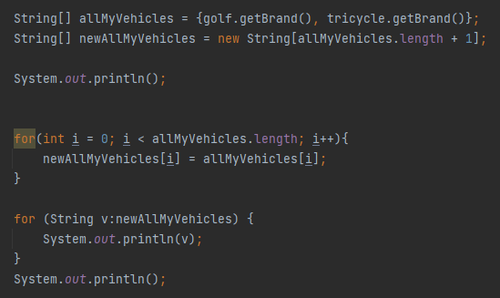
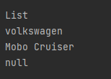
List

Slide 12
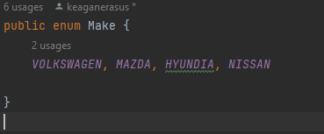
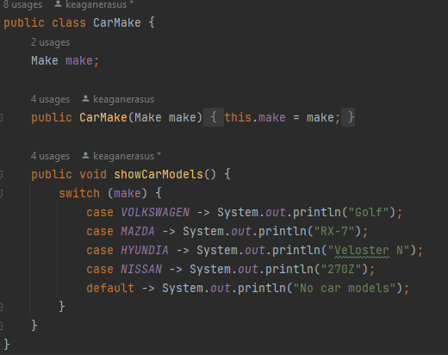
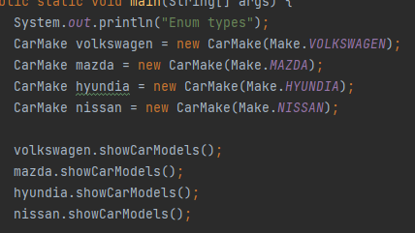
Enum Types

Slide 13
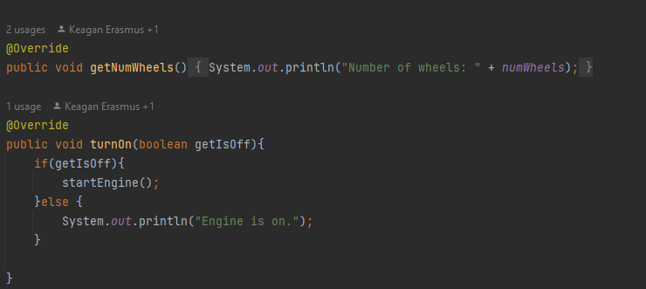
Annotations

Slide 14
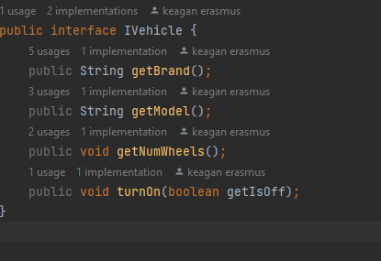
Interface

Slide 15

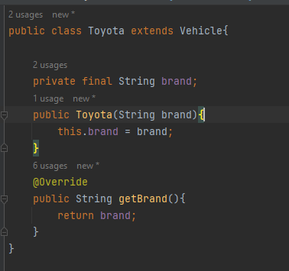


Inheritance

Slide 16
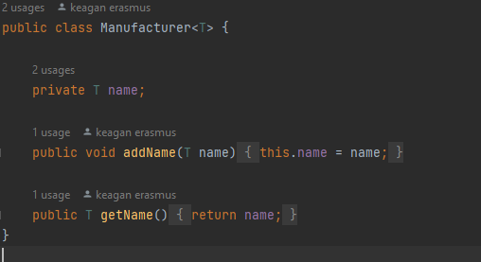

Generics

Slide 17
Packages

Slide 18

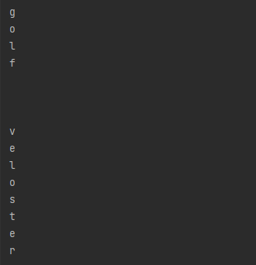
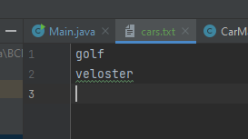
File I/O streams

Slide 19

Exceptions

Slide 20
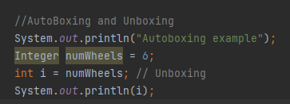
autoboxing and unboxing

Slide 21
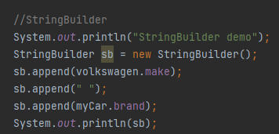

StringBuilder

Slide 22
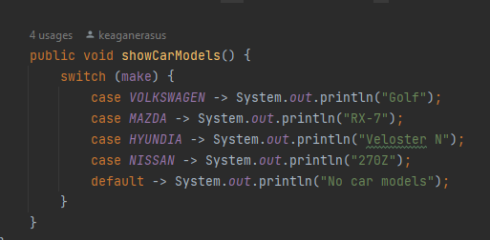
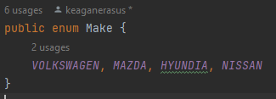

Switch expressions

Slide 23
Record classes

Slide 24

var local type inference

Slide 25

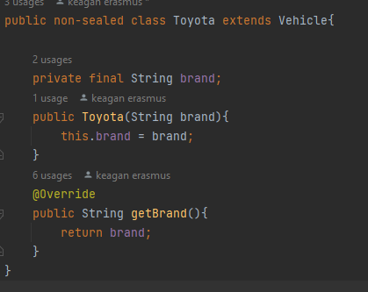
Sealed classes

Slide 26
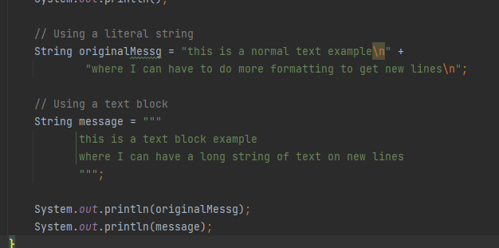
Text Blocks

Slide 27
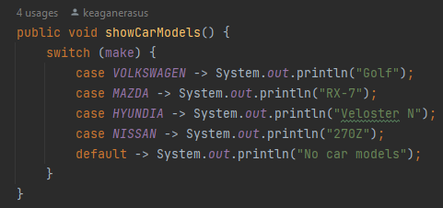
Pattern Matching

Slide 28
25/26
Part A
I’ve researched this.
All demos come from Oracle tutorials

Slide 29
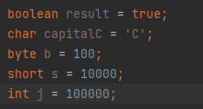
Primitive Data Types

Slide 30
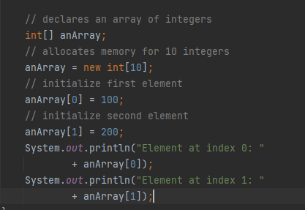
Arrays

Slide 31
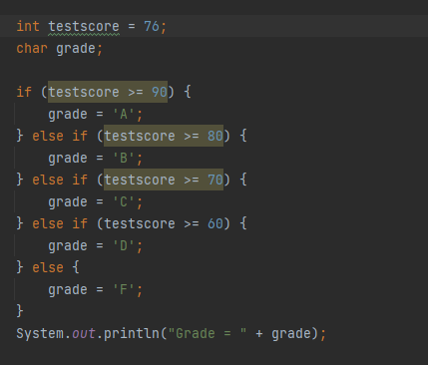
Control flow statements

Slide 32
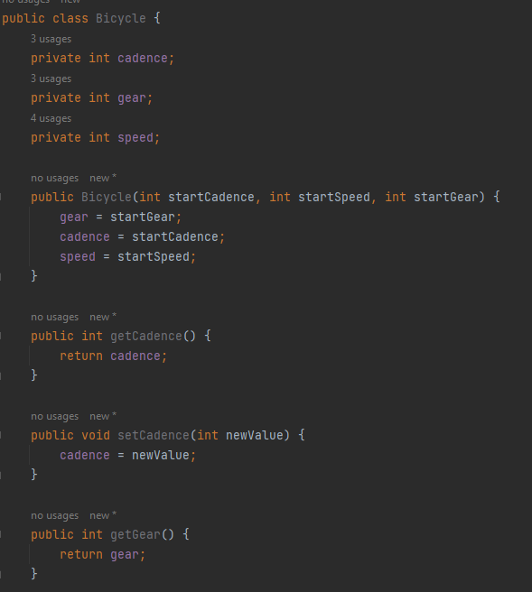
Classes

Slide 33

Passing Information to a Method or a Constructor and returning values

Slide 34
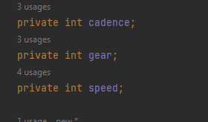
Controlling Access Members of a Class

Slide 35

Static and Final

Slide 36
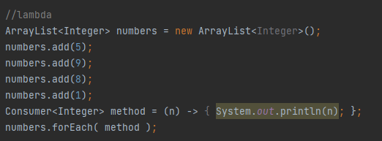
Lambda Expression

Slide 37


Method References

Slide 38
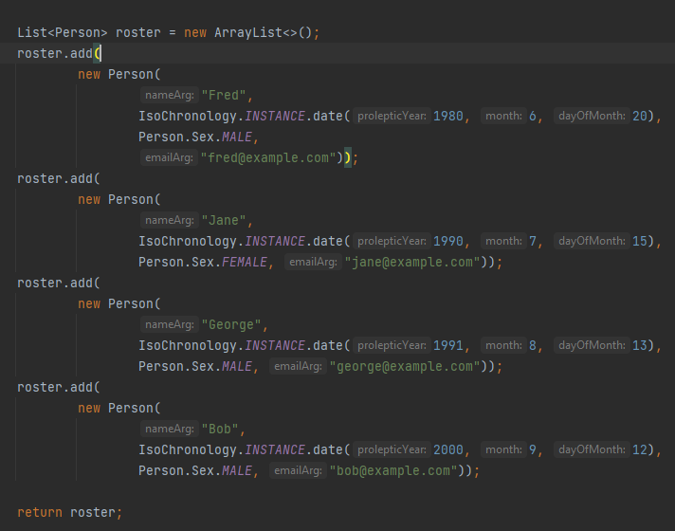
List

Slide 39
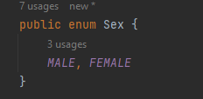

Enum Types

Slide 40
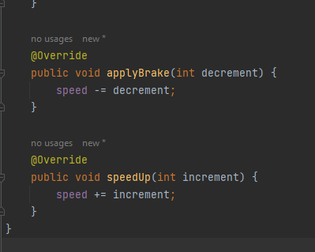
Annotations

Slide 41
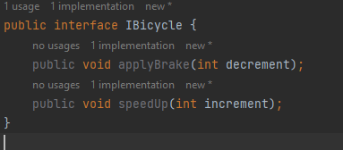
Interface

Slide 42
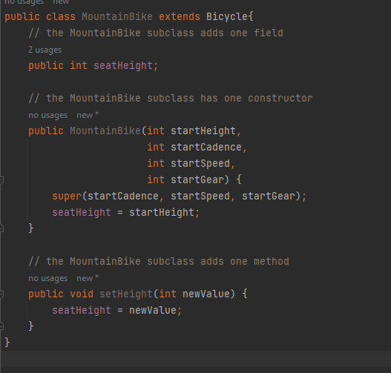
Inheritance

Slide 43


Generics

Slide 44
Packages

Slide 45
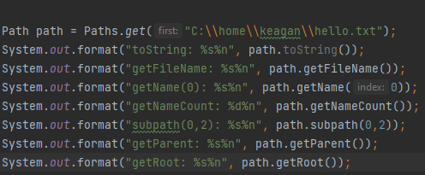

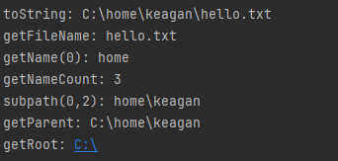
File I/O streams

Slide 46

Exceptions

Slide 47
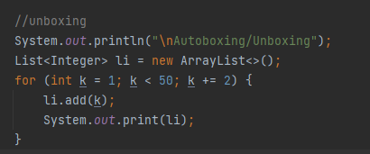
autoboxing and unboxing

Slide 48

StringBuilder

Slide 49
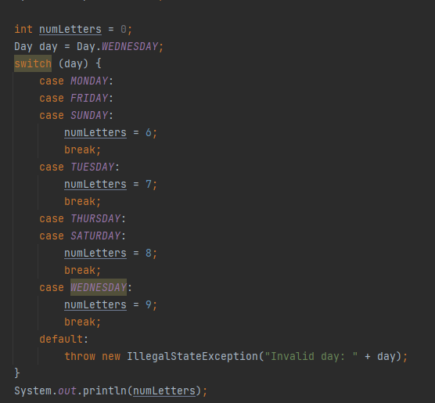

Switch expressions

Slide 50
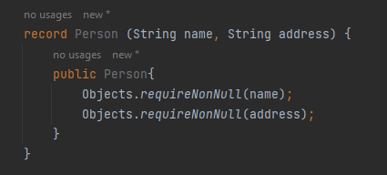
Record classes

Slide 51


var local type inference

Slide 52


Sealed classes

Slide 53
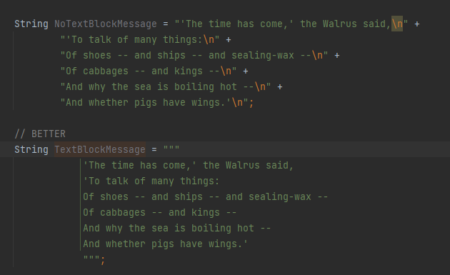
Text Blocks

Slide 54

Pattern Matching

