Slide 1
Eyeball Maze
Keagan Erasmus

Slide 2
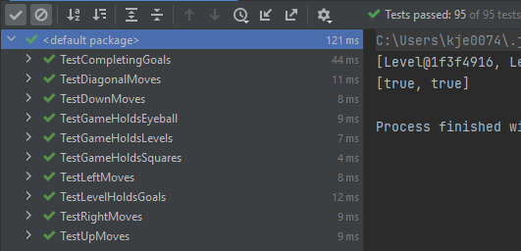
Expected Marks
Tests 95/95
Class Diagram 5/5
Total Marks 100/100 ☺

Slide 3
Class Diagram as a separate PDF because it is too big to fit on a single slide

Slide 4
TestGameHoldsLevels
testGetLevelWidth
testGetLevelheight
testGetLevelCountWithTwoLevels
testMostRecentlyAddedLevelIsCurrentLevelbyCheckingSize
testSettingLevelChangesCurrentLevelbyCheckingSize
testSettingLeveltoToolargeNumberThrowsException

Slide 5
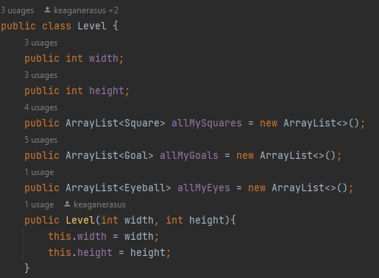
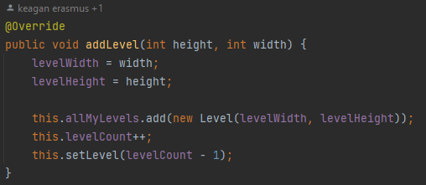
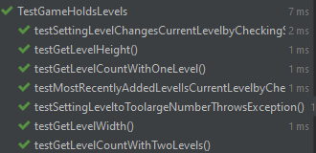

Slide 6
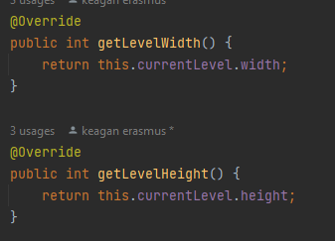
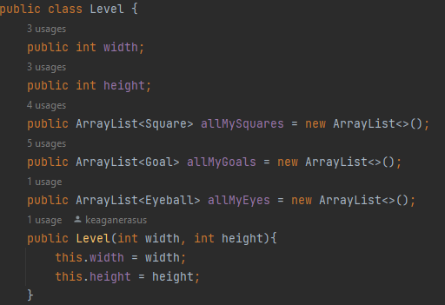
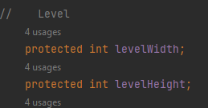
testGetLevelWidth & testGetLevelHeight

Slide 7


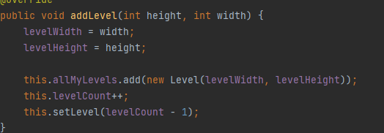
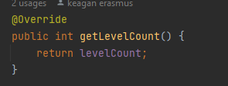
testGetLevelCountWithOneLevel & testGetLevelCountWithTwoLevels

Slide 8
testMostRecentlyAddedLevelIsCurrentLevelbyCheckingSize

Slide 9
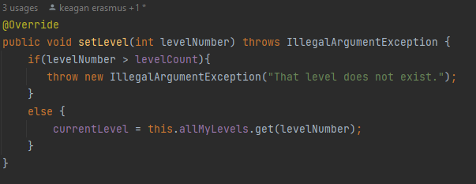
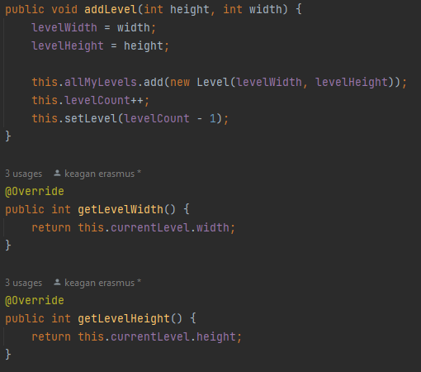
testSettingLevelChangesCurrentLevelbyCheckingSize

Slide 10
testSettingLeveltoToolargeNumberThrowsException

Slide 11
TestLevelHoldsGoals
testAddingOneGoalIncreasesGoalCountTo1
testAddingOneGoalputsGoalAtExpectedPosition
testAddingTwoGoalIncreasesGoalCountTo2
testAddingTwoGoalsPutsGoalsAtExpectedPositions
testNewGamehas0CompletedGoals
testAddingGoalOutsideLevelHeightThrowsRangeException
testAddingGoalsOutsideLevelWidthThrowsRangeException

Slide 12
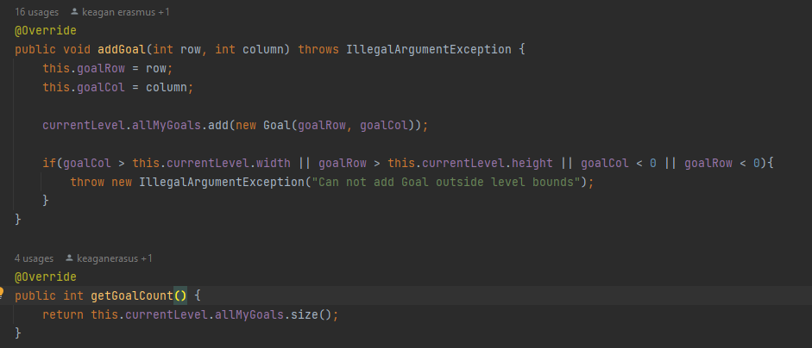
testAddingOneGoalIncreasesGoalCountTo1 testAddingTwoGoalIncreasesGoalCountTo2

Slide 13
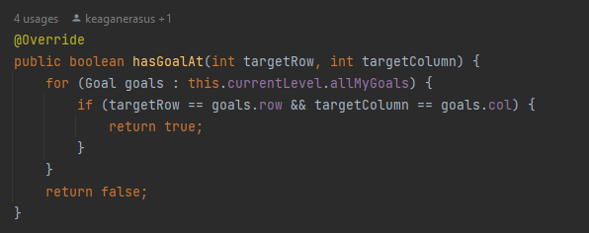
testAddingOneGoalputsGoalAtExpectedPosition testAddingTwoGoalsPutsGoalsAtExpectedPositions

Slide 14

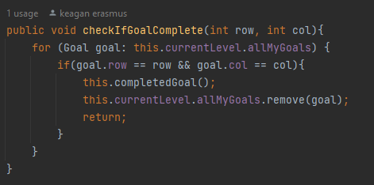
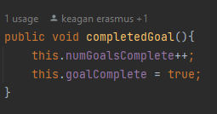
testNewGamehas0CompletedGoals

Slide 15
testAddingGoalOutsideLevelHeightThrowsRangeException testAddingGoalsOutsideLevelWidthThrowsRangeException

Slide 16
TestGameHoldsSquares
testAddingSquareOutsideLevelWidthThrowsException
testAddingSquareOutsideLevelHeightThrowsException
testColoursAreAdded
testShapesAreAdded

Slide 17
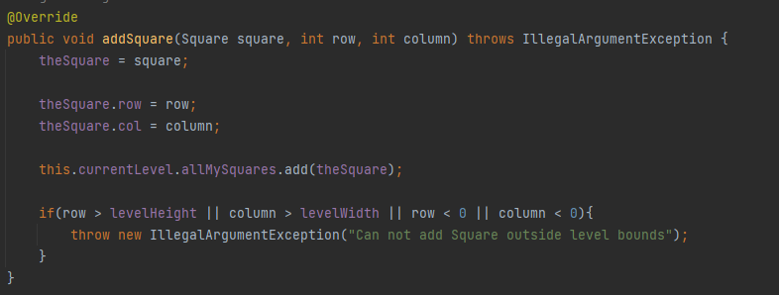
testAddingSquareOutsideLevelWidthThrowsException testAddingSquareOutsideLevelHeightThrowsException

Slide 18
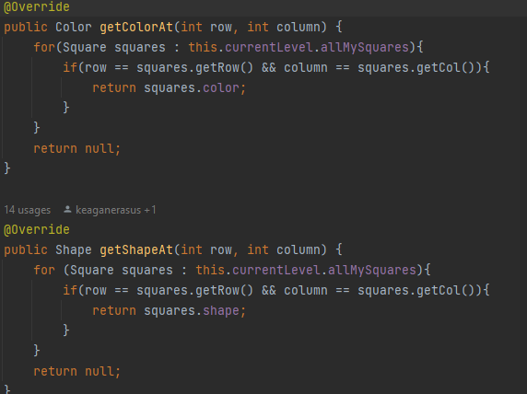
testColoursAreAdded testShapesAreAdded

Slide 19
TestGameHoldsEyeBall
testAddingEyeballOutsideHeightThrowsException
testAddingEyeballOutsideWidthThrowsException
testAddingEyeballPutsItWhereExpected
testAddingEyeballFacingUpFacesUp
testAddingEyeballFacingDownFacesDown
testAddingEyeballFacingLeftFacesLeft
testAddingEyeballFacingRightFacesRight

Slide 20
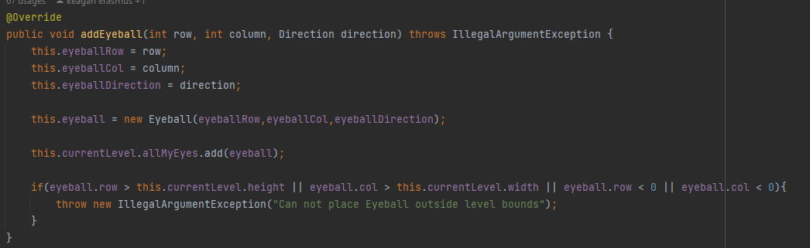
testAddingEyeballOutsideHeightThrowsException testAddingEyeballOutsideWidthThrowsException

Slide 21
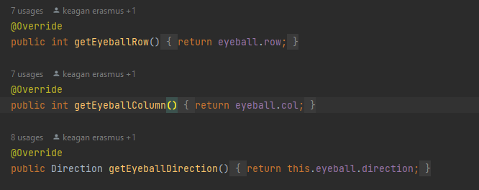
testAddingEyeballPutsItWhereExpected

Slide 22
testAddingEyeballFacingUpFacesUp testAddingEyeballFacingDownFacesDown testAddingEyeballFacingLeftFacesLeft testAddingEyeballFacingRightFacesRight

Slide 23
TestMovesUp/Left/Right/Up/Down/Diagonal
testOkToMoveToSameColorOrShape
testNotOkToMoveToDifferentColorAndShape
testNoErrorMessageWhenMovingToSameColorOrShape
testGetsErrorMessageWhenMovingToDifferentColorAndShape
testOkWhenEyeballFacesRightOnMovingUp
testOkWhenEyeballFacesLeftOnMovingUp
testNotOkWhenMovingBackwards
testsGetsErrorMessageWhenMovingBackwards
testNotOkWhenPathToDestinationCrossesBlank
testEyeballMovesToDestinationRowAndColumn
testEyeballFacesUPOnMovingUp

Slide 24
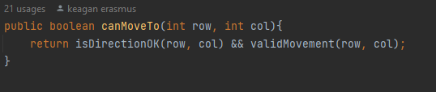
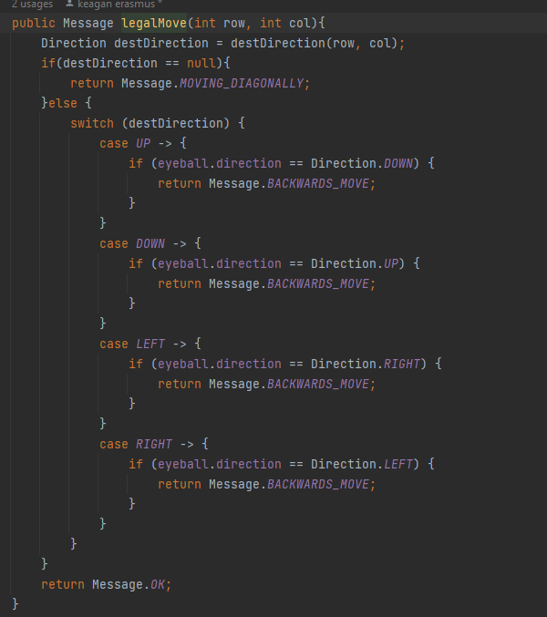
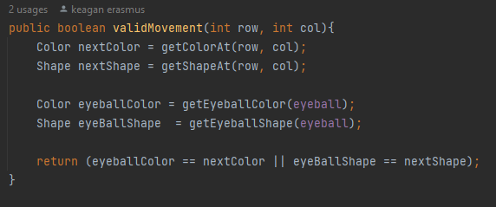
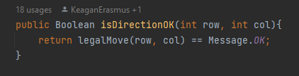
testOkToMoveToSameColorOrShape

Slide 25
testNotOkToMoveToDifferentColorAndShape

Slide 26
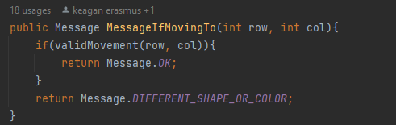
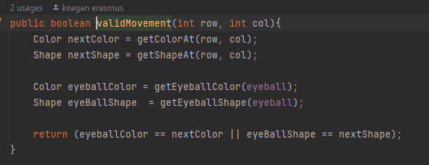
testNoErrorMessageWhenMovingToSameColorOrShape

Slide 27
testGetsErrorMessageWhenMovingToDifferentColorAndShape

Slide 28
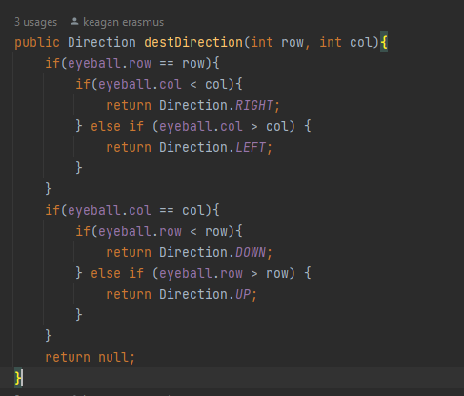
Test facing in the right directions

Slide 29
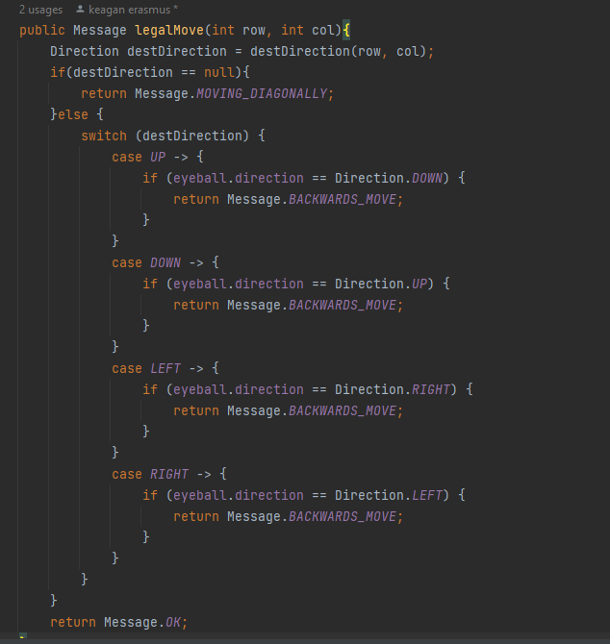
testNotOkWhenMovingBackwards testsGetsErrorMessageWhenMovingBackwards

Slide 30
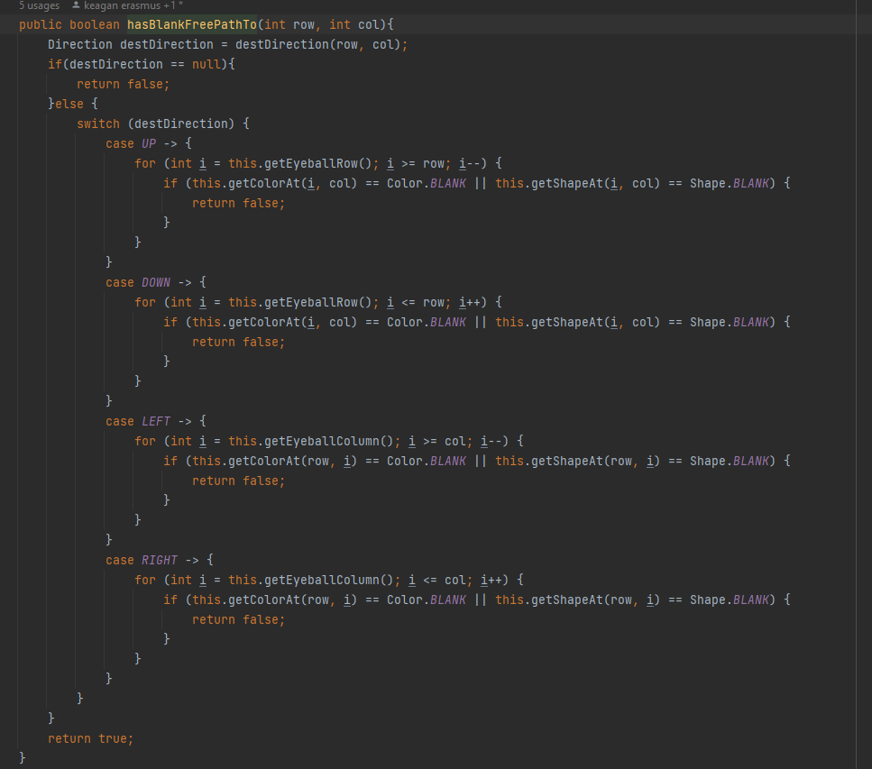
testNotOkWhenPathToDestinationCrossesBlank

Slide 31
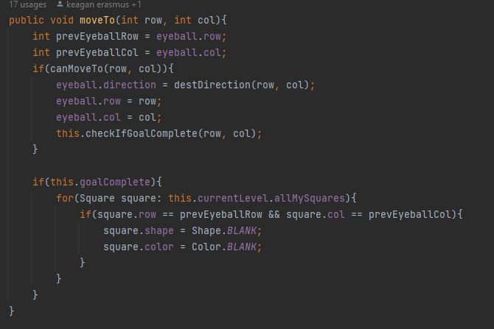
testEyeballMovesToDestinationRowAndColumn

Slide 32
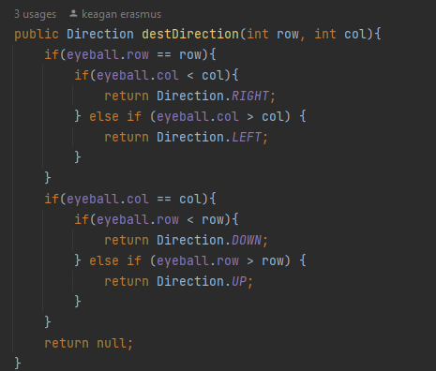
Test Eyeball faces correct direction after moving

Slide 33
TestCompletingGoals
testCompletingLevelOne
testOkToMoveToAGoalWithSameColorOrShape
testNoErrorMessageWhenMovingToAGoalWithSameColorOrShape
testNotOkToMoveToAGoalWithDifferentColorOrShape
testGetsErrorMessageWhenMovingToAGoalWithDifferentColorOrShape
testNotOkToMoveToAGoalAtADiagonalSquare
testNotOkWhenMovingBackwardsToAGoalWithSameColorOrShape
testCompleting1GoalIncreasesCompletedGoalCountBy1
testCompleting1GoalDecreaseGoalCountBy1
testGoalWillBeRemovedFromSquareAfterCompletingTheGoal
testGoalSquareWillNotBeChangedWhenEyeballMovesOntoIt
testGoalSquareBecomesBlankSquareAfterEyeballMovesToAnotherSquare

Slide 34
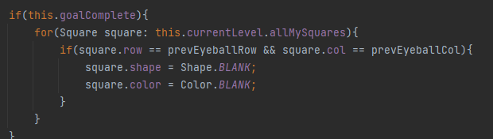
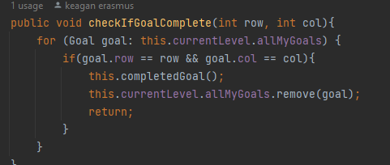
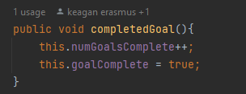
testCompletingLevelOne

Slide 35
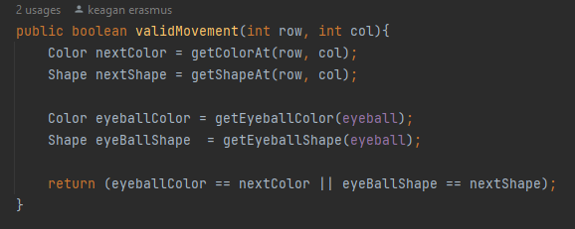
testOkToMoveToAGoalWithSameShapeOrColor

Slide 36
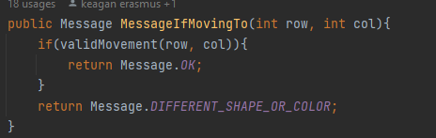
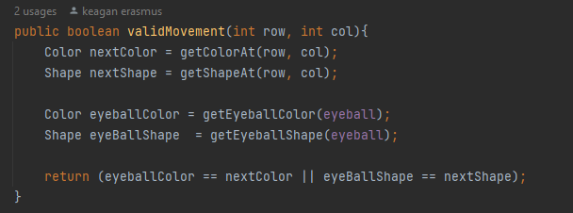
testNoErrorMessageWhenMovingToAGoalWithSameColorOrShape

Slide 37
testNotOkToMoveToAGoalWithDifferentColorOrShape

Slide 38
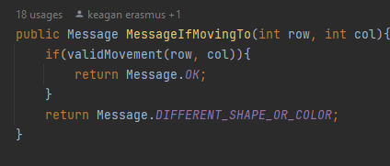
testGetsErrorMessageWhenMovingToAGoalWithDifferentColorOrShape

Slide 39
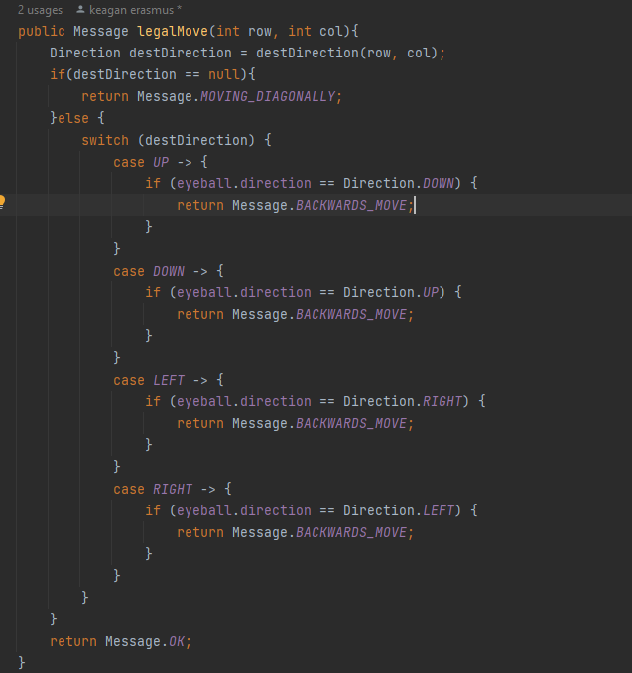
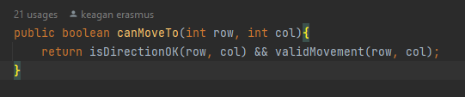
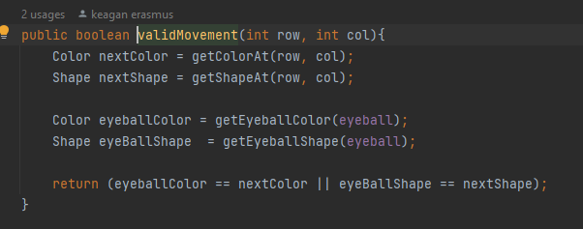
testNotOkToMoveToAGoalAtADiagonalSquare

Slide 40
testNotOkWhenMovingBackwardsToAGoalWithSameColorOrShape

Slide 41
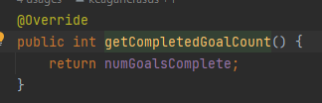
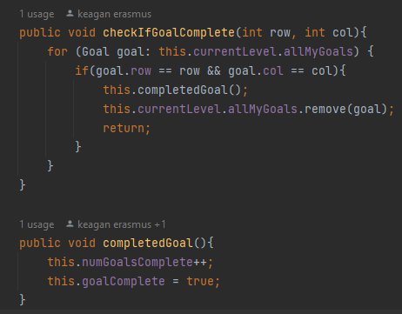
testCompleting1GoalIncreasesCompletedGoalCountBy1 testCompleting1GoalDecreaseGoalCountBy1

Slide 42
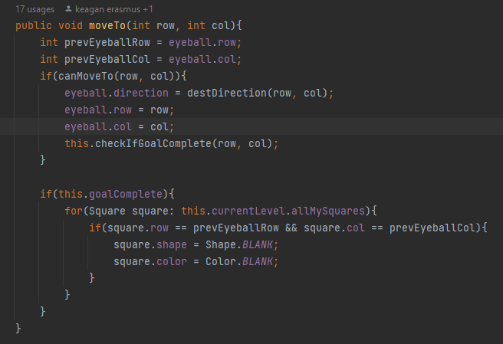
testGoalWillBeRemovedFromSquareAfterCompletingTheGoal

Slide 43
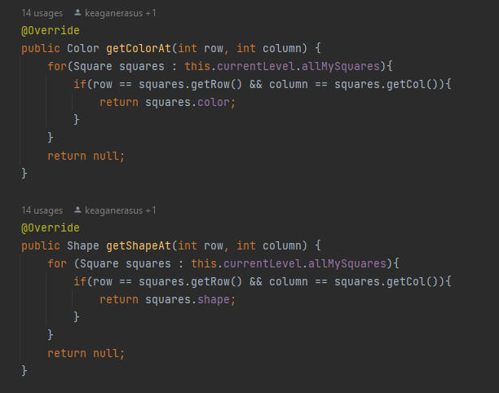
testGoalSquareWillNotBeChangedWhenEyeballMovesOntoIt

Slide 44
testGoalSquareBecomesBlankSquareAfterEyeballMovesToAnotherSquare

