Slide 1

Spongy Dams and Superintelligence: The Unknowable Consequences of Engineering New Technologies
Keagan Rankin

Slide 2
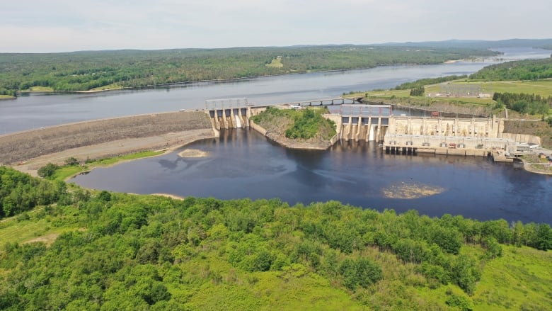
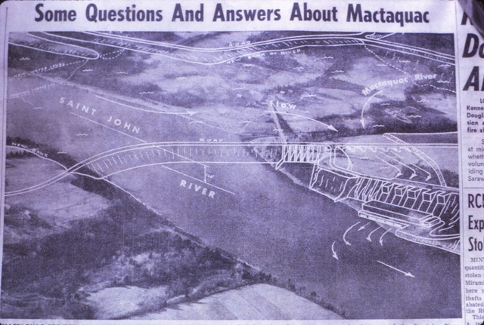
One day, a man decided to build a dam…
Notes:
-New Brunswick Electric Power Commission -> Now NB Power.
-Louis Robichaud -> “Economic Salvation of our Province” to MacLean's https://archive.macleans.ca/article/1964/09/05/the-maritimes
-$110 million -> ~ Billion Dollar Project today.
-Provide massive power all over the province.
Pic: https://www.frederictonregionmuseum.com/2012/07/17/construction-of-the-mactaquac-dam/

Slide 3
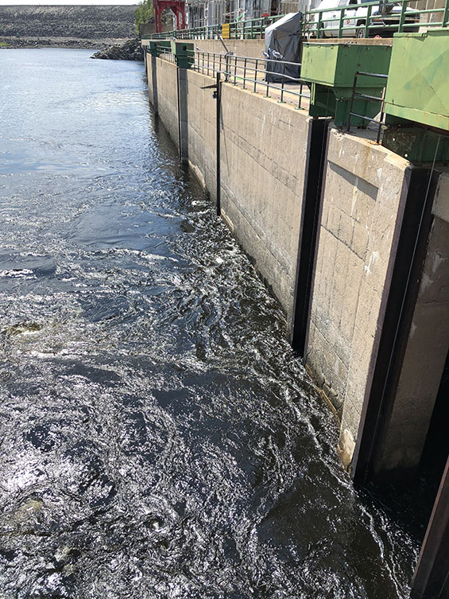
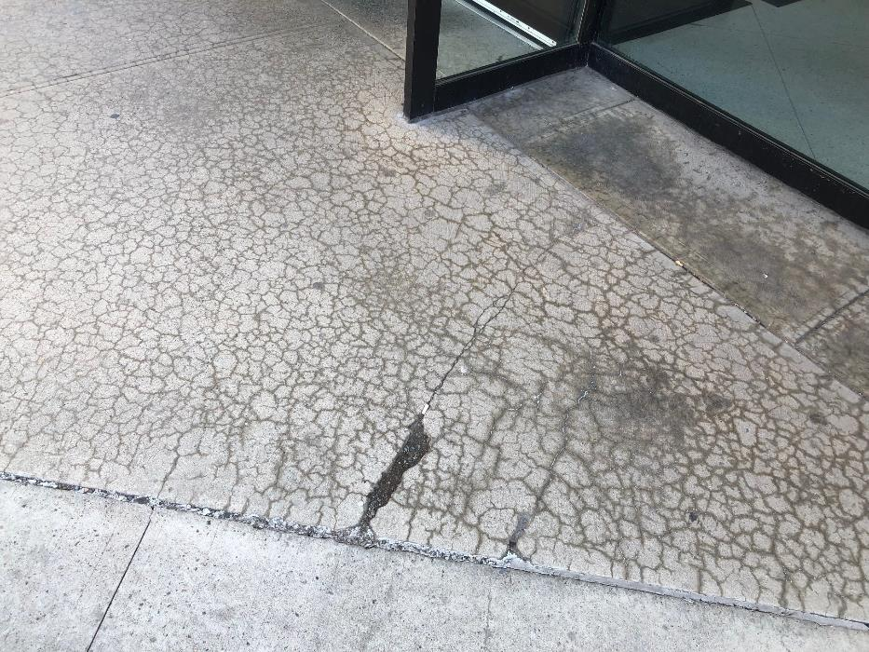
… now the dam has the man in a bit of a jam
Notes:
-ASR: hydrated cement reacts with silica in bad aggregate to produce weeping paste, causes loss of strength and expansion of concrete.
-The type of reaction at the dam only really came to engineering attention in the period right after the dam was complete. Many other structures around Europe and Canada have this problem as well.
-Not just ASR. Structural problems and gate jams. American eel disappeared until found in one spot just under the dam in 2017. Fish passage all messed up.
-Other stuff we don’t know yet: Ex. Changing economic inequity for local first nations?
-MAES, The biggest rivers study in the world is going on right now surrounding the impacts of this hydroelectric station on the ecosystem.
-Scale up your thoughts; Henry Ford and climate change/sedentary lifestyle.
Sustainability, Climate Change etc. This problem accesses our most dangerous domains. See our next story.

Slide 4
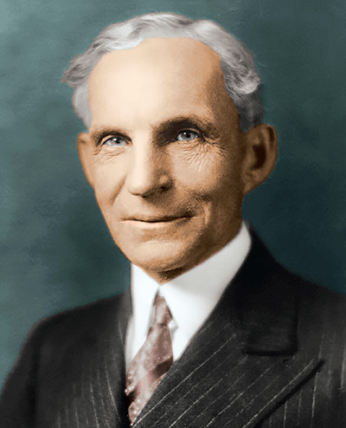
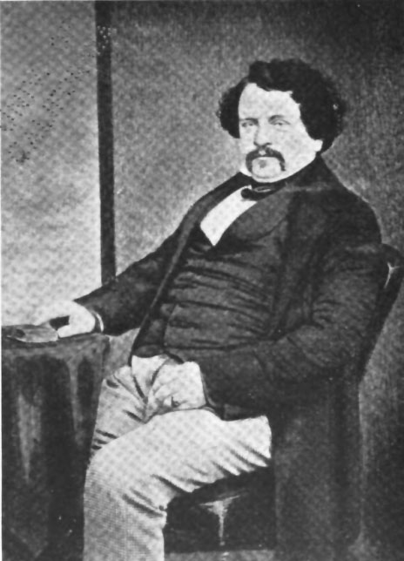
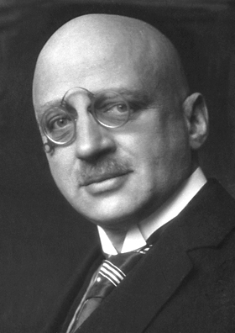
Larger jams
Notes:
-Henry Ford: combustion engine dissemination. 16% of emissions, air quality issues, 30 000 traffic deaths a year.
-William Aspdin: modern portland cement. ~25-33% of emissions, air quality issues.
-Haber: nobel prize for artificial nitrogren fixation, probably the reason we are alive and nourished right now. 1-20% of emissions, catastrophic eutrophication
-Debatably, all of these men thought their innovations were doing good, or at least not trying to do bad.
-We like to think we can’t make the mistakes that even our parents made. We like to think the experts know what they are doing, but everything we “invent” or “design” has consequences we can’t foresee, whether they be good or bad. Because we cannot control for these consequences, those at the tail of the distribution tend to have large effect (The so called “Black Swan Event”).

Slide 5
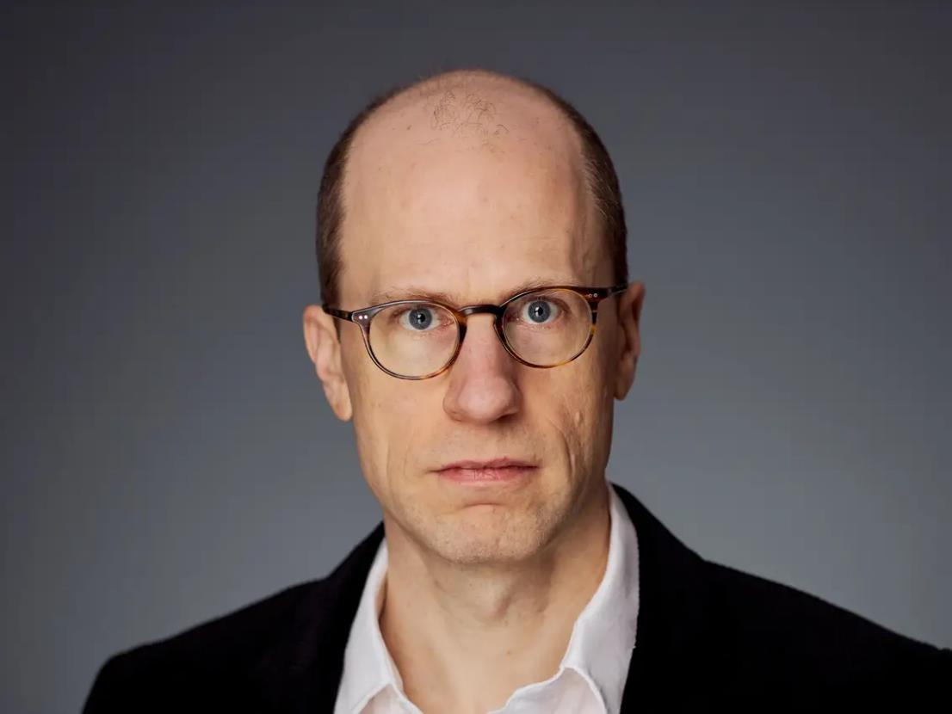
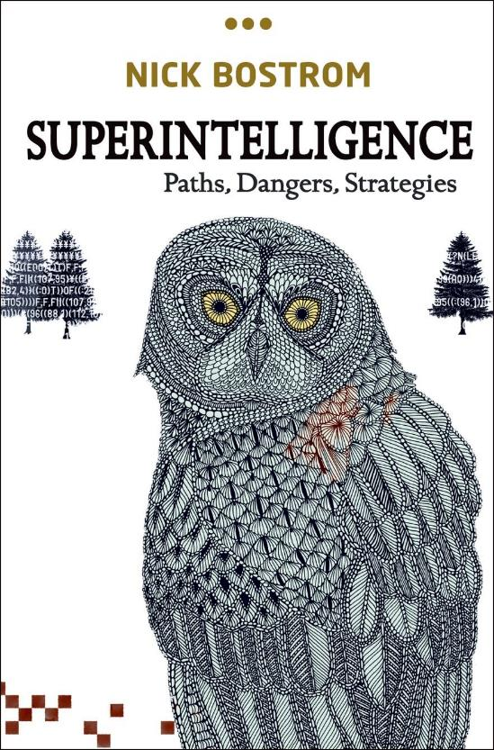
Notes:
-Big head, smart guy. Director of the future of humanities institute at Oxford.
-Bostrom has made an academic career thinking about unintended consequences, and can be pessimistic about humans. We are just smart enough to get a peek over the top of the wall, but we are stupid in that we dive headlong into things we don’t understand the consequences of.

Slide 6
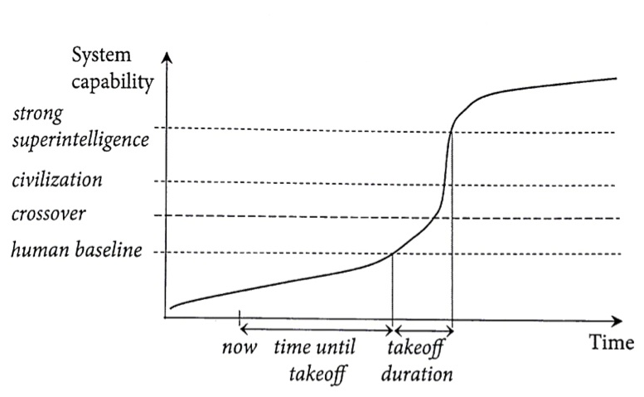
How do you make something that has yet to exist safe?
Surely this technology will be our universal problem solver…
Notes:
The Control Problem, Malignant failure modes, Orthogonality thesis, utility functions, whole brain emulation economies etc.
There is no just world theory…
How do you load values correctly into something that you get one chance at??? (humans, and biology in general, NEVER gets it right the first time).
How do you control and manipulate something when you cannot predict what it will come up with (because it is smarter than you)???

Slide 7

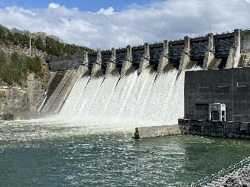

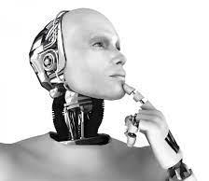
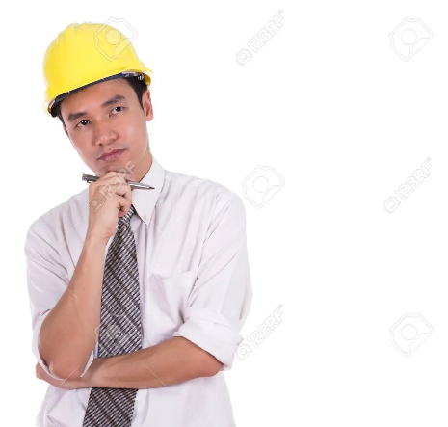
Expectation
Notes:
-Expectation: superintelligence will let us solve wicked problems and have all powerful prediction power.
-Reality: a unproperly value loaded superintelligence will take whatever steps necessary to maximize its value function, even if it means turning half the galaxy into a giant computer to figure out how to create a low impact sustainable dam.
-Even our attempts at addresses unknown risks can lead to unknown risks.
-If many of our big societal problems come from this, then maybe there is a problem with our method.

Slide 8

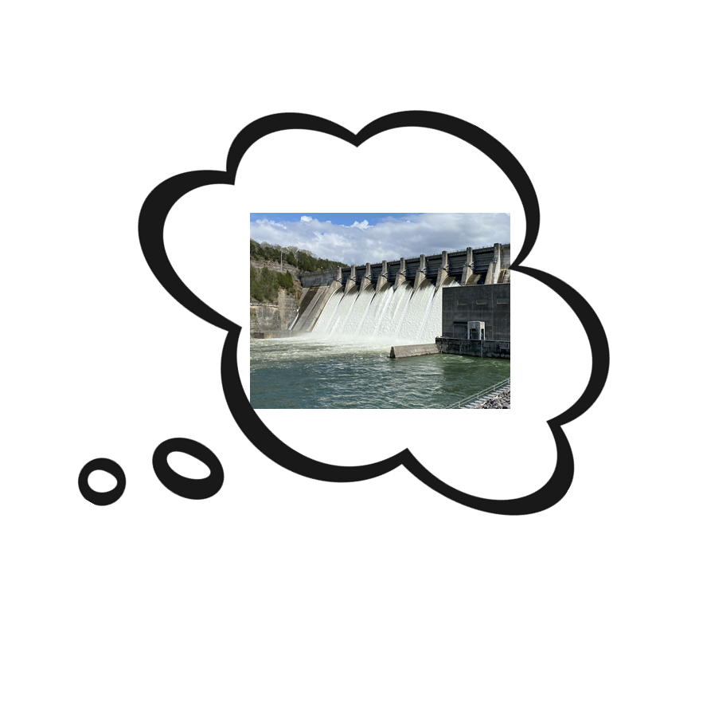
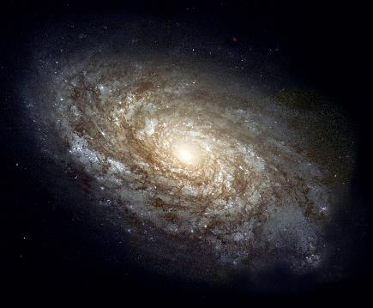

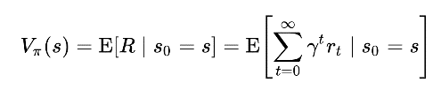
Reality
Notes:
-Expectation: superintelligence will let us solve wicked problems and have all powerful prediction power.
-Reality: a unproperly value loaded superintelligence will take whatever steps necessary to maximize its value function, even if it means turning half the galaxy into a giant computer to figure out how to create a low impact sustainable dam.
-Even our attempts at addressing unknown risks can lead to unknown risks.
-If many of our big societal problems come from this, then maybe there is a problem with our method.

Slide 9
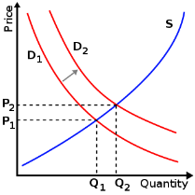
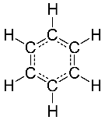


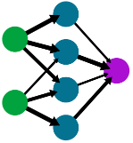

Engineering Now: The Toolbox Problem
Knowable Risks
Unknowable Risks
Notes:
-Engineers love our tools, especially the new and fancy ones (neural nets).
-We love using the wrong tools for the job.
-When we practice good engineering, we can eliminate a lot of the knowable risks.
-For the knowable risks we cannot address, we have good heuristics (dissemination of financial risk in construction).
-But think of this system as being like a subspace closed under addition. The tools and knowable risks can only ever inform each other.
-Whenever an action is taken in learning or development, no matter how smart (steep gradient) the learner is, that action has an effect on the environment that is unknowable.
-These unknowable events occur regularly, and the bad ones at the tail of the distribution tend to disproportionately change our society because we cannot account for them (BLACK SWANS).

Slide 10
Engineering to Come: Four Ideas Moving Forward
Promote interdisciplinary research.
Reform engineering education.
Start with simplest, low-impact solutions. Consider NBS.
Take inspiration from Biology.
Will this solution solve more problems than it creates?
Notes:
-Alanby and Chester: Engineering in the Anthropocene
-NBS: No Build Solution
-Michael Levin – Agencial Materials
-Biology – Offloading risk to mistake already made in the past.
-There is no silver bullet. Learning requires failure. Nature NEVER gets it right the first time.

Slide 11
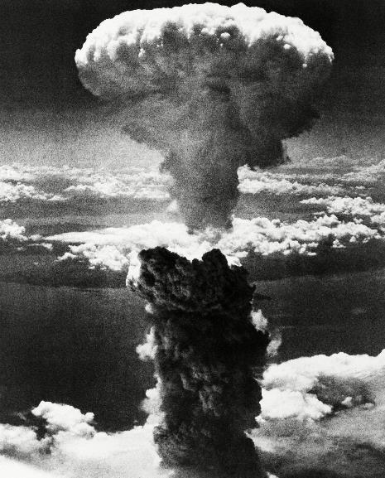
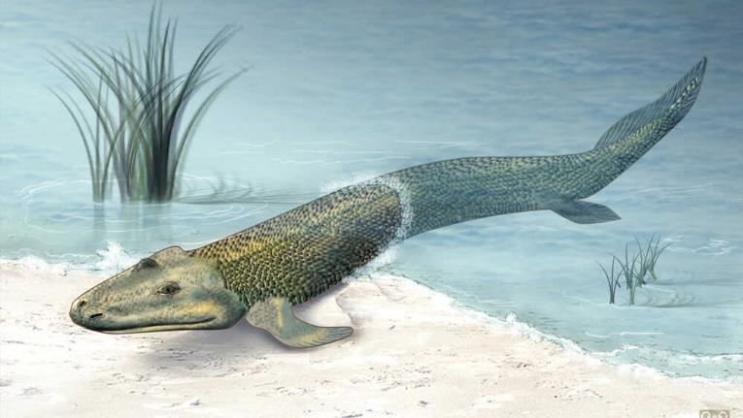
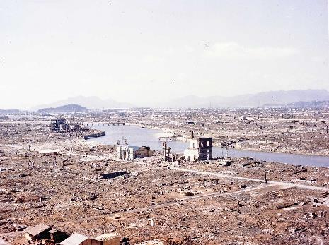
Notes:
-Closing thoughts on culpability. Don’t think we can hold those engineers that messed up the dam back in the 1960’s fully responsible, nor will Geoff Hinton be responsible for the laptopization of man. This is a universal problem that needs wider reconginition.
-Moving forward, engineers and others in the natural sciences, need to be mindful of that everything they do has some unknown consequence.
-Hopefully in fitting with the spooky theme this inspires some existential dread brought about by consequences of superintelligence or by the questionable work engineers do on our hydro electric infrastructure.

Slide 12
Infrastructure In The Anthropocene (Allenby & Chester)
Superintelligence – Paths, Dangers, Strategies (Bostrom)
MACTAQUAC AQUATIC ECOSYSTEM STUDY (Canadian River’s Institute)
Notes:
Unfortunately I do not have a website to plug (yet).
A thought on modelling: generation is not possible yet except in very simply ruled, controlled and open systems with reinforcement learning (Dennis Hasabis and AlphaGo/Star).

