Slide 1
Seeing Ancient Work
Keagen Chapman
Asaf Kedar

Slide 2
Sprint 1 Objectives
Identify Project Objectives
Create Documentation
Clear Documentation with client
Create Proof of Concept

Slide 3
Gathering Requirements
Meet and discuss week’s work with client
4 meetings
Web Database

Slide 4
User Stories
User Role: Administrator Upload & Manual Entry "As an administrator, I want to upload image files and manually input their associated metadata (description, location, date, etc.), so that I can build the database with high-quality, vetted information."
User Role: Academic Researcher / Student (Public User) Search by Metadata" As a researcher, I want to search the database by specific fields (e.g., date, find-spot, object type, material), so that I can find artifacts relevant to my specific area of study."

Slide 5
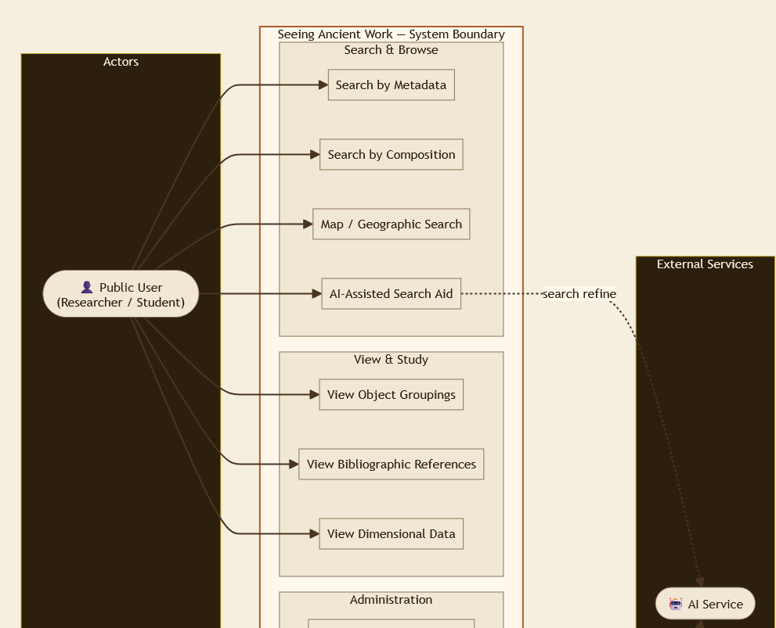
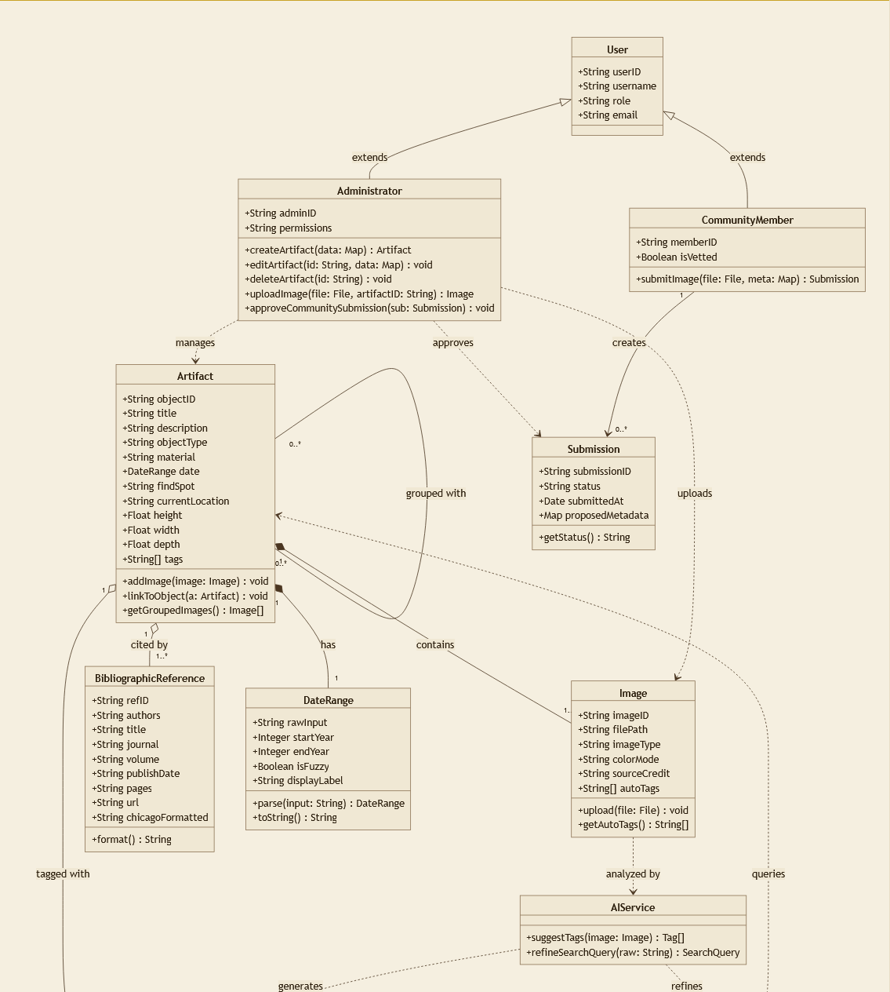
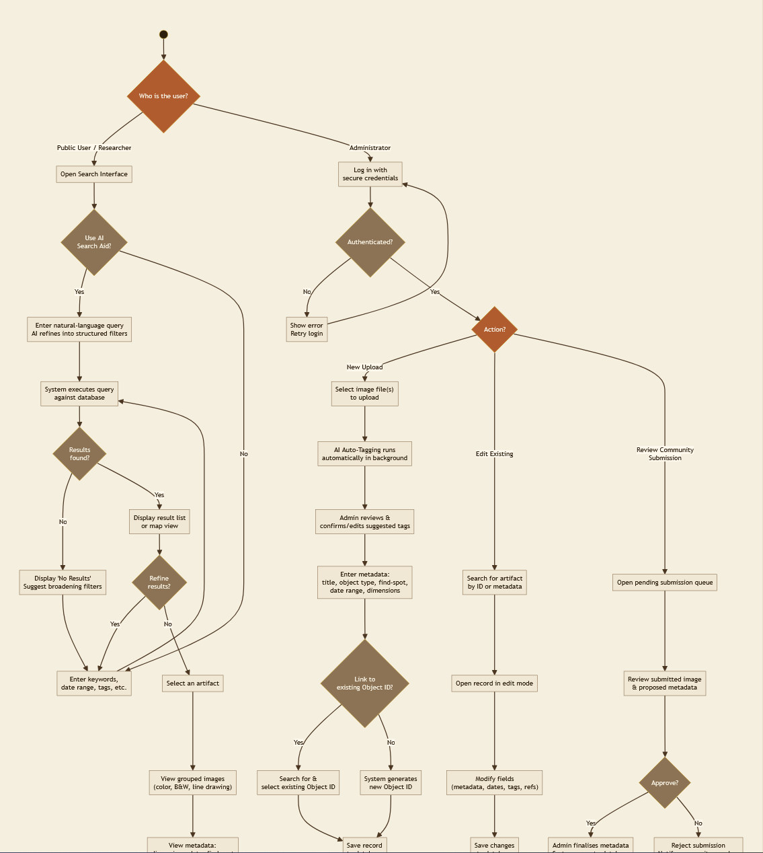
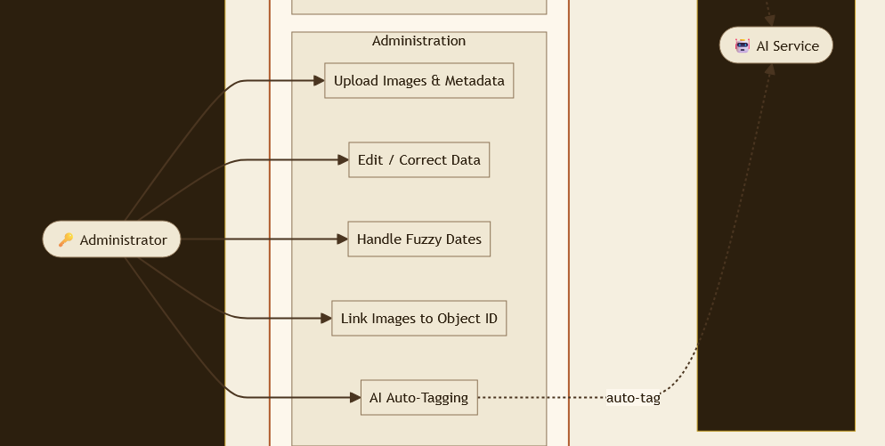
Diagrams

Slide 6
No Existing systems or Platforms

Slide 7
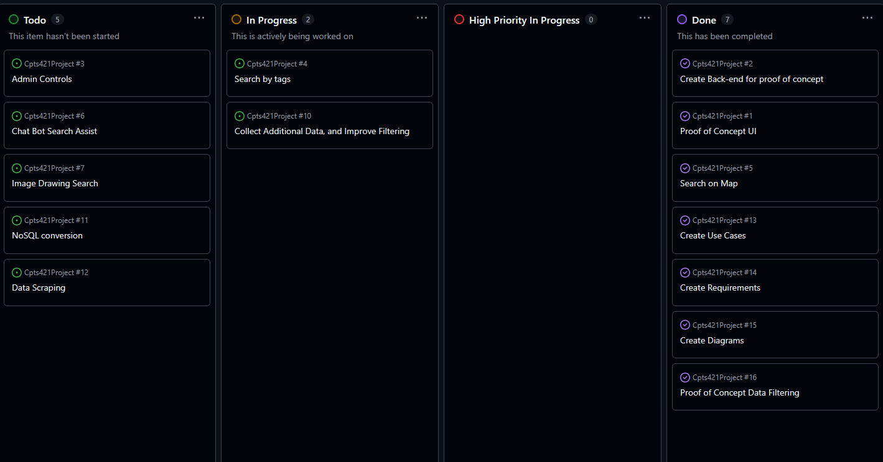
Kanban Board

Slide 8
Achievements and Challenges
Filter Strength

Slide 9
AI Use
Adapt schema of source data to our database’s schema
Adapt documentation to Diagrams
Test programs

Slide 10
Next Steps
Get to Minimum viable product

Slide 11
Conclusion
Thank You Hallie Meredith

