Slide 1
HR ANALYTICS &
EMPLOYEE ATTRITION DASHBOARD
Analyzing employee turnover patterns using Power BI
Power BI • Power Query • DAX • Excel

Slide 2
Project Overview
Objective & dataset
Business Objective
Understand the scale and pattern of employee attrition.
Identify departments and job roles with comparatively high turnover.
Explore attrition across age, gender and education groups.
Examine the association between job satisfaction and attrition.
Turn HR data into clear, interactive and decision-ready insights.
Dataset at a Glance
1,470 employee records analyzed.
237 employees recorded as having left the organization.
1,233 employees remain active.
Overall observed attrition rate: 16.12%.
Average employee age: 37 years.
Core Question
Which employee segments show higher attrition, and where should HR investigate further?
HR Analytics & Employee Attrition | Power BI Project • 2/10

Slide 3
Dashboard KPI Snapshot
Overall workforce
1.47K
Overall Employees
237
Attrition
16.12%
Attrition Rate
1.233K
Active Employees
37
Average Age
What the KPIs tell us
16.1 out of every 100 employees in the dataset are recorded as attrited.
83.88% of the workforce remains active.
Education-category filters can be used to explore segment-level patterns.
Headline
237 employees have left out of 1470, producing a 16.12% observed attrition rate.
HR Analytics & Employee Attrition | Power BI Project • 3/10

Slide 4
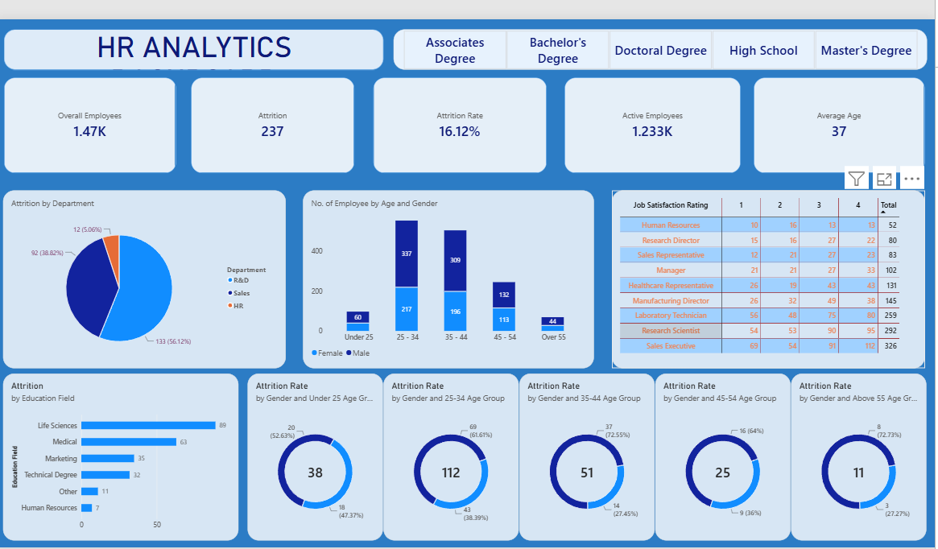
Power BI Dashboard
Interactive overview
HR Analytics & Employee Attrition | Power BI Project • 4/10

Slide 5
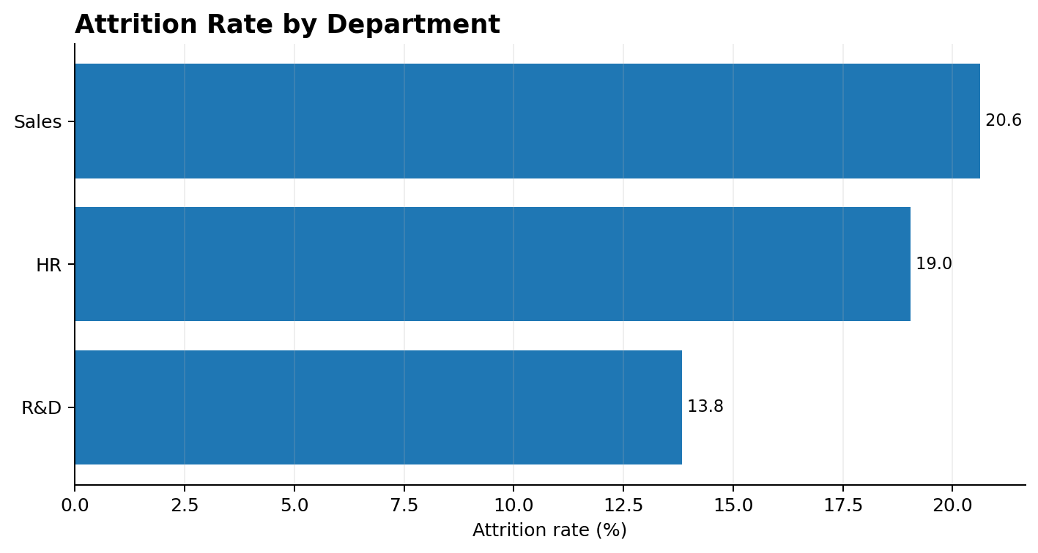
Attrition by Department
Count vs rate
Key Insights
Sales has the highest observed attrition rate: 20.63%.
HR follows at 19.05%.
R&D has the largest attrition count: 133 employees.
R&D's higher count should be interpreted alongside its much larger workforce.
Rate is more useful than count when comparing departments of different sizes.
Takeaway
Sales stands out on attrition rate, while R&D stands out on absolute attrition volume.
HR Analytics & Employee Attrition | Power BI Project • 5/10

Slide 6
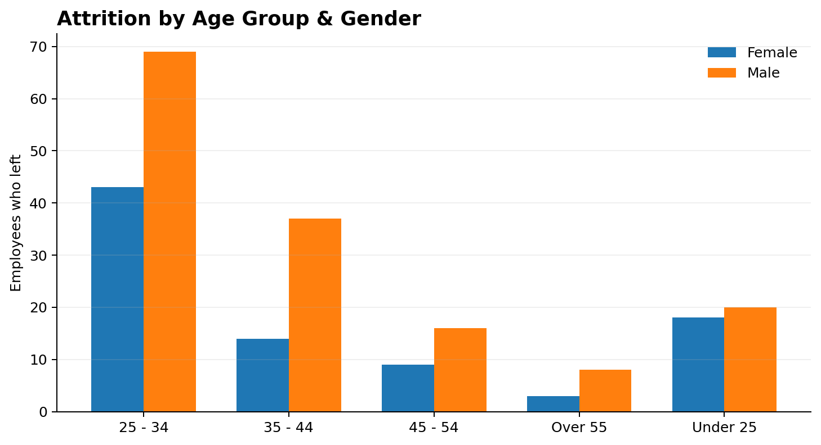
Attrition by Age & Gender
Employee segments
Key Insights
Under-25 employees have the highest observed attrition rate: 39.18%.
The 25–34 group contributes the largest attrition count: 112.
Male attrition count: 150; female: 87.
Male observed rate: 17.01% vs female: 14.80%.
Counts should be considered together with each group's workforce size.
Takeaway
Early-career employees are an important segment for deeper retention analysis.
HR Analytics & Employee Attrition | Power BI Project • 6/10

Slide 7
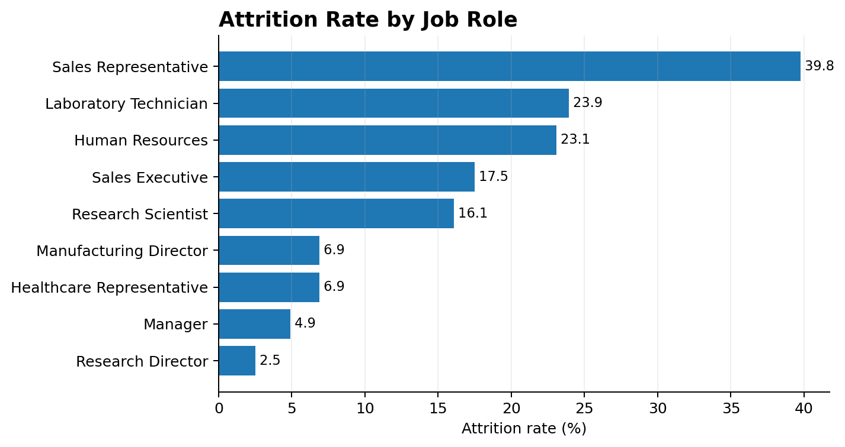
Attrition by Job Role
Where turnover is concentrated
Key Insights
Sales Representative has the highest observed attrition rate: 39.76%.
Laboratory Technician: 23.94%.
Human Resources: 23.08%.
Research Director has the lowest observed rate: 2.50%.
The spread across roles suggests that role-specific factors merit further investigation.
Takeaway
Sales Representative is the clearest high-attrition role in this dataset.
HR Analytics & Employee Attrition | Power BI Project • 7/10

Slide 8
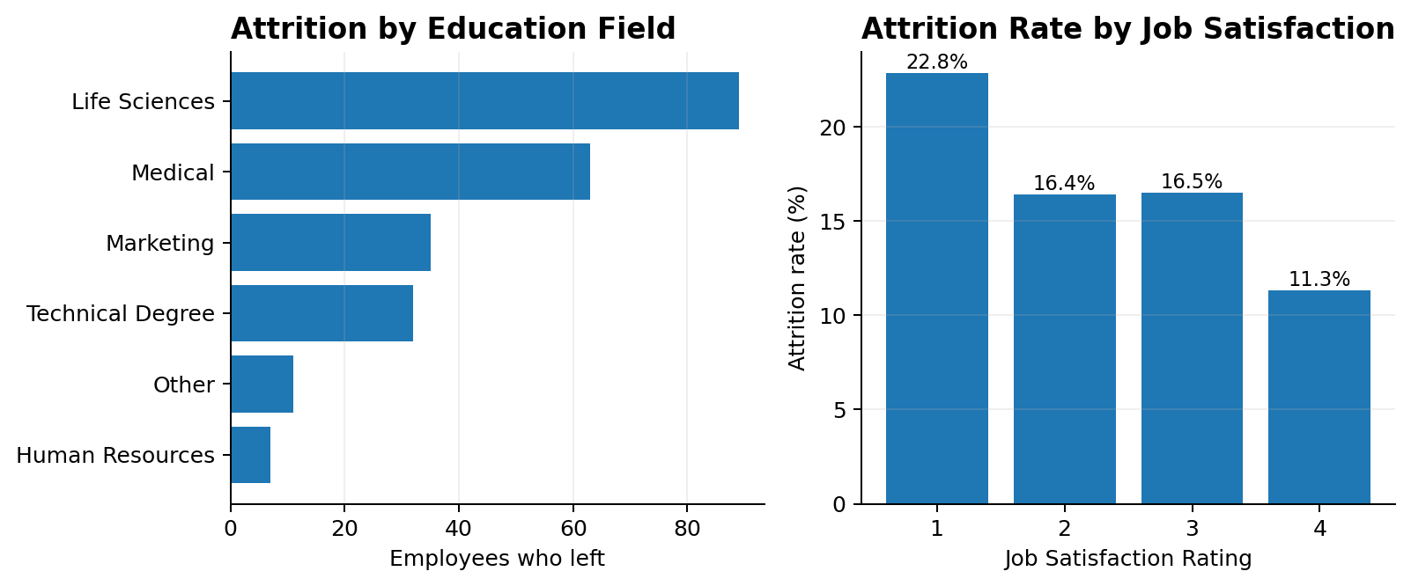
Education & Job Satisfaction
Two additional lenses
Key Insights
Life Sciences has the largest attrition count: 89.
Human Resources has the highest education-field rate: 25.93%, but its workforce is small.
Low satisfaction (rating 1) shows 22.84% attrition.
High satisfaction (rating 4) shows 11.33% attrition.
This pattern is an association, not proof that satisfaction alone causes attrition.
Takeaway
Lower job satisfaction is associated with a higher observed attrition rate in this dataset.
HR Analytics & Employee Attrition | Power BI Project • 8/10

Slide 9
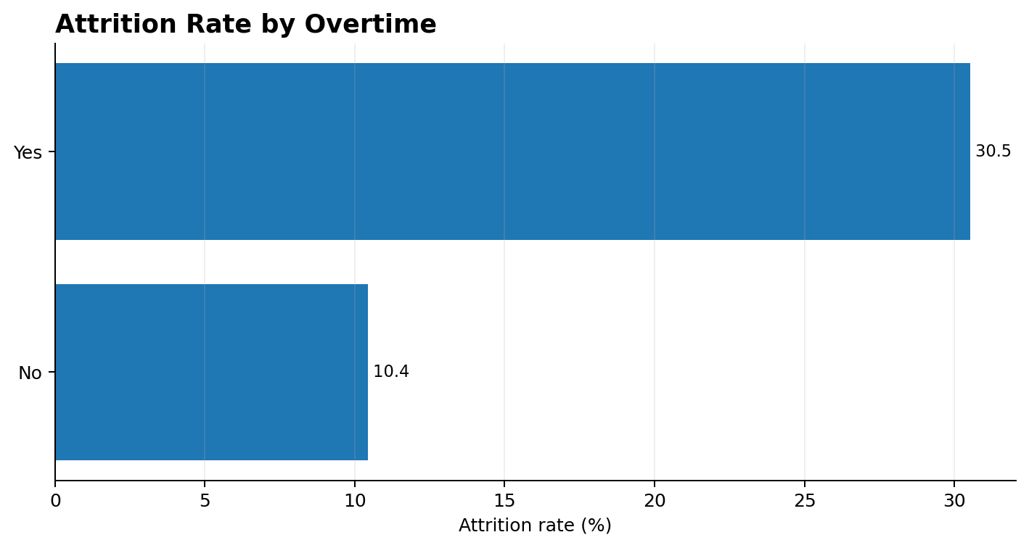
Additional Attrition Driver: Overtime
Dataset-level analysis
30.53%
Overtime = Yes
10.44%
Overtime = No
Interpretation
Overtime group observed attrition rate: 30.53%.
Non-overtime group observed attrition rate: 10.44%.
The observed rate is about 2.9× higher for the overtime group.
This is an association and should be validated with workload, role, tenure and compensation analysis.
Takeaway
Overtime is one of the strongest observed differences in attrition rate in the dataset.
HR Analytics & Employee Attrition | Power BI Project • 9/10

Slide 10
Key Findings & Recommendations
From analysis to action
Key Findings
Overall attrition rate: 16.12% (237 of 1470).
Sales has the highest department attrition rate (20.63%).
Under-25 employees have the highest age-group rate (39.18%).
Sales Representatives have the highest role-level rate (39.76%).
Low satisfaction is associated with higher attrition (22.84% vs 11.33%).
Overtime is associated with a much higher rate (30.53% vs 10.44%).
Recommendations for HR
Investigate workload and career-growth factors in high-attrition roles.
Create targeted retention and onboarding initiatives for younger employees.
Monitor overtime and workload patterns across teams.
Use employee feedback to identify low-satisfaction areas.
Compare attrition with compensation, tenure and promotion data.
Use the Power BI dashboard for regular monitoring.
Final Message
Power BI converts HR records into an interactive view of where employee turnover is concentrated and which segments deserve deeper investigation.
HR Analytics & Employee Attrition | Power BI Project • 10/10

