Slide 1
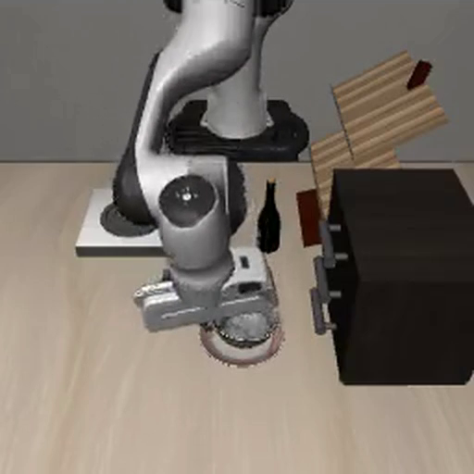
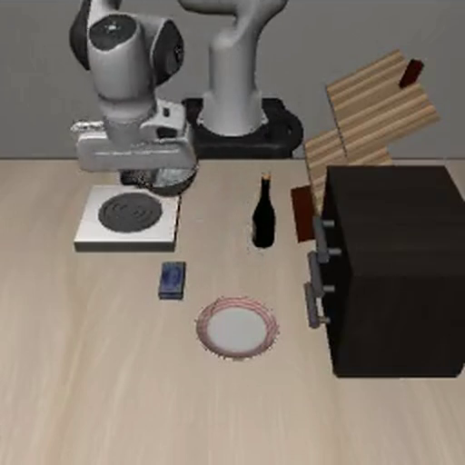
Can we read where a robot is going before it gets there?
put the bowl on the PLATE
put the bowl on the STOVE
Interpretability in a vision-language-action model
Keahi Xie · November 2026

Slide 2
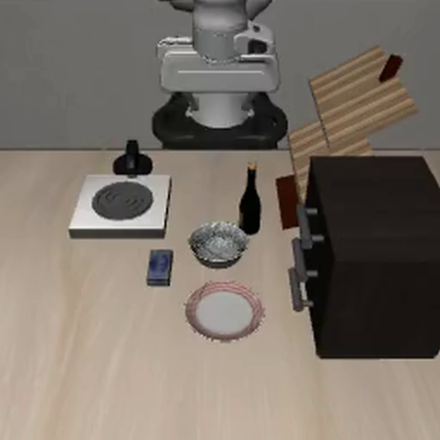
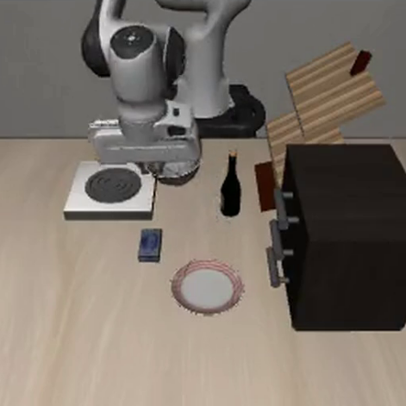
A destination monitor: know where the robot is going from inside the model, before it gets there
THE GOAL
the model
“put the bowl on the stove”
the arm moves
monitor
going to the STOVE
matches the instruction?
yes: carry on
no: flag it or steer it back
Notes:
The goal: read where the robot is going from inside the model, before the arm gets there. If it matches the instruction, carry on; if not, flag it or steer it back. This is a goal, not a result yet: today's work is the first step, finding where the destination lives inside the model.

Slide 3




The path to a destination monitor
THE PLAN
1
2
3
4
Locate
Read
Read early
Steer
where does the destination live inside the model?
build a monitor there
before the arm commits
correct a wrong destination
today: Exp 1–4
Notes:
Four steps. 1, Locate: find where the destination information lives inside the model, using steering (swap the other instruction's activations and see if the plan switches). That is everything in this talk, Exp 1 to 4. 2, Read: build a monitor at that place. 3, Read early: show it works before the arm commits to a direction. 4, Steer: use the same place to correct a wrong destination.

Slide 4
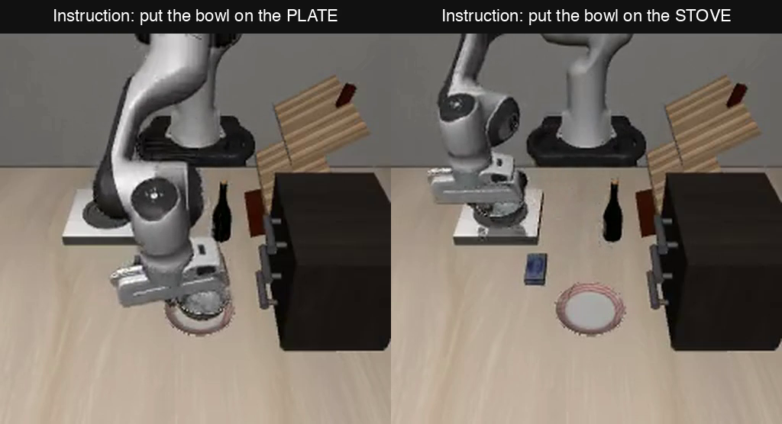
The task: same scene, one word changes where the bowl goes
SETUP · TASK
Notes:
LIBERO-Goal, same starting scene. Left: told to put the bowl on the plate. Right: told the stove. Only the noun in the instruction differs, and the robot goes to a different place. The question: can we read that destination from inside the model, before the bowl gets there?

Slide 5
The model: VLA-0 on a SmolVLM2-500M backbone
SETUP · MODEL
same in both runs
changes with “plate” vs “stove”
layer 31
the plan, typed as text
498 255 457 …
56 numbers = 8 steps × 7
32 transformer layers
960 numbers per token per layer
layer 0
start
camera 1
camera 2
“...put the bowl on the”
plate / stove
robot state
Actions:
template
last
0–4
5–68
72–135
136–143
144
145–179
180–181
182–186
187
input: 188 tokens (position 0–187)
Notes:
Two camera images (64 tokens each), the instruction, the robot state as digits, then the model types its plan as text: 8 steps of 7 numbers. Everything before the noun (position 144) is identical in the plate and stove runs, so only positions 144 to 187 can carry the destination. Colours: blue = the noun, orange = the tokens after it, green = the last position. The same colours are used in every figure.

Slide 6
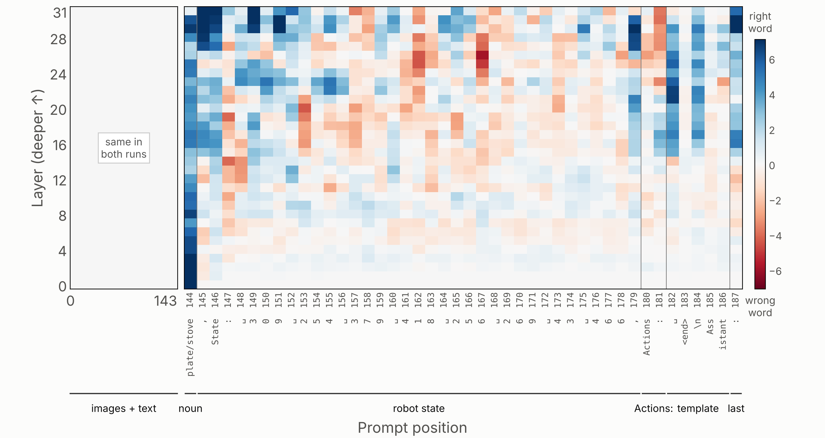
Where can the word lens tell “plate” from “stove”?
EXP 1 · READABILITY MAP
1 Locate
2 Read
3 Read early
4 Steer
Notes:
Each square: (stove minus plate lens reading in the stove run) minus (the same in the plate run), mean of 3 scenes. Blue means the reading moves with the instruction. It is strongest on the noun and in the last few layers (28 to 31). Not yet compared with a random-direction baseline on this slide.

Slide 7
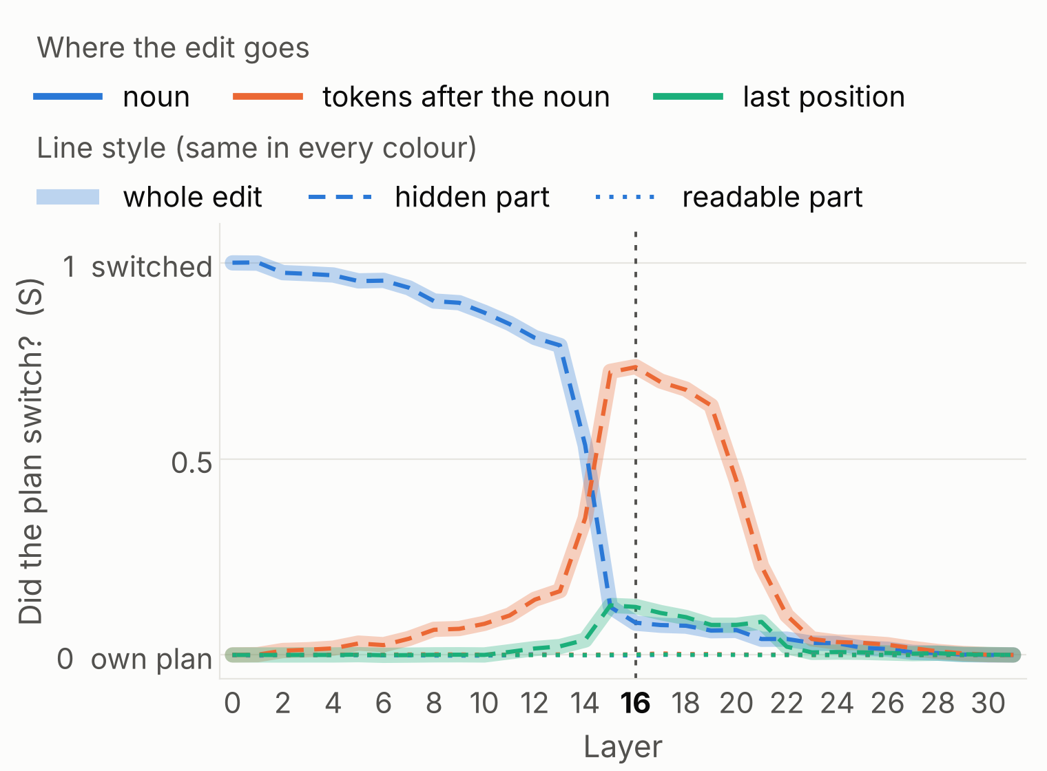
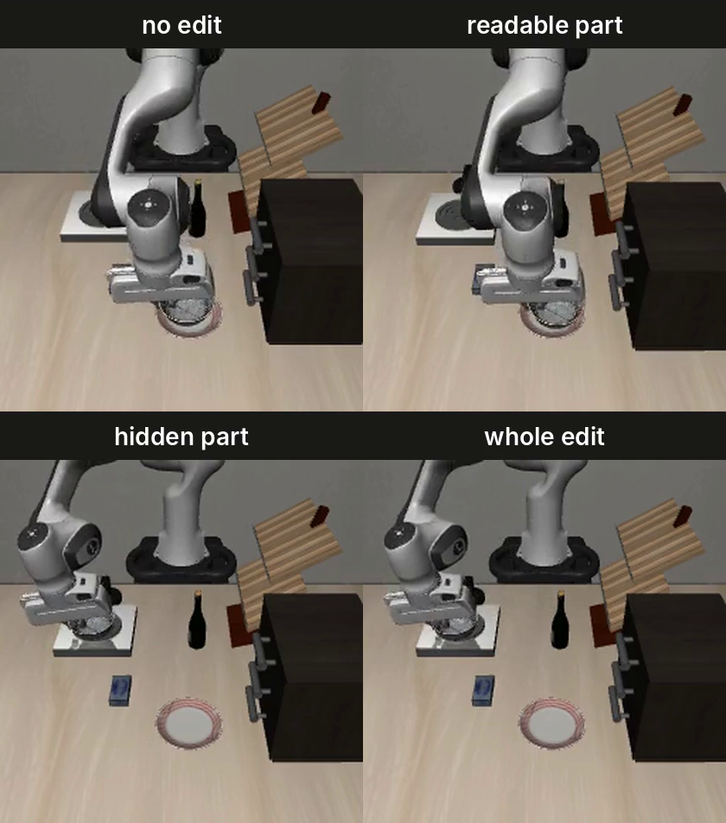
If we swap in the other instruction’s activations at one layer, does the plan switch?
EXP 2 · ACTIVATION SWAP
1 Locate
2 Read
3 Read early
4 Steer
From layer 21
one-layer edits stop working here
why? not sure yet
Layers 13–15
the goal passes from the noun to the tokens after it
Notes:
S on every cell, mean of 3 moments x 2 directions. The noun switches the plan up to layer 13; the tokens after the noun do it at layers 15 to 19 (real rho about 0.9); nothing works from layer 21. The hidden part matches the whole edit and the readable part stays at 0. Video (arrow = edit at layer 16, tokens after the noun, closed loop, plate scene): over 19 starting scenes, the bowl reached the other target 0/19 with the readable part, 10/19 with the hidden part and 14/19 with the whole edit.

Slide 8
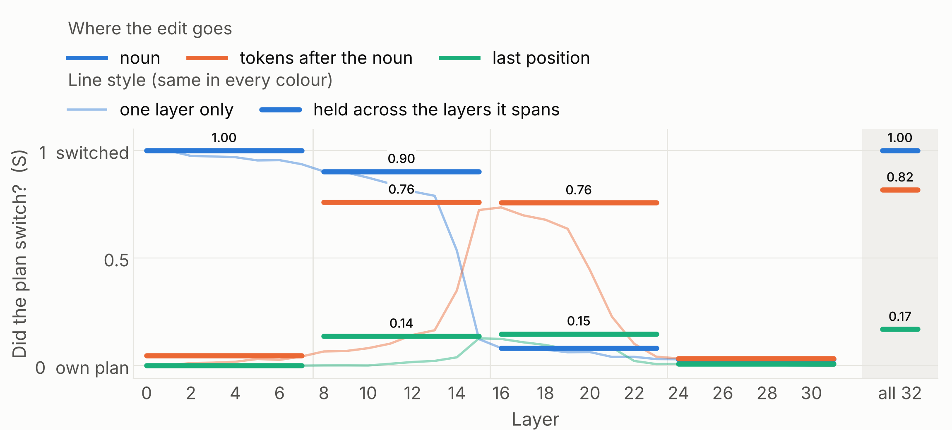
Does editing a group of layers beat editing one?
EXP 3 · LAYER GROUPS
1 Locate
2 Read
3 Read early
4 Steer
Notes:
Holding the edit across 8 layers adds at most about 0.04 over the best single layer in that window. The late window (24 to 31) does nothing. The last position alone never switches the plan, even held at all 32 layers (real rho 0.01).

Slide 9
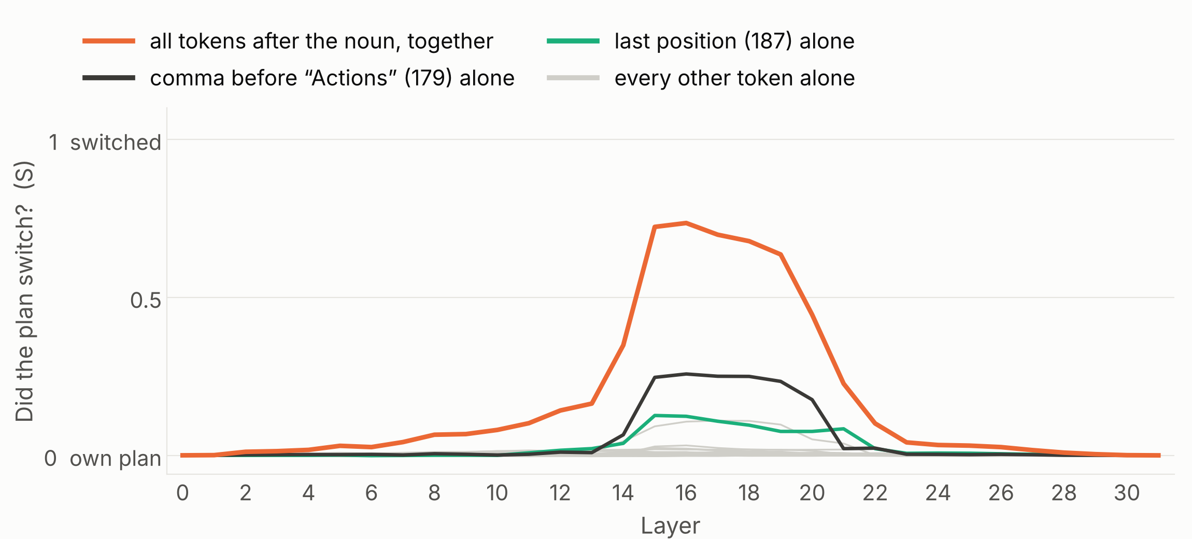
Does one token carry the goal, or does it take the group?
EXP 4 · ONE TOKEN VS THE GROUP
1 Locate
2 Read
3 Read early
4 Steer
Notes:
At layers 15 to 19 the group reaches S about 0.69. The best single token, the comma before Actions (179), reaches 0.25, and its real rho ranged from 0.06 to 0.99 across 5 checked cells. Every other token stays near 0, so the goal is spread across the tokens after the noun.

