Slide 1
Coursera Week 5
Venue Suggestions for Sydney, Brisbane, and Melbourne

Slide 2
Problem
Pandemic has introduced border restrictions which made holidays mundane and lackluster
Countries has made successful moves to flatten the curve
This has made the economy to slowly reopen through venues starting again
Though there is border restrictions between states people are able to go to venues on their homeplace or main city in the state
There is still the need for venues to have more diversity to account for border restrictions that prevents people to have vacation

Slide 3
Data and Method
Investigate Sydney, Brisbane, and Melbourne
Utilize Foursquare API to retrieve their top 100 venue categories
Find the cities popular venues then use it to find similarity index among the cities
Find the most dissimilar cities then recommend to them venues that are popular on the opposite city

Slide 4
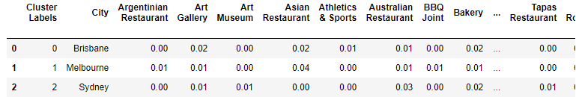
Results KMeans
Kmeans result indicated that the cities are all dissimilar to each other
Further inspection of their Kmeans is needed to achieve similarity index

Slide 5
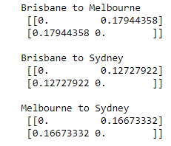
Results Euclidean Distance
Both Brisbane and Sydney are most dissimilar to Melbourne
Melbourne is dissimilar to Brisbane

Slide 6
Conclusion
It is suggested that to open popular venues of Melbourne to Sydney and Brisbane while in Melbourne to open Brisbane’s popular venues
Dissimilarity is used as suggestion points to introduce more diversity to the venues

