Slide 1
 | modeltype | Namespace | Done? | R^2 Score
02 SARIMAX | SARIMAX | SARIMAX | Y
 | SARIMAX | MS_SARIMAX | Y
03_SVM | SVR | SVR | Y
 | SVR | MS_SVR | Y
04_NN | NN | NN | Y
05_RNN | RNN | RNN | Y
06_LSTM | LSTM | LSTM | Y
 | LSTM | MS_LSTM | Y | 0,77
07_EDLSTM | EDLSTM | MS_EDLSTM | Y | 0,56
08_LSTM_HPT | LSTM | MS_LSTM_HPT |  | 0,22
09_ED_LSTM_HPT | EDLSTM | MS_EDLSTM_HPT |  | 0,69
10_ED_LSTM_WL | EDLSTM | MS_EDLSTM_WL |  | 0,81 | Additional Weak learners
10_ED_LSTM_WL2 | EDLSTM | MS_EDLSTM_WL2 |  | 0,83 | 14 day data set
10_ED_LSTM_WL2_1 | EDLSTM | MS_EDLSTM_WL2 |  | 0,81 | ELU Layer
10_ED_LSTM_WL3 | EDLSTM | MS_EDLSTM_WL3 |  | 0,33 | 28 day data set

Slide 2
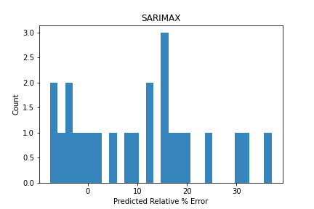
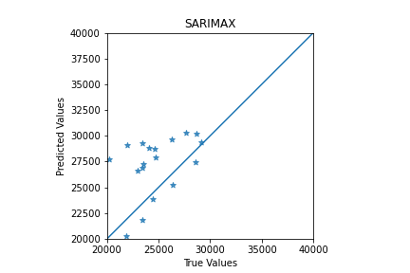
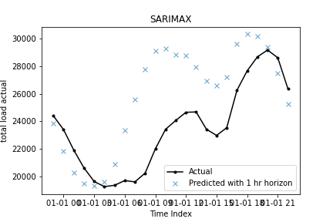
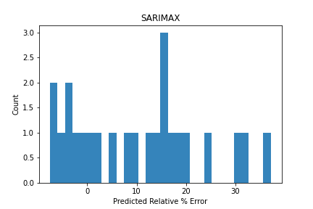


SARIMAX

Slide 3
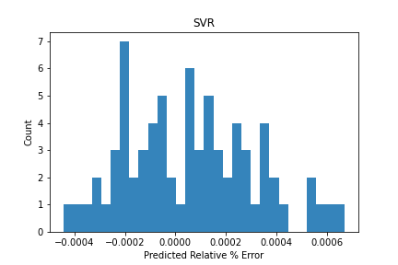
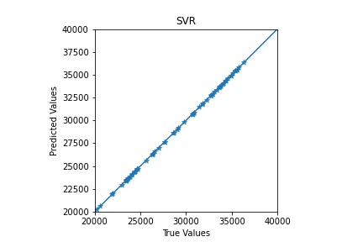
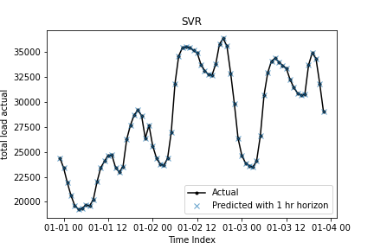
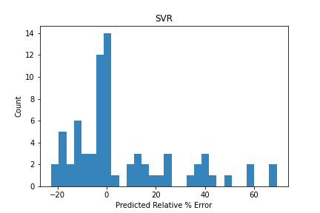
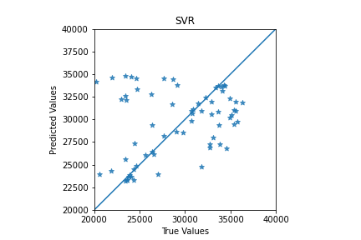
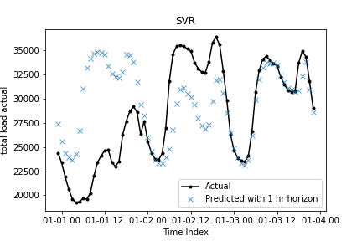
SVM

Slide 4
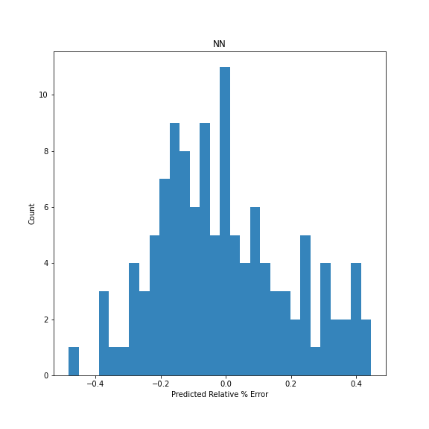
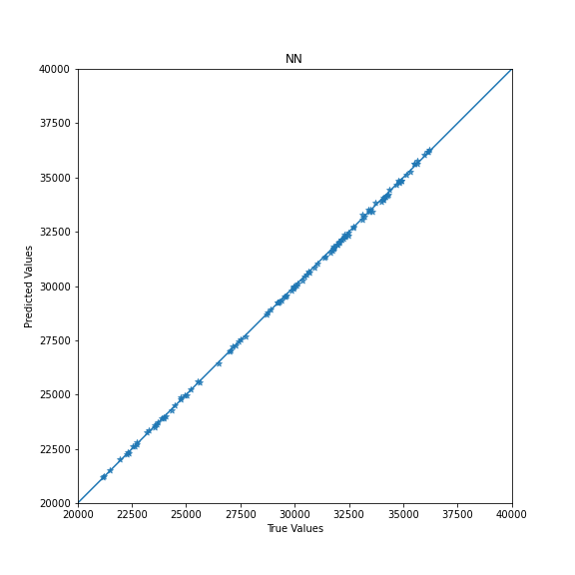
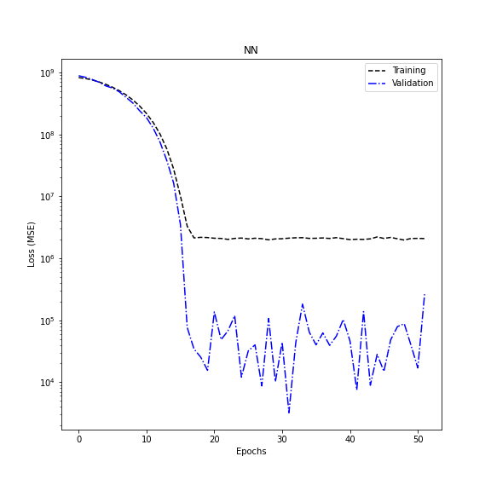
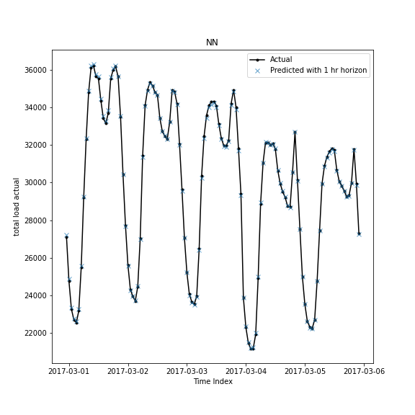
NN

Slide 5
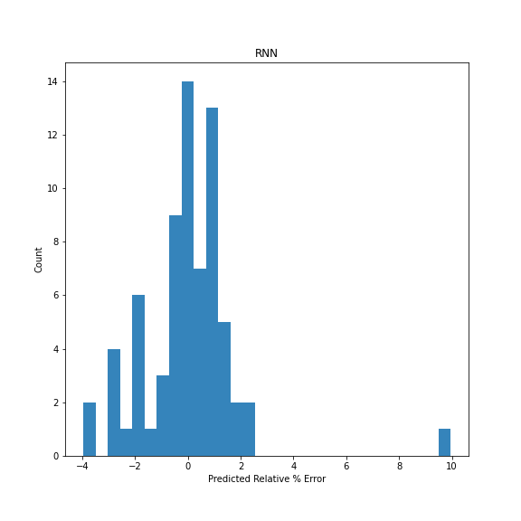
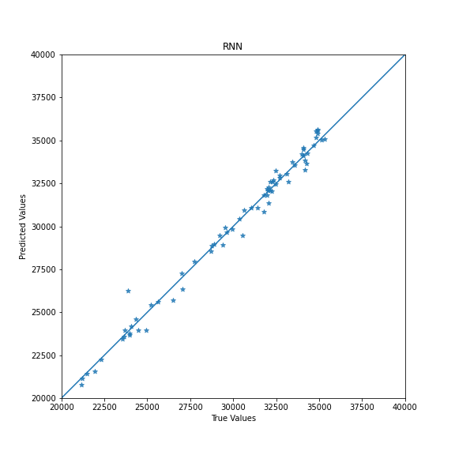
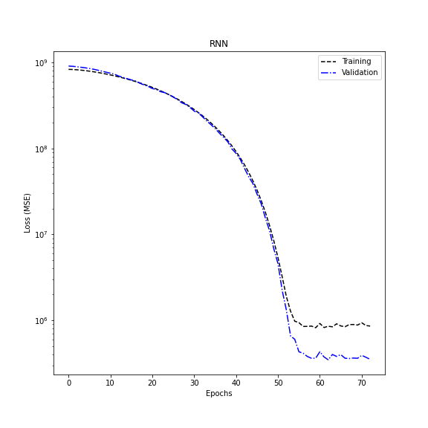
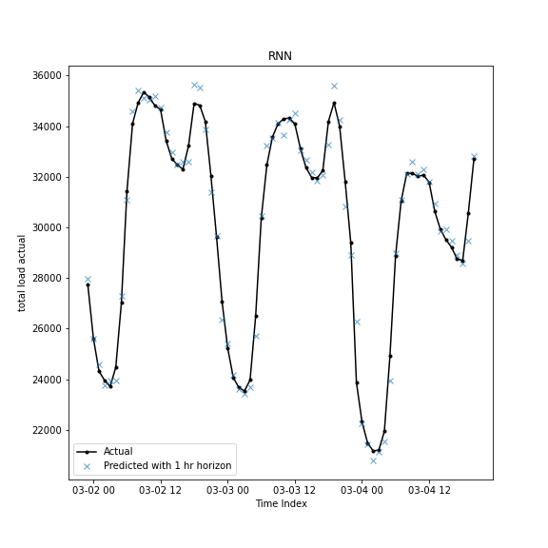
RNN

