Slide 1
 | modeltype | Namespace | Done? | R^2 Score
02 SARIMAX | SARIMAX | SARIMAX | Y
 | SARIMAX | MS_SARIMAX | Y
03_SVM | SVR | SVR | Y
 | SVR | MS_SVR | Y
04_NN | NN | NN | Y
05_RNN | RNN | RNN | Y
06_LSTM | LSTM | LSTM | Y
 | LSTM | MS_LSTM | Y | 0,77
07_EDLSTM | EDLSTM | MS_EDLSTM | Y | 0,56
08_LSTM_HPT | LSTM | MS_LSTM_HPT |  | 0,61
09_ED_LSTM_HPT | EDLSTM | MS_EDLSTM_HPT |  | 0,69

Slide 2
 | modeltype | Namespace | Done? | R^2 Score
10_ED_LSTM_WL | EDLSTM | MS_EDLSTM_WL |  | 0,81 | Additional Weak learners
10_ED_LSTM_WL2 | EDLSTM | MS_EDLSTM_WL2 |  | 0,83 | 14 day data set
10_ED_LSTM_WL2_1 | EDLSTM | MS_EDLSTM_WL2 |  | 0,81 | ELU Layer
10_ED_LSTM_WL3 | EDLSTM | MS_EDLSTM_WL3 |  | 0,33 | 28 day data set
10_ED_LSTM_WL4 | EDLSTM | MS_EDLSTM_WL4 |  | 0,85 | extended data set
10_ED_LSTM_WL5 | EDLSTM | MS_EDLSTM_WL5 |  | 0,9 | HPT
10_ED_LSTM_WL6 | EDLSTM | MS_EDLSTM_WL6 |  |  | Differencing, Smaller NN

Slide 3
Question
Do we need to submit our project in a colab notebook? Or is a github repo sufficient?
Packaging functions?
Documentation on Results only? Or the whole process?
Prediction Goal? Do i need to predict the price or is Load okay
Differencing vs. Scaling?
PCA interpretation
14 day prediction with mean

Slide 4
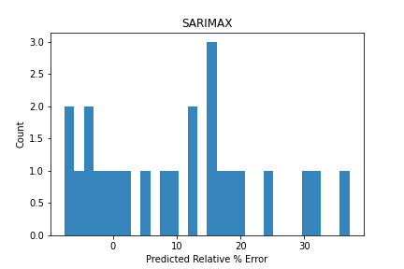
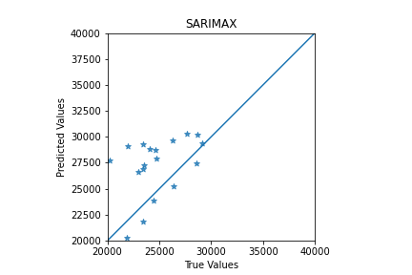
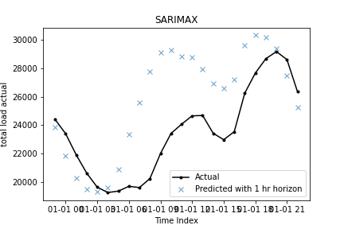
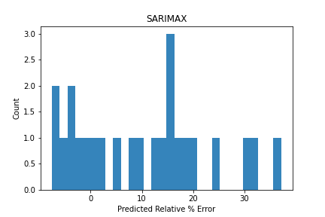


SARIMAX

Slide 5
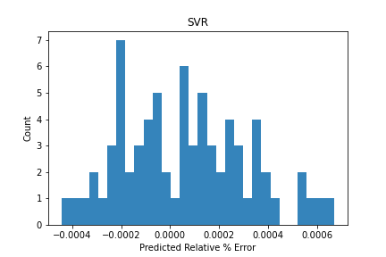
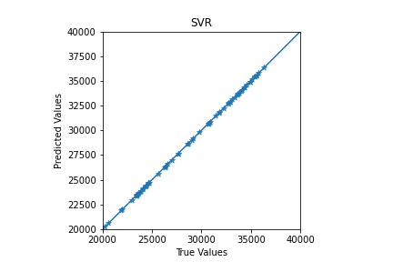
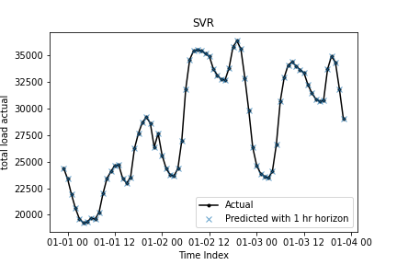
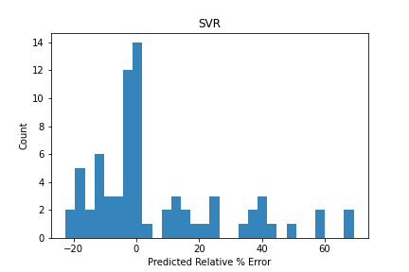
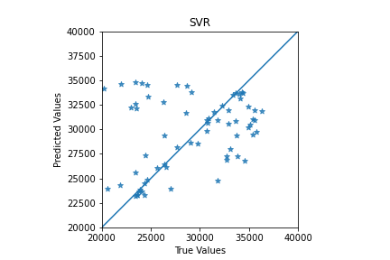
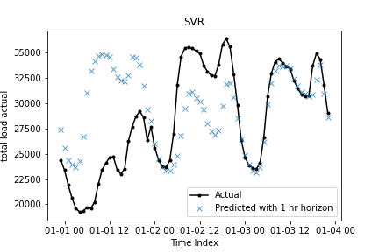
SVM

Slide 6
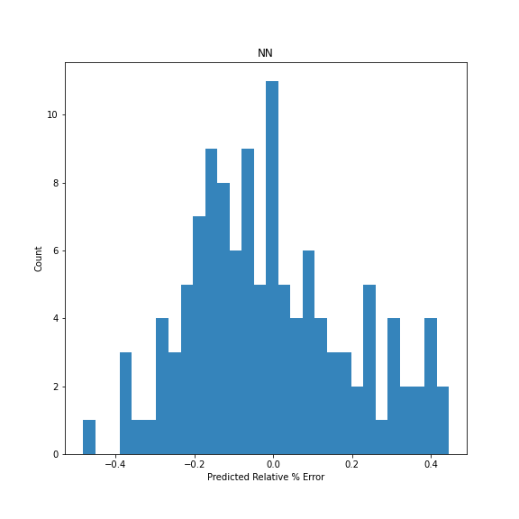
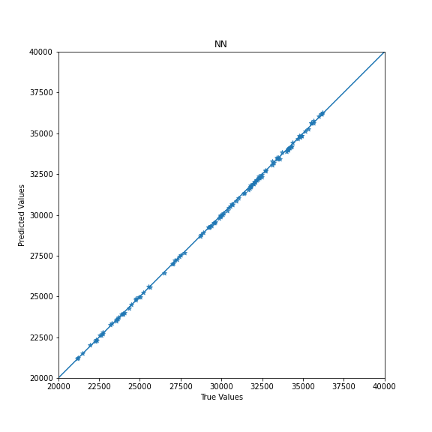
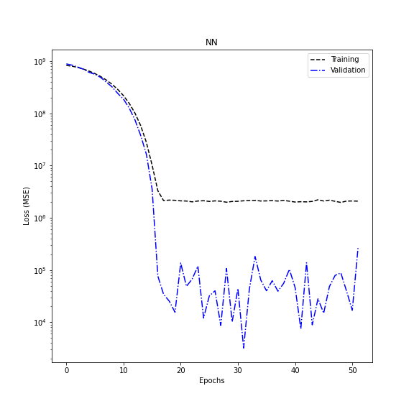
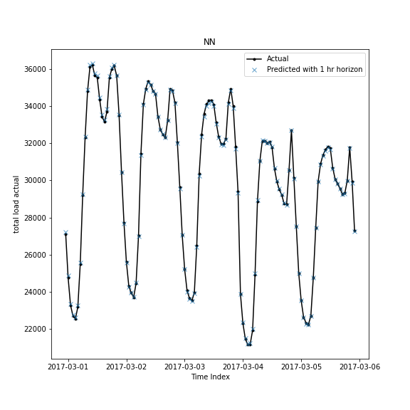
NN

Slide 7
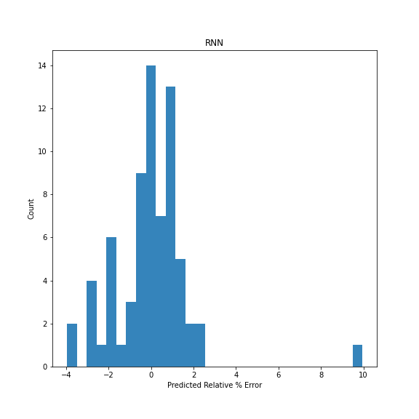
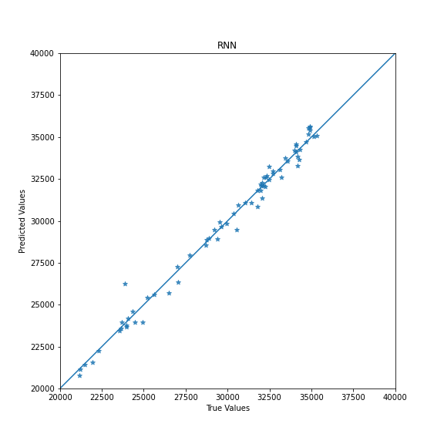
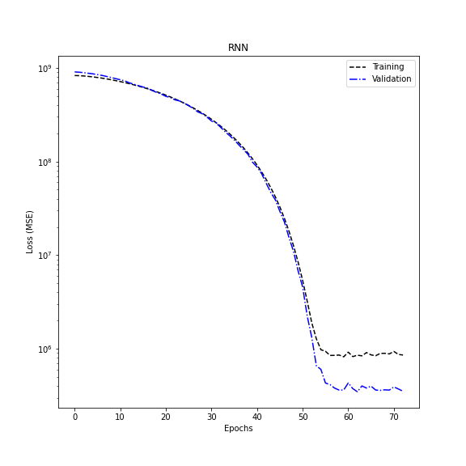
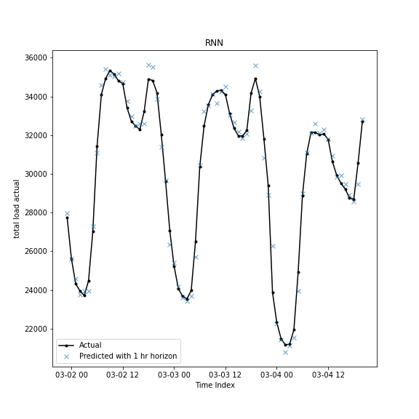
RNN

Slide 8
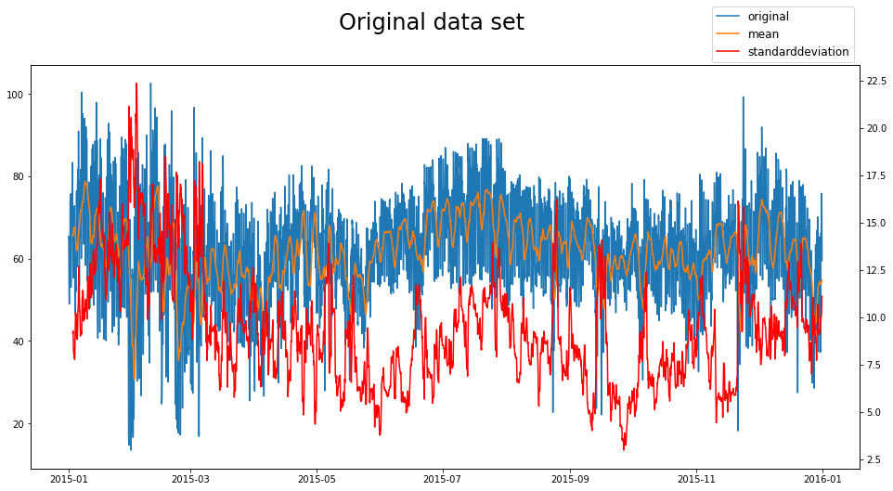
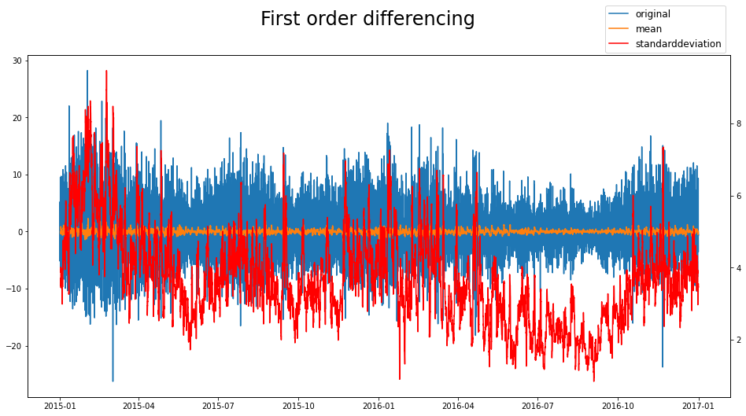
Differencing

Slide 9
Differencing
Past difference data
Prediction difference data
-48
-47
…
-2
-1
0
1
…
22
23
Prediction the change of price
Cumulative sum of diff
Initial value
-1
0
1
…
22
23
Reverting the difference with cumsum
0
1
…
22
23
Actual Result
Actual price prediction

Slide 10
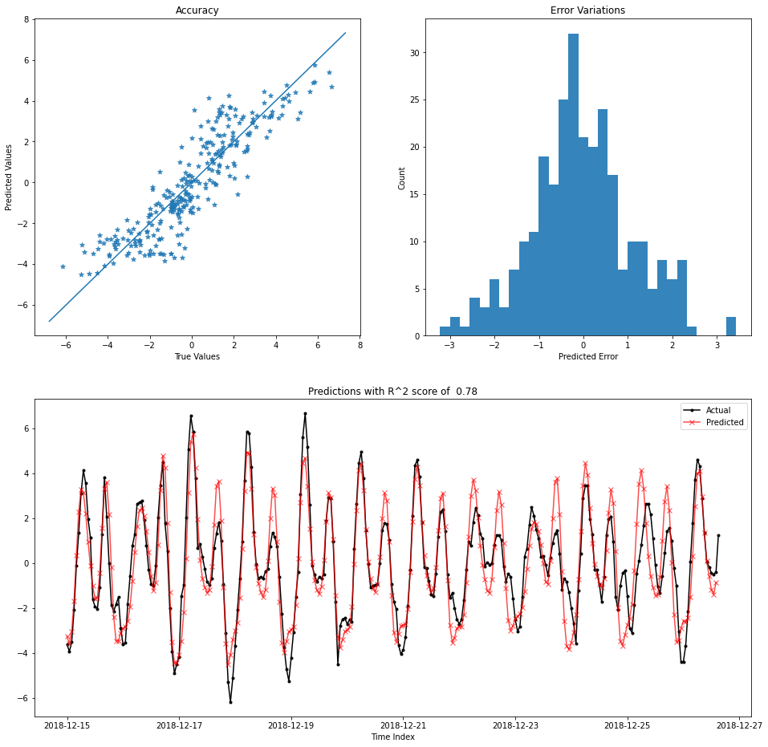
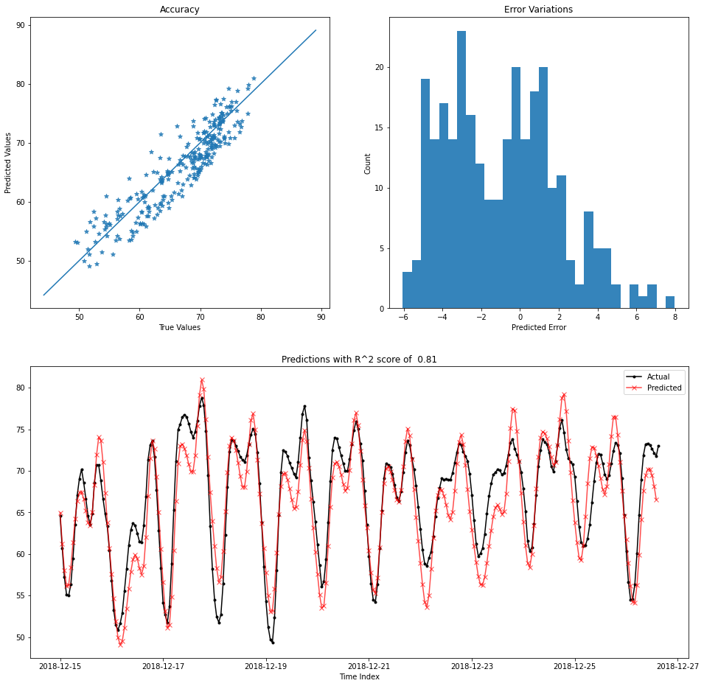
Price change prediction
Actual price prediction

Slide 11
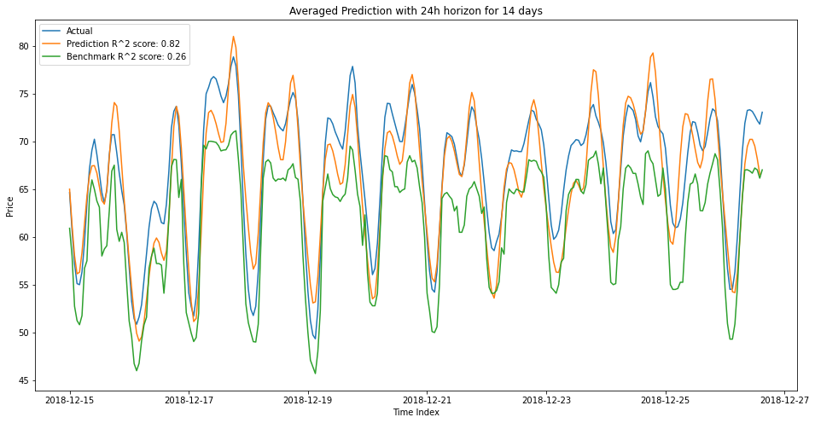
Interim result

