Slide 1
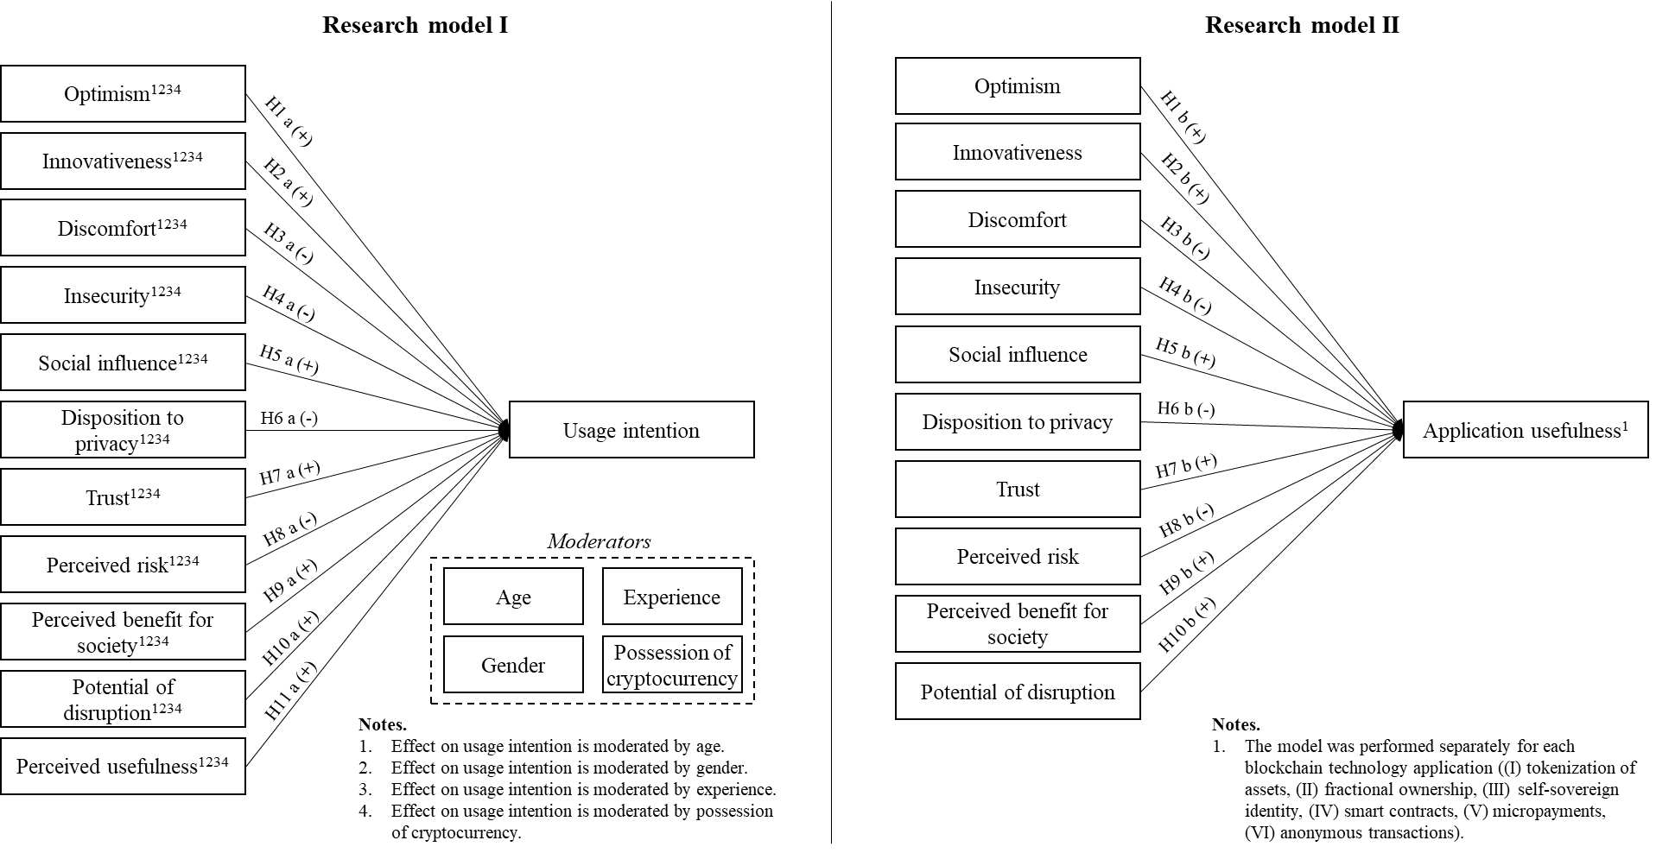
Research model

Slide 2
Research model I
Optimism¹²³⁴
Innovativeness¹²³⁴
H1a (+)
Discomfort¹²³⁴
H2a (+)
Insecurity¹²³⁴
H3a (-)
Social influence¹²³⁴
H4a (-)
H5a (+)
Disposition to privacy¹²³⁴
H6a (-)
Usage intention
Trust¹²³⁴
H7a (+)
Perceived risk¹²³⁴
H8a (-)
Moderators
H9a (+)
Age
Experience
Perceived benefit for society¹²³⁴
H10a (+)
Gender
Possession of cryptocurrency
Potential of disruption¹²³⁴
H11a (+)
Notes.
Effect on usage intention is moderated by age.
Effect on usage intention is moderated by gender.
Effect on usage intention is moderated by experience.
Effect on usage intention is moderated by possession of cryptocurrency.
Perceived usefulness¹²³⁴

Slide 3
Research model II
Optimism
Innovativeness
H1b (+)
Discomfort
H2b (+)
Insecurity
H3b (-)
Social influence
H4b (-)
H5b (+)
Disposition to privacy
H6b (-)
Application usefulness¹
Trust
H7b (+)
Perceived risk
H8b (-)
H9b (+)
Perceived benefit for society
H10b (+)
Potential of disruption
Notes.
The model was performed separately for each blockchain technology application (self-sovereign identity, tokenization of assets, fractional ownership, micropayments, smart contracts, (pseudo-)anonymous transactions).

Slide 4
2 kleinere, nebeneinandern, ohne H
Optimism
Innovativeness
Discomfort
Insecurity
Social influence
Disposition to privacy
Usefulness¹
Trust
Notes.
The model was performed separately for each blockchain technology application ((I) tokenization of assets, (II) fractional ownership, (III) self-sovereign identity, (IV) smart contracts, (V) micropayments, (VI) anonymous transactions).
Perceived risk
Perceived benefit for society
Potential of disruption

Slide 5
Optimism¹²³⁴
H1 a (+)
Innovativeness¹²³⁴
H1 b I-VII (+)
H2 a (+)
Discomfort¹²³⁴
H2 b I-VII (+)
H3 a (-)
H3 b I-VII (-)
Insecurity¹²³⁴
H4 a (-)
H4 b I-VII (-)
Social influence¹²³⁴
Usage intention
H5 a (+)
H5 b I-VII (+)
Usefulness of blockchain applications¹²³⁴⁵
H6 a (-)
Disposition to privacy¹²³⁴
H6 b I-VII (-)
H11 (+)
H7 a (+)
Trust¹²³⁴
H7 b I-VII (+)
H8 a (-)
H8 b I-VII (-)
Perceived risk¹²³⁴
Moderators
H9 a (+)
H9 b I-VII (+)
Age
Perceived benefit for society¹²³⁴
H10 b I-VII (+)
H10 a (+)
Gender
Potential of disruption¹²³⁴
Experience
Notes.
Effect on usage intention is moderated by age.
Effect on usage intention is moderated by gender.
Effect on usage intention is moderated by experience.
Effect on usage intention is moderated by possession of cryptocurrency.
The model is performed on (I) the mean of all usefulness assessments of blockchain technology applications as well as on each application ((II) tokenization of assets, (III) fractional ownership, (IV) self-sovereign identity, (V) smart contracts, (VI) micropayments, (VII) anonymous transactions) respectively.
Possession of cryptocurrency

Slide 6
Optimism¹²³⁴⁵
H1 a (+)
Innovativeness¹²³⁴⁵
H1 b I-VII (+)
H2 a (+)
Discomfort¹²³⁴⁵
H2 b I-VII (+)
H3 a (-)
H3 b I-VII (-)
Insecurity¹²³⁴⁵
H4 a (-)
H4 b I-VII (-)
Social influence¹²³⁴⁵
H10 (+)
Usage intention
H5 a (+)
H5 b I-VII (+)
Usefulness of blockchain applications¹²³⁴⁵⁶
H6 a (-)
Disposition to privacy¹²³⁴⁵
H6 b I-VII (-)
H7 a (+)
Trust¹²³⁴⁵
H7 b I-VII (+)
H8 a (-)
H8 b I-VII (-)
Perceived risk¹²³⁴⁵
Moderators
H9 a (+)
H9 b I-VII (+)
Age⁷
Perceived benefit for society¹²³⁴⁵
Gender⁸
Experience⁹
Notes.
Effect on usage intention is moderated by age.
Effect on usage intention is moderated by gender.
Effect on usage intention is moderated by experience.
Effect on usage intention is moderated by possession of cryptocurrency.
Effect on usage intention is moderated by nationality.
The model is performed on (I) the mean of all usefulness assessments of blockchain technology applications as well as on each application ((II) tokenization of assets, (III) fractional ownership, (IV) self-sovereign identity, (V) smart contracts, (VI) micropayments, (VII) anonymous transactions) respectively.
H11 1a (-), 2a (-), 3a (+), 4a (+), 5a (-), 6a (-), 7a (-), 8a (-), 9a (+), 10a (-)
H12 1a (-), 2a (-), 3a (+), 4a (+), 5a (-), 6a (-), 7a (-), 8a (-), 9a (+), 10a (-)
H13 1a (-), 2a (-), 3a (+), 4a (+), 5a (-), 6a (-), 7a (-), 8a (-), 9a (+), 10a (-)
H14 1a (-), 2a (-), 3a (+), 4a (+), 5a (-), 6a (-), 7a (-), 8a (-), 9a (+), 10a (-)
H15 1a (-), 2a (-), 3a (+), 4a (+), 5a (-), 6a (-), 7a (-), 8a (-), 9a (+), 10a (-)
Possession of cryptocurrency¹⁰
Nationality¹¹
(GER, UK)

Slide 7
Regression equation
General: Y = b₁X₁ + b₂X₂ + b₃X₁X₂
Usage intention
= b₀ + b₁Optimism + b₂Innovativeness + b₃Discomfort + b₄Insecurity
+ b₅Social Influence + b₆Disposition to privacy + b₇Trust + b₈Perceived risk
+ b₉Perceived benefit for society + b₁₀Potential of disruption + b₁₁Application Usefulness + b₁₂M* + b₁₃Optimism ✕ M + b₁₄Innovativeness ✕ M + b₁₅Discomfort ✕ M
+ b₁₆Insecurity ✕ M + b₁₇Social Influence ✕ M+ b₁₈Disposition to privacy ✕ M
+ b₁₉Trust ✕ M+ b₂₀Perceived risk ✕ M + b₂₁Perceived benefit for society ✕ M
+ b₂₂Potential of disruption ✕ M + b₂₃Application Usefulness ✕ M
where…
*M represents moderator variables (age, gender, experience and possession of cryptocurrency) which show interaction effects on usage intention. The model has been performed for each moderator respectively.
Simple effect
Interaction effect

Slide 8
Regression equation
General: Y = b₁X₁ + b₂X₂ + b₃X₁X₂
Application usefulness*
= b₀ + b₁Optimism + b₂Innovativeness + b₃Discomfort + b₄Insecurity
+ b₅Social Influence + b₆Disposition to privacy + b₇Trust + b₈Perceived risk
+ b₉Perceived benefit for society + b₁₀Potential of disruption
+ b₁₂M** + b₁₃Optimism ✕ M + b₁₄Innovativeness ✕ M + b₁₅Discomfort ✕ M
+ b₁₆Insecurity ✕ M + b₁₇Social Influence ✕ M+ b₁₈Disposition to privacy ✕ M
+ b₁₉Trust ✕ M+ b₂₀Perceived risk ✕ M + b₂₁Perceived benefit for society ✕ M
+ b₂₂Potential of disruption ✕ M + b₂₃Usage intention ✕ M
where...
*The model has been performed on the mean of all usefulness assessments of blockchain technology applications as well as on each application (tokenization of assets, fractional ownership, self-sovereign identity, smart contracts, micropayments, anonymous transactions) respectively.
**M represents moderator variables (age, gender, experience, possession of cryptocurrency and nationality) which show interaction effects on application usefulness. The model has been performed for each moderator respectively.
Simple effect

Slide 9
Moderated relationships

Slide 10
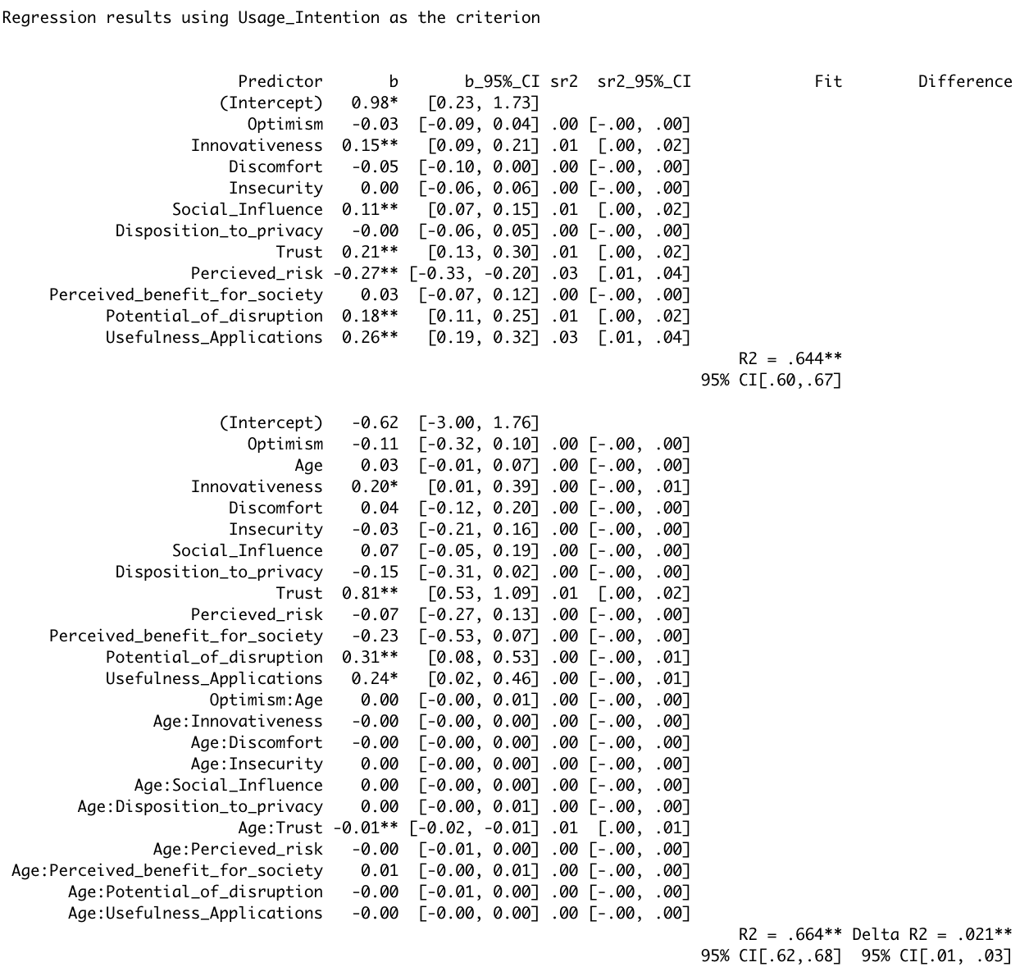
Continuous
moderator
Y= b₁X₁ + b₂X₂ + b₃X₁X₂
Age
b₂ = 0.03
b₃: -0.01**
Trust
Usage Intention
b₁: 0.81**
Total effect of trust on usage intention depends on age:
b_{total} = 0.81 + Age * (-0.01)
Result:
The positive effect of trust on usage intention decreases with increasing age.
Discussion:
The older people get, the less trust they have in blockchain technology, which lowers their usage intention
Companies should appeal to younger people as lead users
Young people show more trust in technology

Slide 11
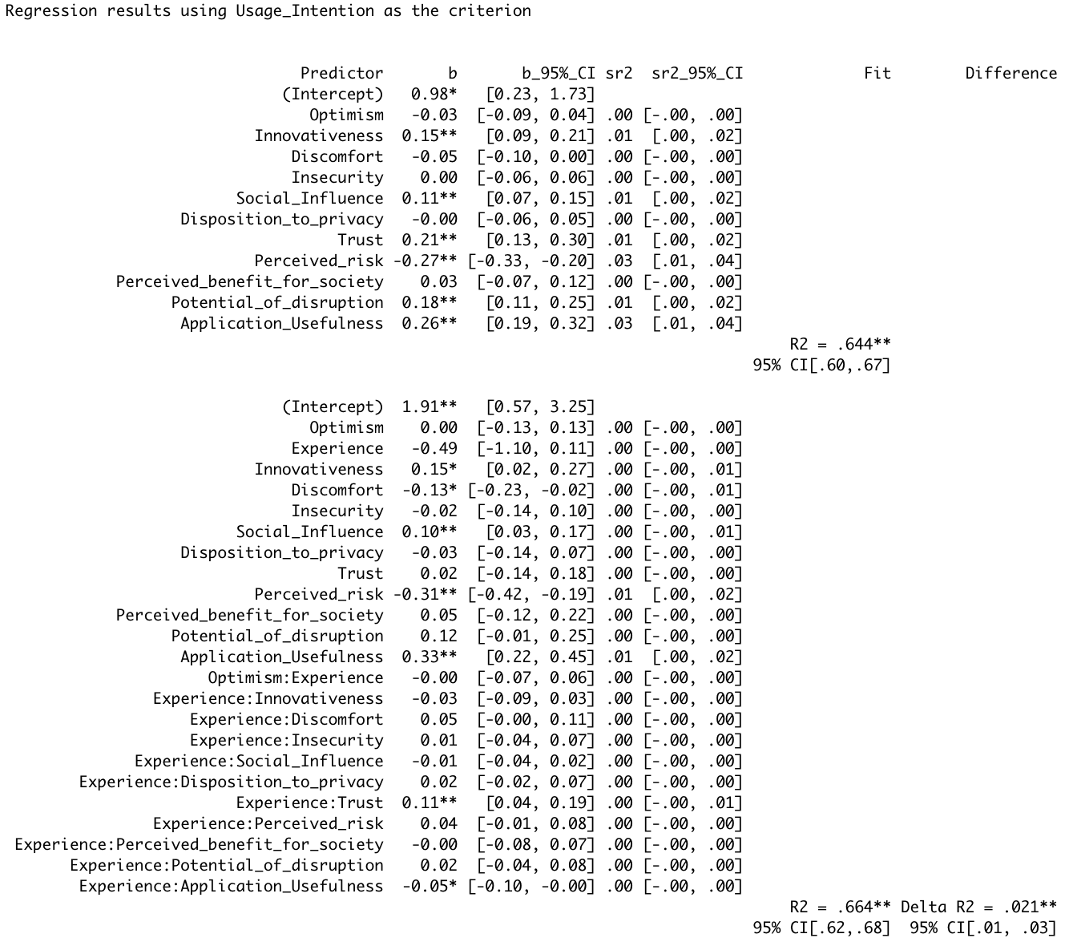
Continuous
moderator
Y= b₁X₁ + b₂X₂ + b₃X₁X₂
Experience
b₂ = -0.49
b₃ = 0.11**
Trust
Usage Intention
b₁ = 0.02
Total effect of trust on usage intention depends on experience:
b_{total} = 0.02 + experience * (0.11)
b_{total} (higher experience) = 0.02 + 5 * (0.11)
b_{total} (lower experience) = 0.02 + 1 * (0.11)
Result:
The positive effect of trust on usage intention increases with experience
Discussion:
The more knowledge about and contact to BT people have, the more they trust BT which increases their usage intention
Companies should increase knowledge of people through campaigns
Give out free trials of their product for people to have more contact with BT

Slide 12
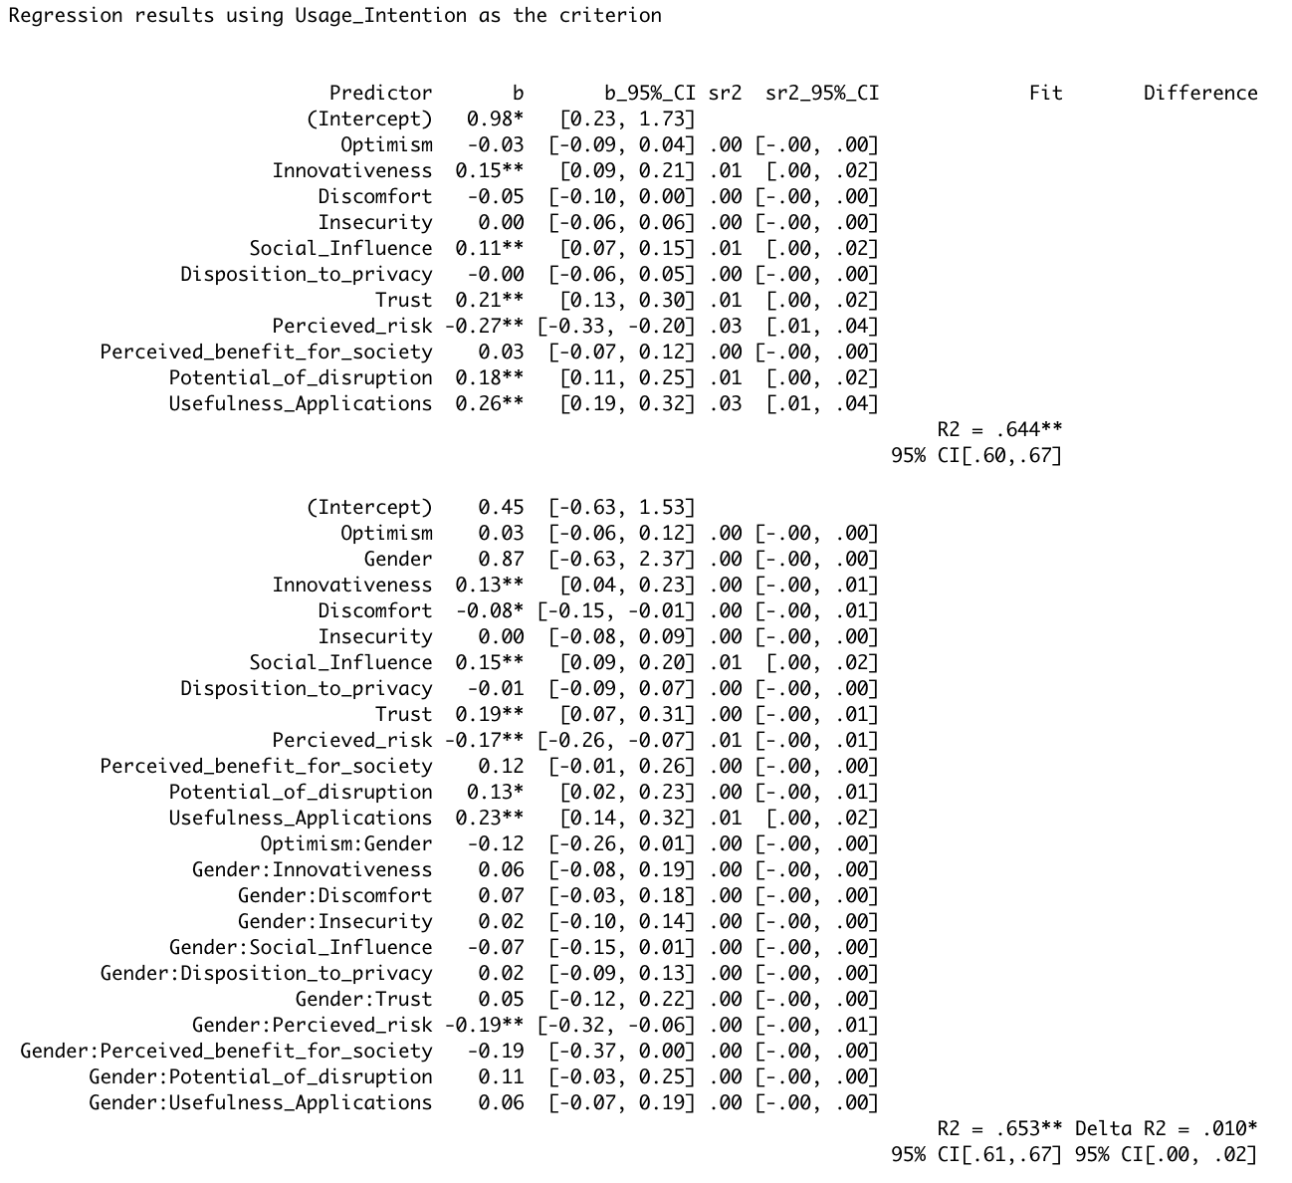
Dichotomous
moderator
Y= b₁X₁ + b₂X₂ + b₃X₁X₂
Gender
b₂ = 0.87
b₃: -0.19**
Perceived risk
Usage Intention
b₁: -0.17**
Total effect of perceived risk on usage intention moderated by gender:
b_{total} (males) = -0.17 + 1 * (-0.19) = - 0.36
b_{total} (females) = -0.17
Result:
The negative effect of perceived risk on usage intention increases for males
Discussion:
Males more sensitive towards risk and usage intention
More consideration of risk factors shows men having more knowledge about downfalls of blockchain technology (Mean knowledge of men, scale 1 to 10: 3.14 for men and 1.99 for women) → Partial MEDIATION ANALYSIS confirmed
Men rather in Cluster Explorer & Pioneer

Slide 13
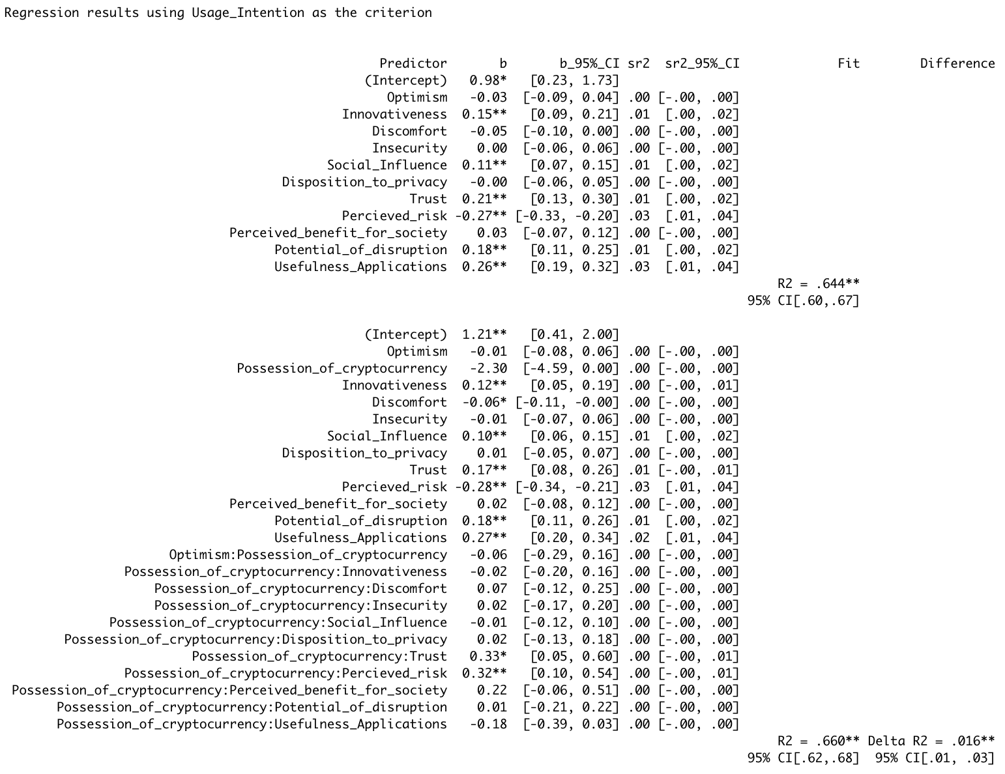
Dichotomous
moderator
Y= b₁X₁ + b₂X₂ + b₃X₁X₂
Possession of Crypto
b₂ = -2.30
b₃: 0.33*
Trust
Usage Intention
b₁: 0.17**
Total effect of people possessing cryptocurrencies on the relationship between trust and usage intention:
b_{total} (crypto) = 0.17 + 0.33 = 0.5
b_{total} (no crypto) = 0.17
Result:
The positive effect of trust on usage intention increases for people possessing cryptocurrency
Discussion:
People possessing cryptocurrency increases their trust in BT which makes them more likely to use BT
Giving out cryptocurrency increases trust and reduces risk perception
Companies should give out cryptocurrency

Slide 14
Dichotomous
moderator
Y= b₁X₁ + b₂X₂ + b₃X₁X₂
Possession of Crypto
b₂ = -2.30
b₃: 0.32**
Perceived Risk
Usage Intention
b₁: -0.28**
Total effect of perceived risk on usage intention for people possessing cryptocurrencies:
b_{total} (crypto) = -0.28 + 0.32 = 0.04 (slightly risk loving)
b_{total} (no crypto) = -0.28 (risk averse)
Result:
The negative effect of perceived risk on usage intention decreases for people possessing cryptocurrencies
Discussion:
Giving people cryptocurrency reduces their risk perception of BT and leads to higher usage intention
Appeal to people who possess crypto

Slide 15
Unmoderated relationships Application usefulness

Slide 16
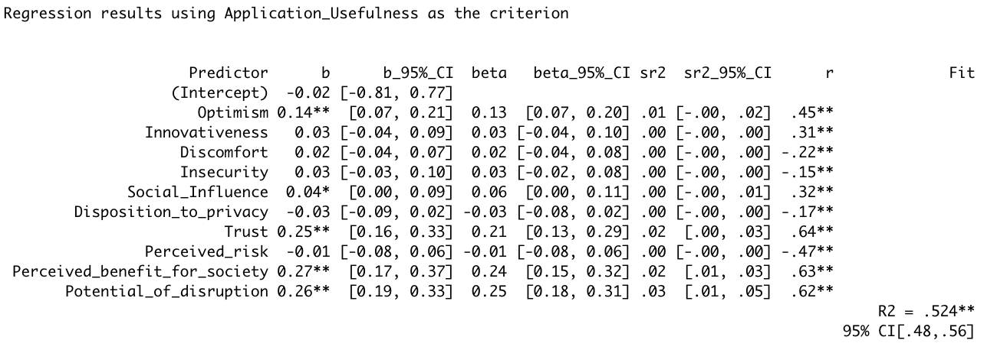
Effects on the overall usefulness of blockchain applications:
Result:
H1 (b) I supported, H7 (b) I supported, H9 (b) I supported, H10 (b) I supported, H11 I supported
Discussion:
Explorers & Pioneer cluster currently →
Business models need to appeal to a customer segment that consists optimistic people with high levels of trust. People who see blockchain applications bring a benefit to society, who see a disruptive potential about BT applications and who show a higher usage intention

Slide 17
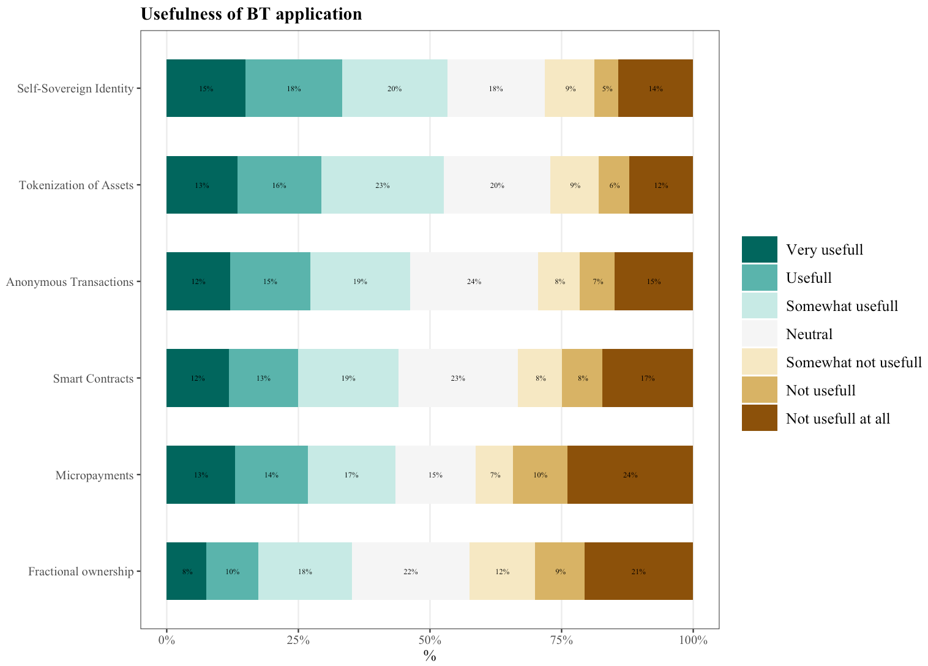

Slide 18
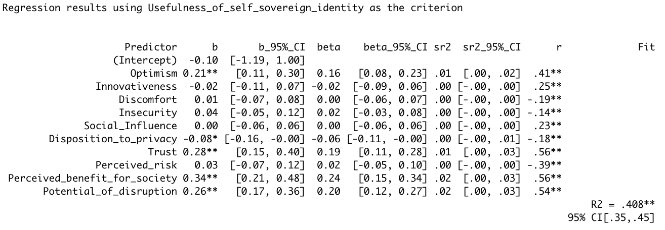
Effects on the usefulness of self-sovereign identity applications:
Result:
H1 (b) IV supported, H7 (b) IV supported, H8 (b) IV supported, H9 (b) IV supported, H10 (b) IV supported, H11 IV supported
Discussion:
Explorer and Pioneer Cluster currently
Business models building upon self-sovereign identity applications need to appeal to a customer group that contains optimistic people with high levels of trust.
People who see blockchain applications bring a benefit to society, who see a disruptive potential about BT applications.
People who risk-loving tendency → Lead users
Self-sovereign identity currently most promising applications with big potential looking ahead -> Also due to descriptive results
Trust, Optimism and Privacy driving factors
Status quo gut, looking ahead most promising
R2 highest

Slide 19
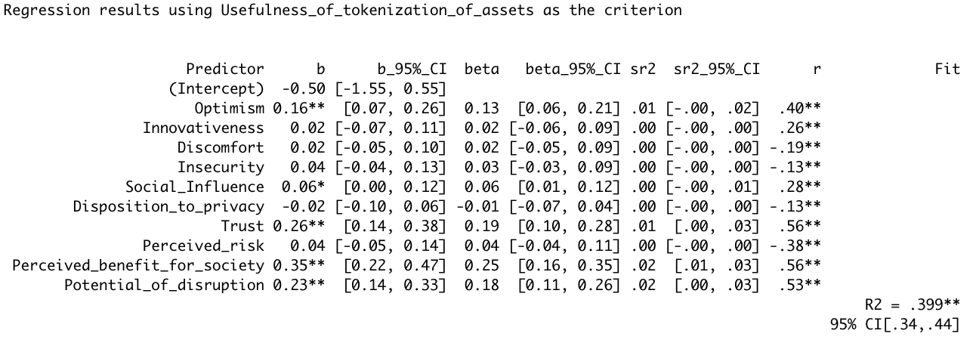
Effects on the usefulness of tokenization of assets:
Result:
H1 (b) II supported, H7 (b) II supported, H8 (b) II supported, H9 (b) II supported, H10 (b) II supported, H11 II supported
Discussion:
very similar to self-sovereign identity
Business models building upon tokenization of assets need to appeal to a customer group that contains optimistic people with high levels of trust.
People who see blockchain applications bring a benefit to society, who see a disruptive potential about BT applications and who show a higher usage intention.
People who show a slightly risk-loving tendency
Usage intention influenced by age, gender, experience and possession of crypto
Similar to discussion above
Explorer and Pioneer Cluster currently
Tokenization of assets currently one of the most promising applications with big potential looking ahead, as many influences already show strong significance
Trust, Optimism and Social influence (-> Network effects?!) driving factors
Zusammenfassend mit Self-Soverign identity --> aktuell und für Zukunft
Fokus im Crypto bereich auf SSI und Tokenization

Slide 20
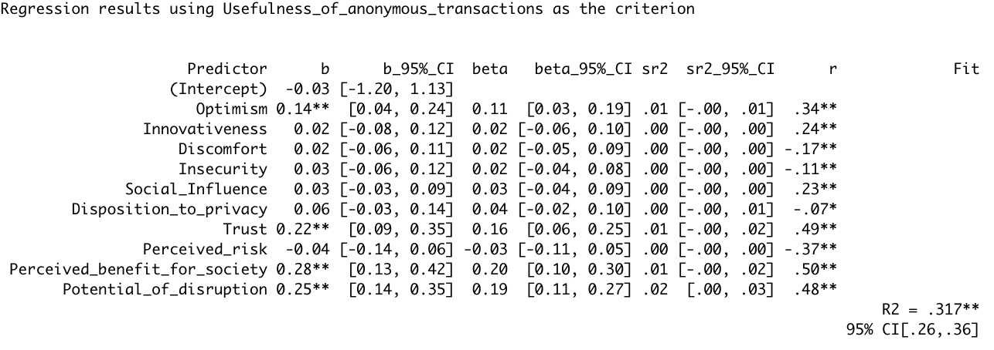
Effects on the usefulness of anonymous transactions:
Result:
H1 (b) VII supported, H7 (b) VII supported, H9 (b) VII supported, H10 (b) VII supported, H11 VII supported
Discussion:
Business models building upon anonymous transactions need to focus on a customer group that contains optimistic people with high levels of trust
People who see blockchain applications bring a benefit to society, who see a disruptive potential about BT applications and who show a higher usage intention.
Usage intention influenced by age, gender, experience and possession of crypto
Similar to discussion above
Rather only Explorer cluster: lower optimism coefficient, lower trust coefficient, no significant risk
Currently less usefulness
Outlook: Mixed outlook
Trust and Optimism driving factors

Slide 21
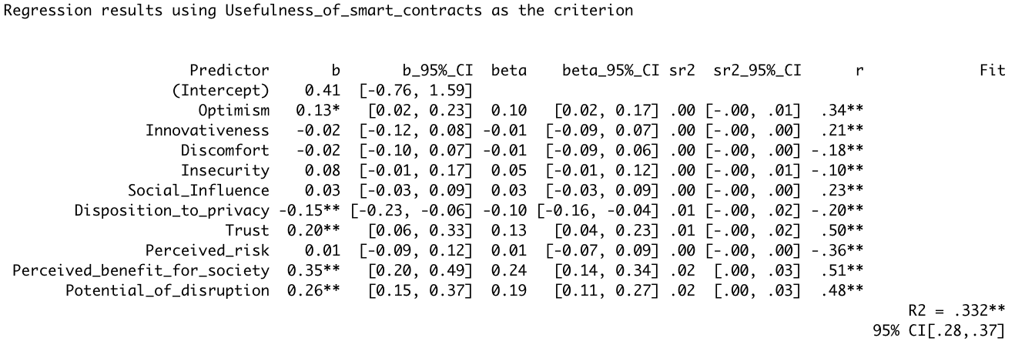
Effects on the usefulness of smart contracts:
Result:
H1 (b) V supported, H6 (b) V supported, H7 (b) V supported, H9 (b) V supported, H10 (b) V supported, H11 V supported
Discussion:
Hesitators show less usefulness due to privacy concerns
Business models building upon smart contracts need to appeal to a customer group that contains optimistic people with high levels of trust.
The higher the privacy concerns, the lower the usefulness → Incentive programs f.e. offering free trials, free versions, to alleviate this concern
People who see blockchain applications bring a benefit to society, who see a disruptive potential about BT applications and who show a higher usage intention.
Usage intention influenced by age, gender, experience and possession of crypto
Similar to discussion above
Smart contracts with mixed outlook
Trust, Privacy Concerns and Optimism driving factors
Paar Sätze in MA: Begründen, warum wir dieses modell genommen haben und nicht z.B. hierarchical multiple regression --> Vergleichbarkeit für dieses Vorgehen

Slide 22
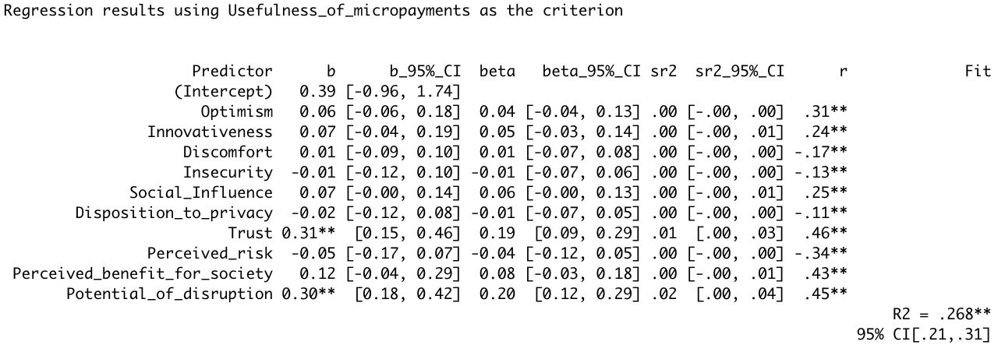
Effects on the usefulness of micropayments:
Result:
H7 (b) VI supported, H10 (b) VI supported, H11 VI supported
Discussion:
Low current usefulness → low R squared im Vergleich zu anderen Modellen
Business models building upon micropayments need to appeal to a customer group that contains people with high levels of trust.
Hard to build
Weak outlook, weak status quo

Slide 23
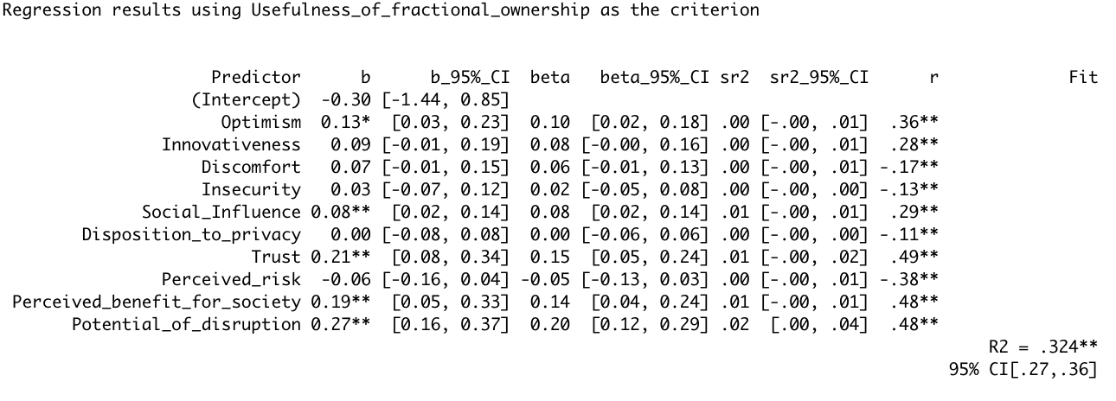
Effects on the usefulness of fractional ownership:
Result:
H1 (b) III supported, H3 (b) III supported, H9 (b) III supported, H10 (b) III supported, H11 III supported
Discussion:
Business models utilizing fractional ownership applications should appeal to optimistic consumer
Still potential of disruption for this application in the future, but currently there is less consent
Appeals to Explorers and Pioneers
People show lower likert assessment, but predictors show more potential for this application than for micropayments and smart contracts
Paradocial
Outlook and Status Quo Tabelle → Applications → Low medium high Status Quo → Übersicht als Tabelle, Begründung in den Text → Comment Spalte
Status Quo, Outlook, Relevant Cluster, Comments

Slide 24
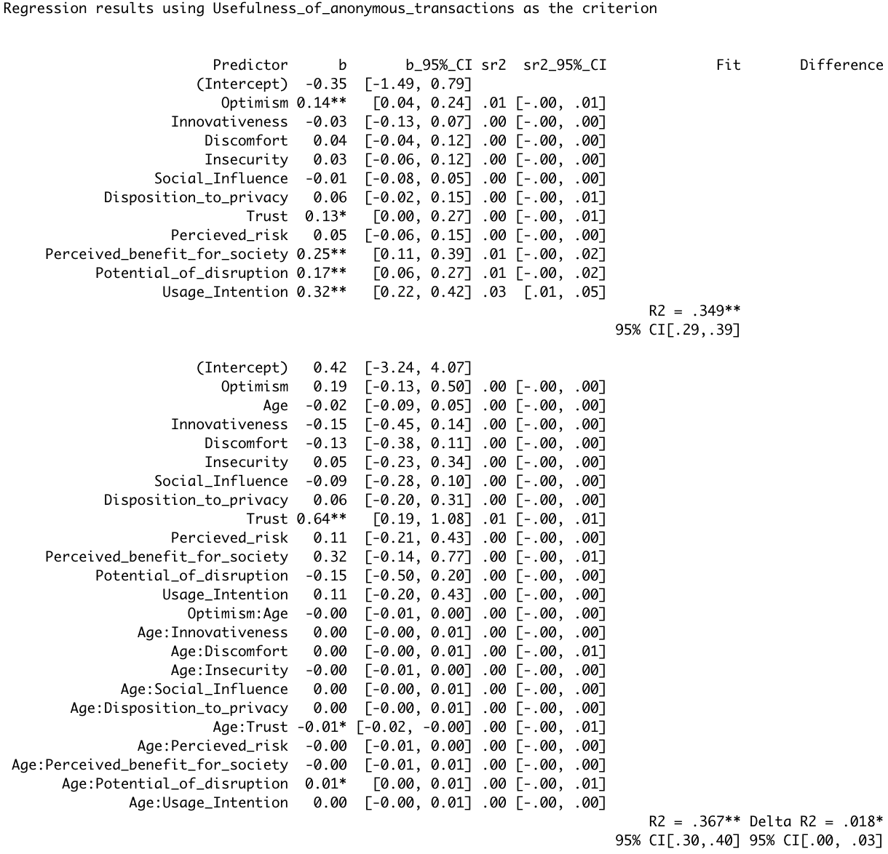
Continuous
moderator
Y= b₁X₁ + b₂X₂ + b₃X₁X₂
Age
b₂ = -0.02
b₃: 0.01*
Potential of disruption
Usefulness of anonymous transactions
b₁: -0.15
Total effect of potential of disruption on the usefulness of anonymous transaction
depends on age:
b_{total} = -0.15 + Age * (0.01)
b_{total} (young person) = -0.15 + 20 * (0.01) = 0.05
b_{total} (older person) = -0.15 + 50 * (0.01) = 0.35
Result:
The negative effect of potential of disruption on the usefulness of anonymous transactions decreases with increasing age
Discussion:
Older people show see more usefulness in anonymous transactions as their negative feeling of disruption potential of this technology is mitigated.
Companies offering anony. transactions should not appeal to young people

Slide 25
H13: The positive effect of optimism on (a) the usefulness of blockchain applications and (b) usage intention increases with age
Moderators
H13: The positive effect of optimism on (a) the usefulness of blockchain applications and (b) usage intention increases with age
Age
H13 (+)
Optimism
Gender
Innovativeness
H1 b (+)
Experience
Discomfort
H2 b (+)
Possession of cryptocurrency
H3 b (-)
Insecurity
Nationality
(GER, UK)
H4 b (-)
Social influence
H5 b (+)
Disposition to privacy
H6 b (-)
Usefulness of blockchain applications*
Trust
H7 b (+)
Perceived risk
H8 b (-)
H1-11 a (+/-)
H9 b (+)
Perceived benefit for society
H10 b (+)
Potential of disruption
H11 b (+)
Usage intention
H12 (+)
*The model has been performed on the mean of all usefulness assessments of blockchain technology applications as well as on each application (tokenization of assets, fractional ownership, self-sovereign identity, smart contracts, micropayments, anonymous transactions) respectively.

Slide 26
Knowledge
H1: Knowledge has a positive effect on the usefulness of blockchain applications.
Zirkelbezug??
H2: Possessing cryptocurrency has a positive effect on the usefulness of blockchain applications.
Possession of crypto-currency
H1 (+)
H3: Experiencing contact with blockchain applications in personal or professional life has a positive effect on the usefulness of blockchain applications.
Contact in professional or personal life
H2 (+)
H4: Social influence has a positive effect on the usefulness of BT applications.
H5: Optimism has a positive effect on the usefulness of blockchain applications.
Social Influence
H3 (+)
H6: Innovativeness has a positive effect on the usefulness of blockchain applications.
H4 (+)
H7: Discomfort has a negative effect on the usefulness of blockchain applications.
Optimism
H5 (+)
Innovativeness
H6 (+)
Discomfort
H7 (-)
Usefulness of blockchain applications*
Insecurity
H8 (-)
Disposition to privacy
H9 (-)
H10 (+)
H14
Trust
H8: Insecurity has a negative effect on the usefulness of blockchain applications.
H11 (-)
H9: Disposition to privacy as a negative effect on the usefulness of blockchain applications.
Perceived risk
H10: Trust has a positive effect on the usefulness of blockchain applications.
H12 (+)
H11: Perceived Risk has a negative effect on the usefulness of BT applications
Potential of disruption
H13 (+)
H12: Potential of disruption has a positive effect on the usefulness of blockchain applications.
H13: Usage intention has a positive effect on the usefulness of blockchain applications.
Usage intention
H14: Independent variables have a positive or negative effect on usage intention.
* Overall, as well as on specific blockchain technology applications, particularly tokenization of assets, fractional ownership, self-sovereign identity, smart contracts, micropayments and anonymous transactions

Slide 27
Independent variables
Knowledge
Possession of crypto-currency
H1 (+)
Contact in professional or personal life
H2 (+)
Social Influence
H3 (+)
H4 (+)
Optimism
H5 (+)
Innovativeness
H6 (+)
Discomfort
H7 (-)
Usefulness of blockchain applications*
Insecurity
H8 (-)
Disposition to privacy
H9 (-)
H10 (+)
H14
Trust
H11 (-)
Perceived risk
H12 (+)
Potential of disruption
H13 (+)
Usage intention
* Overall, as well as on specific blockchain technology applications, particularly tokenization of assets, fractional ownership, self-sovereign identity, smart contracts, micropayments and anonymous transactions

