Slide 1
health Assist Final Deliverable Presentation
By
Emmett Parker & Stephen Kean

Slide 2
Application description
Health Assist is a web-based software application which allows patients to search for doctors based on their specialities and get their contact details (phone number, email address and clinic address, and working hours).
Doctors can provide their practice information using the sign up page within the web application and edit it after signing in via the profile page.
All the information sent through the app will be saved to a MySQL Database

Slide 3
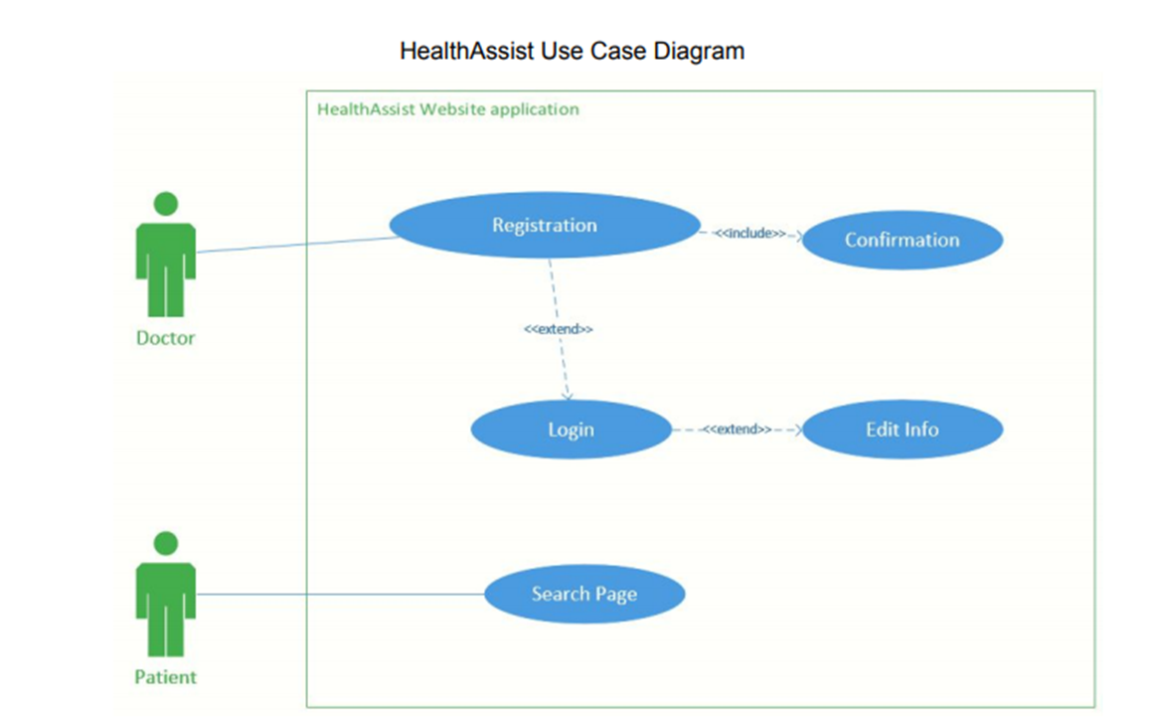

Slide 4
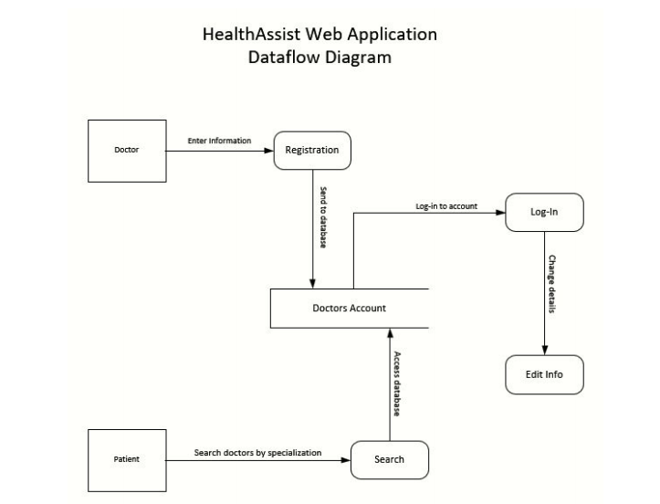

Slide 5
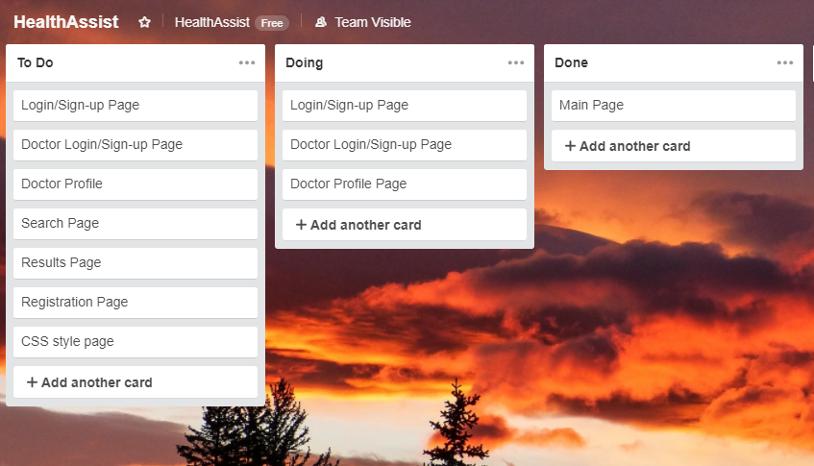
Trello IMPLEMENTATION
While working on this project our team used the project management tool TRELLO.
This allowed us to set up various objectives such as To Do, Doing and Done.
The image to the right shows our progress in the early stages of the project.

Slide 6
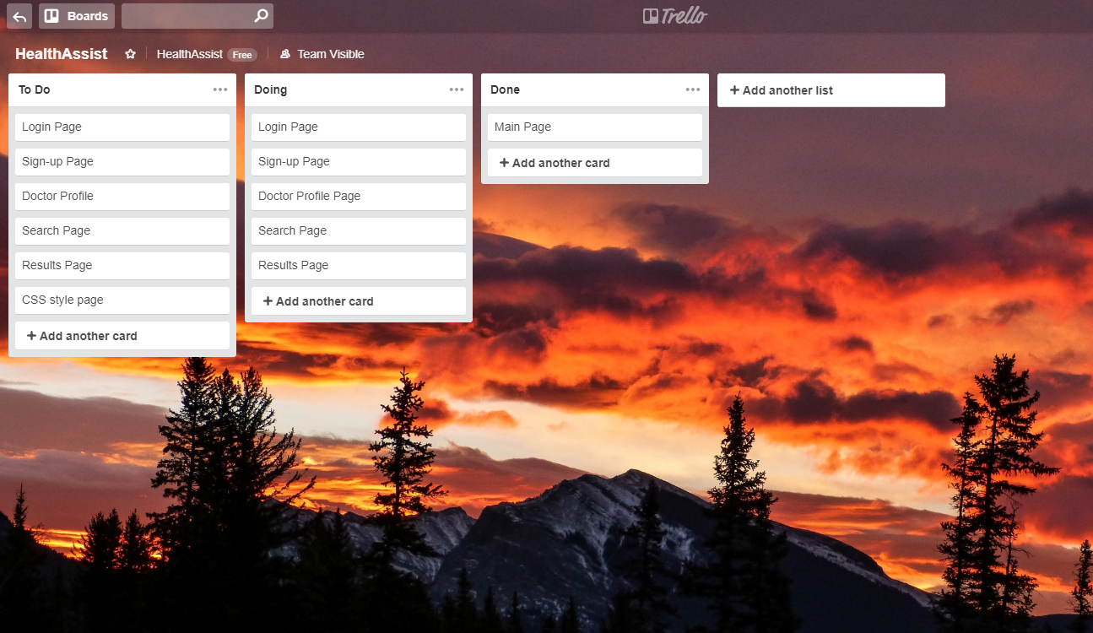
Trello Update
Here is an our TRELLO page after it has been updated.
As more items begin to get worked on, they are added to the Doing section.
Any items that are done will be added to the Done section.

Slide 7
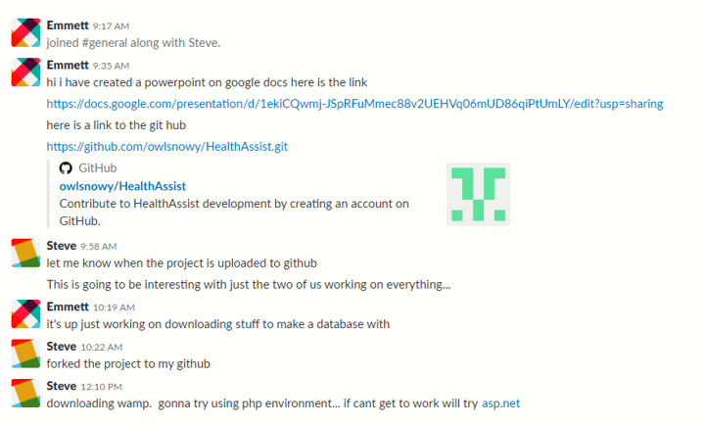
Slack Implementation 1
The following slides include screenshots of Slack in use and a example of the Slack Trello application integration.
We implemented the web-based chat service Slack to allow for effective communication between team members.

Slide 8
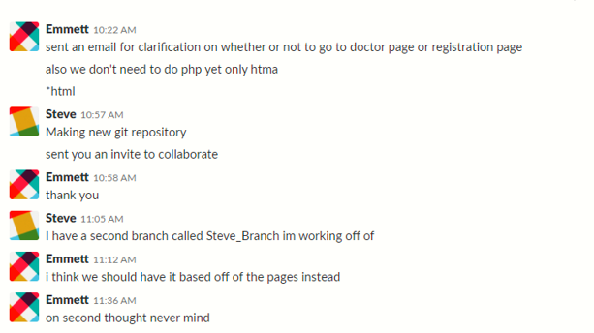
Slack Implementation 2

Slide 9
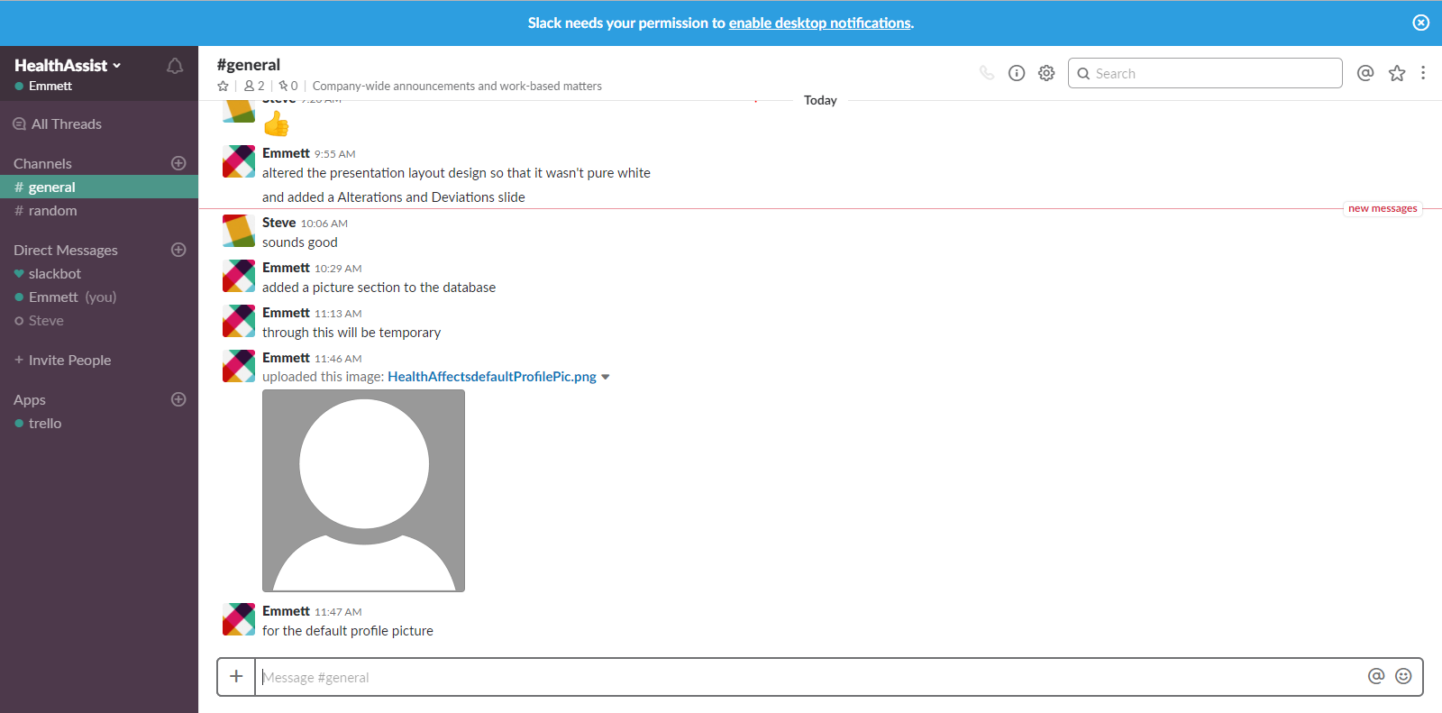
Slack Implementation 3

Slide 10
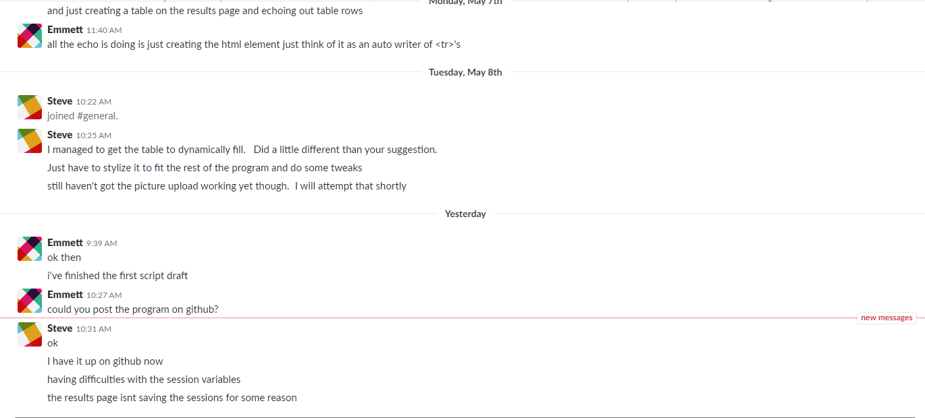
Slack update
Insert picture here

Slide 11
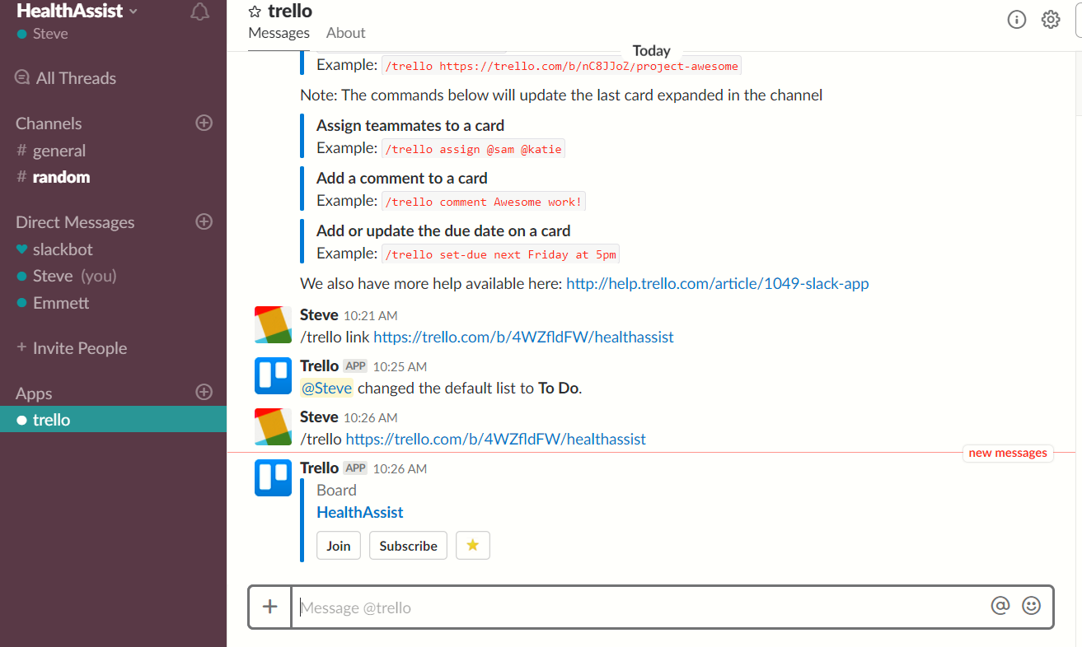
Trello Slack integration
Slack allows the addition of third party applications which has allowed us to implement a Trello application
This allow us to see when there are changes made to the Trello board.

Slide 12
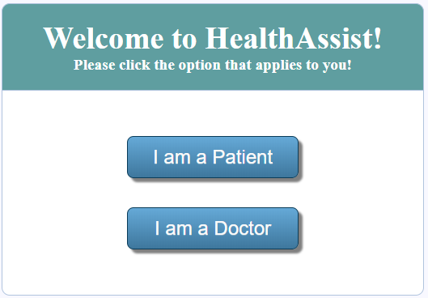
Home Page
This is the home page from here the user can chose the button that applies for them.
The doctor button leads them to the doctor page.
While the patient page leads them to the search page.

Slide 13
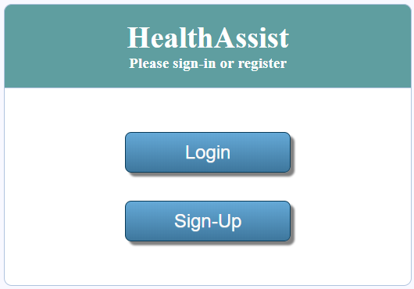
Doctor Page
This is the doctor page from here a doctor has two options:
The first option is if the doctor has an existing account they can choose to login in and edit their profile.
The second is a doctor without an existing account can select sign-up and create an account.

Slide 14
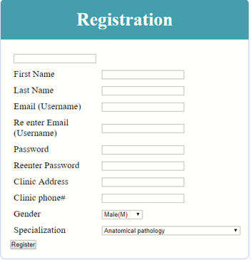
Sign-UP/registraion page
This is the sign-up/registration page. Here a doctor can sign-up to Health Assist by entering all of their information and pressing the register button.
If a field is not filled in the user won’t be able to continue until they are. (a message will let the user know this).
Also, if the email and confirm email inputs don’t match there will be a warning message and the user will be prevented from registering until they do.
This is the same for password/confirm password

Slide 15
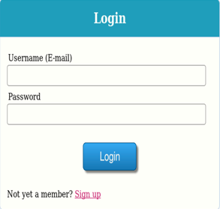
Login page
This is the Login page for registered users (doctors).
Once a doctor is registered they can input their login information here and press the login button which brings the user to the profile page.
If they aren’t registered they can select the sign up link to bring them to the signup page.

Slide 16
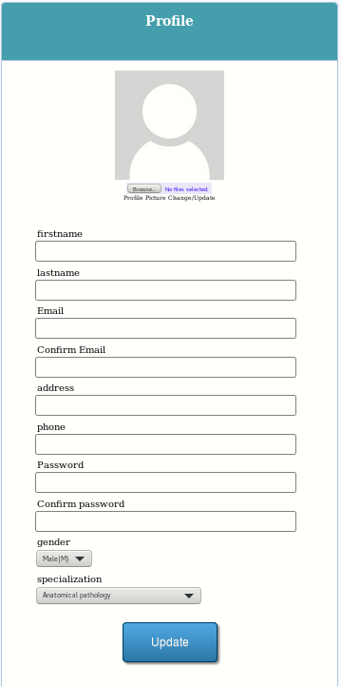
Profile Page
This is the profile page.
Once a user registers they can log in which will send them to this page.
Here they can update their information and add a profile picture.
When the update button is pressed, the database will be updated with the corresponding information.
(Currently an image file can be uploaded to the profile, but it is unable to be saved in the database.)

Slide 17
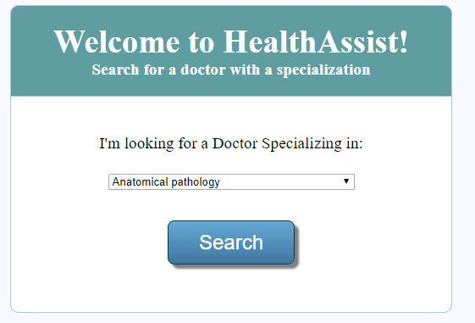
Search page
The search page allows the patient to select their desired specialization from the drop down list.
After selecting their desired criteria they can click the search button to have the results page.

Slide 18
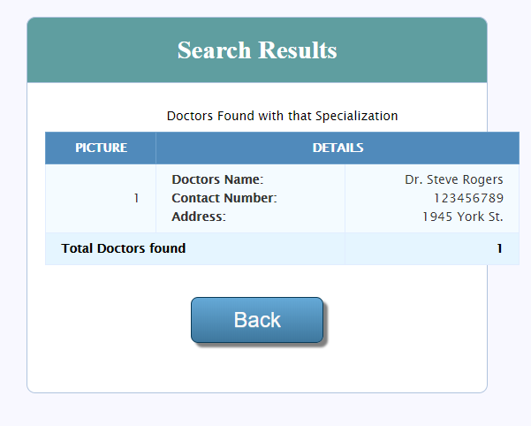
Results Page
This page displays the results of the patient’s search which will be displayed in a readable format.
The user can use the back button to get back to the search page.
(please disregard the graphical bug)

Slide 19
GitHub implementation
We have created an online GitHub repository and have linked it with a local repository to push changes from.
We have added all the developers as contributors to the project and are currently running through individual branches for each developer
The branches will be merged into the final project at project completion.
The branch that was used for this presentation is Emmett_Branch2
Link to GitHub:
https://github.com/KeanConfed/HealthAssist

Slide 20
Alterations and Deviations/Assumptions
The second week plan contained things altered from the initial SRS document as such we have decided to go off of the specifications in the SRS instead of the second week document.
The things changed are the “I am a doctor” button going to the doctor page instead of going to the registration page. This is in order to not make the doctor page missed which would render logging in useless.
Additionally due to our inability to fix a bug with the picture system we aren’t currently allowing people to save custom profile pictures.

Slide 21
Recommendations for the future
Our recommendations for the future are a slightly longer timeline for testing and time to fix bugs found during said testing.
As well as time to finish the unfinished parts for the program.
Some fixes that need to be considered are:
Profile image needs the default image as well as the ability to save to the database.
Implement proper security
Any bug fixing that is needed
Any other issues that are discovered while in the testing phase

Slide 22
The end!!
The End of our PowerPoint
Thank you!

