Slide 1
Intake count by Week Day
Outcome count by Week Day
Bar Plot
Animal Intake in Shelter vs Week Day
Bar Plot
Animal Outcome in Shelter vs Week Day
Filter
Animal Type
Count (y-axis)
Dropdown menu
Count (y-axis)
Week day (x-axis)
Week day (x-axis)
Animal Age Histogram
Box Plot
Histogram Plot
No. of Animals by age
Box Plot
Time spent in Shelter vs Animal type
Filter
Filter
Animal Type/ Year/
Intake_type
Time spent in Shelter (y-axis)
Intake_condition
Count (y-axis)
Dropdown menu
Dropdown menu
Age (x-axis)
Animal Type (x-axis)

Slide 2
Intake/Outake with time
Line Plot
Count of Intake/Outake with Time
Intake/Outake(y-axis)
Time (Month) (x-axis)

Slide 3
Distribution of Dog Age
Point Plot
Time spent in Shelter vs Age coloured on Cat and Dog
Time Spent in Shelter (y-axis)
Distribution of Cat Age
Age (x-axis)

Slide 4
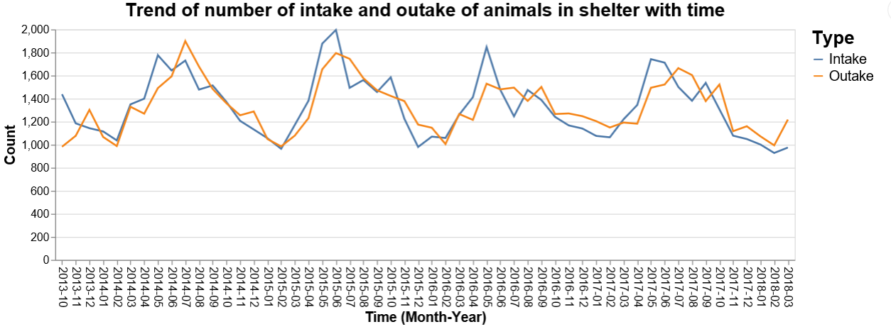
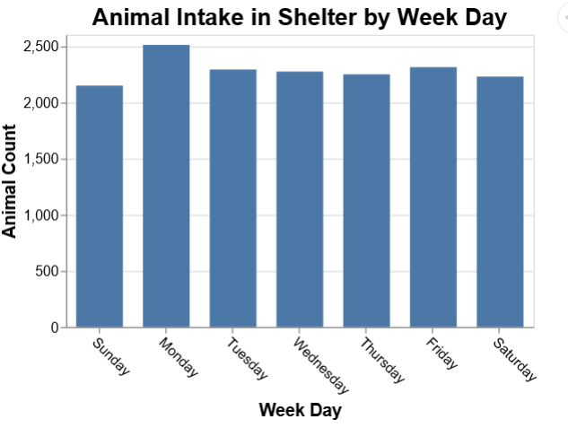
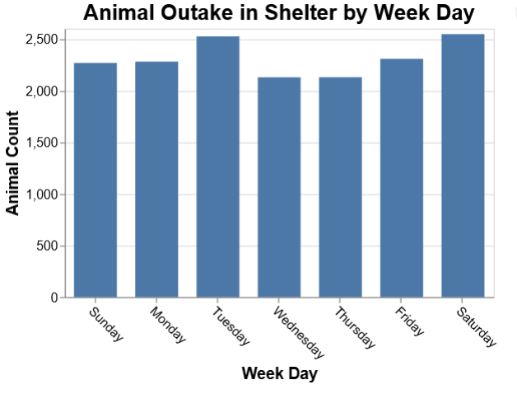

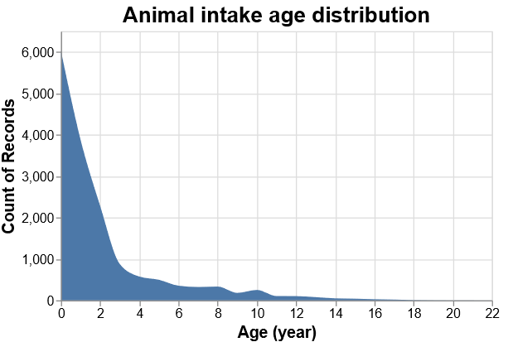
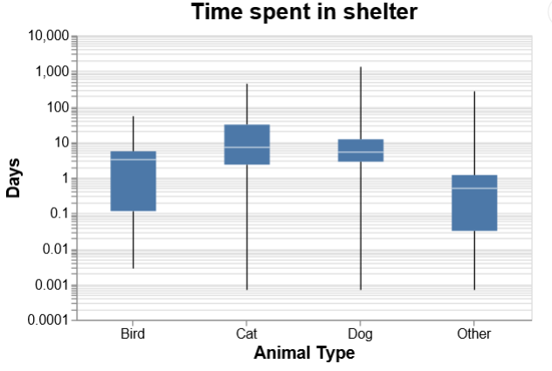


Slider to provide common filter to all graphs on year
Year
2013
2014
2015
2016
2017
2018
2019
Select Option
Dog
Cat
Bird
Other
Drop down option to select animal type for the top two plots
Dog
Normal
Cat
Sick
Bird
Aged
Other
Injured
Pregnant
Radio Button to change option for animal type of left plot
Radio Button to change option animal intake condition of right plot

