Slide 1
HuBERT 4 Zeebees

Slide 2
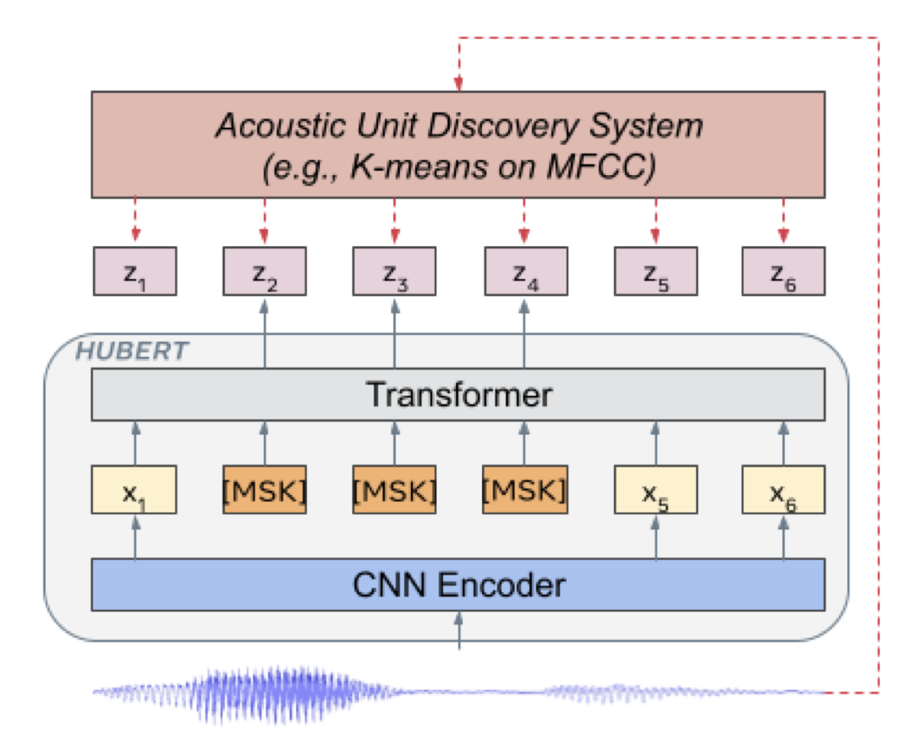

Pre training - iteration 1 (250k steps)
Objective: Learning the CNN encoder’s and the Transformer’s weights to correctly predict the labels z_{i} of both masked (MSK) and unmasked (X₁, X₅,…) time frames of input sound as represented by a convolutional waveform encoder (CNN Encoder).
z_{i} belong to [C], the C-class categorical variable
In our case [C] is obtained by applying k-means on 10ms snippets of spectrograms
In Hsu 2021, [C] is obtained by applying k-means on the 39 MFCC features of 20ms snippets of sounds
#clusters in k-means = 100
Parameters:
p% of time steps selected as start indices of masks (p=8% in Hsu 2021); p=10%
l steps is the span of masked steps (l=10 in Hsu 2021)
⍺ weight parameter of the weighted sum between the Loss calculated on MSK steps (L_{M}) and the loss calculated on unmasked (L_{U})
20 ms framerate (Hsu et al 2021)
25ms frame size with 20ms hop

Slide 3
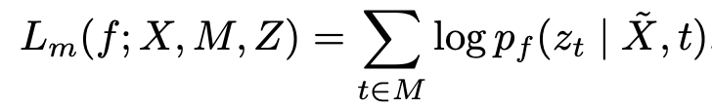
Pre training – Loss functions
Corrupted = masked X
Time steps
Predicted label
All masked time steps
⍺ = 0 <-> learning process limited to mimicking the clustering model
⍺ = 1 <-> process forced to learn from both the acoustics of U segments and the long-range temporal structures
Adam optimizer -> Beta = (0.9, 0.98)

Slide 4
Pre training – Loss functions
Corrupted = masked X
Unmasked X
L_{U}
X
Time steps
Predicted label
All masked time steps
All unmasked time steps
⍺ = 0 <-> learning process limited to mimicking the clustering model
⍺ = 1 <-> process forced to learn from both the acoustics of U segments and the long-range temporal structures
Adam optimizer -> Beta = (0.9, 0.98)

Slide 5
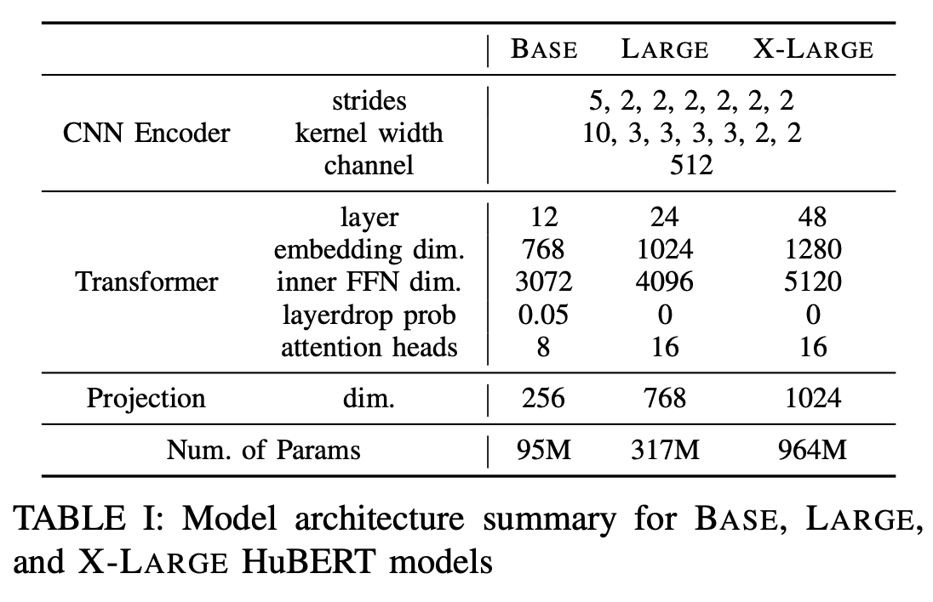
Pre training
Fine Tuning
7 layers
Randomly initialized softmax layer of dim 29 (CTC target vocabulary)

Slide 6
Pre training – iteration 2 (400k steps)
Objective: iterative refinement of cluster assignment. Learning the CNN encoder’s and the Transformer’s weights to correctly predict the labels z_{i} of both masked (MSK) and unmasked (X₁, X₅,…) time frames of input sound as represented by a convolutional waveform encoder (CNN Encoder).
z_{i} belong to [C], the C-class categorical variable
After one iteration [C] is obtained by applying k-means at some intermediate (6th) transformer layer of the first iteration model (Dim 768 for BASE) fitted on 10% of the data
#clusters in k-means = 500
Transformer layer
20 ms framerate (Hsu et al 2021)

Slide 7
Fine tuning of transformer weights
Connectionist Temporal Classification
29 Dim
Objective: Fine tuning the BERT weights to achieve Automatic Speech Recognition (ASR) in Hsu et al 2021, using the Connectionist Temporal Classification (CTC) loss.
Fine tuning
Frozen
Audio books

Slide 8
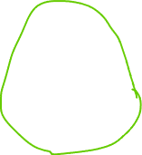




= 1 spectrogram of 25ms duration, 1kHz sampling rate

Slide 9
Let’s set mask_length = 3 which corresponds to masks of 25*3 = 75ms
Let’s keep the mask_prob to 0.8

