Slide 1

A unified travel assistant for Klang Valley– Discover KV
Team Members:
1. Kearney Leith Julius
2. Adam bin Azuddin
3. Nabil Irfan bin Muhamad Sakowi
4. Teo Tze Hong
5. Muhammad Amir Firdaus bin Mohd Kamal

Slide 2
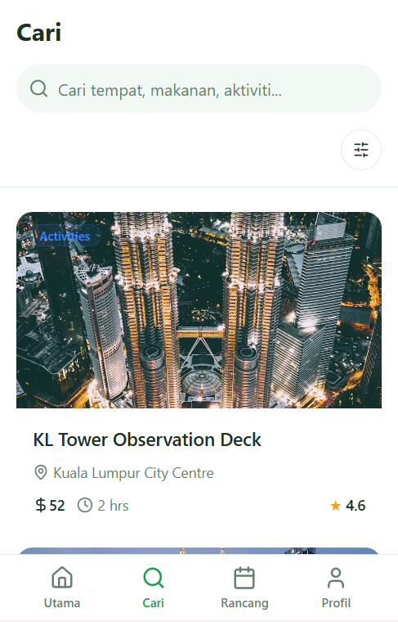
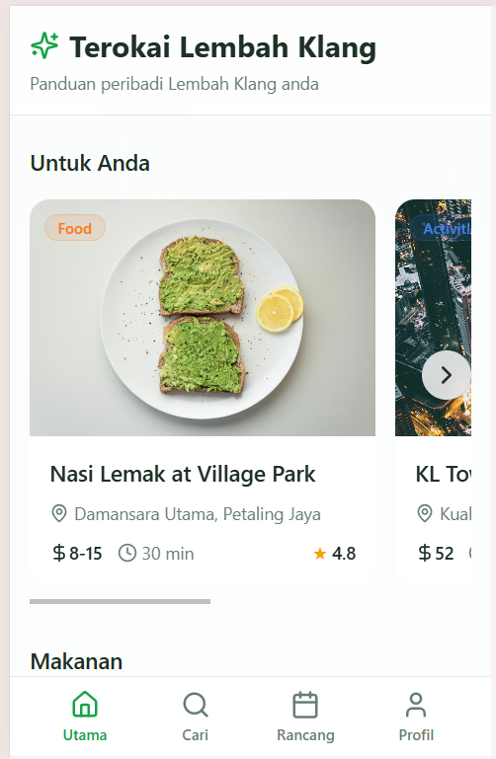
First look on the UI

Slide 3
Tourists face multiple challenges when visiting Klang Valley
Don’t know where to go, what to eat, or how to travel
Confusing ticket prices (MyKad vs Non-Malaysian)
Long queues for ticketing
Navigation difficulty without transport
Dietary restrictions (Halal/Vegetarian) limits food choices
Lack of guides → hard to learn the history of a place

Slide 4
Target Users
International tourists
Local Malaysian tourists (with MyKad)
Anyone needing easy navigation and fast planning

Slide 5
Our Solution
We centralize the entire Klang Valley experience
One-stop guide for attractions and food
Clear MyKad vs Non-Malaysian ticket price display
Online booking links to skip queues
Transport navigation with station suggestion + walking time
Religion-based food filters (Halal / Vegetarian first)
AI spot recognition: upload a photo -> get history/description instantly

Slide 6

System Architecture (pt1)
React Frontend
Login (with religion selection)
Search & filtering
Attraction/Food details
Daily itinerary generator
Image upload for AI recognition

Slide 7
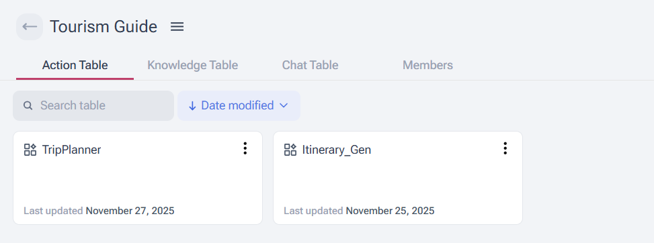
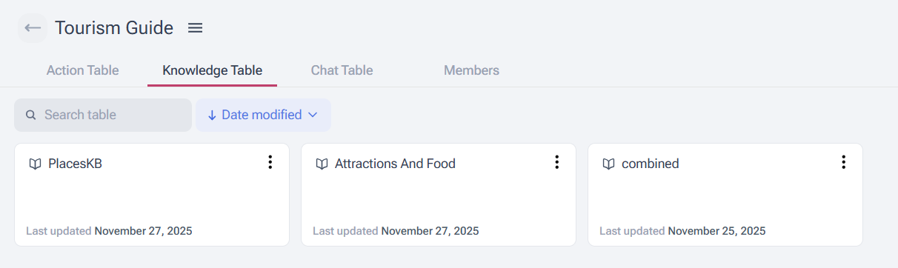
System Architecture (pt2)
Jamaibase Backend
Tourist spot DB
MyKad vs Non-Malaysian pricing
Transport info (LRT/MRT)
Religion tags (Halal/Vegetarian)
User history & preferences

Slide 8

System Architecture (pt3)
AI Layer
Recommendations
Itinerary generation
Image recognition + historical explanation

Slide 9
Data Flow
User interacts with React
React sends queries to Jamaibase
Jamaibase returns:
Tourist data
Prices
Food recommendations
Navigation info
AI processes results --> React displays personalized output

Slide 10
Lists of Features
Feature 1: Smart Prediction & Filtering
Feature 2: Daily Trip Planner (AI Itinerary Generator)
Feature 3: Image/Text Spot Recognition
Feature 4: User History Tracking

Slide 11
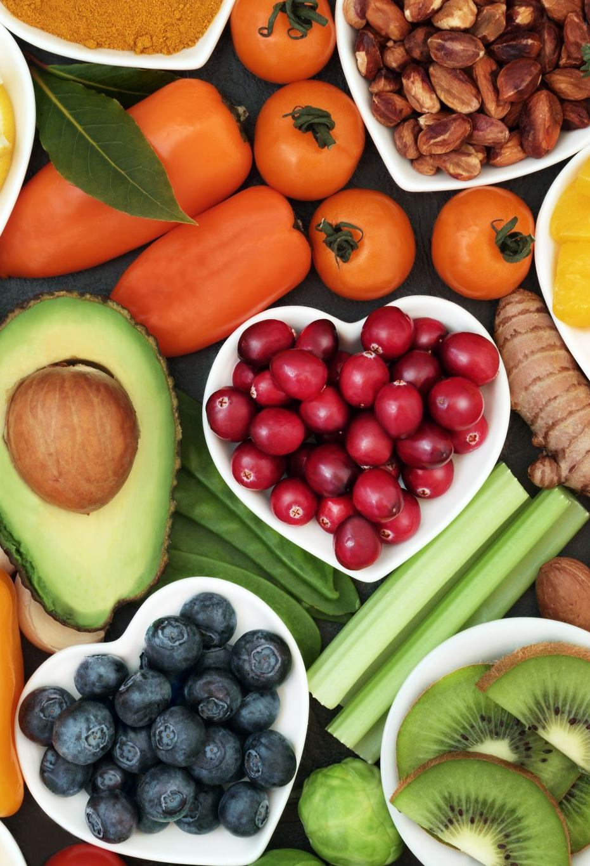
Feature 1: Smart Prediction & Filtering pt1
Users can filter by:
Food / Attraction
Price range
Dietary needs (Halal / No preference)
Opening hours (closed places pushed down)

Slide 12

Feature 1: Smart Prediction & Filtering pt2
System predicts what users want during:
Past searches
Dietary requirement
Time of day vs operating hours

Slide 13

Feature 1: Smart Prediction & Filtering pt3
Each result shows:
Title
Location (district, city)
Price range
Status: open/closed with disclaimer

Slide 14
Feature 1: Smart Prediction & Filtering pt4
Tap result -> Full details:
Description
Price range (food)
Halal status
Ticket breakdown (attractions)
Online booking links
How to get there (AI generated)
Address
Operating hours + current status

Slide 15
Feature 2: Daily Trip Planner (AI Itinerary Generator)
User selects start time -> System generates:
Full daily schedule
Optimized attraction/restaurant sequence
Must-try nearby food
Travel time estimation
Same detailed info format as Feature 1
Makes trip planning fast, simple. And personalized

Slide 16
Feature 3: Image/Text Spot Recognition
User enters text or uploads a photo -> system identifies place and returns:
Name of tourist spot
Description
Historical background
Cultural significance
Acts as a personal “digital tour guide”.

Slide 17
Feature 4: User History Tracking
Stores:
Previously viewed places
Past searches
Old itineraries
Used for:
Faster suggestions
Personalized recommendations
Smarter ranking of results

Slide 18
Feature 5: Backend Integration
Frontend (React stacks)
Login + preference setup
Filtering system
Suggestion UI
Itinerary view
Image recognition page
Backend (Jamaibase)
Stores:
Tourist spots
Food data
Prices
Transport routes
Operating hours
Religious tags
Descriptions & history
User profile + history

Slide 19
Closing Statement
A complete, centralized travel companion that solves the major pain points of Klang Valley tourism – discovery, pricing, transport, food, culture, and itinerary planning – all powered by AI.

