Slide 1
Identification of Similar Differential Expression Genes between Schizophrenia and Autism Spectrum Disorder Patients
Keaton Banik

Slide 2

Schizophrenia (SCZ)
“A server mental disorder, schizophrenia causes hallucinations and delusions leading to a significantly decreased quality of life”
Almost entirely a mystery to the scientific community
Heritable
Gene Expression Array Comparisons elucidate potential candidate mechanism loci

Slide 3

Autism Spectrum Disorder (ASD)
Well studied neurological and developmental disorder
Communication difficulties
Repetitive behaviors and restrictive interests
Symptoms that affect all aspects of life
Aberrant interpretation of the world around them, like Schizophrenia

Slide 4
PREVIOUS STUDIES
Bipolar Disorder and Recurrent Major Depressive Disorder Gene Comparisons
Revealed FK506 binding protein, prostaglandin E synthase 3 and BCL2 associated athanogene 1 expression similarities to SCZ
Success in samples from prefrontal cortex, hippocampus, and cerebellum
Can we do the same with ASD?

Slide 5
Objective
→ Push the search for schizophrenia mechanisms using RNA-seq data and autism spectrum disorder differential gene expression analysis

Slide 6
AIMS
Goal 1)
Currate dataset of both samples types and controls
Goal 2)
Identify common regions in the transcriptome that have the same expression levels to each other and different from controls

Slide 7
METHODOLGY
1
2
3
DATA COLLECTION
ALIGNMENT
CLUSTER
- SCZ
- ASD
-Controls
- Kallisto
-SLEUTH

Slide 8
METHODOLGY
Gene Targets for SCZ Pathogensis Studies
4
5
DIFFERENTIAL EXPRESSION
GENE ANNOTATION
- SLEUTH
- Top 10%
- Annotation Reference Table

Slide 9
WORKFLOW
Output Gene Candidates
SCZ →ASD
SCZ →Controls
ASD →Controls

Slide 10
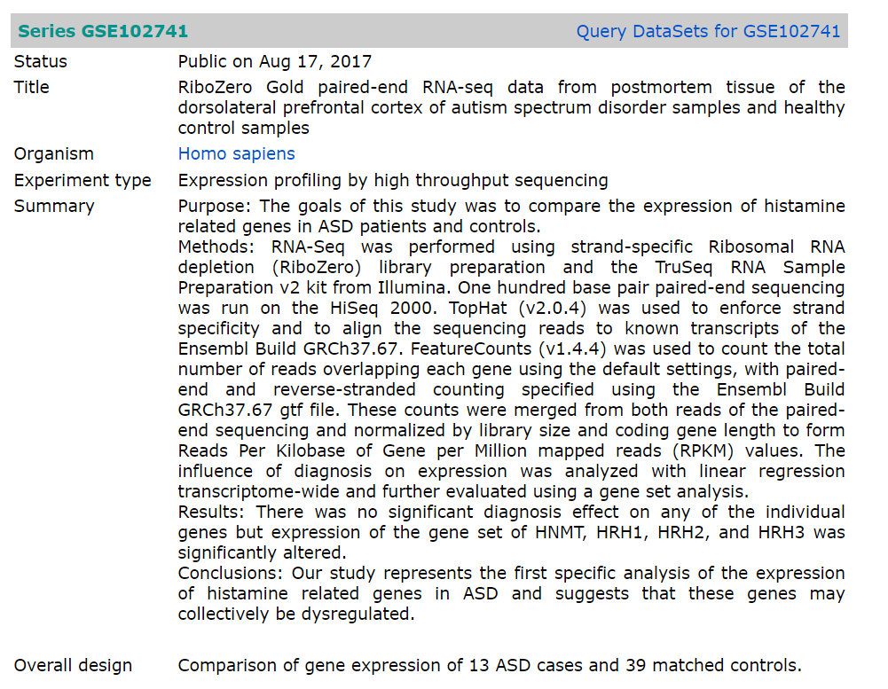
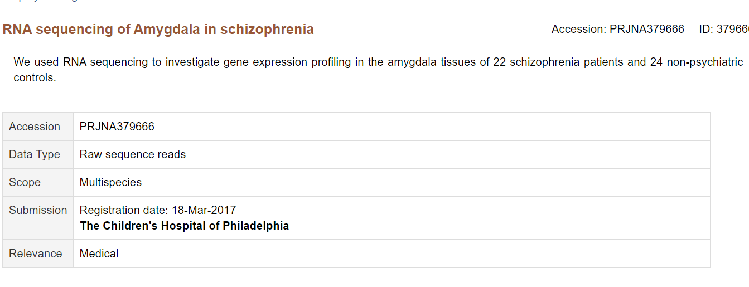


CURRENT DATA
SCZ
ASD

Slide 11
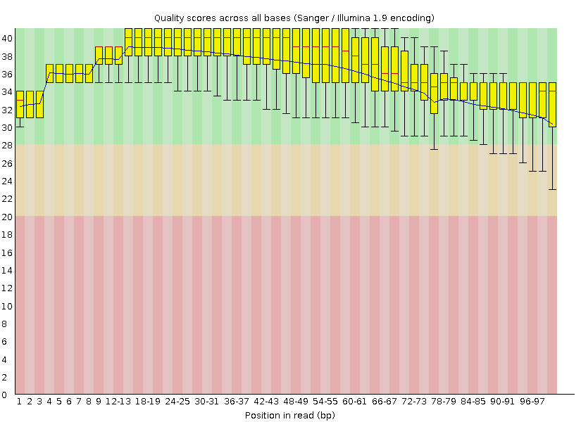
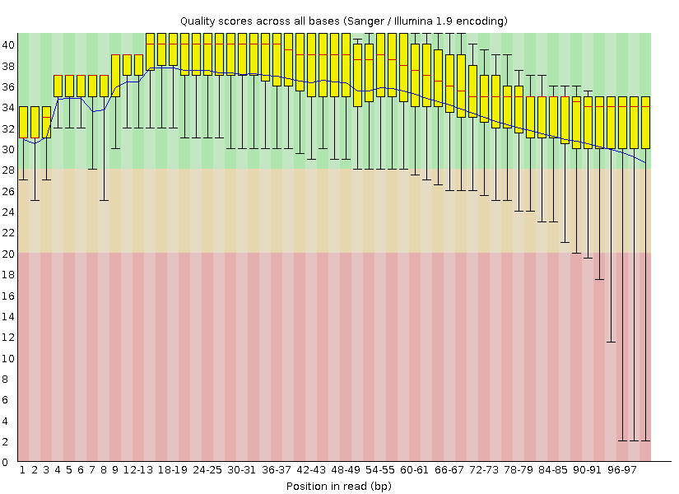
SCZ QUALIY CONTROL (Test Read)
FORWARD
REVERSE

Slide 12
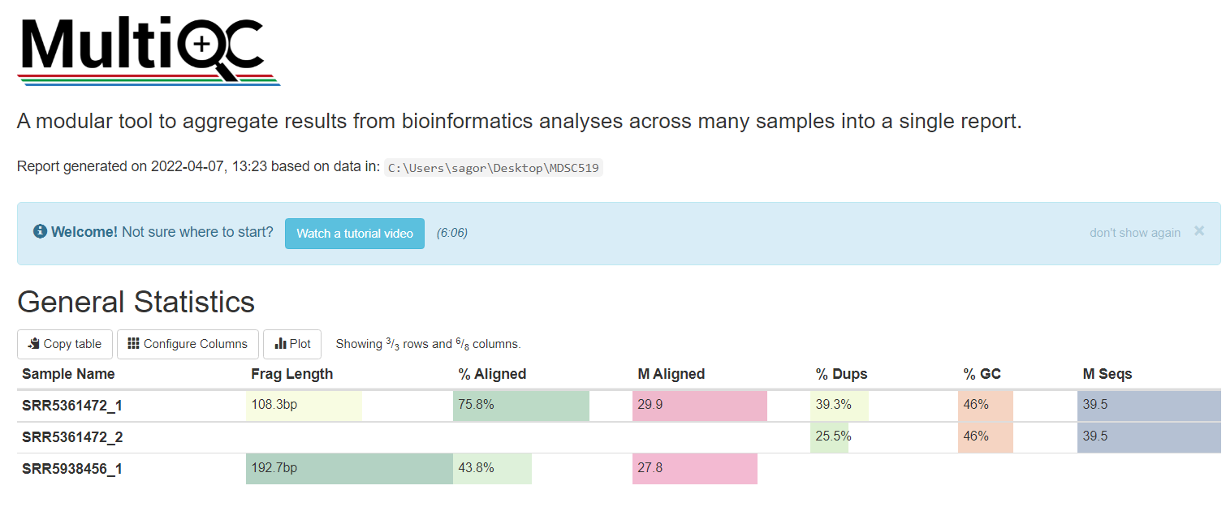
SCZ/ASD QUALIY CONTROL

Slide 13
TO-DO
QC ASD + CONTROLS
ALIGN SCZ + ASD
ALIGN CONTROLS
SRA toolkit
FastQC
- Kallisto
- Kallisto
PCA CLUSTER
DIFFERENTIAL EXPRESSION
GENE ANNOTATION
- SLEUTH
- SLEUTH
- SLEUTH

Slide 14
THANKS
DO YOU HAVE ANY QUESTIONS?

