Slide 1
A New Way to Work
The Resonant Organization
A New Framework for Scaling High Performance Teams
First Date: 6/26/25
By Keaton Smith

Slide 2
The Problems
Attrition: Lack of meaningful engagement leads to work becoming something to escape from.
Stagnation: Lack of anywhere to grow towards long term makes for poor career planning.
Grind: Burnout. Some members of the team shoulder the slack for others, and in doing so lose long term stability.

Slide 3
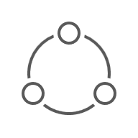


The Solution: The Pirouette Framework’s Resonant Organization
Inspired by Physics, Designed for Business:
The Pirouette Framework models teams not as cogs in a machine,
but as resonant systems that can self-tune.
From Top-Down Control to Triaxial Alignment:
Instead of imposing rigid processes, we align teams along three core principles to achieve a state of collective "flow."
The Goal - Freedom in Fractal Scalability:
Create teams that are like Lego blocks. Modular, stable, and able to combine into larger structures without breaking.
$$T_{a}$$
Γ
$$K_{i}$$

Slide 4
The Attrition: We solve it with Accessibility
$$T_{a}$$
Technology:
The new application interface being developed for live production gives new visibility, tools and features for allowing focus on workflow.
People:
Each representative, agent or conversationalist has a role, place and function within our network of people.
Shared Vision:
Aligning Agent goals to our own drives efficiency. By aligning the agent goal more closely with our needs we invite success.
Γ
$$K_{i}$$

Slide 5
The Stagnation: We solve it with Pathways
$$T_{a}$$
We stratify our CSRs into Nodules:
This allows for there to be additional promotion structure. Imagine CSR I, II and III.
We classify stratifications as roles:
This means we promote based on ability, and ability type.
We collect our opportunities:
Create sales “clusters” of products we can arm outbound or inbound sales teams with.
Γ
$$K_{i}$$

Slide 6
The Grind: We solve it with Coherence
$$T_{a}$$
Friction becomes an ally:
When goals are aligned friction faces the same direction, reducing our workload by having agents solve problems in bite-sizes.
Goals become mazes, not mountains:
By making training, QA and even call flow “laminar” through manipulating physics, we can achieve things that look impossible.
Gathering knowledge becomes gravity:
Setting up processes that naturally harvest the rich data landscape we inhabit makes Ttec a data broker without having to use client APIs.
Γ
$$K_{i}$$

Slide 7
The Structure: Modular Teams
Interface Nodule
Support Nodules
Core Nodule
Core Nodule
Feedback Nodule
Core Nodule
Interaction
Support
Production
A Self-Correcting Unit: It trains itself, integrates itself, QAs itself.
Interface Nodule: Traditional “TL” but more like “Lead Agent” in scope.
Feedback Nodule: Metrics, Measurement and Motive.
Core Nodule: Drive the work. Produce sales. Keep adherence high.
Support Nodule: Train, Evaluate and Uplift the Team.
Fractal by Design: This 7-person pattern is the fundamental unit that replicates across the organization, ensuring coherence as you scale.

Slide 8


Explanation: The Pirouette Framework
$$T_{a}$$
The Pirouette Framework is a Physics‑inspired model of coherent systems.
Three core parameters govern dynamics:
Time‑Adherence (Tₐ) – temporal coherence
Gladiator Force (Γ) – boundary permeability
Ki (Kᵢ) – intrinsic rhythm / cycle
In business, these map to execution cadence, structural agility, and growth cycles
There are math equations assigned to the measurement of each. Detail can be provided (too much).
Time Adherence
(execution cadence)
Gladiator Force
(structural agility)
Γ
$$K_{i}$$
Ki
(Growth Cycles)

Slide 9
Explanation: The Pirouette Framework
$$T_{a}$$
Time-Adherence: Workflow Coherence
The Question: Are we hitting every green light,
or are we stuck in traffic?
The Metric: Measures process efficiency and eliminates
systemic "wait" time.
Gladiator Force: Modular Cohesion
The Question: Are our team's walls windows or barriers?
The Metric: Balances team identity with cross-functional
collaboration, preventing silos.
Ki: Feedback Cadence
The Question: What is our team's natural heartbeat?
The Metric: Sets the optimal rhythm for work, feedback,
and planning cycles (e.g., weekly, biweekly sprints).
Time Adherence
(execution cadence)
Gladiator Force
(structural agility)
Γ
$$K_{i}$$
Ki
(Growth Cycles)

Slide 10
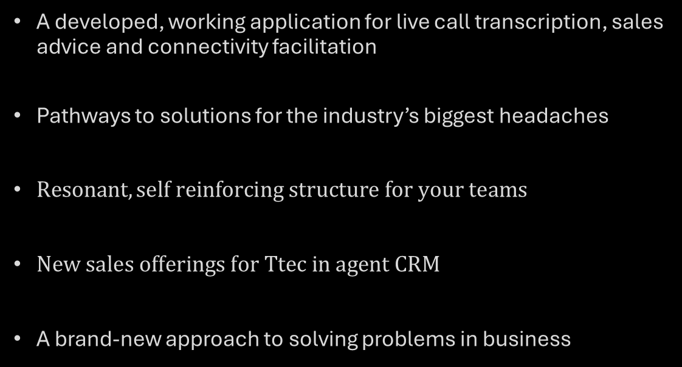
What’s In It For Me?
$$T_{a}$$
A developed, working application for live call transcription, sales advice and connectivity facilitation
Pathways to solutions for the industry’s biggest headaches
$Resonant, self reinforcing structure for your teams$
$New sales offerings for Ttec in agent CRM$
A brand-new approach to solving problems in business
Γ
$$K_{i}$$

Slide 11
What’s the Ask?
$$T_{a}$$
Select: Choose one outbound sales Frame (7 people).
2. Baseline: Measure initial Ta/Γ/Ki metrics on Day 1.
3. Implement:
Phase 1 (Unwinding): Disseminate roles to the team, allow settling.
Phase 2 (Winding): Tune the team’s dynamic through iterative control of feedback analytics.
4. Review & Iterate: Measure progress and review results on Day 15 and Day 30.
Γ
$$K_{i}$$

Slide 12
Questions?
$$T_{a}$$
Γ
$$K_{i}$$

Slide 13
A Day in the Life: The Rhythm
08:30 Morning Huddle (15 min): Whole team sync – review yesterday’s results, set daily game plan collaboratively. Team chooses a lunch period. (Establishes the day’s rhythm)
09:00–11:30 Focus Block 1: All sellers on calls; (All “in flow” – minimal interruptions.)
11:30 Quick Stand-up (5 min): Share any urgent findings. If calls going great, keep it up; if not, adjust scripts or targeting. (Immediate feedback loop.)
11:40 – 12:00 Prep & QA: support researching next prospects; feedback watching/ taking live stats; Interface and support researching leads for Core to call.
13:00–15:30 Focus Block 2: Continue outreach. Everyone knows their role for this block; same intensity, same coordination.
15:30 Debrief & QA: Short meeting to recap wins/challenges. Support starts prepping for tomorrow (e.g., compile new lead list). Feedback analyst updates the dashboard and flags anything for manager’s attention.
End of Day: Team closes together – all updates done, no loose ends. (Team “closes the loop” to be ready for next cycle.)
Breaks are team determined on a schedule. Higher sales/ adherence pick slots at priority.

