Slide 1

Smarter Together: From Bin to Neighbor Through Community Sharing and Smart Technologies for a Future-Ready Waste Collection Ecosystem
Paper ID - 862

Slide 2


Author Details
RAKK Ranasinghe is a fourth-year undergraduate pursuing a BSc (Hons) in Information Technology at the Faculty of Computing, General Sir John Kotelawala Defence University
39-bit-0039@kdu.ac.lk
Mr. RPS Kathriarachchi is a Senior Lecturer Grade II in the Department of Information Technology, Faculty of Computing, at General Sir John Kotelawala Defence University
pathum@kdu.ac.lk

Slide 3
Table of Content
Introduction
Research Questions
Aims
Objectives
Literature Review
Methodology
Findings and Discussion
Conclusion
References

Slide 4
Introduction
Urbanization and population growth increase waste collection challenges
Traditional waste collection methods are inefficient and costly - leading to overflowing bins, irregular pickups, and unnecessary disposal of reusable items
Sri Lanka lacks an integrated system that combines modern technology with community participation. Modern technologies (IoT, AI, GIS, ML, Mobile & Web Applications) offer smarter waste collection solutions
This study introduces Clea-Ro, a Smart Waste Collection System integrating IoT-enabled bins, Algorithm based route optimization, and a community sharing platform for reusable items
Importance: Tackles inefficiency, enhances engagement, reduces environmental impact, and promotes long-term sustainability
Notes:
Urbanization and population growth have made waste collection a huge challenge.
Traditional waste collection is often inefficient and costly, leading to overflowing bins and unnecessary disposal of reusable items.
In Sri Lanka, there is no integrated system that combines technology and community participation.
This research introduces Clea-Ro, a Smart Waste Collection System that integrates IoT-enabled bins, algorithm-based route optimization, and a community sharing platform for reusable items.
Its main contribution is to make waste management efficient, citizen-friendly, and environmentally sustainable.

Slide 5
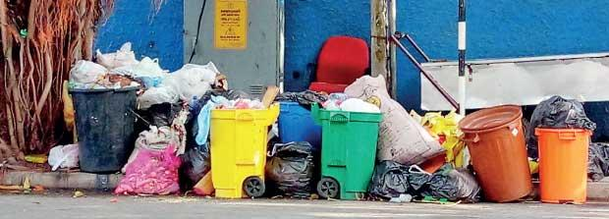
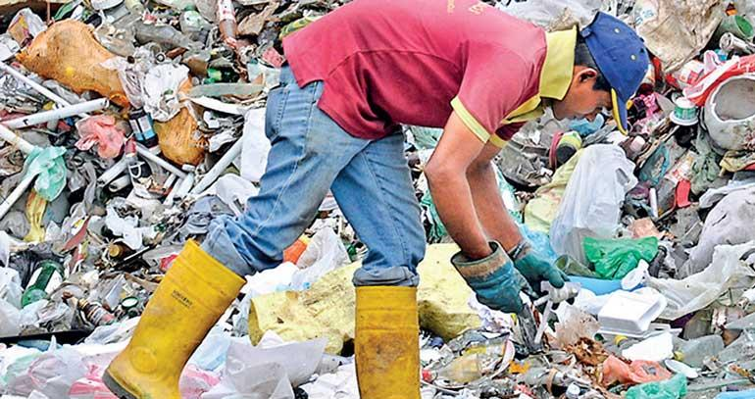
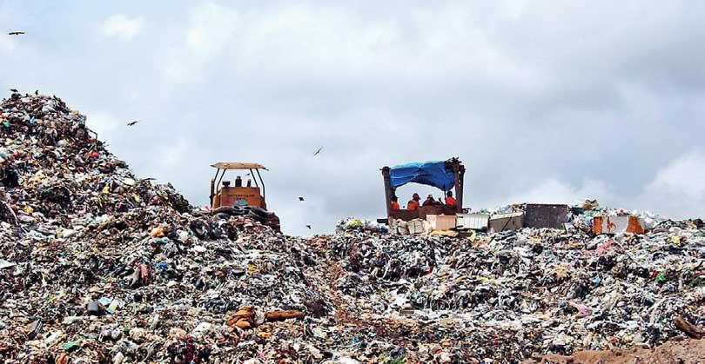
Research Questions
How can modern technologies improve efficiency in urban waste collection?
What role does community participation play in reducing waste at the source?
Can an integrated system combining smart technologies and community sharing provide a sustainable model for waste collection in developing regions?
How does user-friendly and user-centered design affect citizen participation and accessibility?
Notes:
The research was guided by four key questions:
How can modern technologies improve efficiency in urban waste collection?
What role does citizen participation play in reducing waste at the source?
Can a combined system of smart technologies and sharing create a sustainable model for developing regions?
How does user-friendly design influence participation and accessibility?

Slide 6
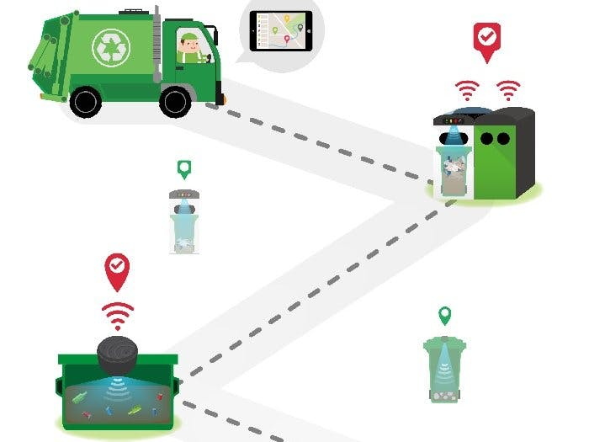
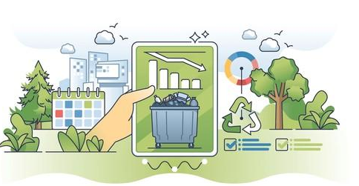
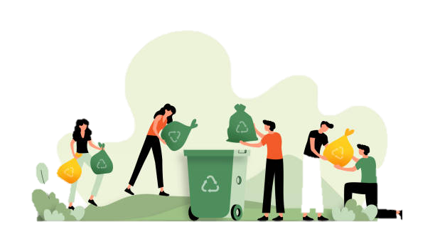
Aim
To develop an integrated smart waste collection system that enhances operational efficiency, encourages item reuse, and strengthens community participation by using modern technologies, while ensuring sustainability and providing a citizen-friendly approach to waste management
Notes:
The aim of this study was to develop an integrated smart waste collection system that improves operational efficiency, encourages item reuse, and strengthens community participation using modern technologies, while promoting long-term sustainability

Slide 7
Objectives
Analyze Traditional Methods: Identify inefficiencies in conventional waste collection, such as fixed schedules, high costs, irregular pickups, and environmental impacts
Review Modern Technologies: Explore IoT-enabled smart bins, Route optimization, and mobile/web apps for real-time interaction
Introduce Community Sharing: Enable residents to share reusable items before disposal, reducing waste at the source
Design an Integrated Framework: Develop a unified smart waste ecosystem combining IoT bins, user/driver apps, and a web platform for administrators
Promote Collaboration and Sustainability: Enhance coordination among citizens, drivers, and authorities while using real-time data and community engagement to improve recycling, reuse, and citizen-friendly waste collection system
Notes:
To achieve this aim, the study focused on:
Identifying inefficiencies in conventional waste collection, such as irregular pickups and high costs.
Reviewing modern technologies like IoT-enabled bins, route optimization, and mobile/web apps.
Introducing community sharing to reduce waste before disposal.
Designing an integrated framework that connects IoT bins, resident and driver apps, and a web dashboard for administrators.
Promoting collaboration between citizens, drivers, and authorities to create a citizen-friendly and sustainable system

Slide 8
Literature Review
Paper | Technology Used | Major Findings | Challenges/Limitations
A. Smart Waste Collection Technologies
[2],[5], [15] | IoT sensors, Arduino/ESP32, cloud storage | Real-time bin monitoring improved routing efficiency | Focused on sensing; lacked community engagement
[6], [3], [8],[14], [17] | Smart bins, GIS, auto-sorting, VRPTW, LNS algorithms, GPS, CVRP heuristics | Efficient sorting and energy recovery. Improved reporting, tracking, and user experience | Technical challenges, limited real-world use
[16], [12] | GPS, shortest path algorithm, Truck tracking | Real-time tracking, Optimized routes reduced travel time & fuel | Communication gaps, limited IoT integration
[1],[10], [11] | Mobile/web apps for scheduling, notifications, trading recyclables | Boosted engagement, aligned with sustainability goals | Not integrated with IoT or routing systems
B. Community Sharing in Waste Collection
[9],[7] [4],[1] | Web/mobile apps, marketplaces, incentive systems | Supported reuse, recycling, eco-craftsmen, and citizen awareness | Focused on economic reuse or incentives; not daily waste collection
C. Intersection: Technology + Community
[4],[16], [18], [9], [13] | Mobile/Web apps, IoT bin data, community-sharing platforms, Reporting, Optimized Routes | Improved citizen-authority communication, tracking with reduced errors, and long-term recycling behavior. Combined social innovation with waste reduction. | Limited scope; not fully integrated framework combining IoT, AI, routing, and No reuse & sharing or incentives included also not address citizen-friendly apps and web applications
Notes:
1. Smart Waste Collection Technologies: IoT sensors, smart bins, and GPS tracking improve bin monitoring, route planning, and fuel efficiency. Apps for scheduling and notifications boost engagement. However, most systems focus only on technology and lack community involvement or real-world deployment.
2. Community Sharing in Waste Collection: Web and mobile platforms, online marketplaces, and incentive systems encourage reuse and recycling. They raise awareness and promote sharing, but mainly target economic incentives rather than daily household waste.
3. Combining Technology and Community: Some studies integrate IoT, routing, and sharing, improving participation and recycling. Yet, they remain limited, missing full integration of IoT, AI, routing, community sharing, multilingual support, and citizen-friendly features.
So, There is a need for a fully integrated system combining technology, route optimization, and community participation—addressing the gaps identified in previous research.

Slide 9
Methodology
This study followed the System Development Life Cycle (SDLC) approach to design and develop the proposed smart waste collection system, Clea-Ro
Planning -Identified inefficiencies in existing municipal waste collection, including fixed schedules, overflowing bins, irregular pickups, limited citizen participation, and lack of reuse mechanisms. Defined system goals and boundaries, and conducted a feasibility study covering technical, financial, and operational aspects
Requirement Gathering and Analysis – Reviewed 50+ papers, deeply analyzed 18. Also Conducted Stakeholder interviews with municipal councils, truck drivers, residents, shop owners and revealing the need for multilingual support, community sharing features, and real-time notifications
Notes:
In Methodology, Used the System Development Life Cycle.
In the planning phase, identified inefficiencies and carried out a feasibility study.
Then gathered requirements by reviewing over 50 papers and conducting interviews with municipal councils, drivers, and residents and shop owners
This helped understand needs like multilingual support, real-time notifications, and sharing features.

Slide 10
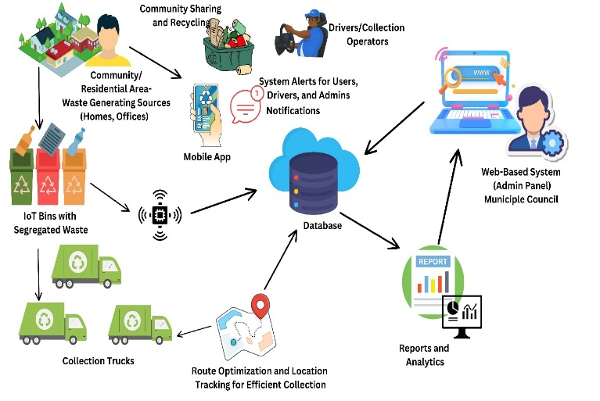
Methodology Cont.
System Design
Web Dashboard (Admins): Real-time bin monitoring, truck scheduling, route management, and reporting
Mobile App: Residents - Monitor bins, request pickups, share reusable items, receive notifications; multilingual support. Drivers - Optimized navigation and task management
IoT Smart Bins: ESP32, sensors, GPS; detect fill-level, location, tampering, and send data wirelessly
Notes:
system has three key components:
A Web Dashboard for admins to monitor bins, manage trucks, and schedule pickups.
A Mobile App for residents and drivers of garbage trucks
IoT-enabled Smart Bins with sensors and GPS to send real-time data. This 3 section combing together and providing smart framework.

Slide 11
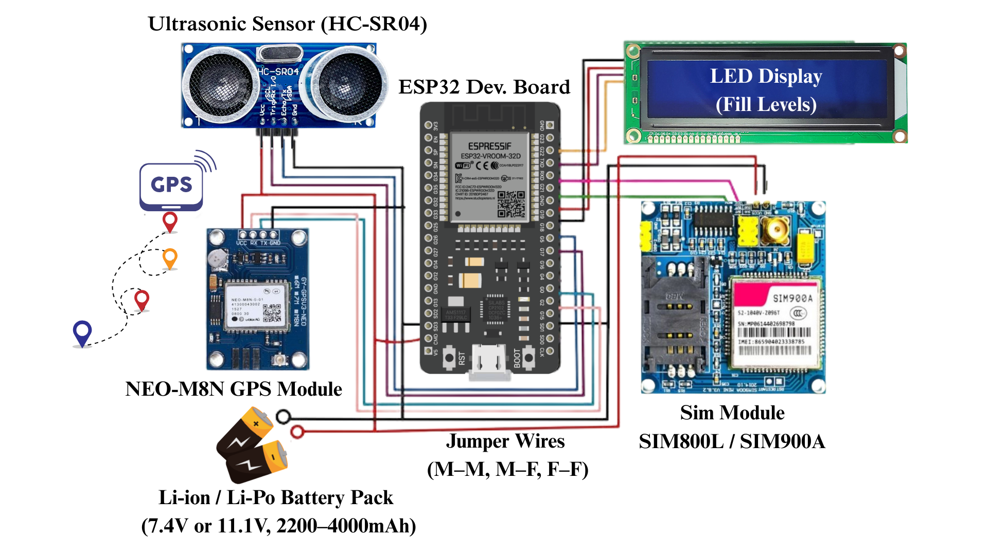
Methodology Cont.
Implementation: ESP32-based IoT bins send real-time data to Firebase. Admin panel (React) and mobile app (Flutter) support route optimization, notifications, multilingual support, and community sharing. Backend uses Node.js/Express.js with REST APIs
Testing: Testing evaluates sensor accuracy, interface usability, communication reliability, notifications, pickup scheduling, and community-sharing features. Unit, integration, and interface tests ensure all modules function correctly
Notes:
So in Implementation, Used ESP32 boards for IoT bins, Firebase for data storage, React for the admin panel, and Flutter for the app and Node js and Express.js for backend with rest APIs.
In Testing conducted unit, integration, and interface tests to ensure the system works reliably — from sensor accuracy to user interface usability.

Slide 12
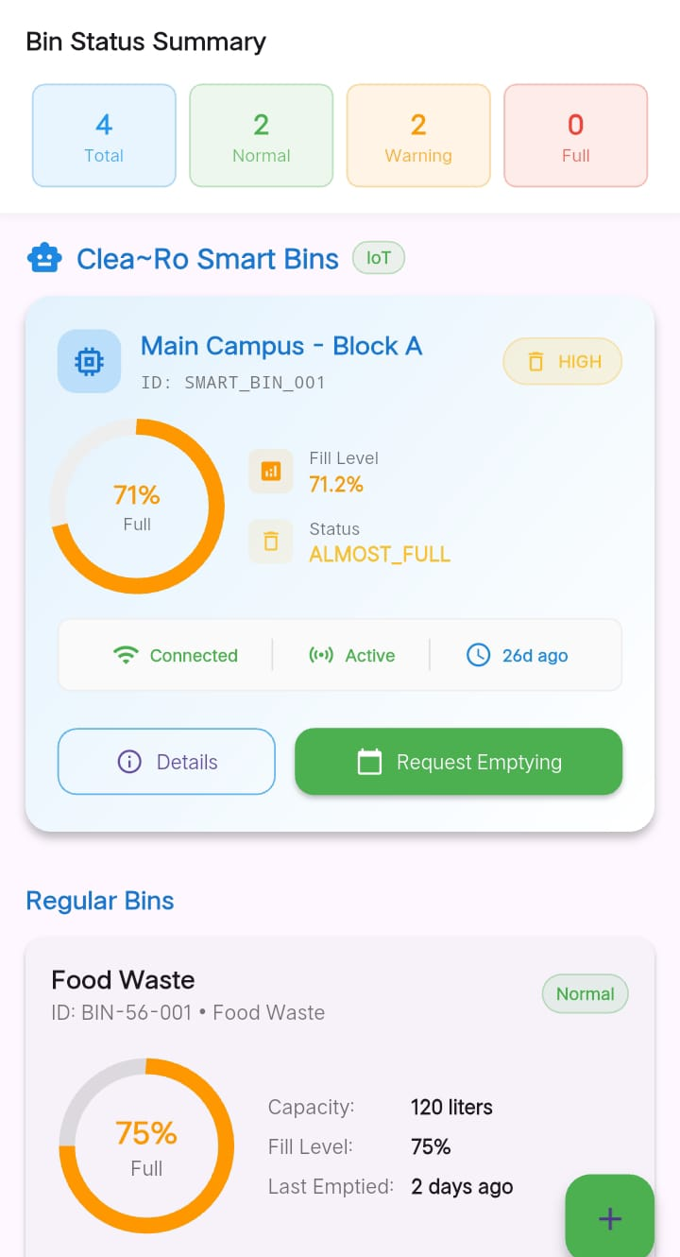
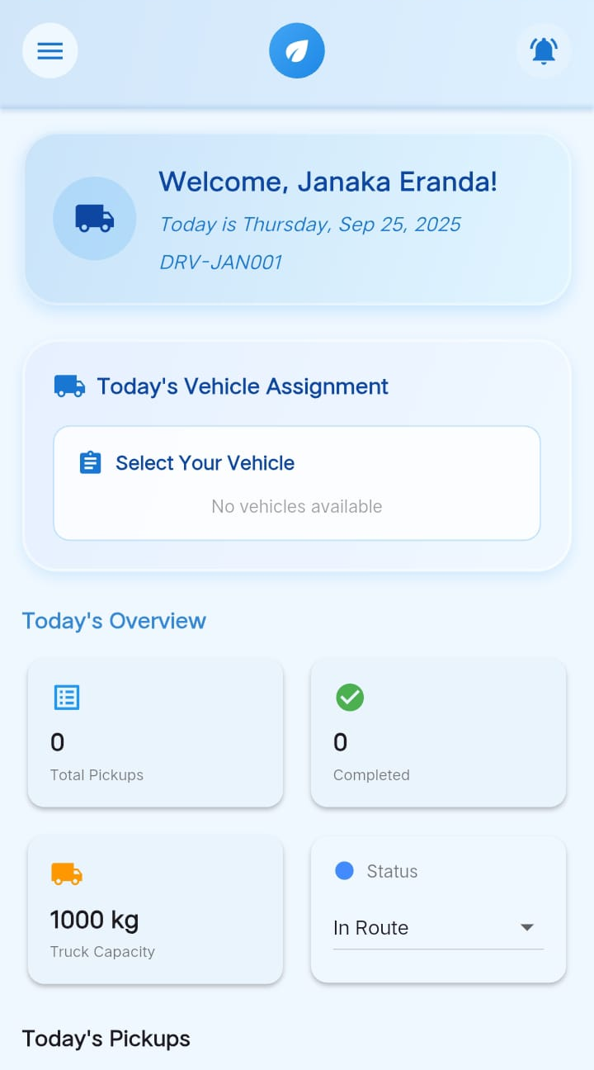
Results & Discussion
Addresses inefficiencies: irregular pickups, overflowing bins, low citizen participation
Real-Time Monitoring: Bins transmit fill-level data to server; visualized on dashboard and app; residents can request pickups proactively
Admin Dashboard: Track bins, assign routes, monitor trucks, manage feedback; Google Maps for optimized routing
Resident App: Multilingual (Sinhala, Tamil, English); monitor bins, request pickups, report issues, track trucks, access recycling tips and community sharing feature. Driver App: Optimized navigation, task updates, notifications for efficient collection
Clea-Ro combines all components into one framework, enabling smart, coordinated, and sustainable waste collection system
Notes:
This system successfully solved key inefficiencies such as irregular pickups, overflowing bins, and low citizen participation.
With real-time monitoring, bins send fill-level data to the server, which is displayed on the dashboard and app. Residents can request pickups before bins overflow.
The admin dashboard allows registering and tracking bins, assigning routes, monitoring trucks, and managing feedback — with Google Maps providing optimized routing.
The resident app supports Sinhala, Tamil, and English, letting users monitor bins, request pickups, report issues, track trucks, and access recycling tips and the community sharing feature.
The driver app provides optimized navigation, task updates, and notifications to improve efficiency.
Overall, Clea-Ro combines all these components into a single framework, making waste collection smarter, more coordinated, and sustainable.

Slide 13
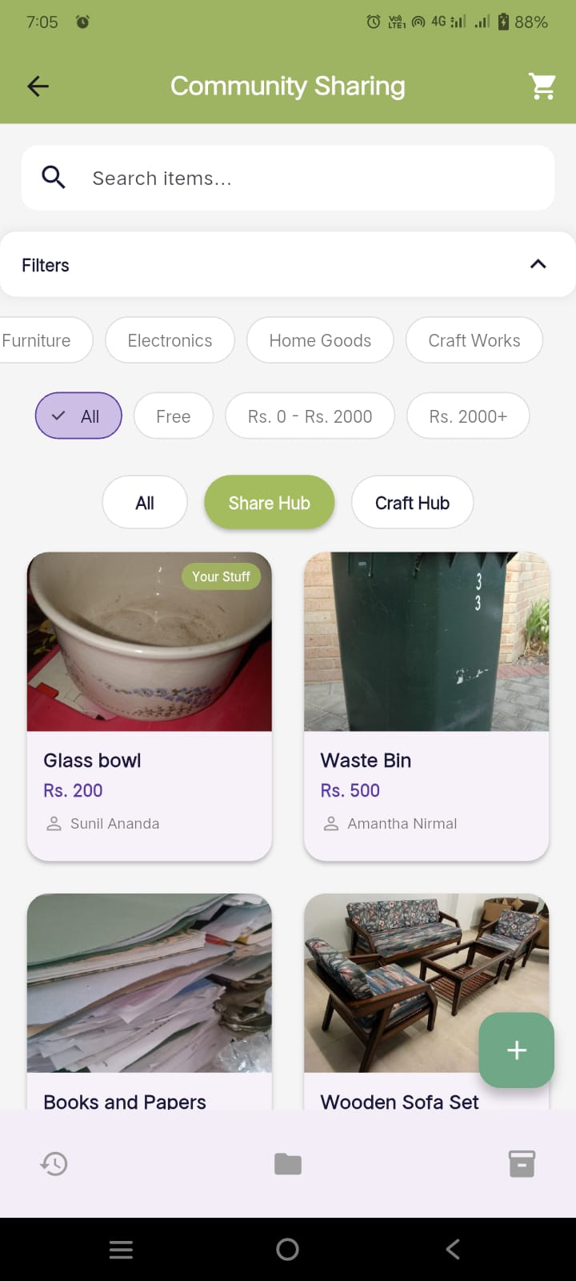
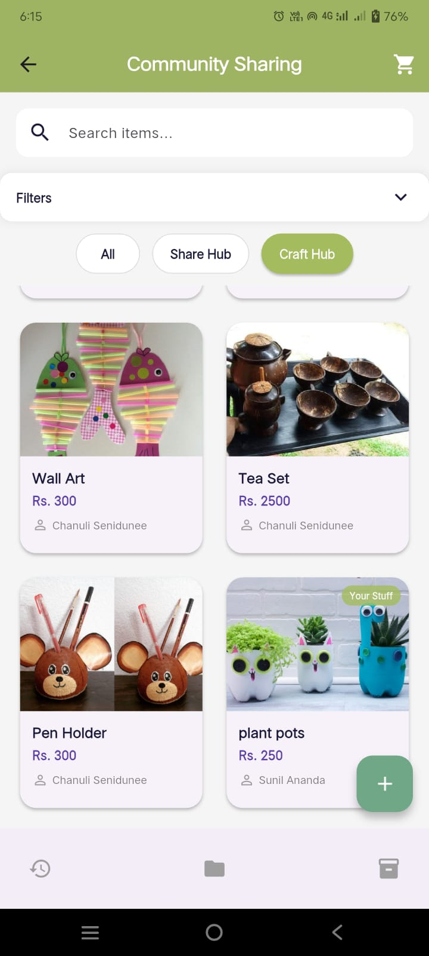
Results & Discussion
Community Sharing – Key Innovation
Enabled neighbors to claim reusable items (e.g., Home Goods, electronics, clothes) before disposal (Share Hub)
Supports chat, cart management, checkout, and reviews to facilitate smooth transactions
Includes a Creative Works section for selling products made from reusable materials (Craft Hub)
Promotes sustainability, creativity, and active community engagement
Notes:
One of the most innovative features of this system is Community Sharing.
Instead of throwing away items that are still usable, residents can upload them to the app so their neighbors can claim them.
For example, if a family replaces their dining table, they can take a photo, add details like its condition and pickup location, and post it on the Share Hub. A neighbor who needs a table can see it, reserve it, and collect it easily. This saves money, reduces waste, and gives items a second life.
Items can either be shared for free or listed for a small price. An expiry date can also be added — so if no one claims the item by that date, it can then be safely disposed of.
Residents can upload multiple photos and notes for each item, making it clear to neighbors exactly what they are receiving.
To make the process smooth and convenient, the system includes:
Chat, so the giver and receiver can coordinate pickup times.
Cart and checkout, allowing users to claim several items at once.
Reviews, to build trust and encourage responsible sharing.
In addition, there is a Craft Hub — a platform for selling creative products made from reused or recycled materials. For example, someone can turn coconut shells into tea sets or pencil holders, or create flower pots from plastic bottles and cans. These items can then be priced and sold to neighbors through the app. This motivates people not to throw everything away, but to turn waste into valuable items — encouraging creativity, entrepreneurship, and sustainability.
Overall, this feature does two key things:
Reduces waste at the source, meaning fewer reusable items end up in the trash.
Strengthens community relationships, as neighbors interact, share resources, and support one another.
This transforms waste collection from a simple municipal service into a collaborative, eco-friendly, and community-driven activity.

Slide 14
Conclusion
A future-ready smart waste collection model was developed, integrating IoT, real-time monitoring, and community participation
The system demonstrated: Improved operational efficiency, Reduced environmental impact, Enhanced citizen engagement
Unique Contribution: Introduced reuse at the source through a community sharing feature, addressing a gap in existing solutions
Challenges Identified: High setup costs, data security concerns, and scalability issues
Future Work: Develop predictive models for demand forecasting, Expand community engagement strategies, Strengthen data privacy and security mechanisms
Notes:
This study developed a smart waste collection model combining IoT, real-time monitoring, route optimization, and community sharing. It improved efficiency, reduced environmental impact, and increased citizen engagement.
The key innovation is reuse at the source through community sharing. Challenges include setup costs, data security, and scalability, and future work will focus on predictive models, stronger security, and broader community participation

Slide 15
References
Ablaza-Cruz, M., 2020. Designing a Mobile Application Framework as an Innovative IT Solution for Waste Recycling. IOP Conf. Ser. Mater. Sci. Eng., 803, 012046. https://doi.org/10.1088/1757-899X/803/1/012046
Alduais, N., Lim, E., 2024. An IoT and Web-Based System for Efficient Waste Collection and Monitoring. Appl. Inf. Technol. Comput. Sci., 5, 291–310. https://doi.org/10.30880/aitcs.2024.05.02.016
Arsita, T., Lapatta, N., Joefri, Y., Angreni, D., Pratama, S., 2025. Optimization of Urban Waste Collection Routes Using the Held-Karp Algorithm. J. Appl. Inform. Comput., 9, 202–210. https://doi.org/10.30871/jaic.v9i1.8832
Bandara, M., Udayangi, T.G.I., 2023. Bin-Eazy: Tracking-Based Solid Waste Collection System.
Chen, D.M.-C., Bodirsky, B.L., Krueger, T., Mishra, A., Popp, A., 2020. The World’s Growing Municipal Solid Waste: Trends and Impacts. Environ. Res. Lett., 15, 074021. https://doi.org/10.1088/1748-9326/ab8659
Fernando, A., Kathriarachchi, R., 2019. IoT Based Smart Solution for Waste Collection and Recycling.
Fidje, E., Haddara, M., Langseth, M., 2023. Sustainable Smart Waste Management Adoption Challenges in Developing Countries. Procedia Comput. Sci., 219, 905–914. https://doi.org/10.1016/j.procs.2023.01.366
Henrys, K., 2021. Mobile Application Model for Solid Waste Collection-Management. https://doi.org/10.2139/ssrn.3808542
Indrawan, K.W., Kristiawan, S., Zoe, T.M., Tania, S., Song, F.I., Saputra, J.N., Alam, I.N., Andryani, N.A.C., 2023. Digital Marketplace Design & Development for Creative Recycle Products. IEEE ITIS 2023, 1–6. https://doi.org/10.1109/ITIS59651.2023.10419958

Slide 16
References Cont.
Leelarathne, K., Niroshan, R.T., Kalansooriya, L.P., 2021. Optimum Waste Collection System with Smart Mobile Application.
Marković, D., Nikolić, L., Stankovic, A., Markovic, S., 2023. Hybrid Waste Collection System.
Neto, A., Simões, C., Simoes, R., 2024. Optimization of Municipal Solid Waste Collection System: Systematic Review with Bibliometric Analysis. J. Mater. Cycles Waste Manag., 26. https://doi.org/10.1007/s10163-024-01966-y
Ogawa, A., Pandyaswargo, A., Tsubouchi, R., Onoda, H., 2023. Demonstration of a Contactless Waste Collection System: A Japanese Case Study. IET Smart Cities, 5. https://doi.org/10.1049/smc2.12065
Singh, D., Dikshit, A.K., Kumar, S., 2024. Smart Technological Options in Collection and Transportation of Municipal Solid Waste: A Mini Review. Waste Manag. Res., 42, 3–15. https://doi.org/10.1177/0734242X231175816
Sosunova, I., Porras, J., 2022. IoT-Enabled Smart Waste Management Systems for Smart Cities: A Systematic Review. IEEE Access, 10, 73326–73363. https://doi.org/10.1109/ACCESS.2022.3188308
Wijendra, D., De Silva, D.I., Gunawardhena, N.M., Wijayarathna, S.M., Aluthwaththage, J.H., 2022. A Mobile Based Garbage Collection System. IISEC 2022, 1–6. https://doi.org/10.1109/IISEC56263.2022.9998268
Zeb, A., Ali, Q., Saleem, M.Q., Awan, K.M., Alowayr, A.S., Uddin, J., Iqbal, S., Bashir, F., 2019. IoT-Enabled Smart Waste Bin Management System and Efficient Route Selection. J. Comput. Netw. Commun., 2019, 7043674. https://doi.org/10.1155/2019/7043674
Zhou, J., Jiang, P., Yang, J., Liu, X., 2021. Designing a Smart Incentive-Based Recycling System for Household Recyclable Waste. Waste Manag., 123, 142–153. https://doi.org/10.1016/j.wasman.2021.01.030

Slide 17
Acknowledgement
I would like to express my sincere gratitude to all the individuals and organizations who contributed to the success of this research. I am especially thankful to my supervisor Mr. R.P.S. Kathriarachchi, for their continuous guidance and encouragement. Special thanks to the staff of the Dehiwala - Mount Lavinia Municipal Council and all survey and interview participants for their valuable input. I also appreciate the support of my colleagues and friends for their helpful discussions and encouragement. Finally, I am deeply grateful to my family for their unwavering support and motivation throughout this journey
R.A. Kebuni Ranasinghe
39-bit-0039@kdu.ac.lk

Slide 18
THANK YOU !

