Slide 1

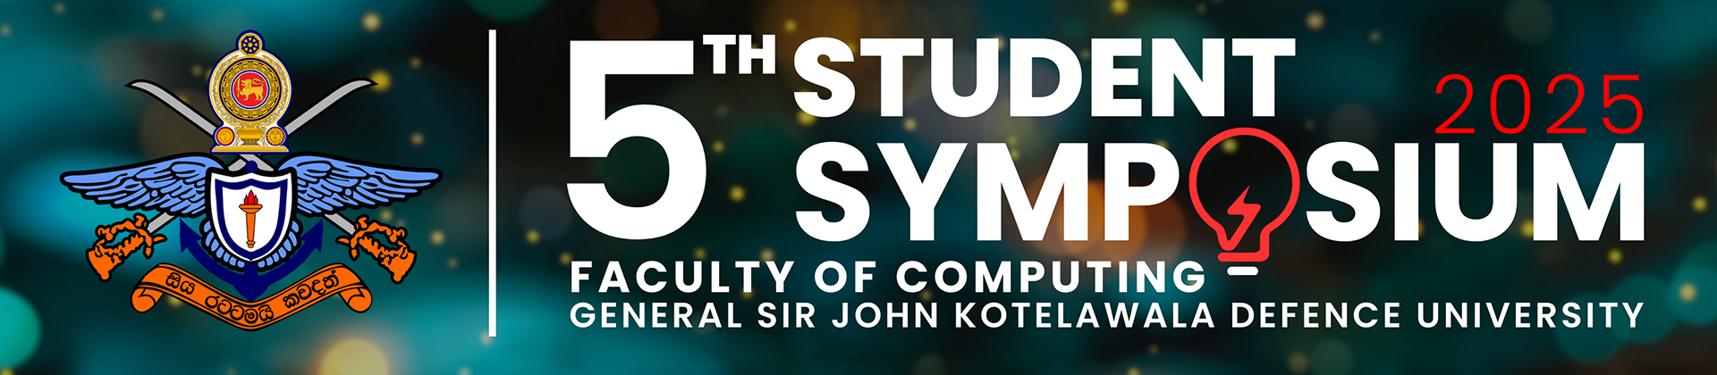

5th Student Symposium
EMPOWERING DIGITAL SOCIETY WITH COMPUTATIONAL INTELLIGENCE TOWARDS SUSTAINABILITY
A Comprehensive Review of Modern Technologies in Waste Collection: Driving Smarter and Greener Solutions for a Future-Ready Approach Paper ID : 151
RAKK Ranasinghe
RPS Kathriarachchi & GAD Ganepola

Slide 2
Table of Contents
Introduction
Research Questions
Aims
Objectives
Literature Review
Methodology
Findings and Discussion
Conclusion
References

Slide 3
Introduction
Urbanization and population growth increase waste collection challenges
Traditional waste collection methods are inefficient and costly
Modern technologies (IoT, AI, GIS, ML, Mobile & Web Applications) offer smarter waste collection solutions
This study reviews key advancements and their impact on sustainability
The research highlights the role of technology in improving efficiency, reducing operational costs, and minimizing environmental impact
The importance of integrating smart waste collection systems into urban infrastructure to ensure long-term sustainability

Slide 4
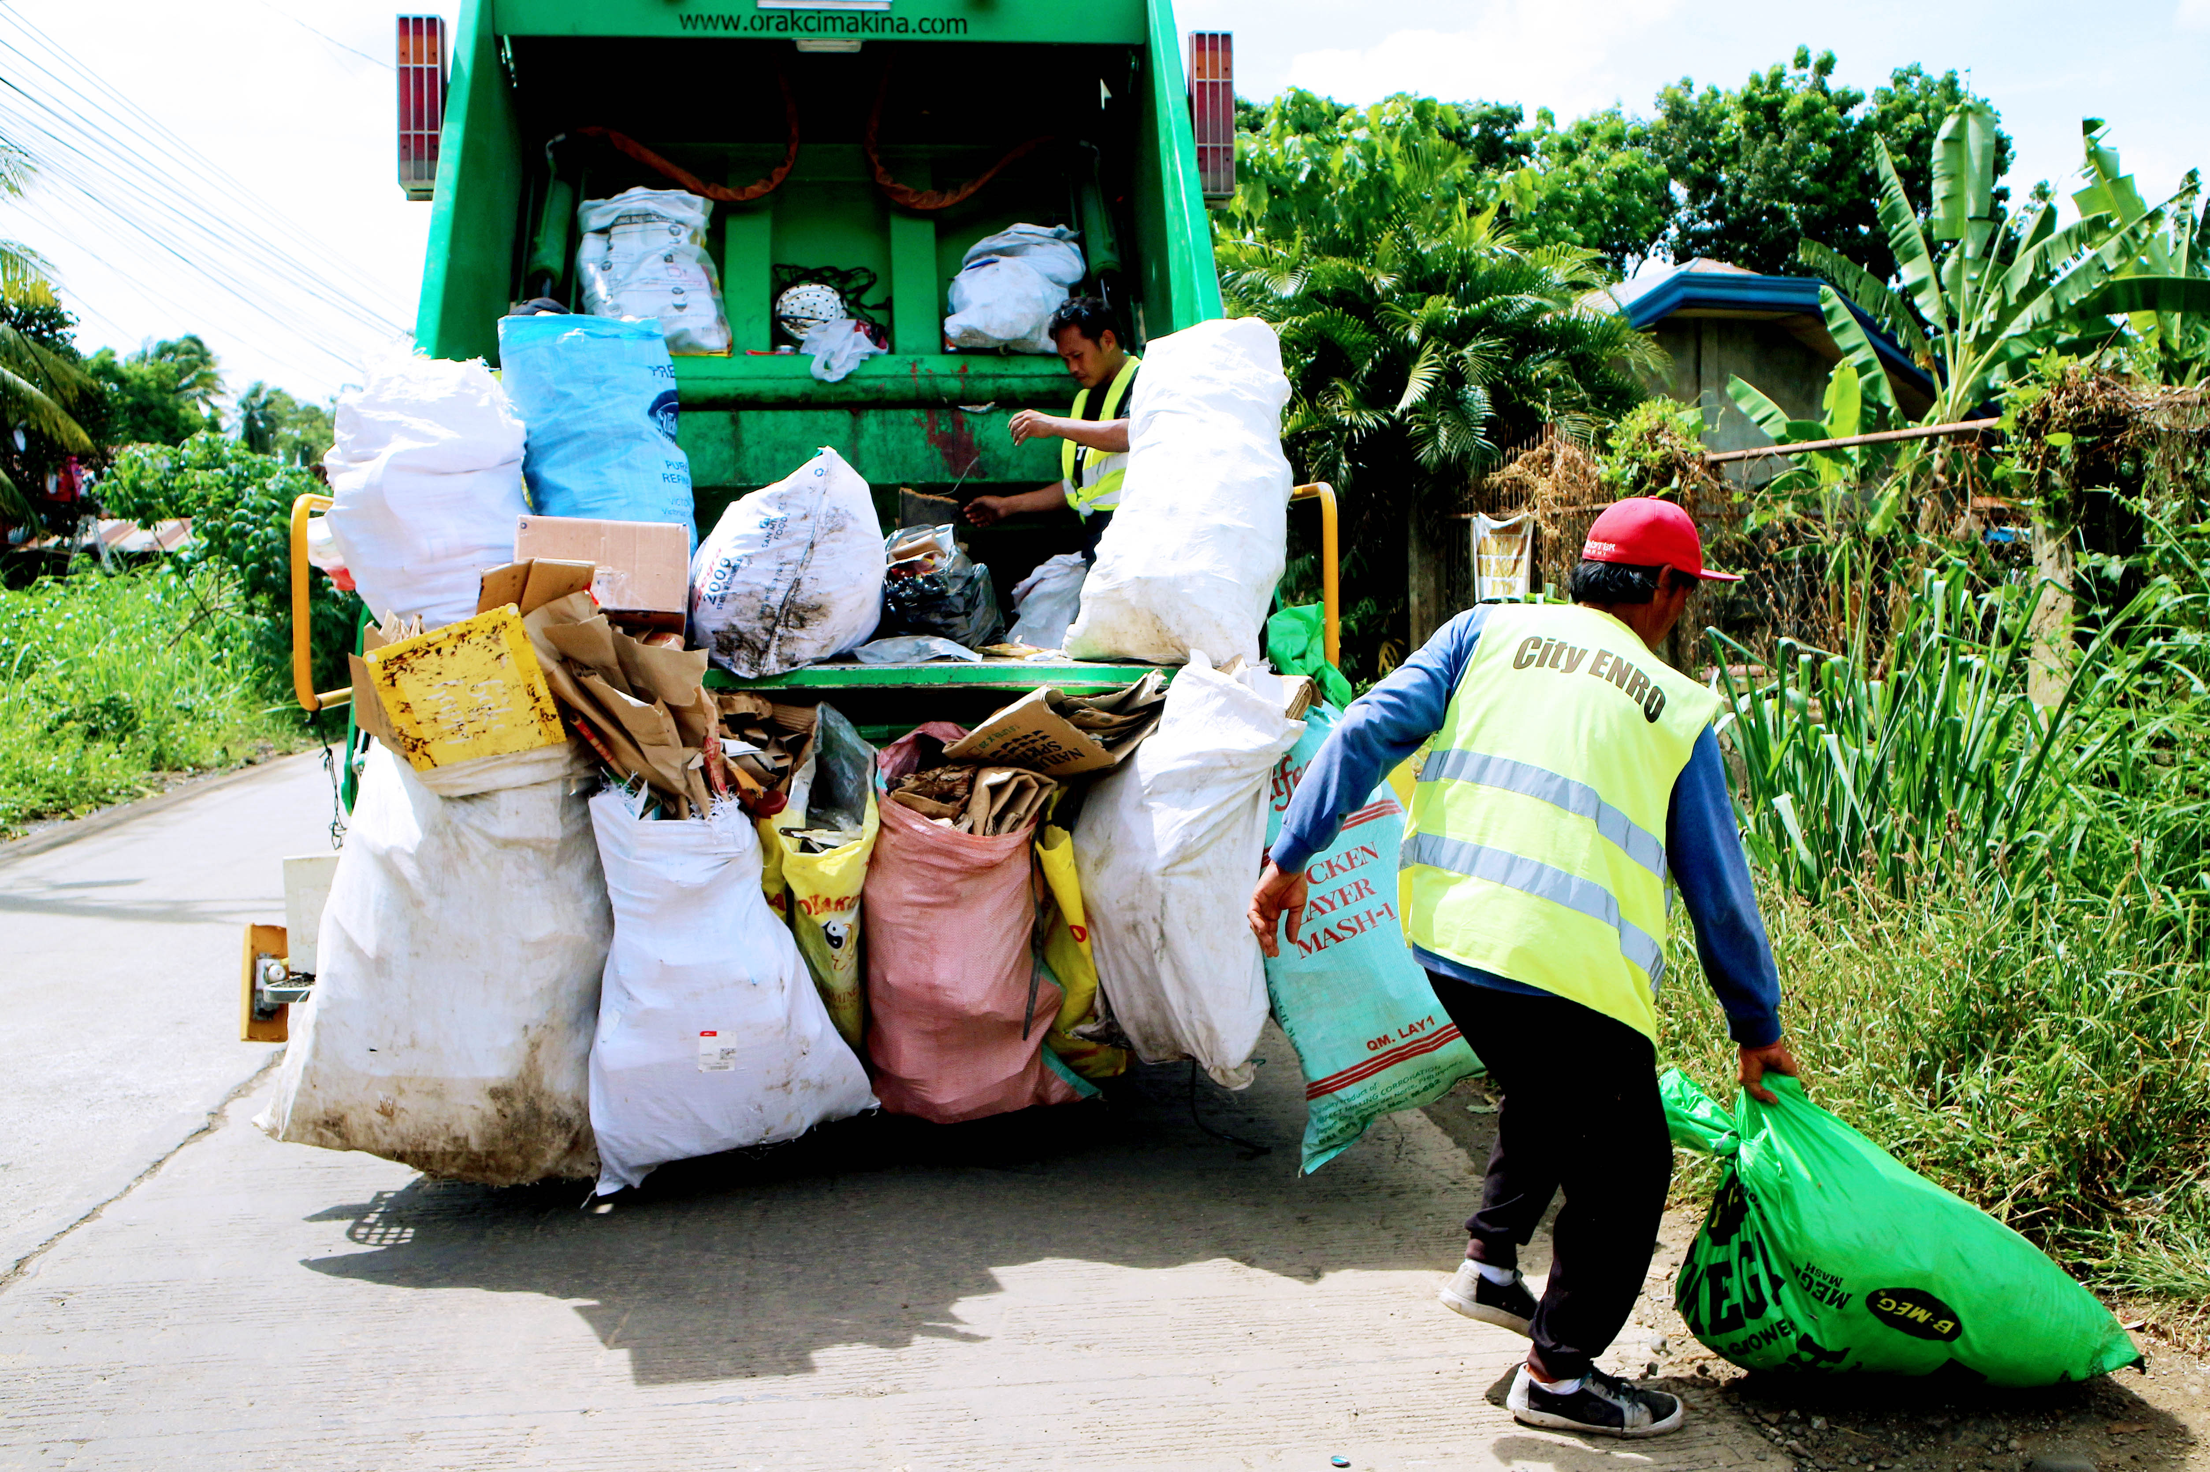
Research Questions
How can IoT, AI, and other modern technologies enhance the efficiency and sustainability of waste collection systems?
What are the primary benefits and challenges of implementing smart waste collection solutions?
How does the integration of mobile and web applications influence community engagement and overall waste management performance?

Slide 5
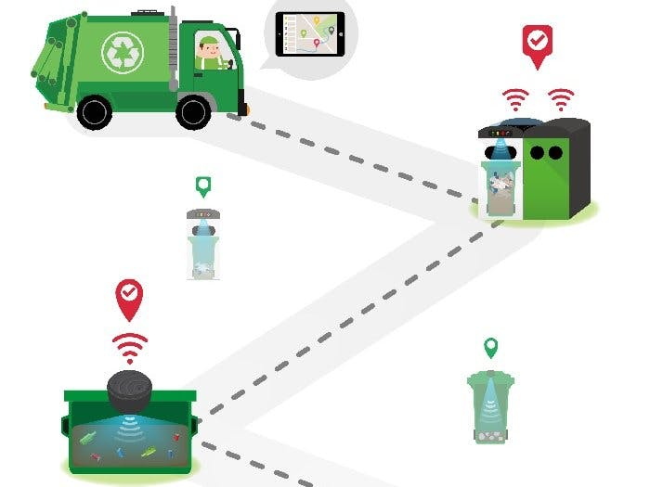
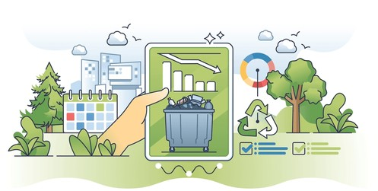
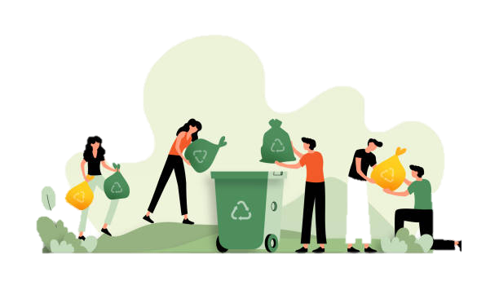
Aims
To explore how modern technologies can enhance waste collection, making it more efficient, sustainable, and citizen-friendly while supporting the goals of smart cities and environmental sustainability. This review provides a future-focused analysis of waste collection through technological advancements.

Slide 6
Objectives
Analyze Traditional Methods: Identify inefficiencies in conventional waste collection systems, including fixed schedules, high operational costs, and environmental concerns
Review Modern Technologies: Study IoT-based smart bins, AI-driven route optimization, GIS for spatial analysis, and mobile applications for real-time user interaction
Assess User Engagement: Explore how digital platforms, incentives, and mobile apps enhance citizen participation in waste collection efforts
Propose Future Solutions: Integrate AI, IoT, GIS, and cloud computing to create a dynamic, data-driven waste collection system that improves efficiency and sustainability

Slide 7
Literature Review
Paper | Technology Used | Major Findings | Advantages | Challenges/Limitations
[2] | IoT-enabled smart bins, RFID, MQTT, Android & web platform | Real-time data improves route optimization. | Reduced fuel consumption, cost savings. | High setup costs, maintenance needs, data delays.
[4] | IoT, ultrasonic sensors, Arduino, Ubidots Cloud | Real-time bin monitoring with SMS alerts. | Prevents overflow, enhances efficiency. | High maintenance costs, connectivity issues.
[6] | Smart bins, GIS, auto-sorting, bio-refineries, microbial fuel cells | Efficient sorting and energy recovery. | Supports circular economy, resource recovery. | Technical challenges, limited real-world use.
[7] | GPS, shortest path algorithm, mobile tracking | Real-time tracking for waste collection. | Reduces waiting time, improves routing. | Communication gaps, limited IoT integration.
[8] | CPS, IoT, sensors, NFC | Real-time monitoring aids semi-urban areas. | Better resource allocation, transparency. | Maintenance issues, scalability limits, user education needed.
[9] | Tech for developing countries | Community-focused waste collection. | Enhances engagement, public health. | High costs, lack of regulatory support, limited research.
[10] | IoT, sensors, cloud computing | Optimized routes with real-time analytics. | Supports data-driven decisions. | Data security, connectivity challenges, user education.
[11] | User-friendly e-waste collection interface | Flexible pickups, user notifications. | Improves user experience, reduces e-waste. | Adoption challenges, limited long-term data.
[14] | Dynamic planning, HMM, machine learning | Predictive models optimize waste collection. | Reduces unnecessary collections, saves resources. | Complex implementation, high data needs.

Slide 8
Literature Review Cont.
Aspect | Traditional Methods | Benefits | Modern Methods | Benefits
Collection Frequency | Fixed schedules, regardless of bin fill levels | Simple, predictable timing for residents. | Real-time monitoring based on bin fill levels | Fewer trips, fuel savings
Routing | Pre-determined, static routes | Easy to plan & implement | Dynamic routing with GPS, IoT, Data analytics | Time, fuel, and congestion reduction
Sorting | Manual at disposal sites | Basic waste separation | Automated with sensors and robotics | Better accuracy, higher recycling rate
User Engagement | Limited involvement | Low effort for users | Mobile apps, real-time alerts | Higher participation, waste reduction
Data Collection | Manual records | Simple, tech-free | Real-time data with IoT, cloud storage | Predictive insights, improved decisions
Cost Efficiency | Lower initial cost, no tech maintenance | Low setup cost | Higher setup cost, long-term savings | Fuel and labor savings
Environmental Impact | Higher fuel use, no real-time adjustments | General approach | Optimized routes, waste-to-energy, biofuel conversion | Sustainable, lower emissions

Slide 9
Methodology
Literature Survey: Identified key techniques for waste collection improvement
Database Selection: Used ScienceDirect, IEEE, Elsevier, ResearchGate, and Google Scholar (2019-2024)
Search Strategy: Reviewed industry reports and academic sources using keywords like "smart waste collection" and "AI & IoT in waste collection"
Screening & Selection: Followed PRISMA methodology, selecting 15 relevant studies
Data Analysis: Evaluated findings, ethical considerations, and geographic coverage
Limitations: Possible bias due to language restrictions and reliance on grey literature
Achieves Objective: The study systematically adopts a data-driven approach, effectively identifying modern waste collection technologies while providing valuable insights into real-time tracking, route optimization, and smart waste monitoring.

Slide 10
Findings and Discussion
Traditional vs. Smart Waste Collection: Traditional methods rely on fixed schedules, leading to inefficiencies like unnecessary trips and higher costs. Smart systems integrate IoT, GPS, and AI for real-time monitoring, optimized routing, and reduced environmental impact
Key Benefits: Smart waste collection systems lead to reduced operational costs, improved efficiency, lower emissions, and enhanced user participation
Challenges: High setup costs, maintenance needs, data security concerns, and infrastructure dependency remain major hurdles
Future Perspective: Integration of predictive analytics, AI-driven automation, and waste-to-energy technologies will further enhance waste collection efficiency and sustainability

Slide 11
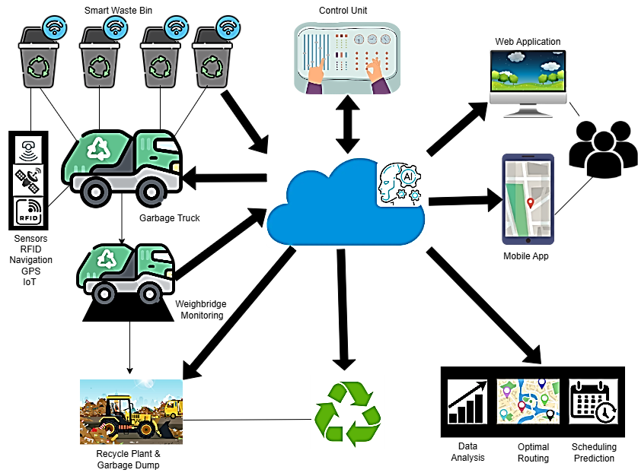
Findings and Discussion Cont.
IoT Smart Bins: Enable real-time waste level monitoring, reducing overflow and unnecessary pickups
GIS & GPS: Improve route efficiency, cutting fuel consumption
AI & Machine Learning: Optimize collection schedules and predict waste levels
Cloud Computing: Facilitates real-time data integration and decision-making
Mobile Applications: Enhance user engagement through notifications and reporting features

Slide 12
Conclusion
Technology Integration: Combines IoT, AI, and GIS to enhance waste collection
Real-Time Monitoring: Enables efficient tracking and dynamic route optimization
Improved Communication: Enhances interaction with residents for better waste management
Operational Efficiency: Reduces fuel consumption and operational costs
Environmental Impact: Supports sustainable urban growth by minimizing waste-related pollution
Challenges: High initial costs and data security concerns
Future Potential: Scalable solutions for smarter waste collection
Research Scope: Refining predictive models and increasing community engagement

Slide 13
References
[1] “What a Waste 2.0 : A Global Snapshot of Solid Waste Management to 2050,” World Bank. Accessed: Oct. 29, 2024.Available:https://documents.worldbank.org/pt/publication/documents.
[2] “Modern Technologies for Waste Management: A Review.” Accessed: Oct. 25, 2024. [Online]. Available: https://www.mdpi.com/2076-3417/13/15/8847
[3] B. Chowdhury and M. U. Chowdhury, “RFID-based real-time smart waste management system,” in 2007 Australasian Telecommunication Networks and Applications Conference, Dec. 2007, pp. 175–180. doi: 10.1109/ATNAC.2007.4665232.
[4] Z. Hisham Che Soh, M. Azeer Al-Hami Husa, S. Afzal Che Abdullah, and M. Affandi Shafie, “Smart Waste Collection Monitoring and Alert System via IoT,” Apr. 2019, pp. 50–54. doi: 10.1109/ISCAIE.2019.8743746.
[5] M. Aazam, M. St-Hilaire, C.-H. Lung, and I. Lambadaris, “Cloud-based smart waste management for smart cities,” in 2016 IEEE 21st International Workshop on Computer Aided Modelling and Design of Communication Links and Networks (CAMAD), Oct. 2016, pp. 188–193. doi: 10.1109/CAMAD.2016.7790356.
[6] A. Goutam Mukherjee et al., “A review on modern and smart technologies for efficient waste disposal and management,” J. Environ. Manage., vol. 297, p. 113347, Nov. 2021, doi: 10.1016/j.jenvman.2021.113347.
[7] R. K. A. R. Kariapper, P. Pirapuraj, M. S. S. Razeeth, A. C. M. Nafrees, and K. L. M. Rameez, “Smart Garbage Collection Using GPS & Shortest Path Algorithm,” in 2019 IEEE Pune Section International Conference (PuneCon), Dec. 2019, pp. 1–6. doi: 10.1109/PuneCon46936.2019.9105674.
[8] Y. A. Fatimah, A. Widianto, and M. Hanafi, “Cyber-physical System Enabled in Sustainable Waste Management 4.0: A Smart Waste Collection System for Indonesian Semi-Urban Cities,” Procedia Manuf., vol. 43, pp. 535–542, 2020, doi: 10.1016/j.promfg.2020.02.169.

Slide 14
References Cont.
[9] C. S. de Morais, T. R. P. Ramos, M. Lopes, and A. P. Barbosa-Póvoa, “A data-driven optimization approach to plan smart waste collection operations,” Int. Trans. Oper. Res., vol. 31, no. 4, pp. 2178–2208, 2024, doi: 10.1111/itor.13235.
[10] S. Keerthana, B. Kiruthika, R. Lokeshvaran, B. Midhunchakkaravarthi, and G. Dhivyasri, “A Review on Smart Waste Collection and Disposal System,” J. Phys. Conf. Ser., vol. 1969, p. 012029, Jul. 2021, doi: 10.1088/1742-6596/1969/1/012029.
[11] “Development of User Interface Design for Electronic Waste Collection with a Design Thinking Approach,” in Proceedings of the International Conference on Industrial Engineering and Operations Management, Orlando, USA: IEOM Society International, Jun. 2022, pp. 1636–1646. doi: 10.46254/NA07.20220383.
[12] K. Leelarathne, R. T. Niroshan, and L. P. Kalansooriya, “Optimum Waste Collection System with Smart Mobile Application,” 2021, Accessed: Aug. 06, 2024. [Online]. Available: https://scholar.google.com/scholar?cluster=9887963207950108195&hl=en&oi=scholarr
[13] A. Fernando and R. Kathriarachchi, “IoT Based Smart Solution for Waste Collection and Recycle,” Sep. 2019.
[14] E. Fidje, M. Haddara, and M. Langseth, “Sustainable Smart Waste Management Adoption Challenges in Developing Countries,” Procedia Comput. Sci., vol. 219, pp. 905–914, Jan. 2023, doi: 10.1016/j.procs.2023.01.366.
[15] A. Mager and V. Blass, “From Illegal Waste Dumps to Beneficial Resources Using Drone Technology and Advanced Data Analysis Tools: A Feasibility Study,” Remote Sens., vol. 14, no. 16, Art. no. 16, Jan. 2022, doi: 10.3390/rs14163923.
[16] T. Sutikno, H. I. K. Fathurrahman, T. Wahono, and L. Handayani, “Robotics Technologies in Urban Smart Waste Management,” High-Tech Innov. Ser., vol. 1, pp. 43–54, Jun. 2024.
[17] “IoT based Waste Bin Monitoring for Smart Cities.” Accessed: Oct. 27, 2024. [Online]. Available: https://psiborg.in/iot-based-waste-bin-monitoring-for-smart-cities/
[18] P. D. Gunasekara, “SMART SYSTEM FOR WASTE MANAGEMENT”.

Slide 15
Acknowledgment
I extend my heartfelt gratitude to my supervisor, Mr. R.P.S. Kathriarachchi, for his guidance and invaluable assistance throughout my research. I am also grateful for the support of my second supervisor, Miss. G.A.D. Ganepola, whose contributions were instrumental. I would like to thank the senior and junior lecturers who shared their expertise and provided invaluable feedback, significantly improving the quality of my work. Lastly, I wish to acknowledge my family and colleagues, whose unwavering support made this research possible

Slide 16
THANK YOU !

