Slide 1
Predicting Employee Attrition and Salaries
Kebur Fantahun
04/17/2021

Slide 2
Dataset
The employee data provided from DDSAnalytics includes the following properties:
Notes:
The goal is to predict attrition based on several attributes from the data of employees

Slide 3
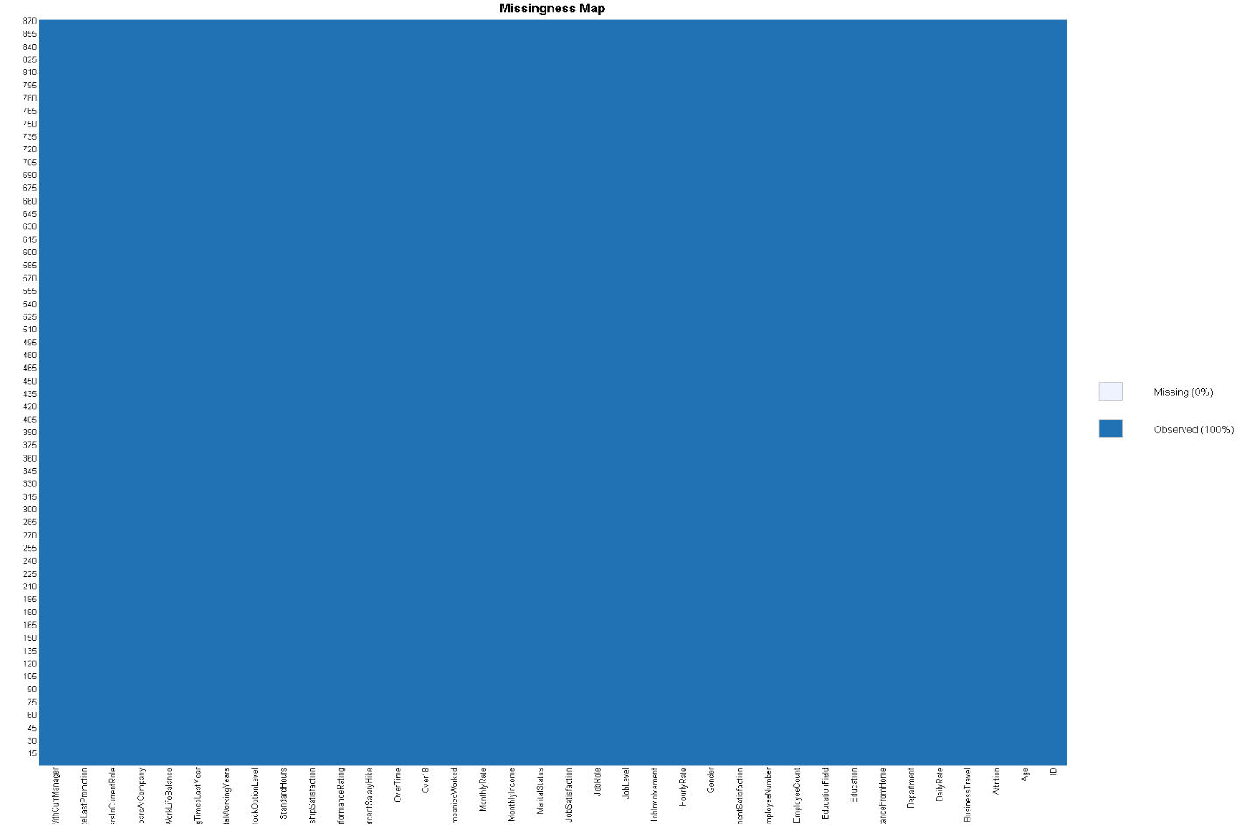
Missing Map
A first look into the “missmap” of the data shows that there are no NA’s so we can proceed to investigate trends before modeling
Notes:
The left plot shows the percentage of missing values by attribute. The right plot gives a picture of the percentage of missing vs available data. The bars at the farthest right show the percentage size( from bottom to top) of 1) the available data, 2) the largest missing data attribute, 3) the next largest missing data
So here that would be, a large portion of the data is available. Next, IBU is missing a lot of data. Following that ABV, then Style and finally at the smallest is the 2 missing brewery ID’s.

Slide 4
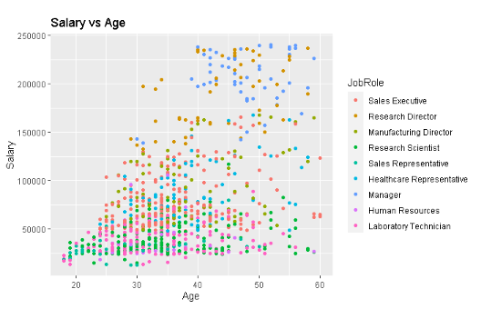
Job Role Specific Trends
Notes:
One interesting job trend found was that older people tend to make more and they also tend to be managers. This could be because as one gets older and more experienced, they become better suited to the workload required of a higher-level position, so they are compensated for being able to execute harder work like company decisions and priorities. Following managers are other positions that take longer to grow into such as Directors or Executives.

Slide 5
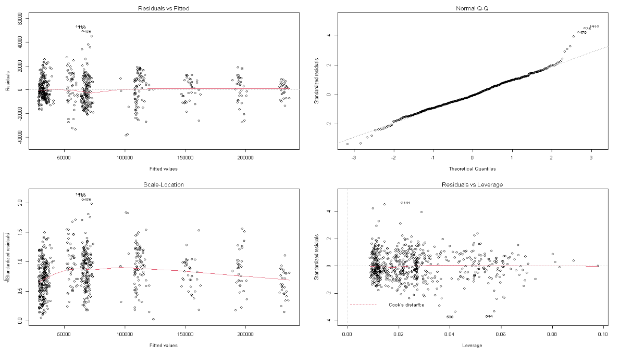

Slide 6


Slide 7
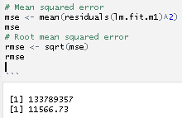

Slide 8
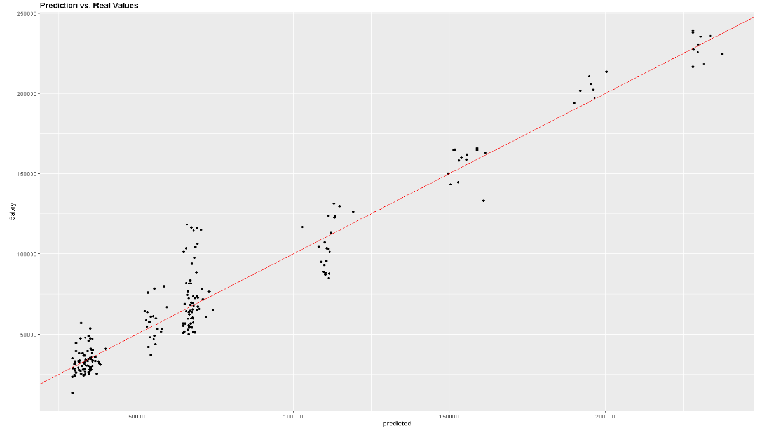

Slide 9
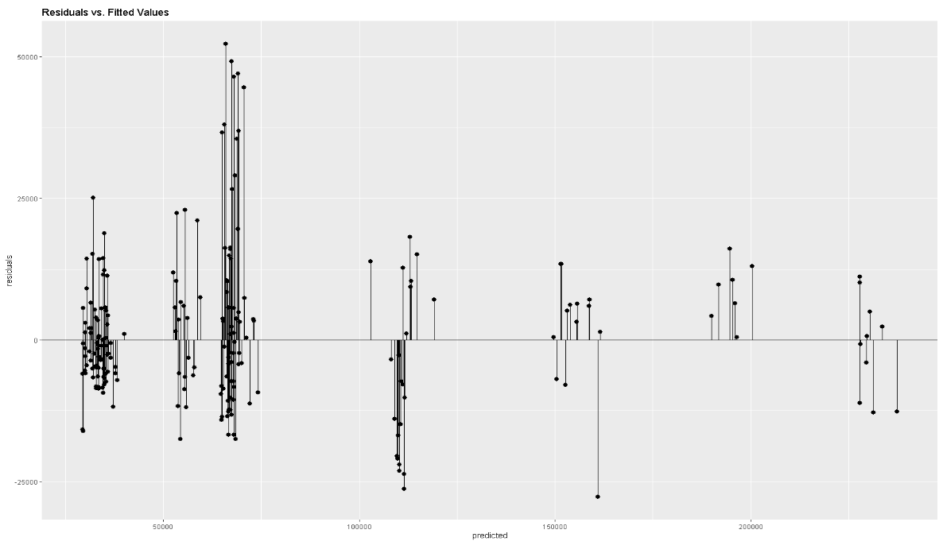

Slide 10
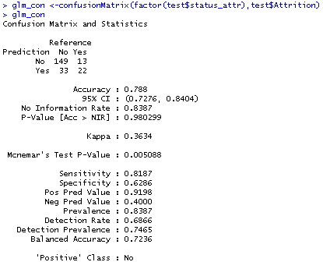

Slide 11
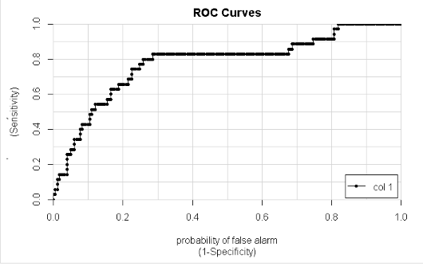

Slide 12
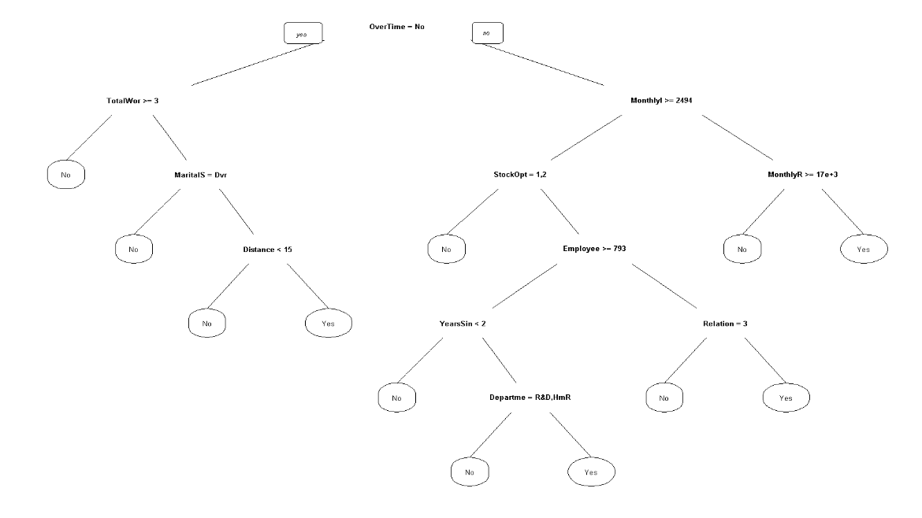

Slide 13
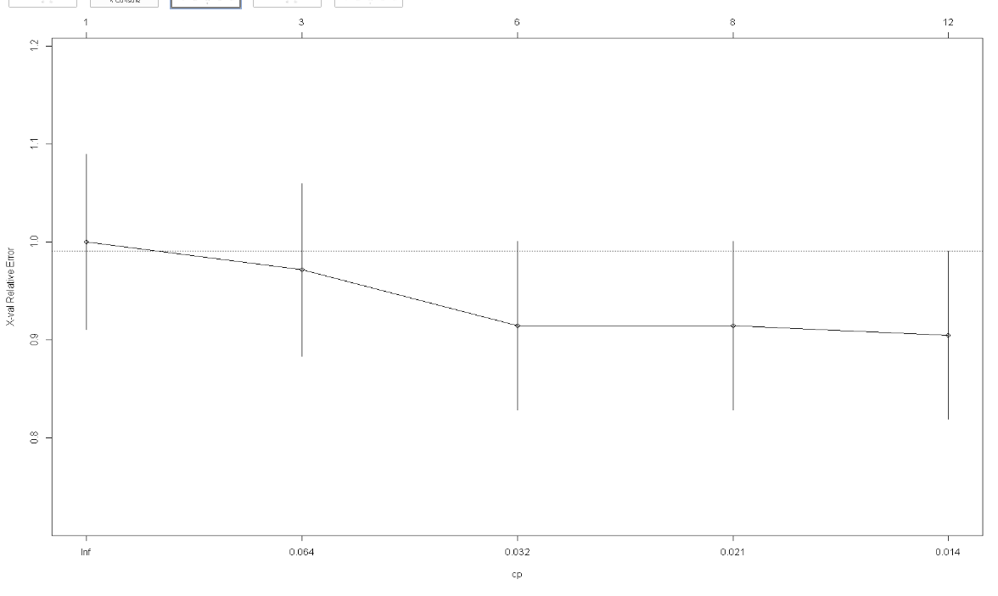

Slide 14
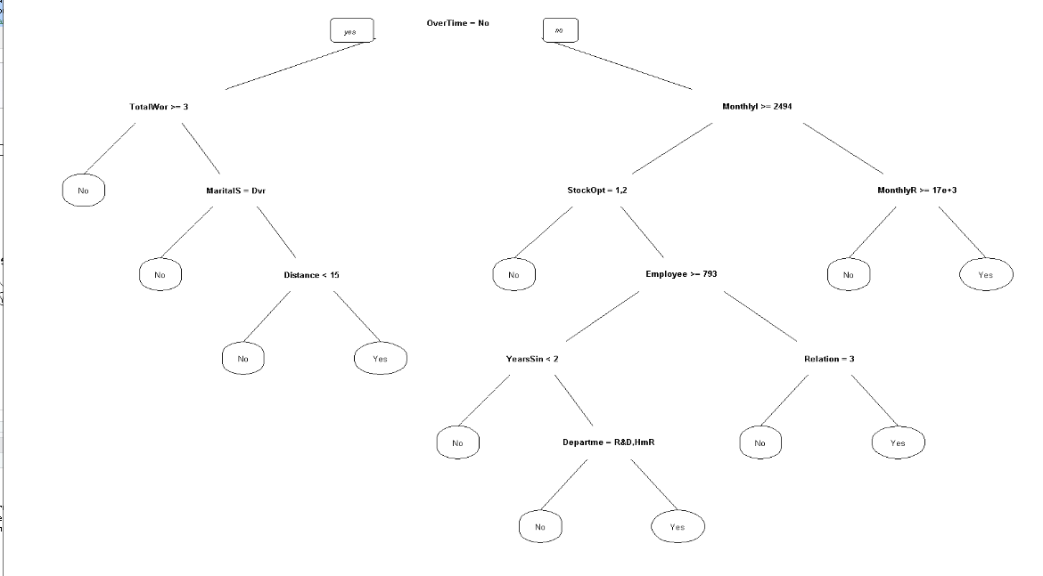

Slide 15
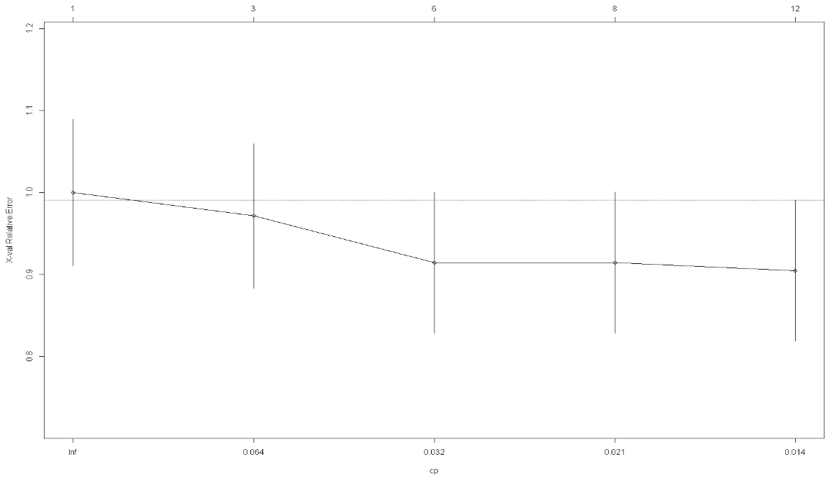

Slide 17
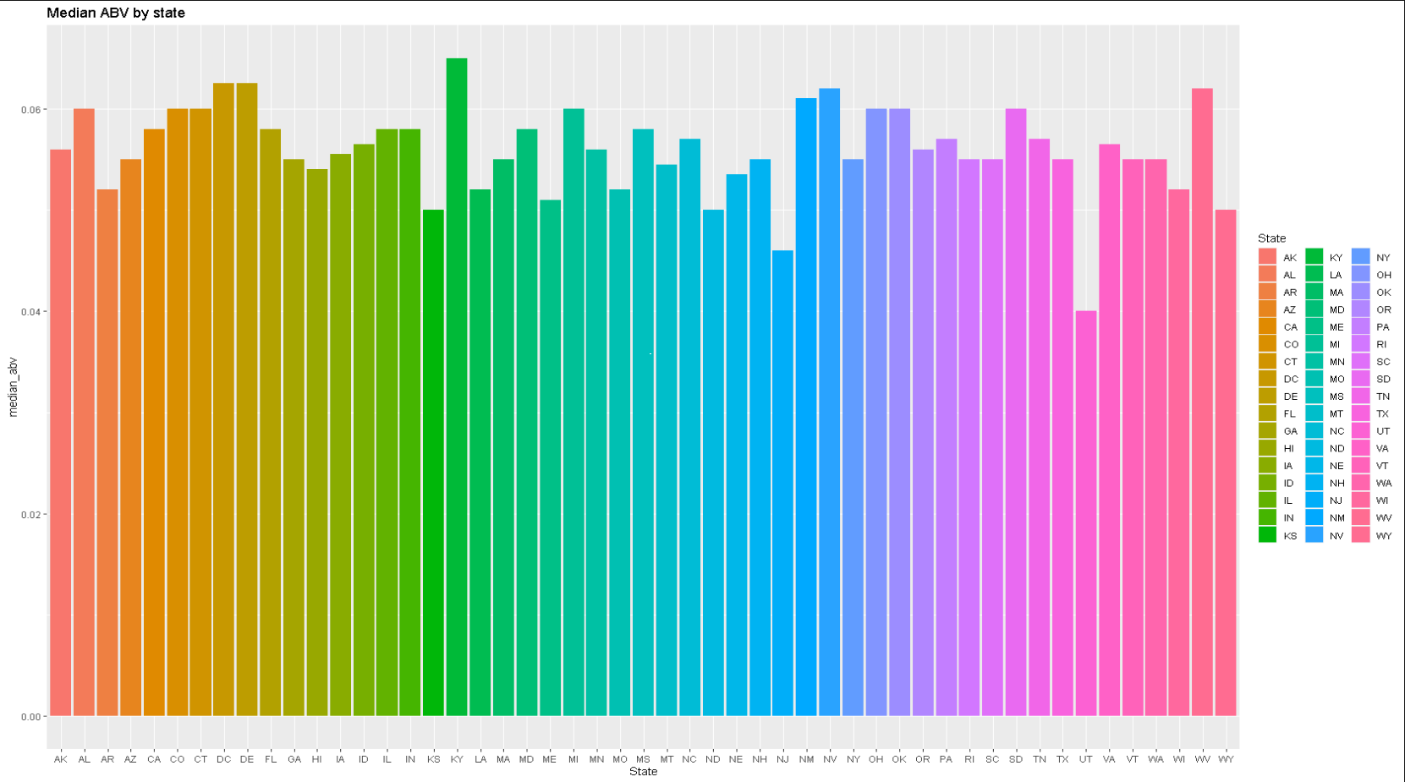
Median ABV by State
Notes:
Kentucky has the highest median ABV. Utah has the lowest ABV per state (state law mandates 4.0% for most beers)
This is likely due to a variety of reasons such as local laws, climate, demographics, local diet, income per capita, etc.

Slide 18
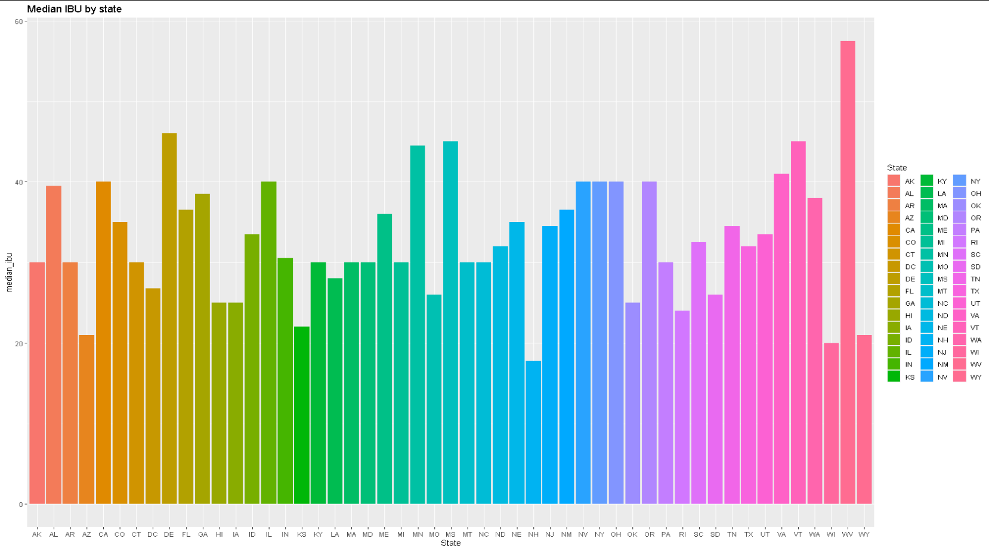
Median IBU by State
Notes:
As you can see, West Virginia has the highest median IBU and New Hampshire has the lowest median IBU per state.
Again, this is likely due to a variety of reasons such as local laws, climate, demographics, local diet, income per capita, etc.

Slide 19
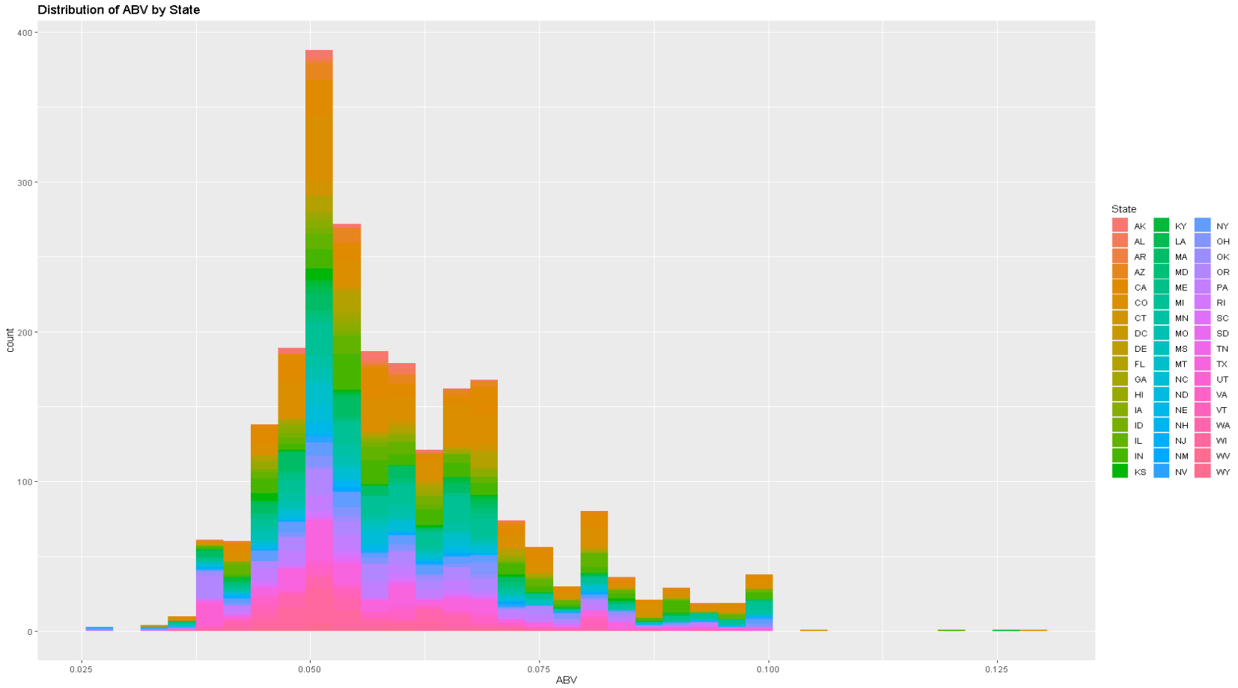
ABV Distribution
Notes:
The ABV distribution is slightly right skewed. ABV can only ever be positive which might explain the skew.
It seems that most popular beers will have around 5% ABV.

Slide 20
Which states have the max ABV/IBU?
Colorado has the max ABV at 12.8%
Oregon has the highest IBU at 138.
Notes:
Maybe this is not a surprise since there are 40+ breweries in CO.
Colorado has an unusually high number of breweries, and as such there is more opportunity to see a variety of ABV’s.
Oregon is where hops are grown, and very hoppy beers are popular there.

Slide 21
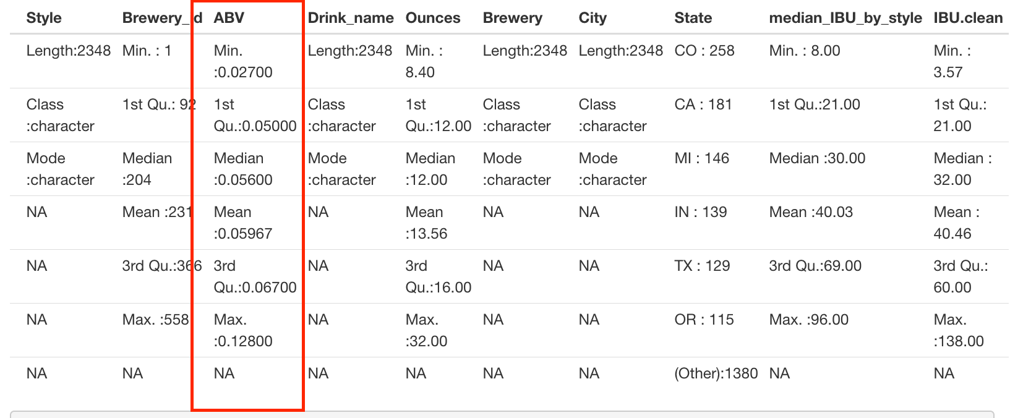
Summary Statistics
Notes:
Minimum ABV is 0.027, the maximum ABV is 0.128. The minimum being 2.7 suggests no non-alcoholic beer is present in our dataset and that the lowest ABV is like a Raddler or a VERY weak session ale. The highest ABV is consistent with Barley wines, Imperial Stouts, or other High gravity beers. The inter-quartile range for the mean 50% of beers ranges from .050 to .0670 suggesting most craft beers have a predictable ABV.

Slide 22
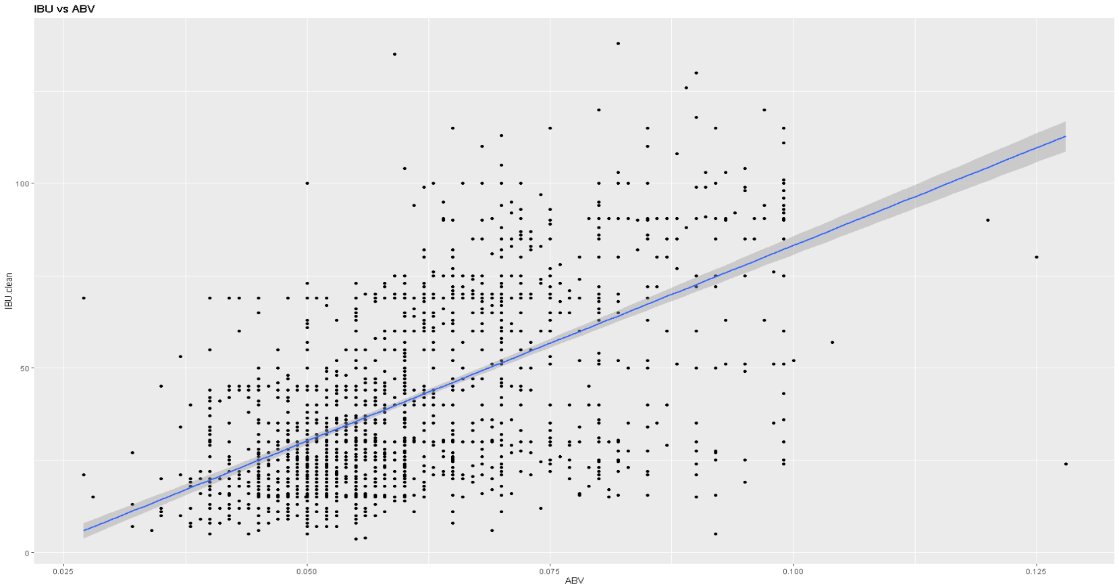
ABV vs IBU Relationship
Notes:
This is the same plot as the slide before except not colorized and fitted with a linear model line.

Slide 23
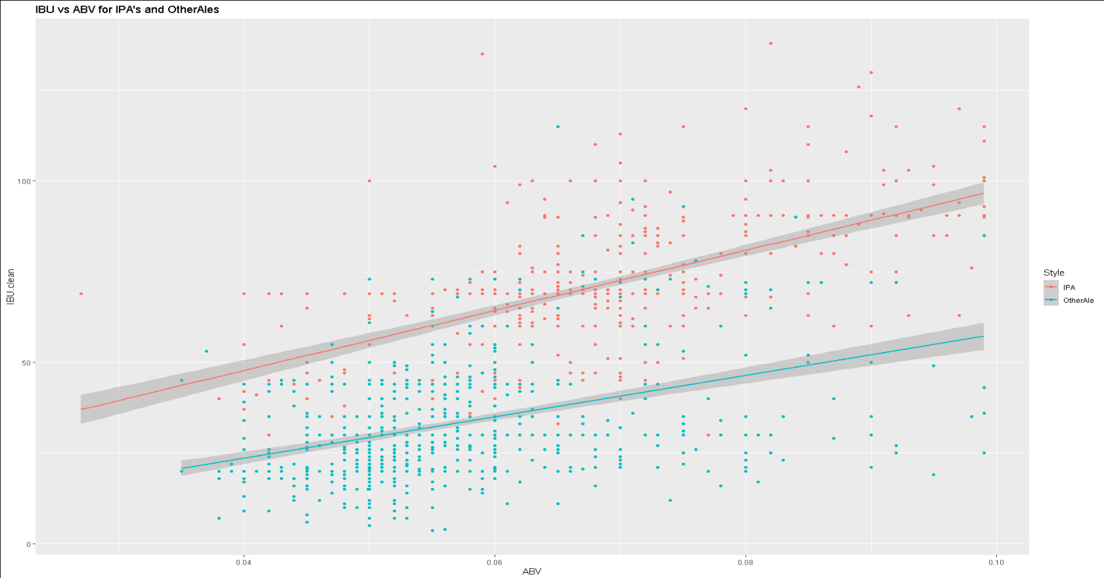
What about IPA’s vs Other Ales?
Notes:
As you can see the red line shows the trend for IPA and the blue shows the trend for Other ale.
IPAs are generally hoppier for the same ABV when compared to Other Ales. This is likely because IPAs use a lot of hops in the brewing process.

Slide 24
Top 3 factors that lead to attrition
Variables actually used in tree construction:
DailyRate JobRole MonthlyIncome

Slide 25
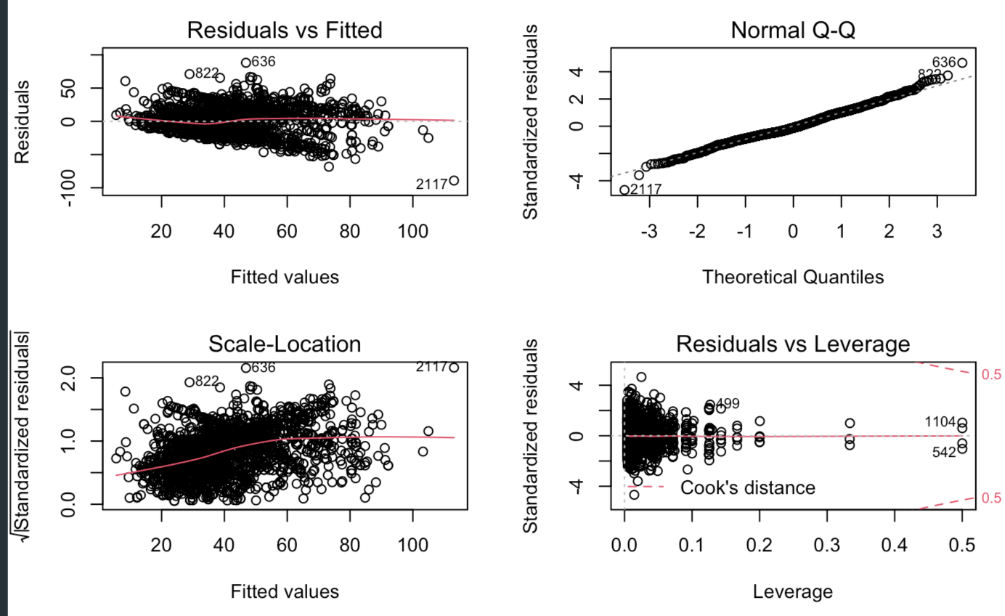
Appendix: ABV vs IBU Relationship
Residuals after fitting Multiple Linear Regression, Linear-Linear: IBU vs ABV model
IBU given State, ABV

