Slide 1
Predicting Employee Attrition
Kebur Fantahun
04/17/2021
Notes:
Introduction
Normally in a steady economy, it is expected that some employee turnover will happen. Many factors can influence a person's choice to consider other career paths such as family, a different compensation, or simply a different job environment. Although some turnover is expected, if actions can be taken to understand it before it happens then a greater understanding of attrition could help to prevent a loss of employees.

Slide 2
Dataset
The employee data provided from DDSAnalytics includes the following properties:
Notes:
The goal is to predict attrition based on several attributes from the data of employees

Slide 3
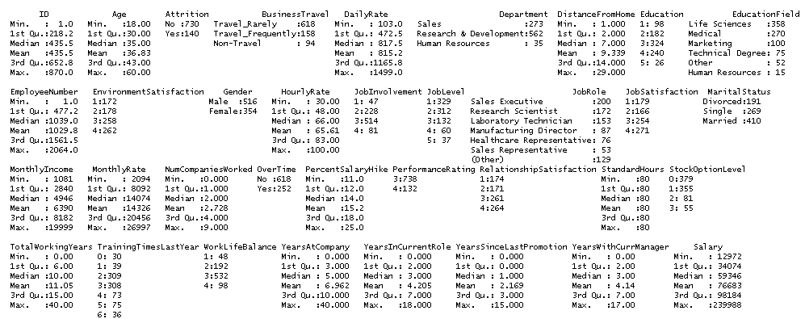
Summary Statistics
Notes:
We see that the dataset is 870 x 36. The variable age indicates that no information about young children(17-) or very elderly persons are included. We see that there are many non-numeric variables. We can also see that Attrition has a high number of no compared to yes in regards to leaving where they work. MonthlyIncome takes a wide range of values from $1,081 to $19,999 - the difference in the median and mean indicates that there may be some outliers in the MonthlyIncome statistic.

Slide 4
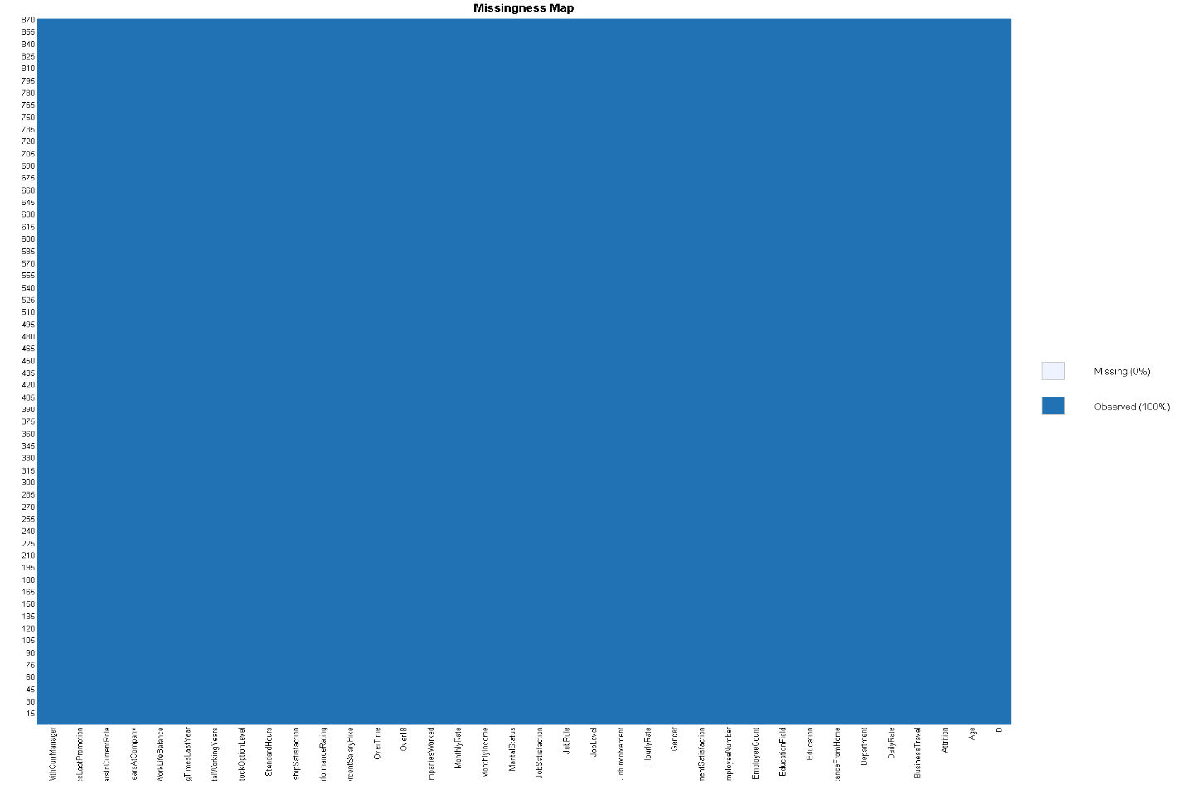
Missing Map
A first look into the “missmap” of the data shows that there are no NA’s so we can proceed to investigate trends before modeling
Notes:
The left plot shows the percentage of missing values by attribute. The right plot gives a picture of the percentage of missing vs available data. The bars at the farthest right show the percentage size( from bottom to top) of 1) the available data, 2) the largest missing data attribute, 3) the next largest missing data
So here that would be, a large portion of the data is available. Next, IBU is missing a lot of data. Following that ABV, then Style and finally at the smallest is the 2 missing brewery ID’s.

Slide 5
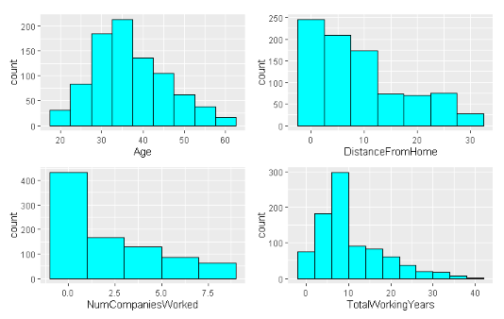
EDA
Notes:
Age is visually close to normally distributed.
Distance from Home, Num of Companies worked and Total working Years is right skewed and may need to be transformed

Slide 6
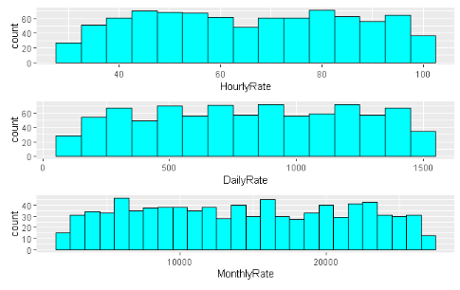
EDA
Notes:
No clear trend is displayed from these

Slide 7
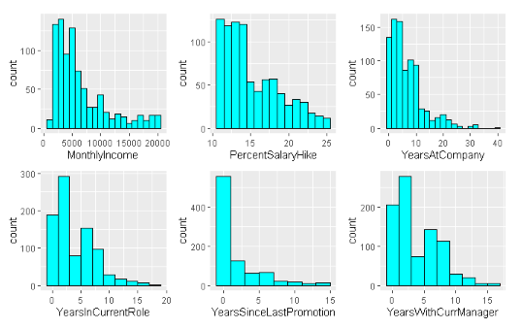
EDA
Notes:
These all tended to be right skewed so a log transform should help here as well. This is expected since a monthly income is just the income/12 and distributions of income are known to be right skewed since a great portion of people have lower incomes compared to very high ones.

Slide 8
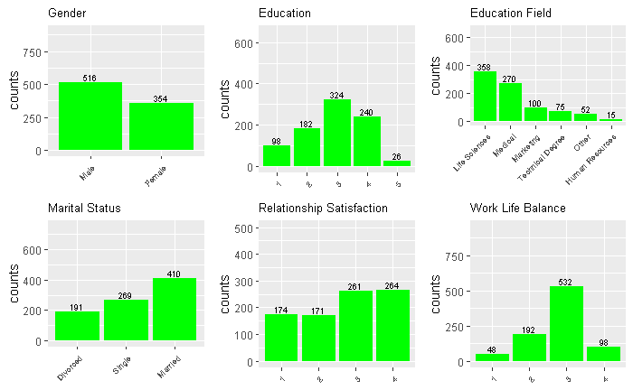
EDA
Notes:
There seem to be more males than females by about a 100
The largest portion of education seems to be with a bachelor's degree and the next highest is a masters degree.
A great deal of employees work in Life Sciences and the Medical background.
The highest marital status is marrried whereas the smallest portion are divorced.
Over half of the employees have a High or Very High Relationship Satisfaction.
Over half of the employees feel they have a better work life balance.

Slide 9
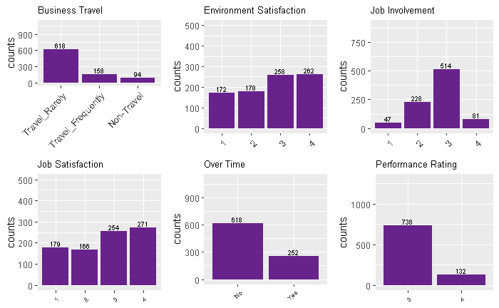
EDA
Notes:
A large portion of the employees Travel rarely for work.
About 60% of the employees have a high and very high environment satisfaction each.
Almost 59% of the employees assumethey have a High job involvement at work.
Again in Job Satisifaction we see that 60% employees have a high and a very high job satisfaction each.
More than 71% of the people seem to be working over time.
85% of the employees have an excellent performance rating.

Slide 10
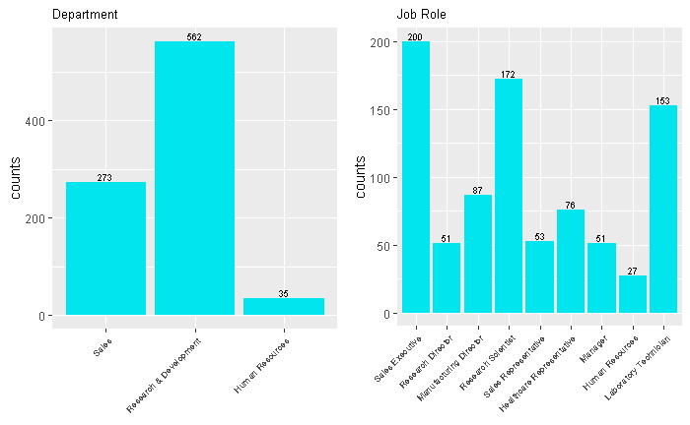
EDA
Notes:
64%of the employees work for the R&D department.
Most of the job roles are Research Scientists, Sales Executives, and Laboratory Technicians.

Slide 11
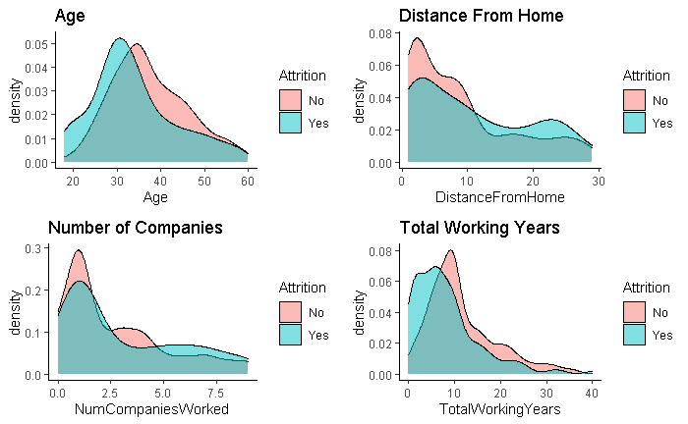
EDA
Notes:
Younger employees tend to have a higher attrition rate. Perhaps due to the adjusting period.
We see a lower attrition rate when the Distance from home is close, about within 10 kms. The attrition rate increase once past 10kms. Perhaps the short commutes help people get in and out on time and back home nicely.
The attrition rate tends to be higher with employees who have worked with 5 to 7 companies. This could be due to either growing out of a position or not fitting well at a certain company.
The attrition rate is the highest when an employee is starting their career. Since they are building experience about the job world this could be due to changing interests or prospects. Attrition rate seems to be extremely high amongst employees who have a total working experience between 0 to 7 years approximately.

Slide 12
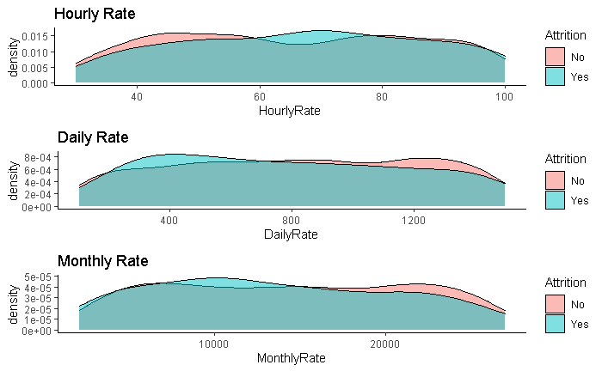
EDA
Notes:
Nothing stands out here except it looks like there might be a two-modal distribution with DailyRate. It seems that on the lower end of DailyRate there is a high attrition and on the higher end there is a lower attrition.

Slide 13
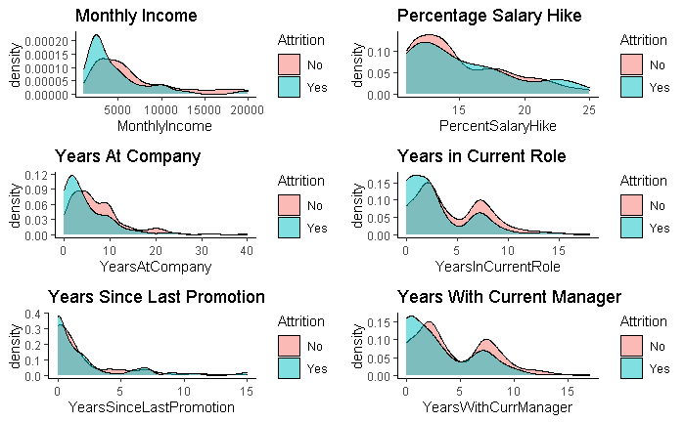
EDA
Notes:
Peak at 2500. There is a high level of attrition at low monthly income. This is likely due to not being satisfied with pay so employees quickly join and leave the workforce.
When the employee is with the company for 0-2 years approximately, there tends to be high attrition. Likely the new employees are seeking a fast track to CEO positions or the like and so if they don’t see growth or potential early on they leave.
There are two modes observed in the “Years in Current Role” plot. The attrition tends to be high early in the employees career or right inbetween 5 and 10 years of employment. Same as before with low satisfaction probably early on and at milestones like 5-7 years.
There’s also a two-modal distribution observed in the “Years with current manager” plot. The employee tends to leave if he is with the same manager for the first few years or between 5-10 years approximately.

Slide 14
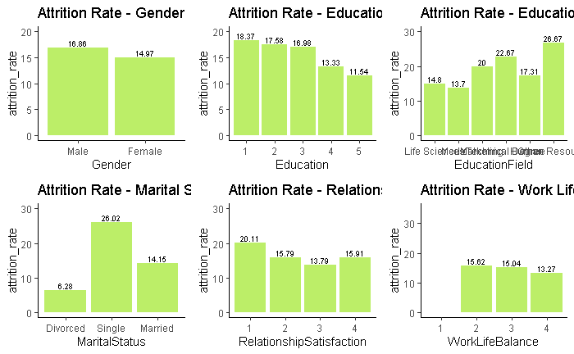
EDA
Notes:
Attrition Rate is a little higher in Males as compared to Females.
Attrition tends to be higher the less education an employee has. Perhaps this is because of the avenues that education can open and maybe a lack of job variety at a lower education level.
Attrition rate is very high amongst employees from HR, Technical and Marketing backgrounds.
Attrition tends to be higher for employees who have a bad work life balance, this is self-explanatory.

Slide 15
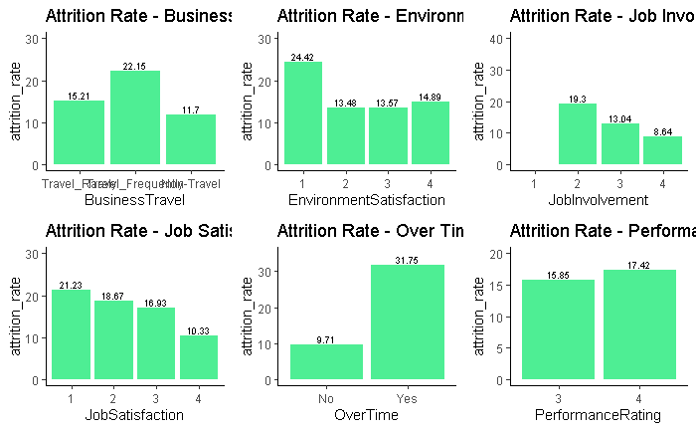
EDA
Notes:
Attrition rate is higher amongst people who travel for work.
Each of the stats low environment satisfaction, low job involvement and low job satisfaction all lead to a generally higher attrition rate.
The attrition rate is near 30% for those employees who work over time.
Although with self reported data there may be a bias in employees who report their performance rating, we find that the ones who report themselves the best tend to have higher attrition rates than those who report 3’s or lower.

Slide 16
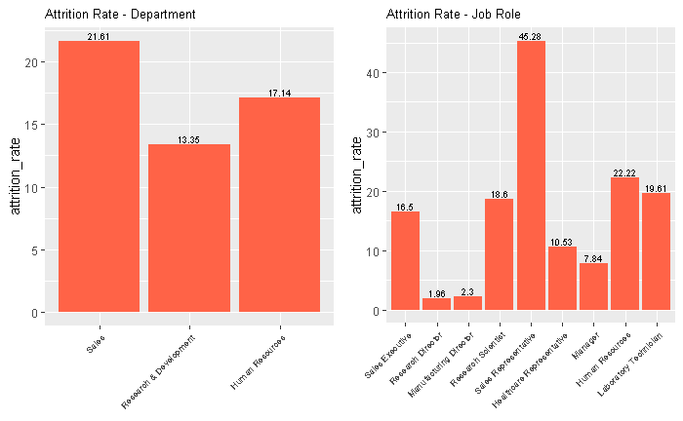
EDA
Notes:
Sales department have the highest attrition at 20% followed by HR and then R&D.
Sales Representatives must make a large portion of the department statistic up because they have the highest attrition at 45%. However, HR’s attrition rate sits at around 22%.

Slide 17
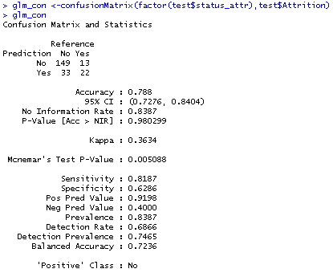
Confusion Matrix for a Logistic Regression

Slide 18
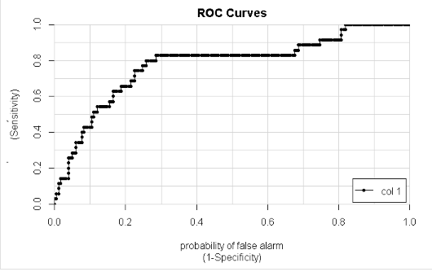
Logistic ROC Curve
Notes:
This curve guided me in choosing the right cutoff which turned out to be low around either 0.2 or 0.3. This could be because the attrition was heavier on the no side.

Slide 19
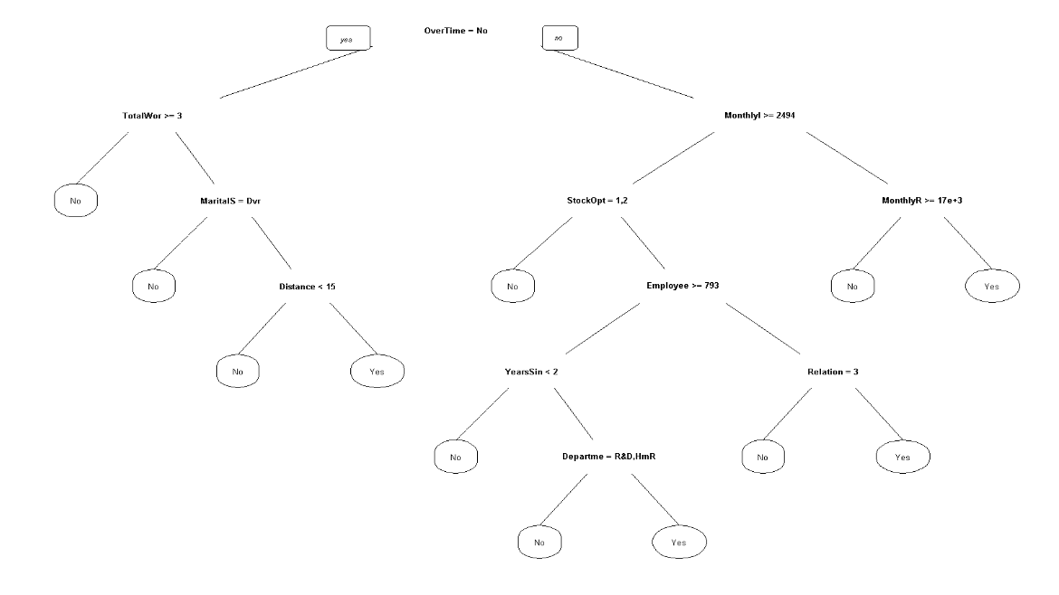
Decision Tree

Slide 20
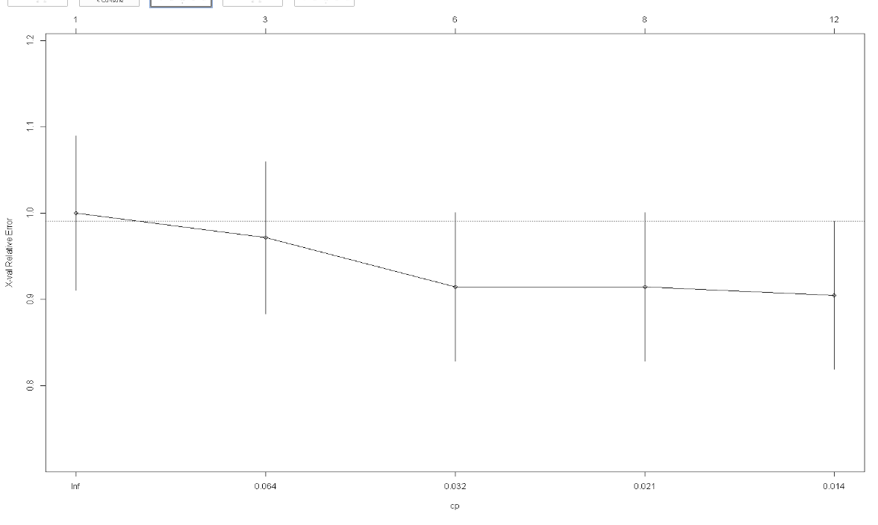
Decision tree size optimization
Notes:
The complexity parameter (cp) is useful in controlling the size of the decision tree and helps to select the best tree size. As the cp goes down, it’s because the lack of fit is going down leading to an accurate prediction for attrition.

Slide 21
Top 3 factors that lead to attrition
From the decision tree:
DailyRate
JobRole
MonthlyIncome

Slide 22
Future
Given more time I would more deeply explore alternate models such as Ensemble Modeling which runs two related, but different models then combines the results into a single score to improve predictive power.
Notes:
To conclude, we have seen the data be imported, investigated, known at a high level, carried out EDA and then preprocessed and finally built models that will predict the classification accurately.
Depending on the model, the researcher may find it beneficial to tune parameters to achieve better statistics. These could be anything from accuracy, false positive rate, or false negative rate. Here we were asked to keep rates of sensitivity and specificity at 60% and that was accomplished by logistic regression.

Slide 23
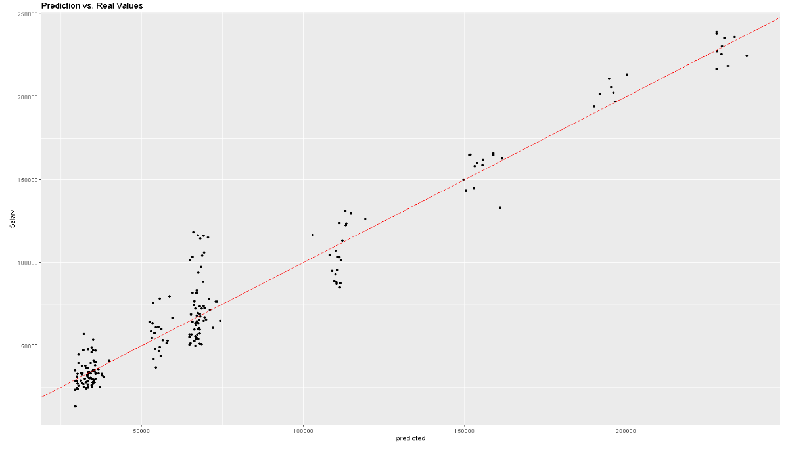
Linear model

Slide 24
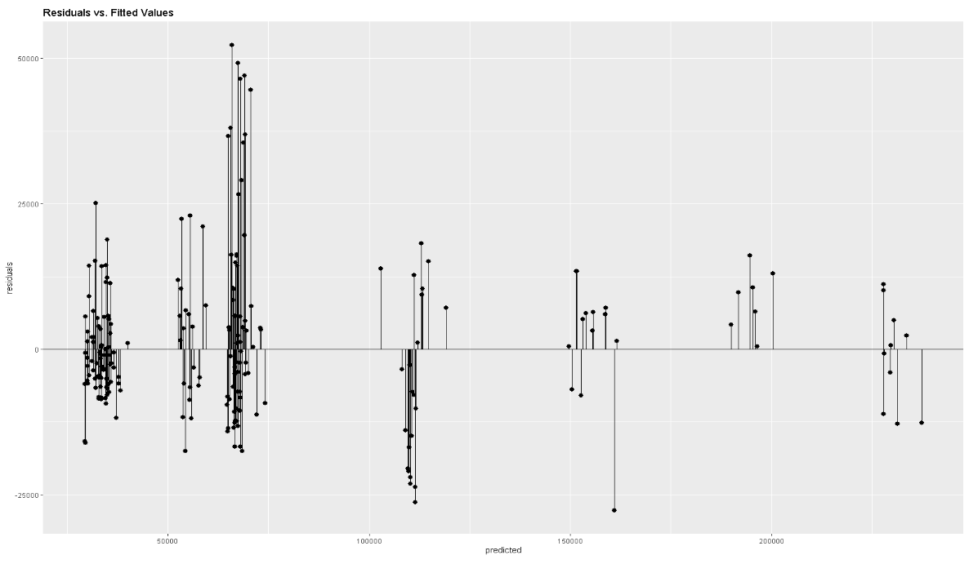
Linear model: residuals

Slide 25
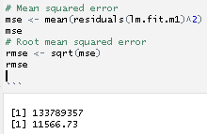

Linear model

Slide 26
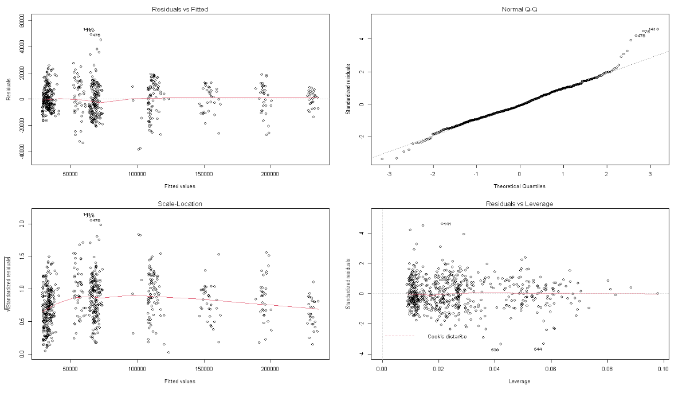
Linear Model

Slide 27
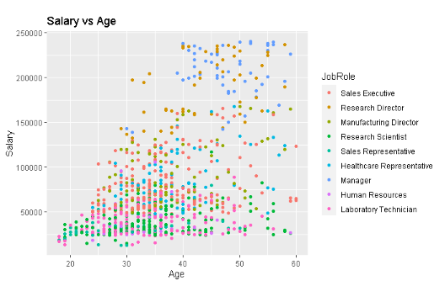
Job Role Specific Trends
Notes:
One interesting job trend found was that older people tend to make more and they also tend to be managers. This could be because as one gets older and more experienced, they become better suited to the workload required of a higher-level position, so they are compensated for being able to execute harder work like company decisions and priorities. Following managers are other positions that take longer to grow into such as Directors or Executives.

