Slide 1
Craft Beers and Breweries
Kebur Fantahun and Ricco Ferraro
03/07/2021

Slide 2
Question of Interest:
Assess relationships for craft beers across the united states
Notes:
Our Goal is to assess existing relationships including IBU and ABV for Ales, across the united states

Slide 3
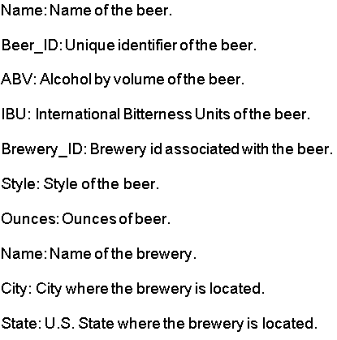
Dataset
The beer data collected across the United States includes the following properties:
Notes:
Intro to dataset, style is important for us since we imputed based on the median in the same style
Styles of beer: Porters and Lagers, Amber or Pale ales and the like

Slide 4
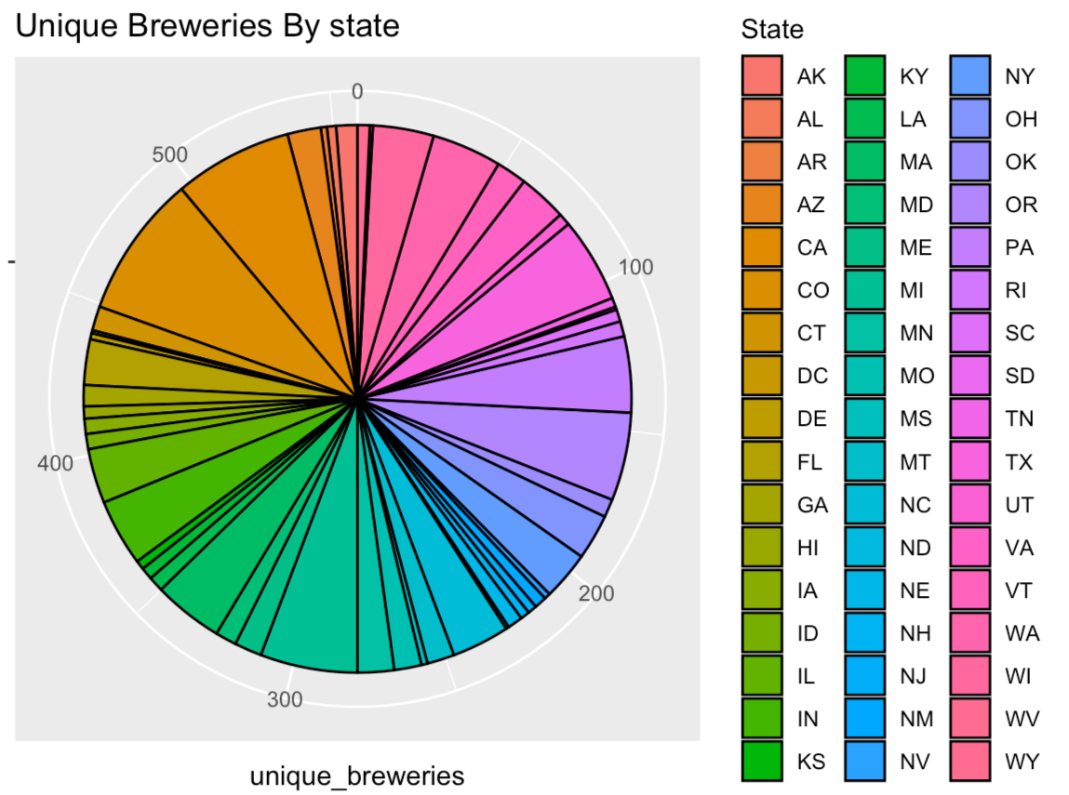
Number of Breweries in each state
Max =CO
Min = ND
Notes:
The pie chart shows the number of unique breweries in each state in a counterclockwise/alphabetic fashion. Starting from the 0 line and going CCW we can follow alphabetically and see that the chart goes from Arkansas to Wyoming.
Potential reasons:
This is most likely due to factors such as state population, state demographics and availability of materials.

Slide 5
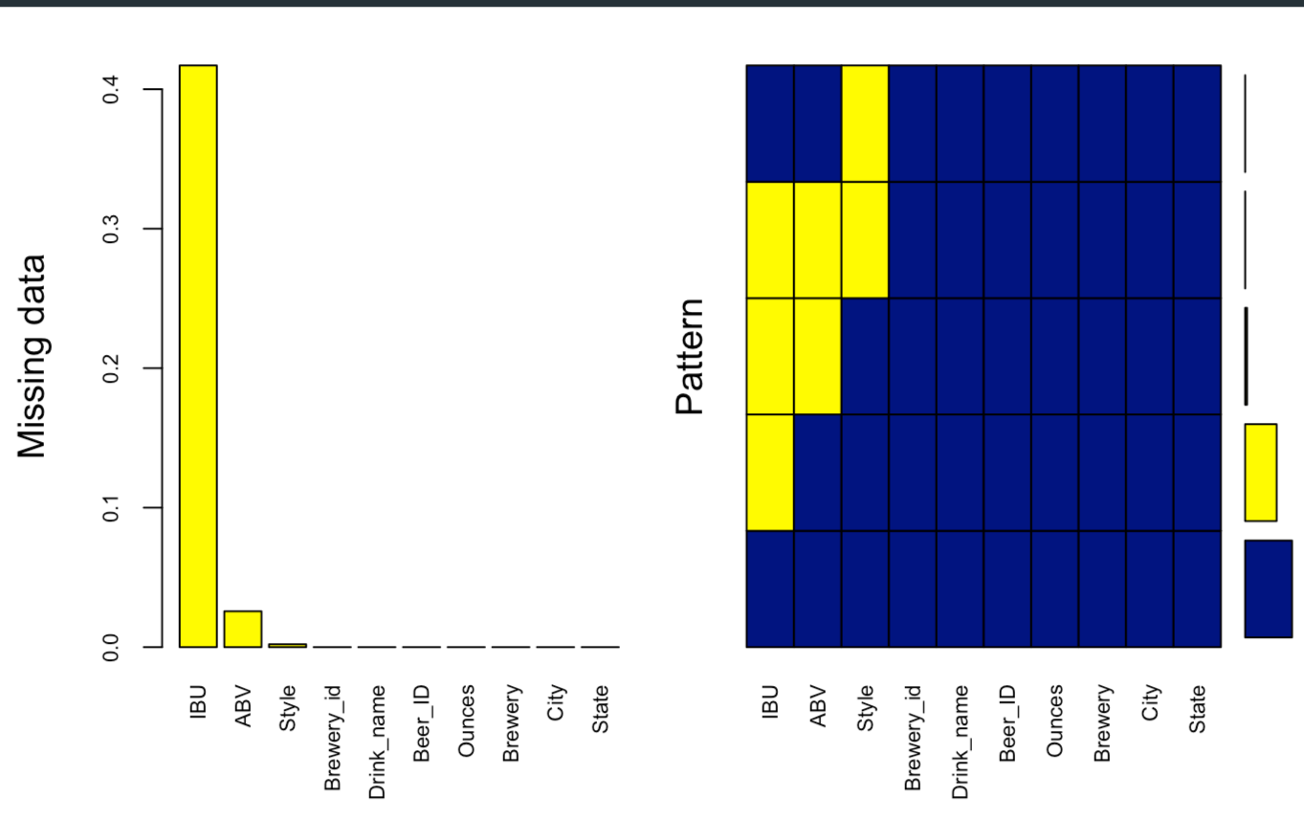
Missing Values
Notes:
The left plot shows the percentage of missing values by attribute. The right plot gives a picture of the percentage of missing vs available data. The bars at the farthest right show the percentage size( from bottom to top) of 1) the available data, 2) the largest missing data attribute, 3) the next largest missing data
So here that would be, a large portion of the data is available. Next, IBU is missing a lot of data. Following that ABV, then Style and finally at the smallest is the 2 missing brewery ID’s.

Slide 6
Missing Data: Strategy
Hand enter all data missing BOTH IBU and ABV
Drop entries missing both IBU and ABV with no available data
Impute IBU based on Median IBU by style for entries that ONLY lack IBU data.
Notes:
Self explanatory slide.
Most ABVs were found through research, and some IBUs along with them
We can talk about how imputing on both statistics can be detrimental to the data.
Problem #1: Mean imputation does not preserve the relationships among variables.
Problem #2: Mean Imputation Leads to An Underestimate of Standard Errors
Source: https://www.theanalysisfactor.com/mean-imputation/ - although this is about mean imputation, I think the effects still apply.
I think the essential point is that any kind of imputation will bias the standard error because the model is not aware that we added these values in(that has its own error). If it was aware then the error could be added automatically but since it isn’t, it’s kind of biased.

Slide 7
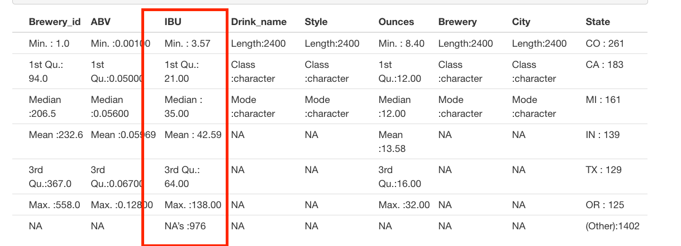
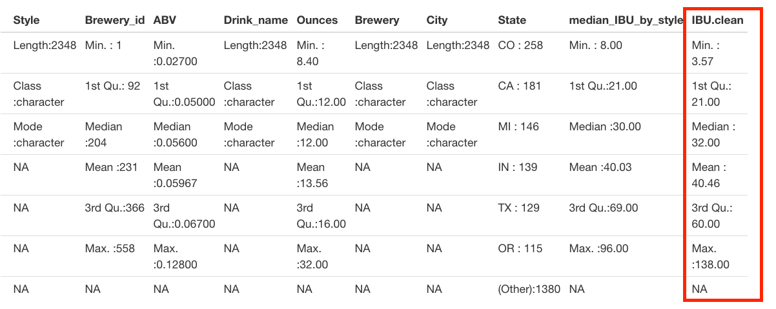
Missing Data: IBU Imputation
Before IBU Imputation
Impute via the median IBU per style…
After IBU Imputation
Notes:
As you can see, after imputation the median and mean IBU values drop slightly, but this effect is somewhat negligible. We proceeded with our imputed IBU values.

Slide 8
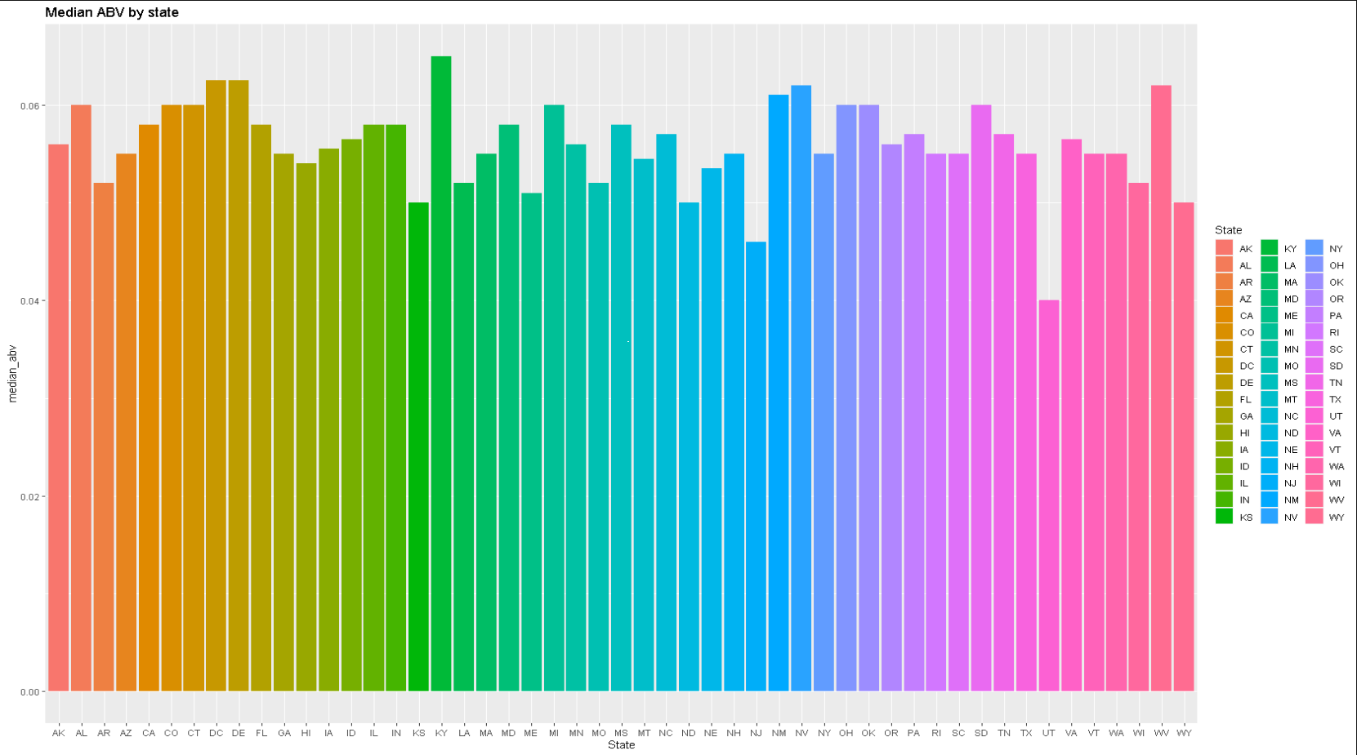
Median ABV by State
Notes:
Kentucky has the highest median ABV. Utah has the lowest ABV per state (state law mandates 4.0% for most beers)
This is likely due to a variety of reasons such as local laws, climate, demographics, local diet, income per capita, etc.

Slide 9
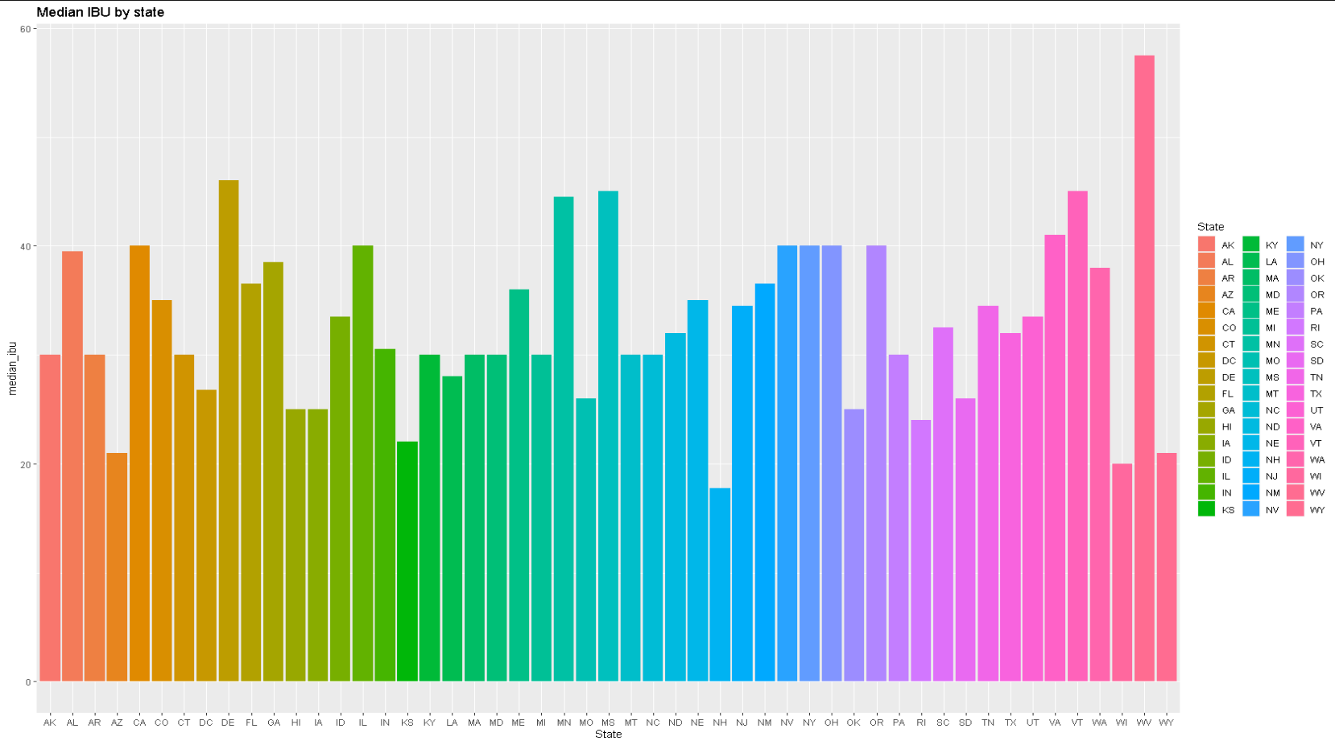
Median IBU by State
Notes:
As you can see, West Virginia has the highest median IBU and New Hampshire has the lowest median IBU per state.
Again, this is likely due to a variety of reasons such as local laws, climate, demographics, local diet, income per capita, etc.

Slide 10
Which states have the max ABV/IBU?
Colorado has the max ABV at 12.8%
Oregon has the highest IBU at 138.
Notes:
Maybe this is not a surprise since there are 40+ breweries in CO.
Colorado has an unusually high number of breweries, and as such there is more opportunity to see a variety of ABV’s.
Oregon is where hops are grown, and very hoppy beers are popular there.

Slide 11
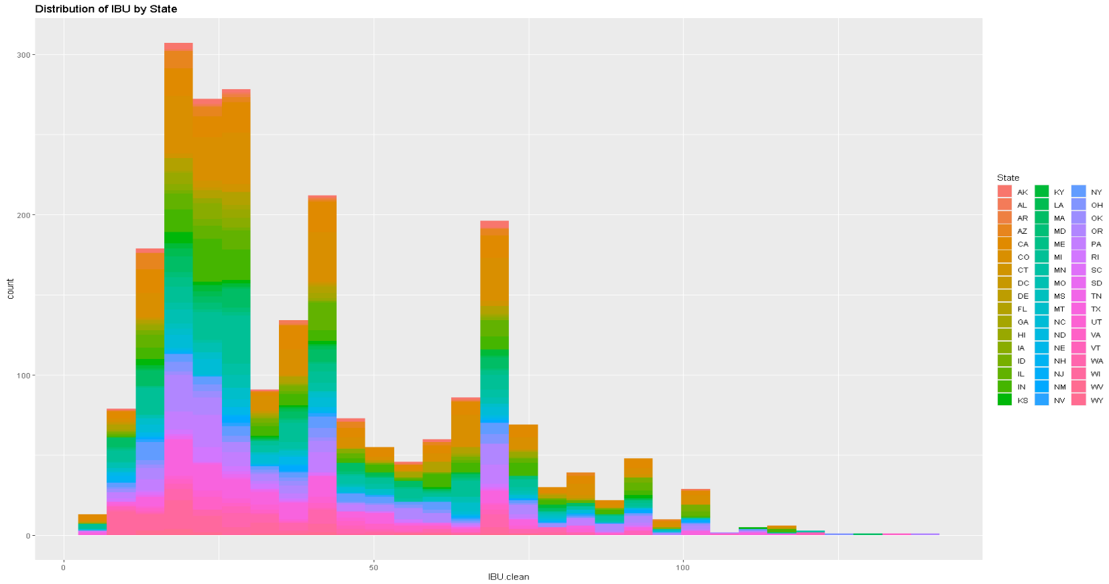
IBU Distribution
Notes:
As you can see this distribution is right skewed. Bitter beer, although popular, is still not more popular than light beer which is not as hoppy.

Slide 12
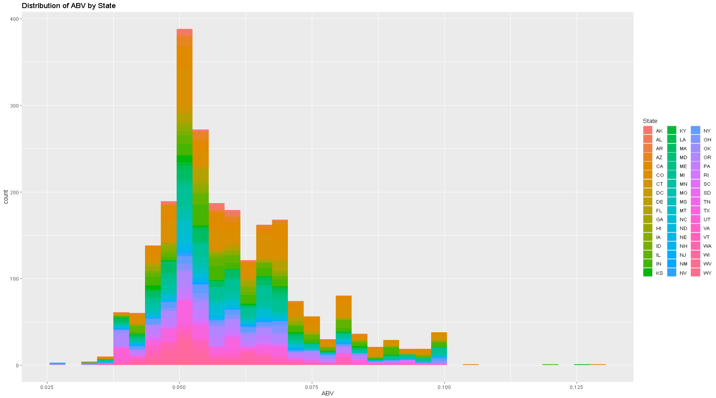
ABV Distribution
Notes:
The ABV distribution is slightly right skewed. ABV can only ever be positive which might explain the skew.
It seems that most popular beers will have around 5% ABV.

Slide 13
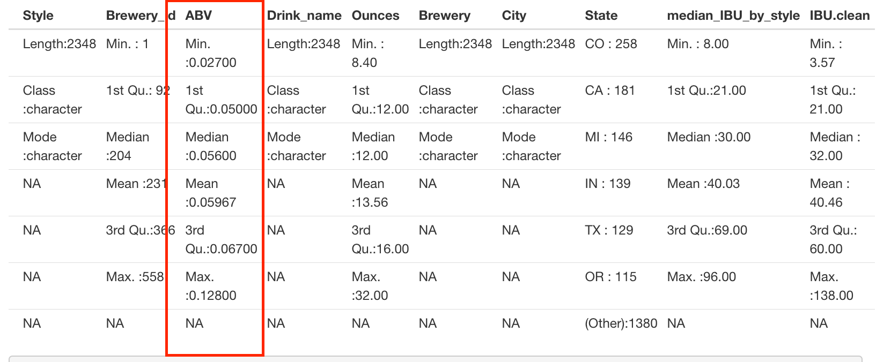
Summary Statistics
Notes:
Minimum ABV is 0.027, the maximum ABV is 0.128. The minimum being 2.7 suggests no non-alcoholic beer is present in our dataset and that the lowest ABV is like a Raddler or a VERY weak session ale. The highest ABV is consistent with Barley wines, Imperial Stouts, or other High gravity beers. The inter-quartile range for the mean 50% of beers ranges from .050 to .0670 suggesting most craft beers have a predictable ABV.

Slide 14
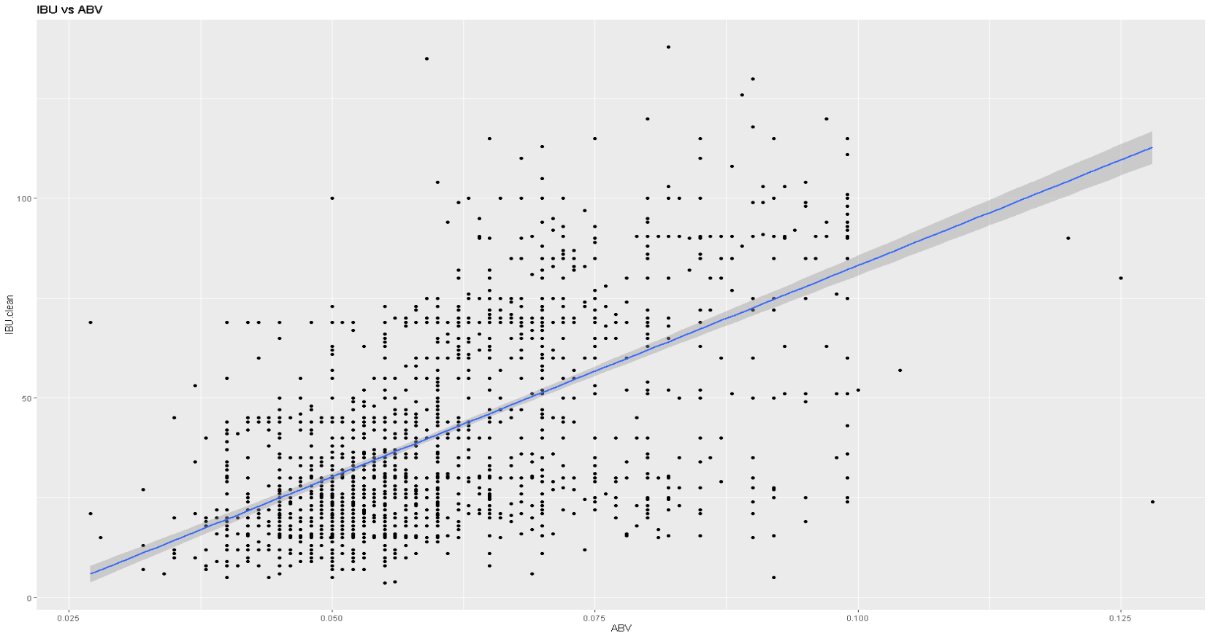
ABV vs IBU Relationship
Notes:
This is the same plot as the slide before except not colorized and fitted with a linear model line.

Slide 15
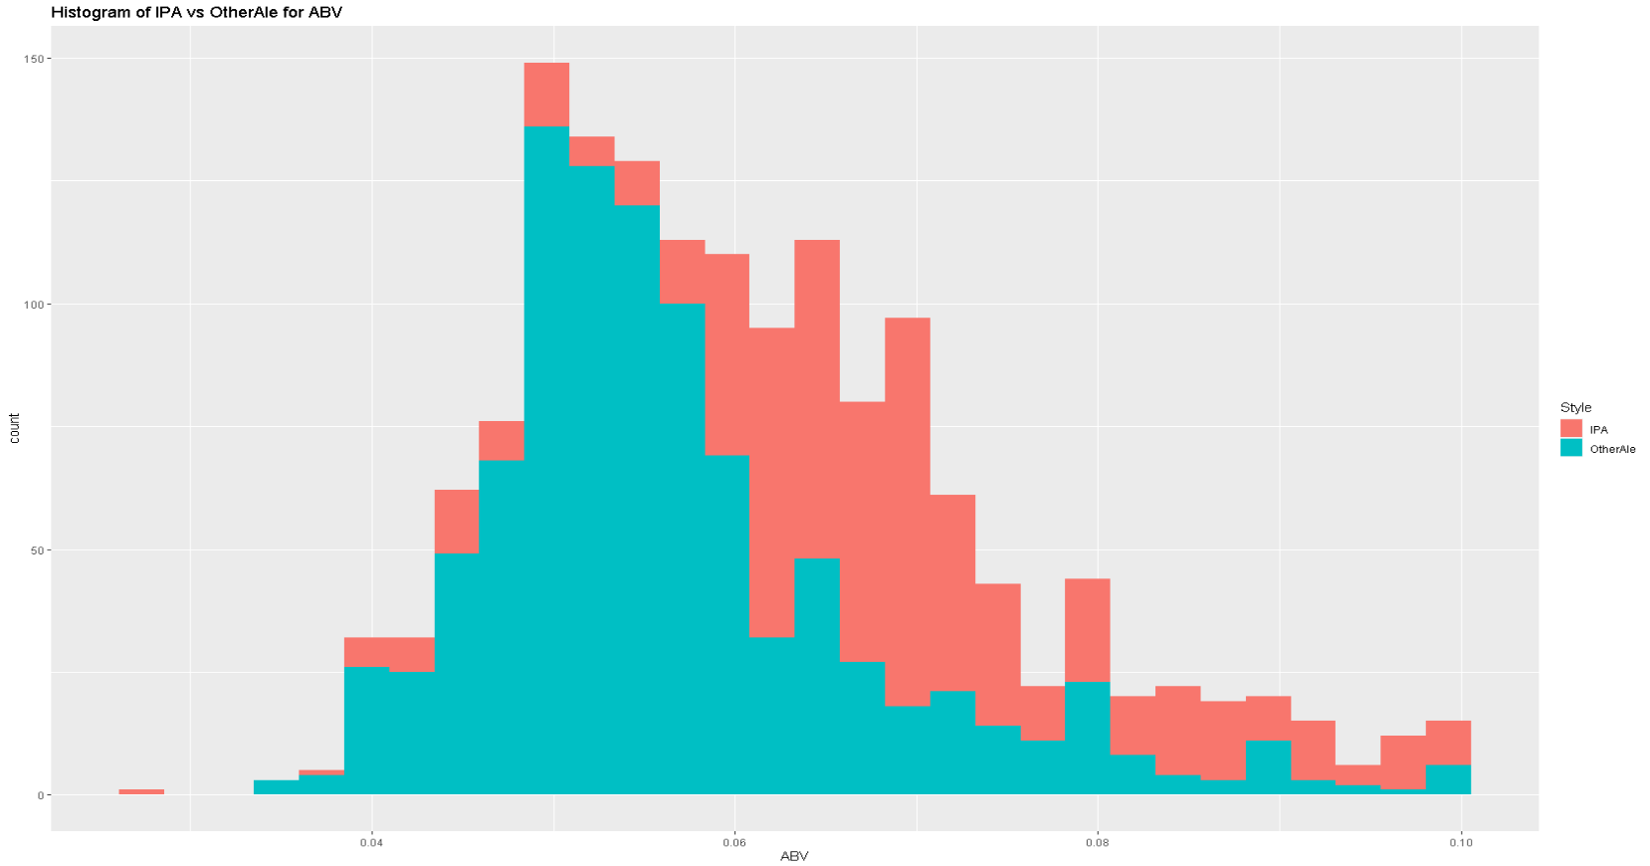
What about IPA’s vs Other Ales?
Notes:
As you can see both distributions are right skewed, and for a set ABV value IPA’s are more right skewed.
It is possible that discerning IPA drinkers might drink fewer beers or pay more for their beer and as such require a higher ABV to get the same buzz.

Slide 16
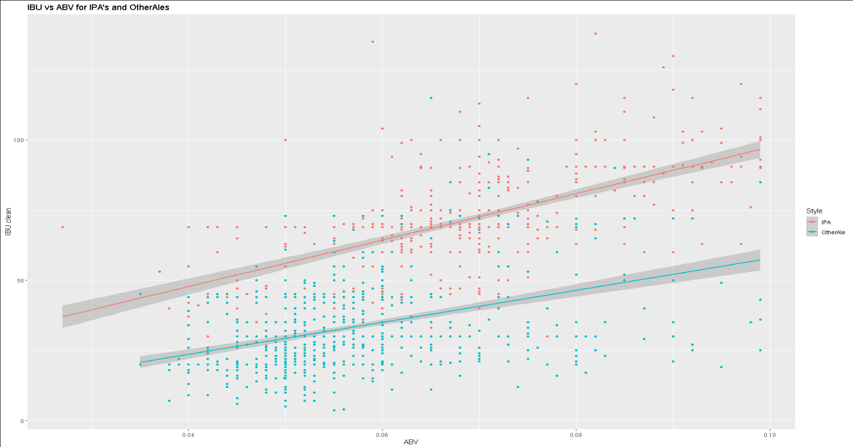
What about IPA’s vs Other Ales?
Notes:
As you can see the red line shows the trend for IPA and the blue shows the trend for Other ale.
IPAs are generally hoppier for the same ABV when compared to Other Ales. This is likely because IPAs use a lot of hops in the brewing process.

Slide 17
Classification of ‘IPA’s’ vs ‘Other Ales’
We classified ‘IPA’s’ vs ‘Other Ales’ by IBU and ABV
We used a nonparametric model(kNN with k = 6)
Classification accuracy was 89% (P-value < 2e-16)
We can be 95% confident that the true accuracy for our model is between [0.8537, 0.9355]
Notes:
Our successful classification of IPAs vs Other Ales reinforces the notions that the relationship between IBU and ABV are different between IPA’s and Other Ales. The reasons for this might include the aforementioned slides.

Slide 18
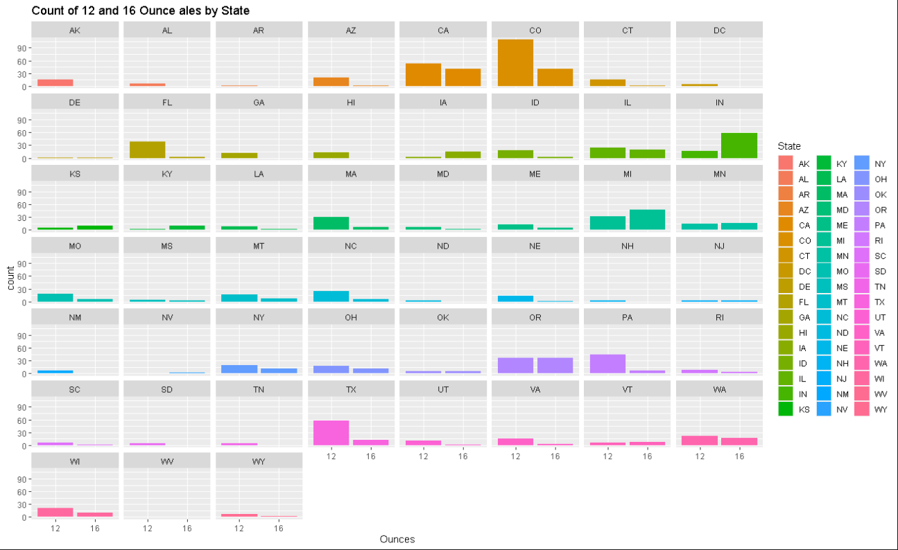
Notes:
Note that ratios between 12- and 16-ounce ales are different for each state highlighting potentially different preferences by state.

Slide 19
Classification of Ounces vs State
We classified Ounces vs State by IBU and ABV
We used a nonparametric model(kNN with k = 8)
Classification accuracy was 71.4 % (P-value < 2e-16)
We can be 95% confident that the true accuracy for our model is between [0.8537, 0.9355]
Notes:
This suggests that when considering what size a beer should be sold in, it could be important to consider what state that beer is going to be brewed in.
This helps align sales with the laws and preferences of that state. For example, Indiana has a high prevalence of 16 ounce ales, whereas Colorado or Texas both lean towards 12 ounce ales. It would be preferable to brew and sell 16 ounce beers in states like Indiana (or other states that have more 16 ounce ales) and 12 ounce beers in Colorado (or other states that have more 12 ounce ales).
The reason for this association may be due to a variety of reasons including income, weather, local diet, and social norms for beer drinkers.

Slide 20
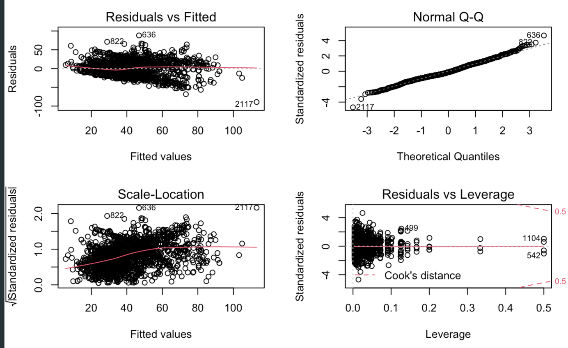
Appendix: ABV vs IBU Relationship
Residuals after fitting Multiple Linear Regression, Linear-Linear: IBU vs ABV model
IBU given State, ABV

