Slide 1
Beers and Breweries: ABV vs IBU Initial EDA
Kebur Fantahun and Ricco Ferraro
03/07/2021
Notes:
voice inflection, Name introduction

Slide 2
Overview
QOI
The Dataset
Number of Breweries in each state
Missing Values
Median ABV vs Median IBU
Max ABV/IBU
Summary Statistics for ABV
ABV vs IBU

Slide 3
Question of Interest:
Assess the relationship between IBU and ABV for beers across different states
Notes:
We want to investigate the relationship between ABV and IBU for several different beers and breweries. What kind of dataset do we have?

Slide 4
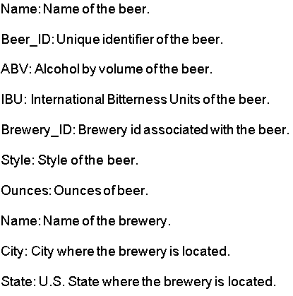
Dataset
The beer data collected across the United States includes the following properties:
Notes:
Intro to dataset, style is important for us since we imputed based on the median in the same style
Styles of beer: Porters and Lagers, Amber or Pale ales and the like

Slide 5
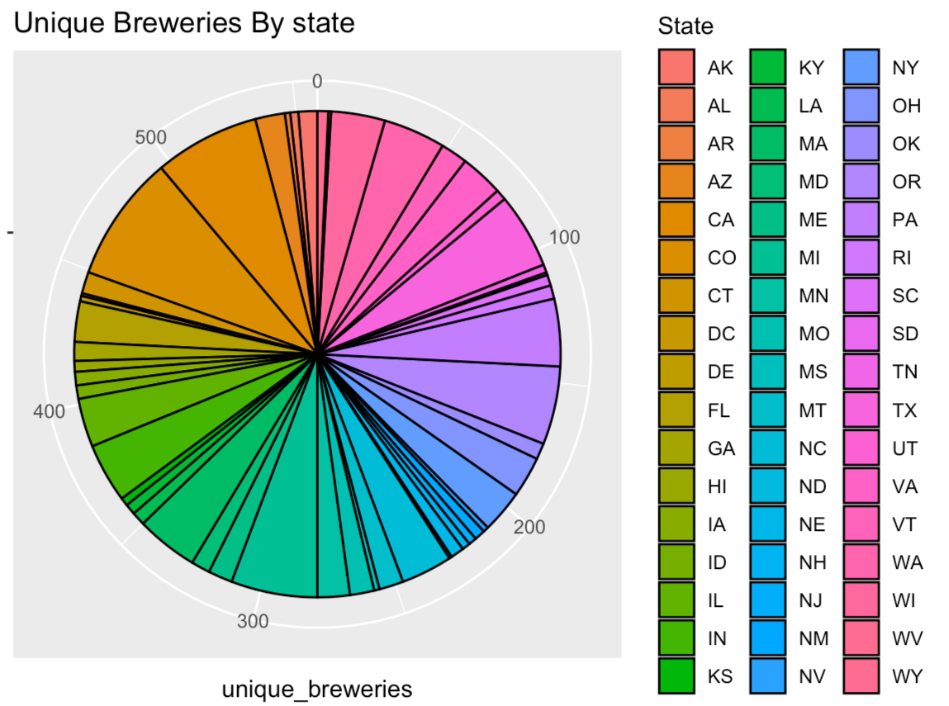
Number of Breweries in each state
Max =CO
Min = ND
Notes:
The pie chart shows the number of unique breweries in each state in a counterclockwise/alphabetic fashion. Starting from the 0 line and going CCW we can follow alphabetically and see that the chart goes from Arkansas to Wyoming.
Potential reasons:
This is most likely due to factors such as state population, state demographics and availability of materials.

Slide 6
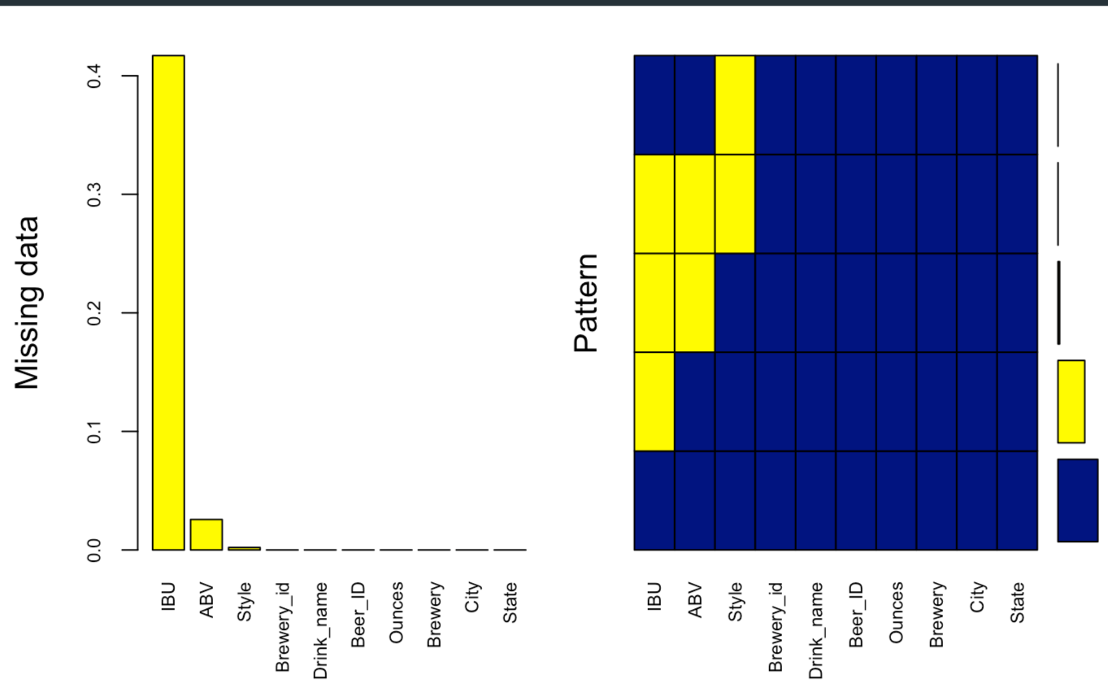
Missing Values
Notes:
The left plot shows the percentage of missing values by attribute. The right plot gives a picture of the percentage of missing vs available data. The bars at the farthest right show the percentage size( from bottom to top) of 1) the available data, 2) the largest missing data attribute, 3) the next largest missing data
So here that would be, a large portion of the data is available. Next, IBU is missing a lot of data. Following that ABV, then Style and finally at the smallest is the 2 missing brewery ID’s.

Slide 7
Missing Data: Strategy
Hand enter all data missing IBU and ABV
Drop entries missing both IBU and ABV with no data online
Impute IBU based on Median IBU by style for entries that ONLY lack IBU data.
Notes:
Self explanatory slide.
Most ABVs were found through research, and some IBUs along with them
We can talk about how imputing on both statistics can be detrimental to the data.
Problem #1: Mean imputation does not preserve the relationships among variables.
Problem #2: Mean Imputation Leads to An Underestimate of Standard Errors
Source: https://www.theanalysisfactor.com/mean-imputation/ - although this is about mean imputation, I think the effects still apply.
I think the essential point is that any kind of imputation will bias the standard error because the model is not aware that we added these values in(that has its own error). If it was aware then the error could be added automatically but since it isn’t, it’s kind of biased.

Slide 8
Missing Data: Hand Entry
No data was found and thus entries with missing data are dropped for:
Cedar Creek - Special Release is ambiguous, missing ABV/IBU/Style it does not solve the QOI.
Oskar Blues Brewery - The Crowler is not an actual beer but a type of can.
Oskar Blues Brewery - Can’d aid foundation is a relief effort that sends water so it does not fit in the dataset.
Beer ID 2364, Royal Lager of Weston Brewing has no ABV/IBU.
Beer ID 2322, Fort Pitt Brewing Company Fort Pitt Ale.
Beer ID 1750, Oskar Blues Brewery Birth IPA.
Beer ID 710, no data.
Beer ID 273, MillKing It Productions AXL Pale Ale, out of business no info.
Beer ID 1095, no data.
Beer ID 963, no data.

Slide 9
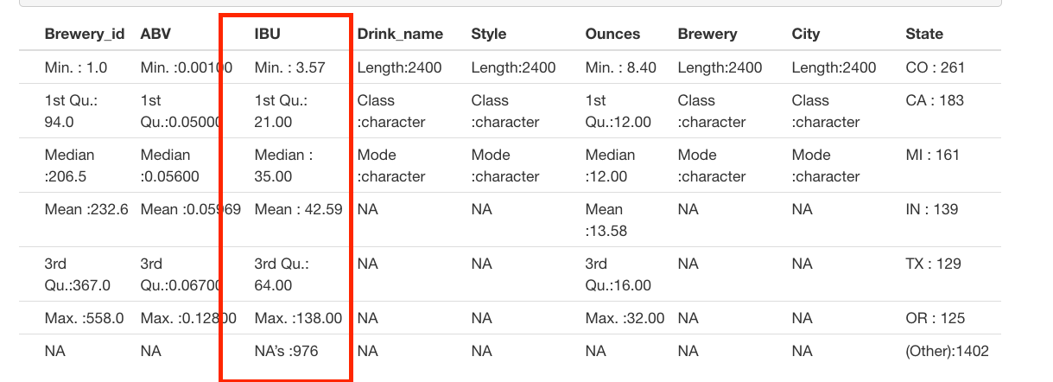
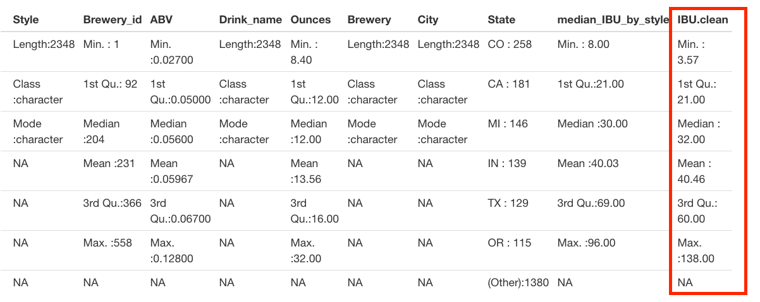
Missing Data: IBU Imputation
Before IBU Imputation
Impute via the median IBU per style…
After IBU Imputation

Slide 10
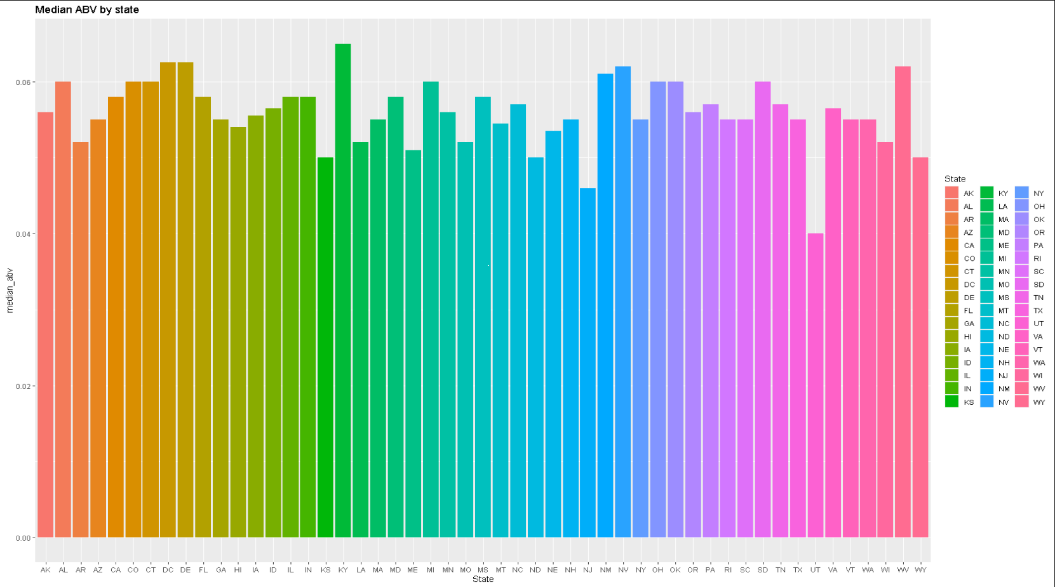
Median ABV by State
Notes:
Kentucky has the highest median ABV. Utah has the lowest ABV per state (state law mandates 4.0% for most beers)
This is likely due to a variety of reasons such as local laws, climate, demographics, local diet, income per capita, etc.

Slide 11
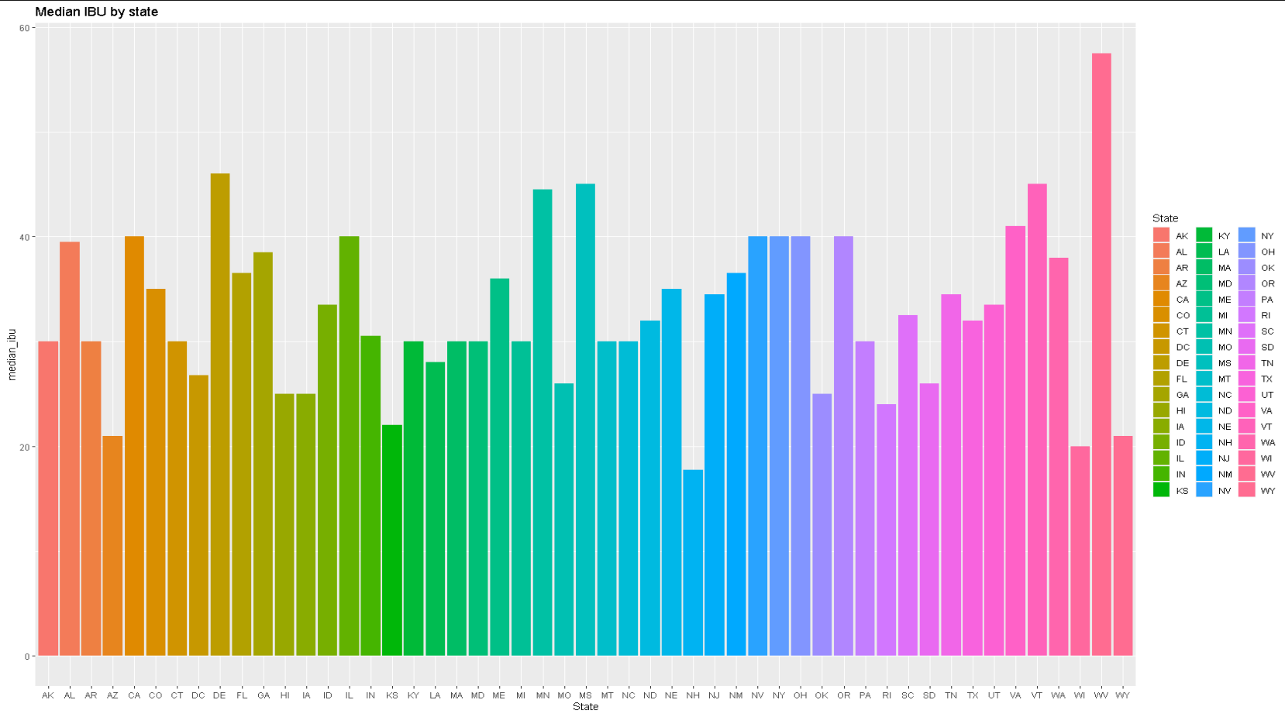
Median IBU by State
Notes:
As you can see, West Virginia has the highest median IBU and New Hampshire has the lowest median IBU per state.
Again, this is likely due to a variety of reasons such as local laws, climate, demographics, local diet, income per capita, etc.

Slide 12
Which states have the max ABV/IBU?
Colorado has the max ABV at 0.128.
Oregon has the most IBU at 138.
Notes:
Maybe this is not a surprise since there are 40+ breweries in CO.
Colorado has an unusually high number of breweries, and as such there is more opportunity to see a variety of ABV’s.
Oregon is where hops are grown, and very hoppy beers are popular there.

Slide 13
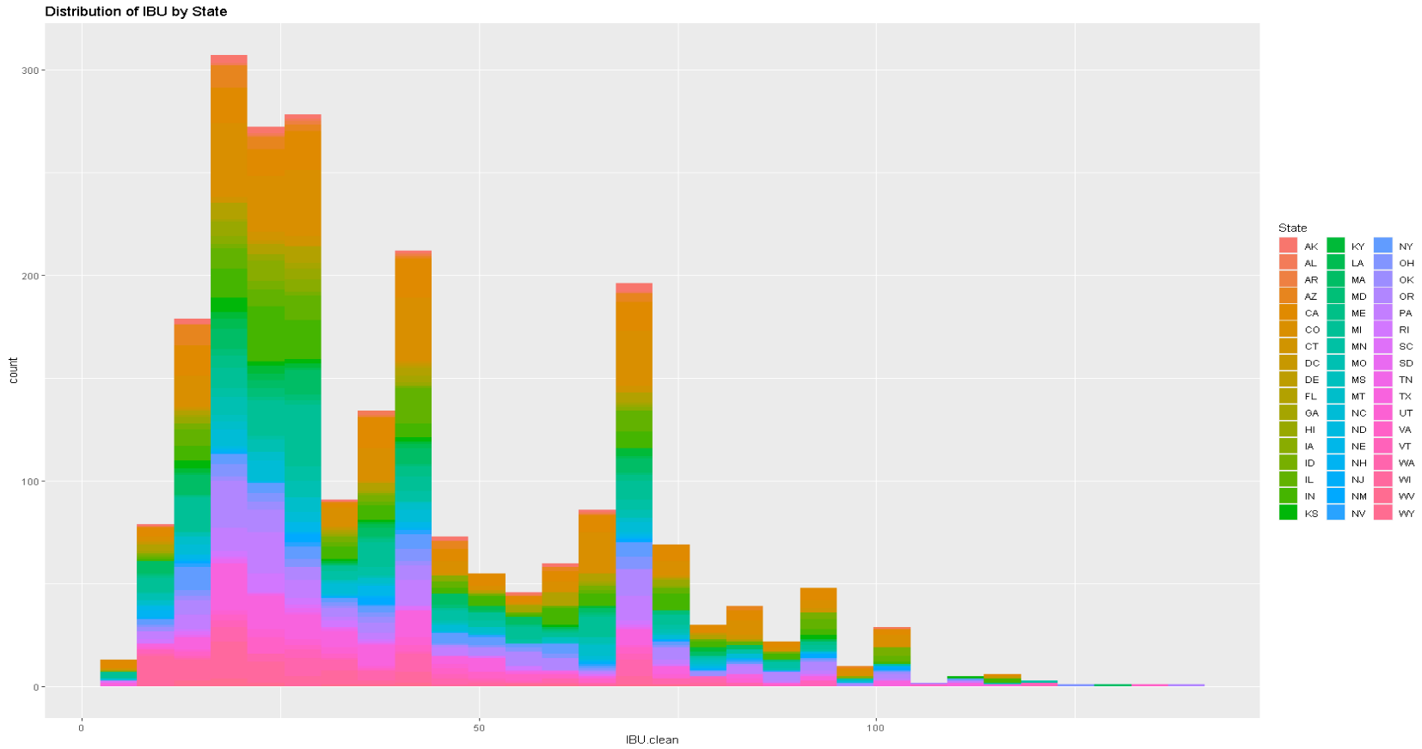
IBU Distribution
Notes:
The IBU distribution is right-skewed which could indicate that more bitter beer is less popular and thus sold less.

Slide 14
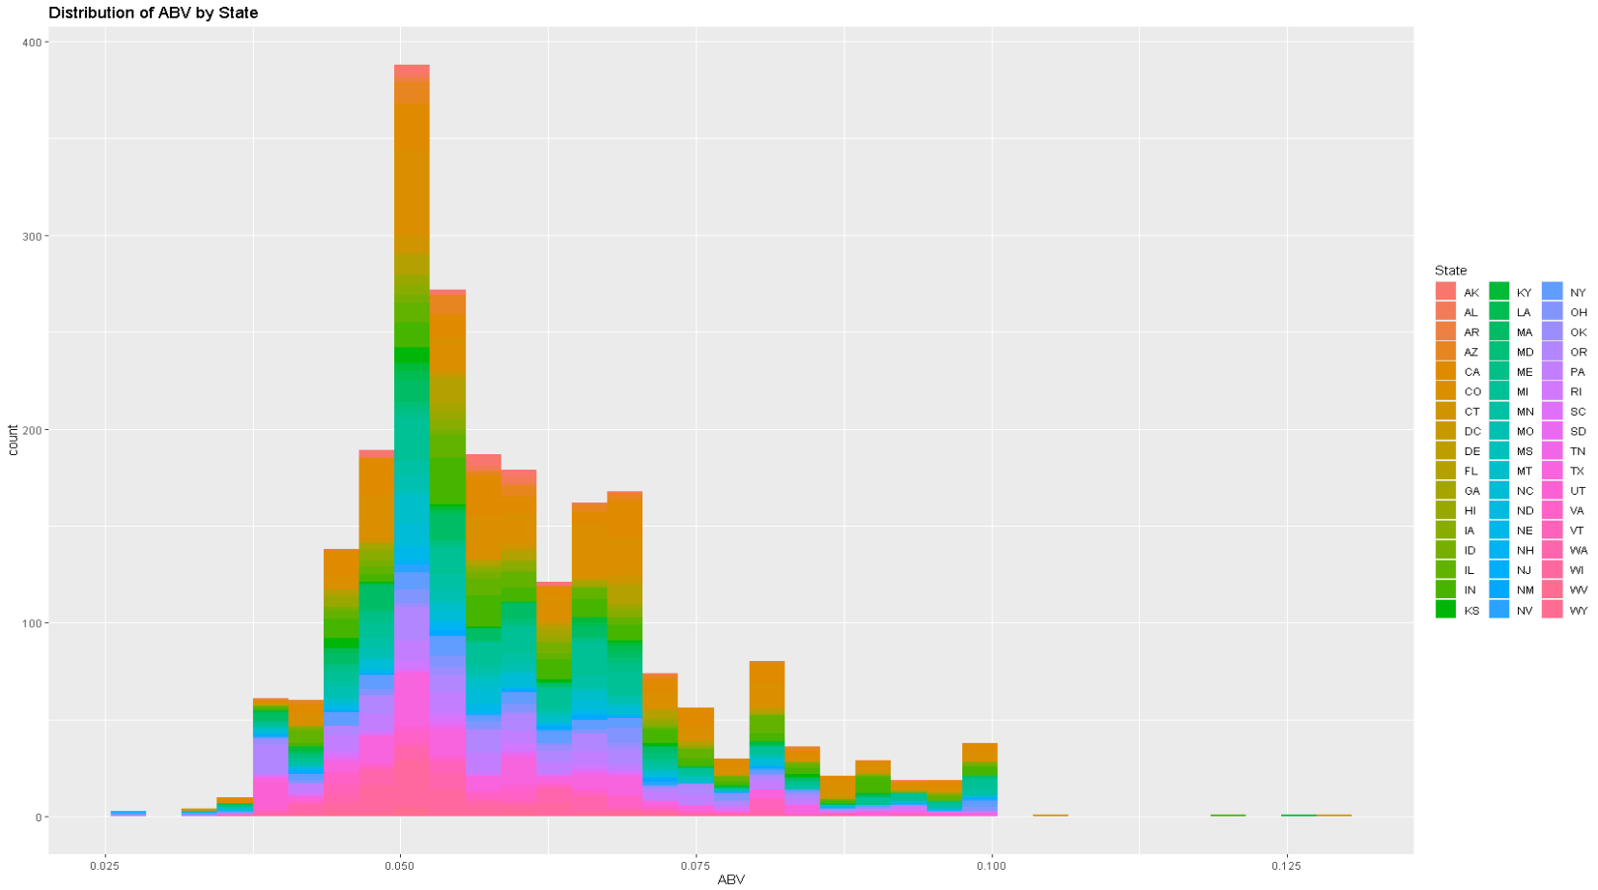
ABV Distribution
Notes:
The ABV distribution is slightly right skewed. ABV can only ever be positive which might explain the skew.
It seems that most popular beers will have around 5% ABV.

Slide 15
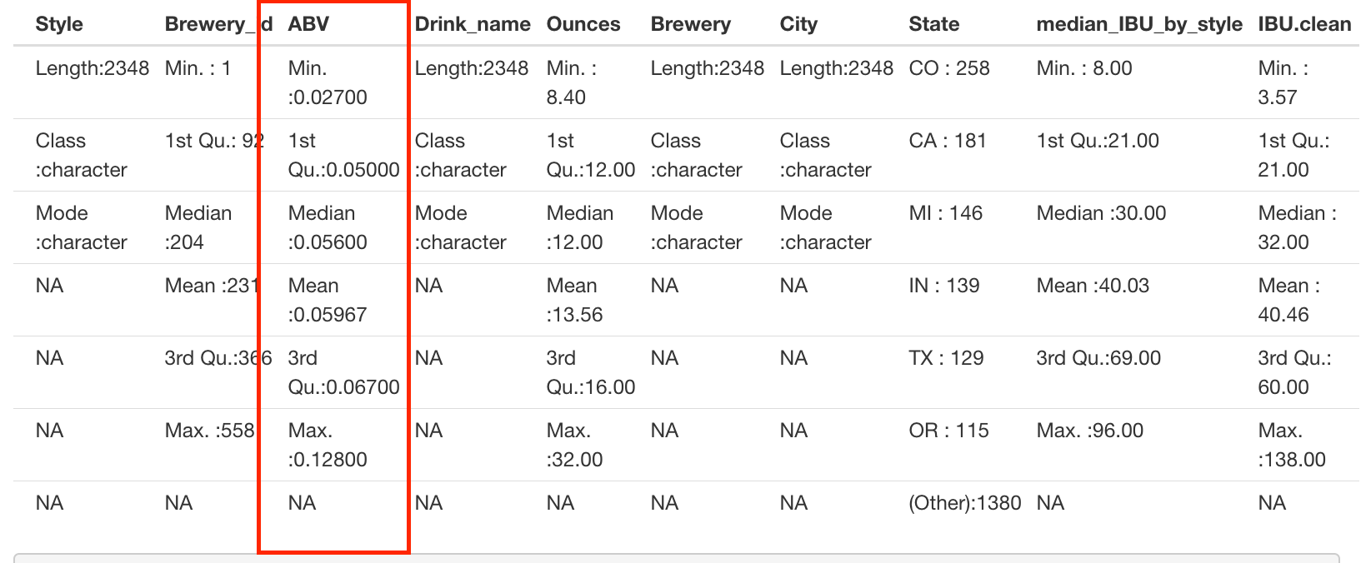
Summary Statistics
Notes:
Minimum ABV is 0.027, the maximum ABV is 0.128. The minimum being 2.7 suggests no non-alcoholic beer is present in our dataset and that the lowest ABV is like a Raddler or a VERY weak session ale. The highest ABV is consistent with Barley wines, Imperial Stouts, or other High gravity beers. The inter-quartile range for the mean 50% of beers ranges from .050 to .0670 suggesting most craft beers have a predictable ABV.

Slide 16
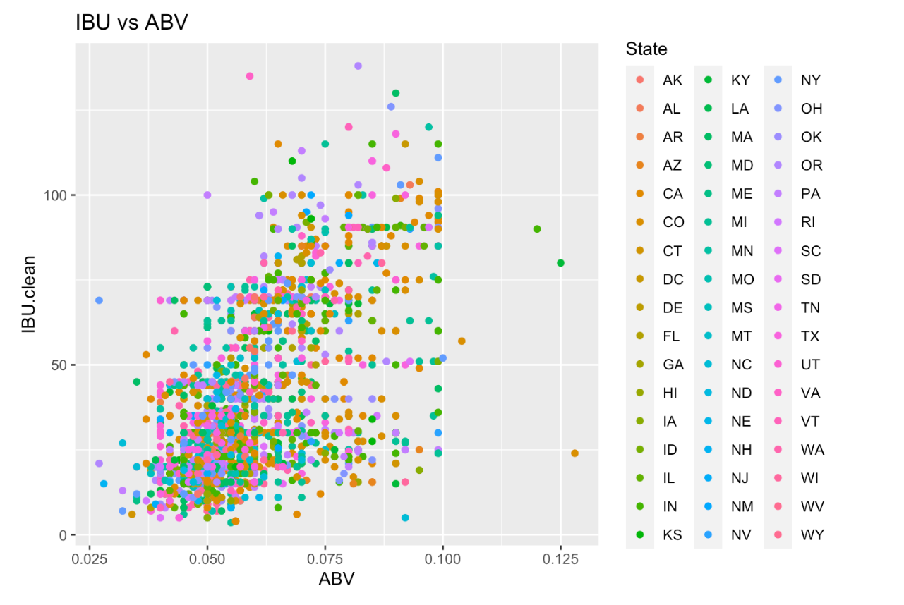
ABV vs IBU Relationship
Notes:
As can be seen, here are the scatter plots for IBU vs ABV, colorized by state with an ordinary least square's regression line.
These plots suggest visually that there is indeed a linear relationship between IBU and ABV and that there are some outliers at the very high and low ABV values.

Slide 17
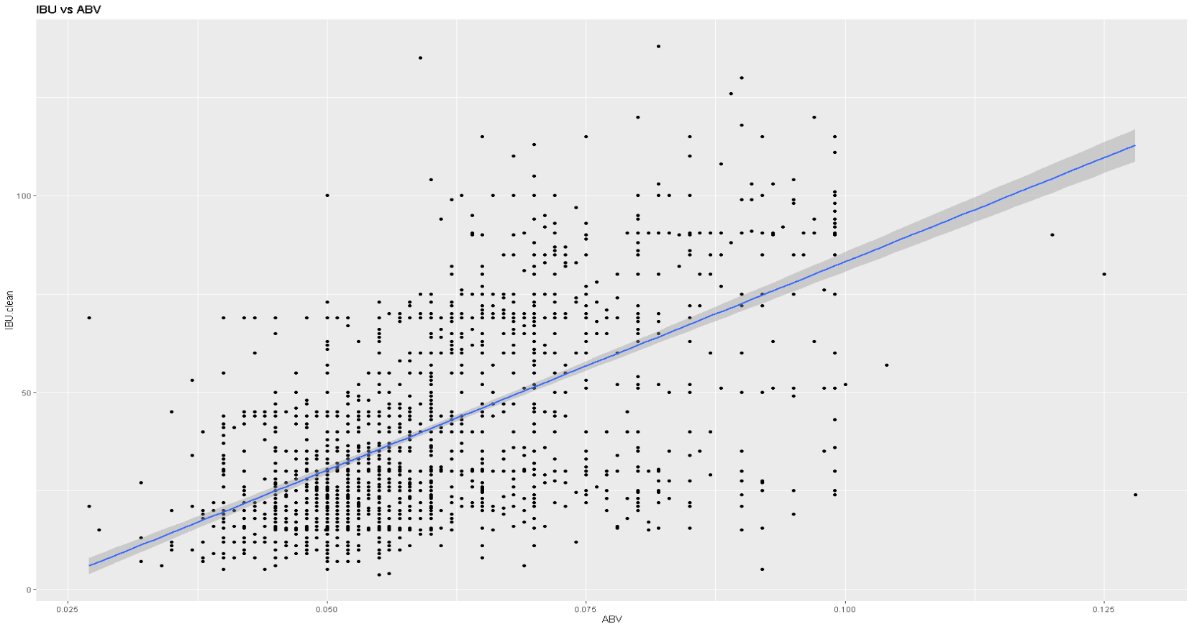
ABV vs IBU Relationship
Notes:
This is the same plot as the slide before except not colorized and fitted with a linear model line.

Slide 18
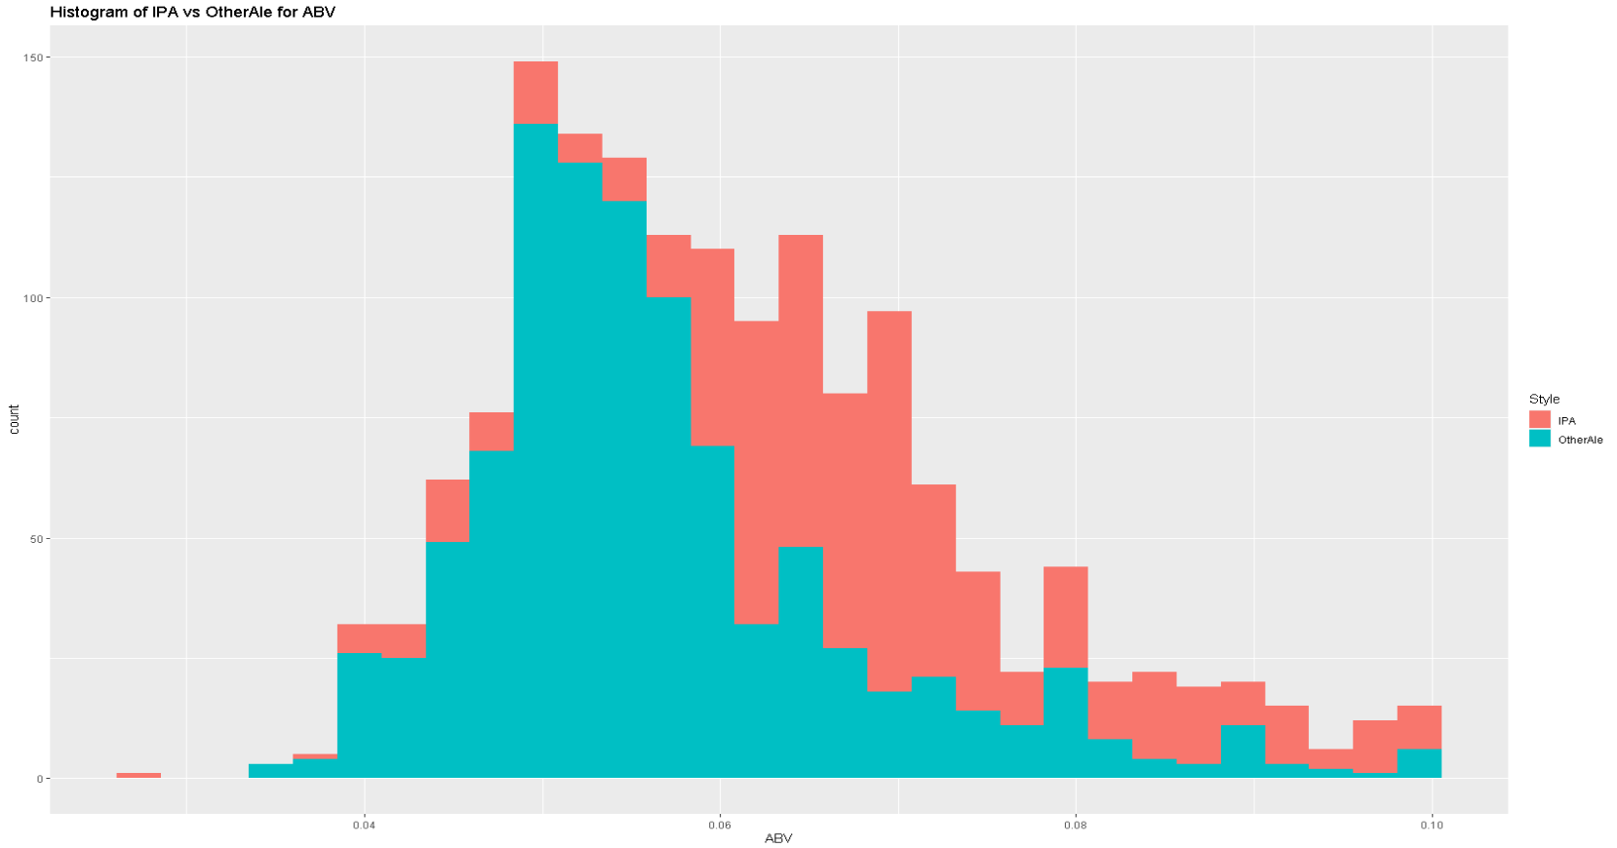
What about IPA’s vs Other Ales?
Notes:
As you can see both distributions are right skewed, and for a set ABV value IPA’s are more right skewed.
It is possible that discerning IPA drinkers might drink fewer beers or pay more for their beer and as such require a higher ABV to get the same buzz.

Slide 19
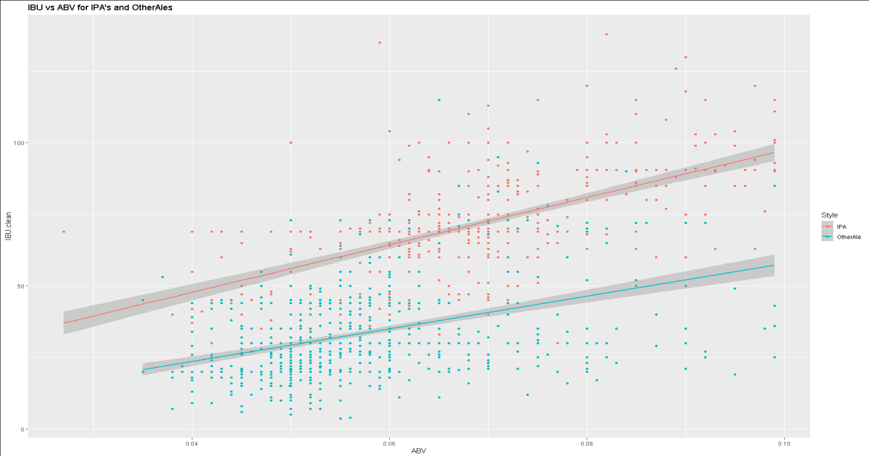
What about IPA’s vs Other Ales?
Notes:
As you can see the red line shows the trend for IPA and the blue shows the trend for Other ale.
IPAs are generally hoppier for the same ABV when compared to Other Ales. This is likely because IPAs use a lot of hops in the brewing process.

Slide 20
Classification of ‘IPA’s’ vs ‘Other Ales’
We classified ‘IPA’s’ vs ‘Other Ales’ by IBU and ABV
We used a nonparametric model(kNN with k = 6)
Classification accuracy was 89% (P-value < 2e-16)
We can be 95% confident that the true accuracy for our model is between [0.8537, 0.9355]
Notes:
Our successful classification of IPAs vs Other Ales reinforces the notions that the relationship between IBU and ABV are different between IPA’s and Other Ales. The reasons for this might include the aforementioned slides.

Slide 21
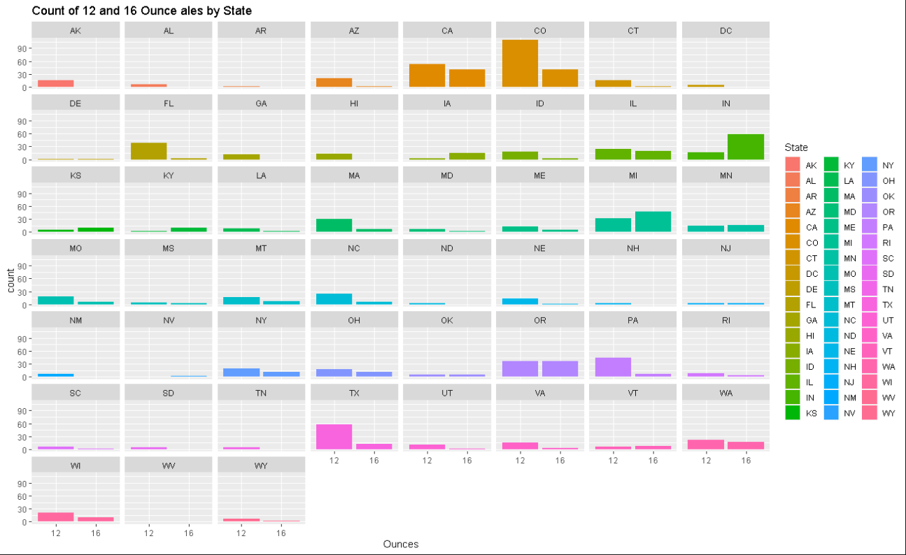
Notes:
Note that ratios between 12- and 16-ounce ales are different for each state highlighting potentially different preferences by state.

Slide 22
Classification of Ounces vs State
We classified Ounces vs State by IBU and ABV
We used a nonparametric model(kNN with k = 8)
Classification accuracy was 71.4 % (P-value < 2e-16)
We can be 95% confident that the true accuracy for our model is between [0.8537, 0.9355]
Notes:
This suggests that when considering what size a beer should be sold in, it could be important to consider what state that beer is going to be brewed in.
This helps align sales with the laws and preferences of that state. For example, Indiana has a high prevalence of 16 ounce ales, whereas Colorado or Texas both lean towards 12 ounce ales. It would be preferable to brew and sell 16 ounce beers in states like Indiana (or other states that have more 16 ounce ales) and 12 ounce beers in Colorado (or other states that have more 12 ounce ales).
The reason for this association may be due to a variety of reasons including income, weather, local diet, and social norms for beer drinkers.

Slide 23
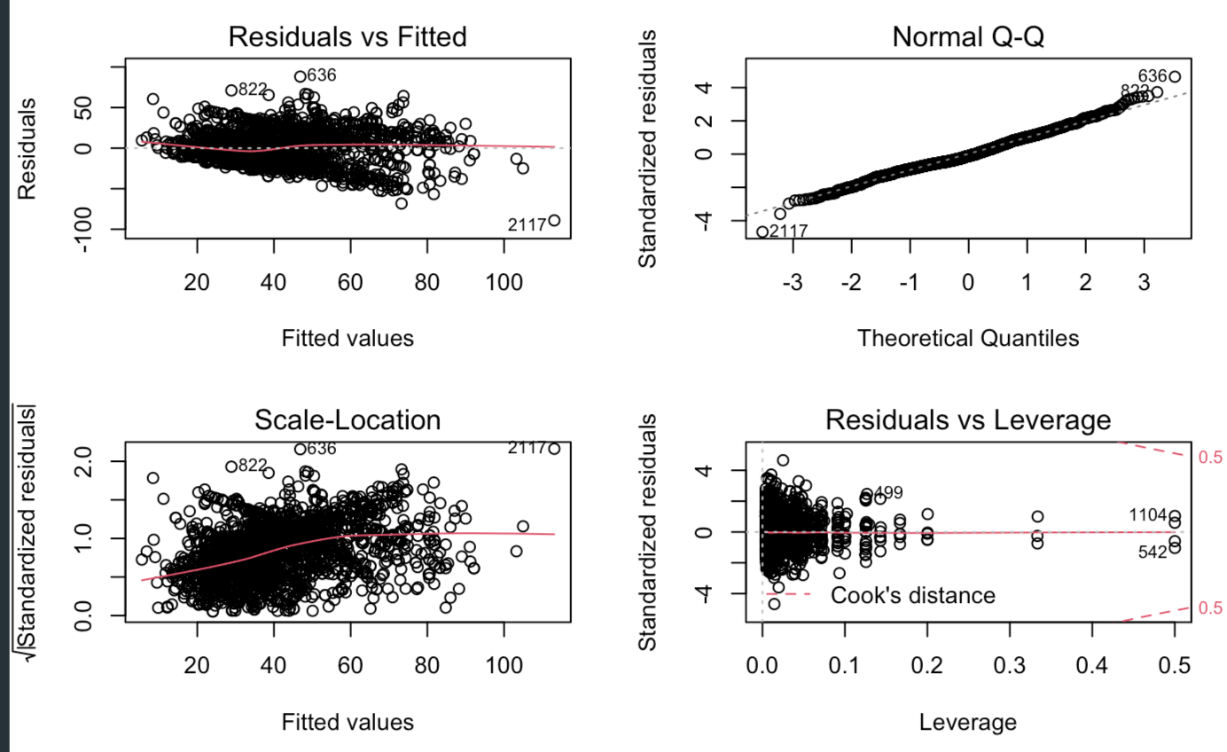
Appendix: ABV vs IBU Relationship
Residuals after fitting Multiple Linear Regression, Linear-Linear: IBU vs ABV model
IBU given State, ABV

