Slide 1
Beers and Breweries: ABV vs IBU Initial EDA
Kebur Fantahun and Ricco Ferraro
02/23/2021
Notes:
Good evening, voice inflection, Name introduction,

Slide 2
Overview
QOI
The Dataset
Number of Breweries in each state
Missing Values
Median ABV vs Median IBU
Max ABV/IBU
Summary Statistics for ABV
ABV vs IBU

Slide 3
Question of Interest:
Assess the relationship between IBU and ABV for beers across different states
Notes:
We want to investigate the relationship between ABV and IBU for several different beers and breweries. What kind of dataset do we have?

Slide 4
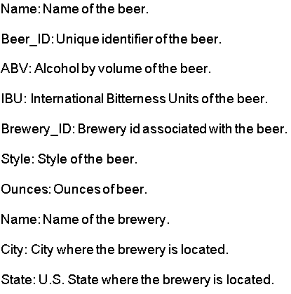
Dataset
The beer data collected across the United States includes the following properties:
Notes:
Intro to dataset, style is important for us since we imputed based on the median in the same style
Styles of beer: Porters and Lagers, Amber or Pale ales and the like

Slide 5
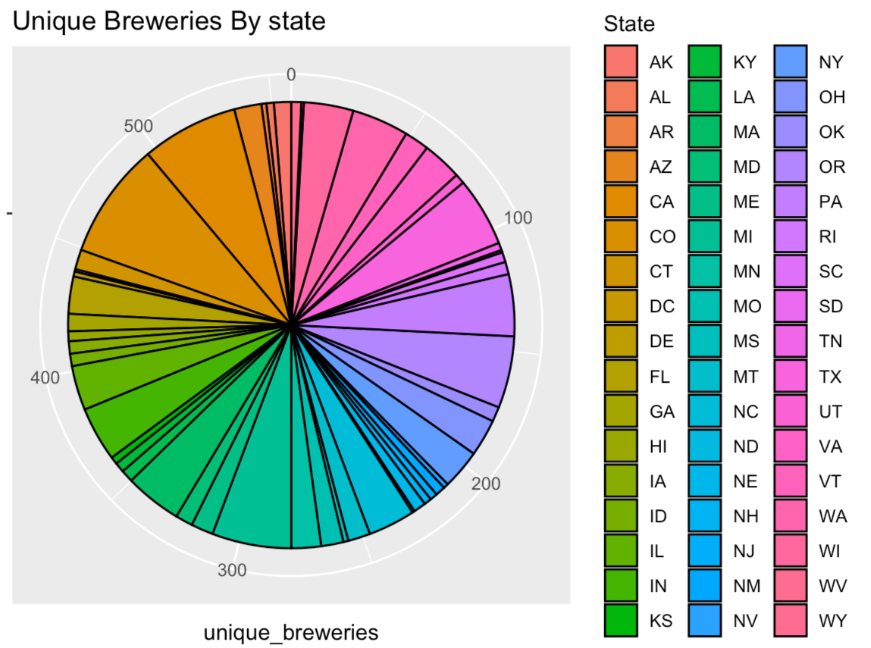
Number of Breweries in each state
Notes:
The pie chart shows the number of unique breweries in each state in a counterclockwise/alphabetic fashion. Starting from the 0 line and going CCW we can follow alphabetically and see that the chart goes from Arkansas to Wyoming.

Slide 6
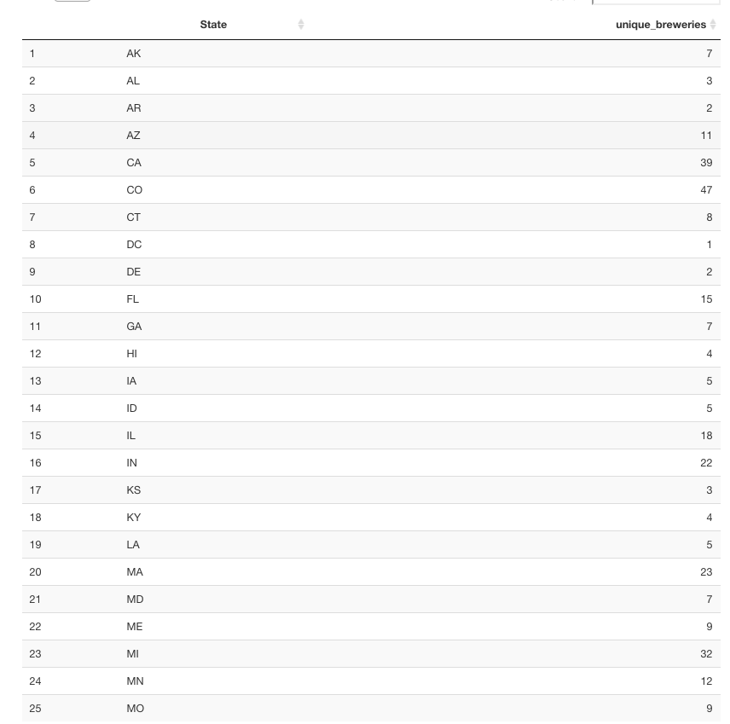
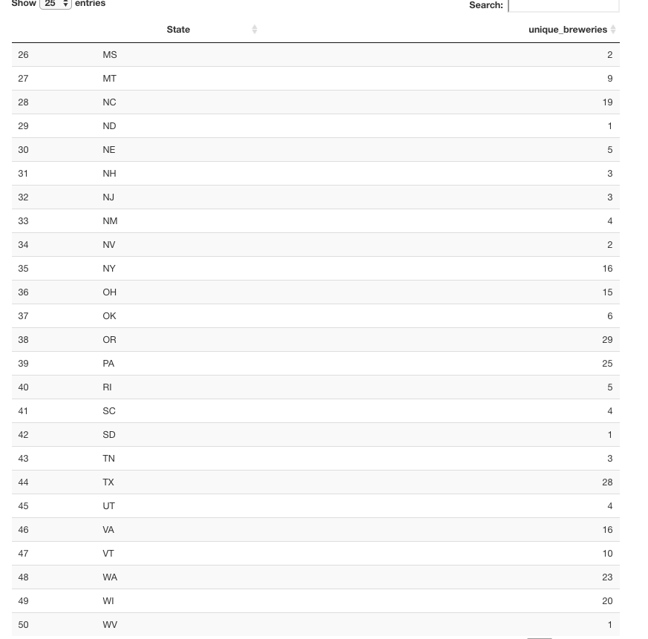
Breweries in each state continued...
Notes:
47 breweries in Colorado, 39 in California and 11 in Arizona

Slide 7
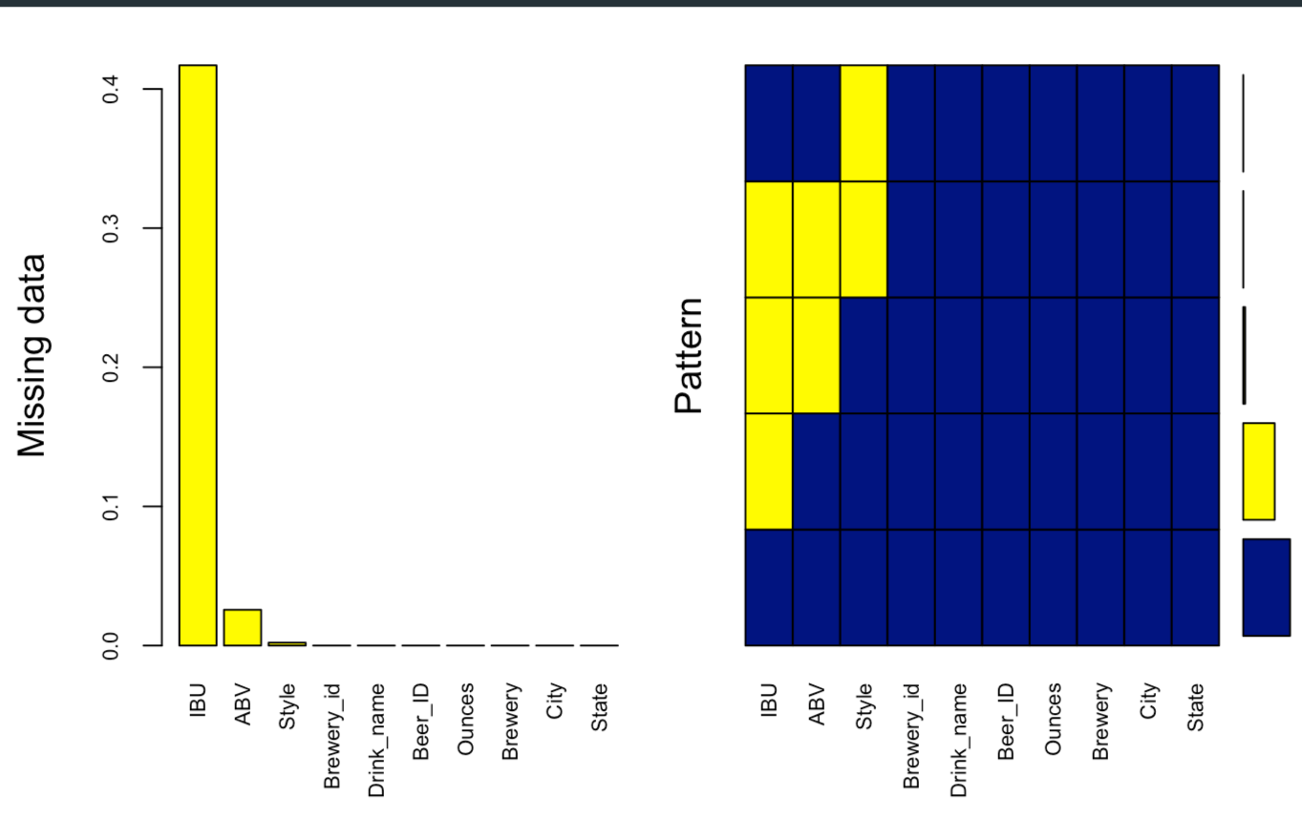
Missing Values
Notes:
The left plot shows the percentage of missing values by attribute. The right plot gives a picture of the percentage of missing vs available data. The bars at the farthest right show the percentage size( from bottom to top) of 1) the available data, 2) the largest missing data attribute, 3) the next largest missing data
So here that would be, a large portion of the data is available. Next, IBU is missing a lot of data. Following that ABV, then Style and finally at the smallest is the 2 missing brewery ID’s.

Slide 8
Missing Data: Strategy
Hand enter all data missing IBU and ABV
Drop entries missing both IBU and ABV with no data online
Impute IBU based on Median IBU by style for entries that ONLY lack IBU data.
Notes:
Self explanatory slide.
Most ABVs were found through research, and some IBUs along with them
We can talk about how imputing on both statistics can be detrimental to the data.
Problem #1: Mean imputation does not preserve the relationships among variables.
Problem #2: Mean Imputation Leads to An Underestimate of Standard Errors
Source: https://www.theanalysisfactor.com/mean-imputation/ - although this is about mean imputation, I think the effects still apply.
I think the essential point is that any kind of imputation will bias the standard error because the model is not aware that we added these values in(that has its own error). If it was aware then the error could be added automatically but since it isn’t, it’s kind of biased.

Slide 9
Missing Data: Hand Entry
No data was found and thus entries with missing data are dropped for:
Cedar Creek - Special Release is ambiguous, missing ABV/IBU/Style it does not solve the QOI.
Oskar Blues Brewery - The Crowler is not an actual beer but a type of can.
Oskar Blues Brewery - Can’d aid foundation is a relief effort that sends water so it does not fit in the dataset.
Beer ID 2364, Royal Lager of Weston Brewing has no ABV/IBU.
Beer ID 2322, Fort Pitt Brewing Company Fort Pitt Ale.
Beer ID 1750, Oskar Blues Brewery Birth IPA.
Beer ID 710, no data.
Beer ID 273, MillKing It Productions AXL Pale Ale, out of business no info.
Beer ID 1095, no data.
Beer ID 963, no data.

Slide 10
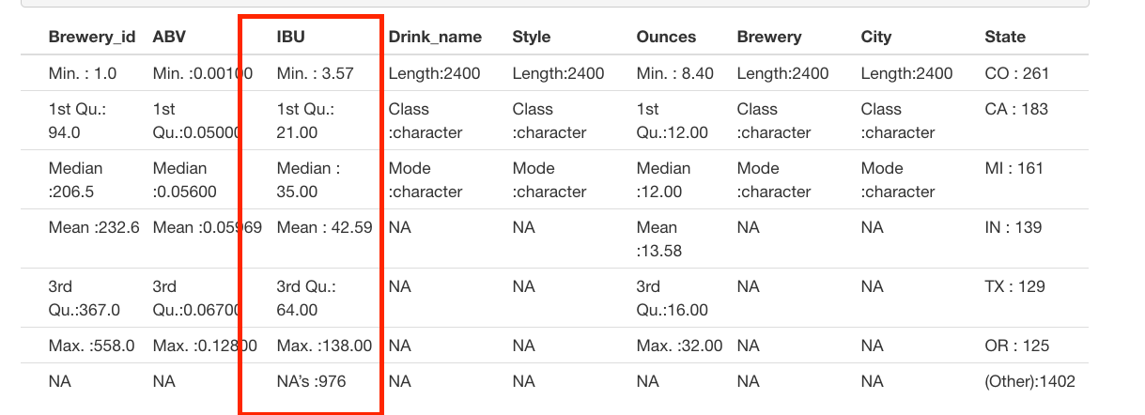
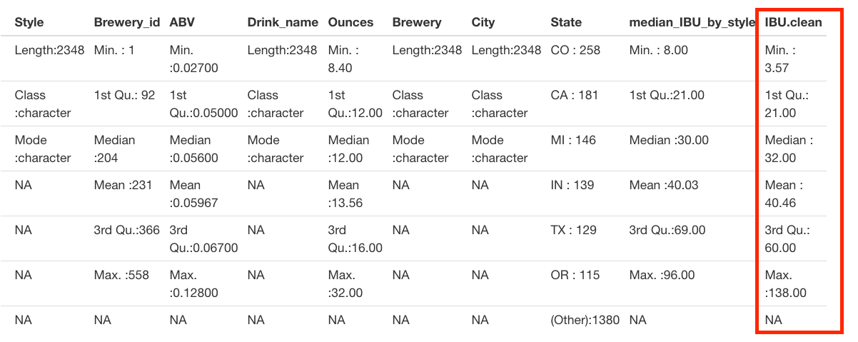
Missing Data: IBU Imputation
Before IBU Imputation
Impute via the median IBU per style…
After IBU Imputation

Slide 11
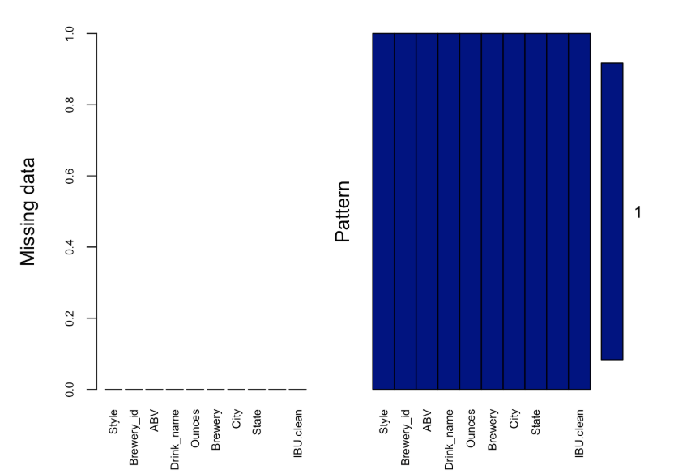
Missing Values after cleanup

Slide 12
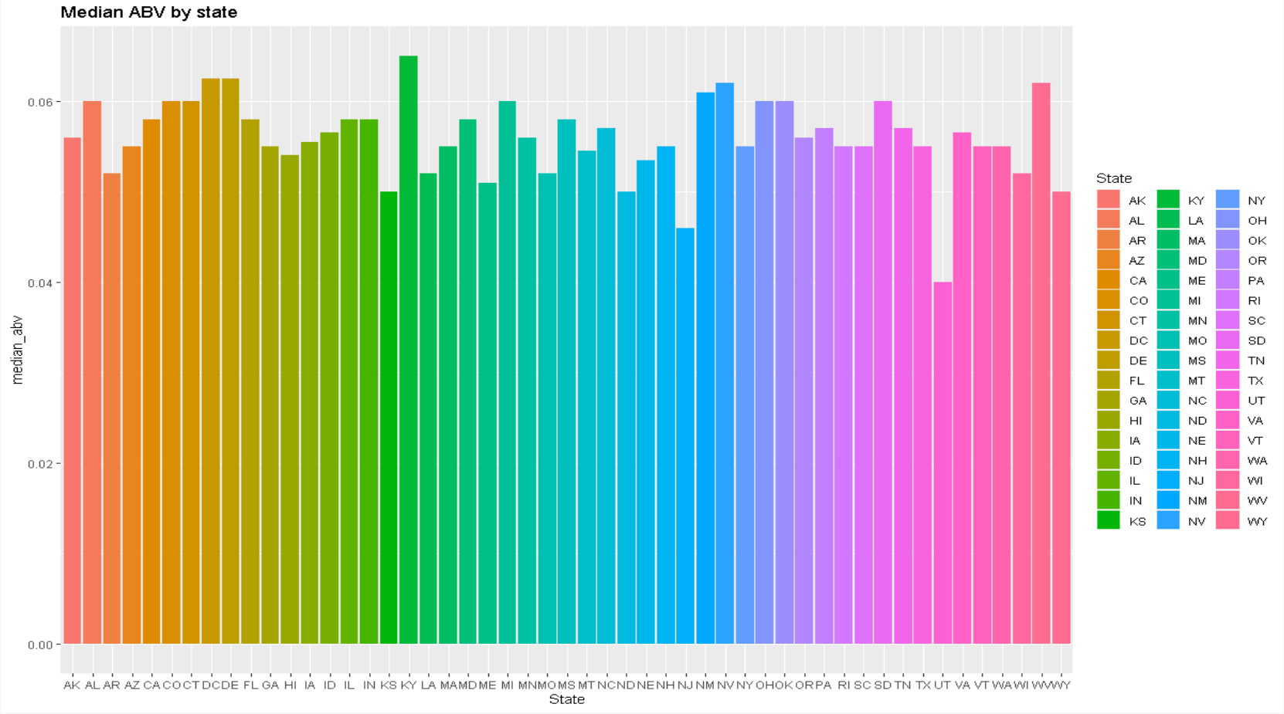
Median ABV by State
Notes:
Kentucky has the highest median abv, Utah has the lowest.

Slide 13
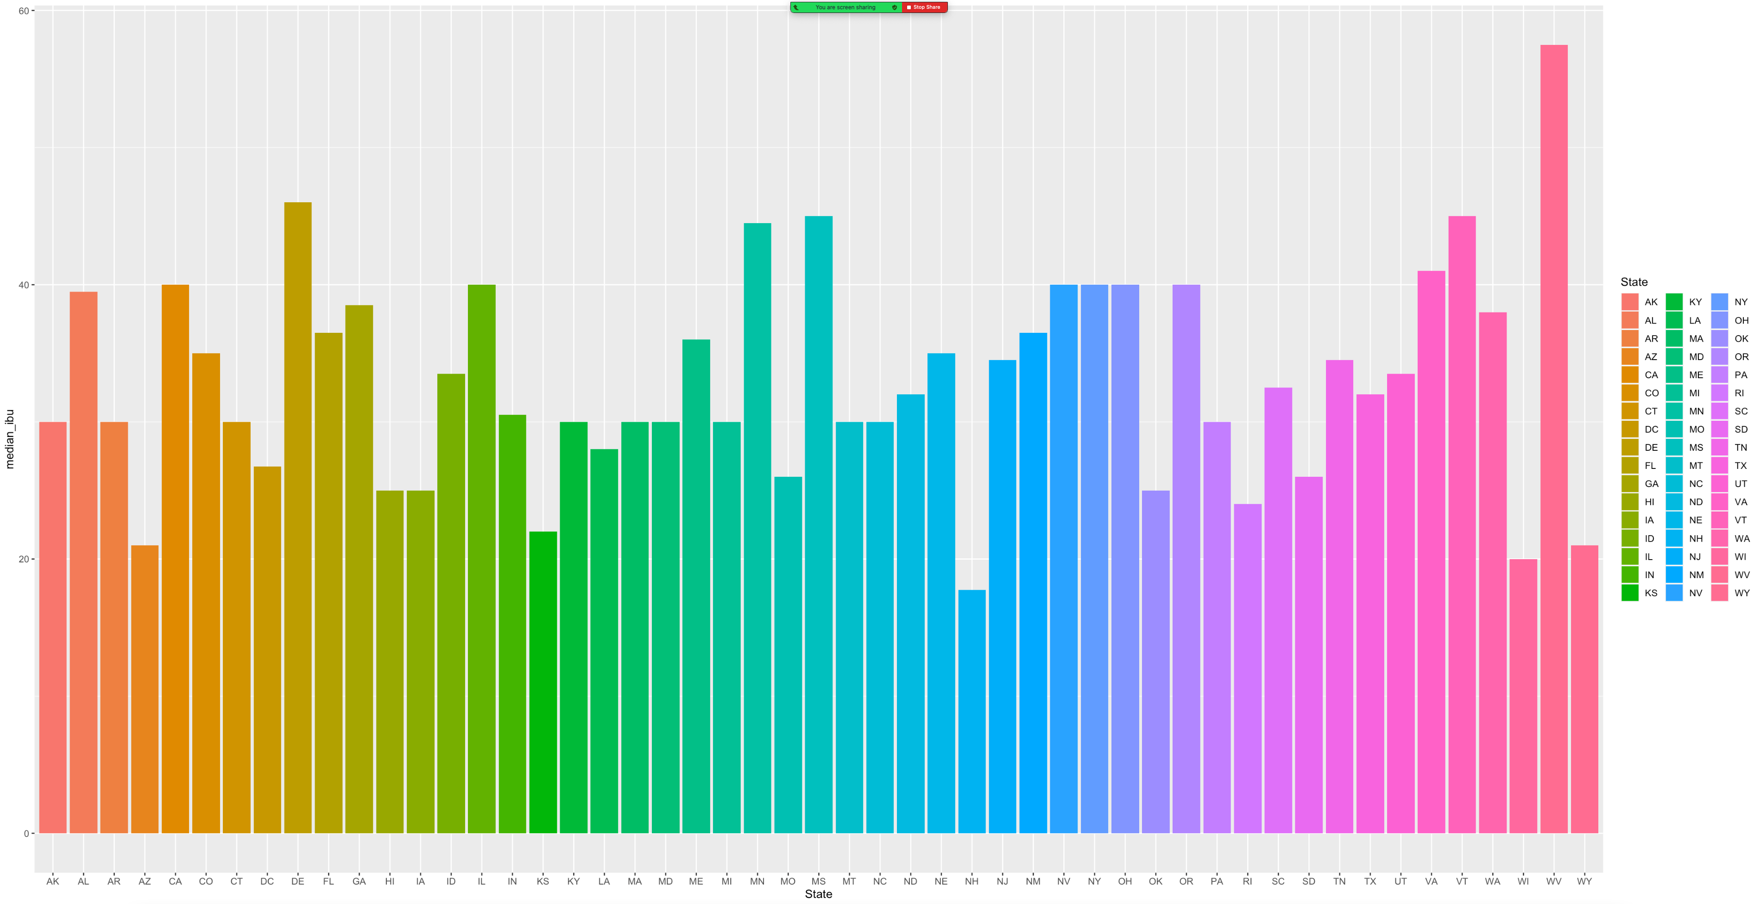
Median IBU by State
Notes:
New Mexico has the minimum IBU median and West Virginia has the max median IBU.

Slide 14
Max ABV/IBU
Which state has the maximum alcoholic (ABV) beer? Colorado has the max ABV at 0.128.
Which state has the most bitter (IBU) beer? Oregon has the most IBU at 138.
Notes:
Maybe this is not a surprise since there are 40+ breweries in CO

Slide 15
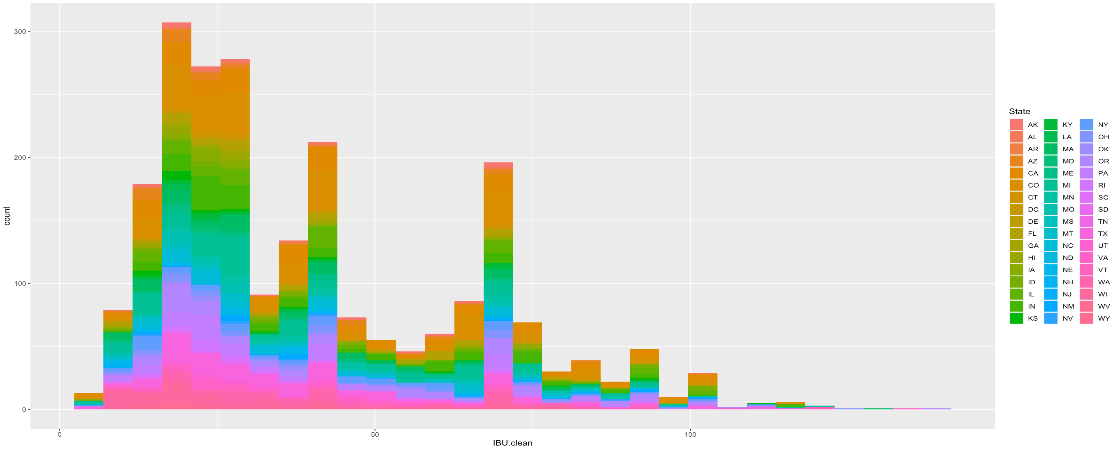
IBU Distribution
Notes:
Most of the beer is located around the lower IBU which could indicate that more bitter beer is less popular and thus sold less.

Slide 16
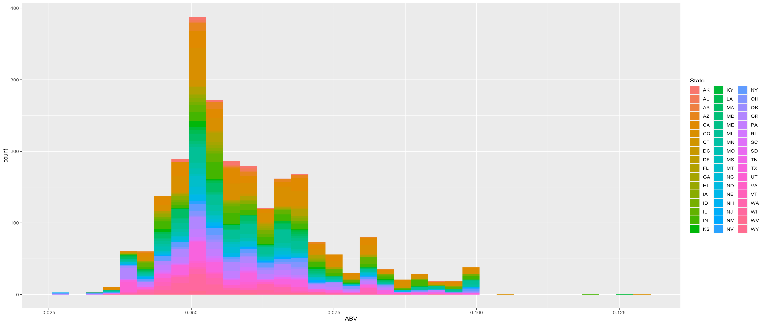
ABV Distribution
Notes:
It seems that most popular beers will have around 5% ABV so that is the peak we see in the middle.

Slide 17
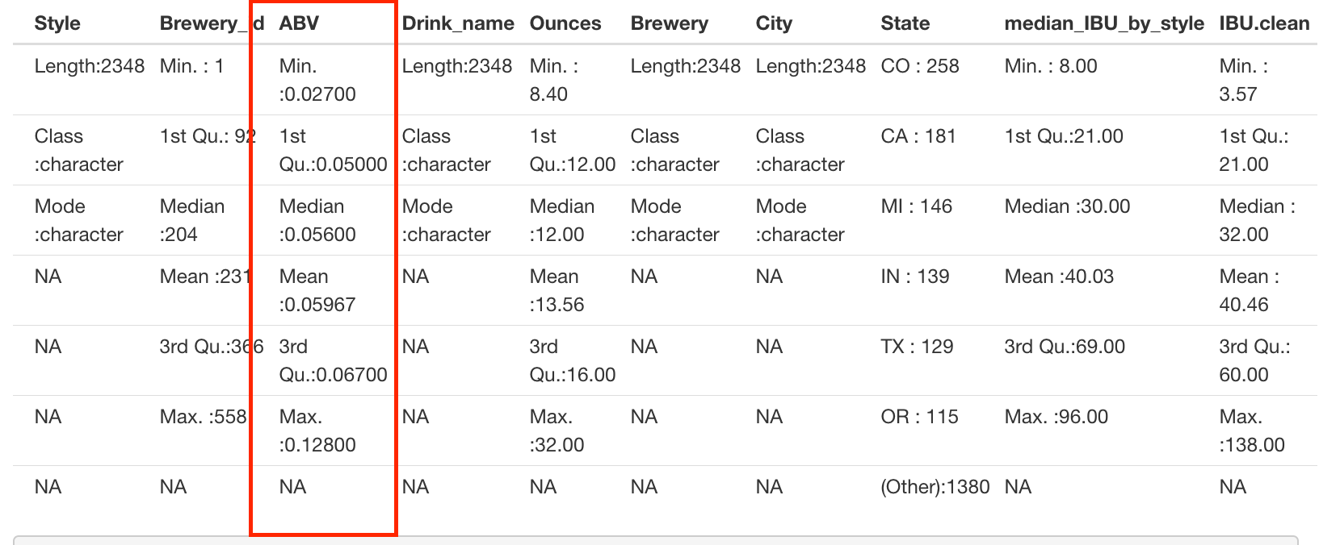
Summary Statistics
Notes:
Maybe we can mention min and max? maybe median/mean

Slide 18
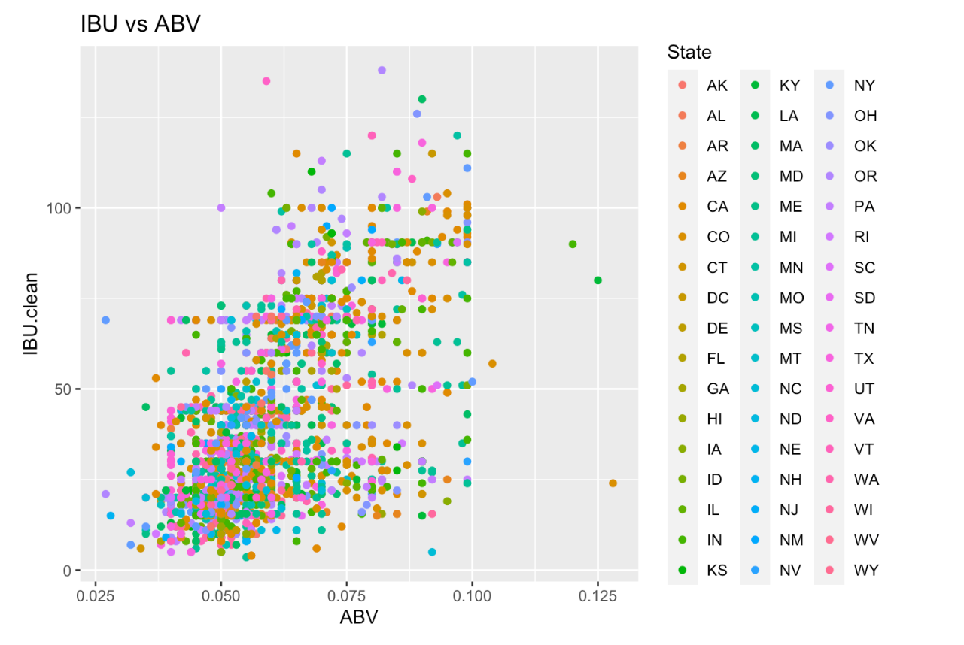
ABV vs IBU Relationship

Slide 19
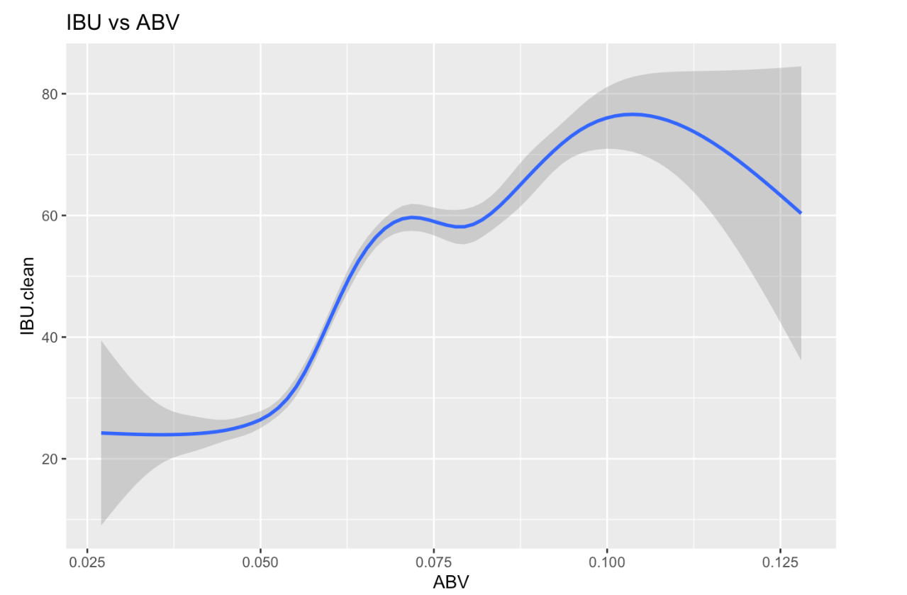
ABV vs IBU Relationship

Slide 20
Any Questions?
Notes:
You might be wondering, “Why did they choose to impute the missing IBU by style?” It seemed to make the most sense as two different beers in the same style family will share an IBU or ABV close to the others in them.
Thank you for your time and we are open to questions.

Slide 21
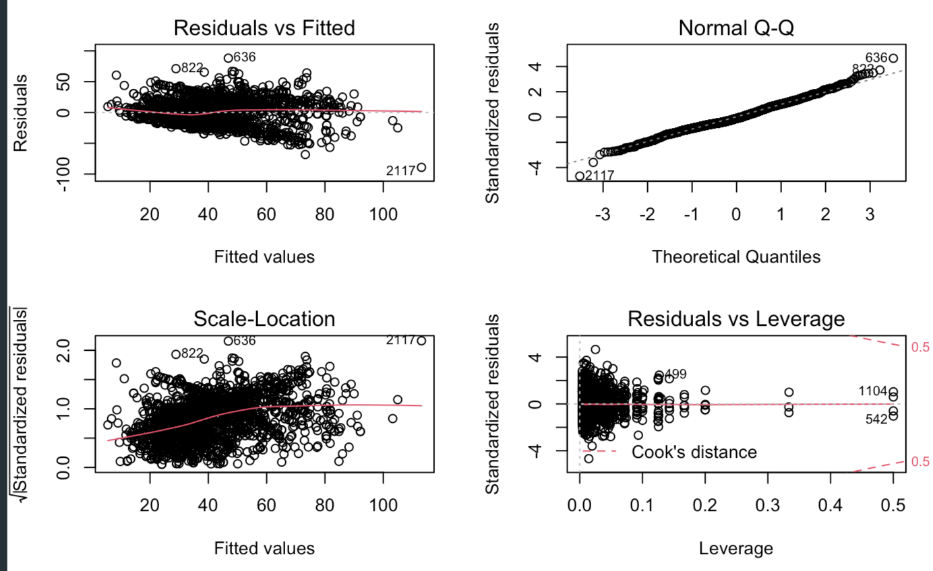
Appendix:
1. Residuals after fitting Multiple Linear Regression, Linear-Linear: IBU vs ABV model
IBU given State, ABV

