Slide 1
Beers and Breweries: ABV vs IBU Initial EDA
Kebur Fantahun and Ricco Ferraro
02/22/2021

Slide 2
Overview
QOI
The Dataset
Number of Breweries in each state
A peek at the data
Missing Values
Median ABV vs Median IBU
Max ABV/IBU
Summary Statistics for ABV
ABV vs IBU

Slide 3
Question of Interest:
Asses the relationship between IBU and ABV for beers across different states

Slide 4
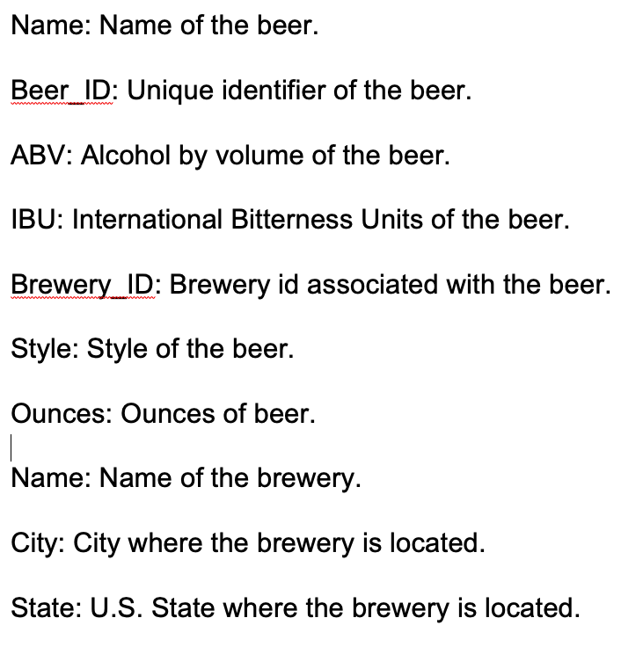
Dataset
Beer data collected across the United states including the following properties:

Slide 5
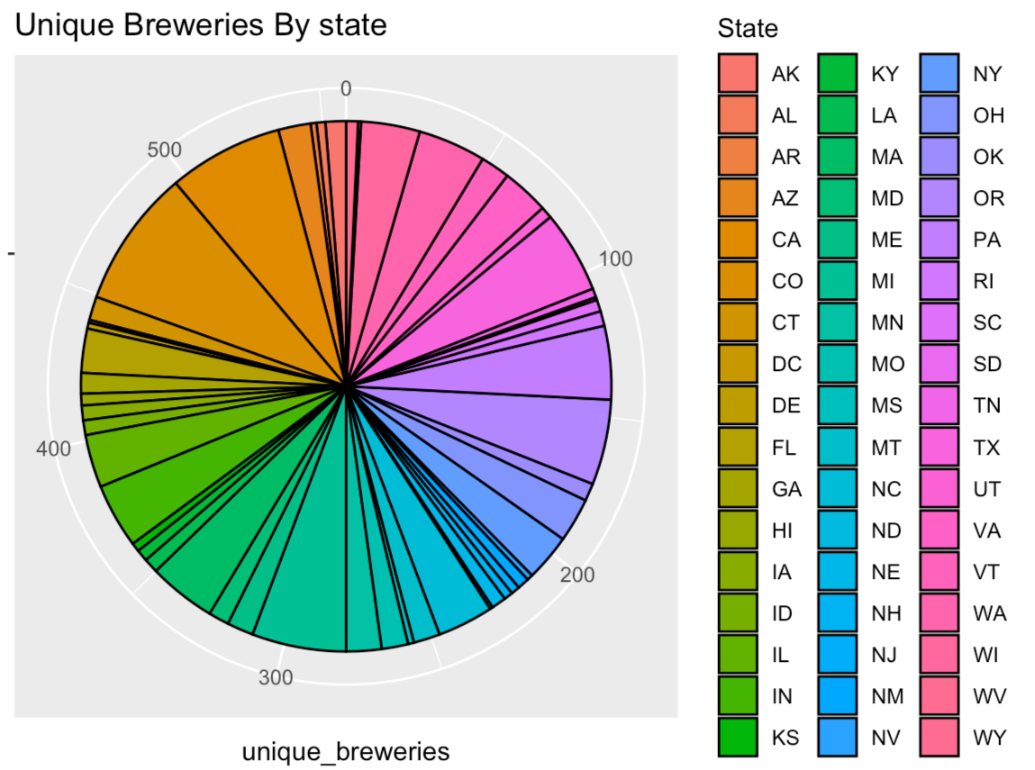
Number of Breweries in each state

Slide 6
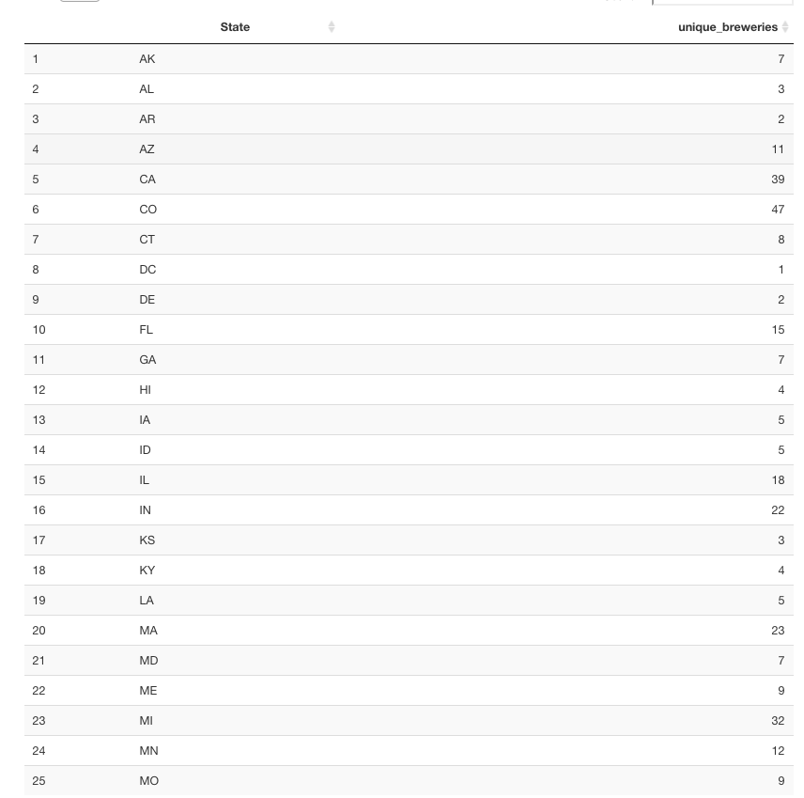
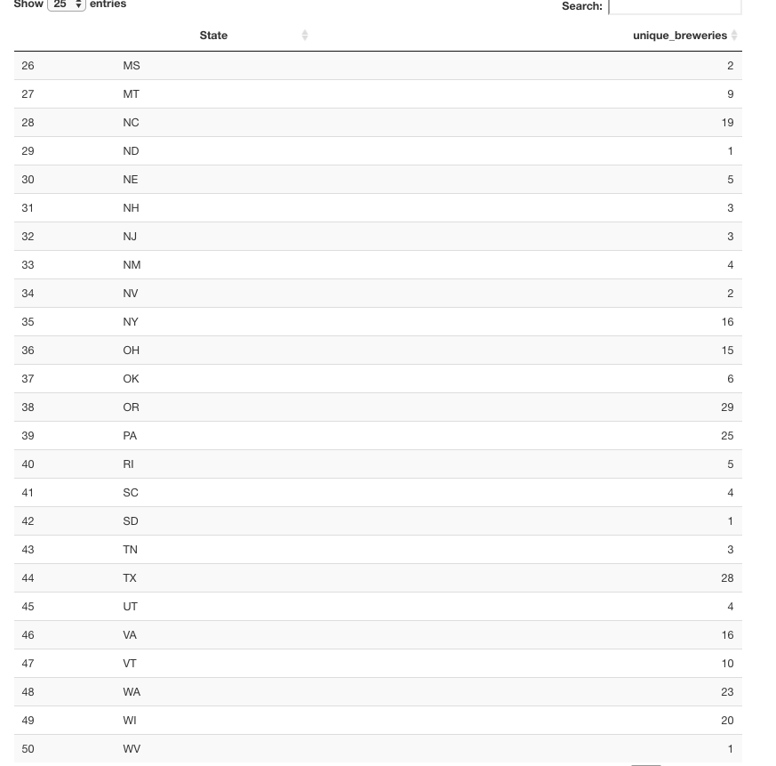
Breweries in each state continued...

Slide 7
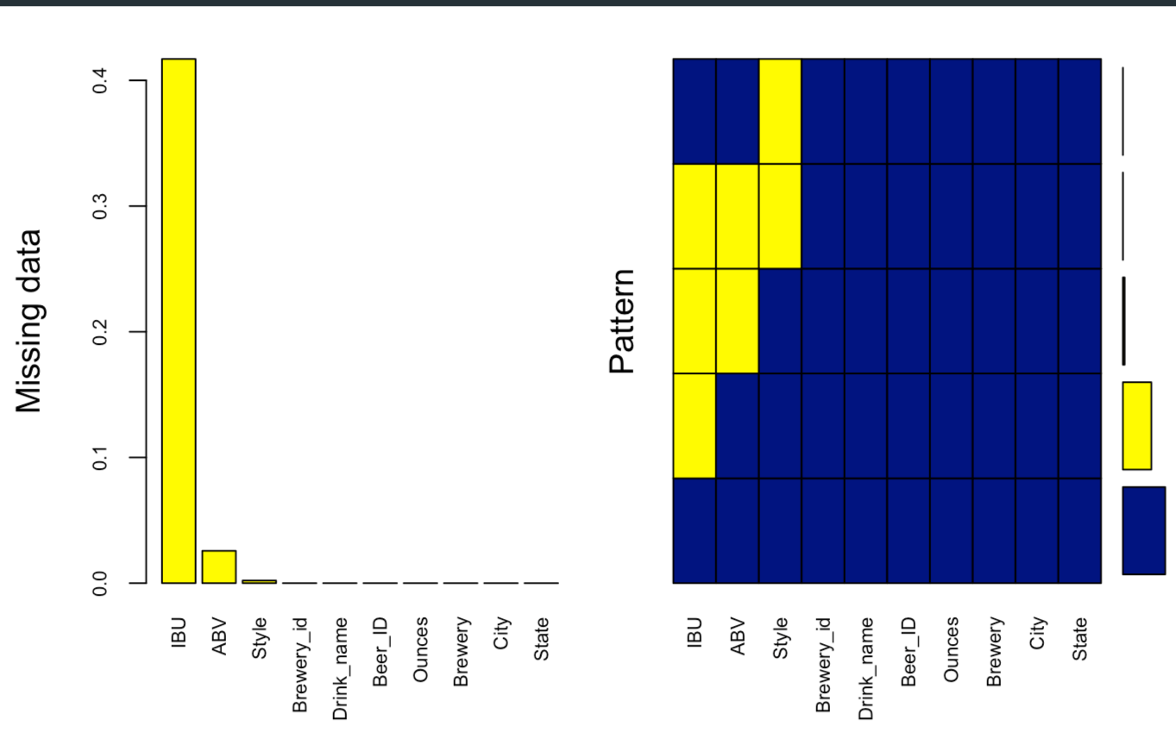
Missing Values

Slide 8
Missing Data: Strategy
Hand enter all data missing IBU and ABV
Drop entries missing both IBU and ABV with no DATA online
Impute IBU based on Median IBU by style for entries that ONLY lack IBU data.

Slide 9
Missing Data: Hand Entry
No DATA was foundand thus entries with missing data are dropped for:
Cedar creek - Special Release is ambiguous, missing ABV/IBU/Style it does not solve the QOI.
Oskar Blues Brewery - The Crowler is not an actual beer but a type of can
Oskar Blues Brewery - Can’d aid foundation is a relief effort that sends water so it does not fit in the dataset.
Beer ID 2364, Royal Lager of Weston Brewing has no ABV/IBU
Same for BID - 2322 Fort Pitt Brewing Company Fort Pitt Ale
Oskar Blues Brewery Birth IPA, 1750
710, no data
MillKing It Productions AXL Pale Ale, 273 - out of business no info
1095 no data
963 no data

Slide 10
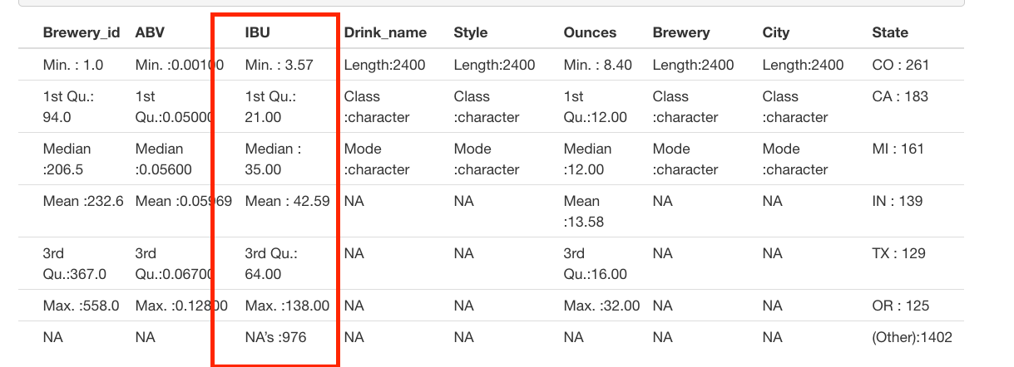
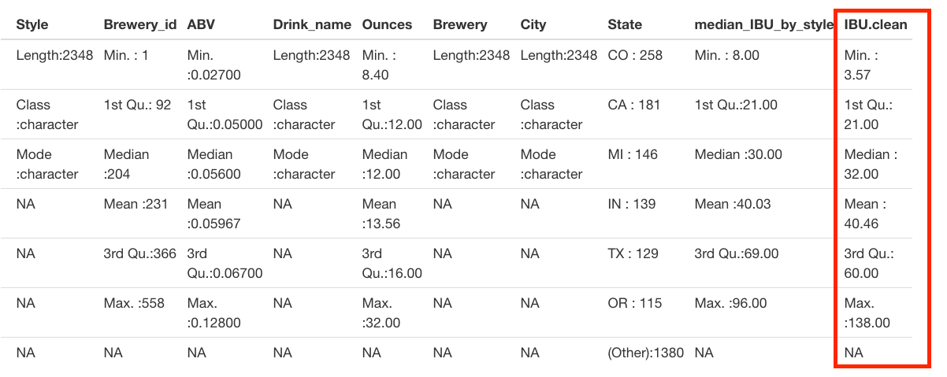
Missing Data: IBU Imputation
Before IBU Imputation
Impute via the median IBU per style…
After IBU Imputation

Slide 11
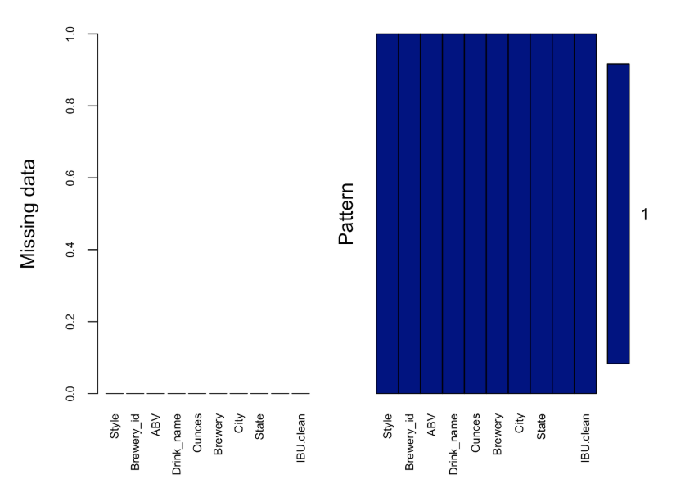
Missing Values after cleanup

Slide 12
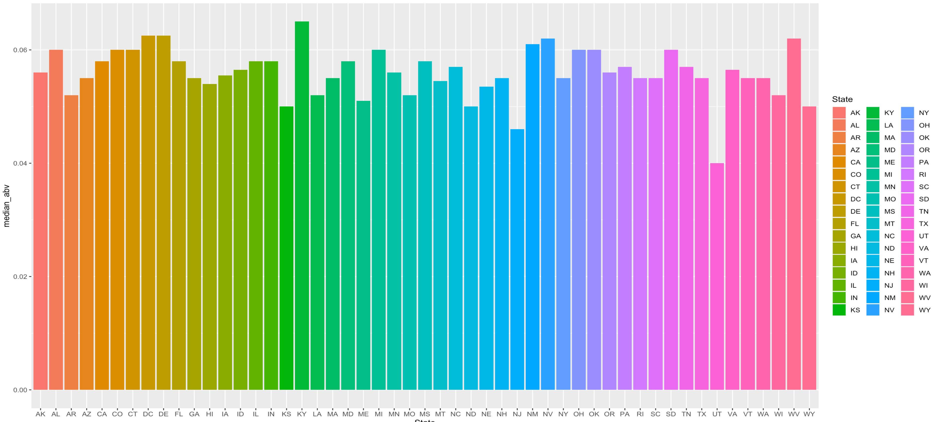
Median ABV by state

Slide 13
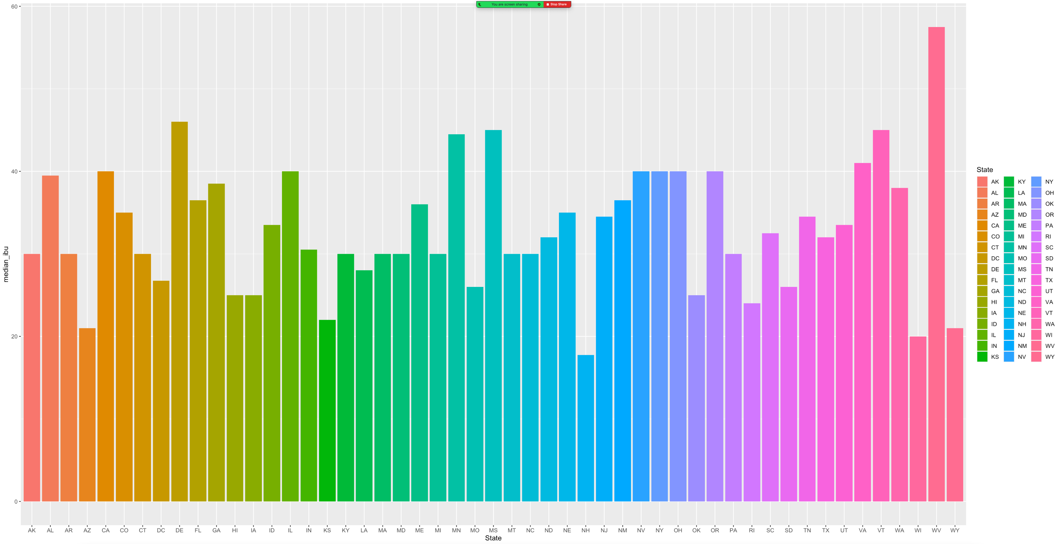
Median IBU by state

Slide 14
Max ABV/IBU
Which state has the maximum alcoholic (ABV) beer? Colorado has the max ABV at 0.128.
Which state has the most bitter (IBU) beer? Oregon has the most IBU at 138.

Slide 15
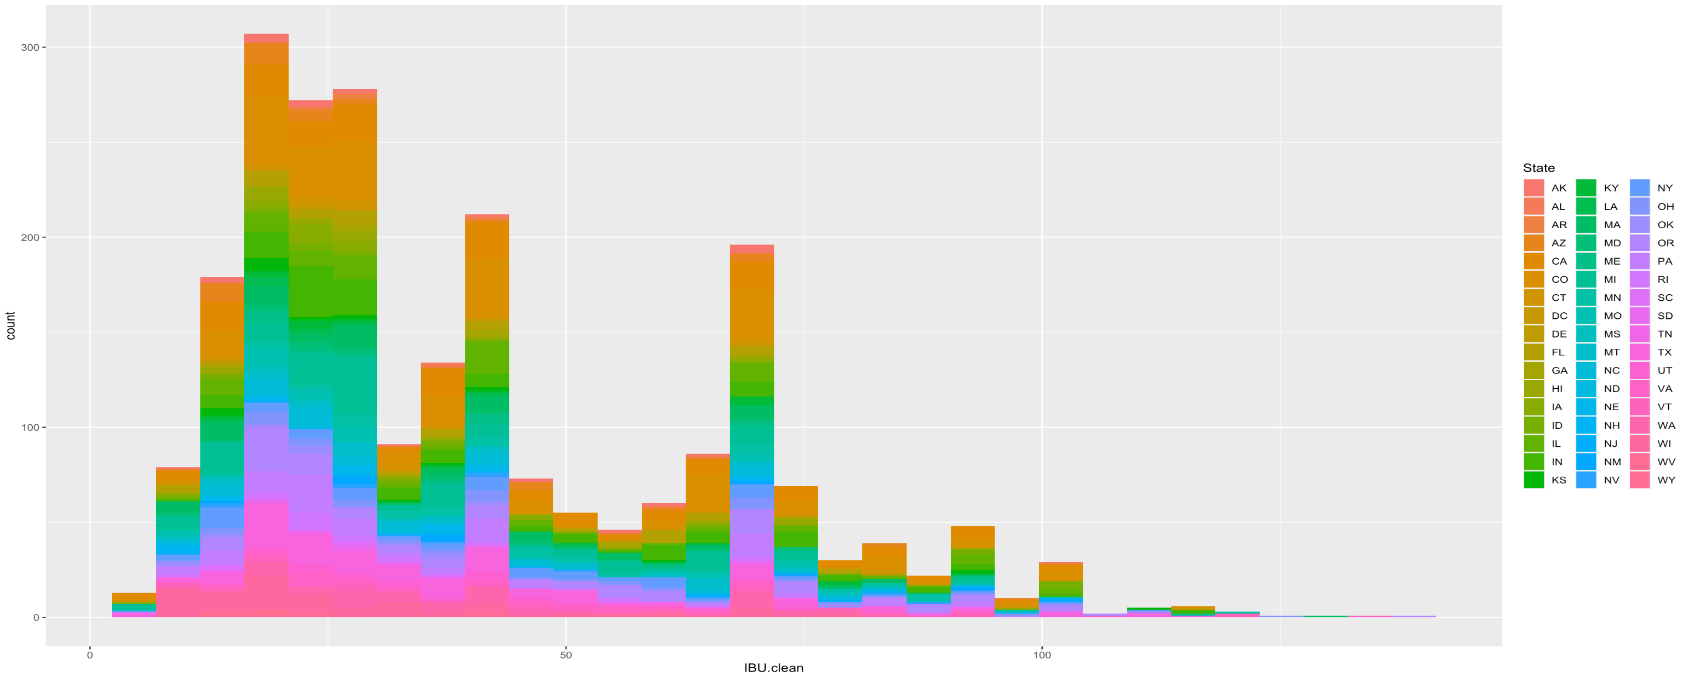
IBU Distribution

Slide 16
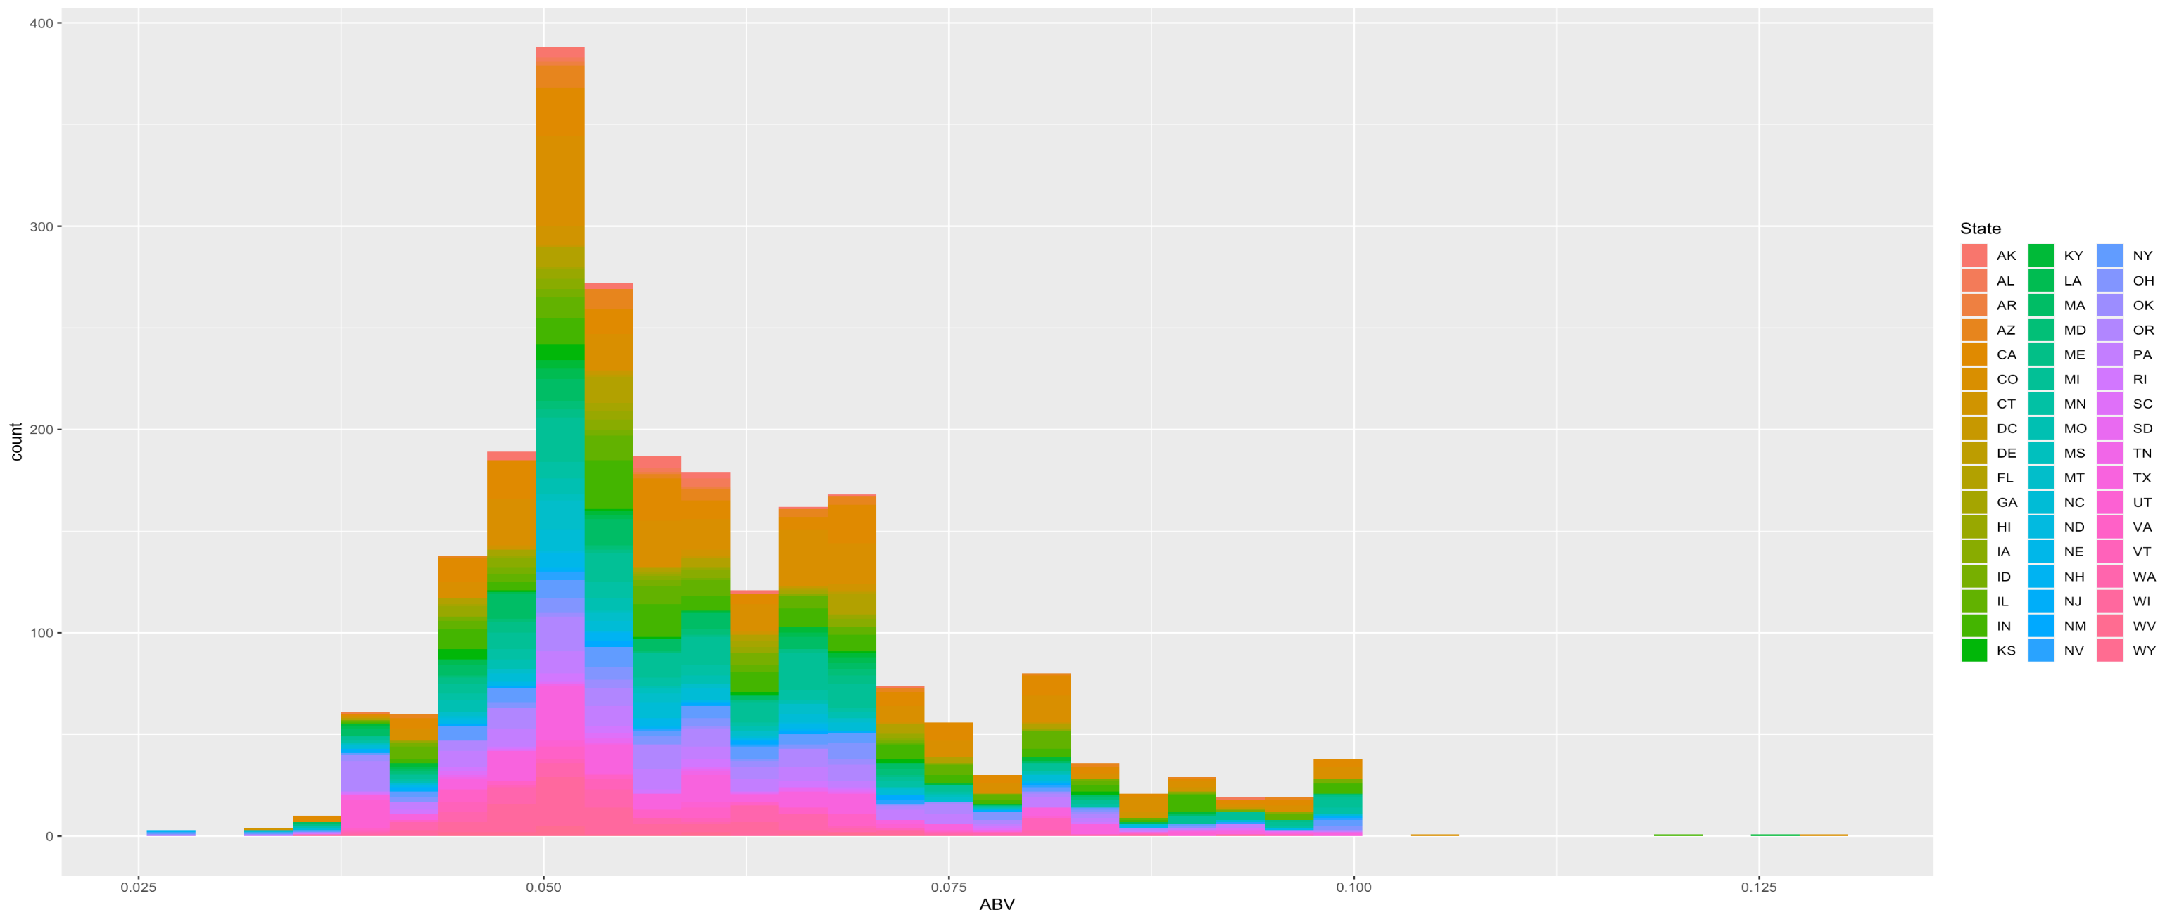
ABV Distribution

Slide 17
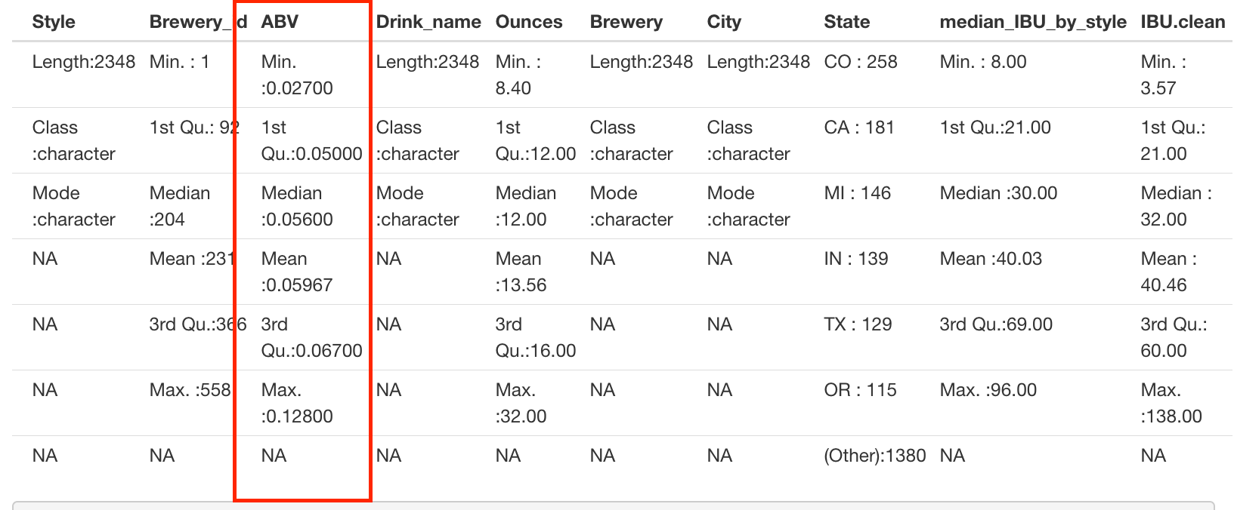
Summary statistics

Slide 18
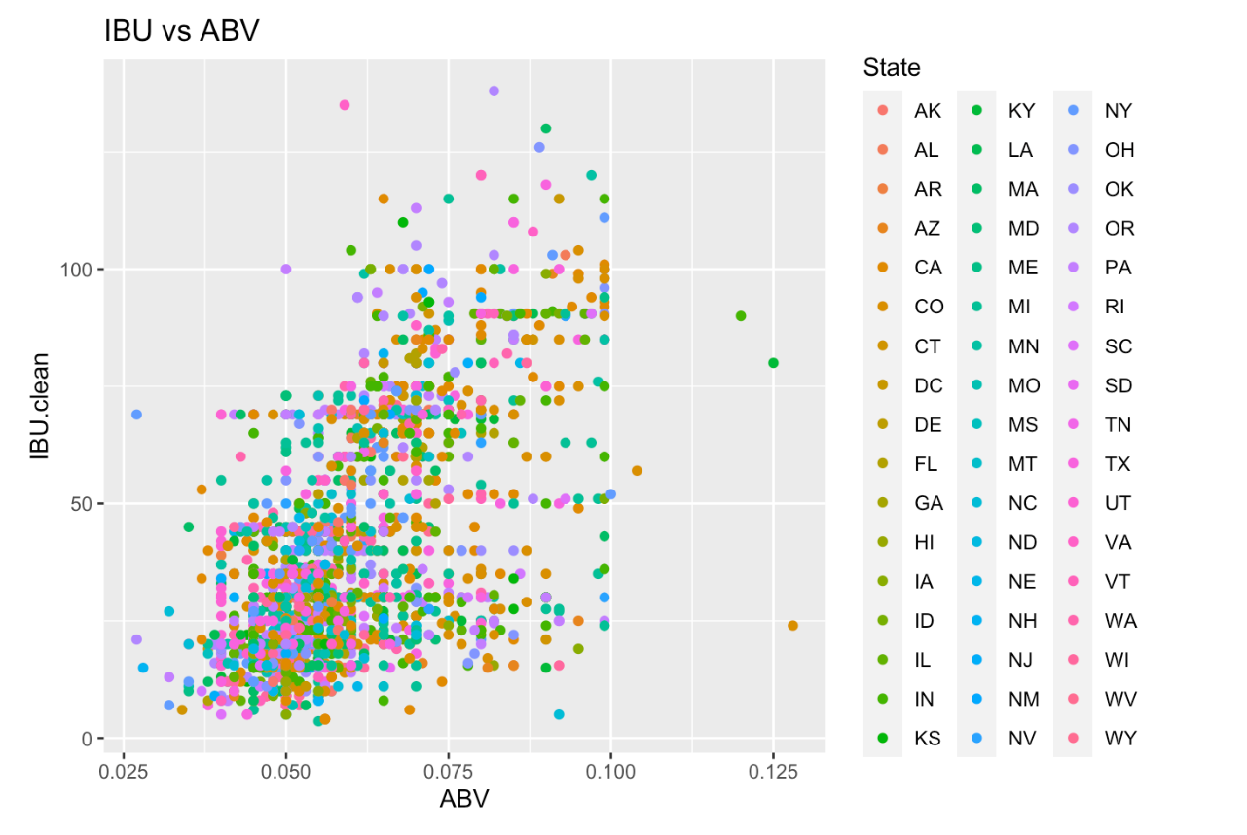
ABV vs IBU relationship

Slide 19
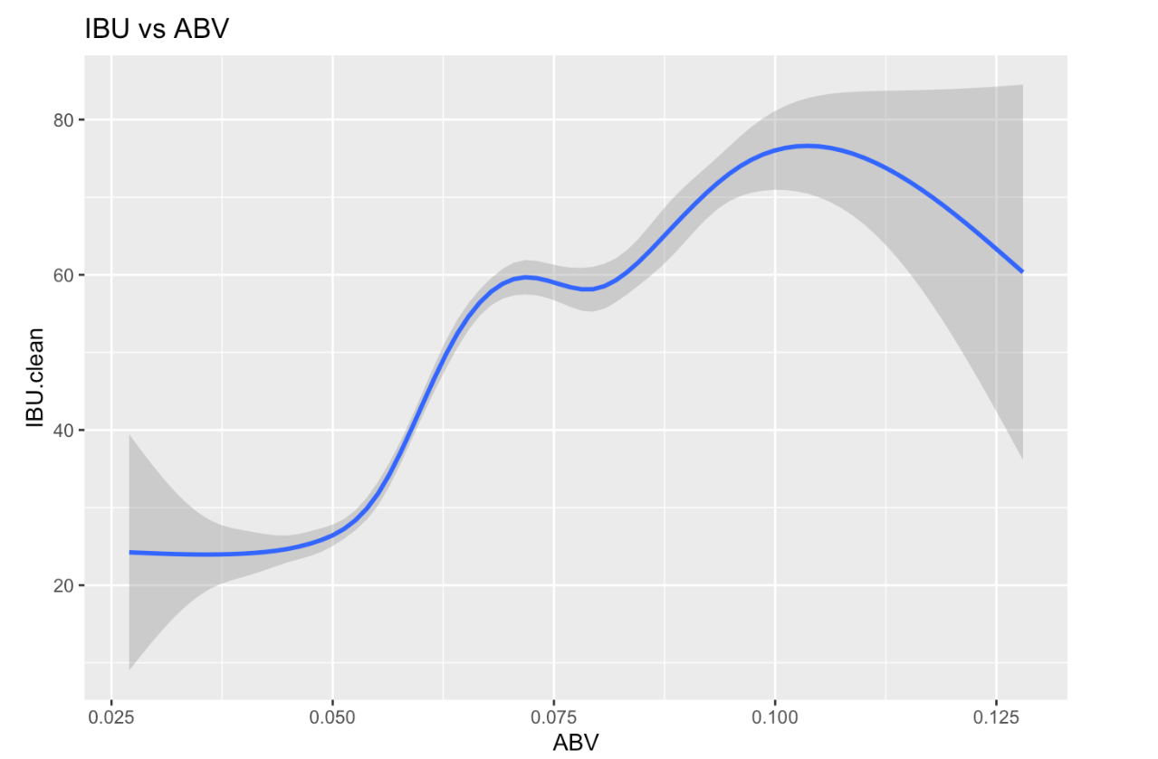
ABV vs IBU Relationship

Slide 20
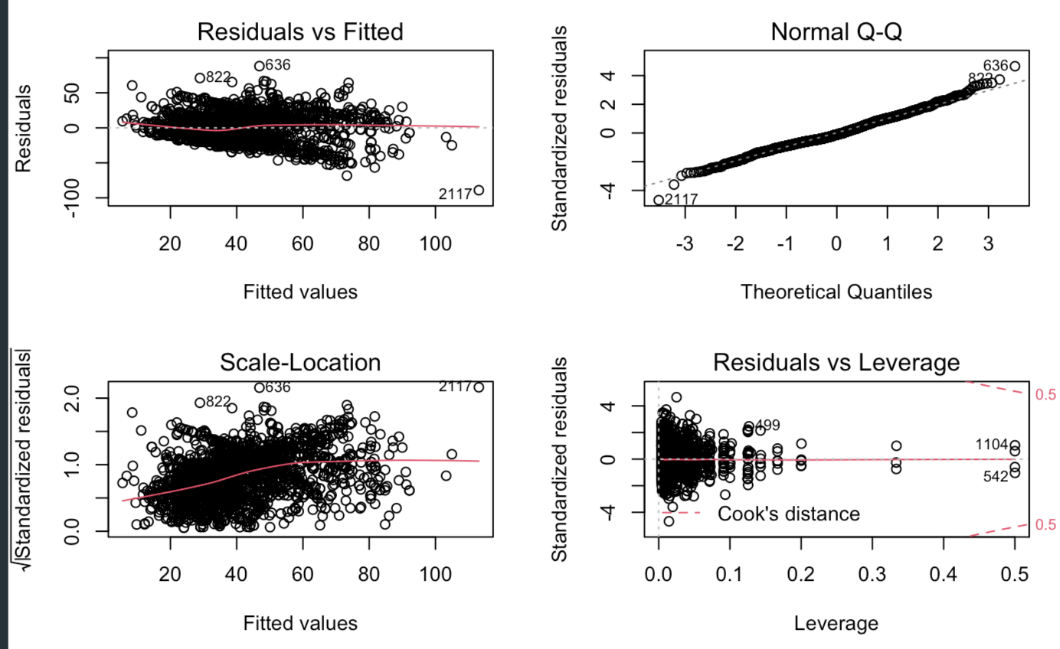
Appendix:
1. Residuals after fitting Multiple Linear Regression, Linear-Linear: IBU vs ABV model
IBU given State, ABV

