Slide 1
Two-Dimensional Heat Analysis
Finite Element Method
20 November 2002
Michelle Blunt
Brian Coldwell

Slide 2
Two-Dimensional Heat Transfer
Fundamental Concepts
Solution Methods
Heat Flux
Mathematical
Adiabatic
Experimental
Steady-State
Theoretical
Finite Differences
Finite Element Analysis
Notes:
Fundamental Concepts:
Heat Flux is the transfer of heat energy between mediums. This may be via conduction, convection, and radiation. Naturally, this occurs in all 3 spatial dimensions and time. Heat flux is proportional to temperature gradient; naturally flows from hot to cold unless work added to system. Special cases include:
Adiabatic means no heat flux with respect to space; i.e., du/dx=0 at boundary. Ask class to give an example: AC ducts, oven door = adiabatic; sink faucet = not adiabatic. Insulated = adiabatic.
Steady-state means no heat flux with respect to time (constant = steady), du/dt=0.
Finite Differences is a numerical approach
Finite Element Analysis is a numerical approach realistically possible only with computer processing, based on finite differences. It divides a region into smaller ‘elements’, which are individually analyzed, in order to derive an approximate response of the overall system.
Solution Methods:
Mathematical is…
Theoretical is…
Experimental solutions are obtained by real-life testing of the mathematical and theoretical models previously mentioned. These results may then be compared with those models to confirm their validity. Sources of error in a 2-D heat transfer experiment include approximations by finite element method, assumption of ‘special cases’ (adiabatic/steady-state), limited temperature measuring devices, etc.

Slide 3
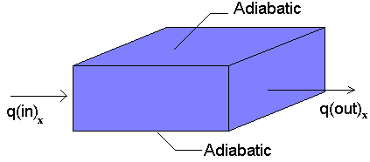
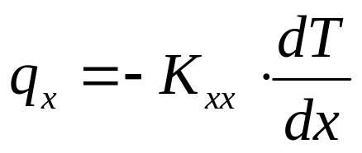
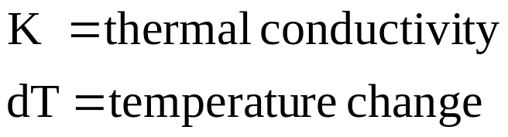
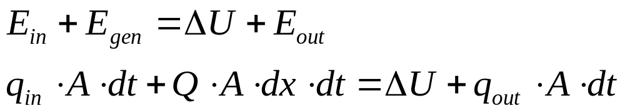
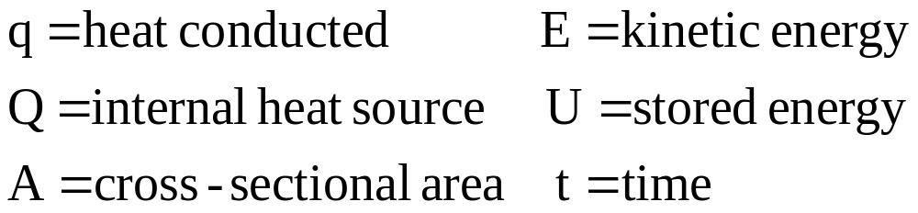
One-Dimensional Conduction
Notes:
Last week we saw how to use the Finite Element Method and Algor to analyze structural problems (trusses, beams, etc.) For that type of problem, equations are derived assuming the displacement function for each element and resulting in the stiffness and force matrices. Same game plan here: assume a temperature function within each element and formulate matrices similar to stiffness and force.
Delta U = change wrt time, but steady-state, therefore delta U = 0!

Slide 4
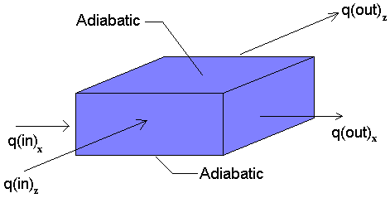
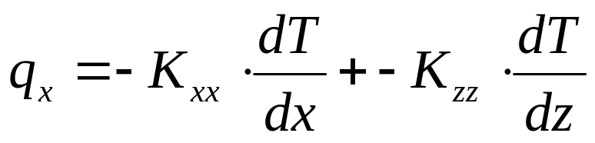
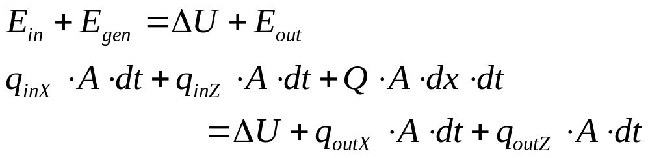
Two-Dimensional Conduction

Slide 5
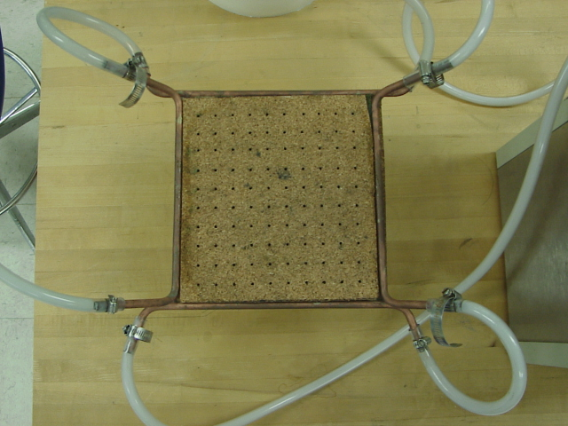
Experimental Model
Two-dimensional heat transfer plate from lab 6.
Upper and left boundary conditions are set at 0ºC; lower and right conditions are constant at 80ºC.
Notes:
A physical/experimental model of the two-dimensional heat transfer system.
We choose a model s similar to the lab we performed in class. The cork on the face of the hot plate eliminates heat transfer in the z-direction (thus, 2-D). Instead of maintaining constant temperature sides, the plate will be given an initial temperature distribution and then the edges will be insulated (adiabatic) and the plate will be left to rest during the transient phase until it reaches steady-state. Then the temperature will be measured as before and compared with the mathematical and theoretical models.

Slide 6
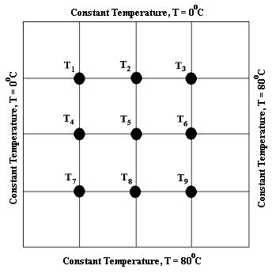
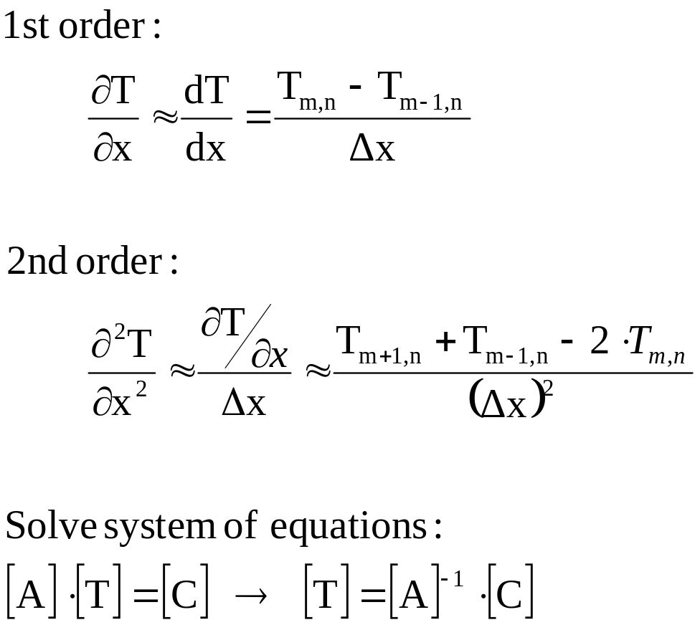
Theoretical Model
Finite Difference
Notes:
Comparison of finite difference (antiquated) and finite element (contemporary).
FINITE DIFFERENCE:
Subdivide area of interest into small regions
Analyze nodes at center of each region as average temperature of that region.
Generate a system of equations by applying the approximation to each node; then solve using linear algebra.
High computational memory required; not practical for more than 10x10=100 nodes. Very easy to make mistake by hand.

Slide 7
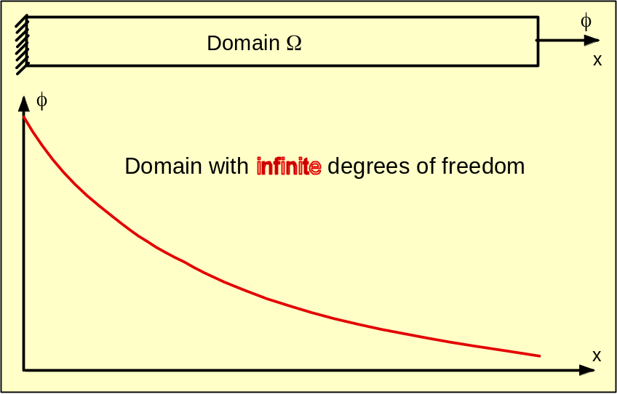
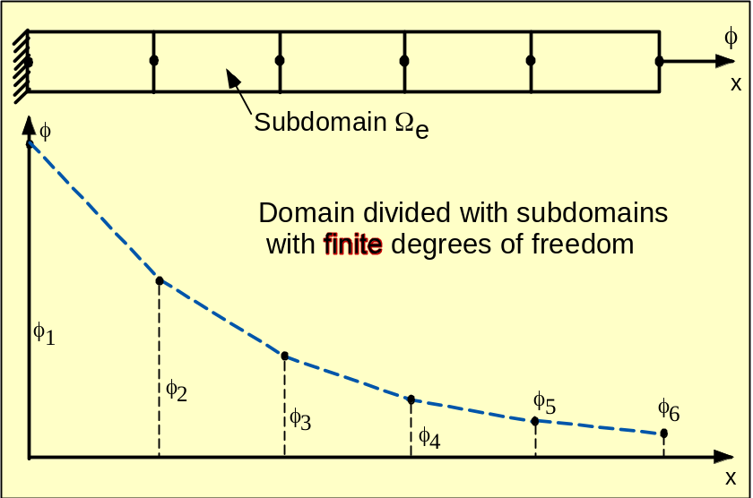
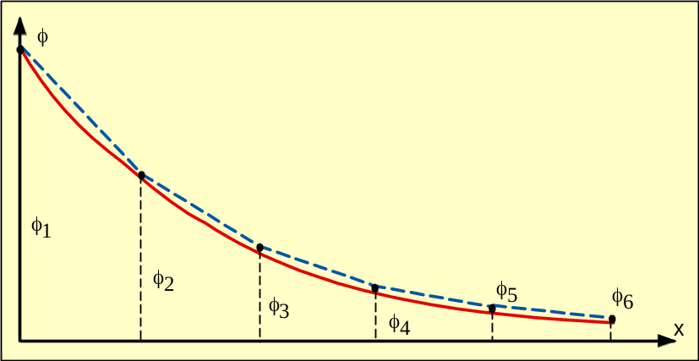
Theoretical Model
Finite Element
The fundamental concept of FEM is that a continuous function of a continuum (given domain Ω) having infinite degrees of freedom is replaced by a discrete model, approximated by a set of piecewise continuous functions having a finite degree of freedom.
Notes:
The Finite Element Method (FEM) is a numerical method of solving a system of governing equations over the domain of a continuous physical system. Remember how to go from Riemann sums to integrals??? Same concept.
-subdivide (discretize) the domain of the solid structure into a FINITE number of small elements (smaller = better but longer analysis)
-elements connect at a FINITE number of nodes/intersections. (3 or 4 per element)
-now we deal with each subdomain (element) individually and then assemble the elements to provide a model of the structure
Pros: solve even with irregular geometry, polycomposites, unlimited boundary conditions, use smaller elements only when necessary, alter model easily, include dynamic effects… all much more easily (realistically) than by classical methods, courtesy of technology.

Slide 8
Structural vs Heat Transfer
Structural Analysis
Thermal Analysis
Select element type
Select element type
Assume displacement function
Assume temperature function
Stress/strain relationships
Temperature relationships
Derive element stiffness
Derive element conduction
Assemble element equations
Assemble element equations
Solve nodal displacements
Solve nodal temperatures
Solve element forces
Solve element gradient/flux

Slide 9
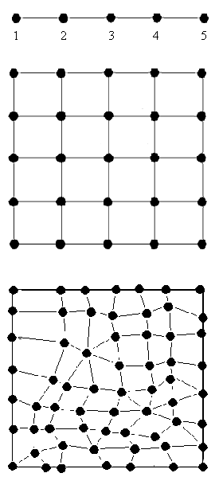
Finite Element 2-D Conduction
Select Element Type
1-d elements are lines
2-d elements are either triangles, quadrilaterals, or a mixture as shown
Label the nodes so that the difference between two nodes on any element is minimized.
Notes:
Following previously mentioned steps:
Select element type
Assume temperature function
Temperature relationships
Derive element conduction
Assemble element equations
Solve nodal temperatures
Solve element gradient/flux

Slide 10
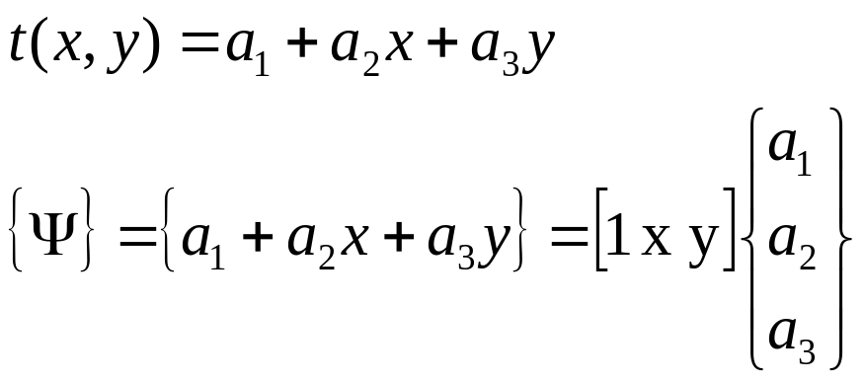
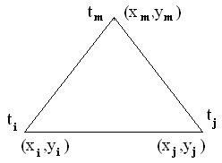
Finite Element 2-D Conduction
Assume (Choose) a Temperature Function
Assume a linear temperature function for each element as:
where u and v describe temperature gradients at (x_{i},y_{i}).
3 Nodes 1 Element
2 DOF: x, y

Slide 11
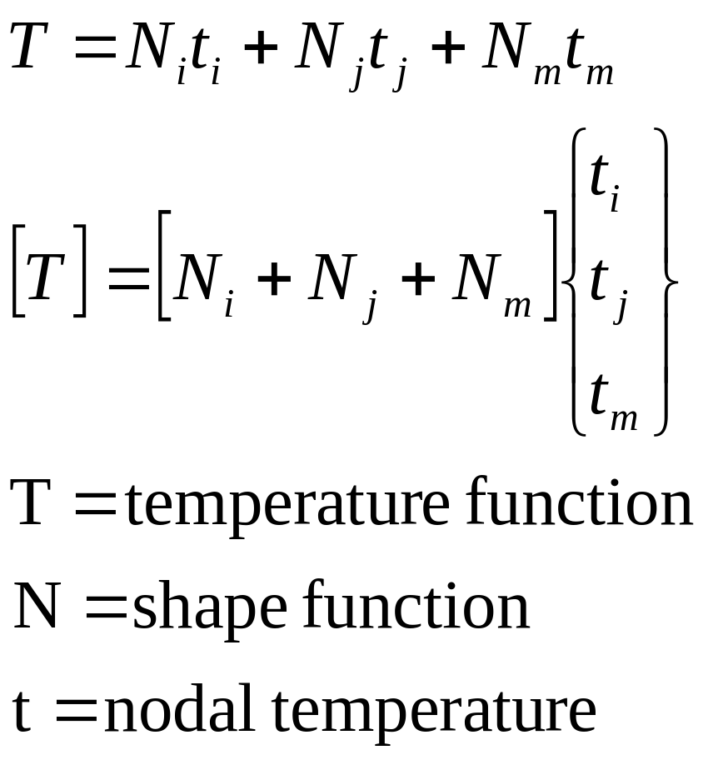
Finite Element 2-D Conduction
Assume (Choose) a Temperature Function

Slide 12
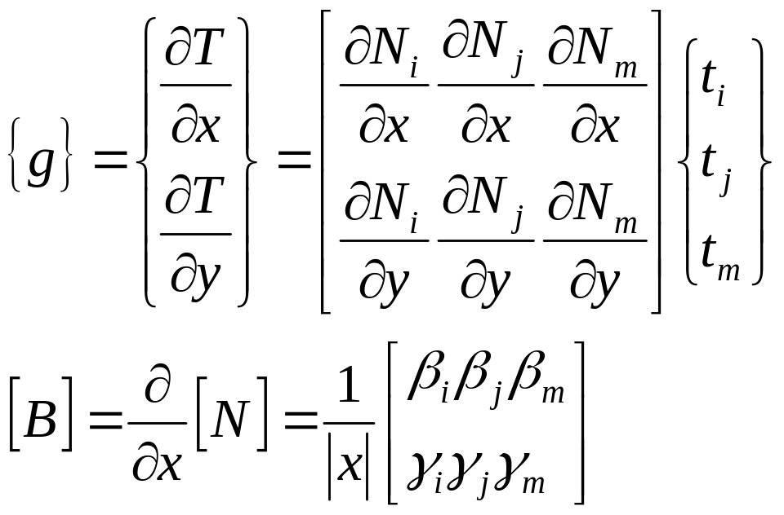
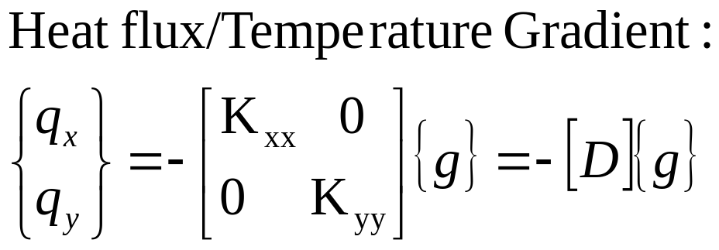
Finite Element 2-D Conduction
Define Temperature Gradient Relationships
Analogous to strain matrix: {g}=[B]{t}
[B] is derivative of [N]

Slide 13
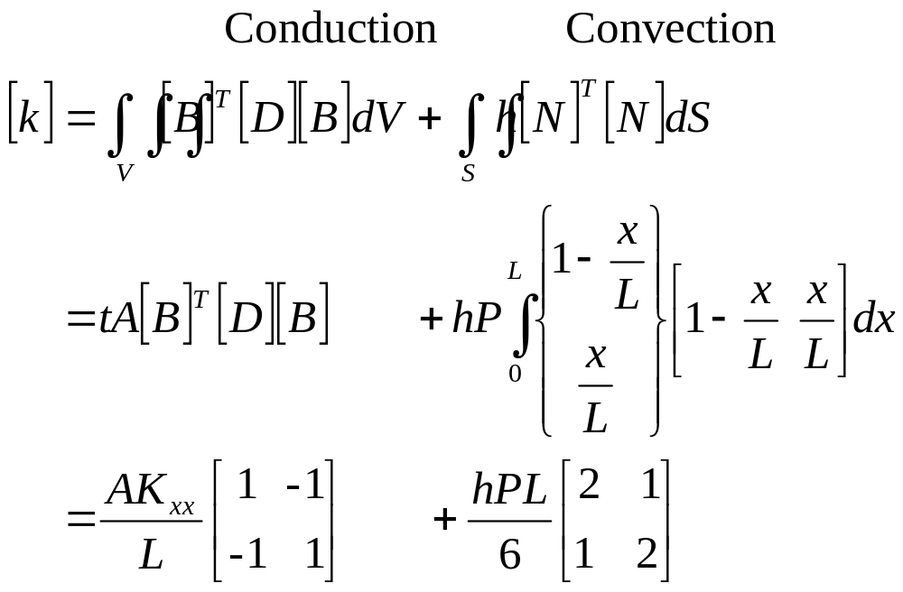
Finite Element 2-D Conduction
Derive Element Conduction Matrix and Equations

Slide 14
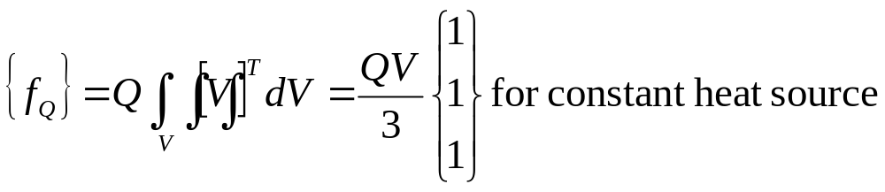
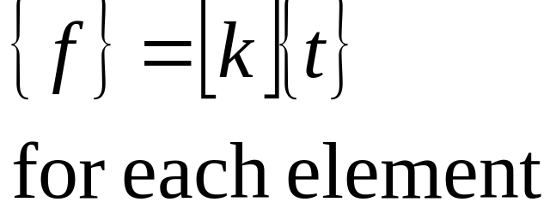
Finite Element 2-D Conduction
Derive Element Conduction Matrix and Equations
Stiffness matrix is general term for a matrix of known coefficients being multiplied by unknown degrees of freedom, i.e., displacement OR temperature, etc. Thus, the element conduction matrix is often referred to as the stiffness matrix.

Slide 15
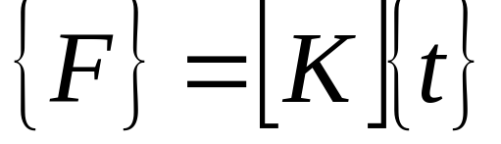
Finite Element 2-D Conduction
Assemble Element Equations, Apply BC’s
From here on virtually the same as structural approach. Heat flux boundary conditions already accounted for in derivation. Just substitute into above equation and solve for the following:
Solve for Nodal Temperatures
Solve for Element Temperature Gradient & Heat Flux

Slide 16
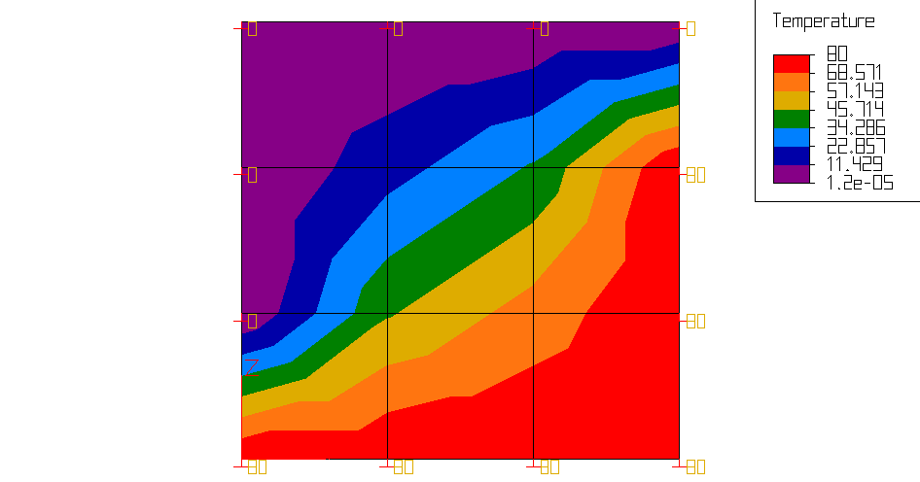
Algor: How many elements?
Elements: 9 Time: 6s
Nodes: 16 Memory: 0.239MB

Slide 17
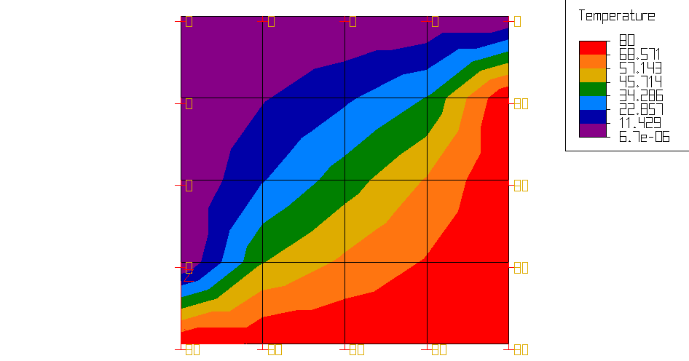
Algor: How many elements?
Elements: 16 Time: 6s
Nodes: 25 Memory: 0.255MB

Slide 18
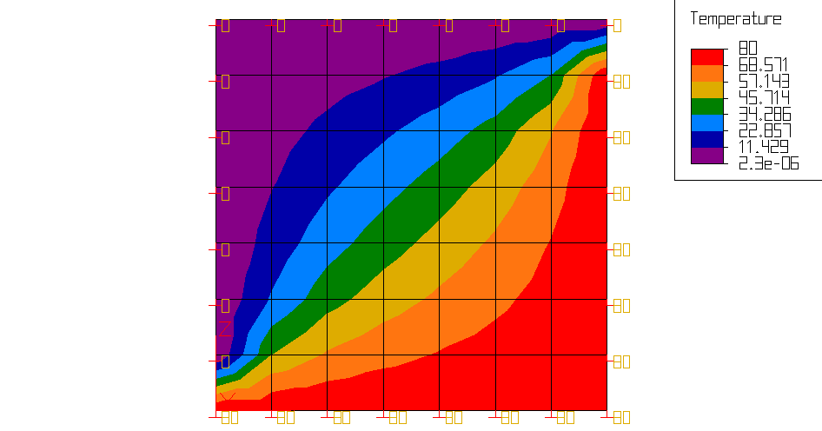
Algor: How many elements?
Elements: 49 Time: 7s
Nodes: 64 Memory: 0.326MB

Slide 19
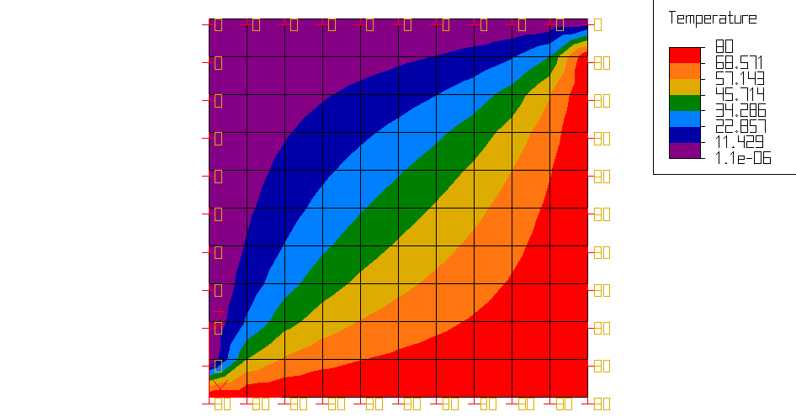
Algor: How many elements?
Elements: 100 Time: 7s
Nodes: 121 Memory: 0.438MB

Slide 20

Algor: How many elements?
Elements: 324 Time: 7s
Nodes: 361 Memory: 0.910MB

Slide 21

Algor: How many elements?
Elements: 625 Time: 9s
Nodes: 676 Memory: 1.535MB

Slide 22
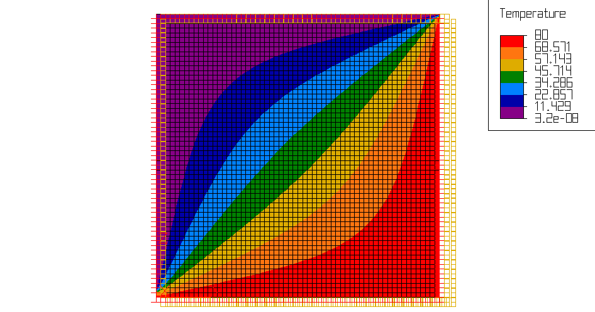
Algor: How many elements?
Elements: 3600 Time: 15s
Nodes: 3721 Memory: 7.684MB

Slide 23

Algor: How many elements?
Automatic Mesh
Elements: 334 Time: 7s
Nodes: 371 Memory: 0.930MB

Slide 24
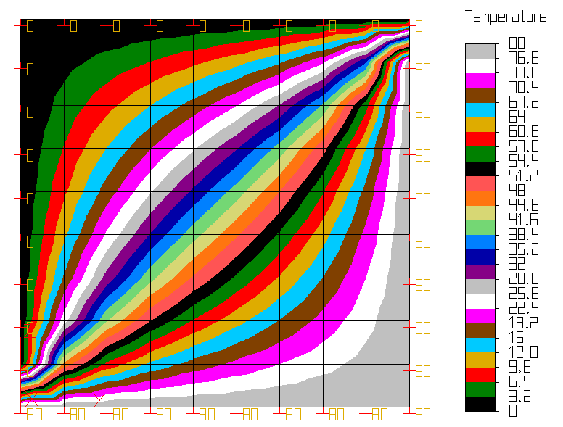
Algor Results Options

Slide 25
Algor: How many elements?
Smaller Elements
Fewer Elements
Higher accuracy
More time, memory
Faster
Less storage space
Notes:
Banded, skyline, and wavefront matrices for memory storage. We will discuss the banded-symmetric format, which is not necessarily the most efficient format, but it is efficient for computational purposes. A matrix is banded if the nonzero terms of the matrix are gathered about the diagonal. (show diagram on board – P. 911)

Slide 26
References
Kreyszig, Erwin. Advanced Engineering Mathematics, 8th ed.(1999)
Chapters: 8, 9
Logan, Daryl L. A First Course in the Finite Element Method Using Algor, 2nd ed.(2001)
Chapters: 13

Slide 27
Questions?
Ha ha ha!!!
Here comes your assignment…

