Slide 1

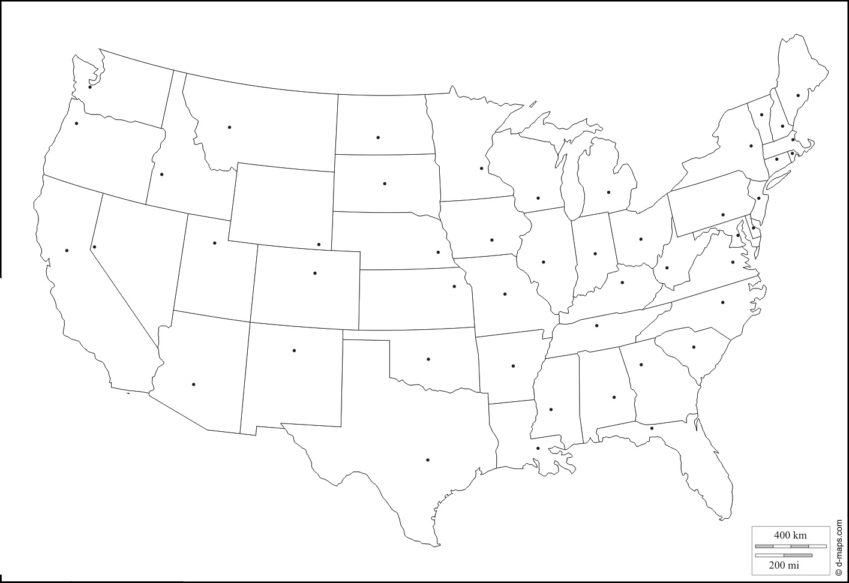
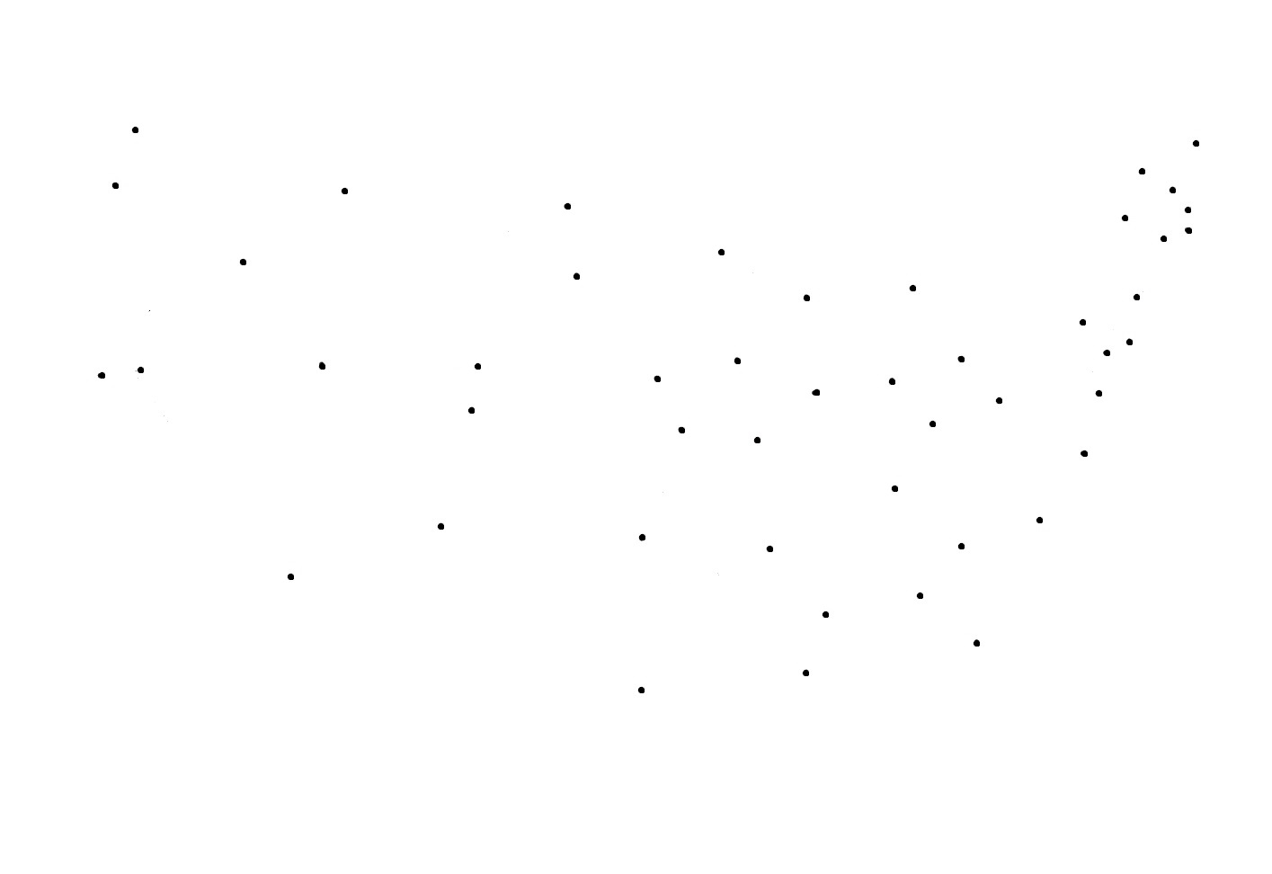
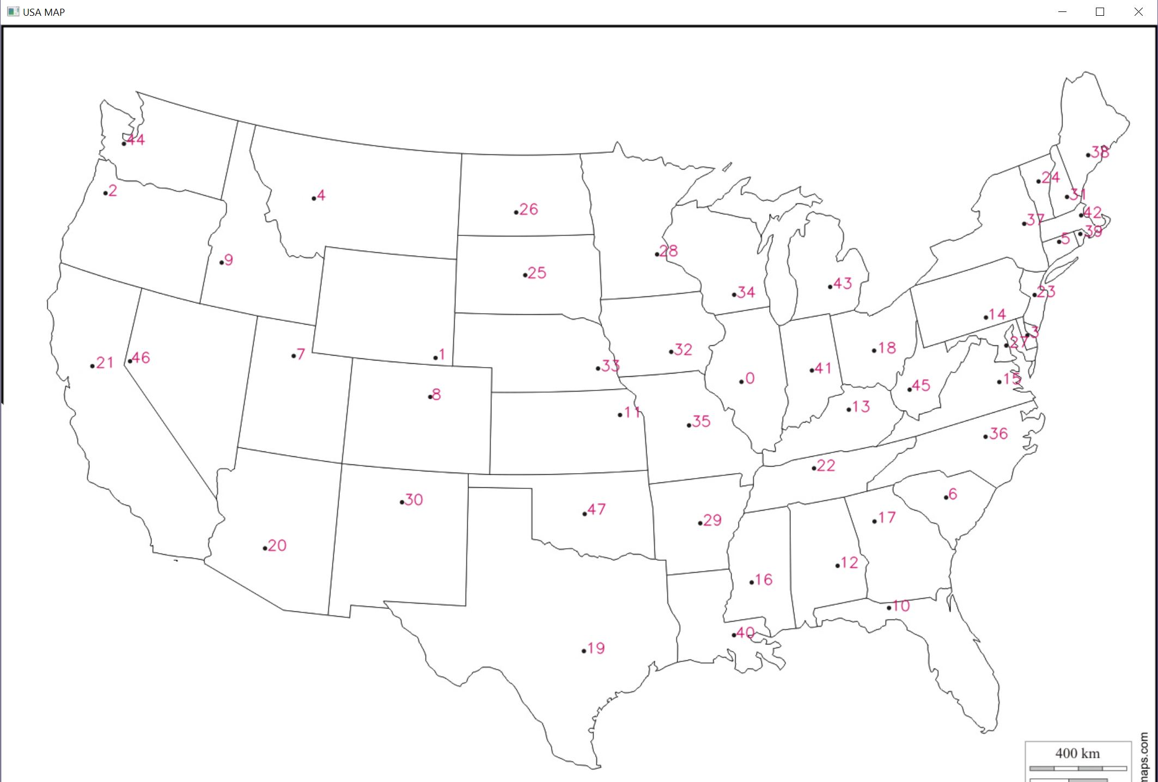
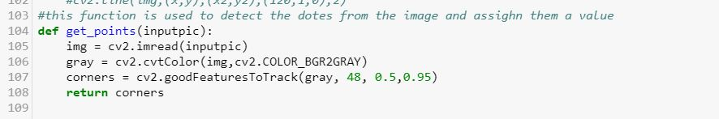
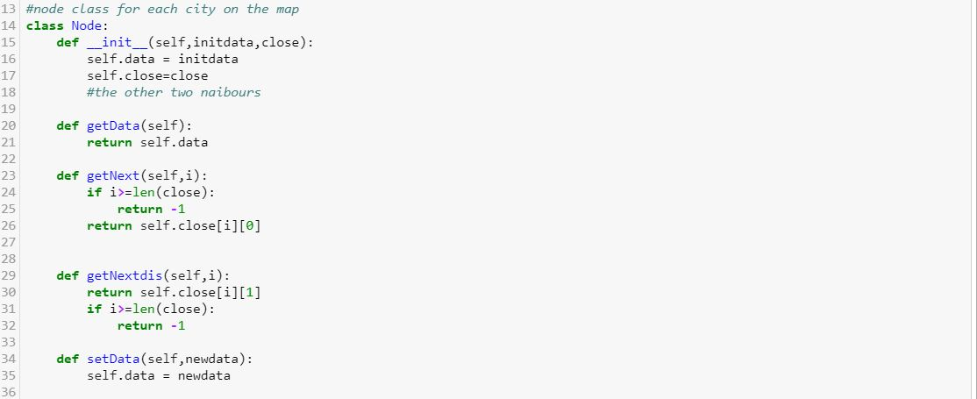
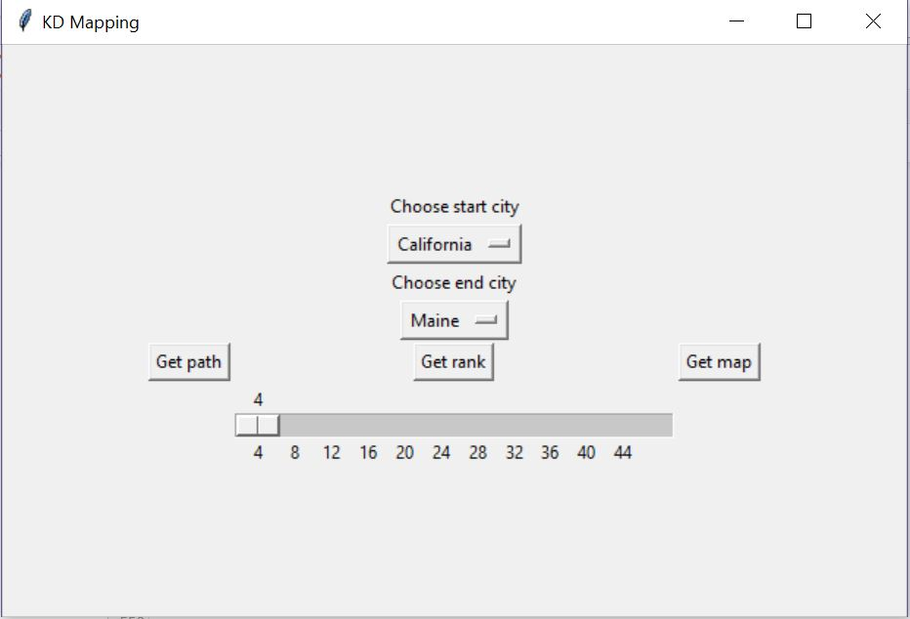
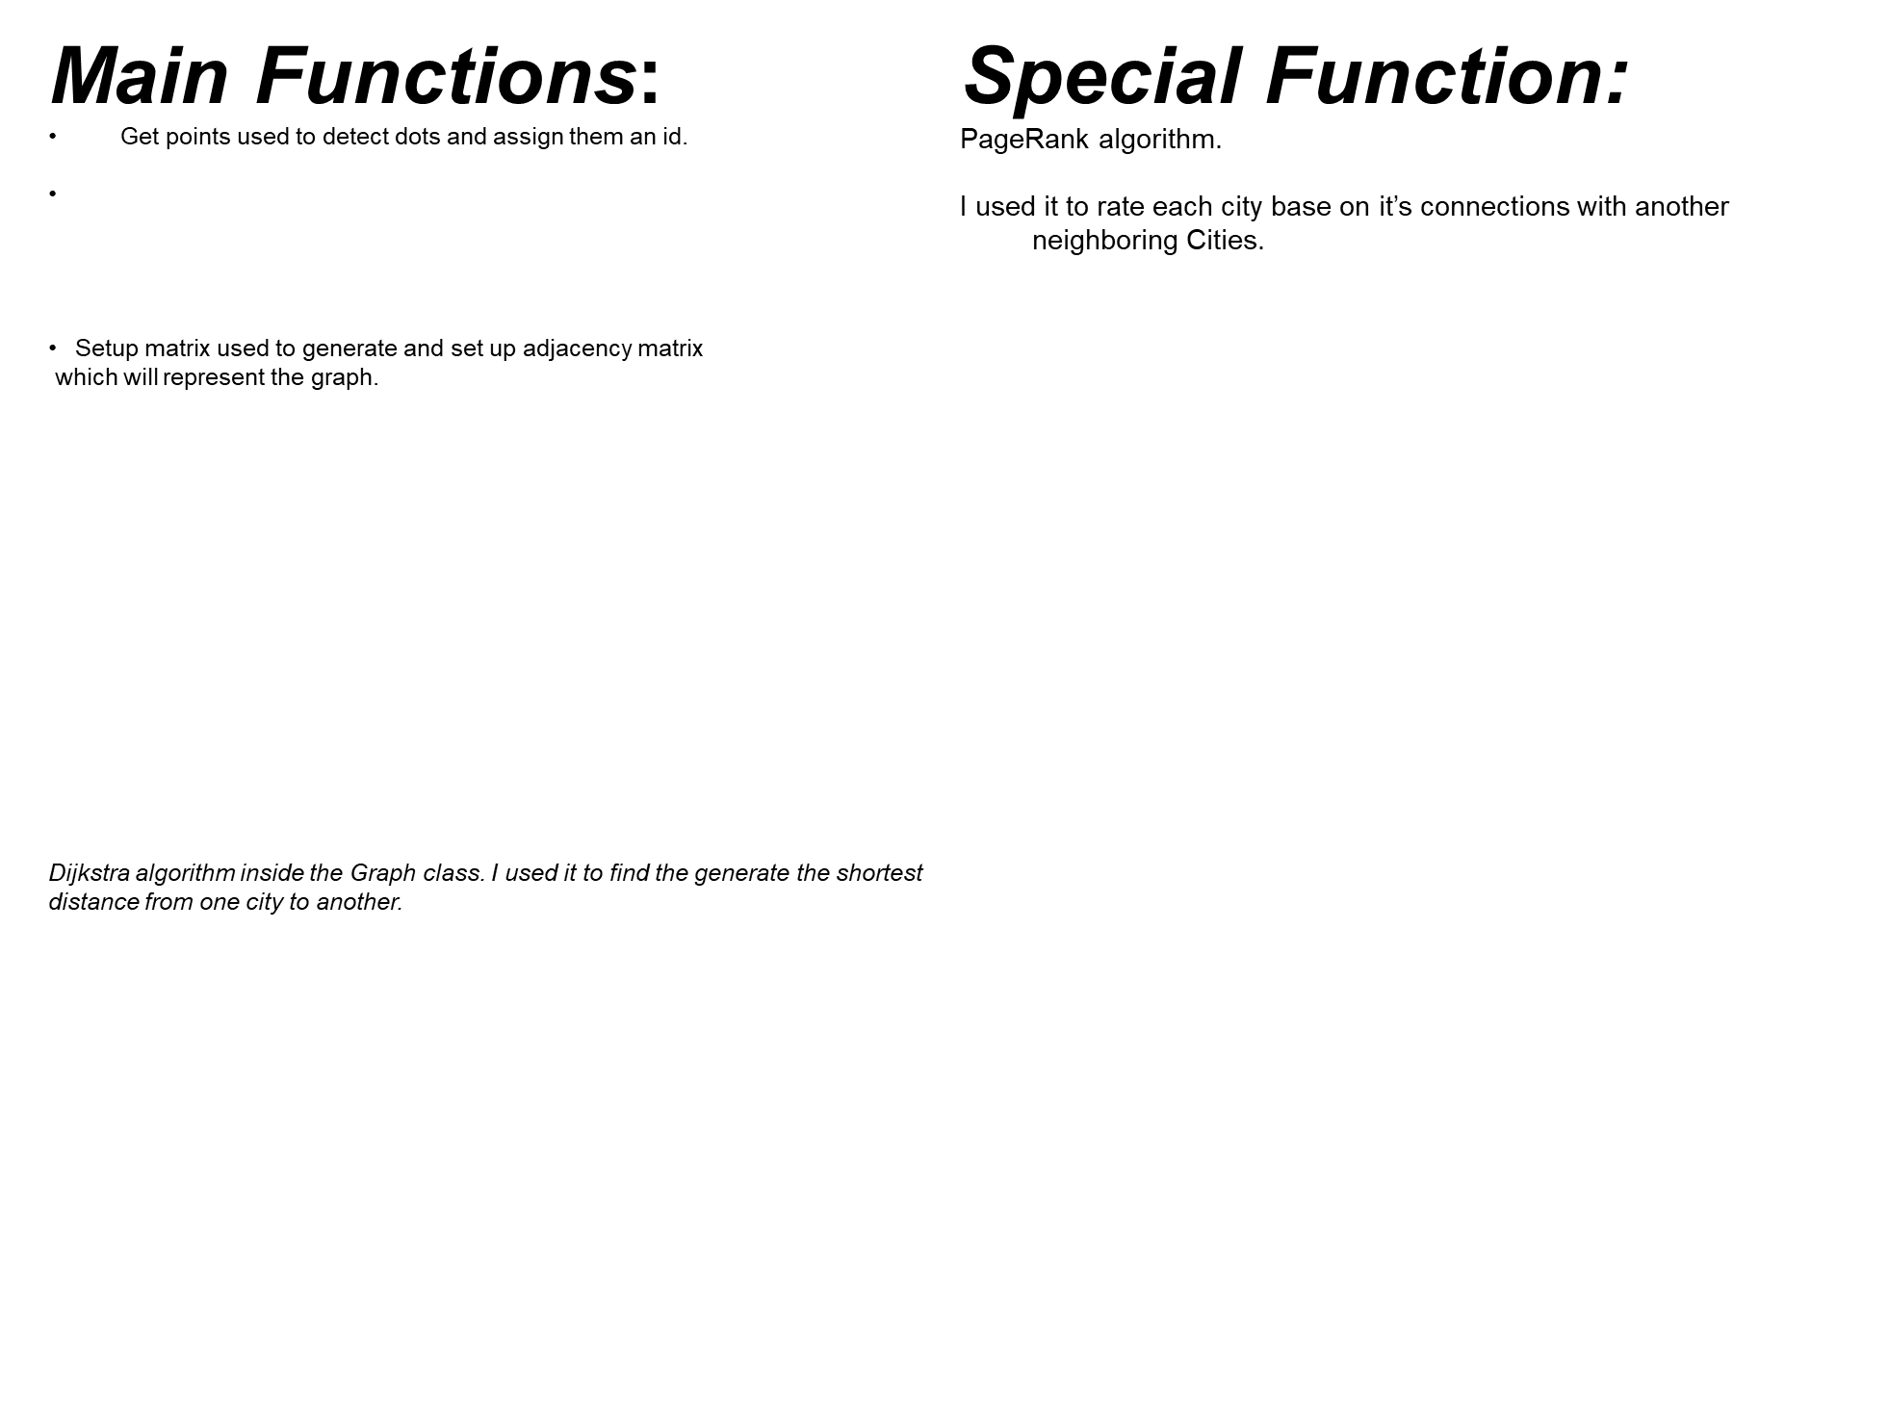
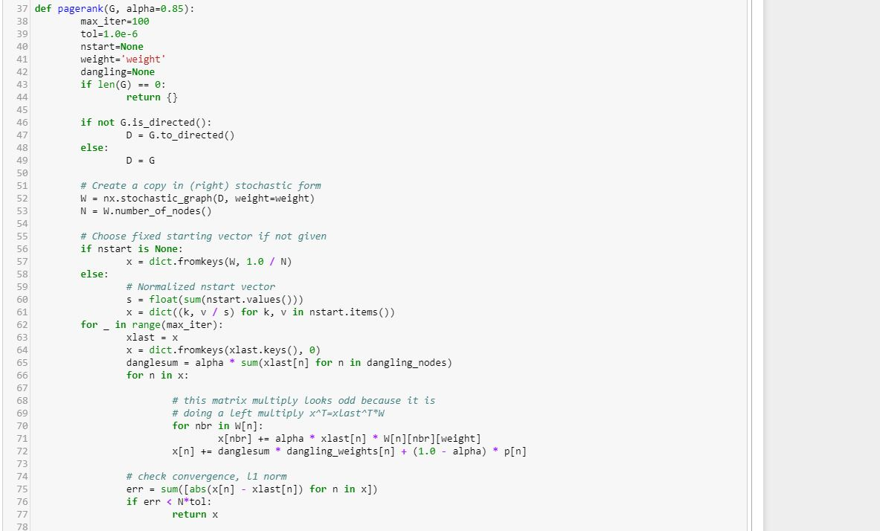
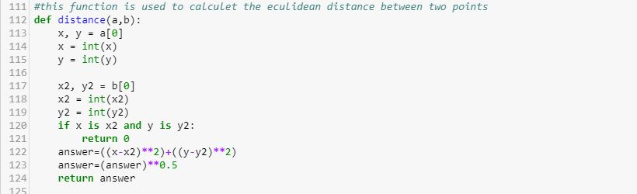
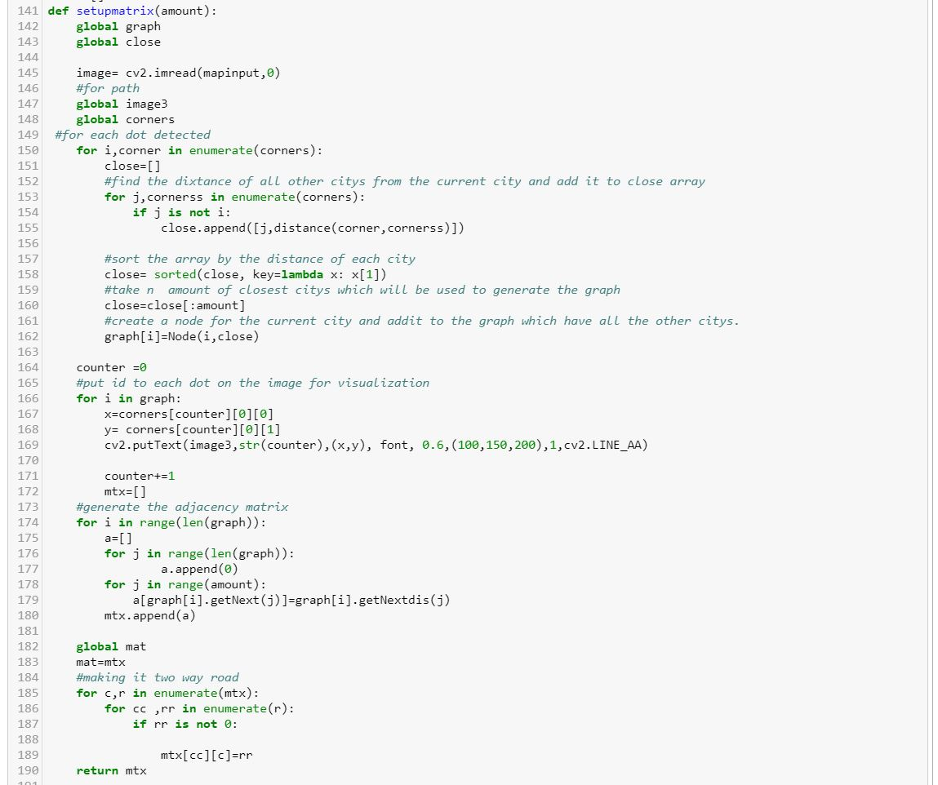
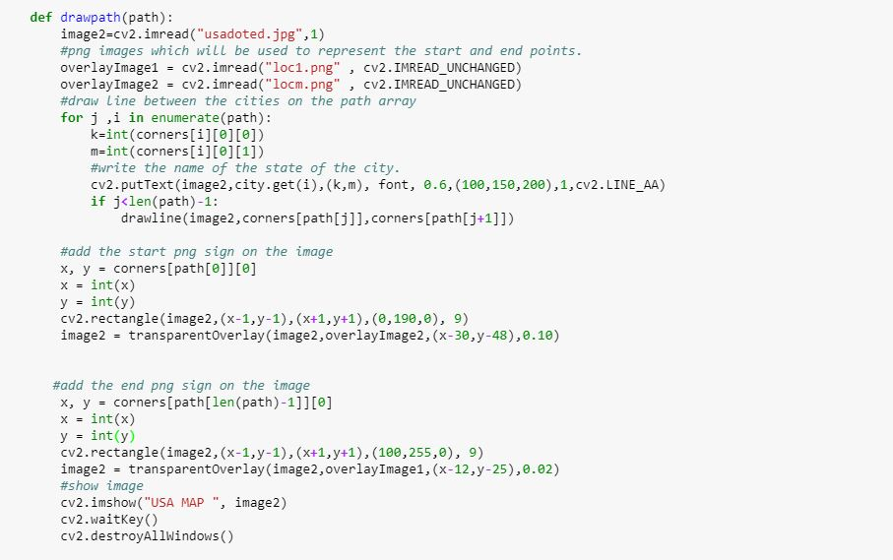
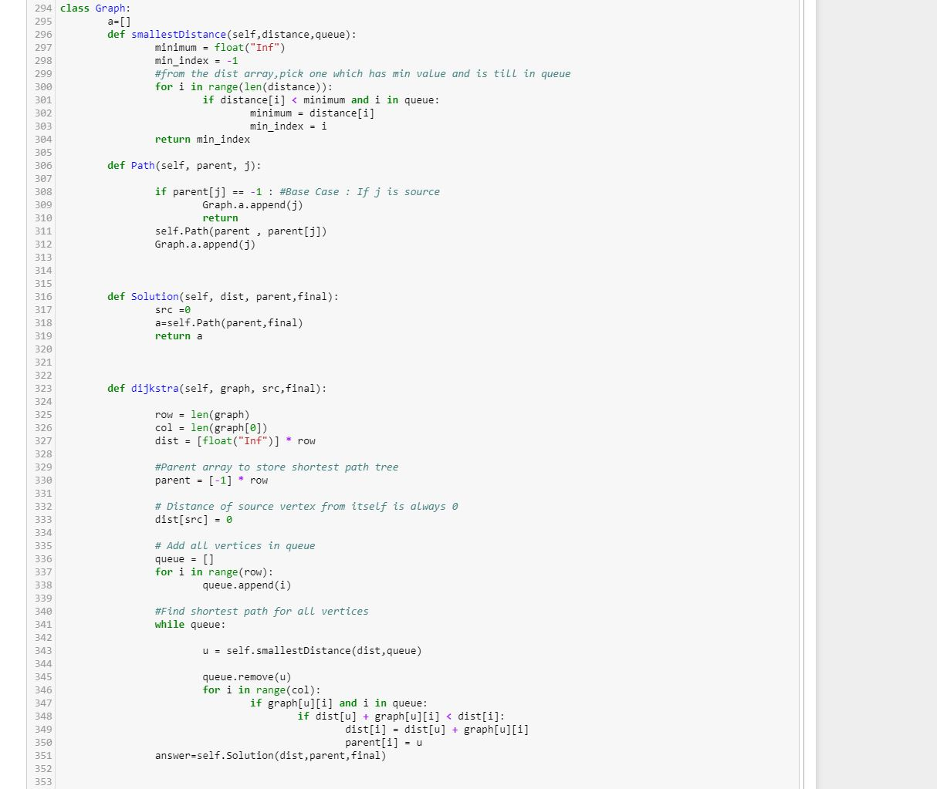
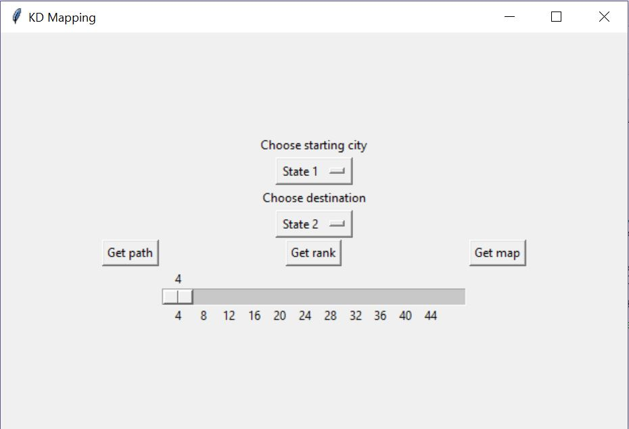
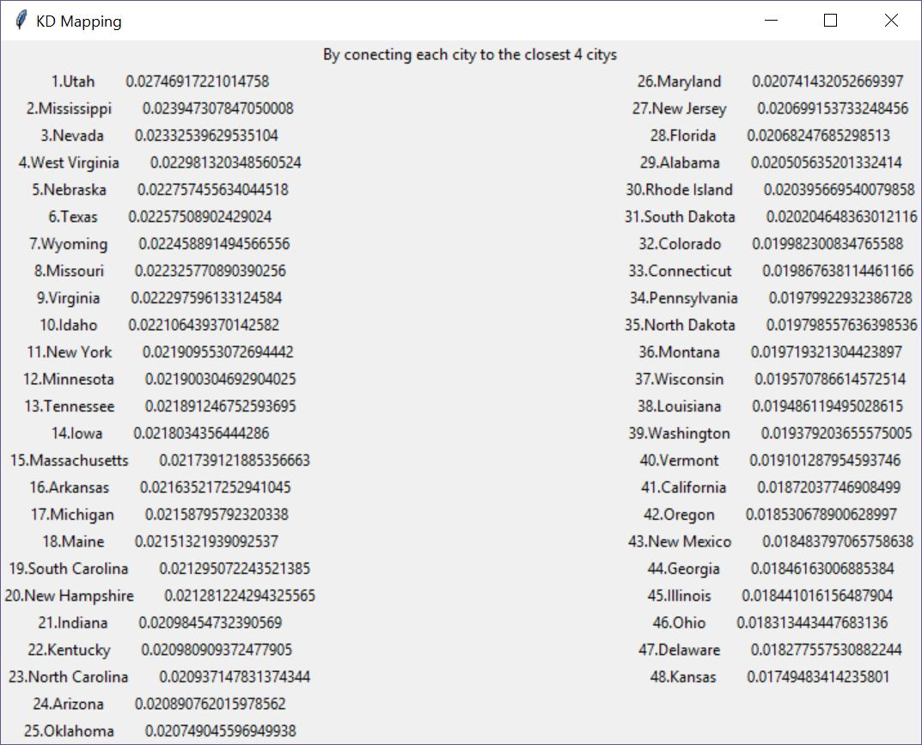
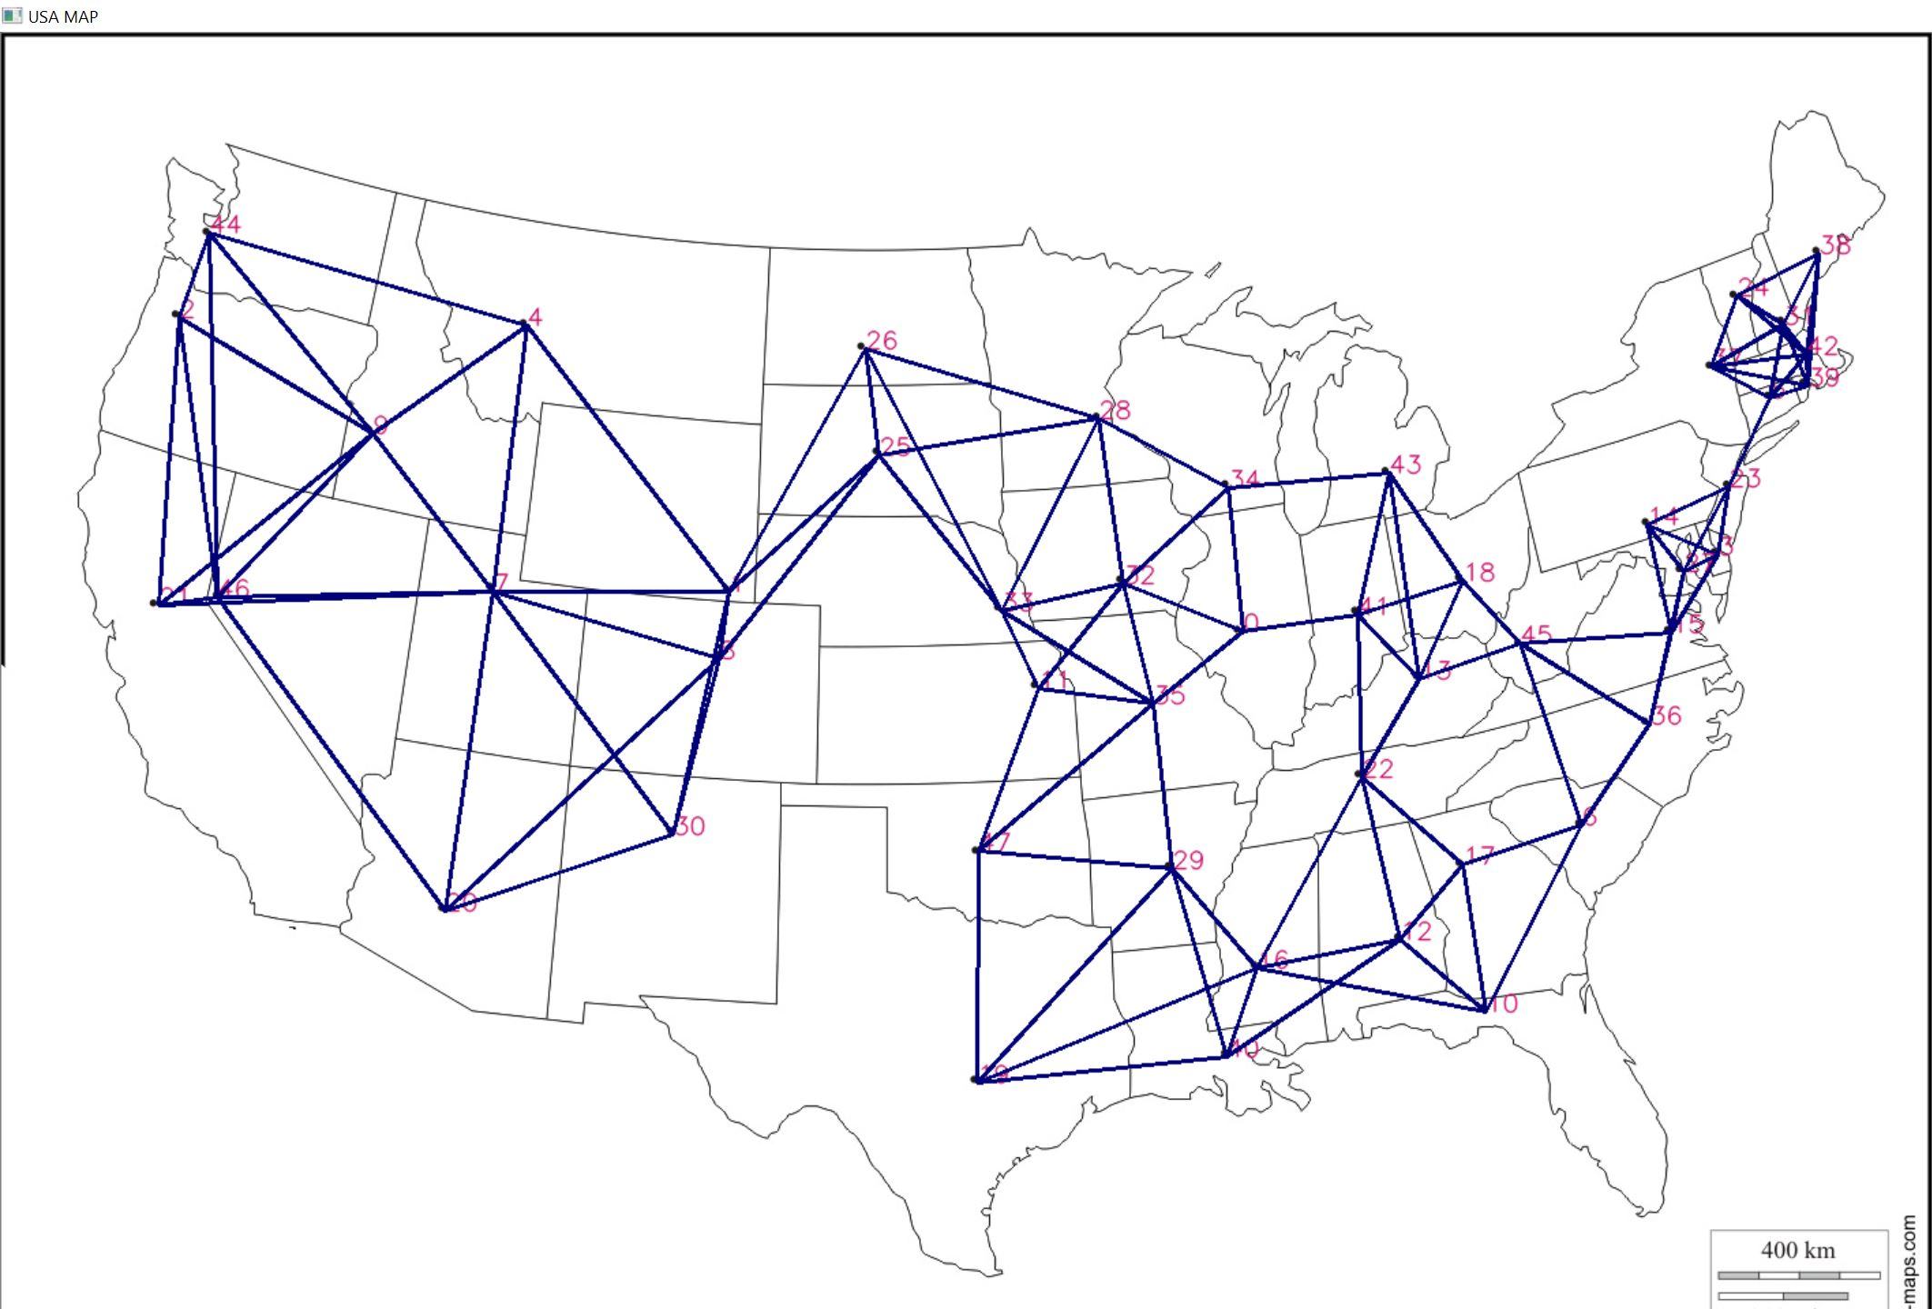
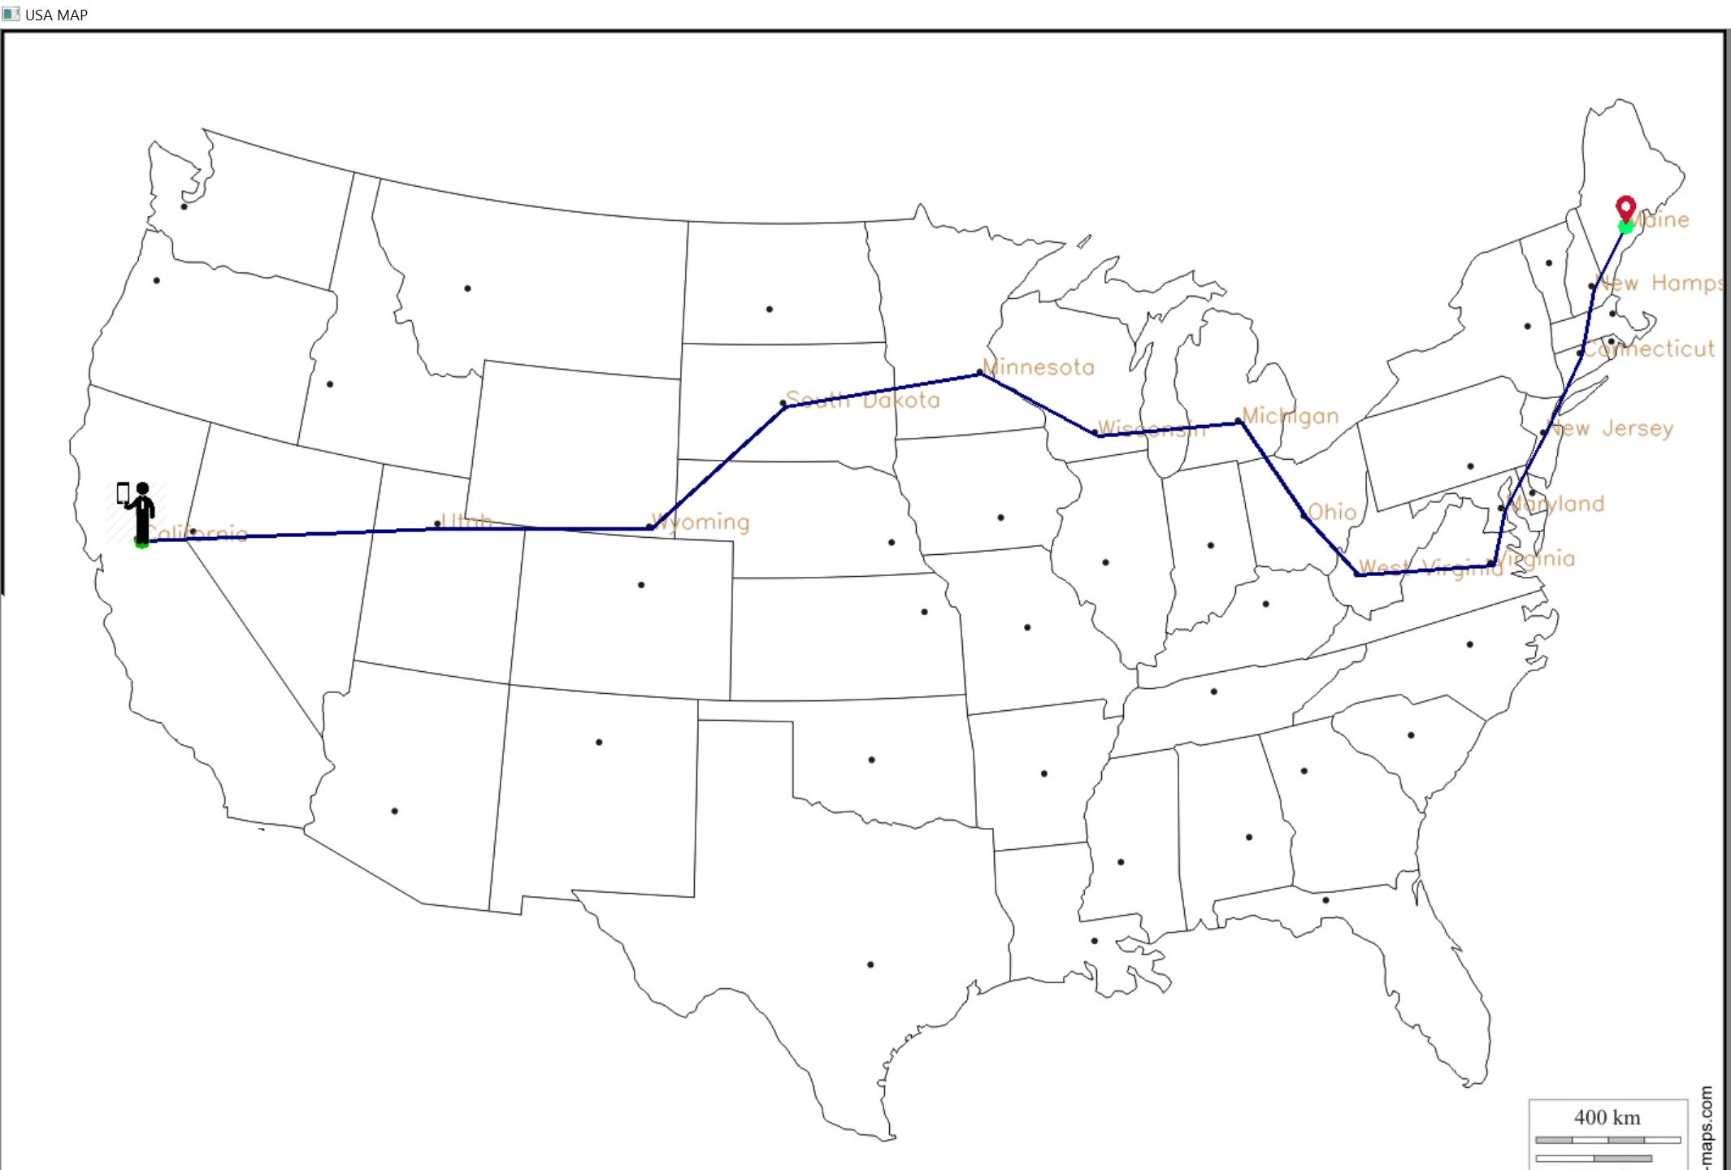
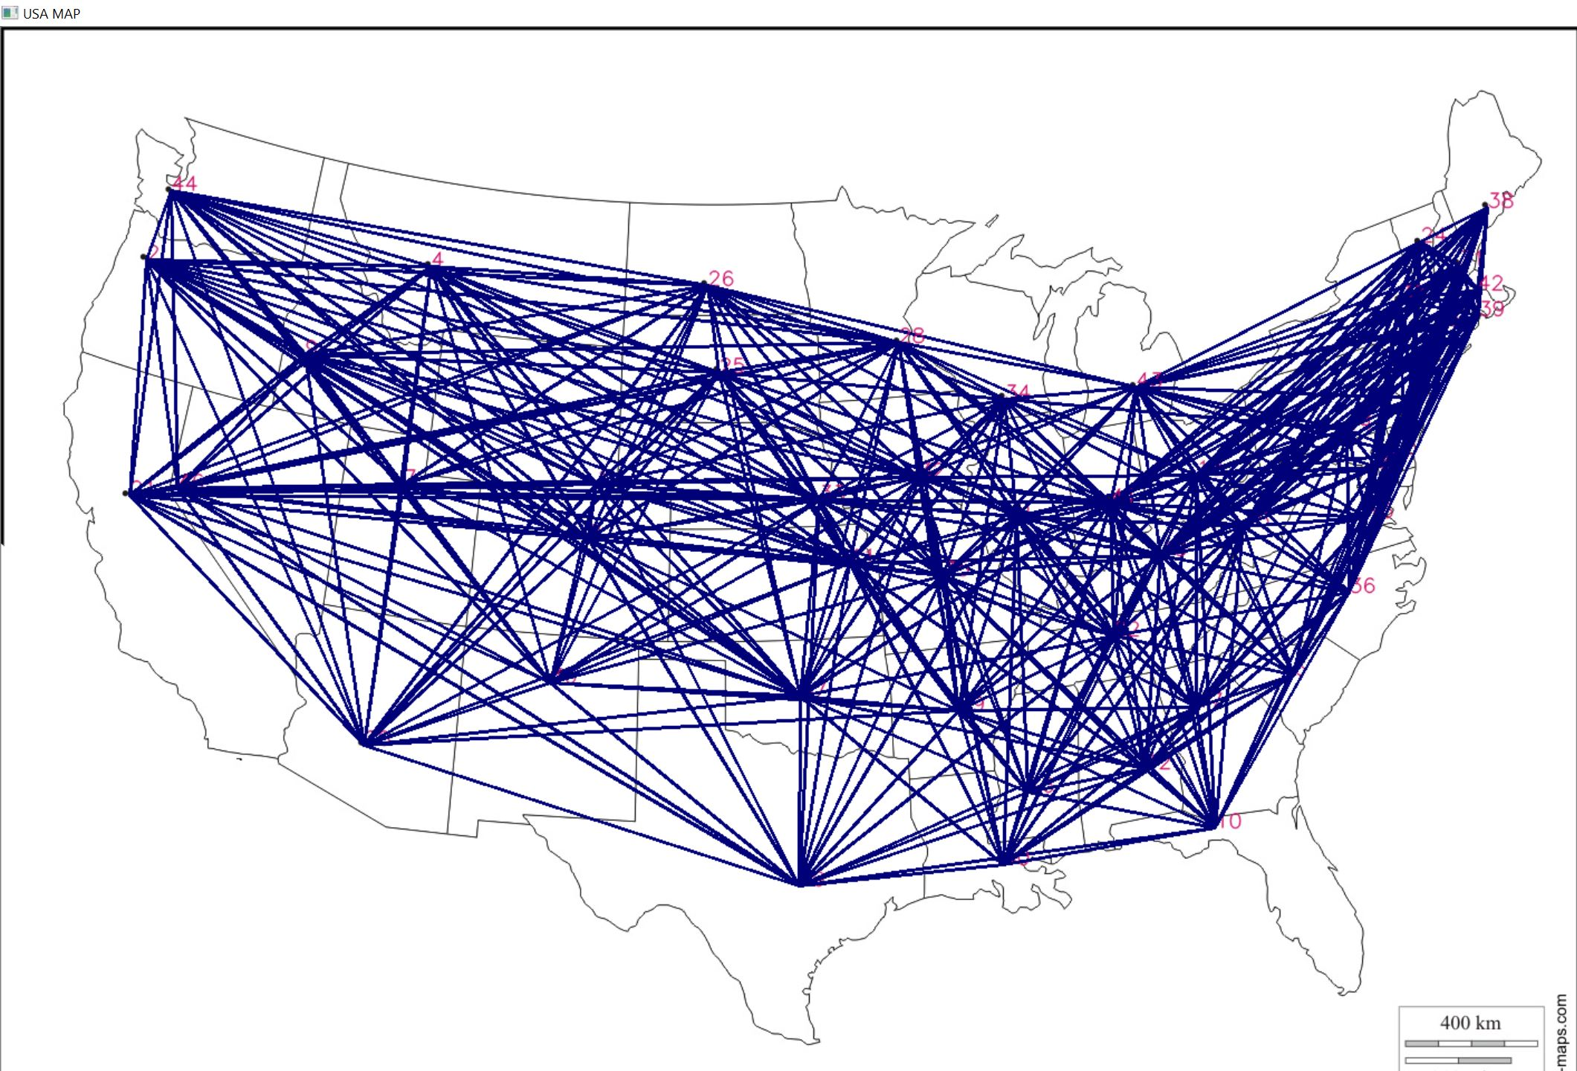
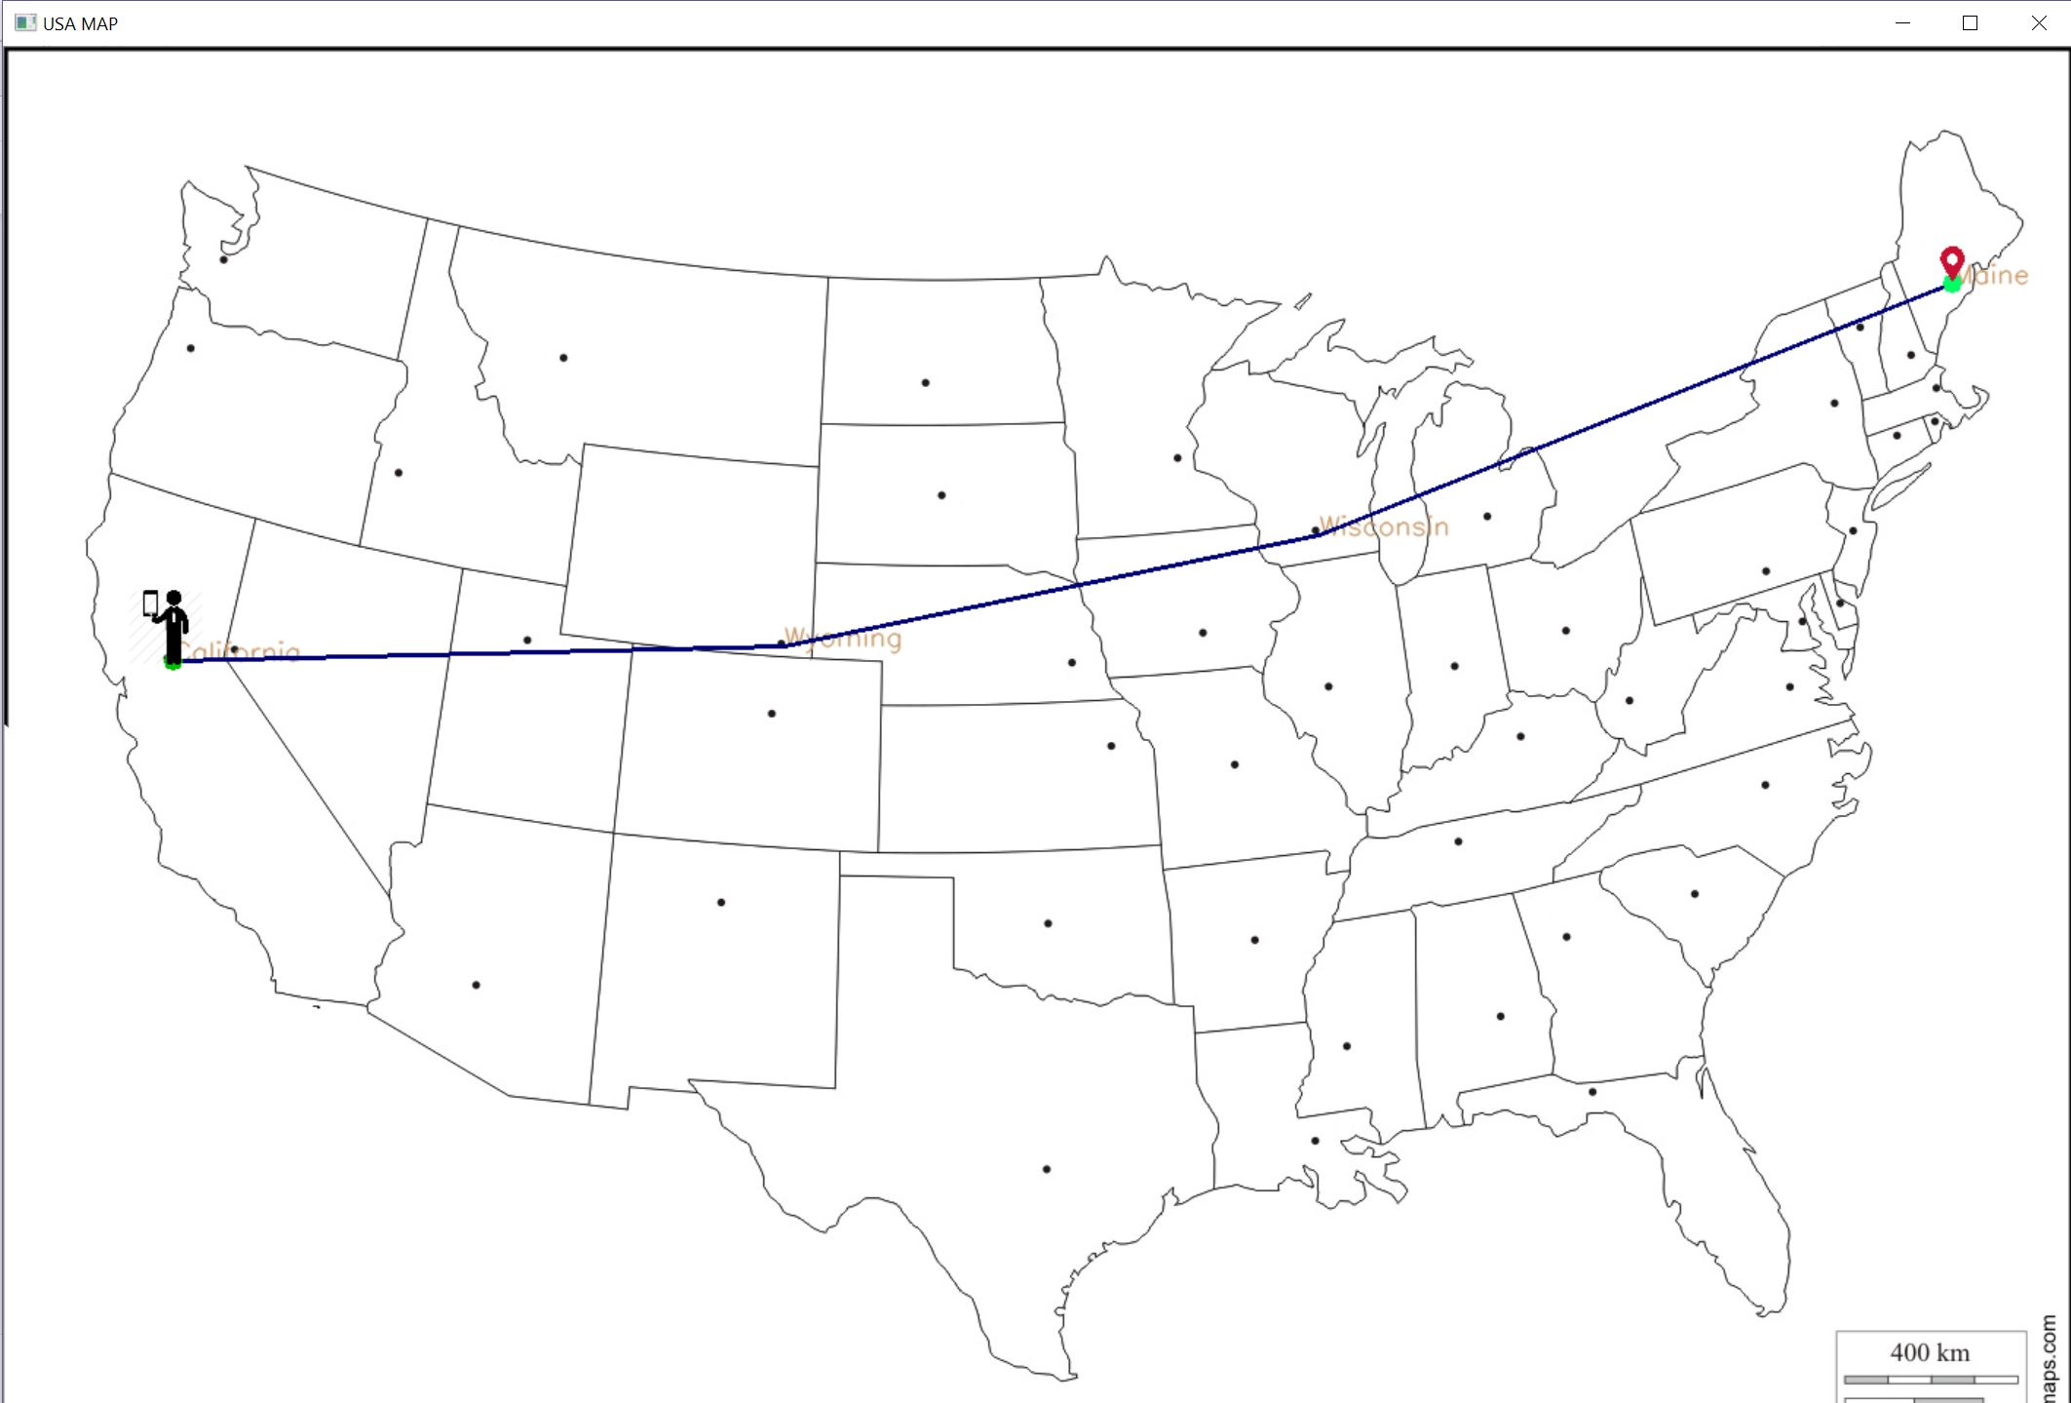

Kedamawi Mulualem
Spring 2018
TITLE OF PROJECT
Problem Statement:
Dynamic optimization of flight routs with n number of stops.
Target audience: Airlines and aviation industry .
Design Strategy:
Detect dots using get points function representing capitals of each state using image processing
and assign them an id.
Create a node that represents each city(dot) using its coordinate location on the image.
Each node will contain a dictionary that uses the id of all the other nodes as a key and their
distance from the current node as a value and it will be sorted in ascending order of the values.
Determine how many n closest neighboring cities each city will connect to. Get n as an input from the user.
Generate adjacency matrix to represent the connection of each node/city to n amount of neighboring cities.
Additional functions:
Distance function is used to find the Euclidean distance between two points.
Draw path function used to draw the generated path/route on the map and display it.
Design Feature:
KD mapping GUI is used to get the inputs from the user.
Inputs consists of the start city and destination.
Using get rank function we can generate rank of the cities based on their connection.
For four Closest cities Utah have the highest rank
Label image:
This graph is generated by connecting each city to the four closest cities to it.
Using the first graph, the path from California to Maine is displayed with 12 stops between the two states.
Using the first graph, the path from California to Maine is displayed with two stops between the two states.
This graph is generated by connecting each city to the nineteen closest cities to it.
Kedamawi Mulualem
Acknowledgements:
I would like to thank Prof. Li Chen for granting me the opportunity to work on this project under his mentorship.

