Slide 1
1 · AlphaEarth embeddings
Bottom line
We already have world-wide embeddings. Building-use labels are clear only when a tag exists.
Question | Answer
Do we have embeddings for the whole world? | Yes. Public AlphaEarth V1 covers land and shallow coast. 10 m. Years 2017–2024. We get them from Earth Engine. Google did not share the model.
Can Overture tell homes from other buildings? | Yes, if the building has a use tag. Most buildings have no tag. In every US city, 23% have a tag (98M buildings). In 15 US downtowns, 34%. In 8 world downtowns, 17%.
So what do we do? | Train on tagged buildings. Use shop and school points to add rough labels. Never treat an untagged building as “not a home.”
Decide today
1. Use the public yearly AlphaEarth layers in Earth Engine.
2. Use Overture use tags as clean home vs not-home labels.
3. Try Places points next to add coverage. Leave untagged buildings out of training.
1

Slide 2
1 · AlphaEarth embeddings
Do we have embeddings for the whole world?
Yes. Use the public yearly product.
Option | Where it covers | What we do
Yearly Satellite Embedding V1 | Land and shallow coast, world-wide | Use this now
Custom embeddings | A place and time we choose | Later, if we need months not years
The AlphaEarth model itself | — | Not shared. We only use the finished numbers.
View | What this means
World | One public 10 m layer for each year 2017–2024. Berlin, Lagos, and Boston use the same numbers.
US: 4 regions | The same layer covers Northeast, Midwest, South, and West. There is no separate US product.
Get it in Earth Engine: GOOGLE/SATELLITE_EMBEDDING/V1/ANNUAL. License is CC-BY 4.0. Each cell is 64 numbers. Google did not share the model.
2

Slide 3
1 · AlphaEarth embeddings
What went into AlphaEarth embeddings?
Google already made the numbers. We use the public 10 m yearly layers. We do not start from raw satellite photos.
Question | Answer
What product? | Satellite Embedding V1, from AlphaEarth Foundations v2.1.
What data sources? | To make the public layers: Sentinel-2, Landsat 8/9, and Sentinel-1. Height, climate, and text were used only while training.
What types of pictures? | Color and infrared photos, heat, and radar. Not close-up commercial photos of building fronts.
What sensors? | Sentinel-2, Landsat 8/9, and Sentinel-1 radar.
What resolution? | Each embedding cell is 10 m across. A house is about 1 to 4 cells.
What years? | 2017 to 2024. One world-wide layer per year. Eight years in total.
What model made them? | AlphaEarth Foundations STP (about 480 million parameters). Google did not share the model.
Sources: DeepMind blog · Brown et al. 2025, arXiv:2507.22291 · Earth Engine catalog GOOGLE/SATELLITE_EMBEDDING/V1/ANNUAL
3

Slide 4
1 · AlphaEarth embeddings
How are the embeddings made?
From Sentinel-2, Landsat, and Sentinel-1. Not from close-up commercial photos.
Type of picture | Sensor | Pixel size | When used
Color / infrared | Sentinel-2 | 10 / 20 / 60 m | To make the public layers
Color / heat | Landsat 8/9 | 15 / 30 / 100 m | To make the public layers
Radar | Sentinel-1 | 10 m | To make the public layers
• The model is AlphaEarth Foundations STP (about 480 million parameters). It learned from millions of year-long clips at sites around the world.
• Height, climate, and land-cover maps were used only in training. Building height in the embeddings is weak.
• A house is about 1 to 4 pixels. Nearby streets and blocks are already in the numbers. We will sample 2024 and average inside each building later.
4

Slide 5
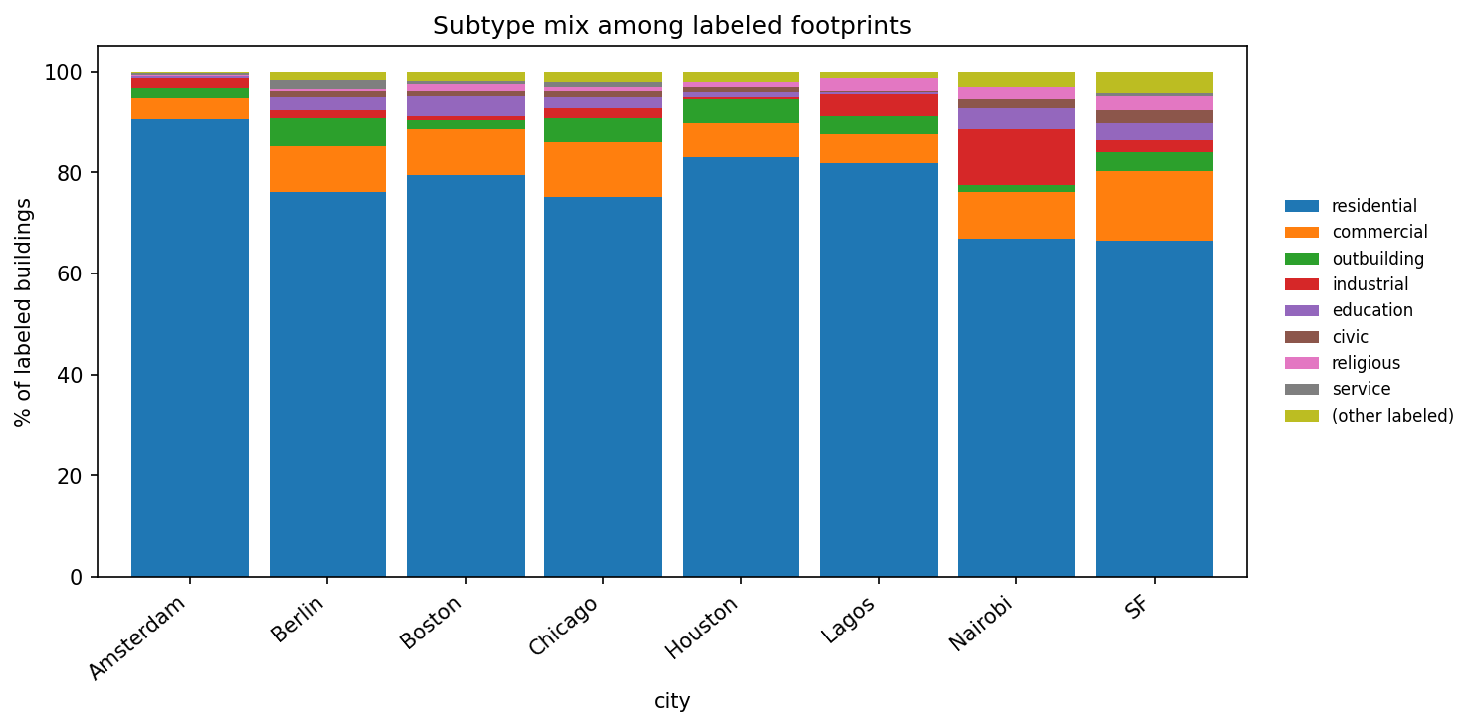
2 · Overture labels · notebook 06
Can Overture tell homes from other buildings?
Yes, if the building has a use tag. Same rule everywhere. Most tagged buildings are homes.
If Overture says… | We treat it as…
residential | Home
any other use tag | Not a home
no tag | Skip. Do not guess.
• Of tagged buildings in the 8 world downtowns, 82% are homes.
• Of tagged buildings in the 15 US downtowns, 86% are homes.
• The rest of the tagged set is shops, schools, offices, and other uses.
• Never treat a missing tag as “not a home.”
5

Slide 6
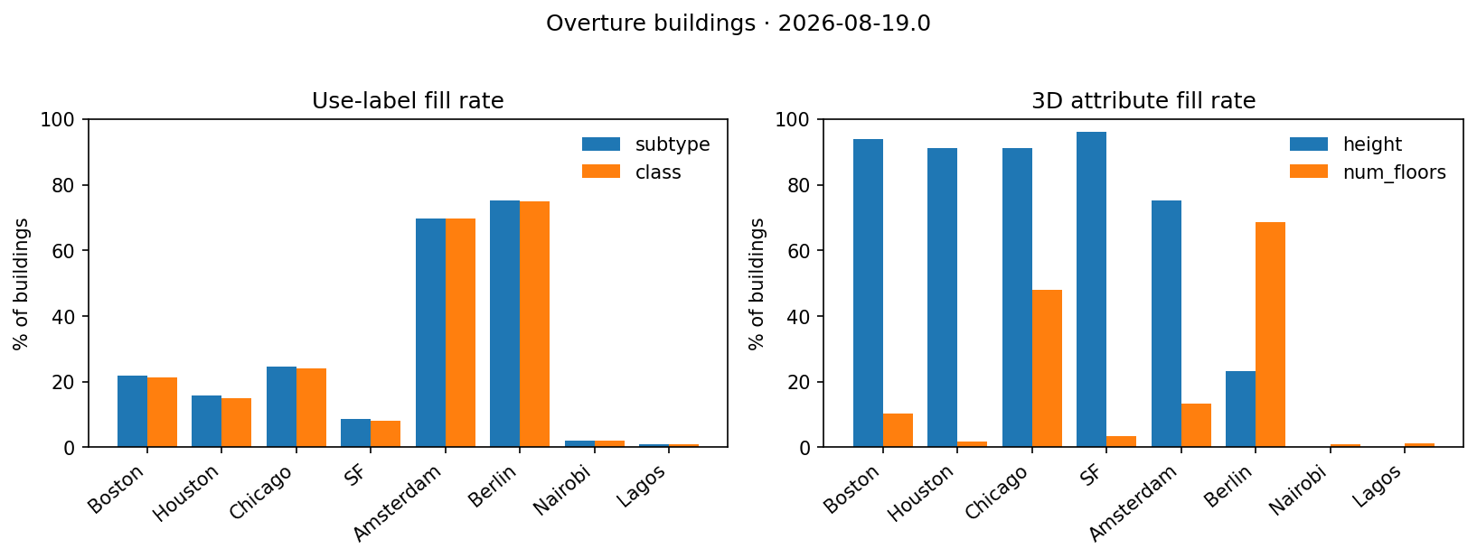
2 · Overture labels · notebook 06
Do enough buildings have a use tag?
No. 17% tagged in all 8 world downtowns (883k buildings). Europe is high. Lagos and Nairobi are not.
City | % with a tag | Of tagged: homes
Berlin | 75% | 76%
Amsterdam | 70% | 91%
Chicago | 24% | 75%
Boston | 22% | 80%
Houston | 16% | 83%
SF | 9% | 67%
Nairobi | 2% | 67%
Lagos | 1% | 82%
All 8 | 17% | 82%
6

Slide 7
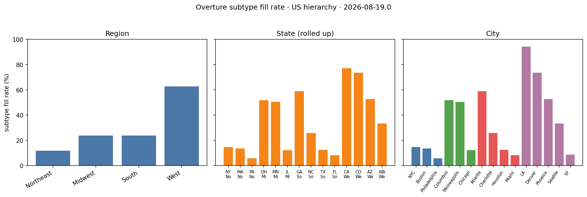
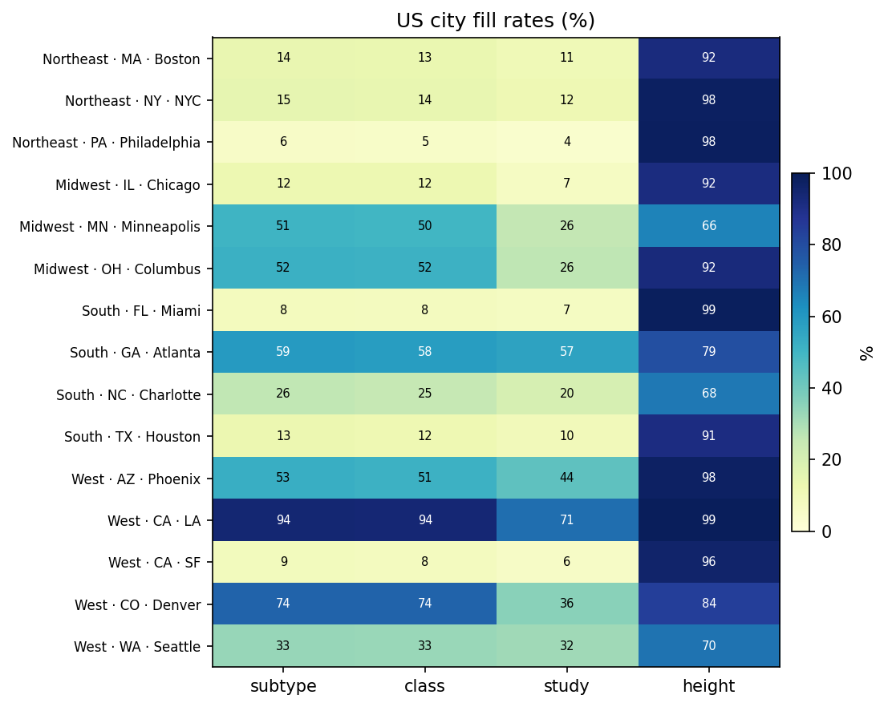
2 · Overture labels · notebook 06
How do US downtowns compare?
34% tagged across all 15 US downtowns (2.18M buildings). The West is high because of LA and Denver.
US region | % tagged | Homes
West | 63% | 87%
Midwest | 24% | 84%
South | 24% | 88%
Northeast | 12% | 78%
All 15 | 34% | 86%
7

Slide 8
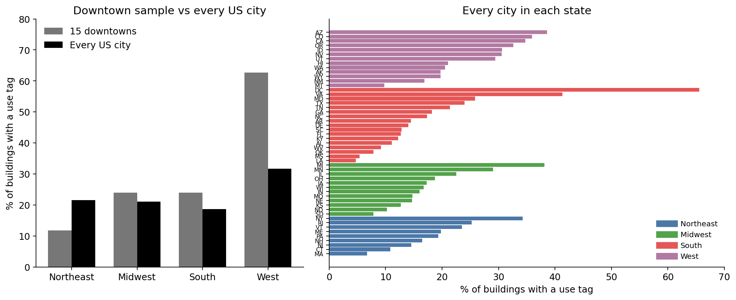
2 · Overture labels · notebook 06
Does the whole US look like those 15 downtowns?
No. In every US city, 23% of 98 million buildings have a use tag. The 15 downtowns were 34%.
US region | Cities | % tagged
West | 6,071 | 32%
Northeast | 4,929 | 21%
Midwest | 10,502 | 21%
South | 10,527 | 19%
All US | 32,029 | 23%
This is every city and town in the 50 states and DC. Of tagged buildings, 89% are homes. Buildings outside a city are left out. The West downtown number was high because of LA and Denver.
8

Slide 9
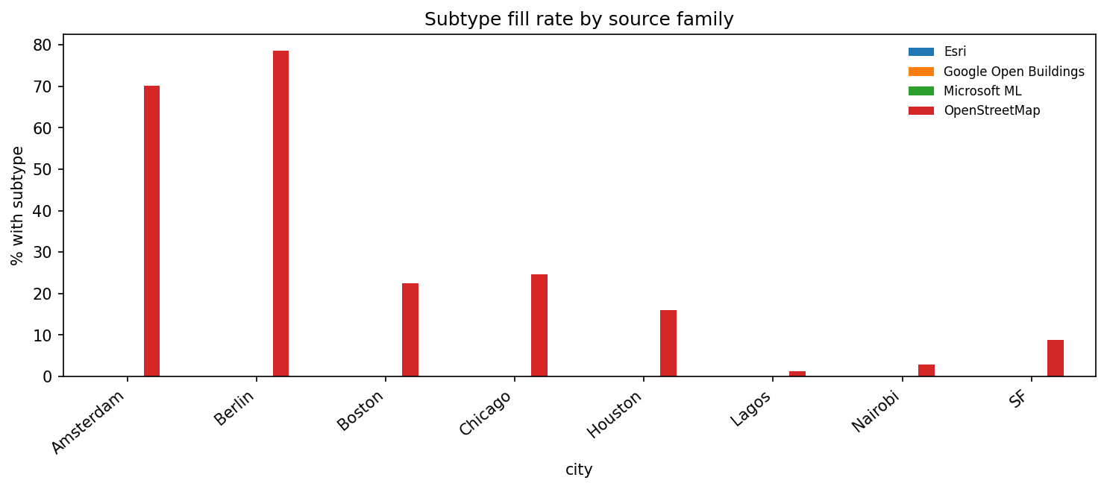
2 · Overture labels · notebook 06
Why do so few buildings have a tag?
Use tags come from OpenStreetMap only. Extra Microsoft and Google outlines have no use tag.
City | OSM % tagged | Extra % tagged
Berlin | 79% | 0%
Amsterdam | 70% | 0%
Boston | 22% | 0%
Houston | 16% | 0%
Nairobi | 3% | 0%
Lagos | 1% | 0%
Every use tag we saw comes from OpenStreetMap. Microsoft, Google, and Esri outlines have zero use tags. Do not treat those outlines as “not a home.”
9

Slide 10
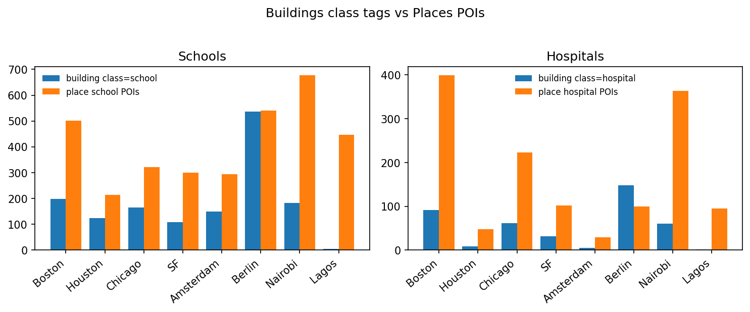
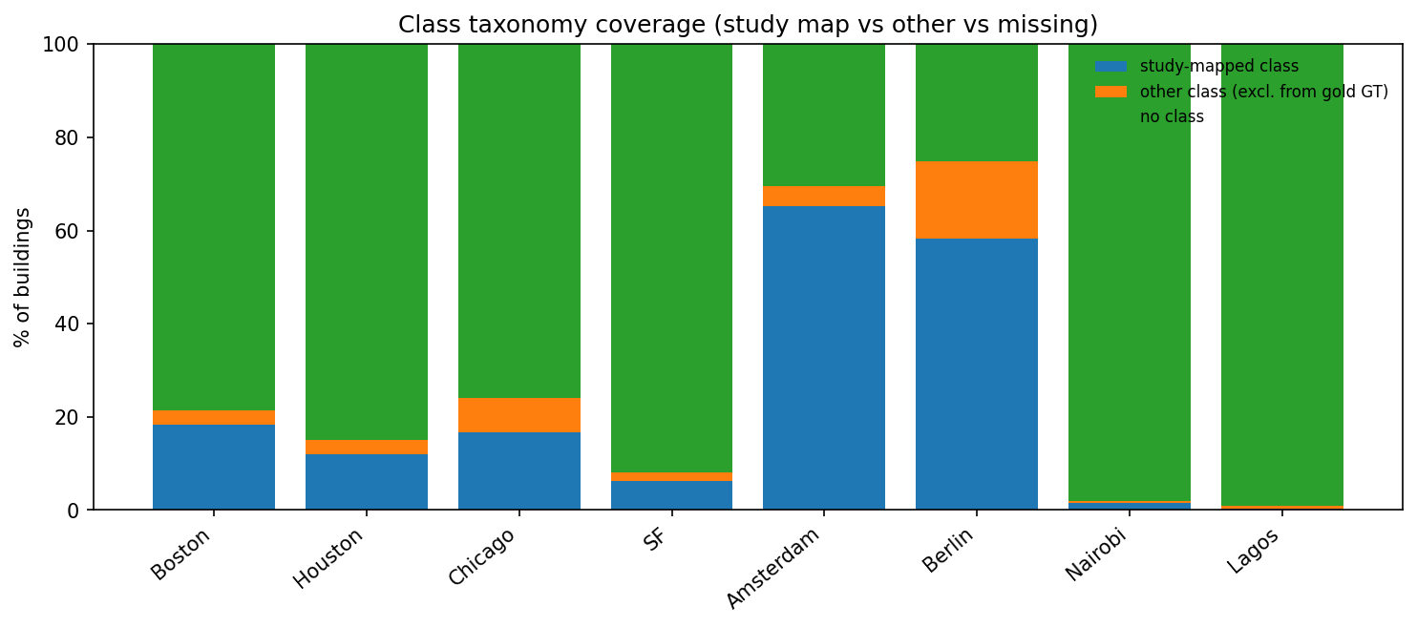
2 · Overture labels · notebook 06
Can extra map points fill the gaps?
Yes. Shop and school points are more common than building tags. Treat them as rough labels, not as truth.
City | School buildings | School points | Hospital buildings | Hospital points
Berlin | 536 | 540 | 148 | 99
Boston | 199 | 502 | 92 | 399
Nairobi | 182 | 677 | 60 | 363
Lagos | 5 | 447 | 2 | 95
All 8 downtowns | 1,468 | 3,295 | 409 | 1,358
10

Slide 11
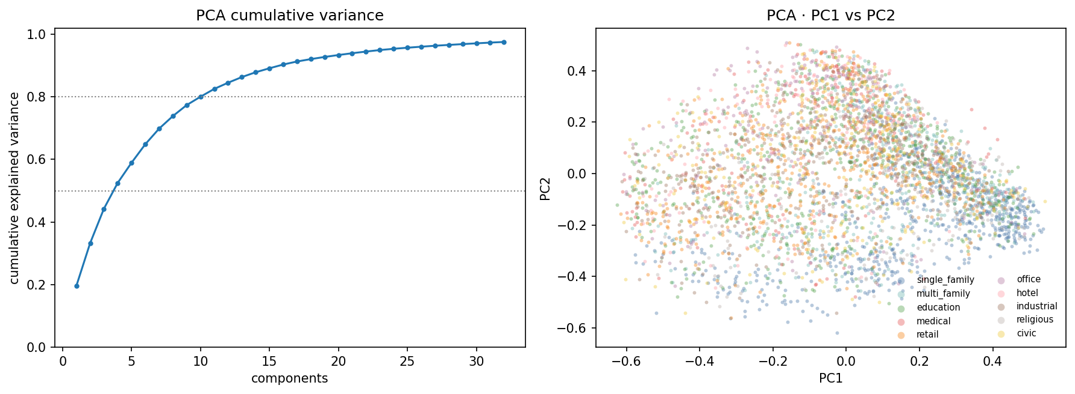
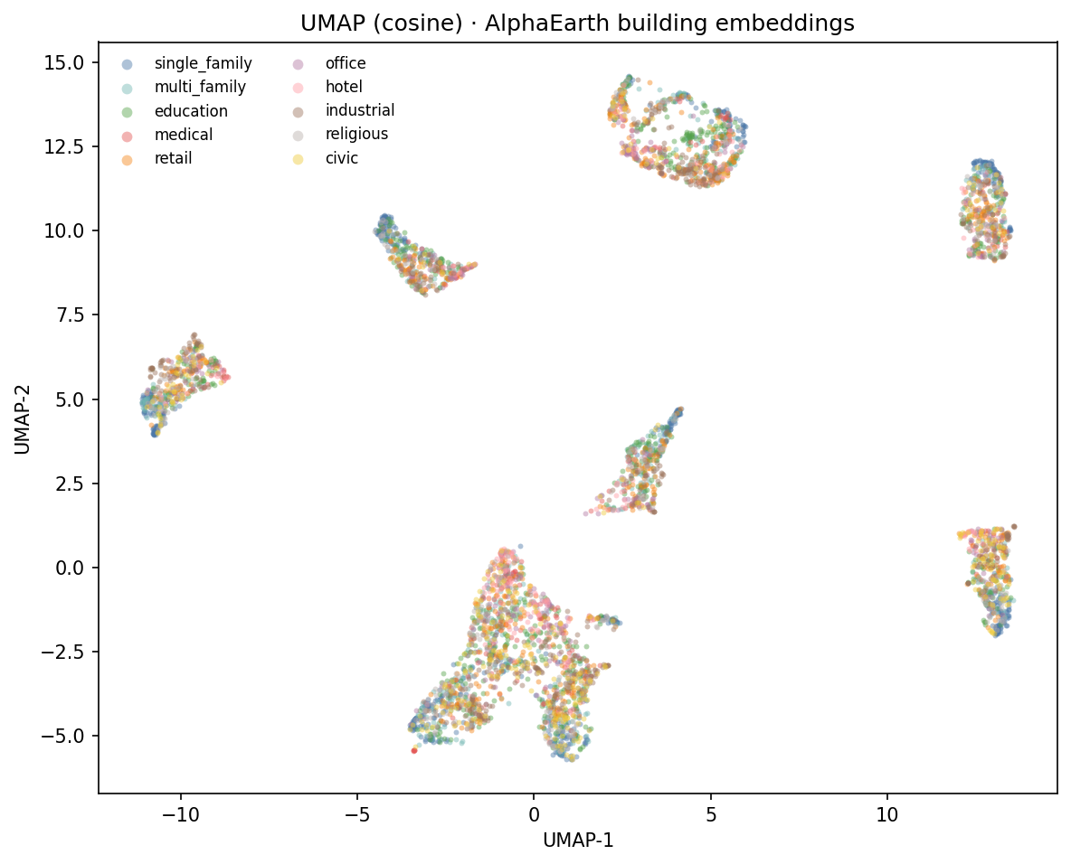
3 · Embedding space · notebook 08
Do building types show up in the embeddings?
A little. 11,280 tagged buildings. Types sit in one cloud, not in clean groups.
First two axes hold 33% of the variance. Ten building types overlap. Houses stand out more than churches or civic buildings.
11

Slide 12
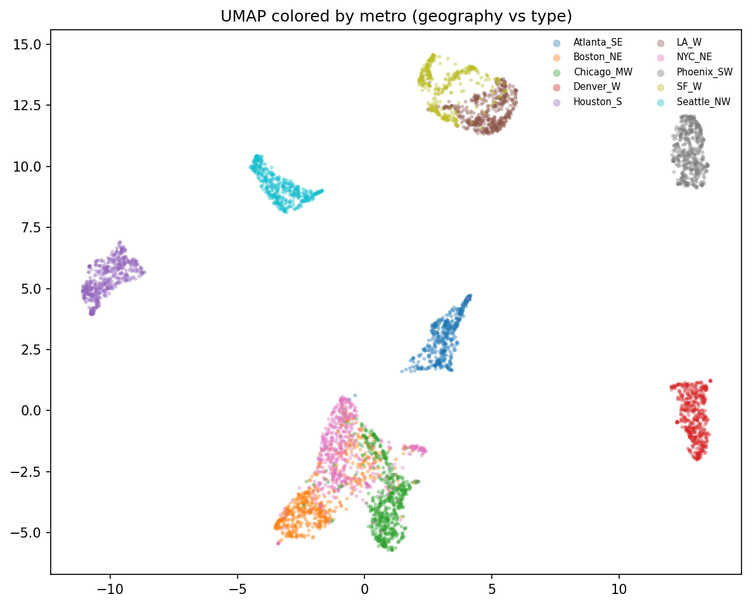
3 · Embedding space · notebook 08
Is the embedding showing place or building type?
Place first. Cities pull apart. Types inside a city do not.
• Boston, LA, and Houston sit in different parts of the plot.
• A house in Boston looks more like a shop in Boston than like a house in LA.
• A model trained in one city will lose some skill in another city.
• We still have type signal, but we must test transfer across cities.
12

Slide 13
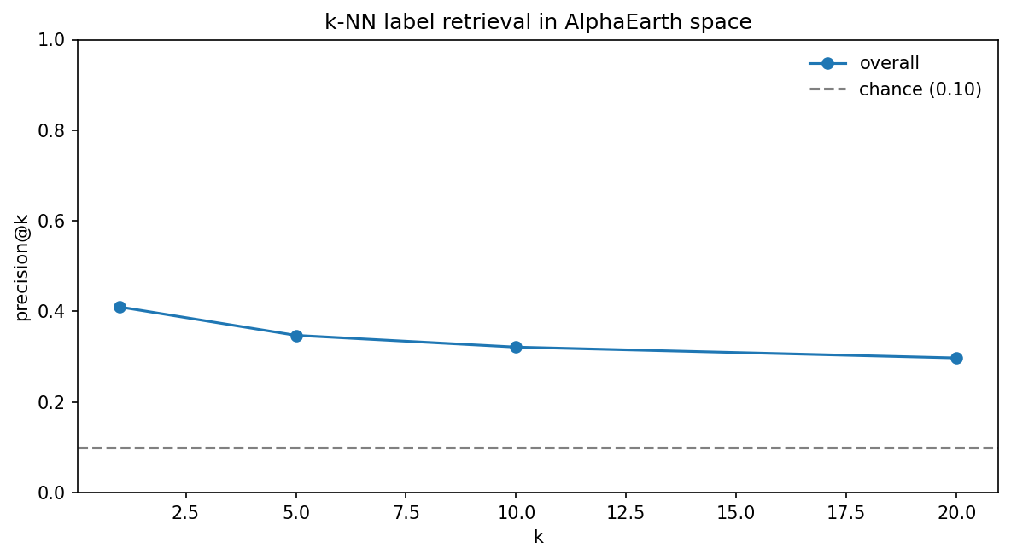
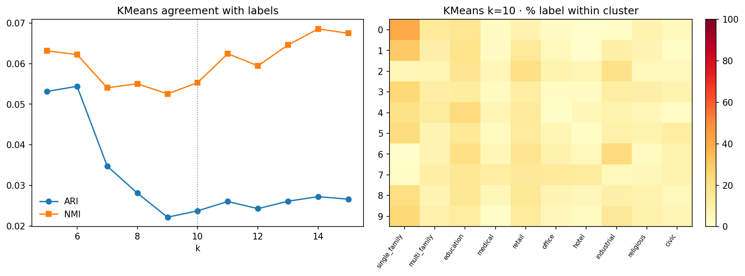
3 · Embedding space · notebook 08
Do nearby buildings share a type?
Yes, more than chance. Neighbors help. Automatic grouping into 10 piles does not.
Check | Score | Chance
Nearest neighbor is the same type | 41% | 10%
Auto 10 groups match true types | 2% | near 0
13

Slide 14
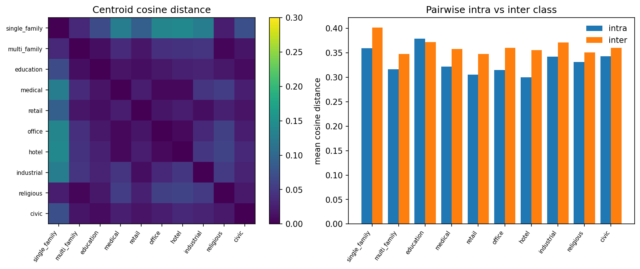
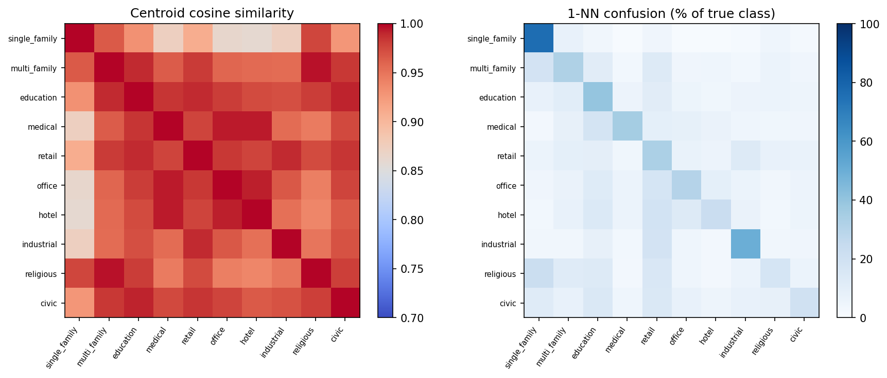
3 · Embedding space · notebook 08
Is there enough signal for a first model?
Yes for a supervised home vs not-home test. No for finding 10 types with no labels.
Same-type buildings are only a little closer than different-type buildings (gap 0.03). Houses match their neighbors 76% of the time. Churches 17%. Enough to train a simple model. Not enough to skip labels.
14

Slide 15
4 · First classifier · notebook 02
Does a simple model work on tagged buildings?
Yes. Logistic regression on 2024 embeddings. 3,600 tagged buildings. 83% on a mixed holdout.
Setup | Choice
Task | Home vs not-home
Labels | Overture use tags only
Features | 64 numbers at the building center, 2024
Model | Logistic regression
Cities | 9 US metros, 200 home + 200 not-home each
Split | Accuracy | Macro F1 | ROC-AUC
Mixed holdout | 83% | 83% | 0.90
Leave one city out (mean) | 77% | 77% | 0.84
Best city (Atlanta) | 87% | 87% | 0.92
Worst city (NYC) | 58% | 57% | 0.67
15

Slide 16
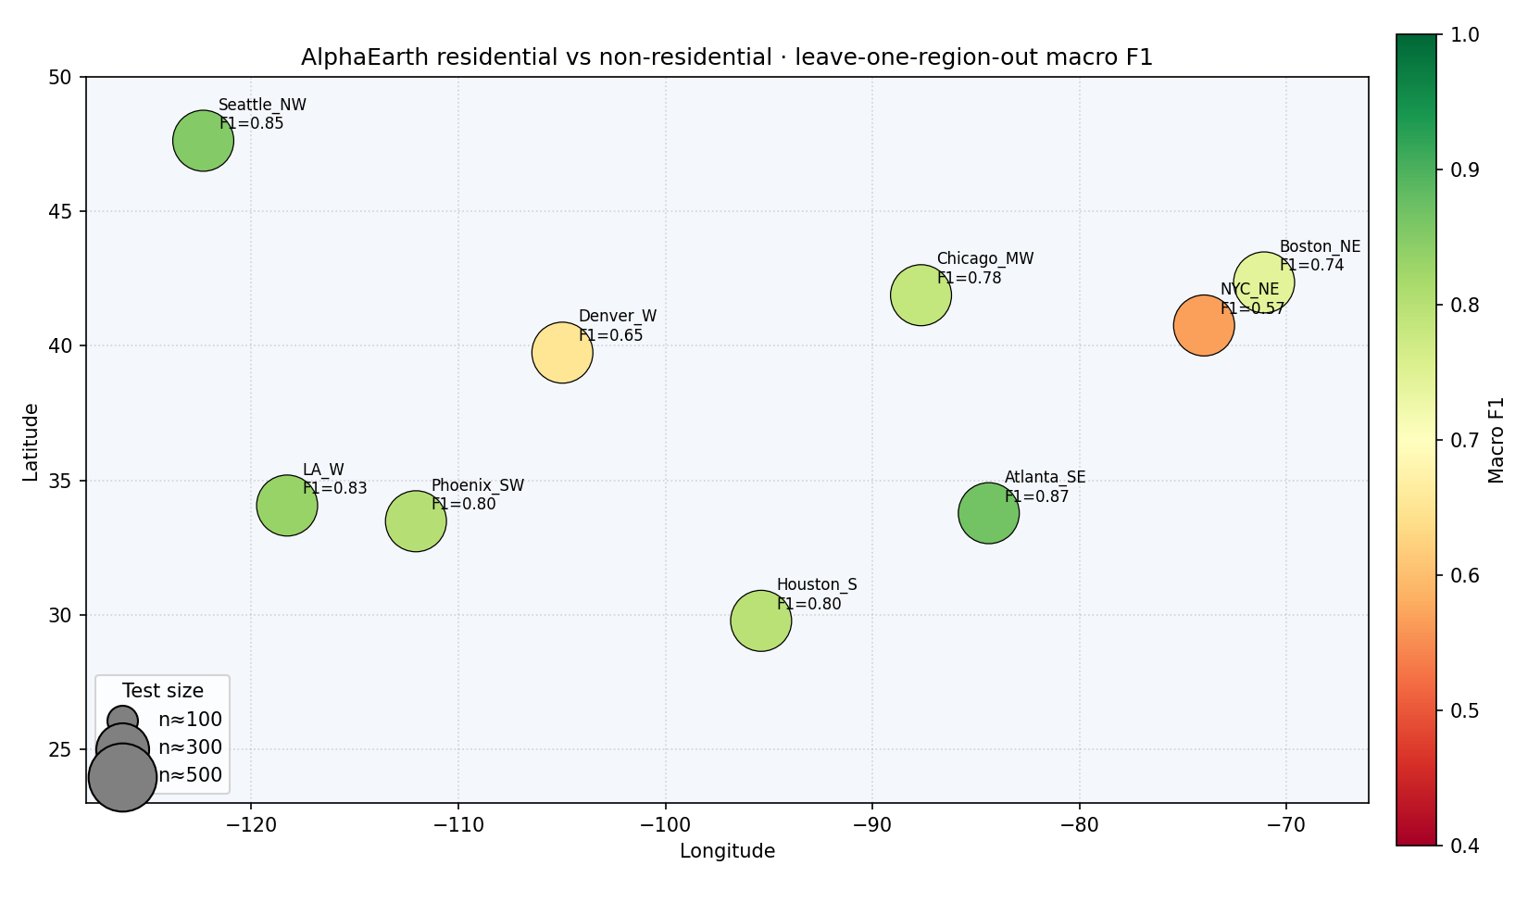
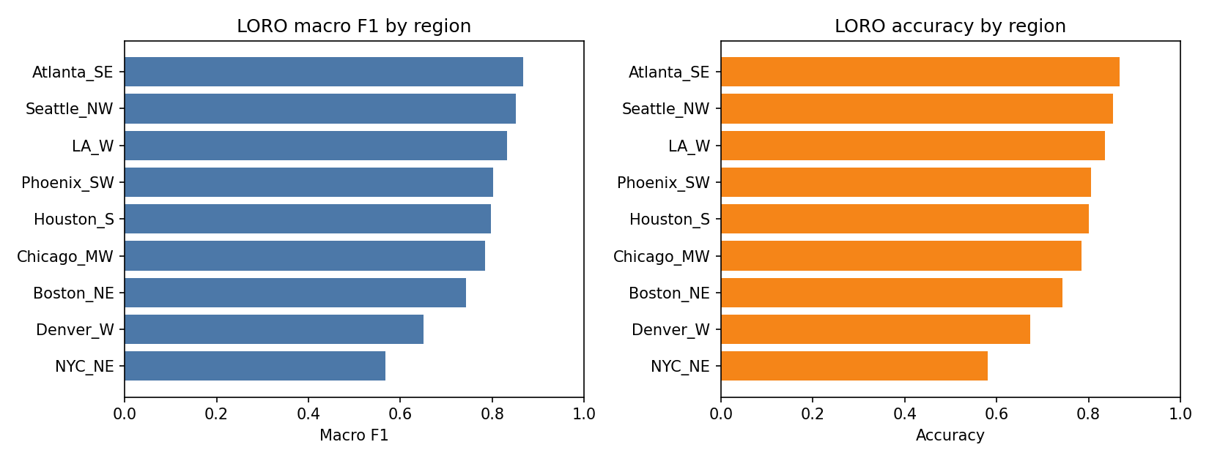
4 · First classifier · notebook 02
Does the model transfer to a new city?
Mostly. Mean leave-one-city-out is 77%. Atlanta, Seattle, and LA hold up. NYC and Denver drop.
16

Slide 17
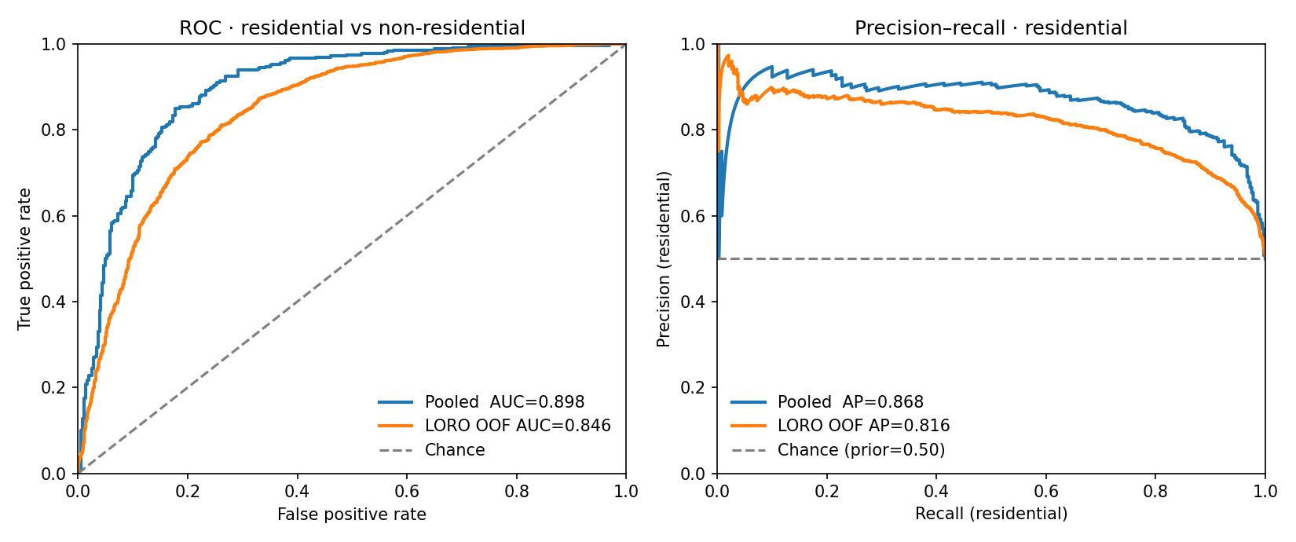
4 · First classifier · notebook 02
What does this first model buy us?
A working home vs not-home baseline on tagged buildings. Not a finished 10-type product.
Keep
• Public yearly AlphaEarth layers.
• Train only on tagged buildings.
• This logistic regression as the first bar to beat.
Next
• Average the embedding inside the building, not just the center.
• Link shop and school points where tags are rare.
• Test Europe and a tagged African downtown.
17

