Slide 1
Residential signal in frozen embeddings
Compact · partly shared · geographically brittle
Notes:
Ten downtowns, leave-one-metro-out, frozen 64-D AlphaEarth, then 100 m tiles and 3D ViTs. One claim: the useful residential direction is short; geography lives in the rest.

Slide 2
Standardized experimental protocol
10 metros
1.75M cells
64-D latent
LORO split
Downtown core boxes
Balanced 1:1 RES vs NRES
Frozen AlphaEarth
Hold-out; threshold 0.50
Notes:
Pure cells under resi_def_v1. Balance seed 42. Same folds across linear and tile runs.

Slide 3
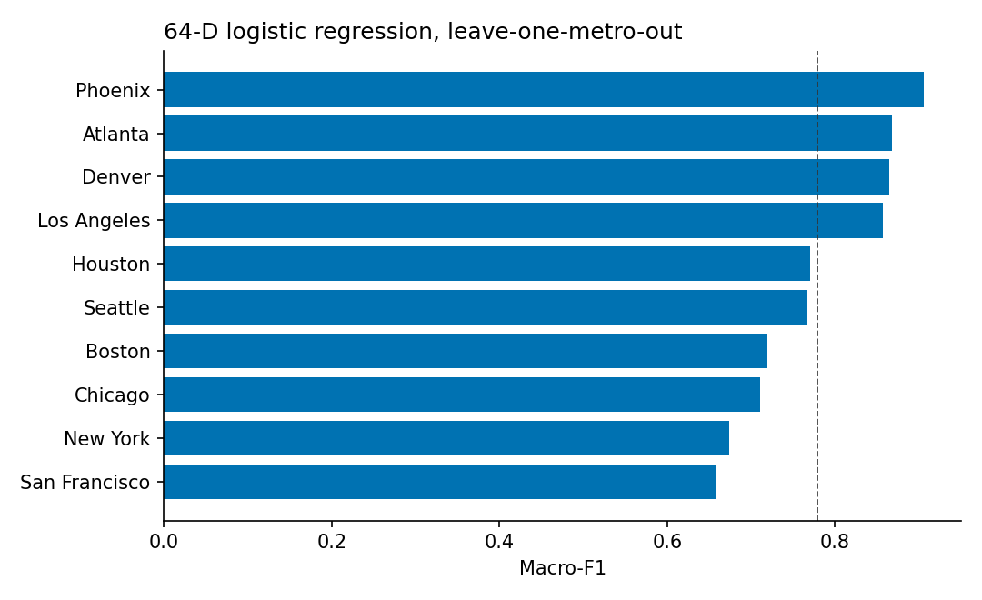
Mean LORO F1 0.779 — metro spread ±0.089
Notes:
Phoenix and Atlanta sit high. NYC and SF sit near 0.66. The spread is the geographic uncertainty that matters.

Slide 4
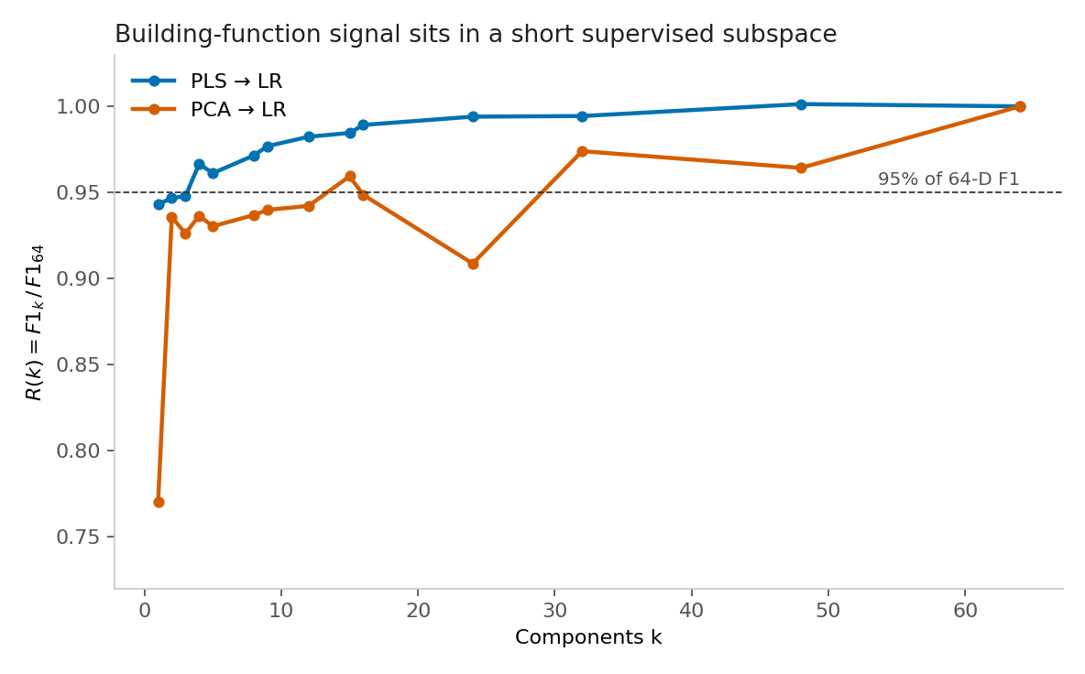
Building signal sits in a short supervised map
Notes:
Supervised PLS beats PCA at the same width. Strong L1 collapses the head onto t₁. Visual: week4/geo_subspace_analysis/figures/paper/01_retention_vs_k.png
PLS k=4
≥95% of full 64-D F1
PCA k=15
Same 95% retention
L1 → t₁
F1 0.735 at C=10

Slide 5
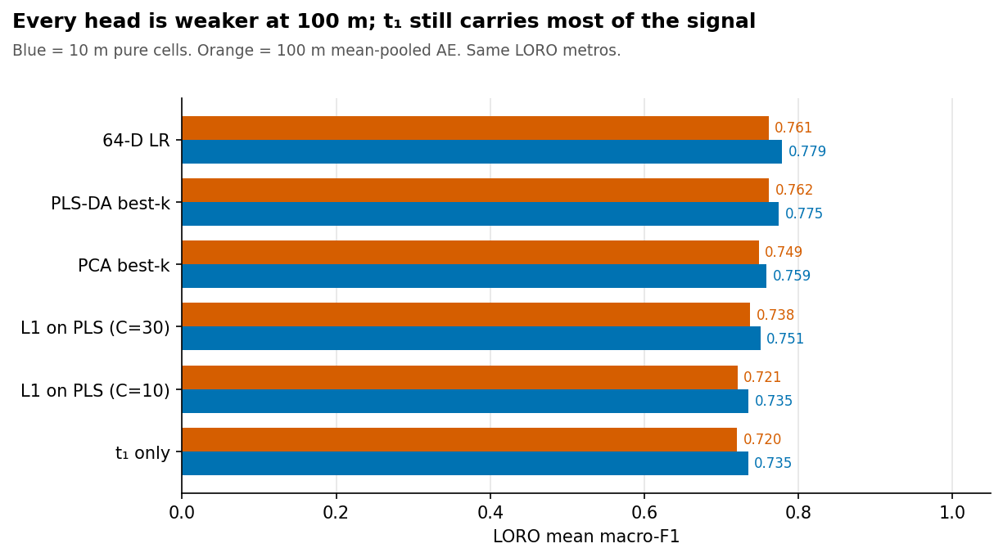
Mean-pooling to 100 m costs 0.01–0.02 F1
Notes:
Same sparsity story at both scales. This is mean-pool 64-D, not the 10×10 grid model. Visual: outputs/week4_pls_10m_vs_100m/figures/f1_family_10m_vs_100m.png

Slide 6
Linear 100 m still wins on F1
Run | LORO F1 | Mean gap
Mean-pool LR | 0.761 | —
ViT 128-D | 0.756 | —
v1 Supervised Contrastive (SupCon) | 0.732 | 1.76
v3 longer | 0.735 | 1.71
v4 gap loss | 0.738 | 2.13
Notes:
Gap target was 3. Raising the held-out gap did not beat linear F1. Each fold has its own 3D axes.

Slide 7
SECTION
ViT 3D tile experiment
Training pipeline · loss functions · what Supervised Contrastive (SupCon) did and did not do

Slide 8
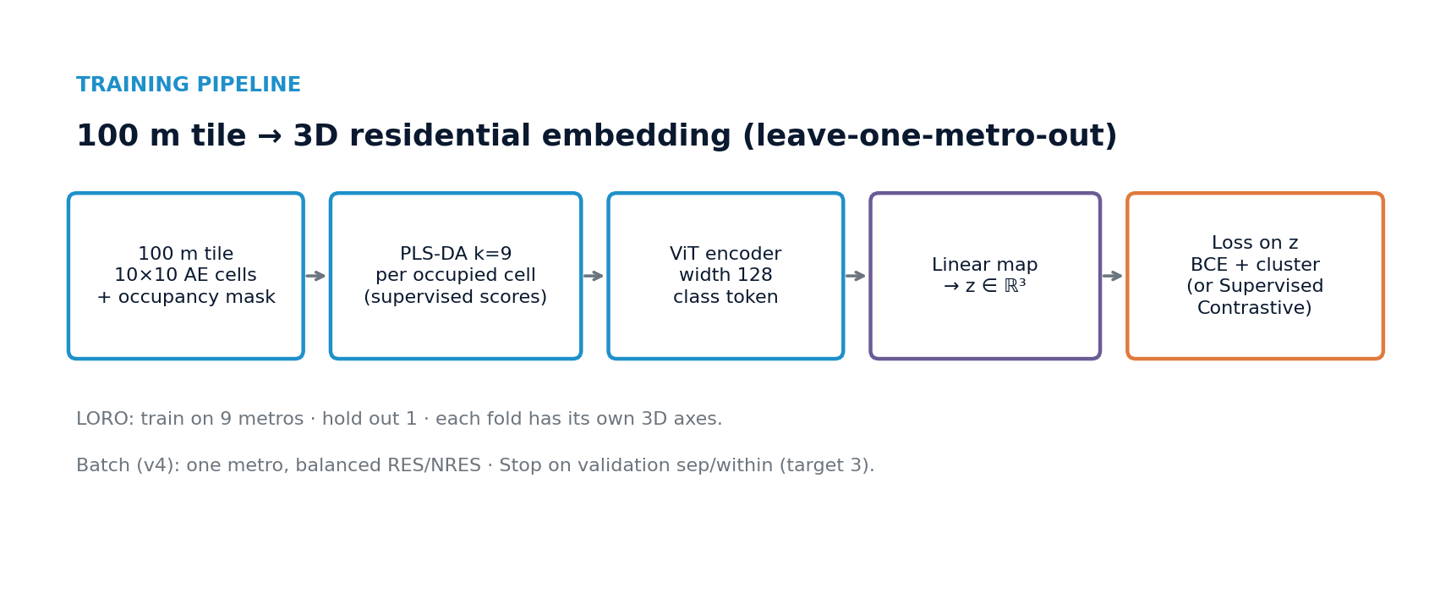
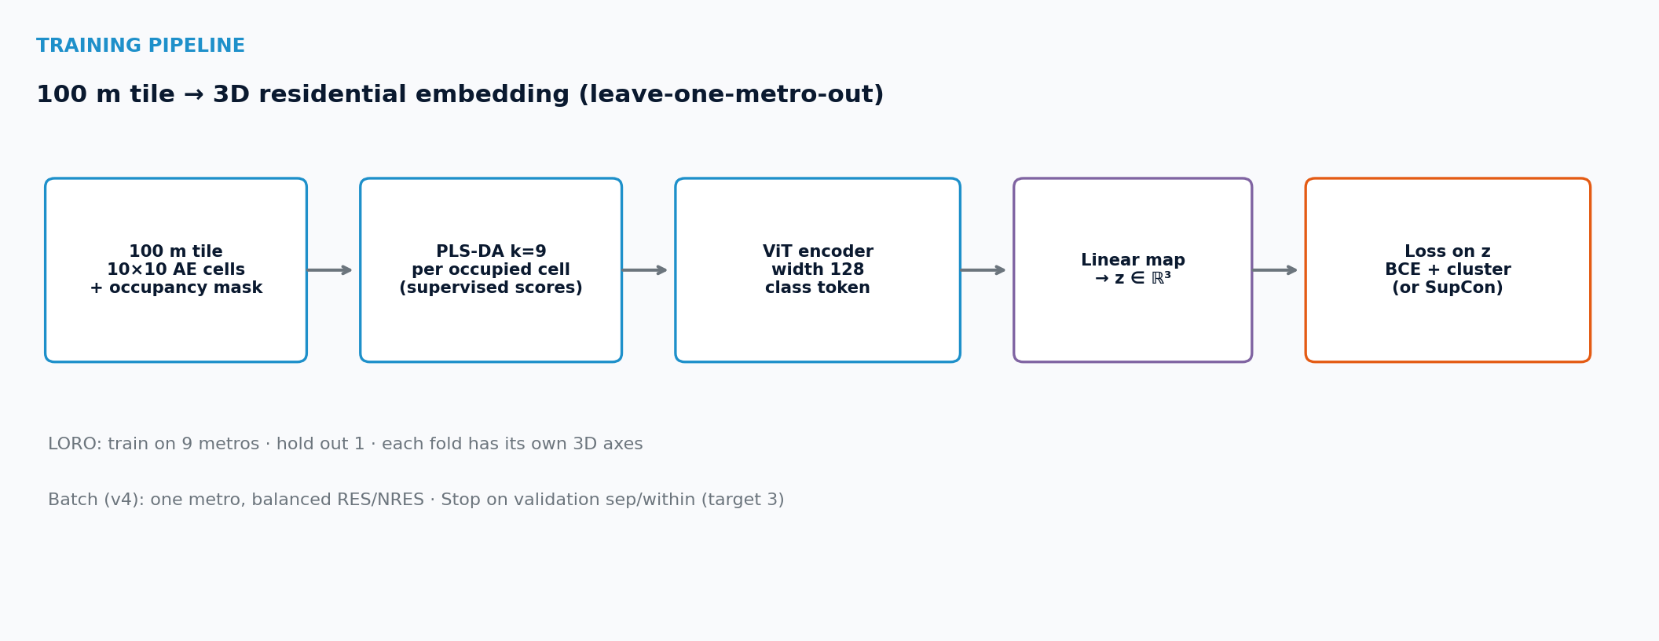
ViT · TRAINING PIPELINE
100 m tile → 3D residential embedding
Leave-one-metro-out · each fold owns its own 3D axes
Notes:
Pipeline: 10×10 AE cells + mask → PLS-DA k=9 per occupied cell → ViT width 128 class token → linear map to z∈R³ → loss on z. v4 batches one metro, balanced RES/NRES; stop on val sep/within targeting 3.

Slide 9
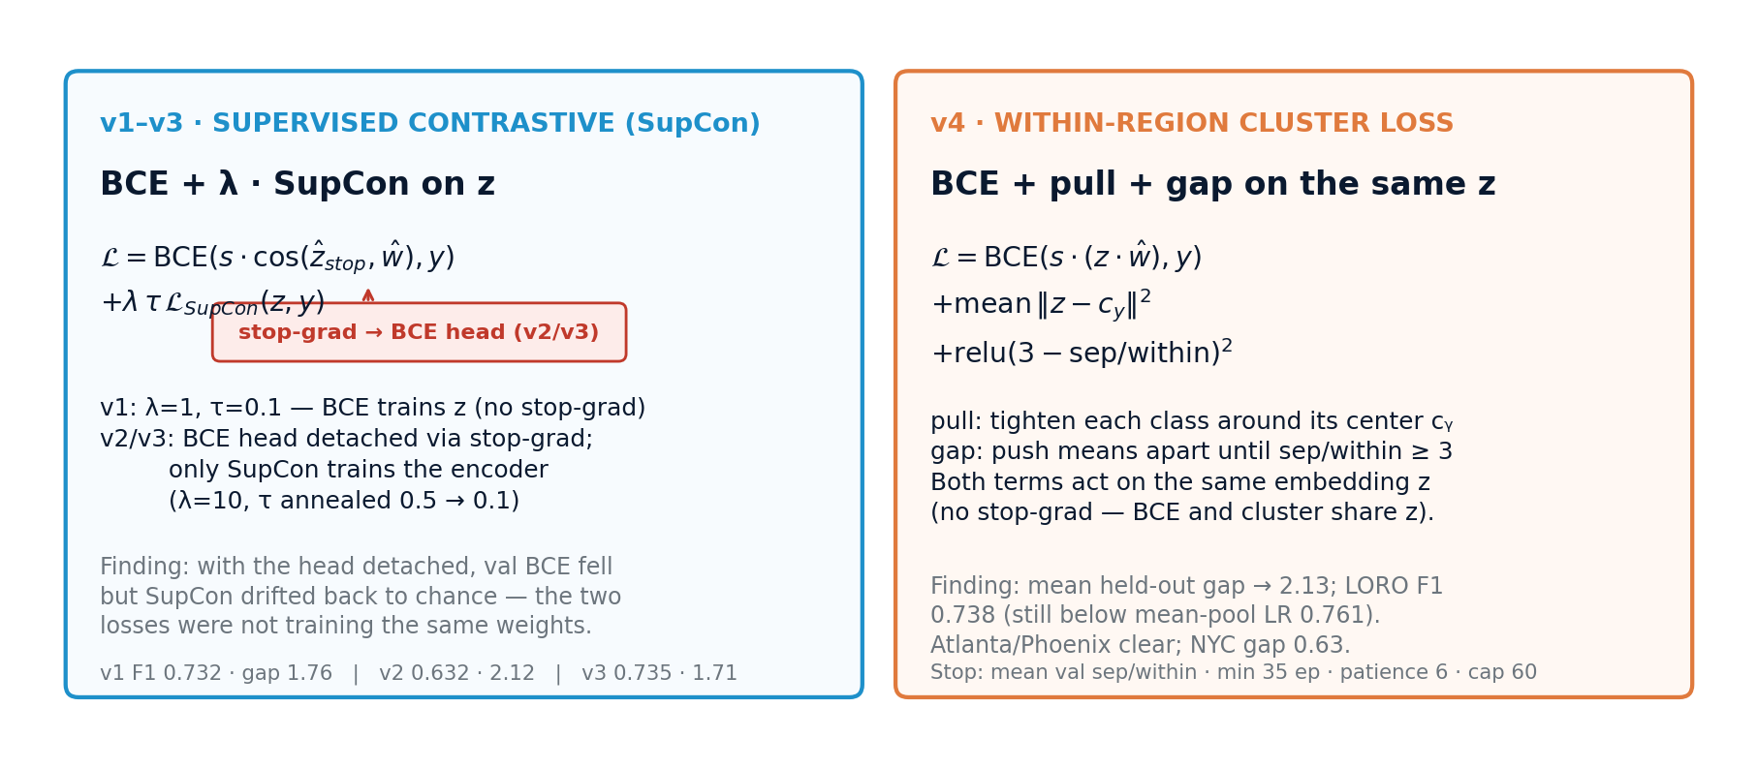
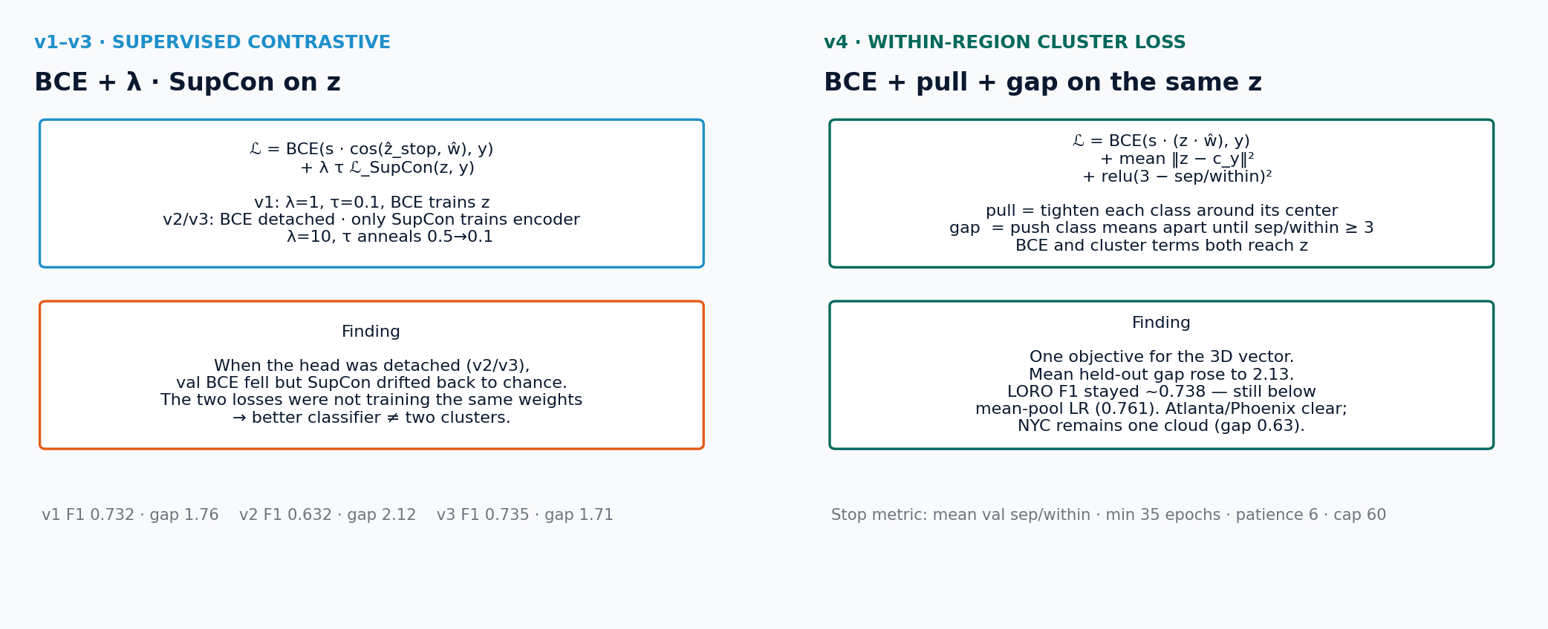
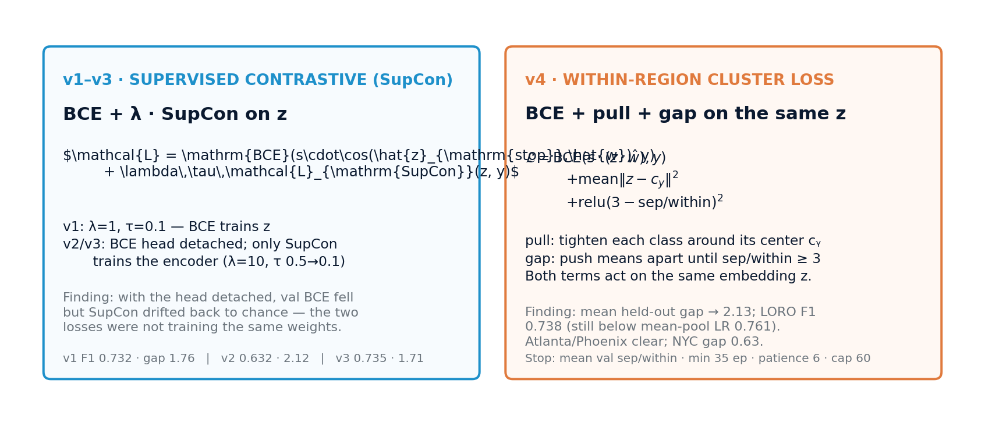
ViT · LOSS FUNCTIONS
Two objectives tried on the same 3D vector
Left: BCE + Supervised Contrastive / SupCon (v1–v3; stop-grad on BCE head in v2/v3) · Right: BCE + pull + gap (v4)
Notes:
v1: BCE and SupCon both train z (λ=1, τ=0.1). v2/v3: detach BCE head so only SupCon trains the encoder (λ=10, τ annealed). v4: drop SupCon; pull class centers + relu gap until sep/within ≥ 3, with BCE on the same z.

Slide 10
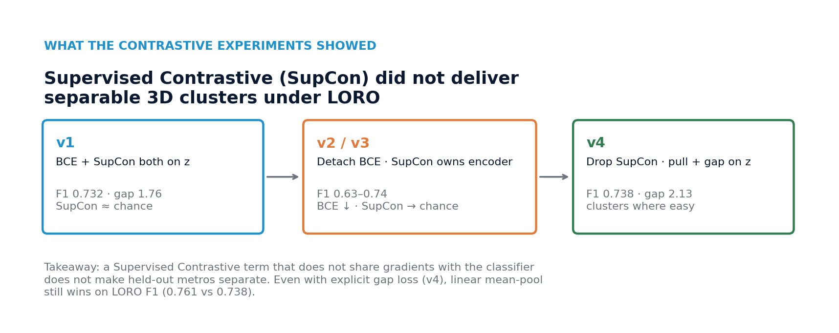
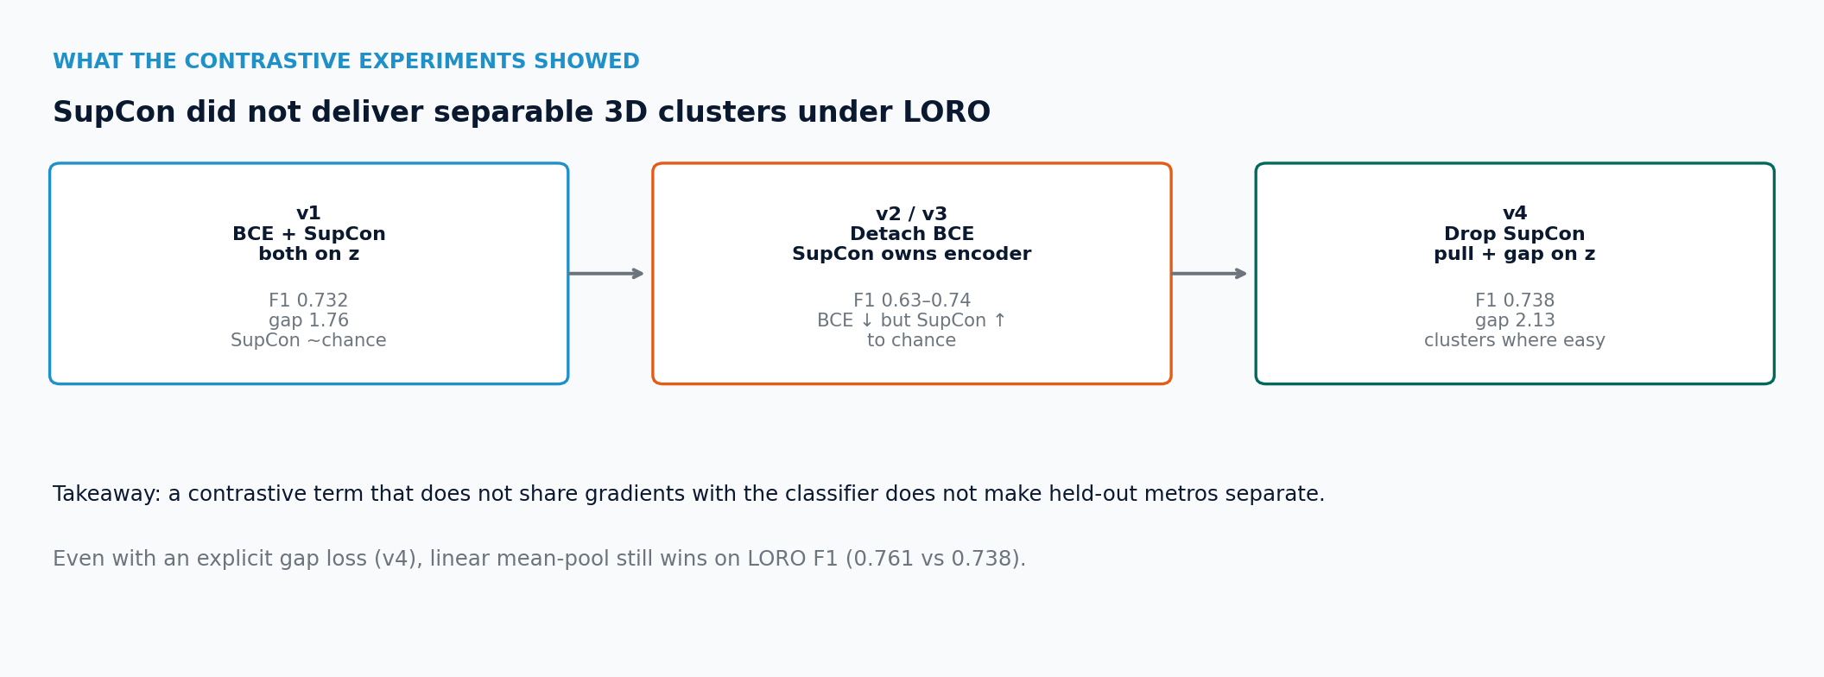
ViT · CONTRASTIVE FINDINGS
Supervised Contrastive (SupCon) did not deliver separable held-out clusters
Detach the classifier and the encoder drifts back toward chance
Notes:
Takeaway: a contrastive term that does not share gradients with the classifier does not make held-out metros separate. Even with explicit gap loss (v4), mean-pool LR still wins on LORO F1 (0.761 vs 0.738).

Slide 11
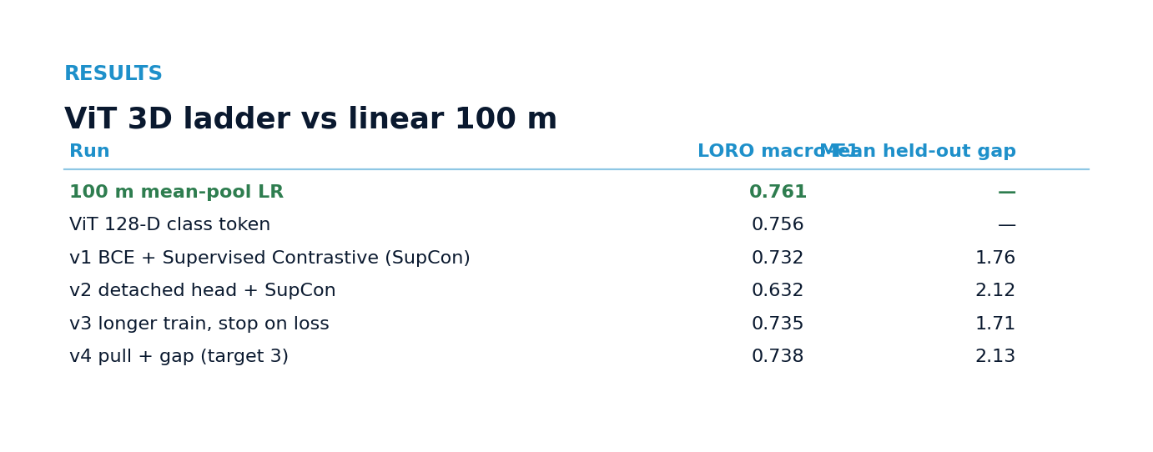
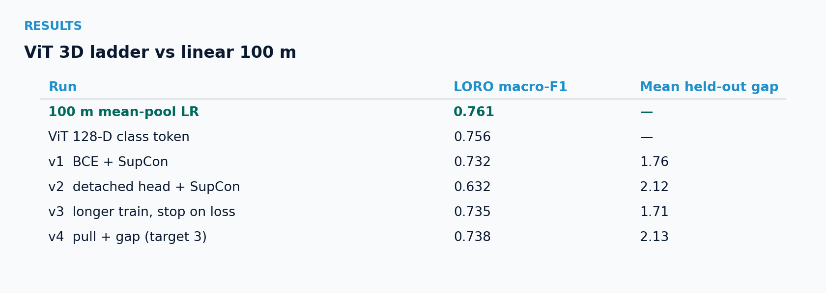
ViT · RESULTS
Ladder vs linear 100 m mean-pool
Raising the held-out gap did not beat linear F1
Notes:
Mean-pool LR 0.761. Best ViT 3D cluster run (v4) 0.738 F1 at mean gap 2.13 (target 3). Atlanta/Phoenix clear; NYC stays a single cloud (gap 0.63).

Slide 12
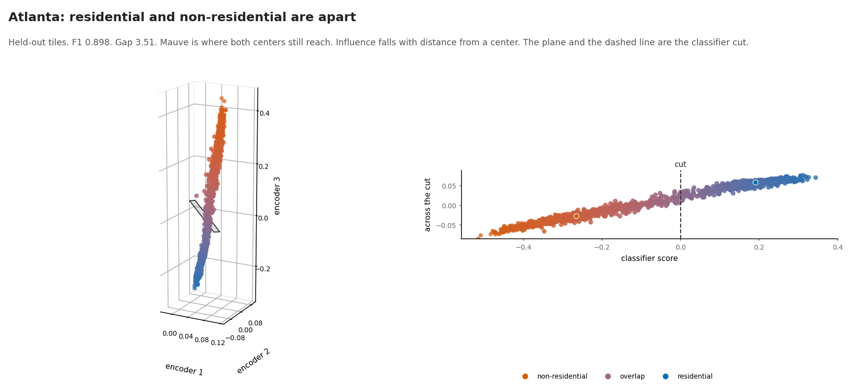
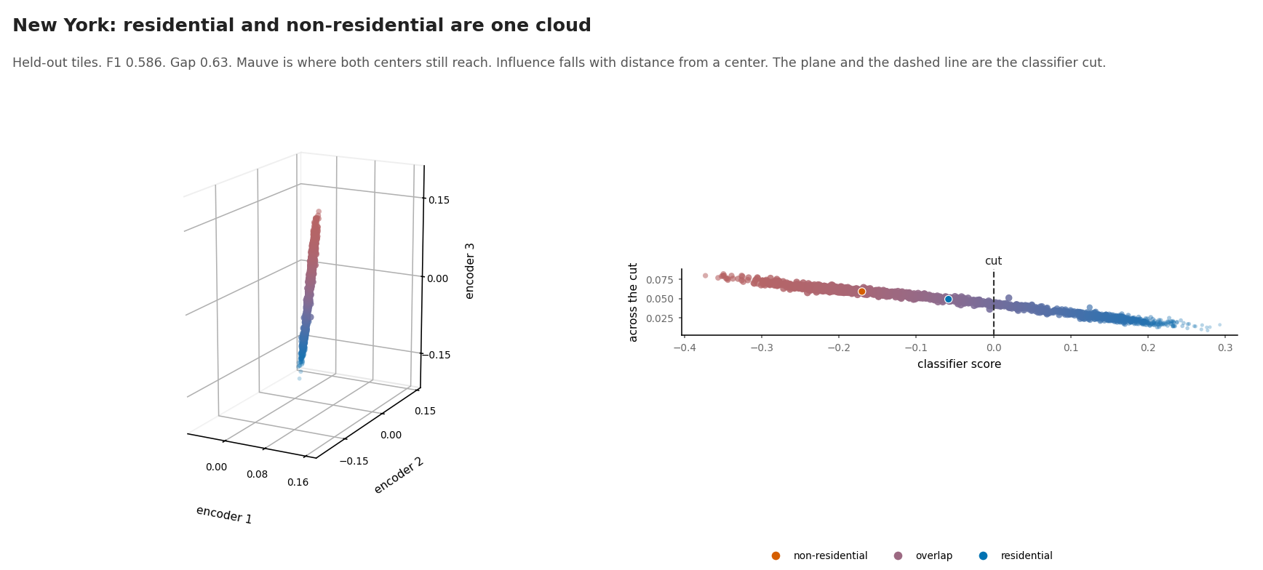
Atlanta clears a gap of 3.5 · NYC does not
Notes:
Validation metros in the NYC fold still separate (best val gap 3.33). Failure is the held-out cloud. Full LORO + NYC-fold validation cluster gallery is appended after slide 12.
Atlanta F1 0.898
Held-out gap 3.51
NYC F1 0.586
Held-out gap 0.63

Slide 13
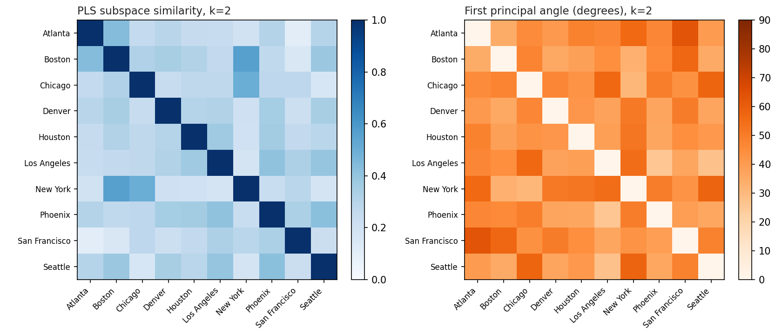
Geographic subspaces — three questions
Notes:
Units are metros and 45 pairs. Pair correlations are descriptive. Visual: week4/geo_subspace_analysis/figures/subspace_k2.png
Signal?
LORO 64-D mean F1 0.779
How short?
PLS ≥95% at k=4
Shared?
Partly; short PLS transfers

Slide 14
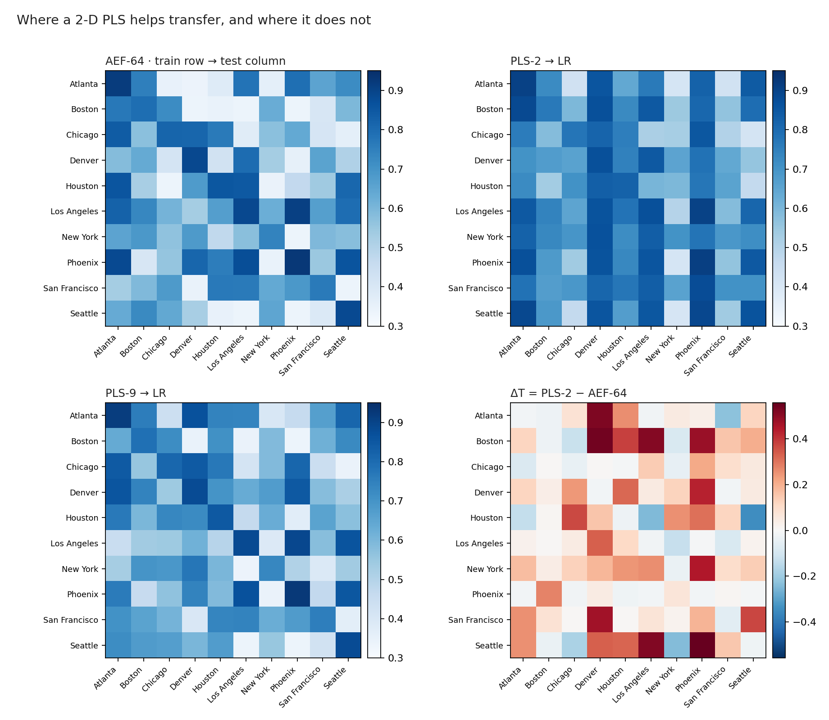
Short PLS transfers better than full 64-D
Notes:
Extra components fit the source metro and travel worse. k=2 similarity tracks retention (ρ≈0.32); geography does not. Visual: week4/geo_subspace_analysis/figures/paper/04_transfer_matrices.png

Slide 15
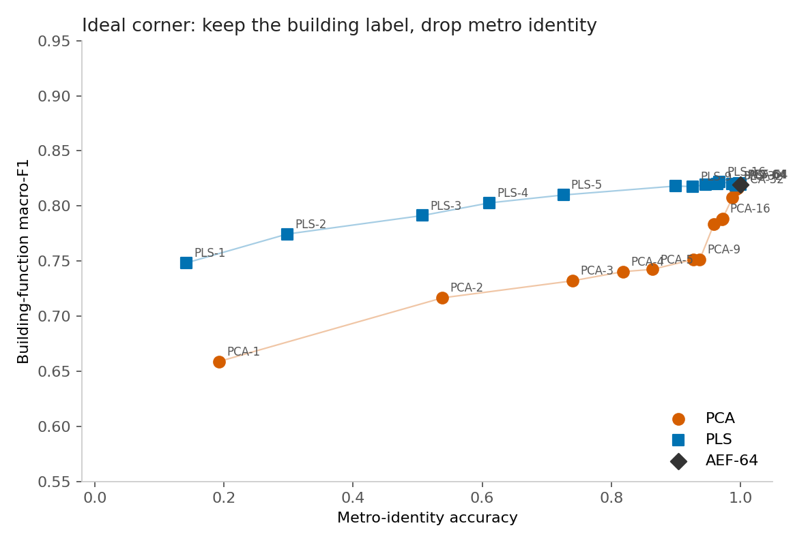
PLS k=2 keeps the label · drops metro identity
Notes:
Pixel diagnostic. Geography re-enters after the first few components. Visual: week4/geo_subspace_analysis/figures/paper/02_pareto_building_vs_metro.png

Slide 16
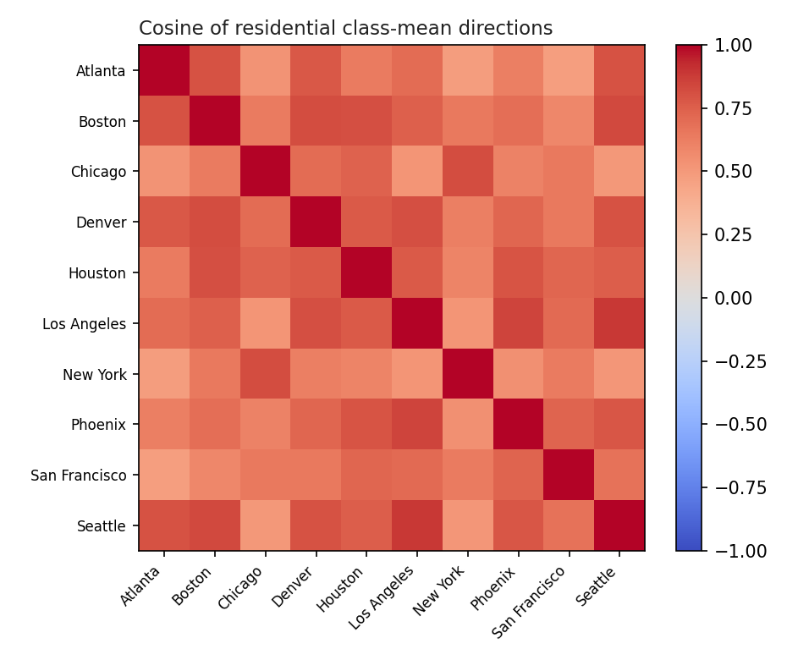
NYC aligns with Chicago — not easy targets
Notes:
Cosine of means is not a subspace test; k=2 similarity tells the same story.
NYC ↔ Chicago cosine 0.815
NYC ↔ Atlanta 0.479
v4 NYC failure is not a rotated axis (min cosine 0.995)
Axis shared · cloud still overlaps

Slide 17
What holds · what does not
~0.78 LORO F1 in frozen AE
Alignment causes transfer
Short PLS carries most of it
Global geographic generalization
Subspaces only partly aligned
v4 fails because the axis is wrong
PLS k=2 ships better than 64-D
Notes:
Keep the short residential direction. Geography lives in the rest of the 64-D probe. Ten US downtowns only.

Slide 18
Appendix · v4 LORO held-out clusters
All ten metros · largest gap first

Slide 19
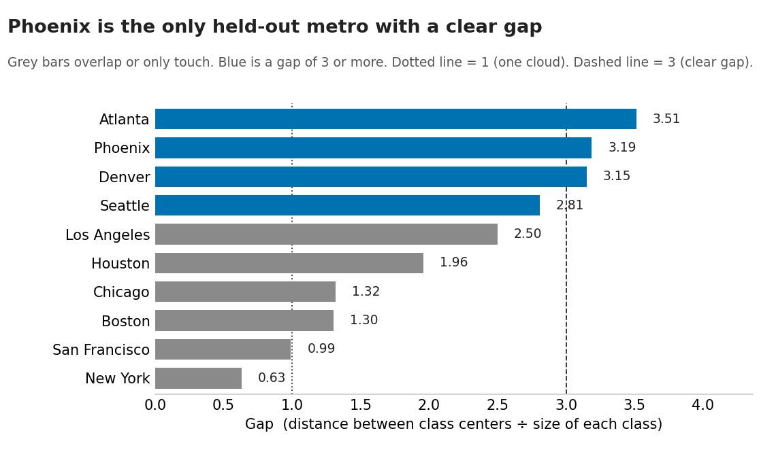
APPENDIX · CLUSTER
Held-out gap by metro
overview

Slide 20
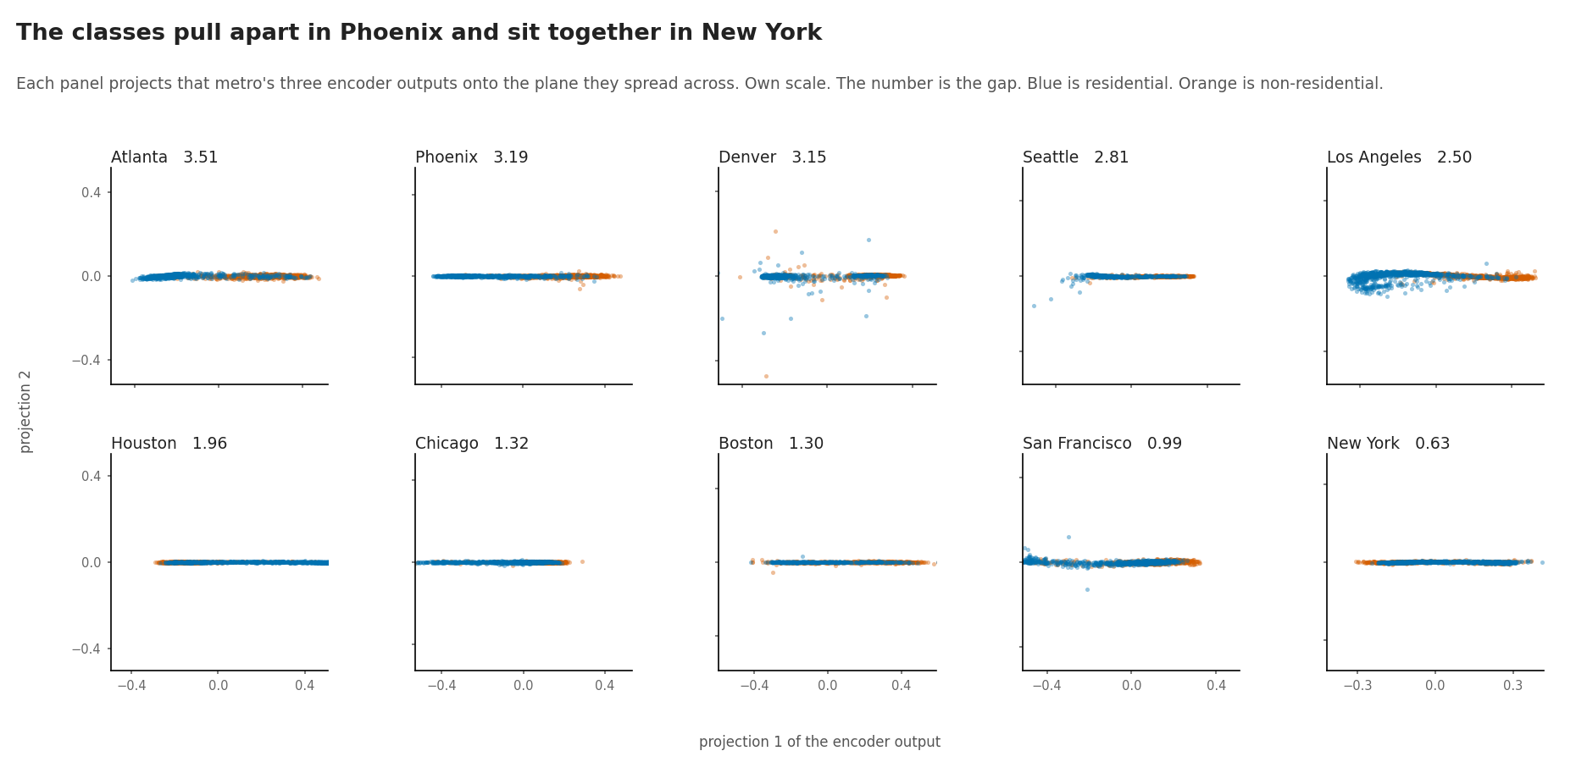
APPENDIX · CLUSTER
2D projection
overview

Slide 21
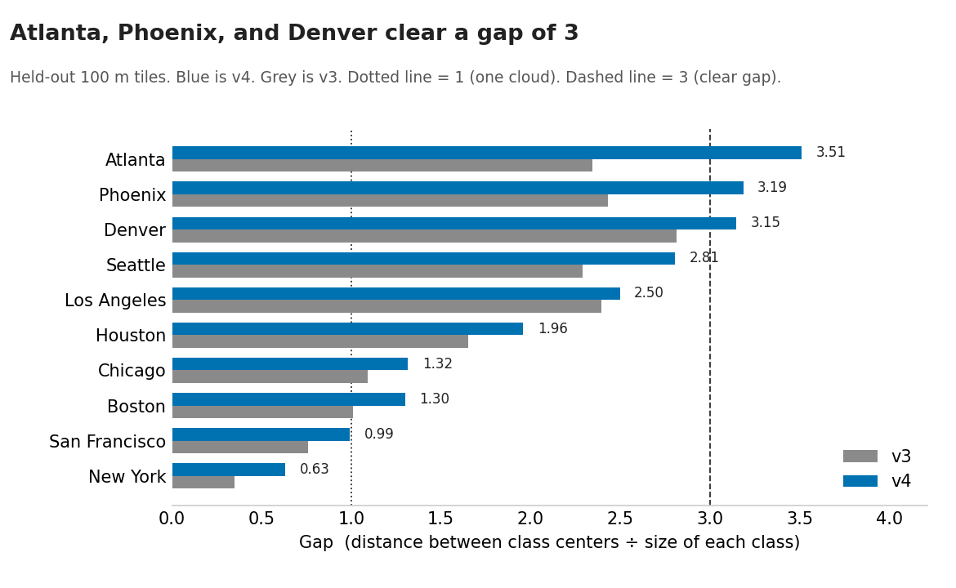
APPENDIX · CLUSTER
v4 vs v3 gap
overview

Slide 22
APPENDIX · CLUSTER
LORO held-out · Atlanta SE
F1 0.898 · gap 3.51

Slide 23
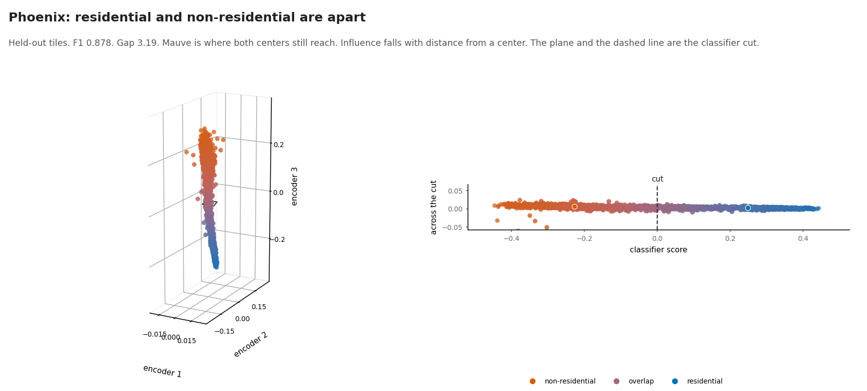
APPENDIX · CLUSTER
LORO held-out · Phoenix SW
F1 0.878 · gap 3.19

Slide 24
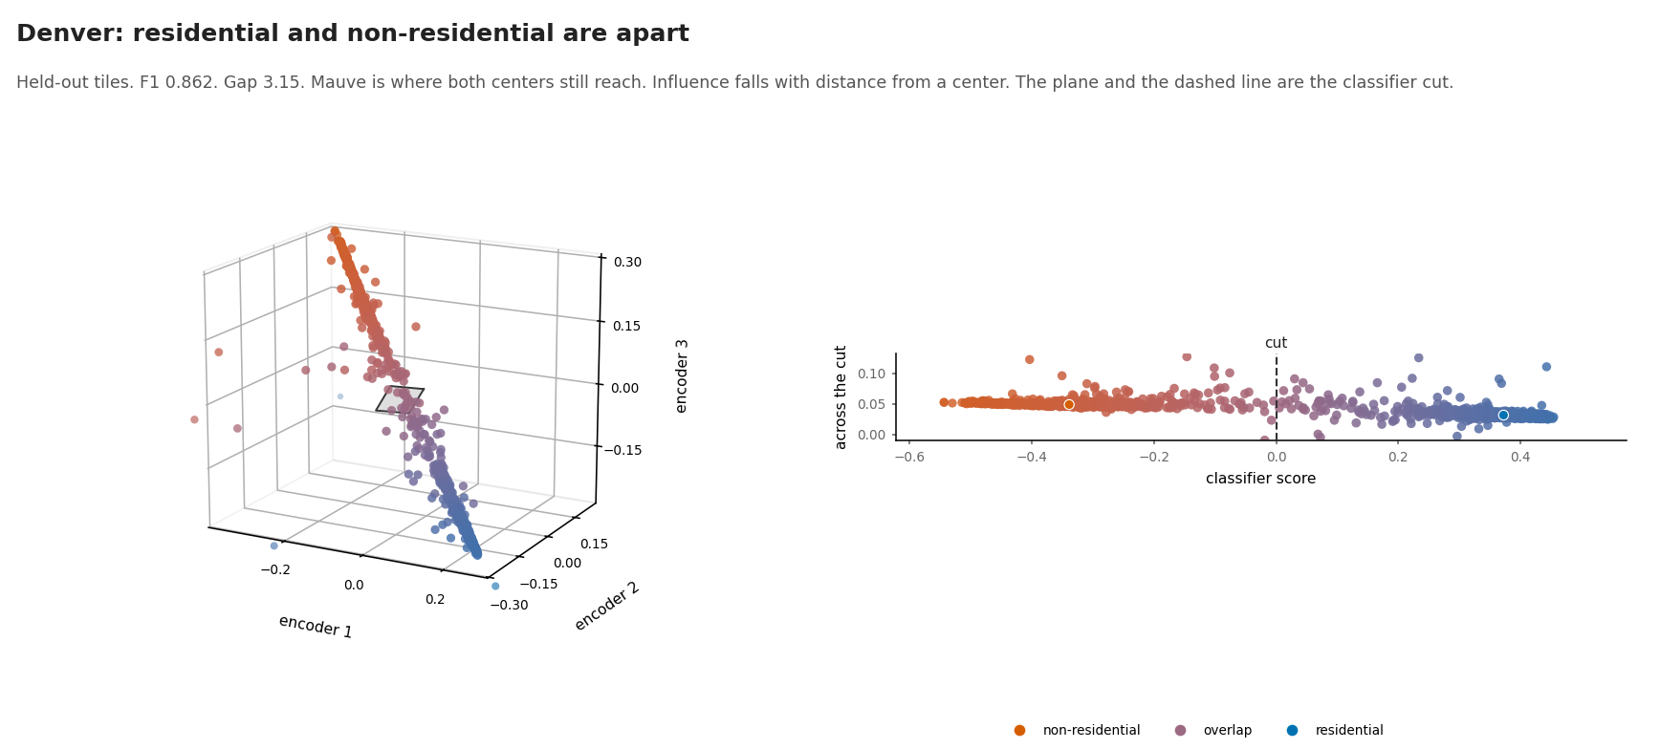
APPENDIX · CLUSTER
LORO held-out · Denver W
F1 0.862 · gap 3.15

Slide 25
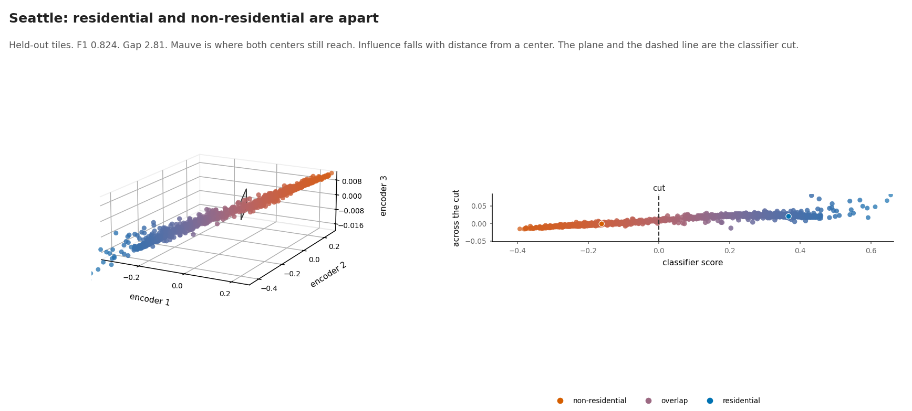
APPENDIX · CLUSTER
LORO held-out · Seattle NW
F1 0.824 · gap 2.81

Slide 26
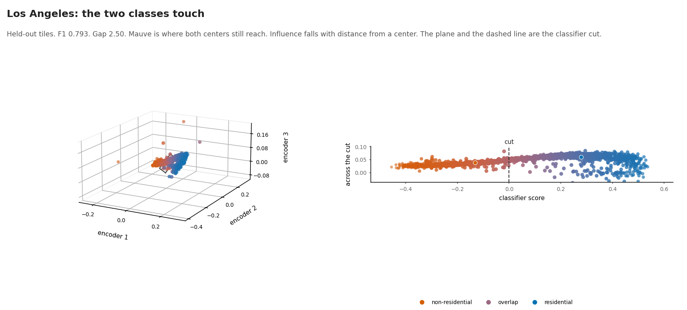
APPENDIX · CLUSTER
LORO held-out · LA W
F1 0.793 · gap 2.50

Slide 27
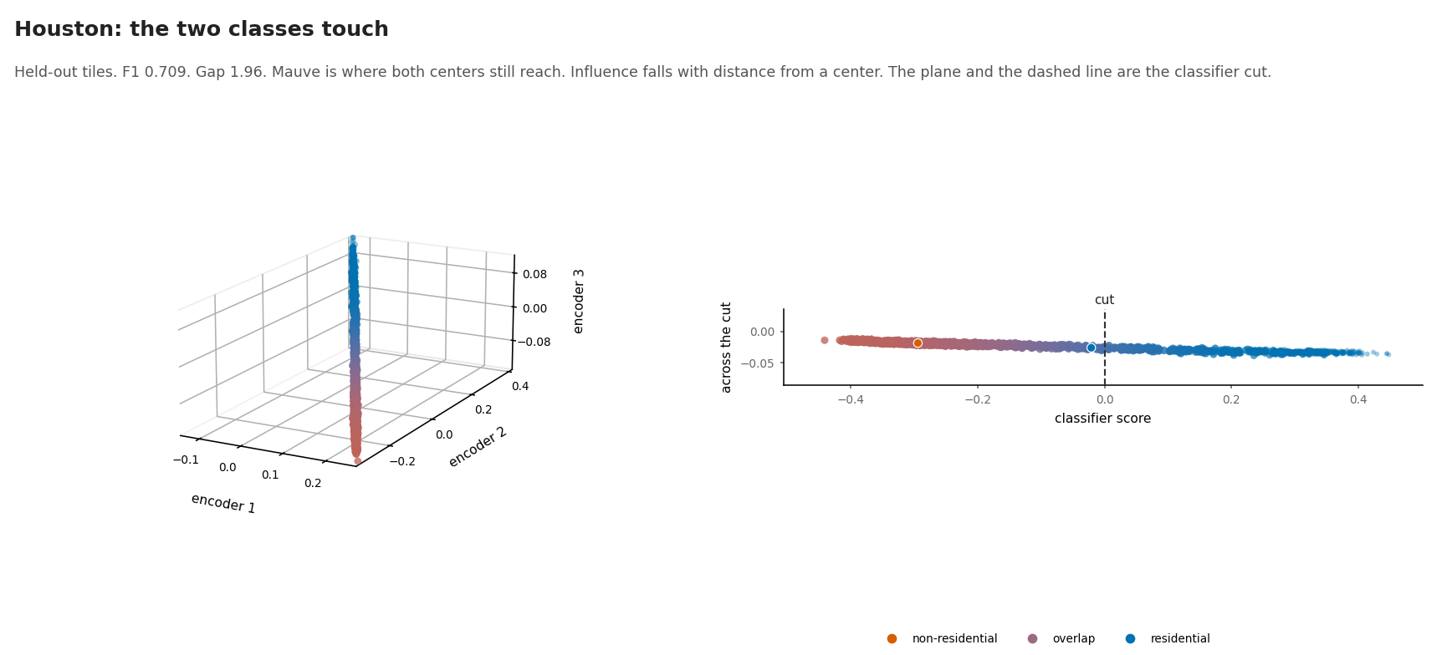
APPENDIX · CLUSTER
LORO held-out · Houston S
F1 0.709 · gap 1.96

Slide 28
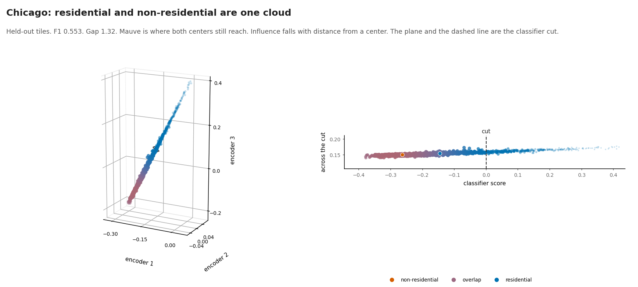
APPENDIX · CLUSTER
LORO held-out · Chicago MW
F1 0.553 · gap 1.32

Slide 29
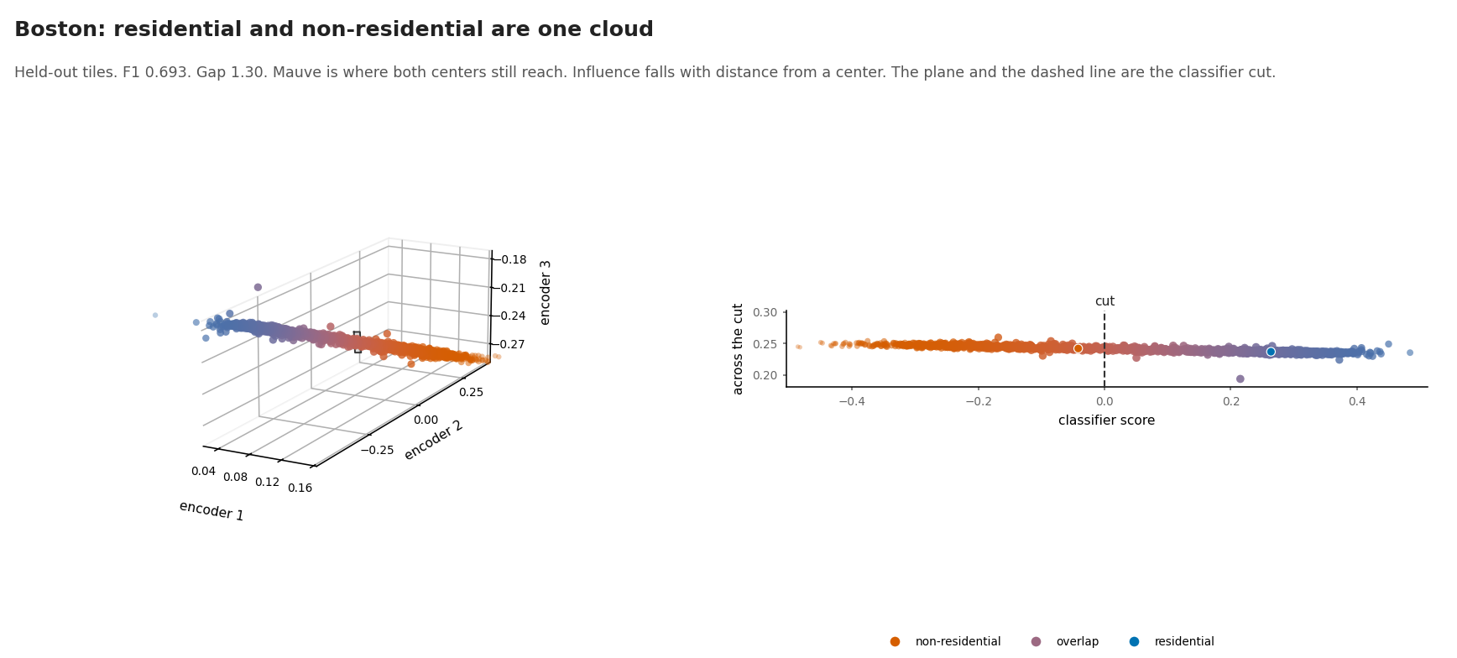
APPENDIX · CLUSTER
LORO held-out · Boston NE
F1 0.693 · gap 1.30

Slide 30
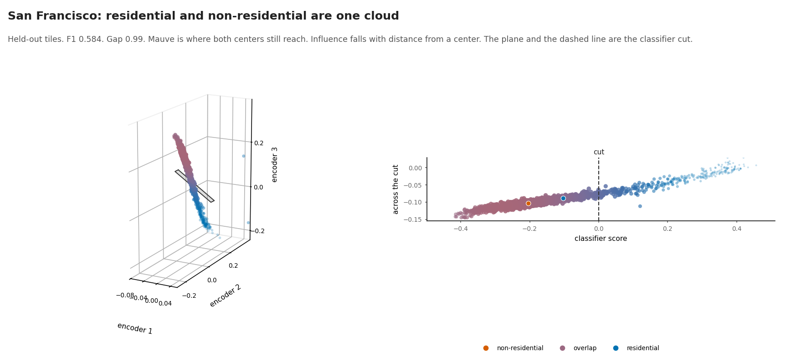
APPENDIX · CLUSTER
LORO held-out · SF W
F1 0.584 · gap 0.99

Slide 31
APPENDIX · CLUSTER
LORO held-out · NYC NE
F1 0.586 · gap 0.63

Slide 32
Appendix · validation while NYC held out
Same NYC-fold checkpoint

Slide 33
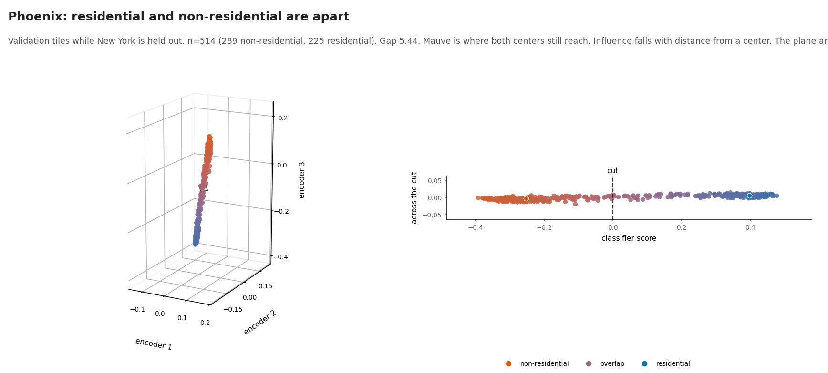
APPENDIX · CLUSTER
NYC-fold validation · Phoenix SW
Gap 5.44

Slide 34
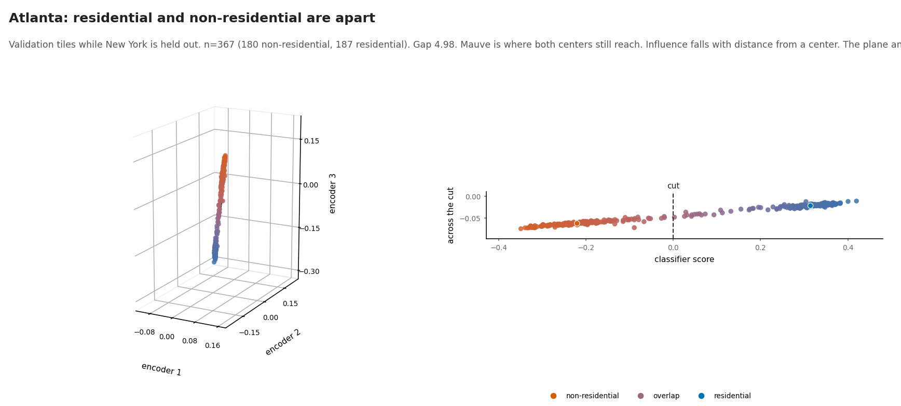
APPENDIX · CLUSTER
NYC-fold validation · Atlanta SE
Gap 4.98

Slide 35
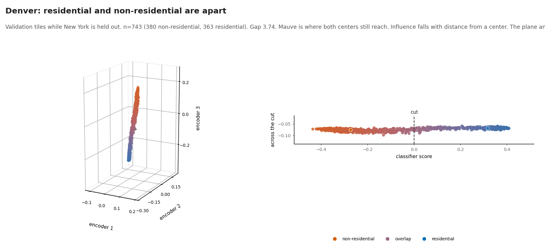
APPENDIX · CLUSTER
NYC-fold validation · Denver W
Gap 3.74

Slide 36
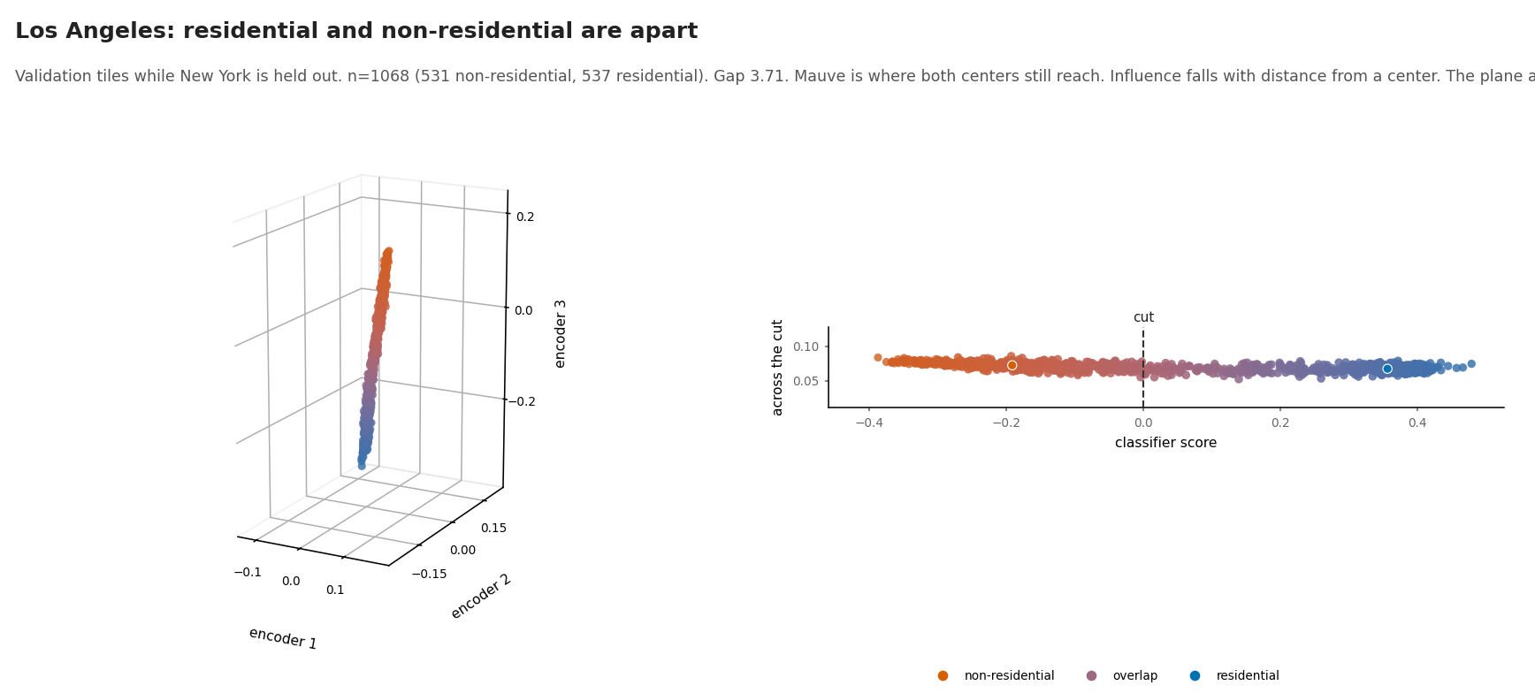
APPENDIX · CLUSTER
NYC-fold validation · LA W
Gap 3.71

Slide 37
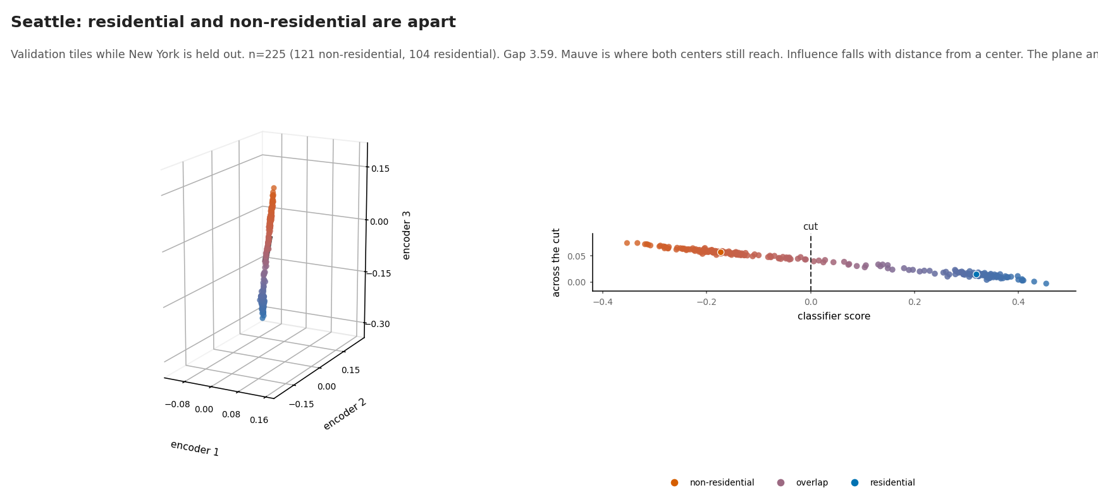
APPENDIX · CLUSTER
NYC-fold validation · Seattle NW
Gap 3.59

Slide 38
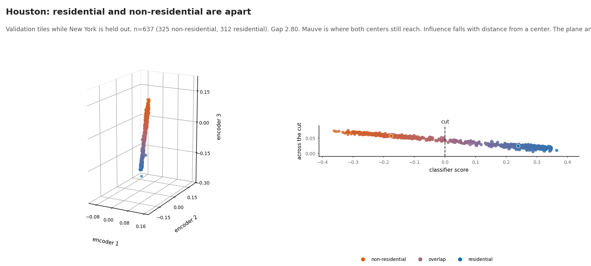
APPENDIX · CLUSTER
NYC-fold validation · Houston S
Gap 2.80

Slide 39
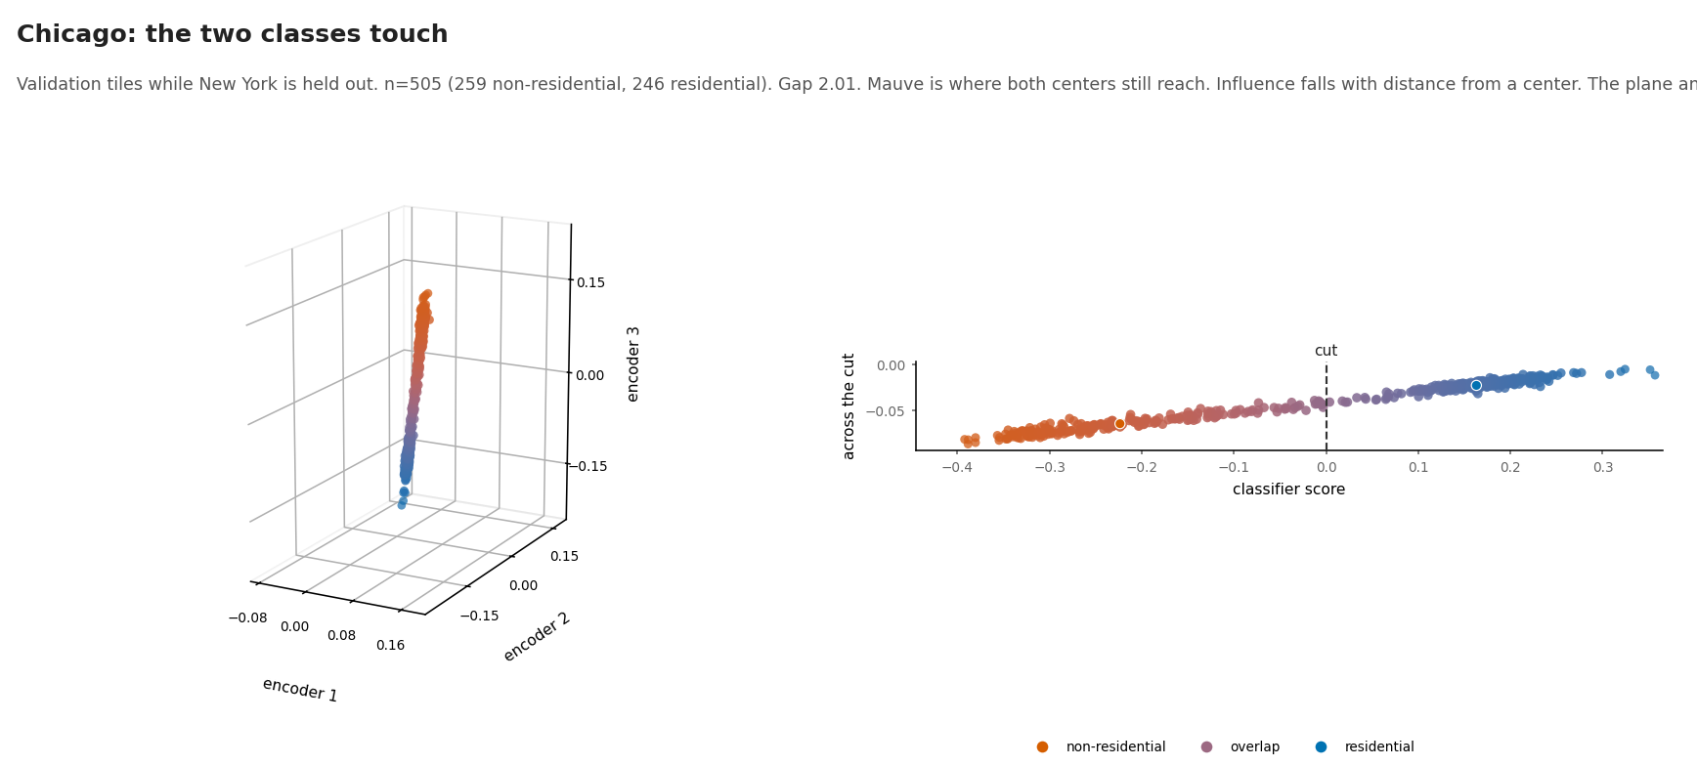
APPENDIX · CLUSTER
NYC-fold validation · Chicago MW
Gap 2.01

Slide 40
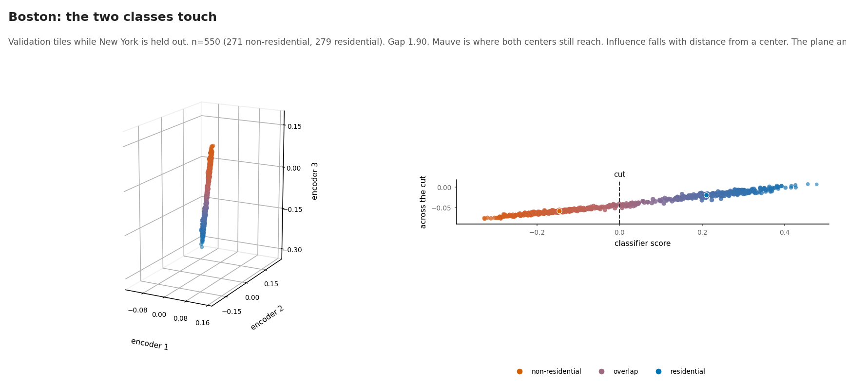
APPENDIX · CLUSTER
NYC-fold validation · Boston NE
Gap 1.90

Slide 41
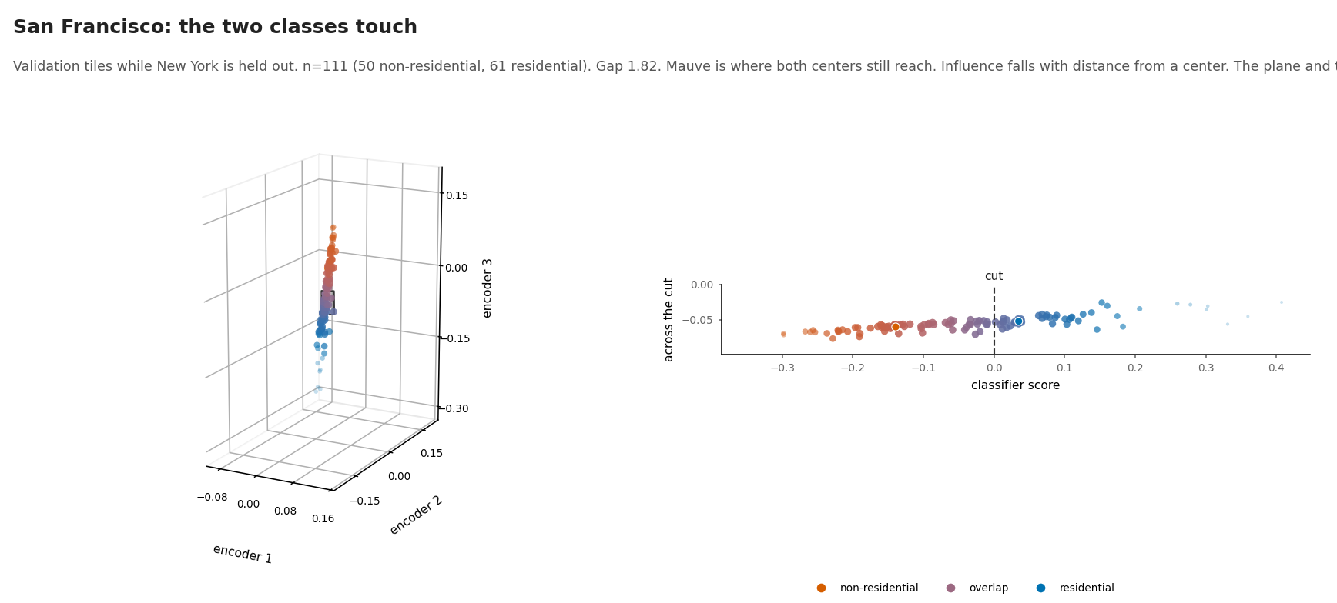
APPENDIX · CLUSTER
NYC-fold validation · SF W
Gap 1.82

