Slide 1
Research
Corporate Actions
Week 2
Corporate Action Intelligence Team
Aesha Gandhi, Pranshul Bhatnagar, Alex Li, Kedar Vaidya, Aaron Jiang
Notes:
Research notes for the BNY capstone: which public data sources support corporate-action extraction and validation, and which event types to prioritize.

Slide 2
01
Scope

Slide 3
Recap
01 Phase 1 Focus
Prioritize complex, decision-based events:
Tender offers
Exchange offers
Rights issues
Mergers
Conversions
Simple mandatory events like ordinary cash dividends are lower priority because they require less reasoning.
02 Core Product Output
A structured, source-grounded event summary containing:
Event classification
Parties & securities
Client options
Key dates & deadlines
Financial terms
Conditions / restrictions
Source passages
Confidence & exception flags
Amendment / change history
03 Evaluation Priorities
Accuracy and auditability first
Extraction accuracy
Completeness of material information
Source grounding
Amendment detection
Appropriate escalation when uncertain

Slide 4
DATA & EDA
What we pull from SEC
EFTS finds the event; EDGAR exhibits contain the terms.
SEC EFTS · Full-text search API
EDGAR download · Documents & exhibits
Hit list + filing metadata
Returns
Form type · filing date · company · file_num · accession
Alone fills ~10–15% of BNY notification fields
Role in the pipeline
Discover and index corporate-action events across 2020–2025.
HTML / PDF filings + exhibits
Returns
Offer to Purchase · Letter of Transmittal · SC 14D-9 body text
Material terms live here — prices, deadlines, conditions, options
Role in the pipeline
Source text for grounded extraction and Concise Rep assembly.
EFTS finds the event; exhibits contain the terms.
197k doc hits · 104k unique filings · 14.5k events · 2020–2025

Slide 5
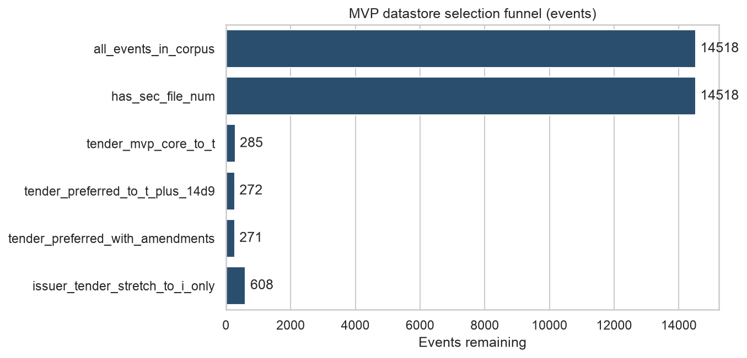
DATA & EDA
Corpus → executable tender pool
Design for five event types; build and evaluate v1 on preferred third-party tenders.
Talk-track numbers
14,518
events in corpus
285
third-party tender core (SC TO-T*)
272
preferred (TO-T + SC 14D9) — 95% of core
~99% of preferred tenders have amendments
Version history is table-stakes, not optional.
Bottom line: five types in product scope — evaluate v1 on this 272-event pool.

Slide 6
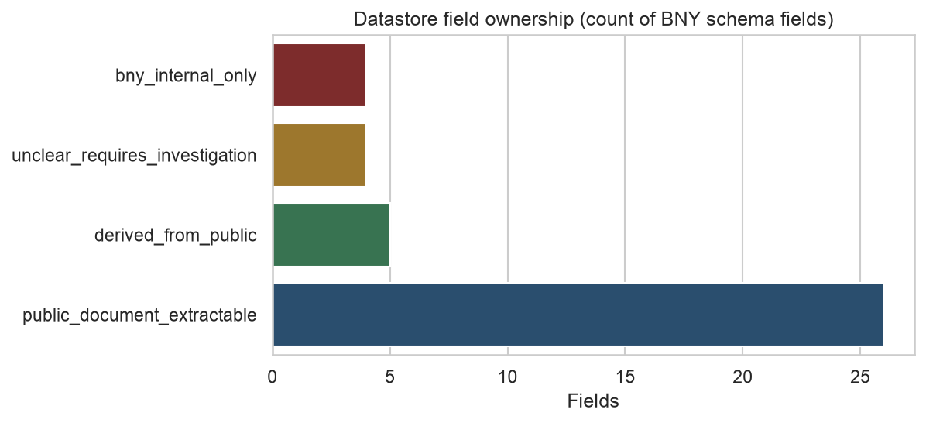
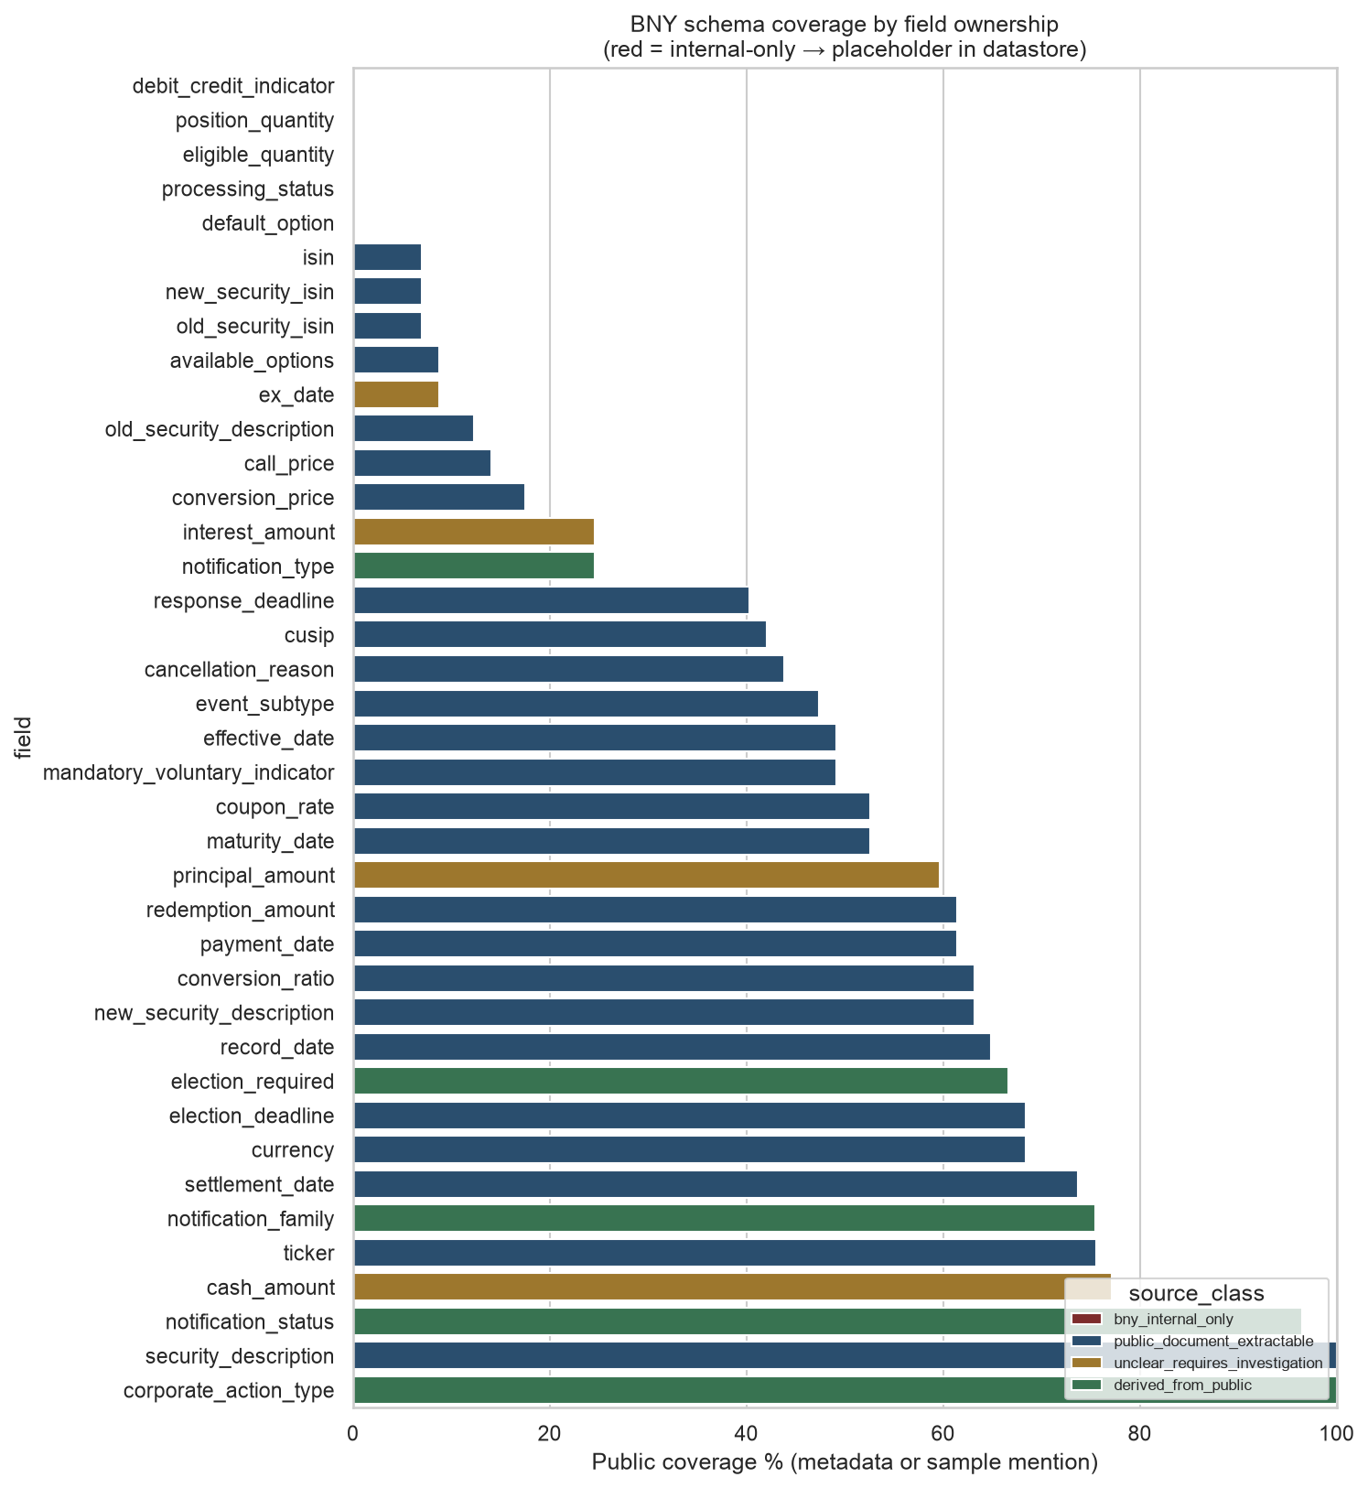
DATA & EDA
Can public docs fill a BNY notification?
Public SEC covers event / security / deadline fields; ledger fields stay BNY-side.
Extract / derive from public
Type · security · ticker · deadlines · offer-price proxy · coarse status
Annotate then store
Options · normalized CUSIP · ratios · amendment deltas
BNY placeholder
Sample mention rates (not extraction accuracy)
High: corporate_action_type / security_description 100% · election_deadline ~68% · cash_amount ~77%
Hard: available_options ~9% · ISIN ~7% · default_option 0%
Internal (definitional 0%): position_quantity · eligible_quantity · processing_status · debit_credit
Position qty · eligible qty · processing status · debit/credit — never score as extraction fail
Caveat: coverage = regex mention on a 57-event sample — not extraction accuracy. Accuracy lands in the eval harness.

Slide 7
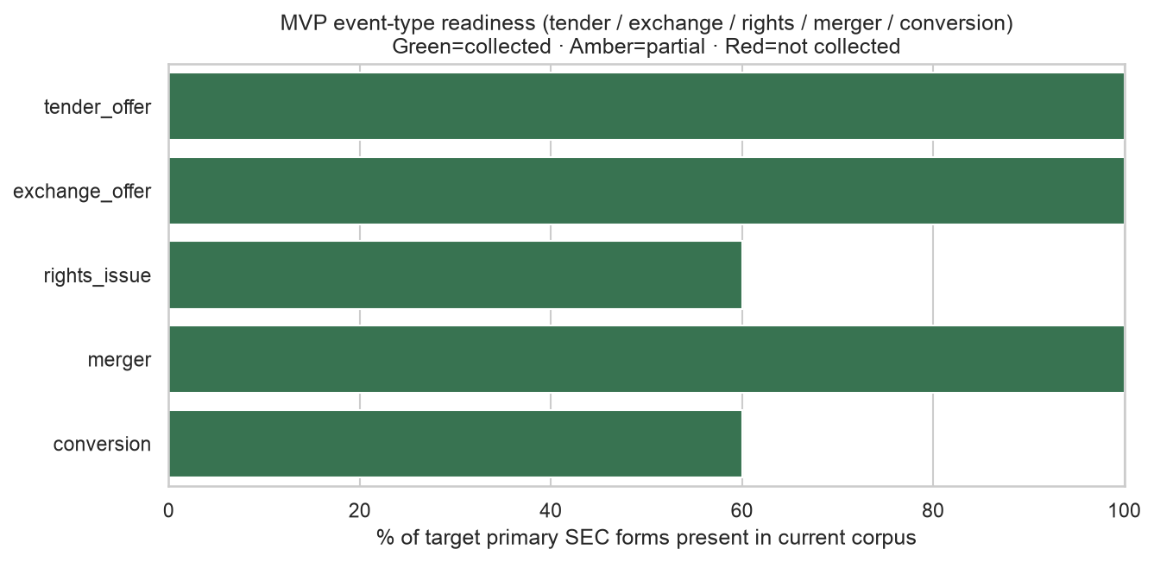
DATA & EDA
Why tender-first
Five types in product scope; one type in executable data scope today.
Build order (from EDA)
1 Tender (TO-T + 14D9)
Corpus-ready now
2 Exchange
Reclassify inside TO + S-4
3 Merger
Proxies / S-4 / 13E-3
4 Rights → Conversion
Noisier filters; need S-3 / subtype labels
Bridge to Pipeline
Preprocess inventored 30 preferred TOs → 29 gold Concise Reps (~75 candidate facts/event) with source spans — enough to start grounded extraction.

Slide 8
Data Schema
01 Core Event Fields
Classification & Evidence
event_id: Internal identifier linking docs/amendments
corporate_action_type: Event classification
event_status: Announced, amended, completed, etc.
mandatory_voluntary_indicator: Mandatory, voluntary, or options
source_document / passages: Supporting text & filing link
confidence & exception_flags: Extraction flags & audit tracking
Entities & Affected Securities
parties: Issuer, target, acquirer, offeror, etc.
security_description: Security affected by the event
ISIN / cusip / ticker: Universal security identifiers
currency: Currency of cash terms
Terms, Options & Restrictions
available_options: Choices available to holder
default_option: Action taken if no election made
financial_terms: Cash price, ratios, conversion price
conditions_restrictions: Eligibility rules, proration & minimums
Critical Dates & Milestones
effective_date: Event execution date
election_deadline: Client decision cutoff
expiration_date: Offer/right expiration
settlement_date: Expected consideration settlement
02 Event-Specific Fields
Tender Offer
offer_price
expiration_date
withdrawal_deadline
minimum_tender_condition
proration_terms
tendering_conditions
Exchange Offer
old_security
new_security
exchange_ratio
expiration_date
withdrawal_deadline
proration_terms
Rights Issue
record_date
subscription_ratio
subscription_price
expiration_date
oversubscription_rights
rights_transferable
Merger
acquirer
target
consideration_type
cash_consideration
stock_exchange_ratio
shareholder_vote_date
closing_conditions
Conversion
old_security
new_security
conversion_ratio
conversion_price
conversion_deadline
conversion_conditions

Slide 9
Corporate Action Events
Corporate Action Main Filings / Documents EDGAR Availability
Tender Offers Schedule TO, TO-T, TO-I, 14D-9, amendments, Offer to Purchase Very strong
Exchange Offers Schedule TO, Offer to Exchange, S-4, amendments Very strong
Rights Issues S-1/S-3, prospectus supplements, 8-K, sometimes Form CB Good
Mergers S-4, 8-K, proxy statements, merger agreement exhibits, sometimes Schedule TO Very strong
Conversions, less standardized8-K, S-3/S-4, prospectuses, security agreements/exhibits Available

Slide 10
02
Pipeline

Slide 11
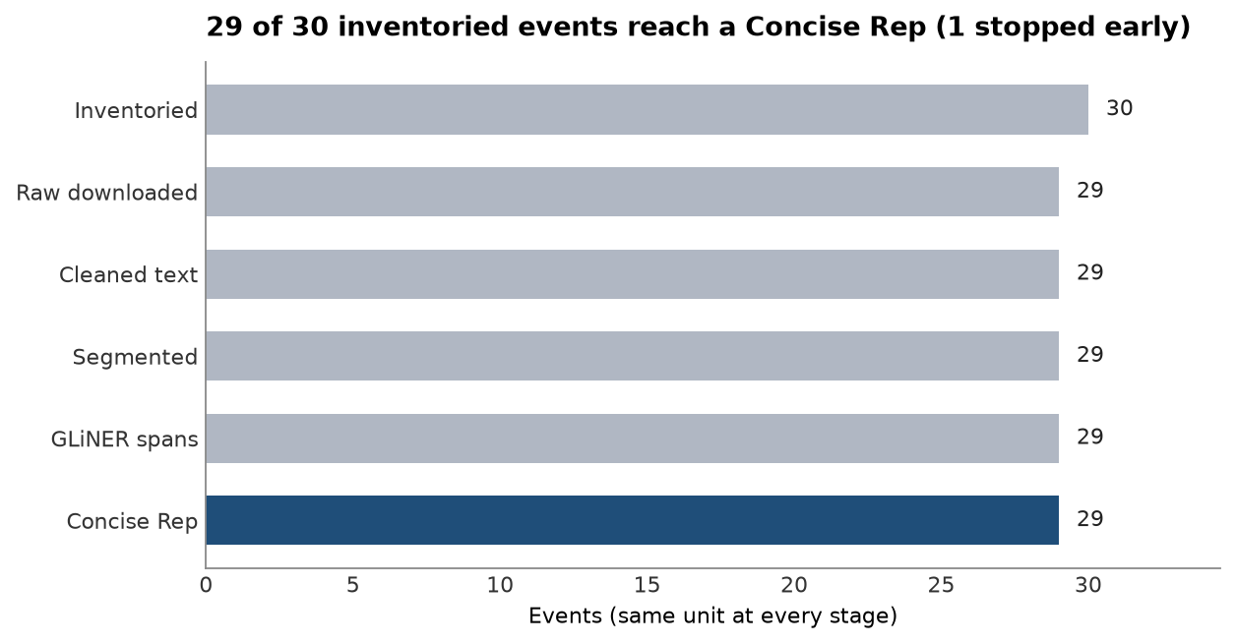
02 · PIPELINE
Raw SEC filings → Concise Representation
Each stage writes versioned artifacts. Downstream agents consume Concise Rep — not raw HTML.
1
2
3
4
5
6
Inventory
→
Download
→
Cleanup
→
Segment
→
GLiNER
→
Assemble
Pick cover / OTP / LoT / 14D-9
Raw HTML on disk
Plain text + meta
TOC / FAQ windows
Labeled spans
Concise Rep JSON
What Concise Rep is
Candidate entities + facts with source passages, confidence, and doc role.
Why it matters
Handoff object for Multi-Agent field resolution, DB load, and notification draft — auditable from day one.
Cohort status (TO path)
30 inventoried → 29 gold Concise Reps
~75 candidate facts / event with GLiNER spans

Slide 12
02 · PIPELINE
Worked example: event 005-02933
Preferred third-party tender (gold) — Volt Information Sciences · SC TO-T + Offer to Purchase + 14D-9
INPUT · Cleaned Offer to Purchase (excerpt)
OUTPUT · Concise Rep candidate facts
How much are you offering to pay for my securities,
and what is the form of payment?
We are offering to pay $6.00 per Share to you in cash,
net of applicable withholding taxes and without interest.
…
Price Offered Per Share
$6.00 per share (the “Offer Price”) in cash…
CUSIP Number of Class of Securities
928703107
~289k chars of cleaned OTP text → segmented before IE
offer_price
$6.00 · conf 0.79 · otp / Summary Term Sheet
cusip
928703107 · conf 0.89 · cover
purchaser
Vega MergerCo, Inc. · conf 0.74 · otp
Each fact carries
passage · doc_role · segment_id · method=gliner
69 candidate facts assembled for this event
Ready for ranking, verification, and notification draft.

Slide 13
KEY PRIOR WORK
Key prior work: Grounded Event Extraction from SEC 8-Ks
Dolphin et al. (2026) · 292,984 SEC 8-K filings · 119-type taxonomy
SEC 8-K
Structured
extraction
Value + exact
source quote
Second-pass
verification
Confidence
score
KEY FINDING
WHAT WE TAKE INTO OUR PROJECT
12% → 96%
Extract
options, deadlines, prices, conditions
Ground
each material field in source text
Reported precision rose from the lowest to highest separately assigned quality-score groups.
Verify
with a separate checking pass
Escalate
low-confidence material fields to human review
Takeaway: don’t just extract an answer — extract it, show the evidence, and independently verify it.
BNY capstone · research synthesis · September 2026
2

Slide 14
VERSIONRAG
Version-aware retrieval for amendments
Corporate-action terms can change after the original filing. A reliable system must preserve history rather than overwrite it.
VERSION 1
LITERATURE RESULT
Offer price $40
MATERIAL CHANGE DETECTED
90%
Deadline Oct 10
VersionRAG accuracy on version-sensitive QA, compared with 58% naive RAG and 64% GraphRAG.
Offer price
$40 → $43
Deadline
Oct 10 → Oct 25
IMPORTANT LIMITATION
AMENDMENT
Keep both versions + surface the delta.
The benchmark used technical documentation, not corporate-action filings. We need our own validation.
Offer price $43
Deadline Oct 25
BNY capstone · research synthesis · September 2026
3

Slide 15
SELECTIVE PREDICTION
Confidence should control automation
The goal is not to automate every event. The goal is to automate the cases we can support reliably.
EXAMPLE EVENT
DECISION LOGIC
Issuer
High
Auto
Independent confidence check
Offer price
High
Auto
Election deadline
High
Auto
High confidence
Low / conflict
Proration condition
Low
Review
Auto-process
Human review
Research implication: evaluate the coverage–risk trade-off, not just raw model accuracy.
BNY capstone · research synthesis · September 2026
4

Slide 16
WHAT WE CAN BUILD
Research → proposed project architecture
The papers give us complementary pieces of one auditable workflow.
1
2
3
4
5
Retrieve
Extract
Ground
Verify
Compare
SEC / public
source documents
Structured
corporate-action fields
Source evidence
for material fields
Independent
confidence check
Amendment /
version diff
Confidence / conflict threshold
OUTPUT
Versioned,
auditable event record
HIGH → auto-process
LOW / CONFLICT → review
BNY capstone · research synthesis · September 2026
6

Slide 17
04
Investment case

Slide 18
Understanding Data and Files
Corporate Action | What the Main Files Mean
Tender Offers | Schedule TO = formal tender-offer filing. TO-T = third-party tender offer; TO-I = issuer buying back its own securities. 14D-9 = target company’s response/recommendation. Offer to Purchase = detailed terms, deadlines, conditions, withdrawal rights, etc. Amendments update those terms.
Exchange Offers | Schedule TO = formal exchange-offer filing. Offer to Exchange = detailed description of what security holders can exchange and what they receive. S-4 is often used when new securities are being issued in the exchange. Amendments capture changed terms.
Rights Issues | S-1 / S-3 = registration statements for the securities being offered. Prospectus / prospectus supplement = detailed rights-offering terms, subscription price, eligibility, expiration, restrictions. 8-K may announce the event or material updates. Form CB can appear in some cross-border rights offerings.
Mergers | S-4 = key filing when stock is being issued as merger consideration. 8-K = announces the merger, material agreements, or completion. Proxy statements explain the deal to shareholders and support voting. Merger agreement exhibits contain the actual legal terms. Schedule TO may appear if the merger starts with a tender offer.
Conversions | Less standardized. 8-K may disclose the conversion event or agreement. S-3 / S-4 may be used if securities involved in the conversion are being registered. Prospectuses explain conversion terms. Security agreements / exhibits often contain the detailed conversion

Slide 19
04 · INVESTMENT CASE
The question the model answers
The question
The decision test
Spend once to build the system in year 0. Does what it saves over the next five years justify that spend?
Five years of Net, valued in today’s dollars, must exceed the build cost — NPV ≥ 0.
Net = Benefits − Costs
Everything in the model exists to define that yearly Net: the baseline of manual work today, what the AI changes, and the cost of running it.
Computed for each of the five years.

Slide 20
04 · INVESTMENT CASE
Benefits: released hours and avoided errors
Released hours
Avoided errors
Baseline: events in scope × share not straight-through × minutes per manual event → hours → FTE → labour cost, split mandatory vs voluntary.
Start from today’s annual error cost — make-goods, claims, remediation.
Count only the share rooted in data sourcing and validation, then the share of that the AI eliminates.
Lever 1 fully automates a share of today’s manual events.
Lever 2 shortens handling time where a person is still needed — data pre-filled, source cited.
Error benefit = annual error cost × share rooted in sourcing × share eliminated
Labour benefit = hours released × cost per FTE × realisation rate

Slide 21
04 · INVESTMENT CASE
Costs: four lines
Build and integration
Run and maintenance
AI processing
Governance and platform
One-time, in year 0. Year-0 Net equals minus the build.
Annual, expressed as a share of the build cost.
Per event, scaling with volume as adoption ramps.
Annual model-risk, oversight and platform cost.
Yearly Net = labour benefit + error benefit − costs

Slide 22
04 · INVESTMENT CASE
Outputs and the question each answers
OUTPUT
QUESTION IT ANSWERS
Payback
How many years until cumulative savings cover the build?
ROI on upfront investment
Net operating benefit earned on the build — five-year and per-year
Break-even build cost
The most the build could cost before the case stops working
NPV and IRR
Value in today’s dollars and the equivalent annual return

Slide 23
Thank You!

