Slide 1

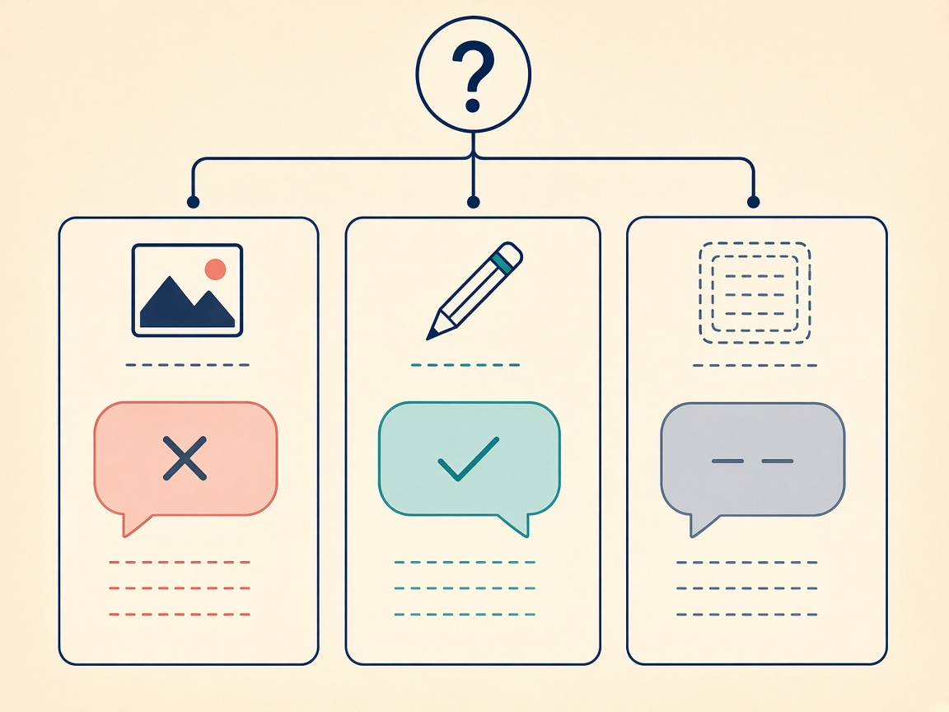
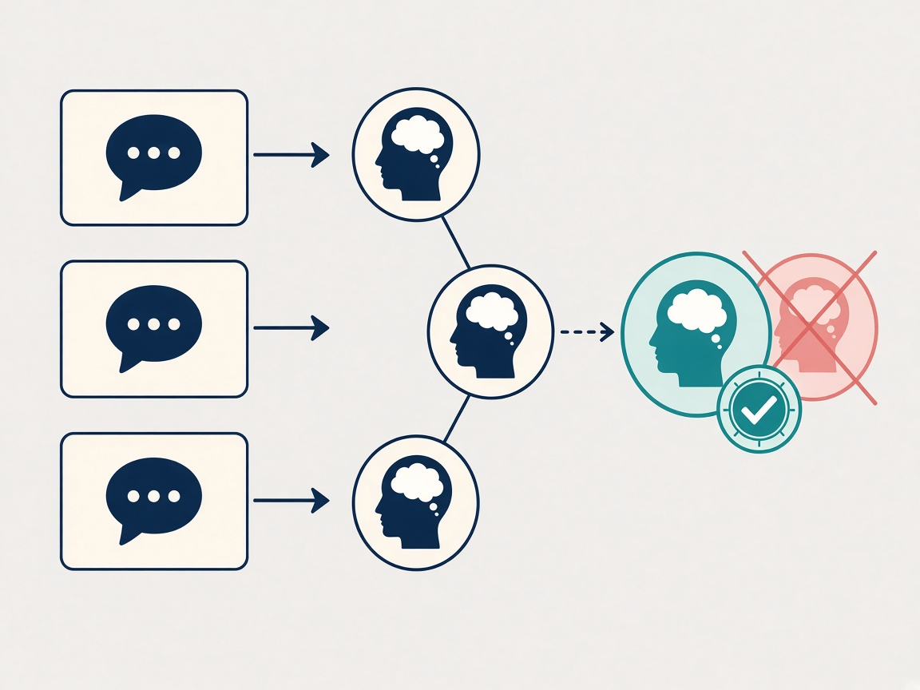
AIPI 590 · Responsible AI · Duke University · Fall 2026
MemoryMirror
Kedar Prashant Vaidya
See, trace, and correct the memories an assistant is using.
Interactive XAI demo · Project 1
MOTIVATION
Assistants now keep durable “memories” about people. When those memories are wrong, stale, or over-inferred, the person usually cannot see the record, cannot prove where it came from, and cannot test whether fixing it changes the next reply.
RESEARCH QUESTION
When an assistant answers from a stored memory, can a person see that memory, trace it to a source message, correct it, and get a different answer to the same question under the same model and the same agent settings?
Domain: Human–AI interaction · Explainable AI · Memory provenance
Audience: People subject to assistant memory, plus builders who need a correction loop they can evaluate
Figure 1 · Memory as a mirror: beliefs become inspectable reflections of prior talk
CONTRIBUTION
METHOD
EVALUATION
An interactive memory lab
Hold the model fixed. Change only memory.
Evidence, not vibes
Profile of active beliefs
Lineage graph: message → belief → reply
Edit / delete with version history kept
Three-arm counterfactual lab
12-case research benchmark + JSON export
Sensitivity filter; local-first privacy
Three synthetic people ship with a planted stale or over-inferred belief. The lab freezes model id and agent options, then swaps only the memory snapshot fed to the prompt.
01
See
Read the belief card
02
Trace
Figure 2 · Same question × three memory arms
Open source message
Correction adherence
03
Correct
Reply must include corrected facts
New version; old kept
Stale-memory leakage
04
Re-ask
Old facts must not reappear (negation window)
Same Q, new memory
Unsupported inference
Blocks diagnoses the seed never stored
INSIGHTS
LIMITATIONS & FUTURE WORK
TAKEAWAY
A correction that never reaches the prompt is theater — the reply arm must consume the new snapshot.
Provenance edges come from recorded ids, not fuzzy wording similarity.
Fixture mode proves the pipeline; live Cursor runs are the model score.
Substring rubrics are honest about their limits — and force reproducible claims.
Synthetic people and planted stale beliefs — not a field study of production chat logs.
Causal claim is scoped: replies differ because the memory list differed, under fixed agent settings.
Rubric is lexical; paraphrases can fail adherence or false-flag leakage.
Next: user study on trust repair; stronger paraphrase scoring; rate limits before wider deploy.
Make the memory loop visible enough to audit — and measurable enough to fail.
Artifact: Next.js demo with fixture + live Cursor agent modes, lineage explorer, counterfactual lab, and a 12-case benchmark you can re-run and export.
MemoryMirror · AIPI 590 Project Expo · Code + README in the project repository · Poster size 24" × 24"

