Slide 1
Module 4
Multiprocessor architectures and programming
Multiprocessors can be characterized by 2 attributes:
---- is a single computer that includes multiple processors
---processors may communicate and cooperate at different levels in solving a problem. Communication may occur by sending messages from one processor to other by sharing a common memory.

Slide 2
Multiprocessors V/s multicomputer systems
(both motivated by same goal- the support of concurrent operations in the system).
A multiple computer system consists of several autonomous computers which may or may not communicate with each other.
eg: IBM Attached Support Processor System.

Slide 3
A multiprocessor system is controlled by one OS which provides interaction between the processors and their programs at the process, data set and data element levels.
eg: Denelcor’s HEP (Heterogeneous Element Processor) system.

Slide 4
2 different sets of architectural models for multiprocessors
----Loosely coupled multiprocessors
----Tightly coupled multiprocessors

Slide 5
Loosely coupled multiprocessors
Loosely coupled systems (LCS) do not encounter the degree of memory conflicts experienced by TCS.
----- each processor has a set of I/O devices and a large local memory where it access most of the instructions and data.
Processor, its local memory and the I/O interfaces are referred as a computer module.

Slide 6
Processes which execute on different computer modules communicate through a message transfer system (MTS). MTS is one of the important factors that determine the performance of the multiprocessor system.
The degree of coupling in such a system is very loose.
Hence, it is often referred to as a distributed system.
The determinant factor of the degree of coupling is the communication topology of the associated MTS.

Slide 7
LCS are efficient when the interaction between tasks are minimal.
TCS can tolerate a higher degree of interaction between tasks without significant deterioration in performance.
eg : computer module of a nonhierarchical loosely coupled multiprocessor system

Slide 8
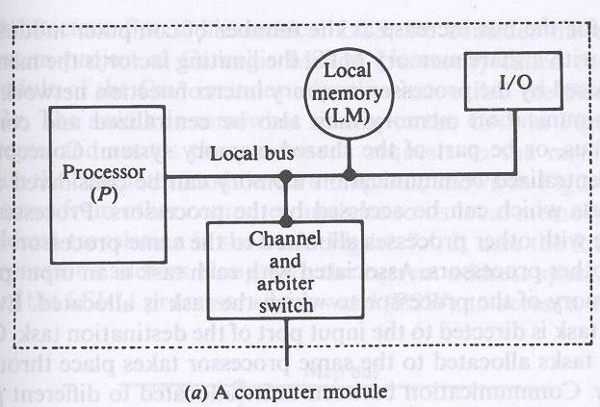

Slide 9
It consists of a processor, a local memory, local I/O devices and an interface to other computer modules. The interface may contain a channel and arbiter switch (CAS).
Connection between computer modules and a message transfer system

Slide 10
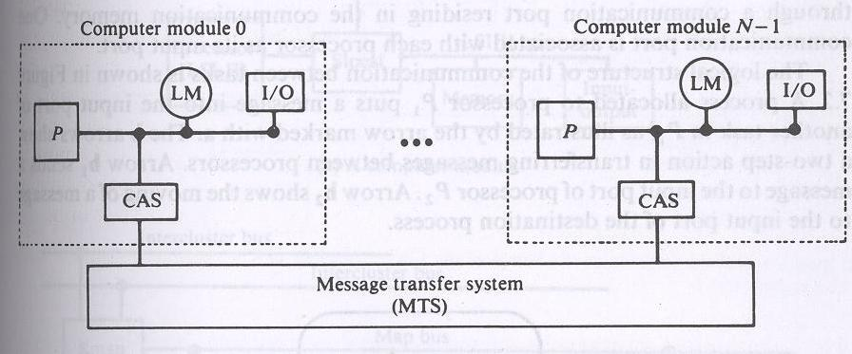

Slide 11
If requests from 2 or more computer modules collide in accessing a physical segment of the MTS, the arbiter is responsible for choosing one of the simultaneous requests according to a given service discipline.
It is also responsible for delaying other requests until the servicing of the selected request is completed.
The channel within the CAS have a high speed communication memory (accessible by all processors) - used for buffering block transfers of messages.

Slide 12
The MTS for a nonhierarchical LCS could be a simple time shared bus.
For LCS that use a single time shared bus, performance is limited by the message arrival rate on the bus, the message length and the bus capacity (in bits per second).
For LCS with a share memory MTS, the limiting factor is the memory conflict problem imposed by the processor-memory interconnection n/w.

Slide 13
The communication memory may be centralized and connected to a time shared bus, or be part of the shared memory system.

Slide 14
Processes (tasks) can communicate with other processes allotted to the same processor, or with tasks allocated to other processors.
Associated with each task is an i/p port stored in the local memory of the processor to which the task is allocated. Every message issued to the task is directed to the I/p port of the destination task.

Slide 15
Communication between tasks allocated to the same processor takes place through local memory.
Communication between tasks allocated to different processors is through a communication port residing in the communication memory. One communication port is associated with each processor as its i/p port.
Logical structure of the communication between tasks

Slide 16
A process allocated to processor p1 puts a message into the i/p port of another task in P1, illustrated by the arrow marked with a.
The b arrows show a two-step action in transferring messages between processors. Arrow b1 sends a message to the i/p port of processor p2. Arrow b2 shows the moving of a message to the i/p port of the destination process.

Slide 17
The Cm* Architecture
---Hierarchical LCS
eg. - Computer system project at Carnegie Mellon University .
Here each computer module includes
-- a local switch called slocal (similar to CAS)
The slocal intercepts and routes the processor’s requests to the memory and I/O devices outside the computer module via a map bus.

Slide 18
It also accepts references from other computer modules to its local m/y and I/O devices.
A cluster of computer modules

Slide 19
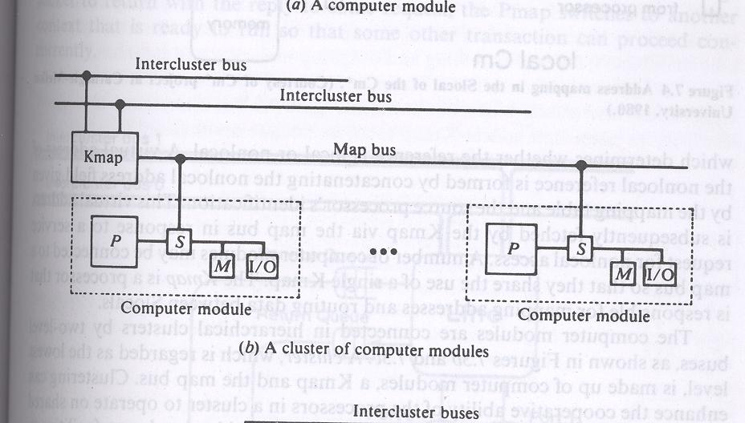

Slide 20
The Kmap is a processor that is responsible for mapping addresses and routing data between slocals.
A cluster is regarded as the lowest level made up of the computer modules, kmap and map bus.
Clusters communicate via intercluster buses which are connected between kmaps.

Slide 21
Tightly coupled multiprocessors
---- If high speed or real time processing is desired
TCS Configuration (2 Typical Models)

Slide 22
It consists of p processors, l memory modules and d I/O channels.
These units are connected through a set of three interconnection n/w namely the
PM interconnection n/w (PMIN),
the I-O/P interconnection n/w (IOPIN) and
the interrupt signal interconnection n/w (ISIN).

Slide 23
The PMIN is a switch which can connect every processor to every memory module. This switch is a p by l crossbar which has pl sets of cross points.
A set of cross points for a particular processor-memory pair includes (n+k) cross points, where n is the width of the address within a module and k is the width of the data path.
Hence the crossbar switch for a p by l multiprocessor system has a complexity O(p/(n+k)).

Slide 24
For large p and l, the crossbar dominates the cost of the multiprocessor system.
Crossbar switch distributed across the memory modules, in results multiported memory.
Complexity of the multiported memory is similar to crossbar.

Slide 25
A memory module can satisfy one processor’s request in a given memory cycle. If 2 or more processors attempt to access the same memory module a conflict occurs which is resolved and arbitrated by the PMIN.
PMIN may be designed to permit broadcasting of data from one processor to 2 or more m/y modules.

Slide 26
To avoid excessive conflicts,
-----the no. of m/y modules l is as large as p.
Another method to reduce the degree of conflicts ----- associate a reserved storage area with each processor - the ULM.
→ used to store kernel code and os tables used by the processes running on that processor.

Slide 27
In multiprocessor organization, each processor make memory references which are accessed in the main memory, that contribute to the memory conflicts at the memory modules. As memory reference goes through PMIN, it encounters delay in the processor memory switch and, hence the instruction cycle time increases.
Increase in instruction cycle time reduces system throughput. This delay can be reduced by associating a cache with each processor to capture most of the references made by a processor.

Slide 28
Another consequence of cache is the traffic through cross bar switch can be reduced, which subsequently reduces the contention at the cross points.

Slide 29
eg. of multiprocessors with private cache:
IBM 3084 and S-1.

Slide 30
A module is attached to each processor that directs the memory references to either ULM or private cache of that processor. This module is called the memory map and is similar to Slocal.

Slide 31
I-O asymmetricity: Asymmetricity of the processors can be extended to the I-O devices with respect to the connectivity of these devices to the processors.
An I/O interconnection n/w that has complete connectivity is symmetric.
Symmetric systems are expensive, so some multiprocessors have a high degree of asymmetry in the I/O subsystem.

Slide 32
Few tightly coupled commercial systems

Slide 33
---Configuration consists of 2 subsystems
the central processing subsystem and
the peripheral processing subsystem.
--- subsystems have access to a common central memory (CM) through a central memory controller.
--- an optional secondary memory called extended core memory (ECM), a low speed random access read-write memory.
ECM and CM form a two level memory hierarchy.

Slide 34
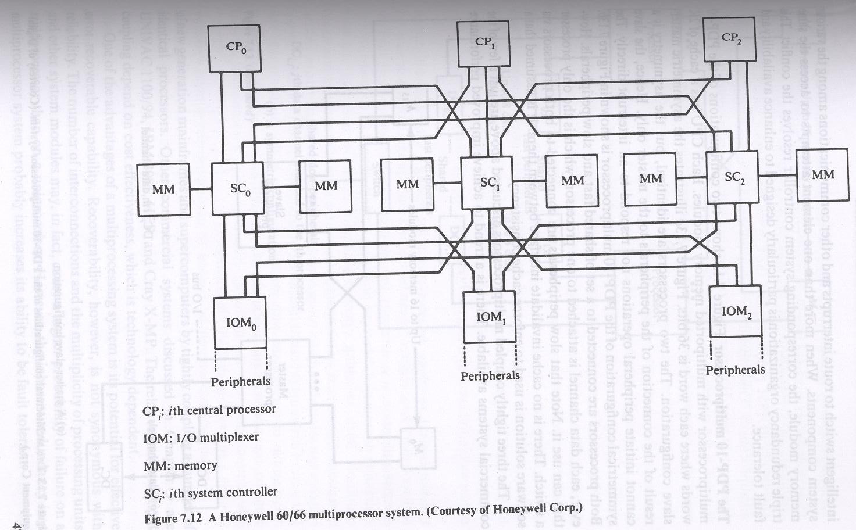
Honeywell 60/66 architecture

Slide 35
Every central processor and every I/O multiplexer is connected to every controller (SC). This provides adequate redundancy in paths for high availability. In the event of failure of SC, all IOMs are still accessible by each processor.
The system controller acts as a memory controller for its associated pair of memory modules.

Slide 36
PDP-10 multiprocessor
The two configurations of PDP-10 multiprocessor are with multiported memory modules. Each CPU has a cache of 2K words where each word is 36 bits.
I configuration shows the asymmetric master slave configuration.
The two processors are identical, but the asymmetry is a result of the connection of the peripherals to the master only. Hence the slave cannot initiate peripheral operations nor respond to an interrupt directly.

Slide 37
In II configuration both processors are connected to a set of shared fast and slow peripherals. Each data channel is attached to one processor, which is the only processor that can use it.
Slow peripherals are connected to both processors via a switch. There is no cache invalidate interface between them.

