Slide 1

Chessablanka
YOLO based chess analysis system
By,
Group number 2
1. Kedar Pravin Damale
2. Rehan Riyaz Dhamaskar
3. Prathamesh Mahesh Arleakar
Under guidance of
Prof. Mandar Joshi

Slide 2
Problem statement
One of the most critical skills in chess is the ability to evaluate a position accurately—identifying the best moves and understanding the strongest lines of play. However, doing this manually, especially from a physical board or an image, is time-consuming and prone to errors.
Chessablanka addresses this challenge by allowing users to upload a photo of a chessboard and receive instant, high-quality analysis—including position evaluation, best move suggestions, and strategic insights—directly through an interactive command-line interface.

Slide 3
Scope
To develop an interactive command-line application that bridges the gap between physical chessboards and digital analysis.
Uses computer vision and chess engine analysis to evaluate real-world board positions from images.
Objectives
Detect and map chess pieces from an input image using a trained object detection model (YOLOv8 via Roboflow).
Convert the detected positions into a standard FEN format for compatibility with chess engines.
Provide position evaluation and best move suggestions using Stockfish.
Ensure the entire process is streamlined through a responsive, easy-to-use CLI interface.
Allow users to explore lines of play and understand positional strengths/weaknesses.

Slide 4
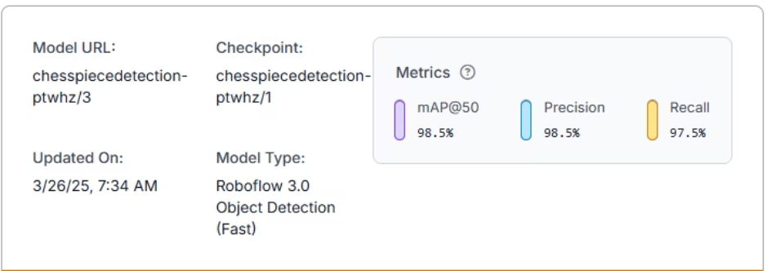
Model Training
Collected 600 images of chess positions, augmented to 1700 images (noise, blur, saturation).
Trained 3 models: YOLOv12, YOLOv8, and RoboCNN.
YOLOv8 was chosen for this project due to its higher accuracy.
Annotated images with classes like black king, white king, etc.
Tested the model's performance on various chessboard images, validating piece detection.

Slide 5
Results
Model Performance
YOLOv8 achieved mAP@50 of 98.5%, indicating strong detection accuracy.
Precision: 98.5% – High accuracy in detecting chess pieces.
Recall: 97.5% – Successfully detected most pieces.
Testing Scenarios
Tested on diverse images: overhead, angled, and under various lighting conditions.
The model performed well in most cases, with a slight dip in accuracy for angled and blurry
images.

Slide 6
Challenges
Accuracy with Angled or Tilted Images
The model struggles with chessboard images taken at non-overhead angles.
Blurry or Low-Quality Images
Images with low resolution or motion blur result in inaccurate piece detection.
Model's performance drops significantly in less-than-ideal image conditions.
Non-Standard Chessboards
Irregular chessboard patterns (e.g., colored squares or unusual designs) confuse the model.
Detection performance drops when boards do not adhere to standard layouts or colors.

Slide 7
Conclusion
Chessablanka successfully bridges the gap between physical chessboards and digital analysis, offering real-time position evaluation and move suggestions.
The YOLOv8 model demonstrated strong accuracy in detecting chess pieces
Stockfish integration provide valuable insights, enabling players to analyze their gameplay.
Future Directions:
Enhance accuracy with better data augmentation, angle correction
Include images of various FIDE recognized chessboards and pieces

Slide 8
Thank You

