Slide 1
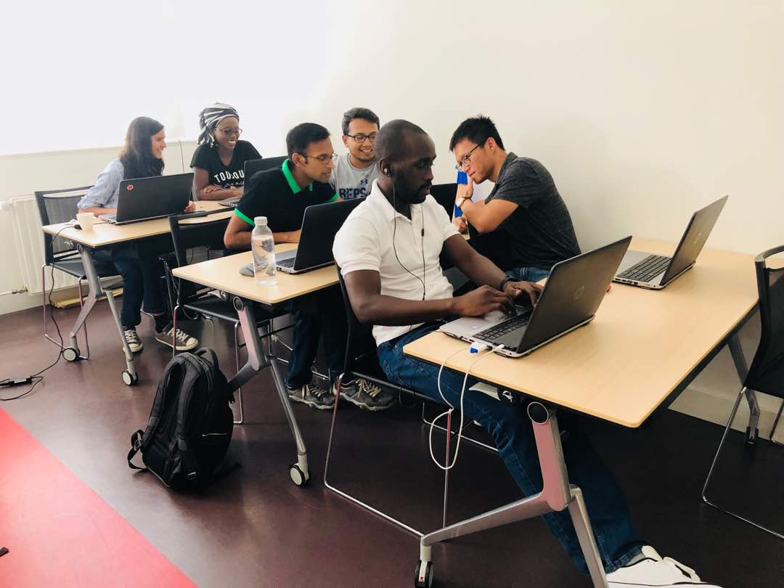
WATER WAR
WSE/HI GROUP
Tanvir Ahmed
Kedar S Ghag
Dianah Nasasira
Neela Mathre
Phuoc Quang Phung
Colis Nicolas Allen

Slide 2
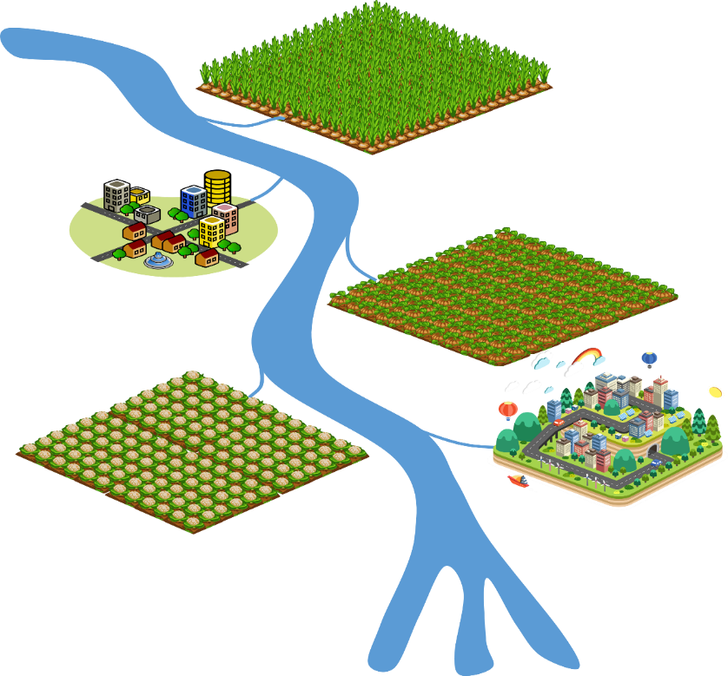
The Problem
The problem we tried to solve with the game is: Water resources allocation
Three Farms
Two Cities
One River
Players must satisfy all their needs and leave enough water in the river for environmental flow.
Take Note!
The more water you take the higher the water price
Water price is higher for upstream users than downstream users
The player with the highest net benefit wins the game
 | Water Requirements (units)
 | Month 1 | Month 2 | Month 3
Shangri-La Farm | 10 | 12 | 8
Zootopia City | 5 | 5 | 5
Farhampton Farm | 8 | 10 | 6
Smallville Farm | 11 | 11 | 9
Atlantis City | 7 | 7 | 7
Narrow sea | 5 | 5 | 5
Average Monthly Flow (units)
Month 1 | Month 2 | Month 3
46 | 50 | 40

Slide 3
Our Solution
Heart of the Game
Maximise user profit while minding the requirements of other users
The Players/Client
Water Authority
The Public
Fix crest level for your demand
Let the water flow!
Check the result
The Process
“Thousands have lived without love, not one without water” Author unknown
Amount of water allocated
Total cost
Total benefit
Net benefit
The Result

Slide 4
First Idea
The first idea was to solve the water resources allocation problem

Slide 5
Feedback from play testers, experts etc.
Display the water requirements on the screen
Provide a bit of a background of the users
It would be better to play more than one round of the game
Display the winner on the screen

Slide 6
Balancing Reality-Meaning-Play
Reality is full of uncertainty as is in the game since the players do not know the dry-normal-rainfall events.

Slide 7
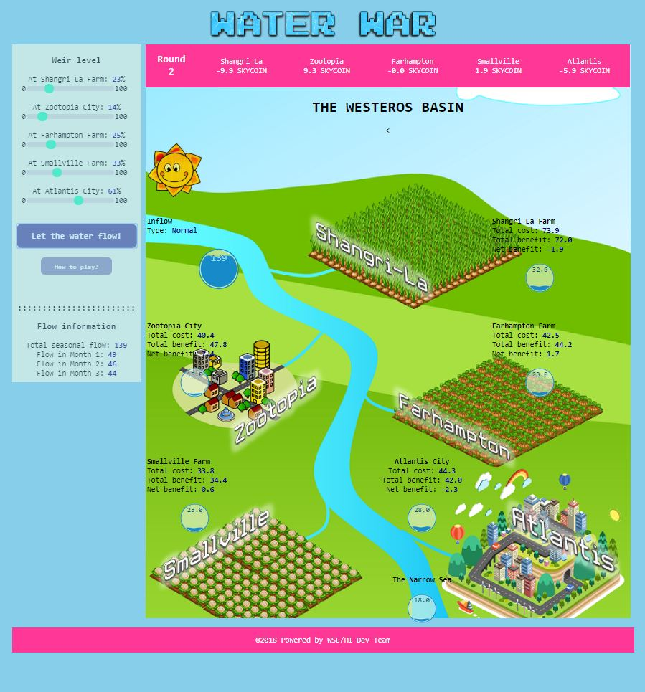
Final game

Slide 8

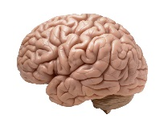

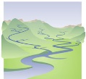
Final playtest results
 | 1. Reaction | Did the players enjoy the game? Yes, however they needed to play more than one round
 | 2. Learning | What did the players learn during the game? It is not easy to balance individual requirements of users in a basin perfectly and get maximum benefits for each user. A decision taken by one user can affect other users
 | 3.Behavior | How might the players’ everyday behaviour change? Players can start to think about other users while utilising water resources in the basin, with the environment in mind
 | 4. Results | How might the target system (river basin etc) change? The river basin can improve or deteriorate depending on how the water is utilized.

Slide 9
Reflections / what we learned
Serious gaming is a resourceful tool for appreciating water resources problems, integrated water resources management and consultation of stakeholders.
While developing a serious game, care should be taken to ensure that it will be useful to solve the problem at hand.
More time for developing, testing and playing the game!
It is not easy to incorporate all uncertainty in the game.

Slide 10
Thank you!!!

