Slide 1
MANUAL LATHE EXTENSION

Slide 2
Contents
Introduction
Overview of Manual Lathe
Advantages of CNC
Idea of Retrofitting
Proposal of Extension
Working
Advantages of this Extension
Conclusion

Slide 3
Introduction

Slide 4
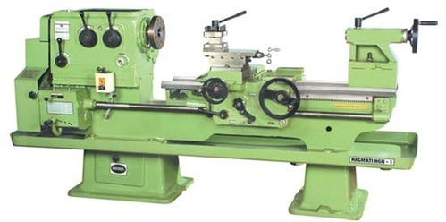
Overview of Manual Lathe
Used for cylindrical work
All work done by hand
Two axis movement
Mother of all machines
fig 4.1 Catia model

Slide 5
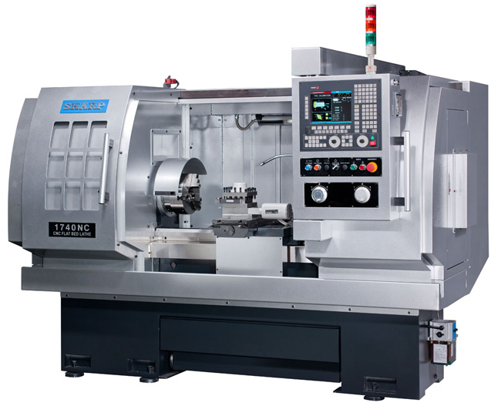
Advantages of CNC
Entry in G-Code
Greater accuracy
Only one skilled labor involved

Slide 6
Idea Of Retroffiting

Slide 7
Extension on Manual Lathe
In retrofitting we add motors to the wheels that we need to rotate in order to move the tool.
Due to this it is converted fully into an automatic machine.
We cant get the manual operations back.
For this we have to add the motors and axis by ourselves.
That is why we need an extension for this purpose.

Slide 8
Working
Catia model video
Bluetooth app

Slide 9
Flow Chart

Slide 10
Advantages of this Extension
No skilled labor needed
Direct connection to the design engineer can be established.
Basic drawing of the part in needed.
Manual lathe can be obtained by detaching the extension.

Slide 11
Limitations
Large amount of material required
Strong clamping force
Limited length and diameter of workpiece can be produced

Slide 12
Conclusion
Thus this extension will greatly help small scale industries.

