Slide 1
CROPOPTIMA : AI-DRIVEN CROP SUITABILITY, HEALTH MONITORING, AND RESOURCE OPTIMIZATION SYSTEM
Batch Number : 12
Ayinavilli siva teja
Padala Kedarnadh Reddy
Kavali Hemantha Rayudu
Makireddy Uday Sai
Guided By :
K Satyanarayana Raju

Slide 2
Abstract
This comprehensive smart agriculture system integrates advanced AI and machine learning techniques to optimize farming practices. It predicts the most suitable crops based on environmental conditions, recommends appropriate fertilizers, detects crop disease using deep-learning image analysis, and recommends pesticides based on the crop disease. This system aims to enhance agricultural productivity, reduce losses, and promote sustainable farming by empowering farmers with data-driven insights and personalized support.

Slide 3
Introduction
Agriculture is vital for global food security but faces challenges like unpredictable environmental conditions, improper crop selection, and diseases. Traditional methods are insufficient, necessitating AI-driven solutions to ensure sustainability.

Slide 4
Literature Review
Patel et al. (2015): AI for crop recommendation. Patel and colleagues developed a machine learning-based crop recommendation system that predicts the best crops to grow based on soil pH, rainfall, temperature, and crop yield data. Their study highlights how AI can optimize crop selection, reduce risks, and boost agricultural productivity.
Mohanty et al. (2016): Deep learning for disease detection. Patel and colleagues developed a machine learning-based crop recommendation system that predicts the best crops to grow based on soil pH, rainfall, temperature, and crop yield data. Their study highlights how AI can optimize crop selection, reduce risks, and boost agricultural productivity.
Priya & Rajesh (2017): IoT-based fertilizer recommendation. Priya and Rajesh created a system combining IoT sensors and AI to recommend fertilizers based on real-time soil data like moisture, nutrients, and temperature. Their work promotes precise, sustainable fertilizer use, reducing waste and environmental harm.
Kamilaris & Prenafeta-Boldú (2018): AI applications in agriculture. Kamilaris and Prenafeta-Boldú reviewed AI applications in agriculture, such as crop prediction, disease detection, irrigation management, and yield estimation. Their work highlights the growing role of AI in tackling global agricultural challenges.
Sharma et al. (2020): AI for precision agriculture. Sharma and colleagues developed a smart farming framework using AI and machine learning for precision agriculture. Their system integrates crop prediction, disease detection, and pest management using sensor and remote imagery data, demonstrating AI's potential to enhance farming and sustainability.

Slide 5
Problem Definition
The agricultural sector faces challenges such as poor crop selection, unscientific fertilizer use, disease detection issues, pesticide mismanagement, and reliance on intuition. Integrating AI and ML can optimize crop selection, fertilizer application, disease identification, and pesticide usage by providing data-driven, real-time analytics. This empowers farmers to make informed decisions, promotes sustainable farming practices, ensures better resource utilization, and ultimately increases productivity.

Slide 6
Proposed System
Our Smart Agriculture Solution uses AI and ML for optimal farming. The system recommends suitable crops, precise fertilizers, identifies crop diseases, and provides eco-friendly pesticide suggestions through a web-based platform, giving farmers actionable insights for better productivity, efficiency, and sustainability.

Slide 7
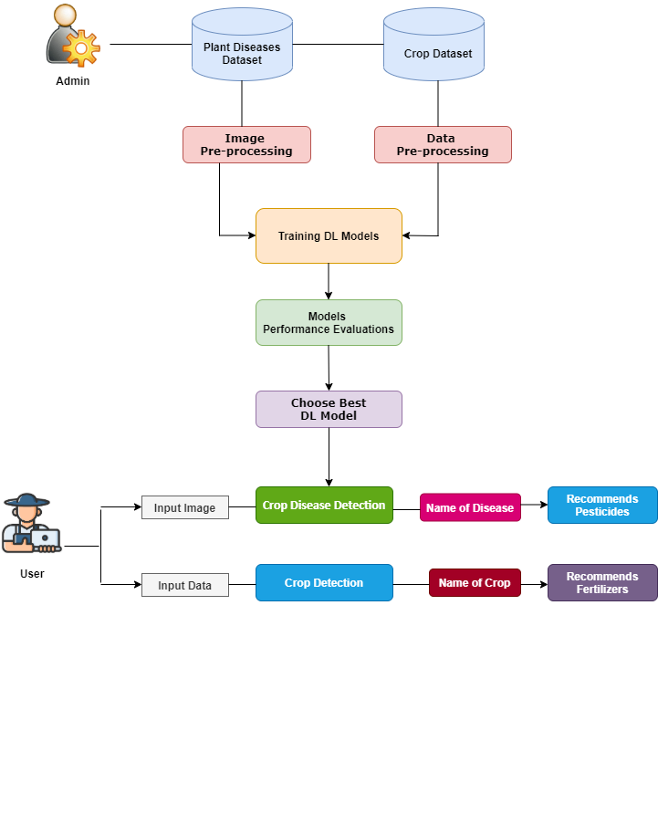
System Architecture

Slide 8
System Implementation
Data collection and preprocessing
Crop prediction using environmental data
Disease detection with CNN models
Real-time recommendations via a web-based platform

Slide 9
System Requirements
Hardware Requirements:
Processor : Intel Core i5/i7 or AMD Ryzen 5/7
Ram : Min 4 GB
Hard Disk : Min 50 gb of free ssd space
Software Requirements:
Operating System : Windows 10/11
Technology : Python 3.8
Front-end Technology : HTML, CSS, JS
Back-end Technology : MySQL
Code Development Tool : PyCharm IDE
Web framework : Flask

Slide 10
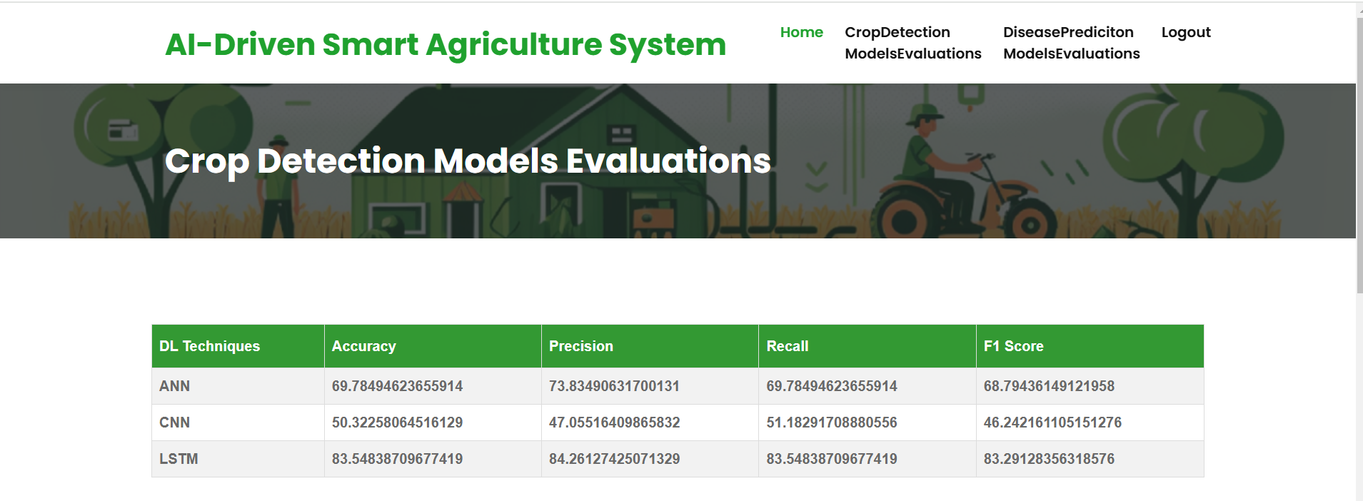
Crop Detection Models Evaluations

Slide 11
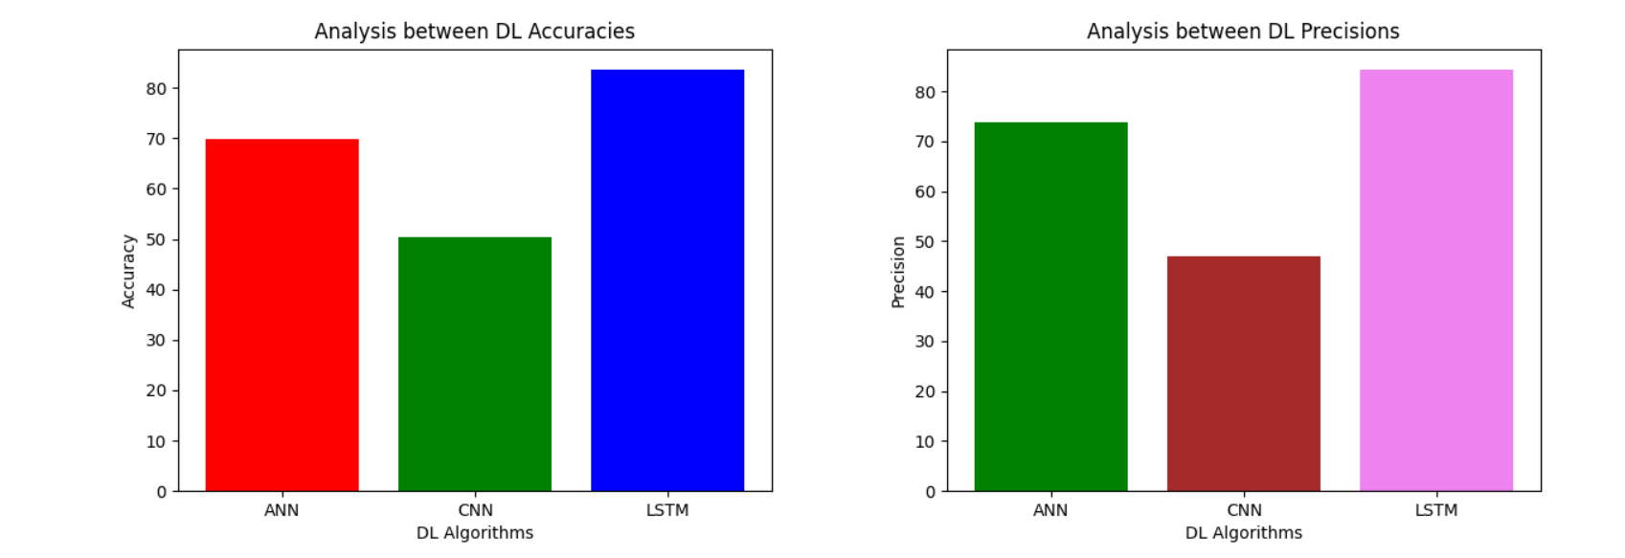
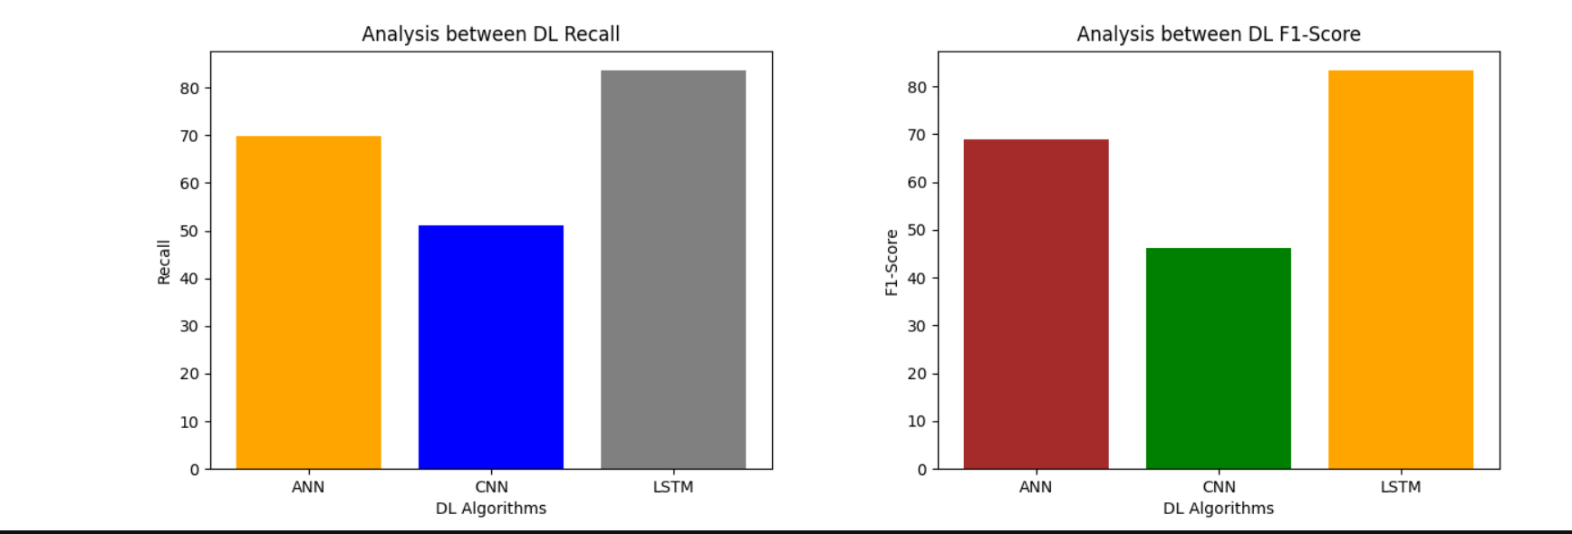
Crop Detection Models Evaluations

Slide 12
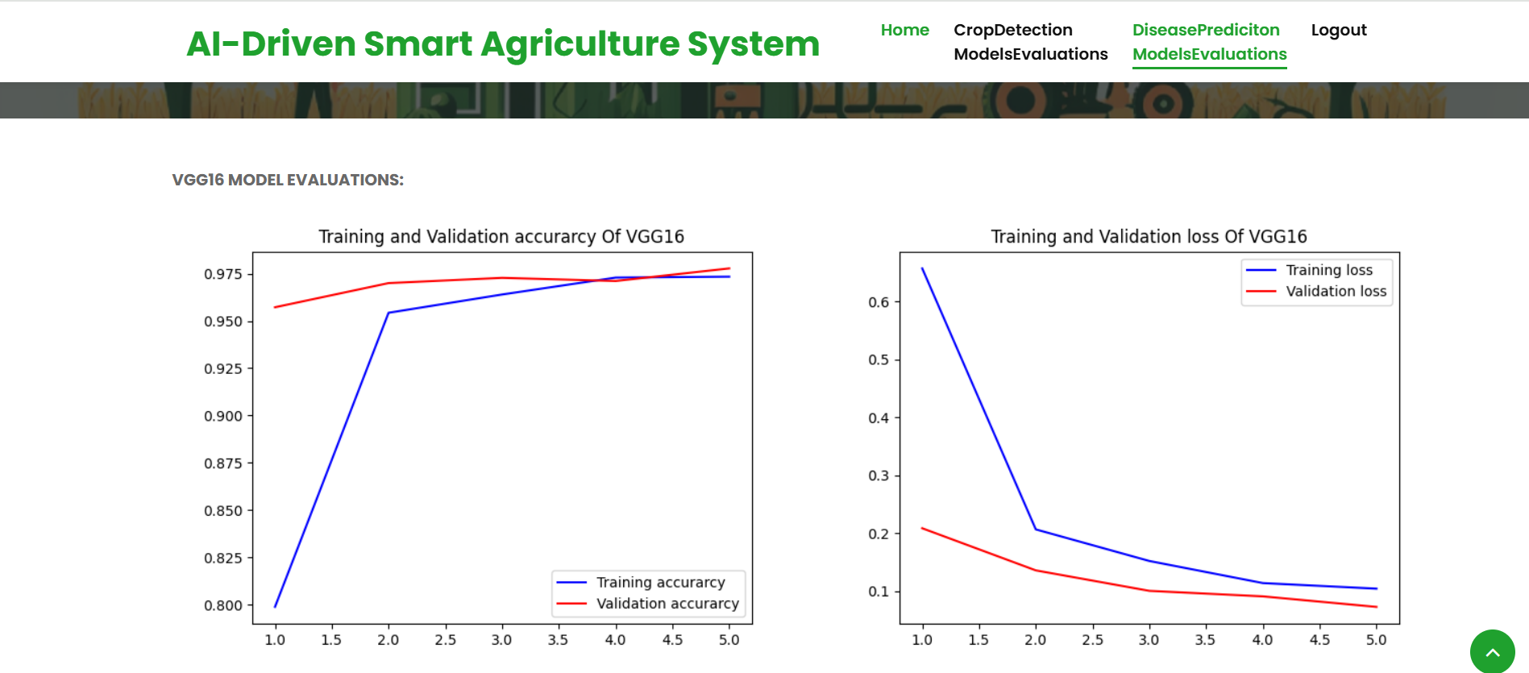
Crop Disease Evaluations

Slide 13
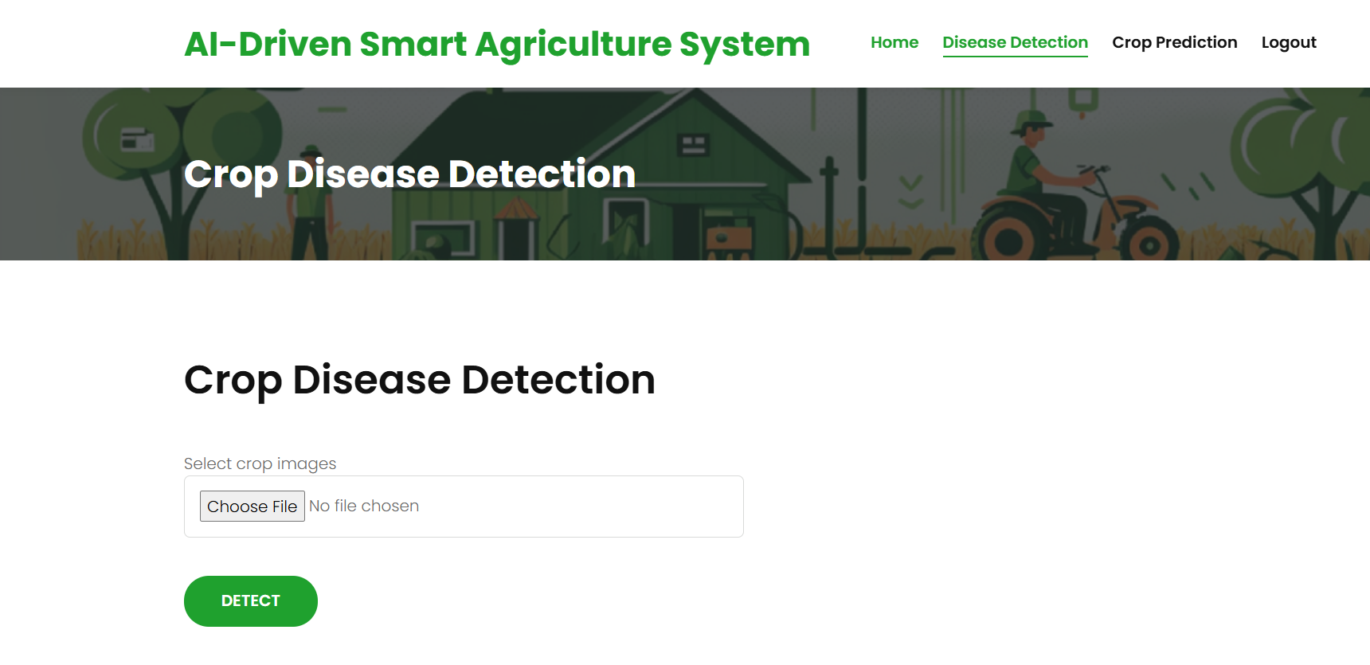
Crop Disease Detection & Results

Slide 14
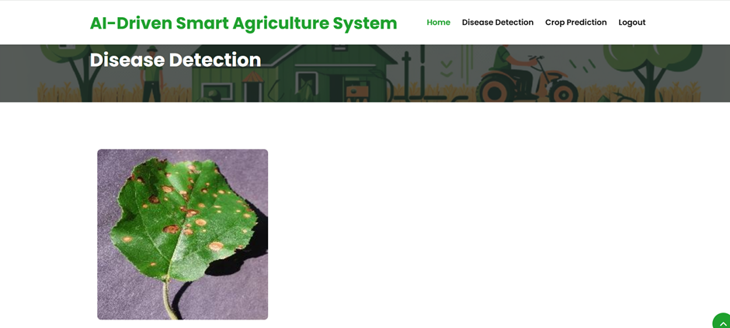
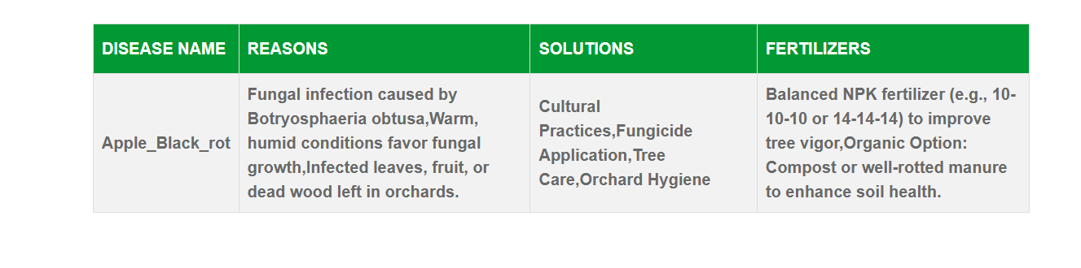

Slide 15
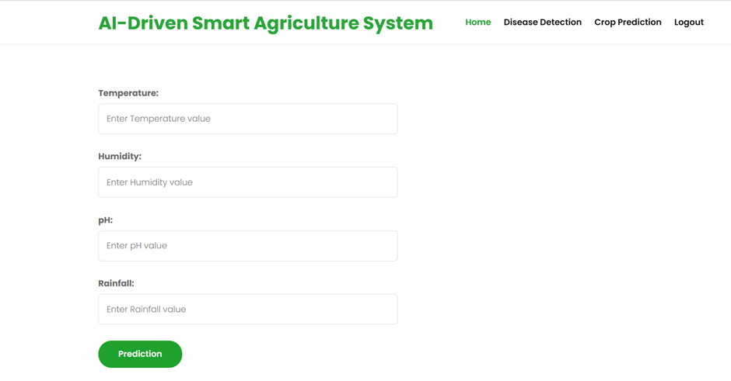
Crop Prediction & Results

Slide 16
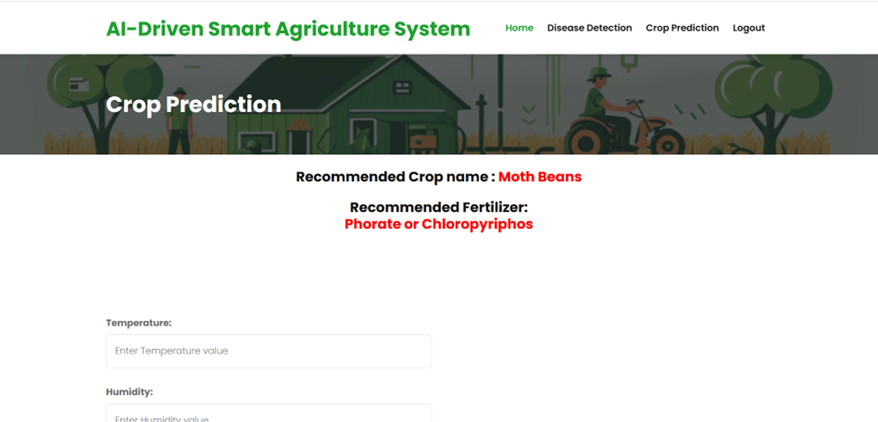

Slide 17
Conclusion
The Smart Agriculture System leverages AI and ML to enhance farming practices, promote sustainability, and ensure food security. It bridges the gap between traditional methods and modern technology.

