Slide 1

Smart system design course project
LANDMINE & IED DETECTION
GROUP N.O- 14
KEDHARESHWAR RAO :Roll n.o 2005A41149
VENKATESHWARLU :Roll n.o 2003A51269
THUMATI VISHNU VARDHAN :Roll n.o 2003A51238
AKULA AKSHITHA :Roll n.o 2003A51157
GADDAM PRUDHVI RAJ :Roll n.o 2005A42015

Slide 2

LANDMINE AND IED DETECTION
One person is killed by a landmine every 15 minutes. 26,000 people a year become landmine victims.
5,554 mine casualties took place in 2019. 80% of them are civilians – children representing 43% of the civilian casualties. Still 61 countries and areas around the world are contaminated by landmines and thousands of people continue living with a this daily threat of losing their life or limb.
Risk is higher for military or defusing squad personnel during terrorist activities that are administered by landmines. So, we should increase using of remotely guided machines which detects the landmines and conveys the location of mine to us which prevents Human loss

Slide 3
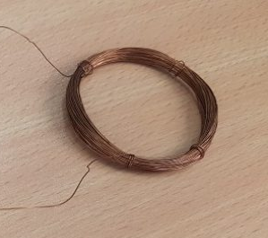
We can make a landmine detector using Arduino ,copper coil, ,ultrasonic sensor , buzzer. Here really we are making a sensor that identifies the metal which is near to it.
when the device gets close to the metal it detects the metal close to it because of the electromagnetic waves are transmitted from the copper loop.
With these electromagnetic waves, the circuit gives signal to the Arduino. Arduino detects that it is a metal or not and sends the guidance to the signal and the LED by the code. Then Arduino also sends the information about address of landmine by sharing location from GPS helping to point and diffuse landmine easily.
The machine also needs to detect the obstacles and move away from it to Overcome the problem of stucking up . When a landmine is detected it turns on the buzzer so that we can spot the location of the machine and landmine.

Slide 4
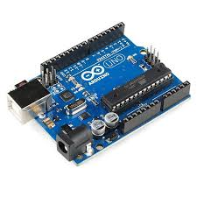
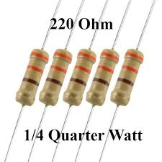
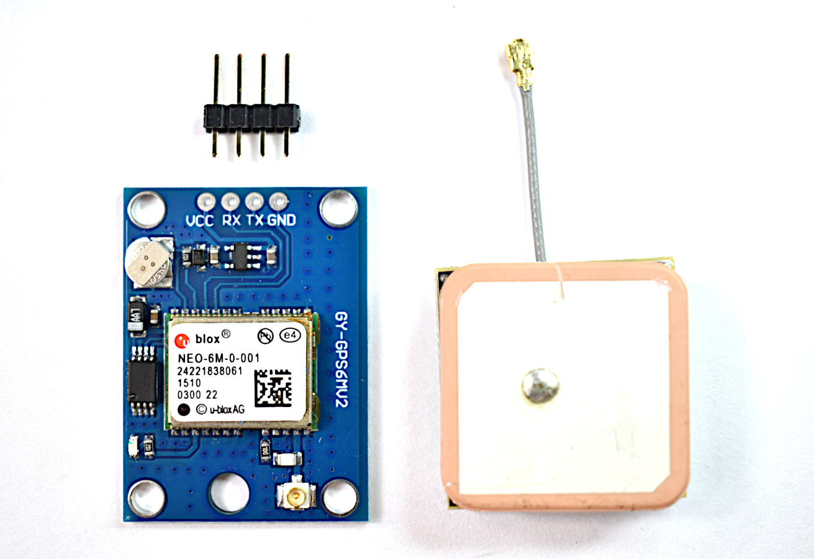
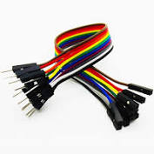
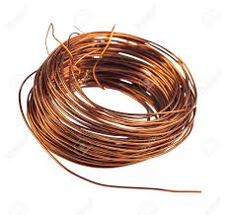
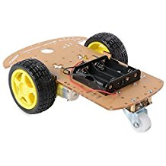
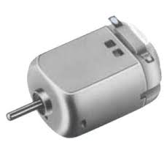
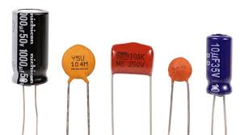
REQUIRED COMPONENTS :
1)Arduino uno
2) 10nF capacitor
3) 220-ohm resistors
4) 220Ohm resistors
5) 1kOhm resistor
6) ~5 meters of thin electric cable
7) Structure to hold the coil
8) NEO-6M GPS Chip with Antennae
(2.5m Horizontal position accuracy)
10)Structure casing with wheels
11)DC motors

Slide 5
MARKET AVAILABILITY
1)Arduino – 330 ₹
2) 10nF capacitor - 20 ₹
3) 220 ohm Resistors - 20 ₹
5) 1kOhm resistors - 5₹
7) Structure to hold the coil –
8) NEO-6M GPS Chip with Antennae
(2.5m Horizontal position accuracy) 300 ₹ - 400 ₹
9)Ultrasonic sensors - 120 ₹
10)Structure casing with wheels - 350 ₹
TOTAL ESTIMATE - 1400₹ - 1600₹

