Slide 1
Final Presentation
2017-20845 Wonjae Jang
2018-25193 Dongwan Kang

Slide 2
Project progress
Analysis of SnuPLc
Planning & Design
Function Inlining
Now
Constant Propagation
Constant Propagation
&
Dead Code Elimination
Deadcode Elimination
Completion

Slide 3
Basic process of Function Inlining
Scan target positions & function code blocks
Generate new variables for parameters & local variables
Replace the function call with the code block
Assign return variables to destination operand

Slide 4
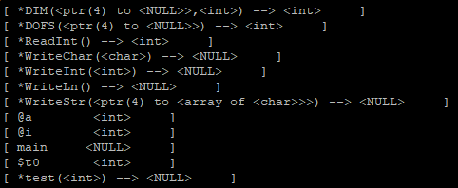


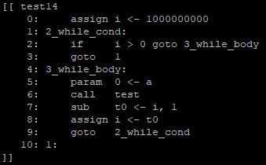


Example of Function Inlining
Symbol Table of Main
Symbol Table of test
All vars
* -> i0_*
All vars
* -> i1_*
All vars
* -> i2_*
Function Body of Main
Function Body of teset

Slide 5
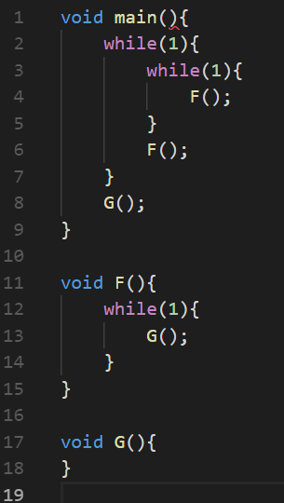
Our Technic to Prevent Code Explosion
Score, then inline one at once in order of score
Score = 1/code_length
Factor = 1 by default
3 * Factor in function scope
5 * Factor in while scope
Length_limitation = origin size of CodeBlock x 2
Factors
Line 4 F() in double loop : 5*5 = 25
Line 6 F() in single loop : 5 = 5
Line 8 G() : 1 = 1
Line 13 G() in loop in funcion: 3*5 = 15

Slide 6
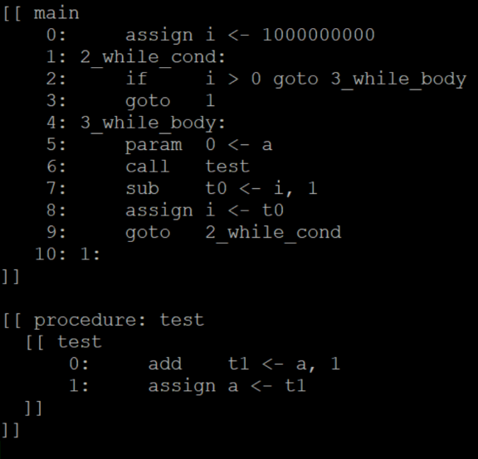
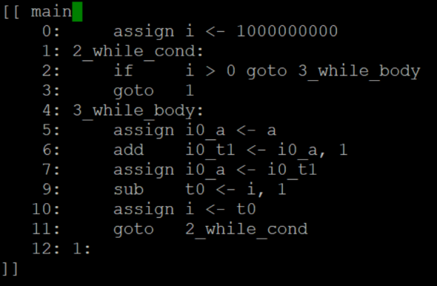
Inlining Result
Compiler Optimization result with simple program
 | Running time | TAC code size
compiled with basic snuplc | 5064 ms | 1281 byte
compiled with ours | 3931 ms | 1401 byte
Performance of running time : 29%↑
TAC code size : 9%↑

Slide 7
Basic process of Constant Prop. and Deadcode Eli.
Make BasicCodeBlock Graph for DFA
Generating new variables for parameters & local variables
Compute ReachingDefinition (IN / OUT)
Replacing the function call with the code block
Replace constant valuable with the constant
Assigning destination operand, with return variable
Eliminate DeadCode

Slide 8
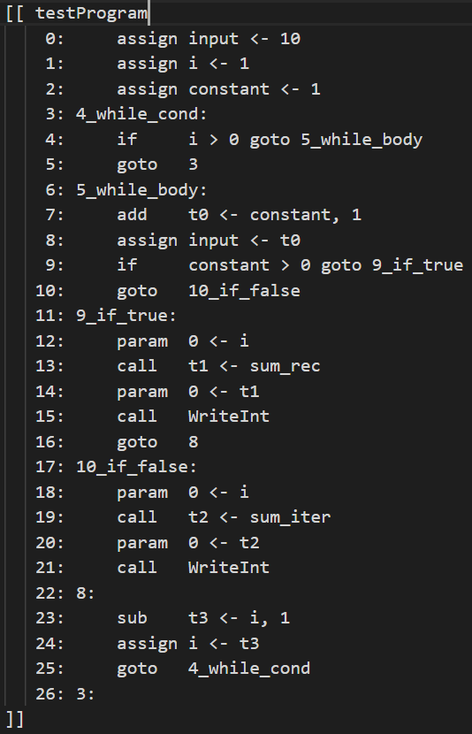
Build Control Flow Graph

Slide 9
Build Control Flow Graph
1
2
3
4
5
6
7

Slide 10
Build Control Flow Graph
1
2
3
4
5
6
7

Slide 11

Reaching Analysis
1
Data-flow Equations
2
3
4
5
 | input i constant input i
 | IN[B] | OUT[B]
B₁ | 0000 0 | 1110 0
B₂ | 1111 1 | 1111 1
B₃ | 1111 1 | 0111 1
B₄ | 0111 1 | 0111 1
B₅ | 0111 1 | 0111 1
B₆ | 0111 1 | 1100 1
B₇ | 1111 1 | 1111 1
6
7

Slide 12
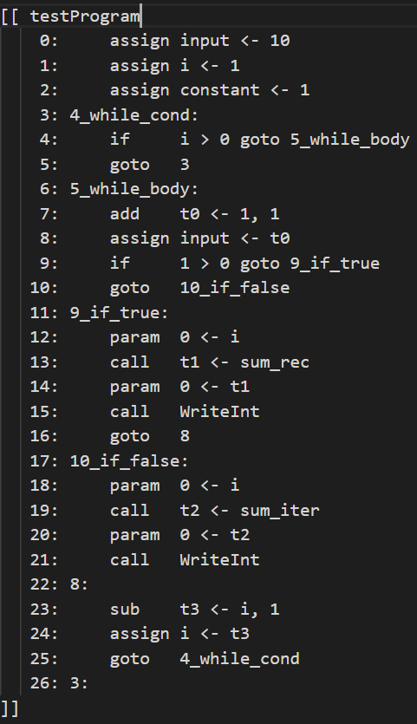
Replace constant valuable with the constant
1
∅
availableDef = IN[B] ∩ OUT[B] – Def_{overlapedName}
2
constant=1
3
3
constant=1
4
constant=1
 | input i constant input i
 | IN[B] | OUT[B] | IN[B} ∩ OUT[B]
B₁ | 0000 0 | 1110 0 | 0000 0
B₂ | 1111 1 | 1111 1 | 1111 1
B₃ | 1111 1 | 0111 1 | 0111 1
B₄ | 0111 1 | 0111 1 | 0111 1
B₅ | 0111 1 | 0111 1 | 0111 1
B₆ | 0111 1 | 1100 1 | 0100 1
B₇ | 1111 1 | 1111 1 | 1111 1
5
constant=1
6
∅
7
constant=1

Slide 13
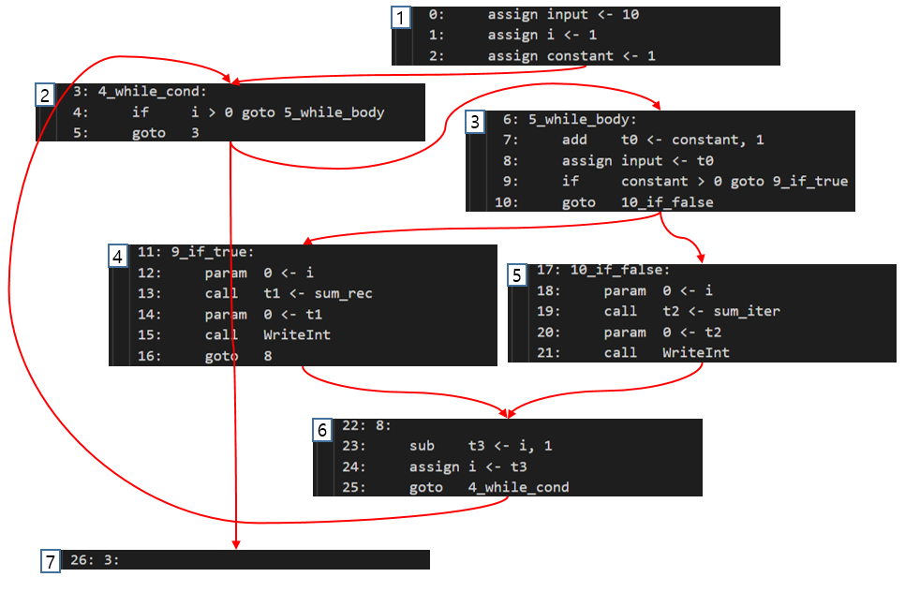
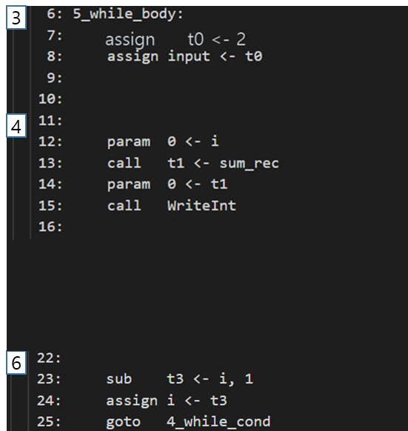
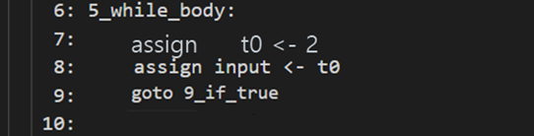
Constance Folding & Deadcode Elimination
1
2
1. Binary/Unary Operation && Change to Constant
-> Calculate it
3
3
assign t0 <- 2
True
4
2. Conditional Branch && Changed to Constant
-> Fix it
5
6
7

Slide 14
Constance Folding & Deadcode Elimination
1
2
For each assignment
Check if it is used
if not -> Delete it!
6
7

Slide 15
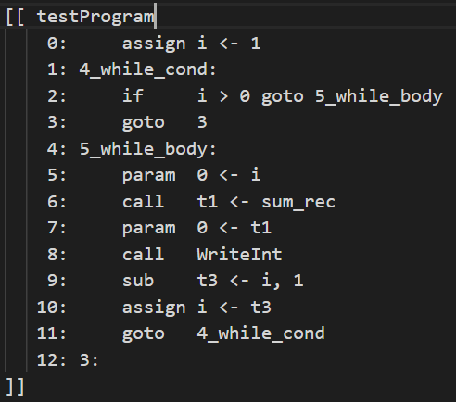
Constance Folding & Deadcode Elimination

Slide 16
Evaluation of Constant Prop. & Deadcode Eli.
Average of 5 times
Type | Original | Constant Prop. | + Deadcode Eli.
Time | 1.6944s | 1.5466s | 1.4846s
Speedup | - | 9.56% | 14.1%

Slide 17
Ongoing Work
Minor Bug Fix
Merge Inlining and Constant Prop. & Deadcode Eli.
Write Final Report

Slide 18
Thanks

Slide 20
Appendix. Midterm slides for Inlining

Slide 21
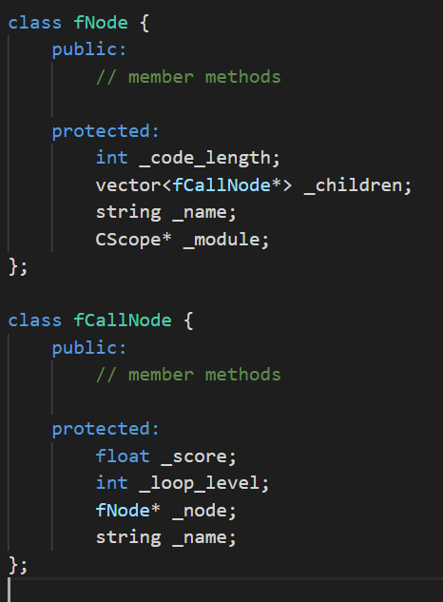
Data Structure
to process each function and each function call
fNode
fCallNode
F()
main
F()
G()
F
G()
G

Slide 22


function Inlining

Slide 23
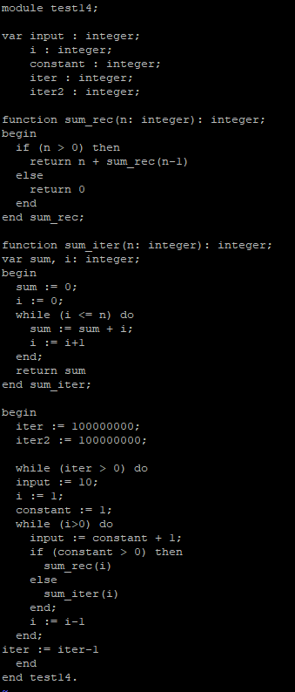
Evaluation of Constant Prop. & Deadcode Eli.

