Slide 1
Wache-Market: An Online Marketplace for Wachemo University
Authors: Samuel Tefera, Kedija Ansha, Angelina Melese, Gideon Daniel, Mohammed Belayneh
Institution: Wachemo University, College of Engineering and Technology, Department of Software Engineering
Date: May 15, 2025

Slide 2
Presentation Outline
Introduction
Team and Acknowledgement
Requirements Analysis
Use Case Modeling
Sequence Diagrams
Class Design
Implementation
Version Control
Unit Testing
Build Process
Conclusion
References

Slide 3
Introduction
Project: Wache-Market, a web-based e-commerce platform for Wachemo University
Objective: Facilitate buying and selling within the university community
Developed by 3rd-year Software Engineering students
Key Features:
Secure user authentication
Flexible product listings
Efficient transaction processing
Role-based access (Buyer, Seller, Admin)

Slide 4
Team and Acknowledgement
Team Members:
Samuel Tefera (1501240)
Kedija Ansha (1501019)
Angelina Melese (1501700)
Gideon Daniel (1308207)
Mohammed Belayneh (1510098)
Acknowledgement:
Mr. Feyisa Kedir (Instructor)

Slide 5
Requirements Analysis
Functional Requirements:
User registration and login
Product browsing and searching
Cart and order management
Payment and wallet integration
Seller product management
Admin user and system management

Slide 6
Non-Functional Requirements:
Security: Encrypted user data
Performance: <3-second page load
Simplicity: Intuitive interface
Reliability: 99% uptime
Scalability: Support growing users

Slide 7
Use Case Modeling
A Use Case Diagram is a type of Unified Modeling Language (UML) diagram that represents the interactions between users (actors) and a system. It helps visualize the functional requirements of a system by showing use cases (goals or tasks) and the actors (users or external systems) involved.

Slide 8
Key Components of a Use Case Diagram
Actors
Use cases
System Boundary
Relationships

Slide 9
What is a Use Case Diagram Used For?
Requirement Analysis
System Design
Project Planning
Documentation
Communication Tool

Slide 10
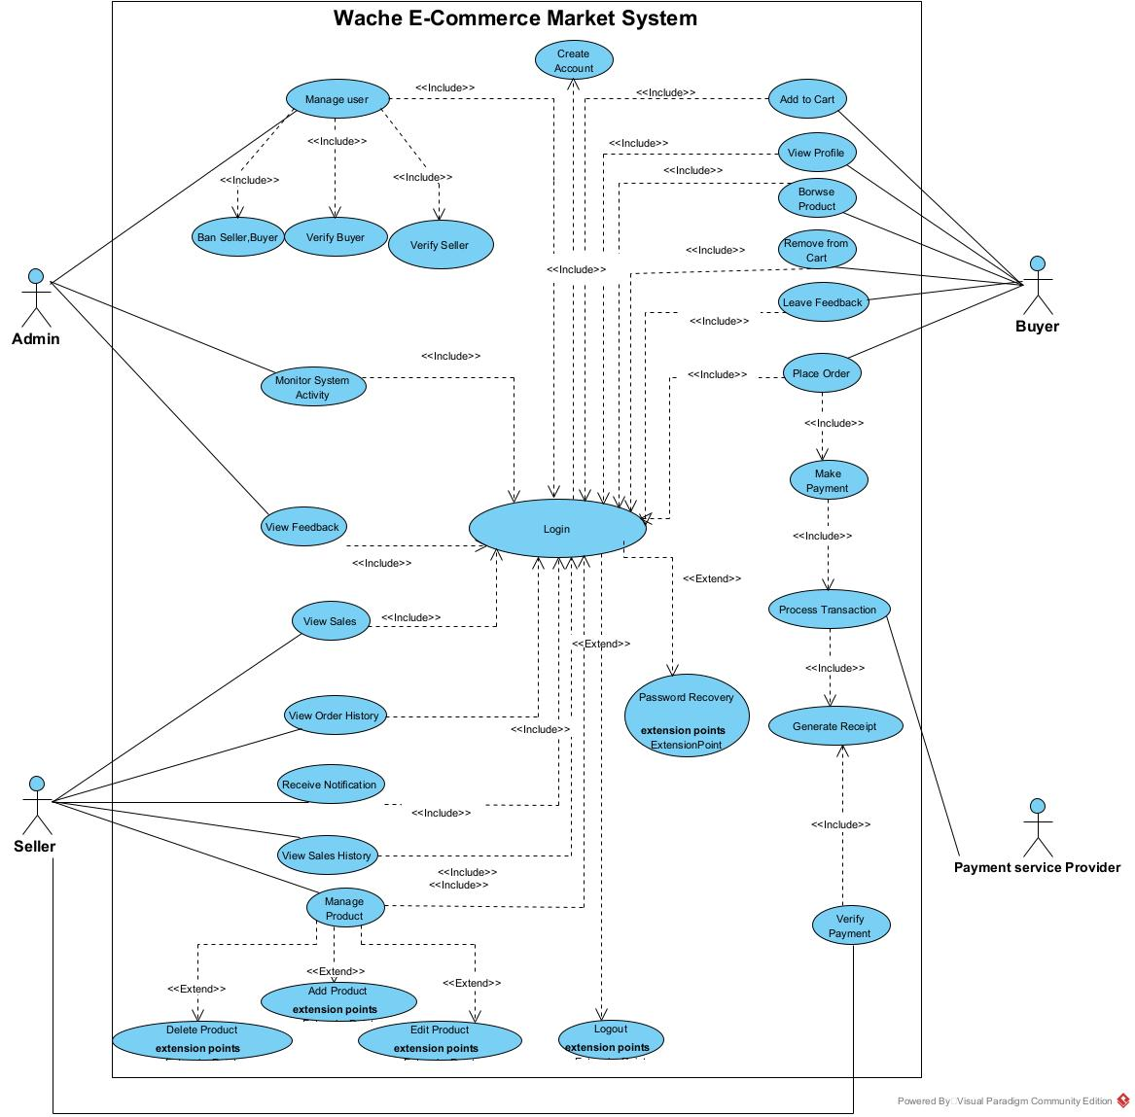
Use Case Modeling

Slide 11
Sequence Diagrams
A UML diagram showing step-by-step interactions between objects/components over time.

Slide 12
Key Elements
Actors/Objects – Participants in the interaction.
Lifelines – Vertical dashed lines showing object lifespan.
Messages – Arrows indicating communication (e.g., requests, responses).
Activation Bars – Time periods when an object is active.

Slide 13
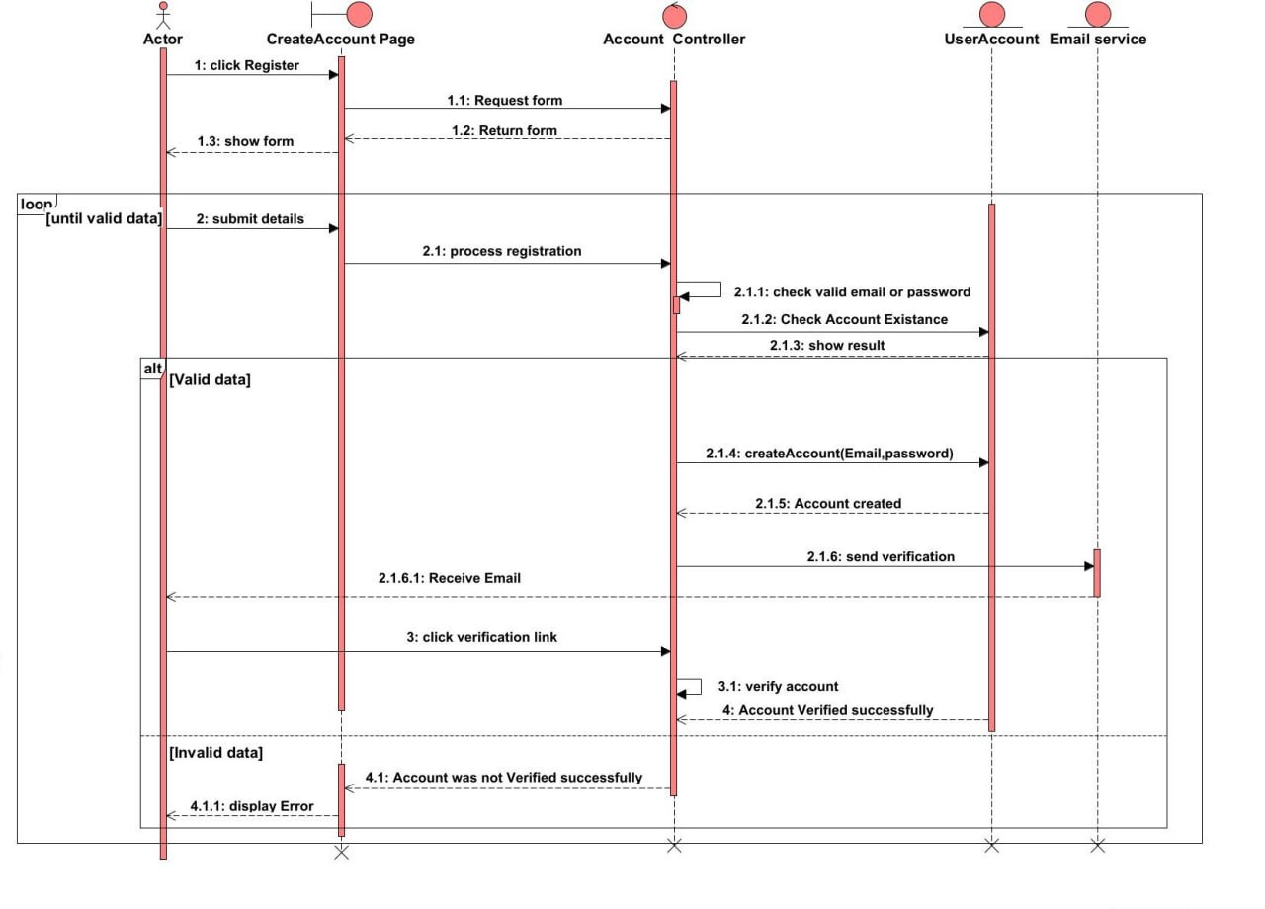
Sequence Diagrams

Slide 14
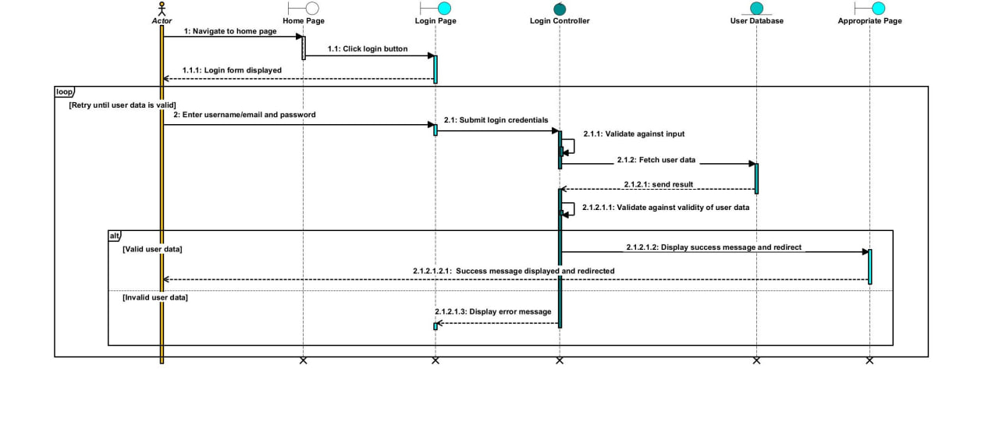

Slide 15
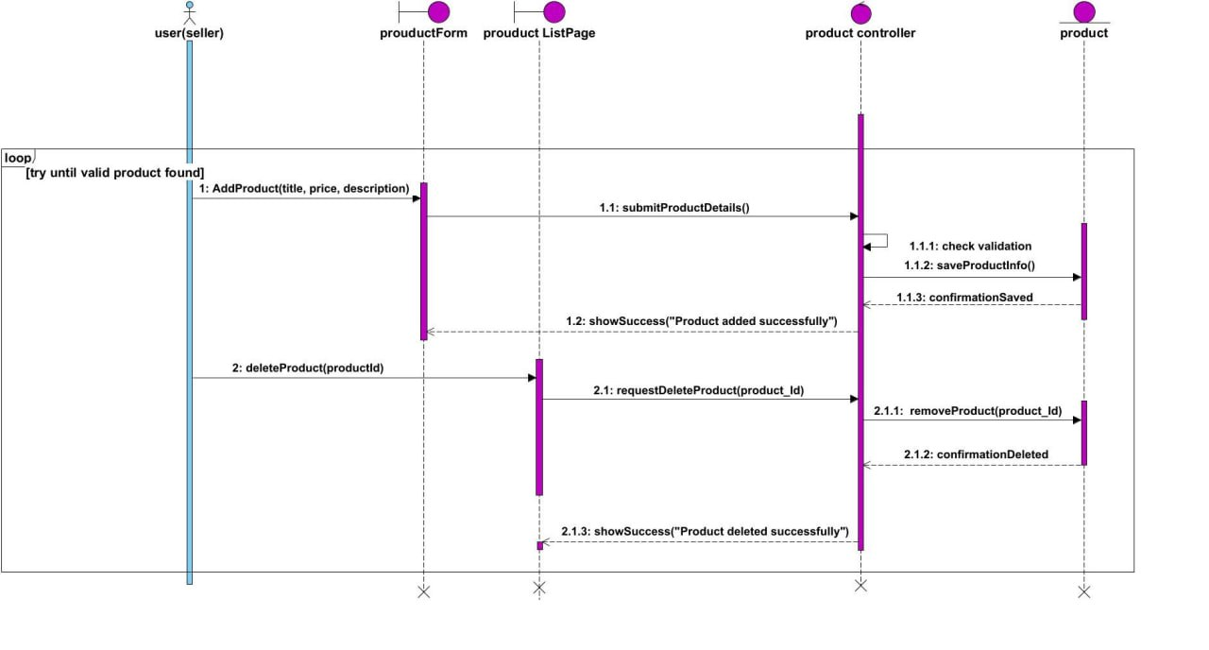

Slide 16
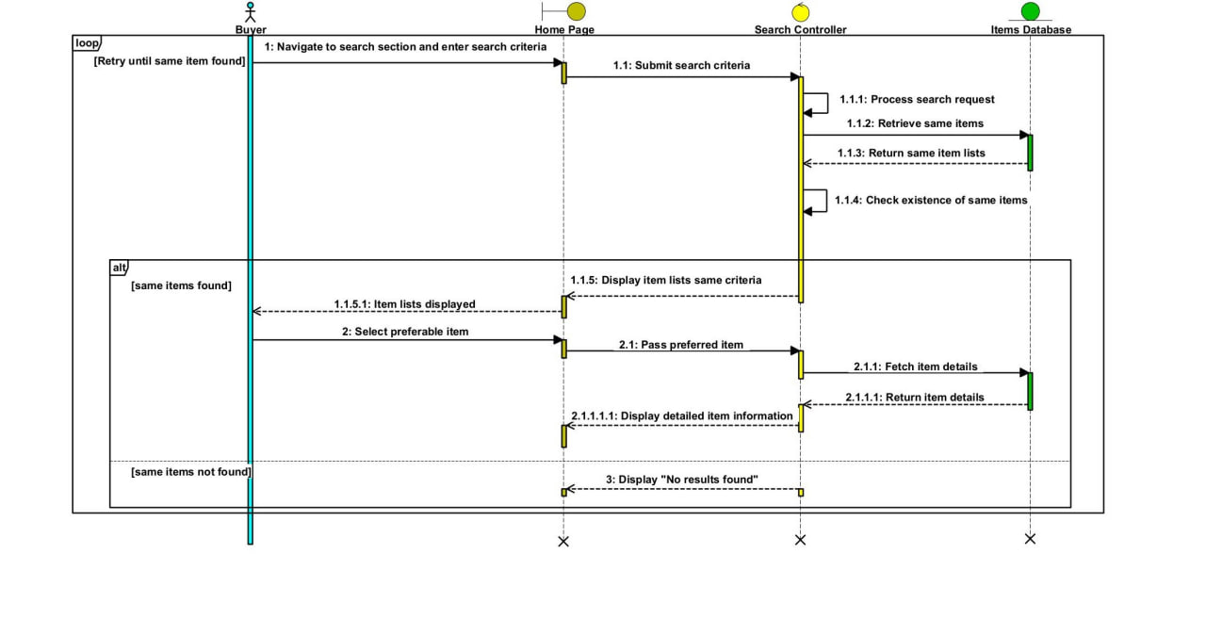

Slide 17
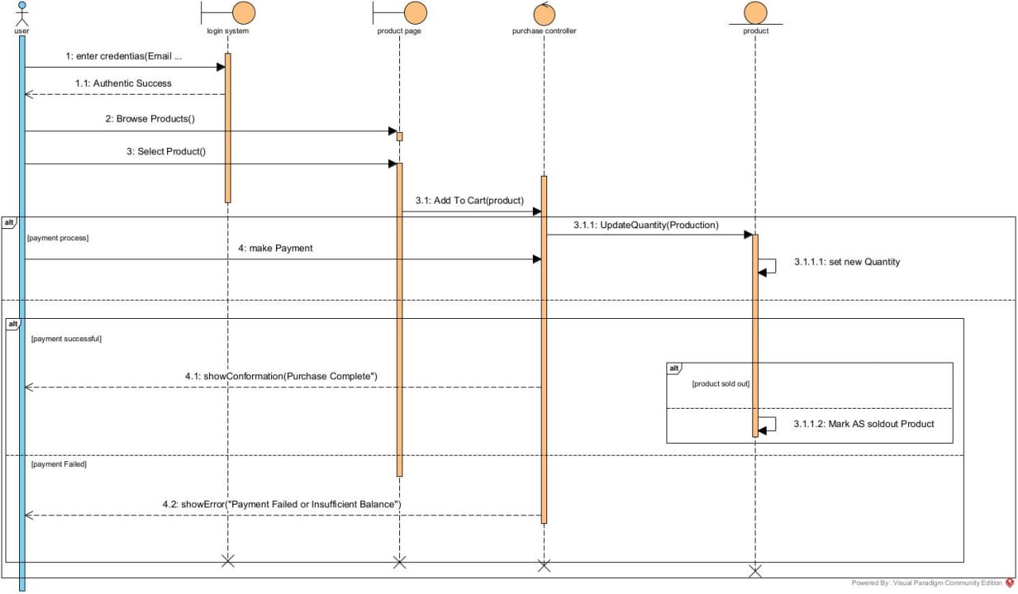

Slide 18
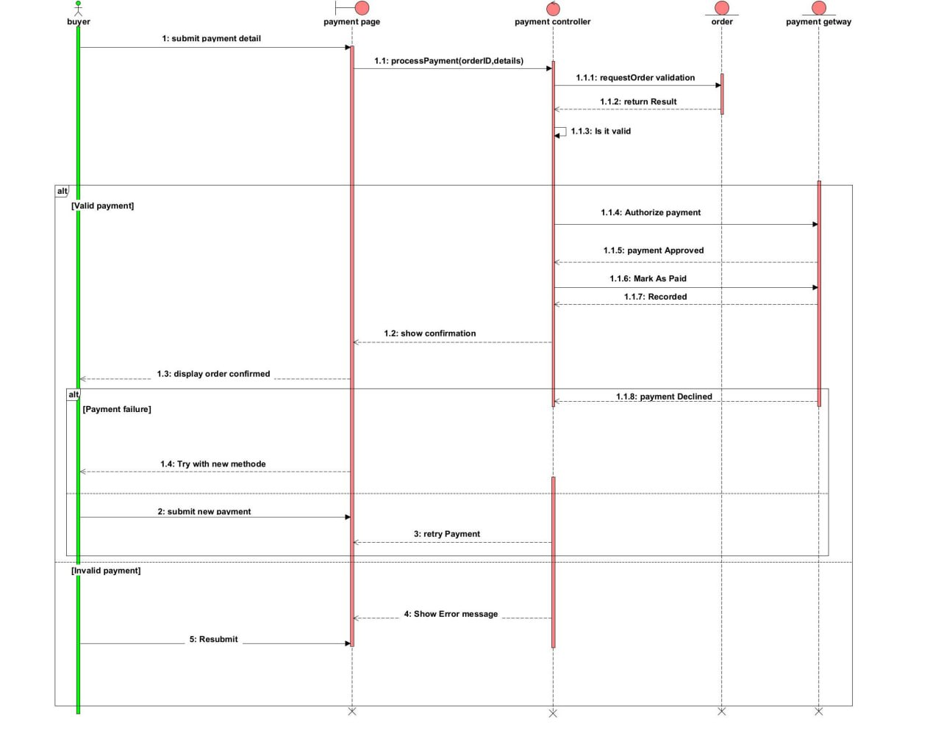

Slide 19
Class Digram
A UML structural diagram that shows classes, attributes, methods, and relationships in a system.
Represents the static structure of an application.

Slide 20
Key Elements
Class – A blueprint for objects (e.g., Customer, Order).
Attributes (Variables: name, id)
Methods (Functions: placeOrder(), cancelOrder())
Relationships – How classes interact:
Association (e.g., Customer → Order)
Inheritance (e.g., Admin extends User)
Aggregation/Composition (e.g., Library has Books)
Multiplicity – Indicates quantity (e.g., 1..*, 0..1).

Slide 21
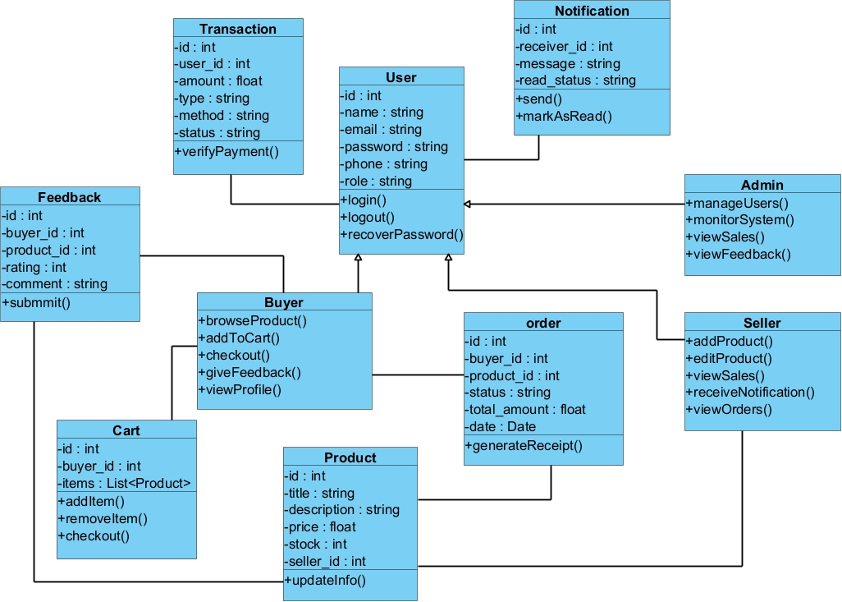
Class Design

Slide 22
Implementation
Code Generation:
Class diagram exported to Java via Visual Paradigm
Generated: Class declarations, attributes, method stubs
Synchronization:
Code updates reflected in diagrams
Reverse engineering for alignment

Slide 23
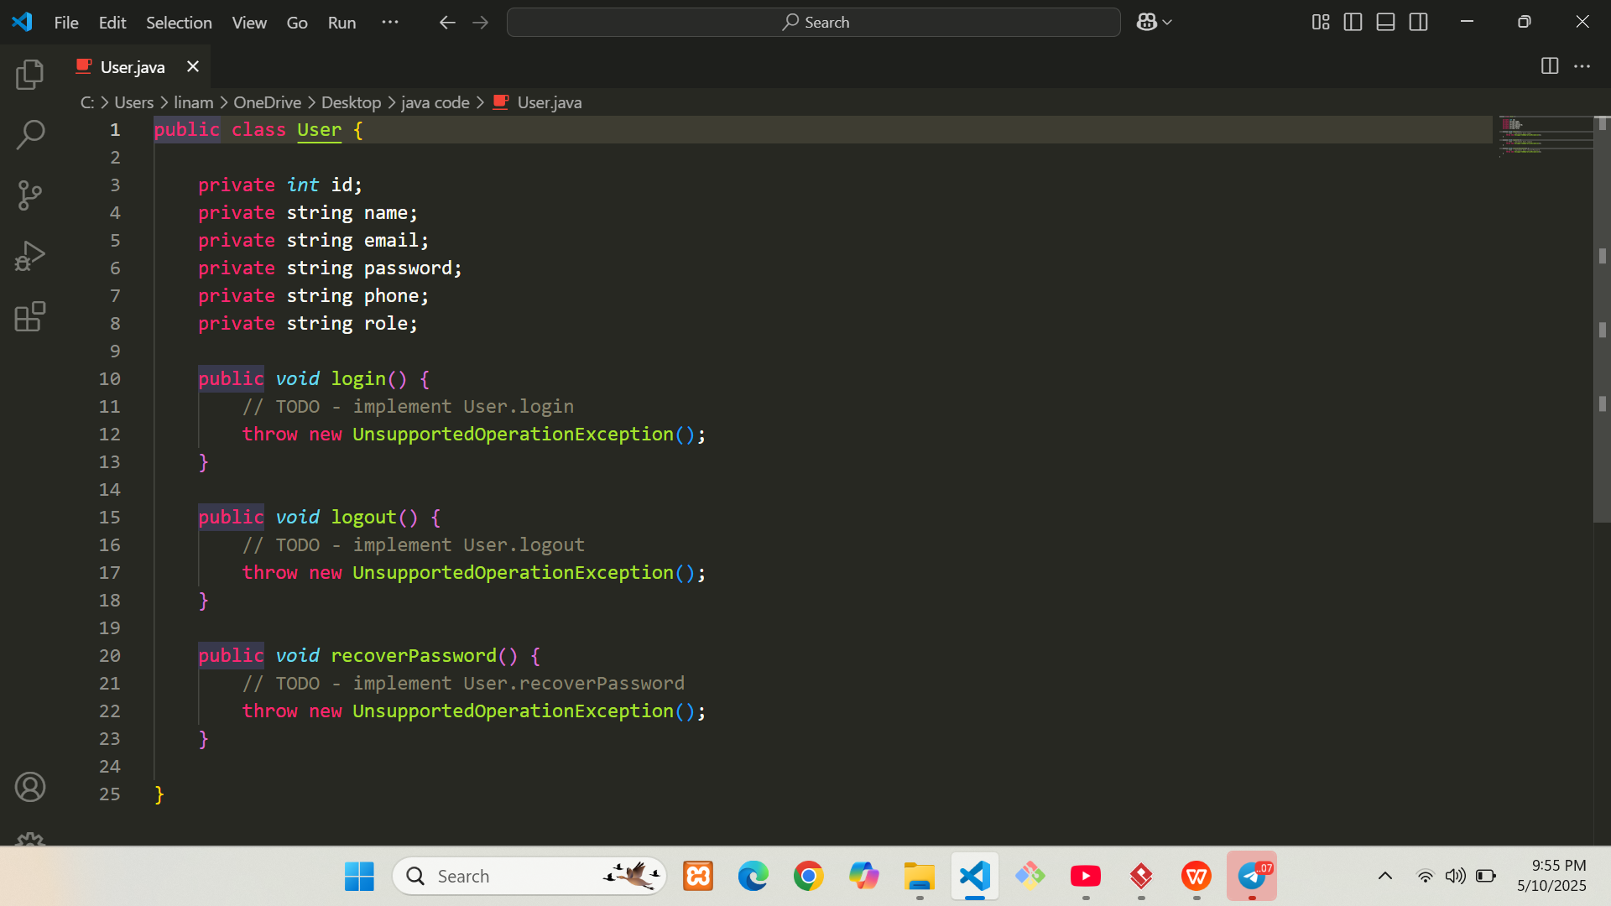

Slide 25
Version Control
Tools: Git, GitHub, Git Bash
Workflow:
Initialize Git repository
Create remote repository on GitHub
Add, commit, push changes
Pull requests and code reviews
Benefits: Track history, enable collaboration, revert to stable versions

Slide 26
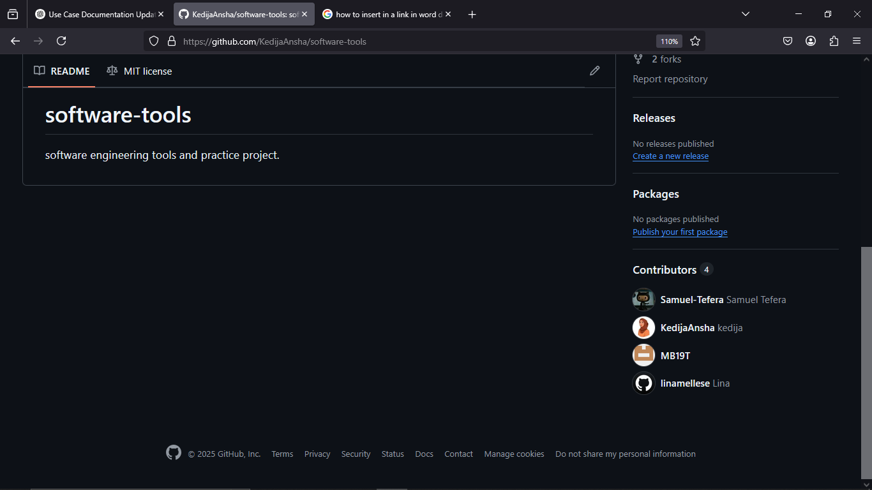

Slide 27
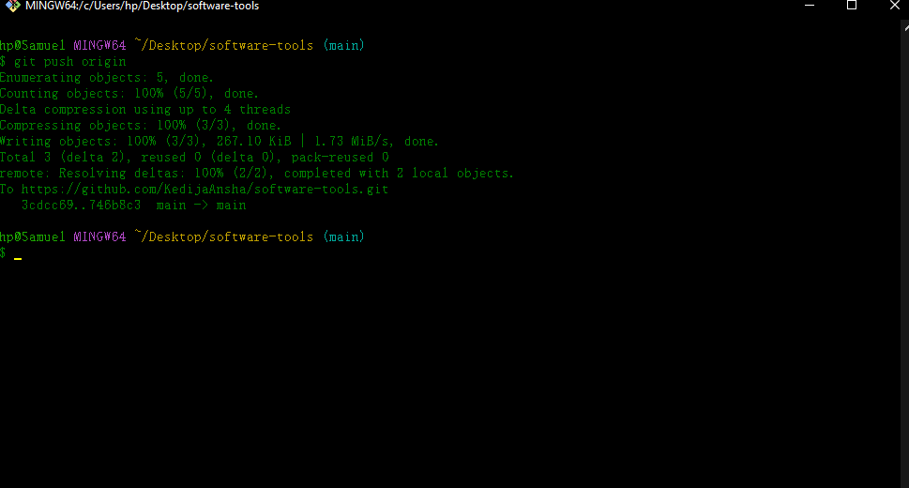

Slide 28
Unit Testing
Tools: Eclipse IDE, JUnit 5
Process:
Generate Java classes from class diagram
Create JUnit test cases
Write test methods with assertions
Run tests and review results

Slide 29
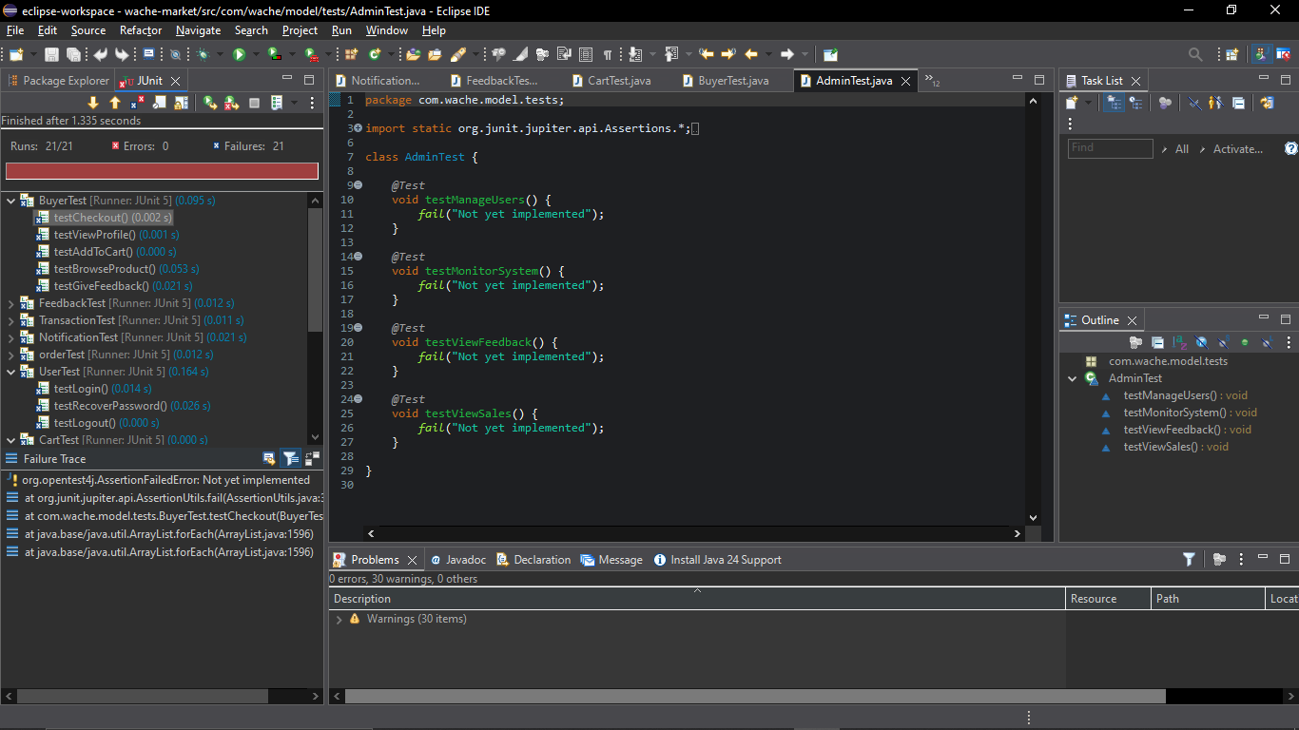

Slide 30
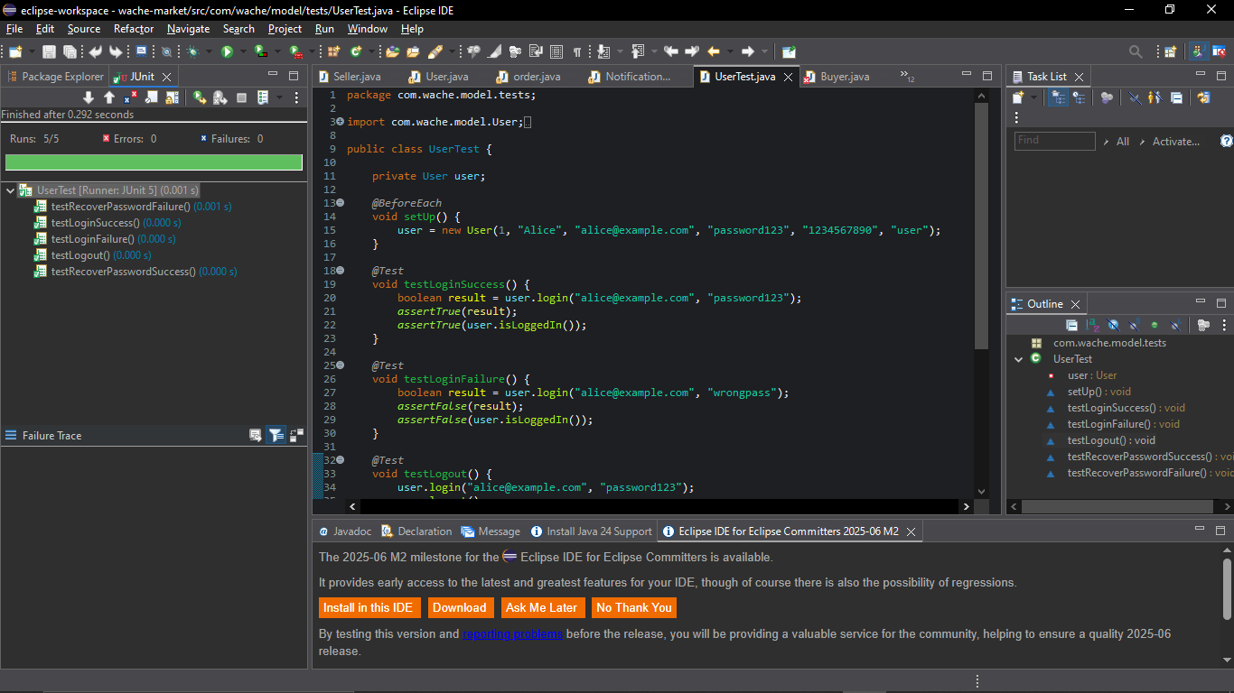

Slide 31
Build Process
Tools: Eclipse IDE, Java Development Kit (JDK)
Steps:
Organize source and test files
Compile Java code
Run unit tests
Export to executable JAR

Slide 32
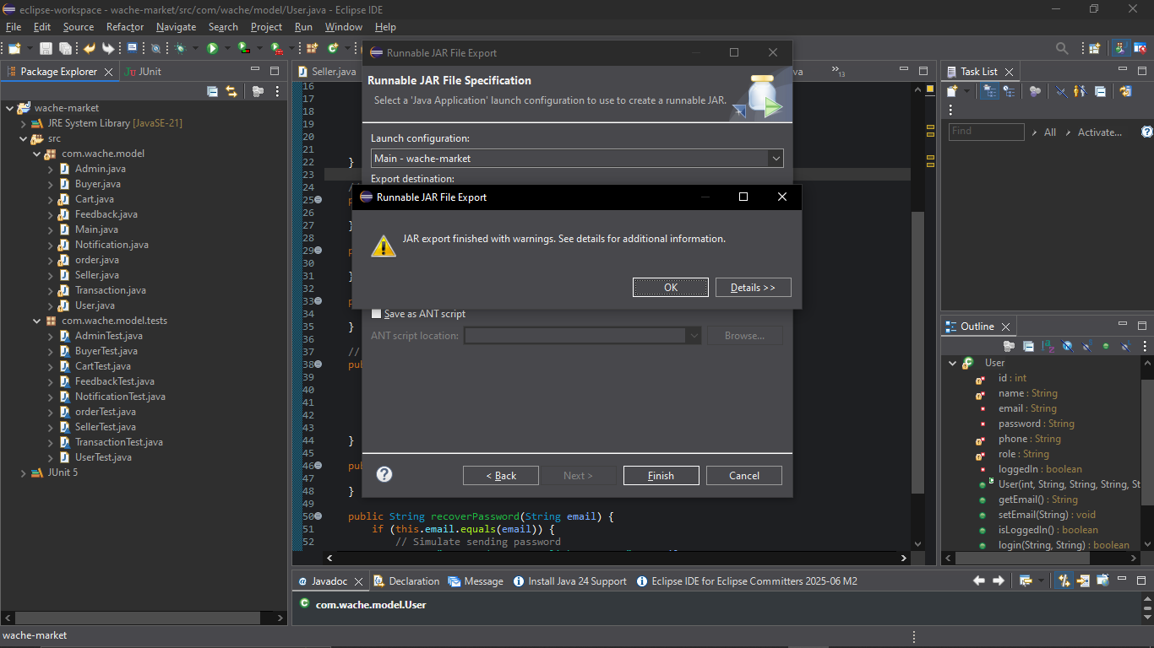

Slide 33
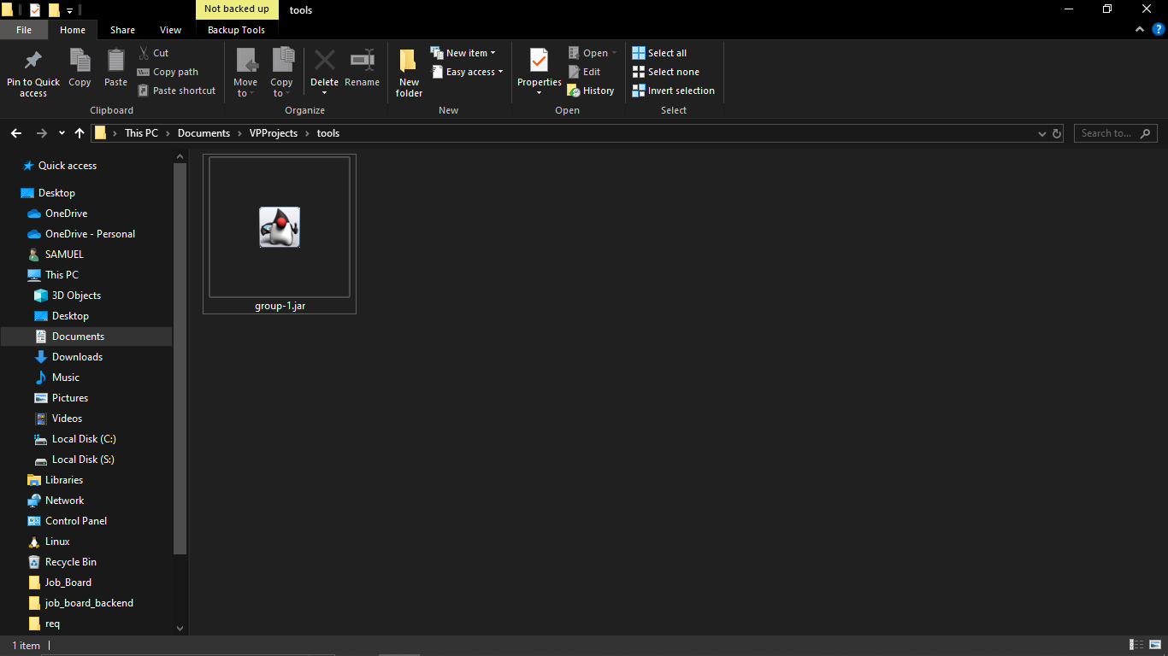

Slide 34
References
Visual Paradigm. (2024). UML Modeling Tools.
Eclipse Foundation. (2024). Eclipse IDE.
JUnit. (2024). Unit Testing Framework.
Git. (2024). Version Control System.
GitHub. (2024). Project Repository Hosting.
Oracle. (2024). Java Documentation.
Course materials from Mr. Feyisa Kedir.

Slide 35
Thank You.

