Slide 1
Wache-Market: An Online Marketplace for Wachemo University
Authors: Samuel Tefera, Kedija Ansha, Angelina Melese, Gideon Daniel, Mohammed Belayneh
Institution: Wachemo University, College of Engineering and Technology, Department of Software Engineering
Date: May 15, 2025

Slide 2
Presentation Outline
Introduction
Team and Acknowledgement
Requirements Analysis
Use Case Modeling
Sequence Diagrams
Class Design
Implementation
Version Control
Unit Testing
Build Process
Conclusion
References

Slide 3
Introduction
Project: Wache-Market, a web-based e-commerce platform for Wachemo University
Objective: Facilitate buying and selling within the university community
Developed by 3rd-year Software Engineering students
Key Features:
Secure user authentication
Flexible product listings
Efficient transaction processing
Role-based access (Buyer, Seller, Admin)

Slide 4
Team and Acknowledgement
Team Members:
Samuel Tefera (1501240)
Kedija Ansha (1501019)
Angelina Melese (1501700)
Gideon Daniel (1308207)
Mohammed Belayneh (1510098)
Acknowledgement:
Mr. Feyisa Kedir (Instructor)

Slide 5
Requirements Analysis
Functional Requirements:
User registration and login
Product browsing and searching
Cart and order management
Payment and wallet integration
Seller product management
Admin user and system management

Slide 6
Non-Functional Requirements:
Security: Encrypted user data
Performance: <3-second page load
Simplicity: Intuitive interface
Reliability: 99% uptime
Scalability: Support growing users

Slide 7
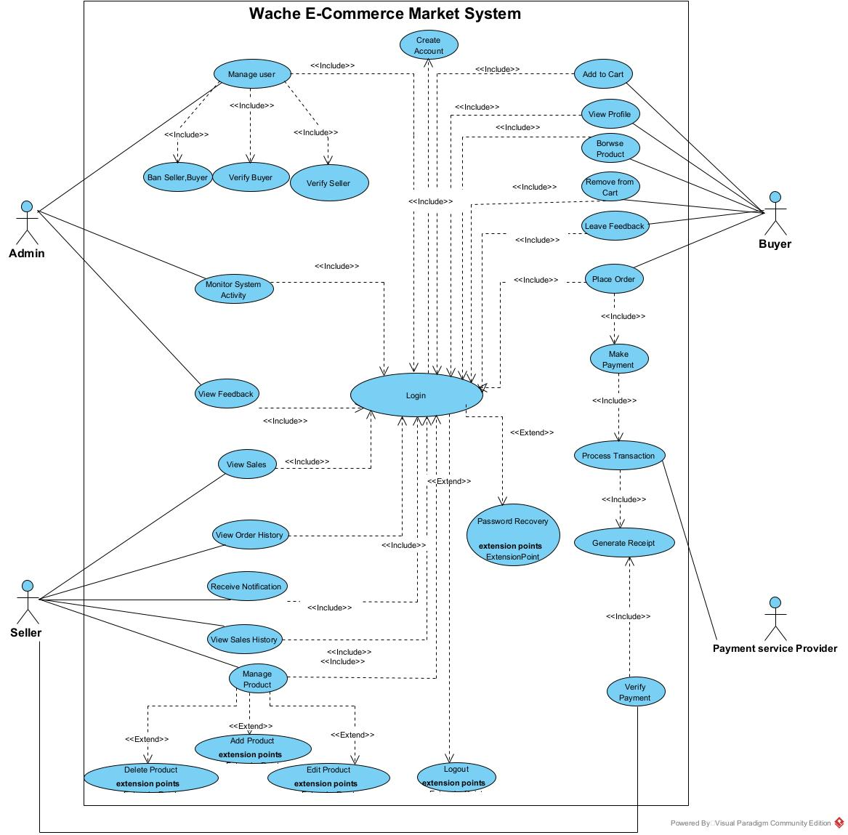
Use Case Modeling

Slide 8
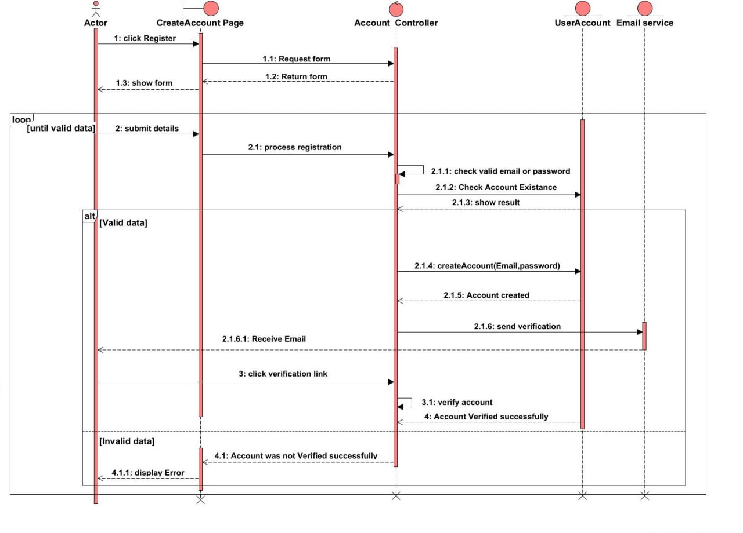
Sequence Diagrams

Slide 9
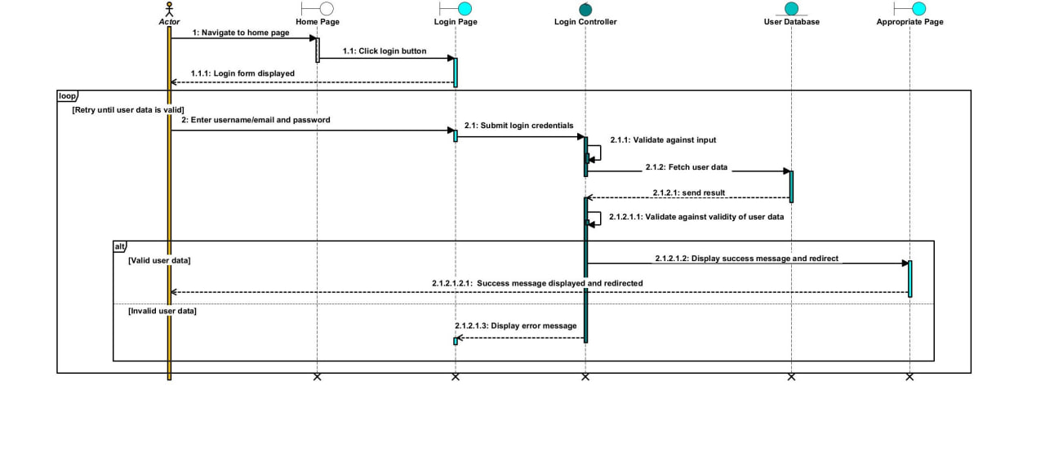

Slide 10
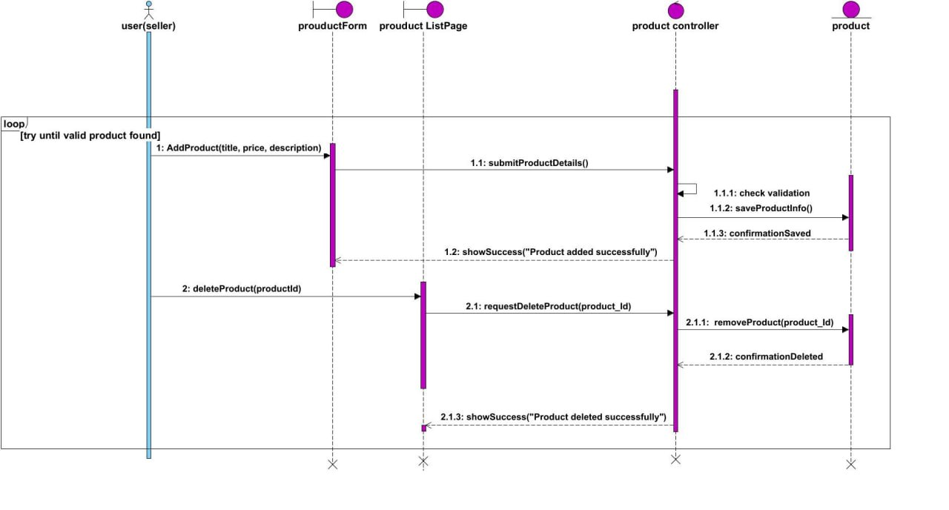

Slide 11
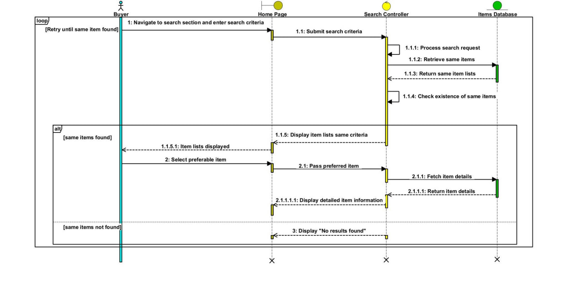

Slide 12
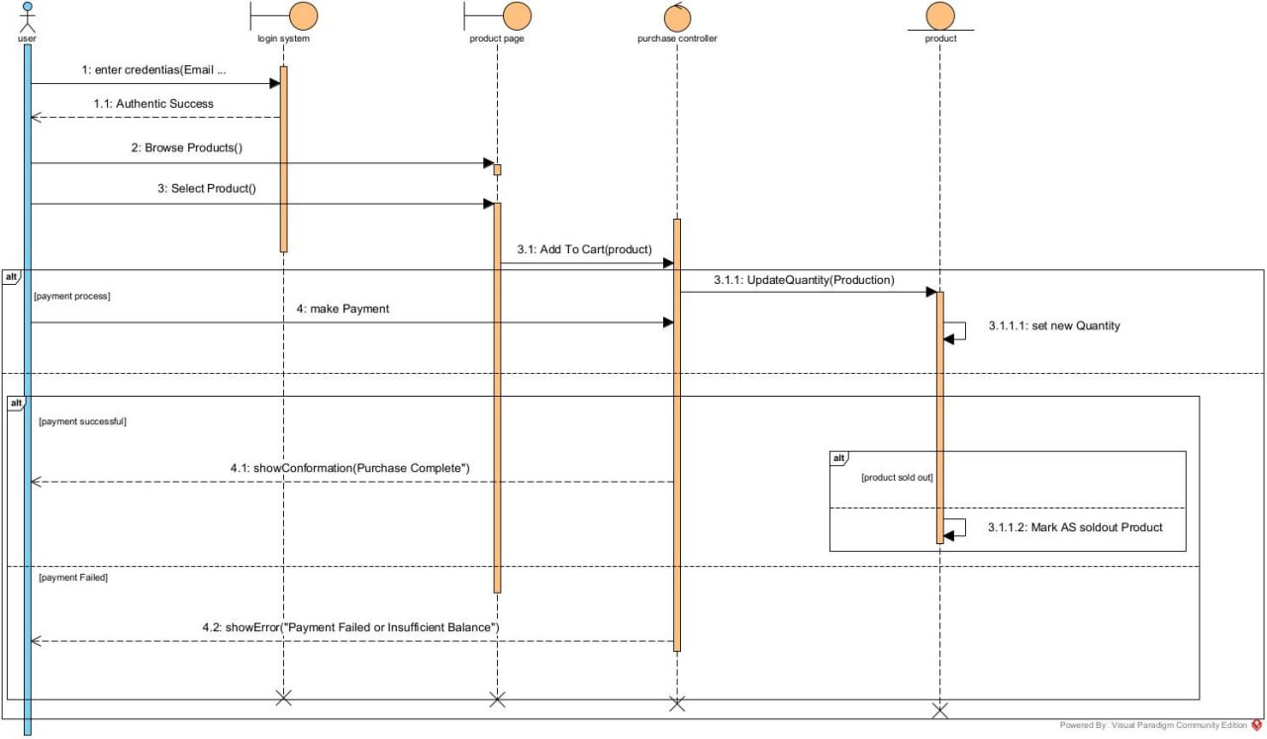

Slide 13
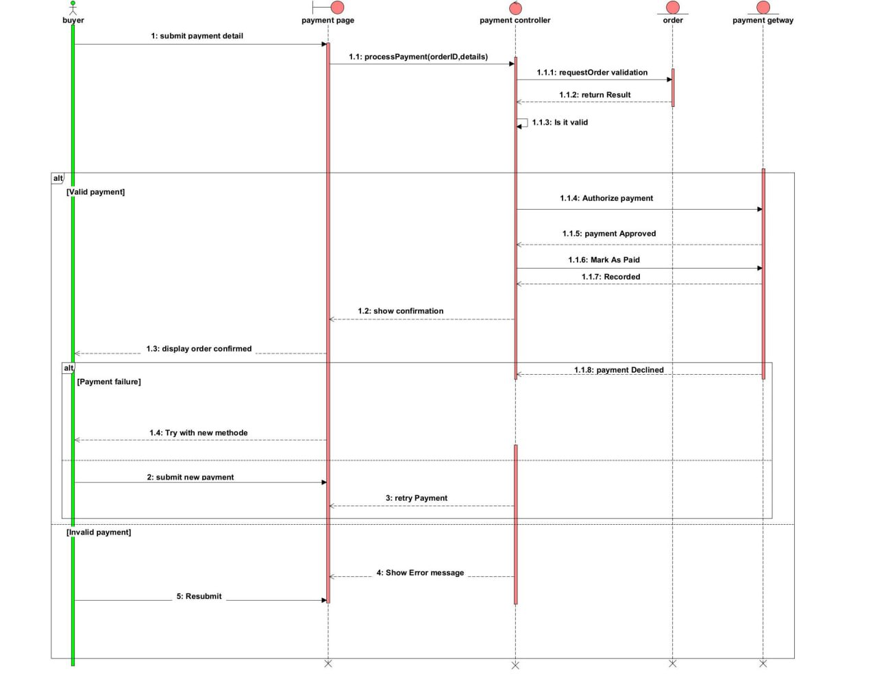

Slide 14
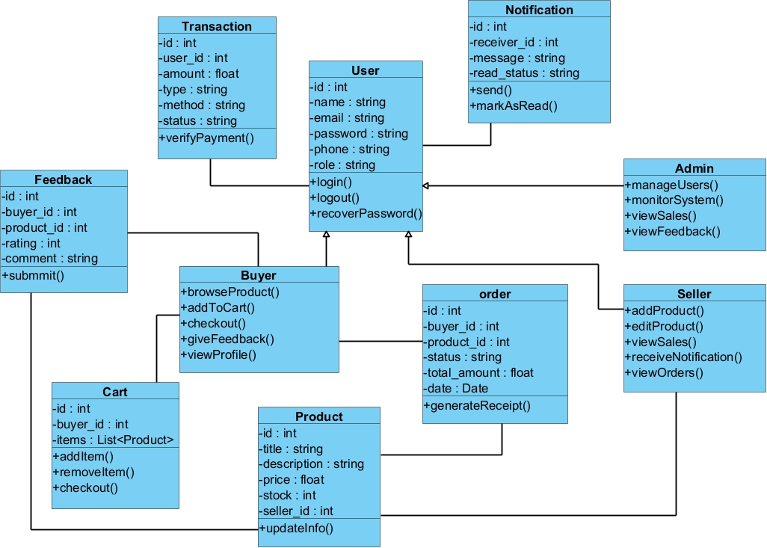
Class Design

Slide 15
Implementation
Code Generation:
Class diagram exported to Java via Visual Paradigm
Generated: Class declarations, attributes, method stubs
Synchronization:
Code updates reflected in diagrams
Reverse engineering for alignment

Slide 16
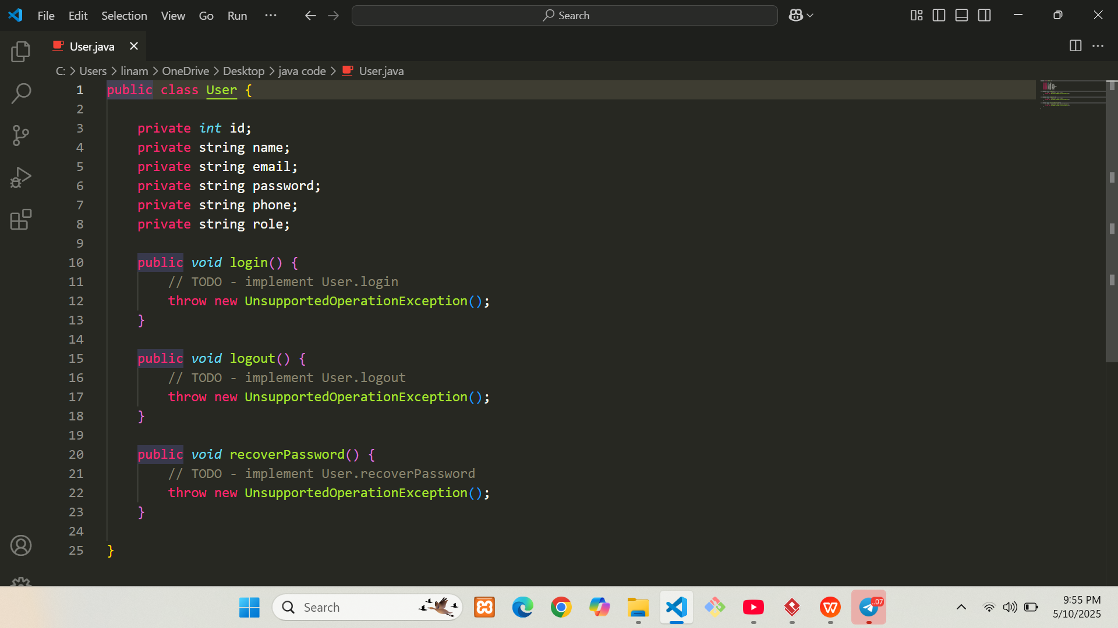

Slide 18
Version Control
Tools: Git, GitHub, Git Bash
Workflow:
Initialize Git repository
Create remote repository on GitHub
Add, commit, push changes
Pull requests and code reviews
Benefits: Track history, enable collaboration, revert to stable versions

Slide 19
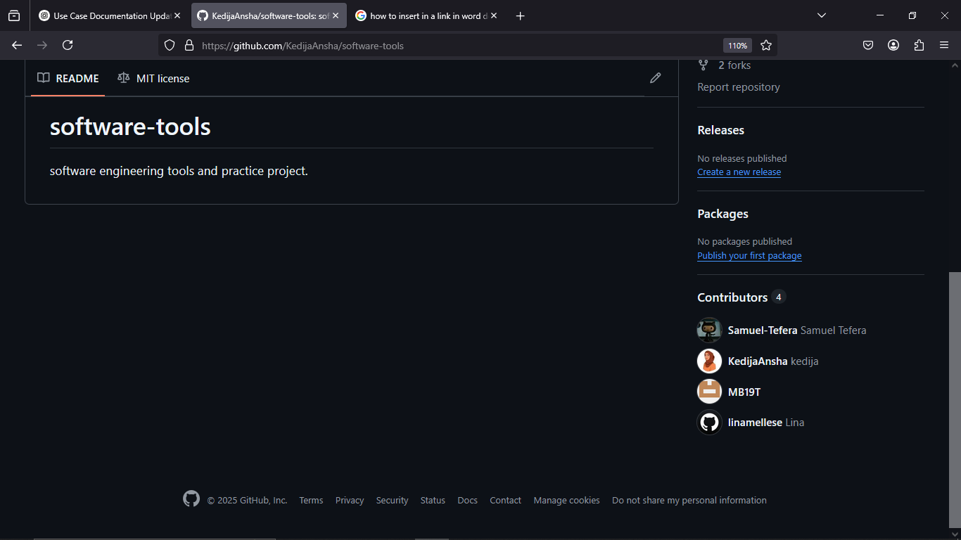

Slide 20
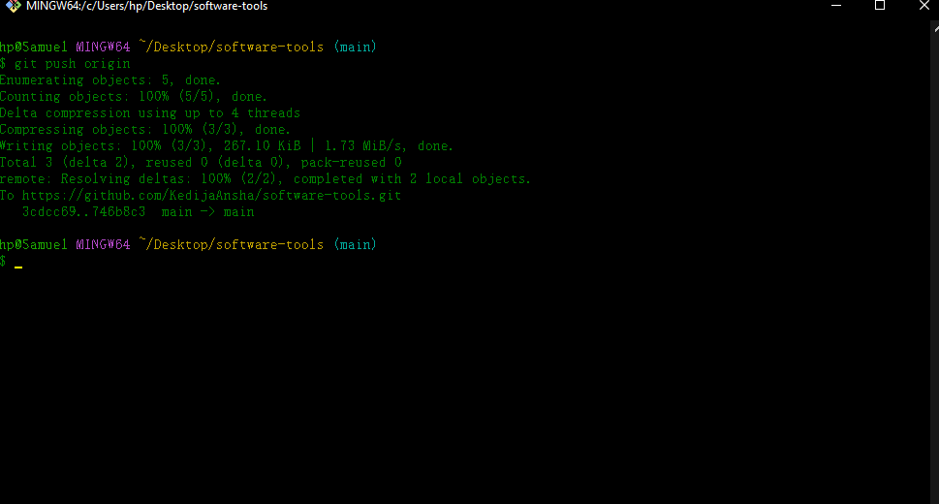

Slide 21
Unit Testing
Tools: Eclipse IDE, JUnit 5
Process:
Generate Java classes from class diagram
Create JUnit test cases
Write test methods with assertions
Run tests and review results

Slide 22
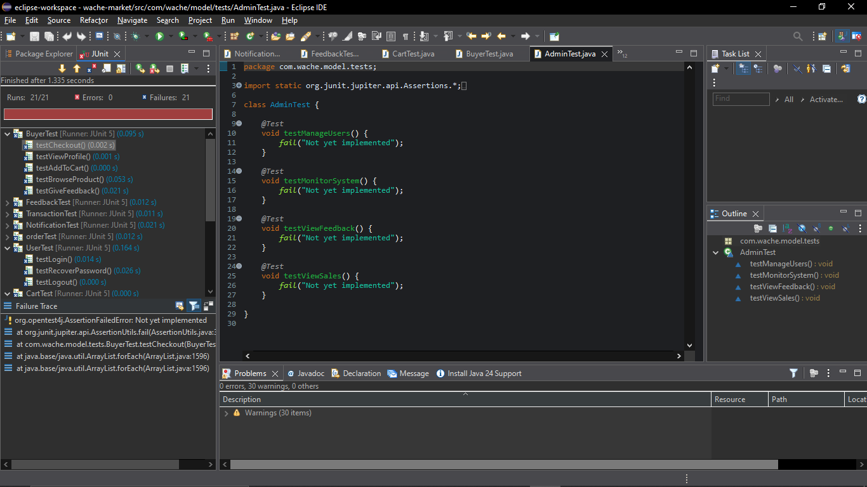

Slide 23
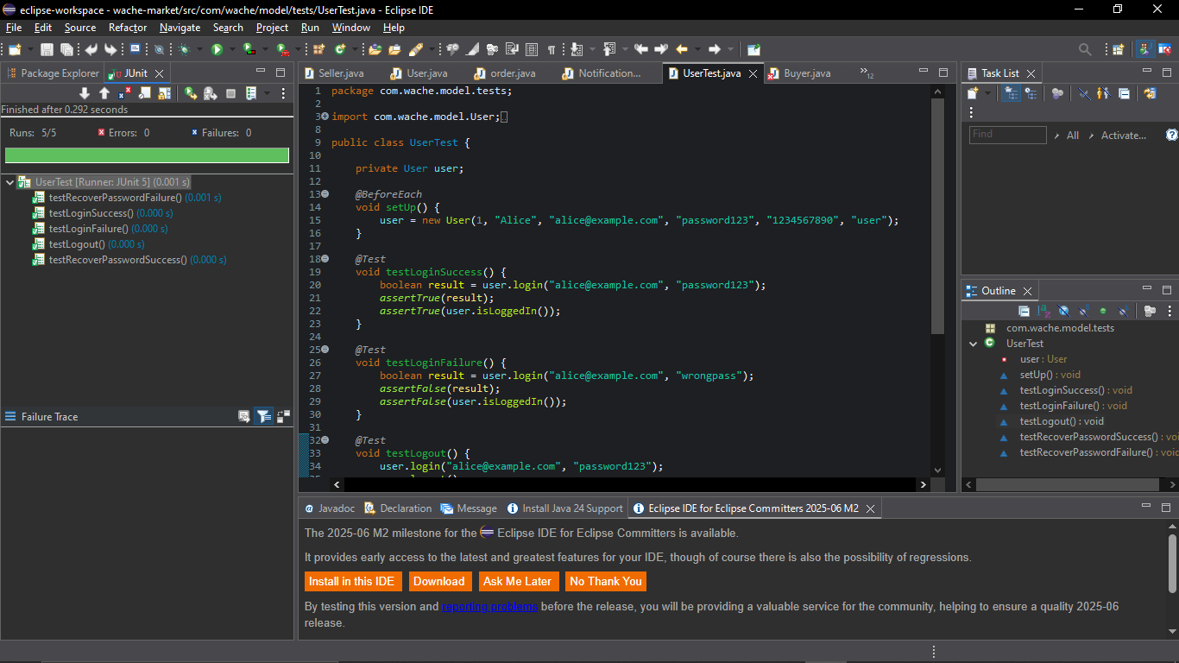

Slide 24
Build Process
Tools: Eclipse IDE, Java Development Kit (JDK)
Steps:
Organize source and test files
Compile Java code
Run unit tests
Export to executable JAR

Slide 25
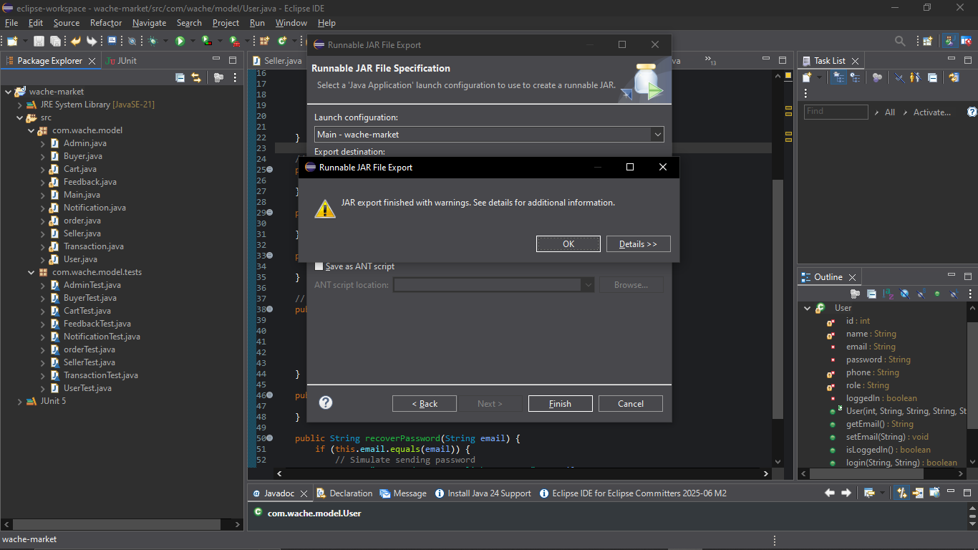

Slide 26
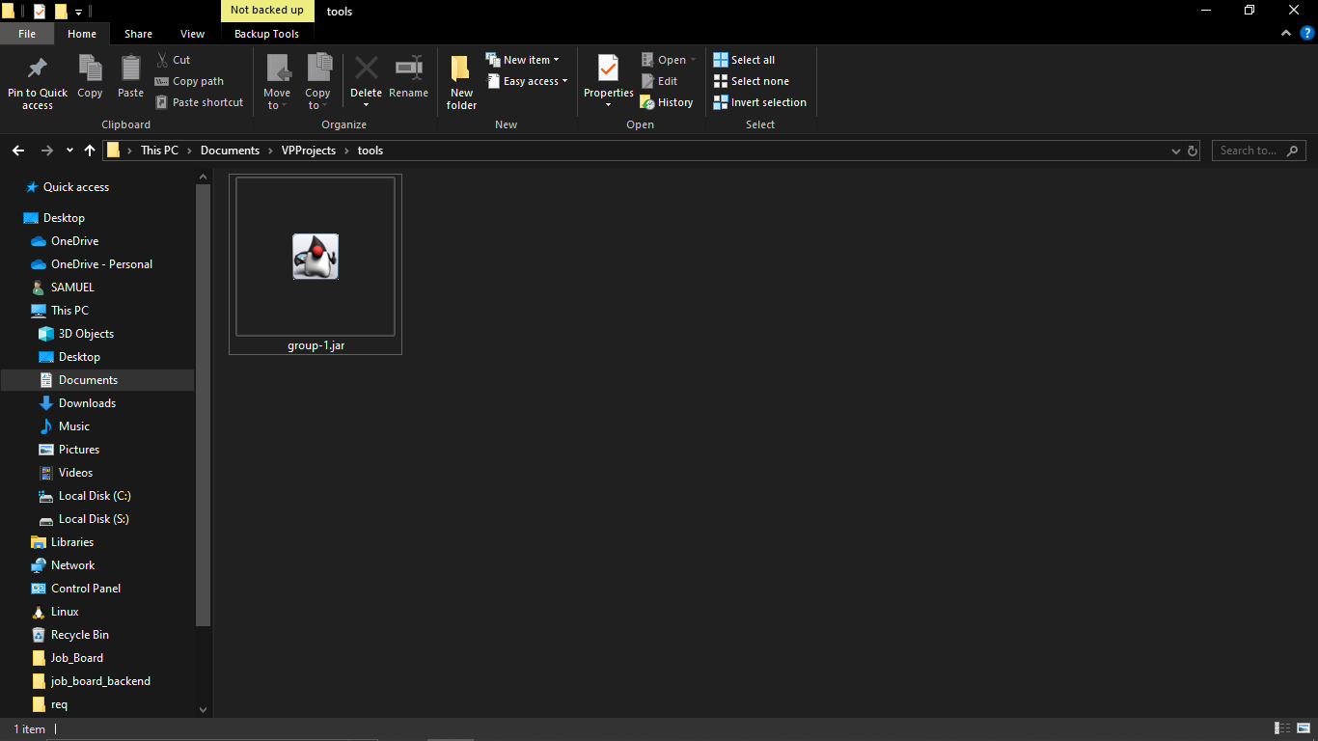

Slide 27
References
Visual Paradigm. (2024). UML Modeling Tools.
Eclipse Foundation. (2024). Eclipse IDE.
JUnit. (2024). Unit Testing Framework.
Git. (2024). Version Control System.
GitHub. (2024). Project Repository Hosting.
Oracle. (2024). Java Documentation.
Course materials from Mr. Feyisa Kedir.

