Slide 1
MOBILE BASED ARCHIVAL AND RETRIEVAL OF MISSING OBJECTS USING IMAGE MATCHING
DATABASE DESIGN AND IMPLEMENTATION

Slide 2
OUTLINE
INTRODUCTION
01
ANALYSIS OF COLLECTED REQUIREMENTS
02
DESIGN PHASE
033
testing
045

Slide 3
INTRODUCTION AND DESCRIPTION
Phase Definition
Phase 2 General Overview
Phase 4 Goals
Phase 3 Objectives

Slide 4
Requirement analysis
1
2
Functional Requirements
Boundaries and scope
product features or functions that developers must implement to enable users to accomplish their tasks

Slide 5
Functional Requirements
Data Storage: The database must handle large volumes of document storage efficiently.
Data Retrieval: Optimize for fast and accurate retrieval of documents.
Metadata Management: Support metadata tagging for categorization and searchability.
Access Control: Implement user roles and permissions in the database.
Version Control: Store version histories within the database.

Slide 6
Functional Requirements
Chat Logs: Store chat history for support interactions.
User Accounts: Store user registration details, login credentials, and profile information.
Authentication Logs: Maintain logs of authentication events for security auditing.
Transaction Records: Maintain records of all payment transactions.

Slide 7
BOUNDARIES AND SCOPE
V
1
2
Support Real time support in connection between users
Handle document storage, retrieval and management
4
3
Supports Registration and authentication
Integrate with a payment gateway to confirm transactions

Slide 8
Parameters And Limitations
User Accesss
1
6
Security
Data Limits
Compliance
2
5
Performance
3
4

Slide 9
Non-Functional Requirements
Related to Design
Front End Tools
Language: Javascript
Framework: React-Native
Library: Redux, React Navigation, Glide
BackEnd
Framework: Node.js with Express
Library: Tensor Flow.js
Cloud Infrastructure: Cloud Platform (AWS):
Database
MongoDB

Slide 10
Design Phase
Conceptual Design
Physical Design
Implementation
Logical Design

Slide 11
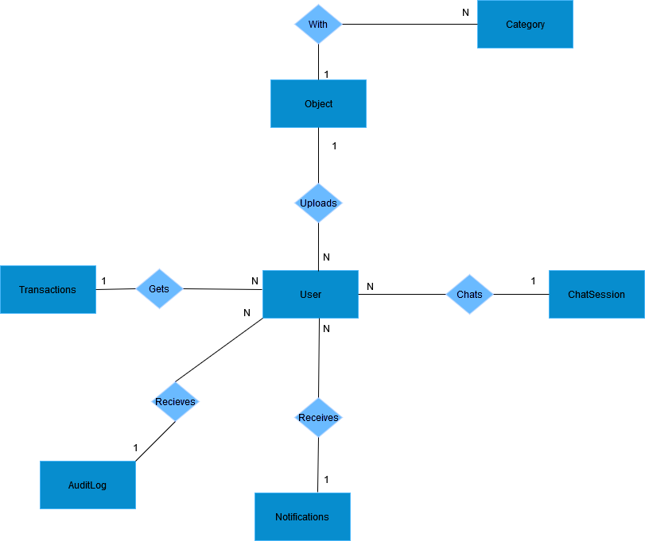
Conceptual Design

Slide 12
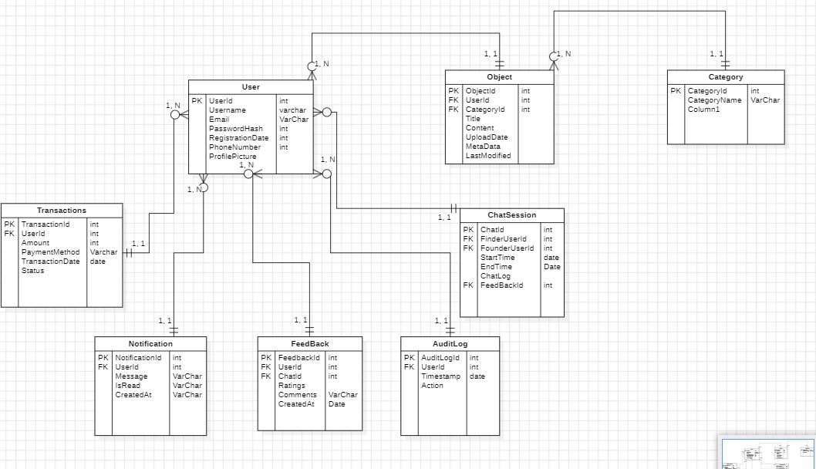
Logical Design

Slide 13
Normalisation
User Table:
Already in 1NF with primary key UserID.
No partial dependencies as UserID is the primary key, thus in 2NF.
No transitive dependencies, thus in 3NF.
Document Table:
Already in 1NF with primary key DocumentID.
UserID and CategoryID fully determine other attributes, thus in 2NF.
No transitive dependencies, thus in 3NF.

Slide 14
Physical Model
Why Mongodb
Flexible schema design
1
6
Handle unstructured data
Document Oriented Storage
Indexing and querying
2
5
Scalability
Performance
3
4

Slide 15
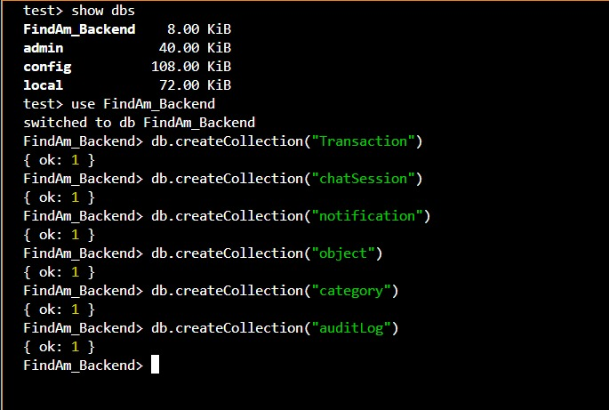
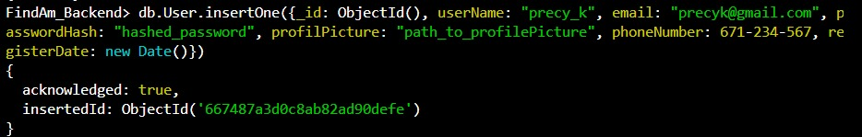

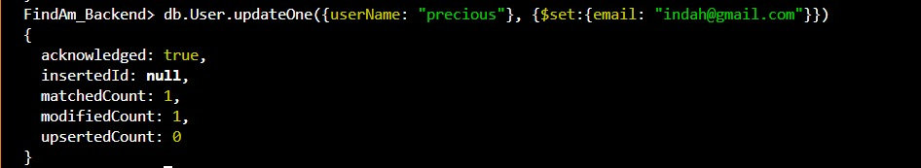
Testing
CRUD operations

Slide 16
CONCLUSION THANKS FOR YOUR KEEN ATTENTION!

