Slide 1
Bayesian Forecasting for Retail Analysis
Kedumetse Nadour Vati, PhD | drkedumvati@gmail.com | github.com/KedumetseVati | Edmonton, Alberta, Canada
Notes:
Introduce yourself, your PhD background, and that this project uses Bayesian forecasting to inform retail decisions.

Slide 2
Project Overview
Bayesian linear regression to forecast monthly retail revenue.
Uncertainty modeled via posterior distributions (credible intervals).
Goal: actionable, probabilistic forecasts for planning and budgeting.
Notes:
Contrast probabilistic forecasts vs point estimates; emphasize business value.

Slide 3
Dataset & Features
36 months of synthetic Costco-style data (monthly Date).
Features: Promo (Oct–Feb), Holiday (Nov–Dec), PriceIndex.
Target: Revenue.
Notes:
Note: synthetic but realistic; reproduces promotions and seasonality.

Slide 4
Methodology
Baseline: y = β0 + β1·t + β2·Promo + ε
Extended: y = Baseline + β3·Holiday + β4·(PriceIndex−1) + ε
Inference: MCMC (PyMC, NUTS) or conjugate posterior sampling.
Evaluation: WAIC & LOO for model selection.
Notes:
Briefly explain priors and why NUTS/MCMC; define credible intervals.

Slide 5
Model Comparison (WAIC & LOO)
Extended model outperforms baseline under WAIC & LOO.
Holiday and PriceIndex materially improve predictive accuracy.
Notes:
Frame results as evidence-based model selection.

Slide 6
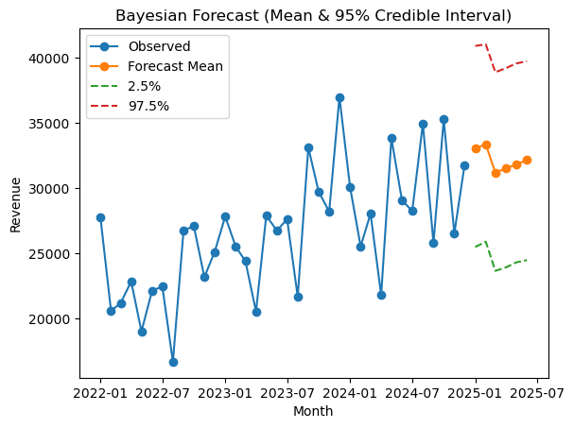
Forecast Results
6-month forecast (mean + 95% credible intervals). Seasonal peaks and promo effects are visible.
Notes:
Walk through interpreting the interval lines and uncertainty.

Slide 7
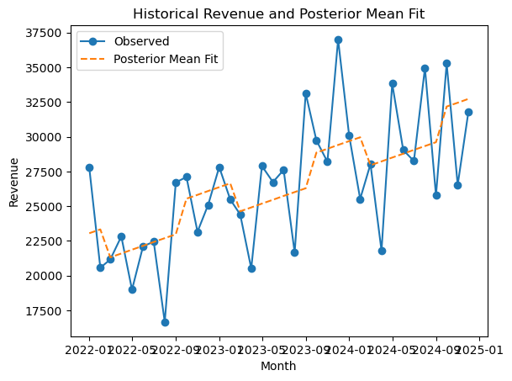
Historical Fit
Posterior mean fit against 36 months of observed revenue.
Notes:
Comment on fit quality and any residual patterns.

Slide 8
Key Insights
Promotions lift sales by roughly +10–15%.
Holiday months (Nov–Dec) show clear seasonal peaks.
PriceIndex shows a negative elasticity with revenue.
Forecast indicates continued growth with quantified uncertainty.
Notes:
Highlight actionable business implications.

Slide 9
Streamlit App Summary
Interactive scenario testing (horizon, promo/holiday toggles, price trend).
Instant updates to forecast table and chart.
Notes:
This helps non-technical stakeholders run 'what-if' analyses.

Slide 10
Key Takeaways & Contact
Bayesian approach => probabilistic forecasts for better decisions.
Feature-rich models improve accuracy vs. simple trend lines.
End-to-end workflow: data → model → diagnostics → deployment.
Contact: drkedumvati@gmail.com | github.com/KedumetseVati | Edmonton, Alberta, Canada
Notes:
Invite questions; emphasize rigor + practicality.

